Slide 1
e⁻ cloud simulations
C.Octavio Domínguez, Giovanni Rumolo, Frank Zimmermann
Thanks to
Humberto Maury Cuna
26th November 2010 - e⁻ cloud simulations

Slide 2
Contents
SPS benchmarking :
SEY scan for different bunch spacing and reflection coefficient
Vacuum pipe shape study
Emittance scan
Plans → Discussion:
Further cross check with Humberto
Plan for LSS3 simulation; Memory effect
Plan for coupled-bunch wake field
2
26th November 2010 - e⁻ cloud simulations

Slide 3
1) SPS benchmarking
3
26th November 2010 - e⁻ cloud simulations

Slide 4
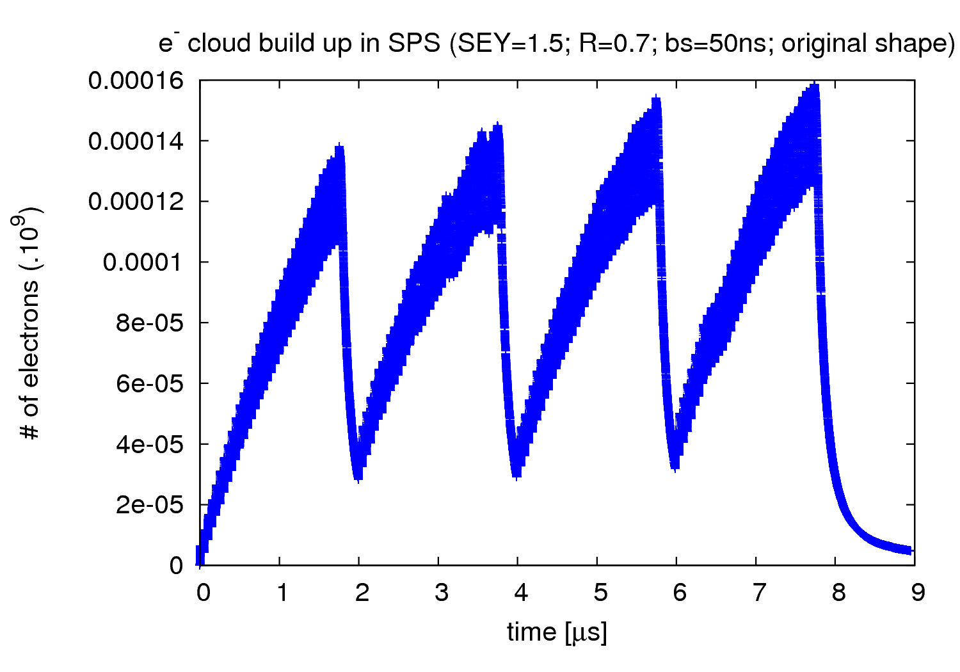
SPS - Introduction
- Goal: To find onset multipacting SEY for several input parameters
4
26th November 2010 - e⁻ cloud simulations

Slide 5
SPS - Introduction
The standard parameters:
Bunch spacing = 50 ns
Energy = 450 GeV (SPS extraction)
R = 0.7
Shape: Elliptical approach of the electron cloud monitor at SPS:
ε_{max} = 230 eV
Gas pressure = 9 nTorr
Beam size: The one at the electron cloud monitor at SPS (ε_{Nx, Ny} = 3.0 μm)
σ_{x} = 0.9 mm
σ_{y} = 0.4 mm
σ_{z} = 11.8 cm
Nb = 1.1 · 10¹¹ ppb
24.3 mm
70.0 mm
5
26th November 2010 - e⁻ cloud simulations

Slide 6
SPS – SEY scan
σ_{x}= 0.9 mm; σ_{y}= 0.4 mm; σ_{z}= 11.8 cm;
ε_{max}= 230 eV; N_{b}=1.1 10¹¹ ppb; P = 9 nTorr;
Bs [ns] | R | onset
25 | 0.5 | 1.4
50 | 0.5 | 1.8
75 | 0.5 | 2.3
25 | 1.0 | 1.3
50 | 1.0 | 1.6
75 | 1.0 | 1.9
24.3 mm
e⁻ cloud monitor (elliptical approach)
70.0 mm
6
26th November 2010 - e⁻ cloud simulations

Slide 7
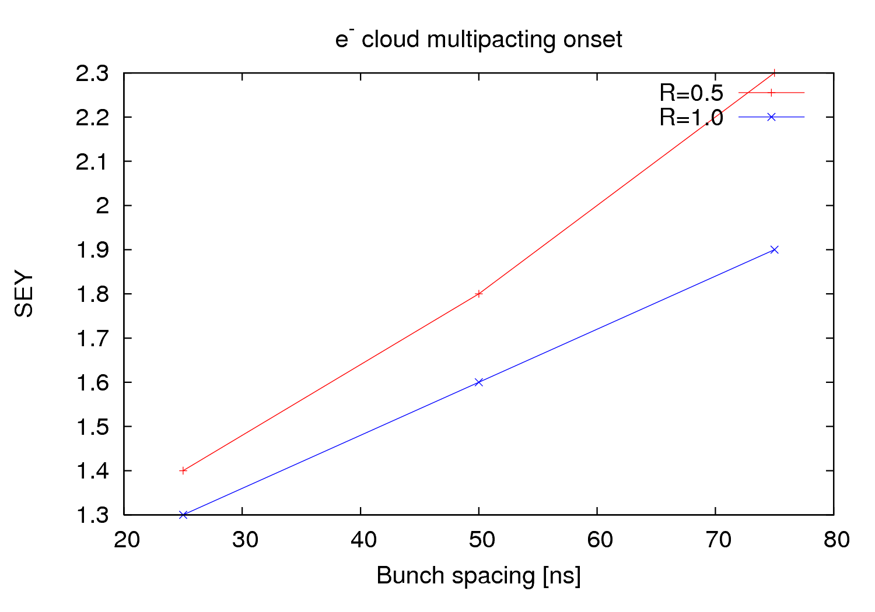
SPS – SEY scan
7
26th November 2010 - e⁻ cloud simulations

Slide 8
1.2) Vacuum pipe shape
8
26th November 2010 - e⁻ cloud simulations

Slide 9
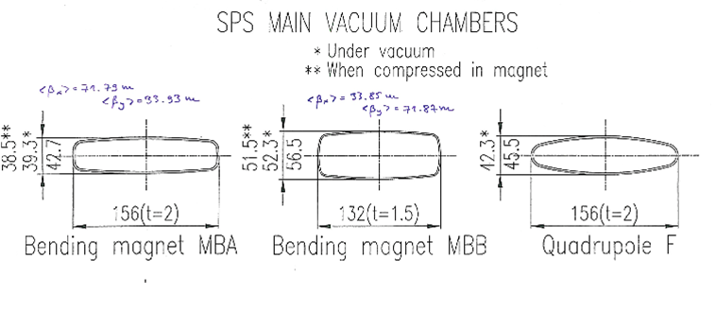
SPS – Pipe shape
24.3 mm
70.0 mm
24.3 mm
47.15 mm
70.0 mm
47.15 mm
9
26th November 2010 - e⁻ cloud simulations

Slide 10
SPS – Pipe shape
σ_{z}= 11.8 cm; bs = 50 ns; ε_{max}= 230 eV;
N_{b}=1.1 10¹¹ ppb; P = 9 nTorr; R = 0.7;
Pipe shape | σ_{x}[mm] | σ_{y}[mm] | sx[m] | sy,sz [m] | onset
e⁻ cloud monitor (Elliptical) | 0.9 | 0.4 | 0.07 | 0.0243 | 1.7
Elliptical | 0.9 | 0.4 | 0.07 | 0.04715 | 1.3
Round | 0.9 | 0.4 | 0.07 | 0.07 | 1.5
Elliptical | 0.9 | 0.4 | 0.04715 | 0.0243 | 1.7
Round | 0.9 | 0.4 | 0.0243 | 0.0243 | 1.6
MBA (Elliptical) | 0.89947 | 0.460687 | 0.078 | 0.01925 | 2.0?
MBB (Elliptical) | 0.756129 | 0.670483 | 0.066 | 0.2575 | <1.7
LHC type (Elliptical) | 1.0 | 1.0 | 0.022 | 0.018 | X
10
26th November 2010 - e⁻ cloud simulations

Slide 11
1.3) Emittance scan
11
26th November 2010 - e⁻ cloud simulations

Slide 12
SPS – ε scan
bs = 50 ns; ε_{max}= 230 eV; N_{b}=1.1 10¹¹ ppb; P = 9 nTorr;
R = 0.7;
ε_{Nx,Ny} [μm] | σ_{x} [mm] | σ_{y} [mm] | onset
1.5 | 0.78912 | 029059 | 1.7?
2.5 | 0.893224 | 0.37515 | 1.7
3.0 | 0.940968 | 0.410956 | 1.7
3.5 | 0.986403 | 0.443883 | 1.7
4.5 | 1.07151 | 0.503317 | 1.7?
5.5 | 1.15033 | 0.556437 | 1.7?
24.3 mm
e⁻ cloud monitor (elliptical approach)
70.0 mm
12
26th November 2010 - e⁻ cloud simulations

Slide 13
SPS benchmarking – conclusions
e⁻ cloud simulation for SPS bending magnets are being redone exploring different
parameters
Agreement (apparently) with previous simulations carried out by Giovanni
Round shape option → Worse results
Emittance scan for different LHC type of beams → Very small differences (negligible)
To do:
Drifts
Quadrupoles
Modify code to simulate an elliptic/rectangular shape for a better approach (already
succeeded once by D. Schulte)
Questions for discussion:
ε_{max} dependence of SEY
β functions at the e⁻ cloud monitor, i.e. beam size
Differences between SPS and LHC simulations
13
26th November 2010 - e⁻ cloud simulations

Slide 14
2) Plans
14
26th November 2010 - e⁻ cloud simulations

Slide 15
2.1) Further cross check with Humberto
15
26th November 2010 - e⁻ cloud simulations

Slide 16
2.2) LSS3 simulation; Memory effect
16
26th November 2010 - e⁻ cloud simulations

Slide 17
LSS3 - Motivation
The biggest problems for e- cloud were found in the LSS3 section
That makes interesting to explore it in more detailed
17
26th November 2010 - e⁻ cloud simulations

Slide 18
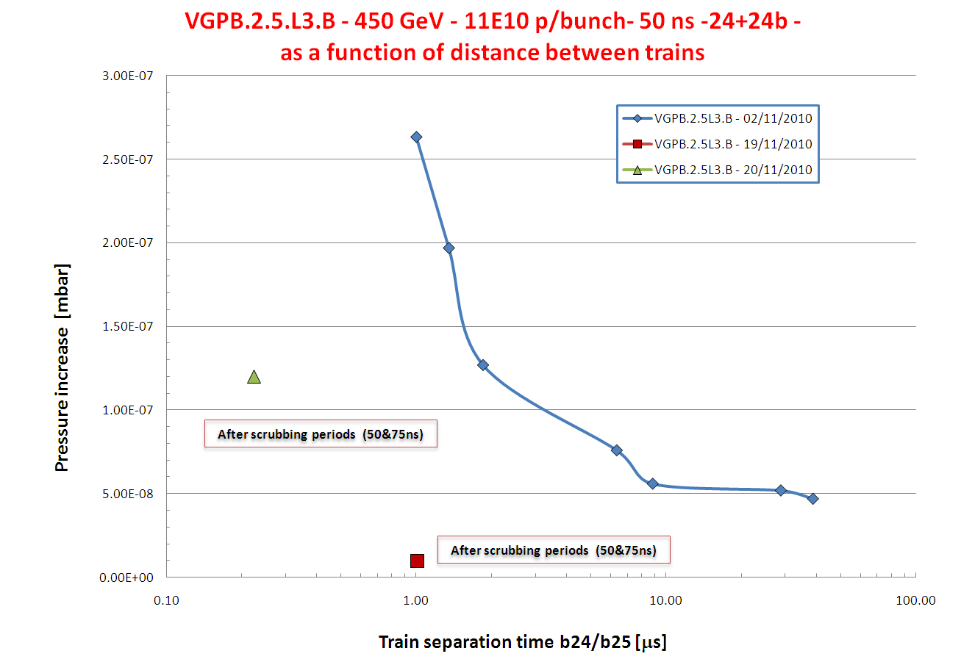
Vincent Baglin
18
26th November 2010 - e⁻ cloud simulations

Slide 19
2.3) Coupled-bunch wake field
19
26th November 2010 - e⁻ cloud simulations

