Slide 1
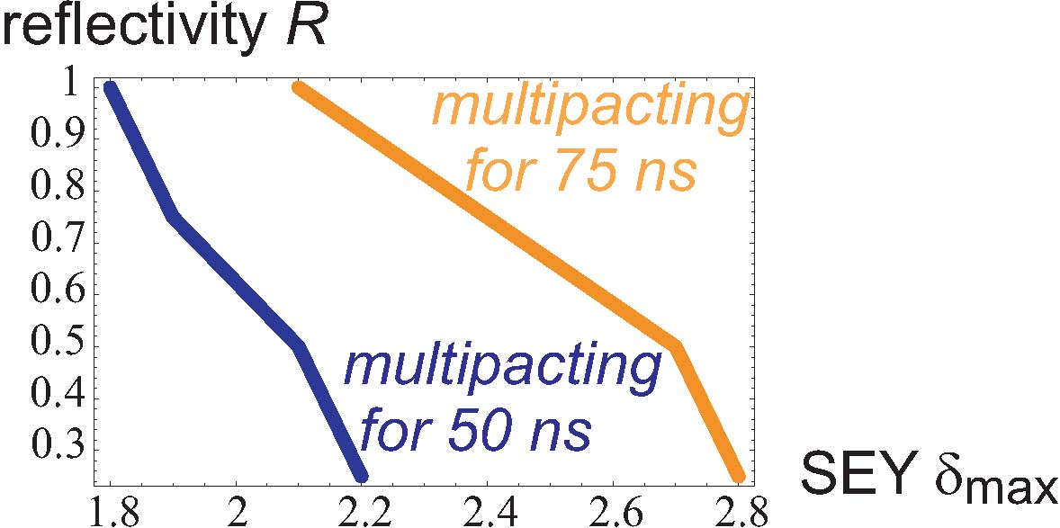
multipacting threshold in the arcs
simulation results from Humberto Maury
N_{b}=1.1x10¹¹
two points for 75-ns should be confirmed
it might be nice if we could add a line for 25 ns as well

Slide 2
effect of magnetic field
H. Maury, 26.11.2010
Bunch spacing | R | SEY | Magnetic Dipole field (T)
50 | 0.5 | 2.5 | 8.4
50 | 1 | 2.1 | 8.4
75 | 1 | 2.3 | 8.4
50 (MD) | 0.75 | 1.9 | 0.54
75 (MD) | 0.75 | 2.4 | 0.54

Slide 3
H. Maury, 14.12.2010

