Slide 1
Ecloud Heat Load simulations for the LHC arcs
E-cloud Simulation Meeting
Humberto Maury Cuna
June 7th, 2011

Slide 2
Simulation parameters for 50 ns
Bunch spacing | Bunch intensity | SEY | Reflectivity | Fill pattern | Energy
50 ns | 1.2 x 10¹¹ p/b | 1.6 - 2.4 | 0.2 - 0.9 | 1 | 3.5 TeV*
Bunch length | sx, sy | Magnetic field | Pressure | Energy
9 cm | 0.3 mm | 4.195 T | --- | 3.5 TeV
* We used a primary photoelectron emission yield =0.0001233
(1)
36bunches
36 bunches
X 3
200ns
1.1 µs
Fill 1704 (13/4/2011 – 12:16 to 16:47)
nistep = 2500

Slide 3
Heat load
3.5 TeV

Slide 6
Multipacting
3.5 TeV

Slide 7
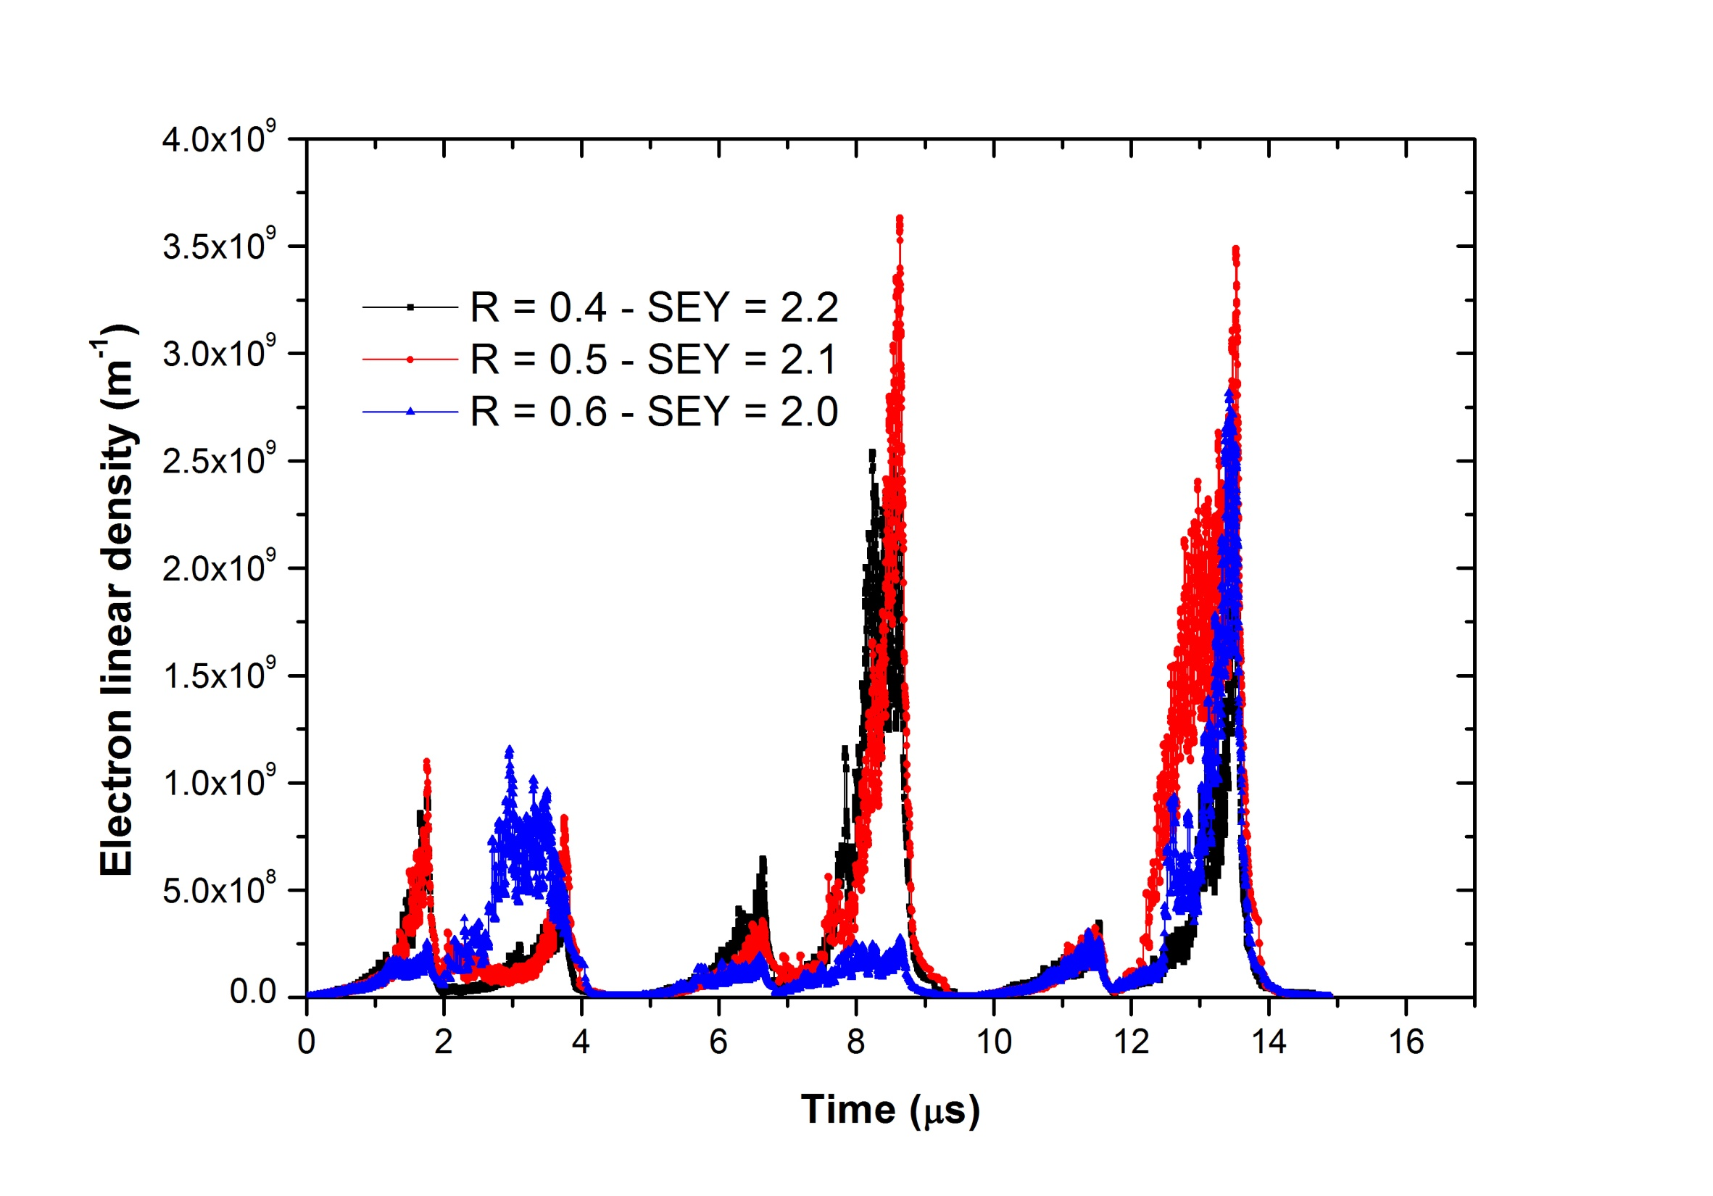

Slide 8
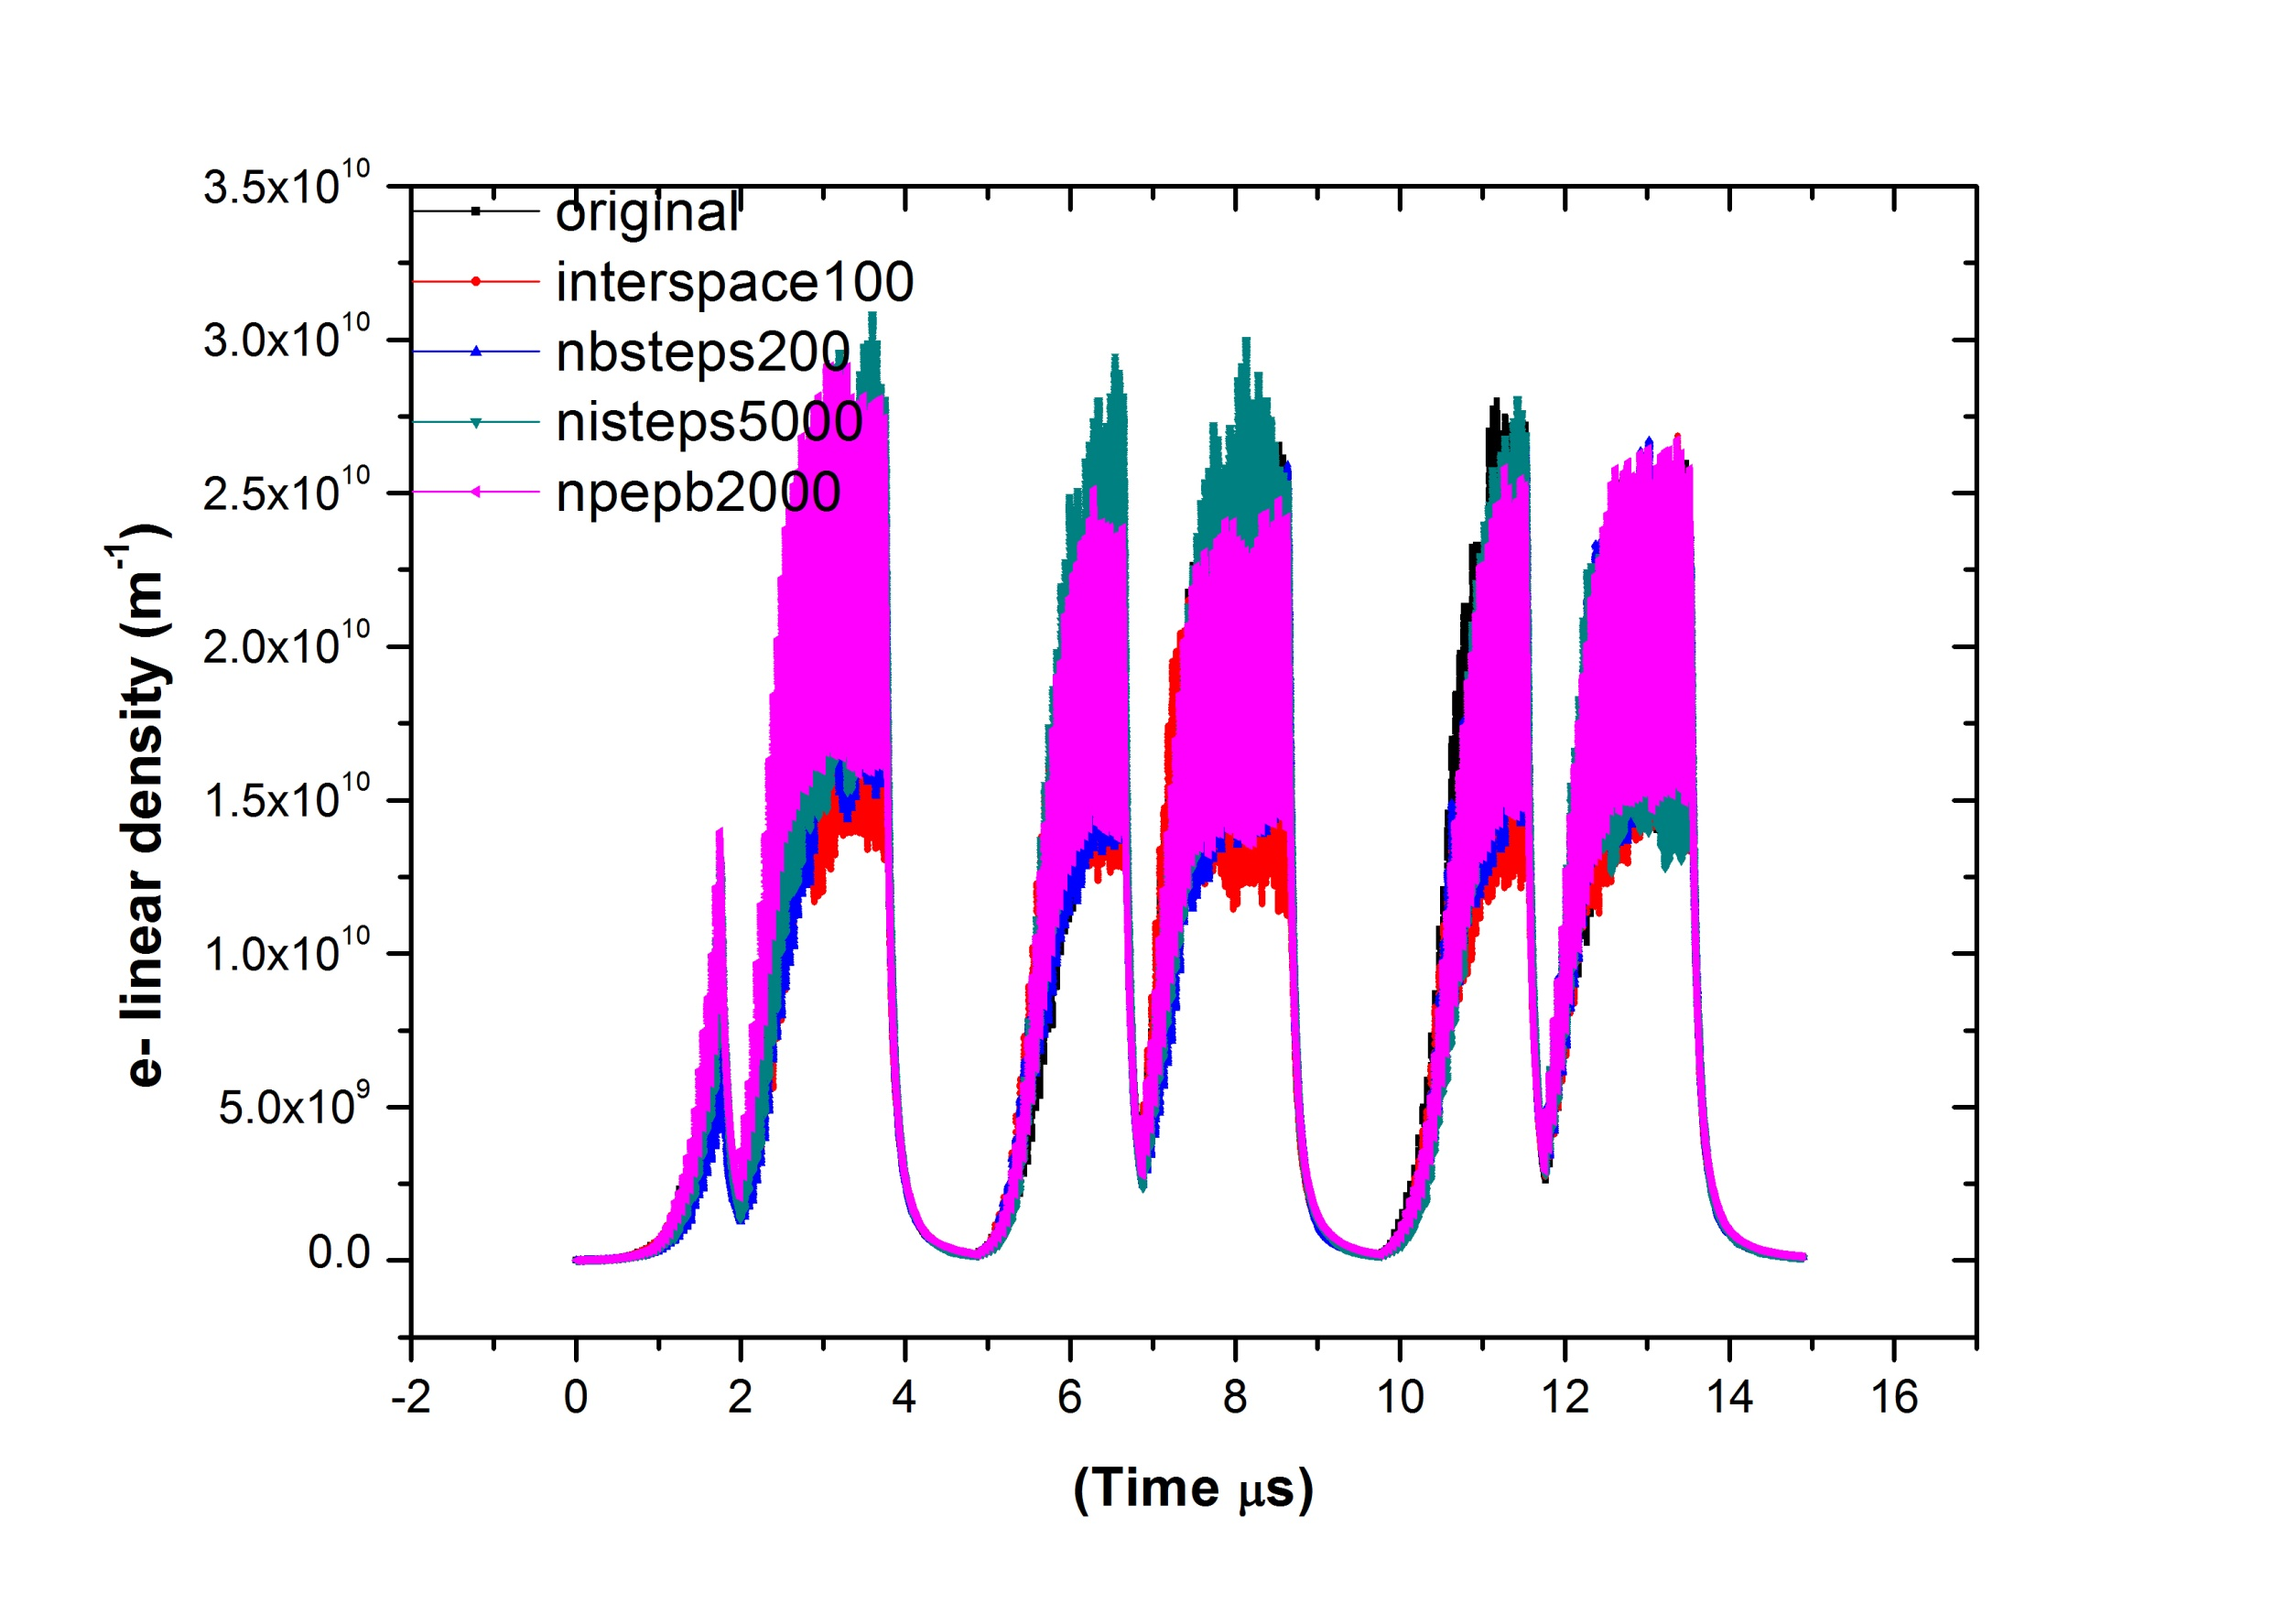

Slide 9
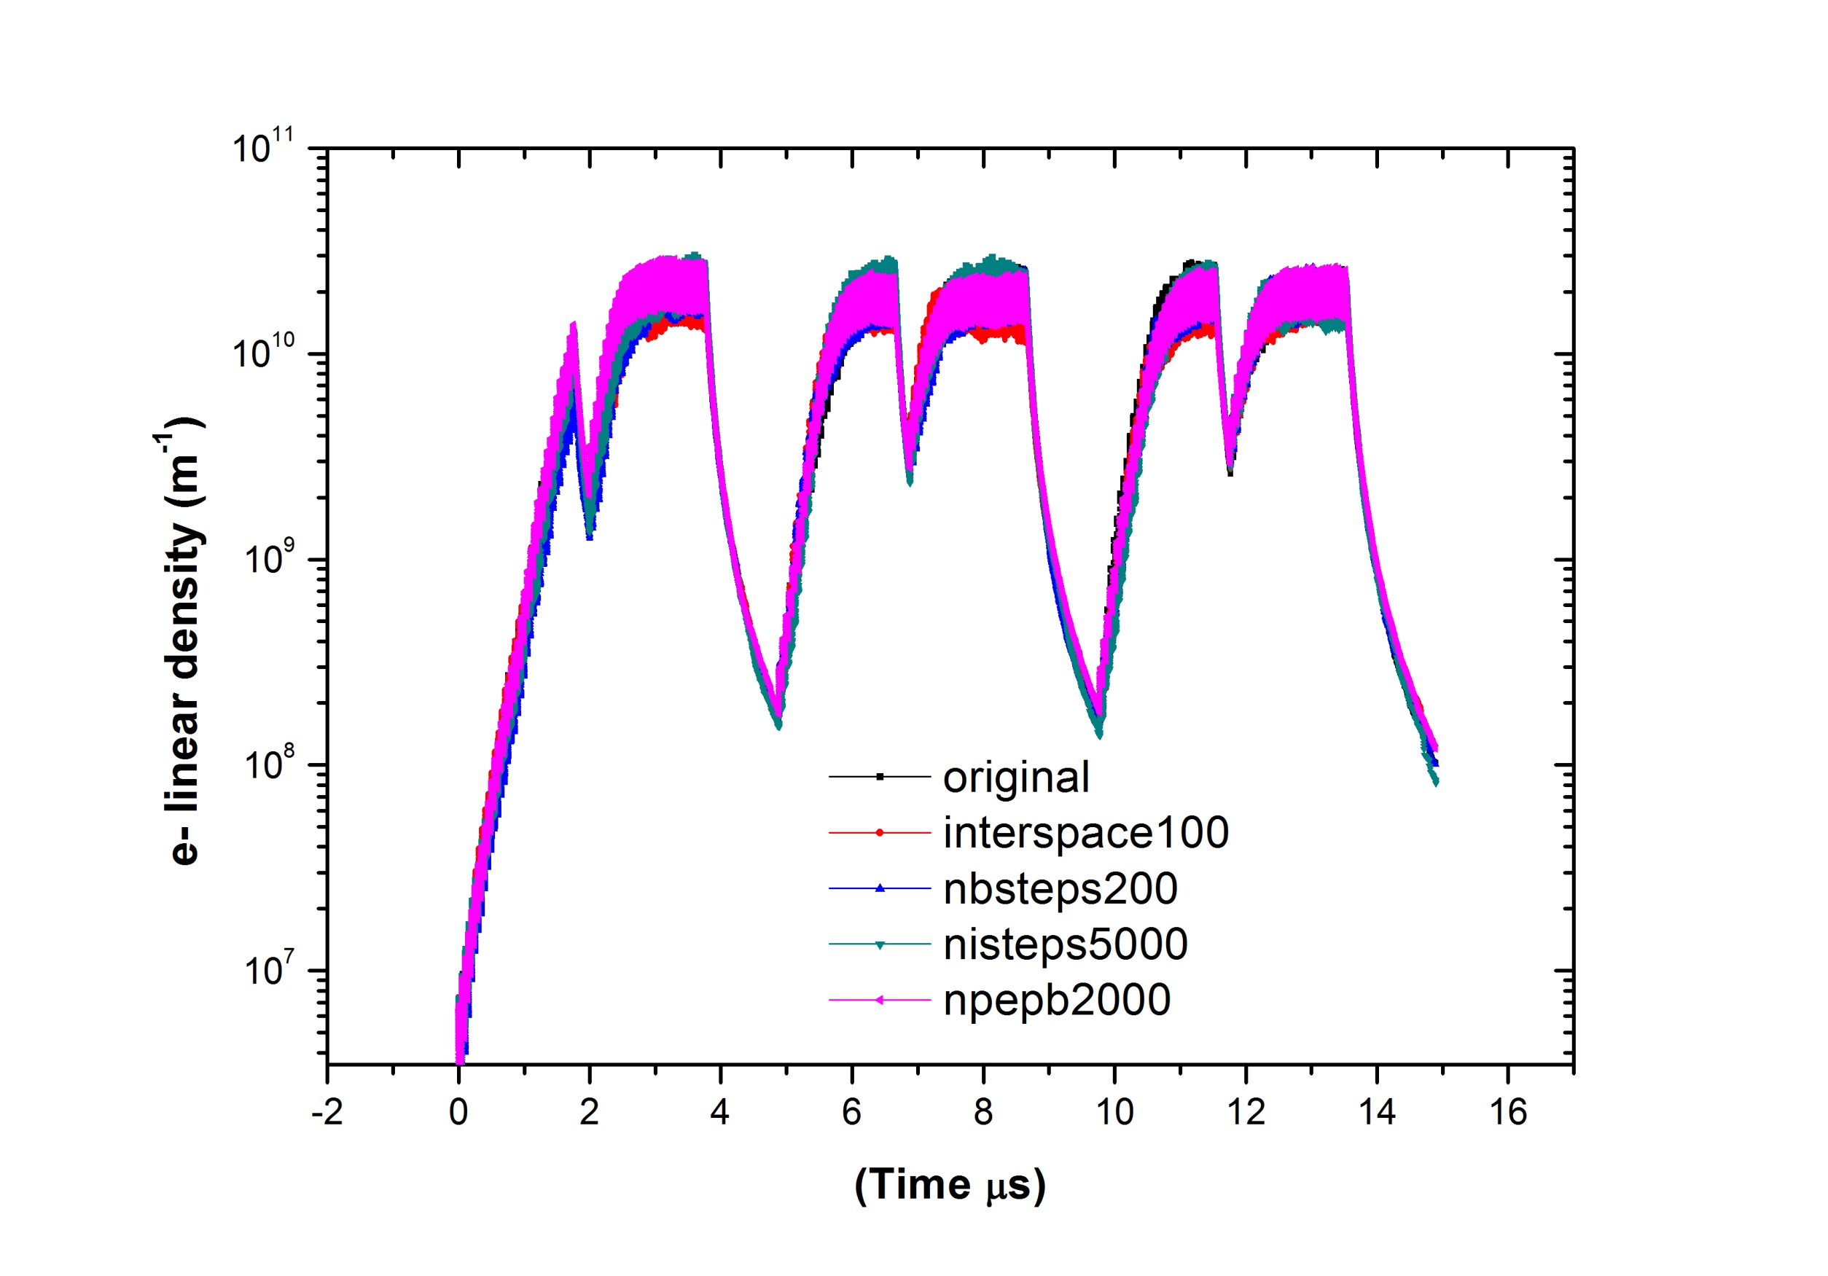

Slide 10
Simulation parameters for 50 ns – Drift
Bunch spacing | Bunch intensity | SEY | Reflectivity | Fill pattern | Energy
50 ns | 1.15 x 10¹¹ p/b | 1.7 - 2.3 | 0.3 | 1 | 3.5 TeV*
Bunch length | sx, sy | Magnetic field | Radius (mm) | Energy
9 cm | 0.3 mm | 4.195 T | 15 - 50 | 3.5 TeV
* We used a primary photoelectron emission yield =0.0001233
(1)
36bunches
36 bunches
200ns
nistep = 2500

Slide 13
Conclusions
We can observe multipacting at:
Section | Energy | Reflectivity | SEY
Dipole | 3.5 TeV | 0.2 0.3 0.4 0.5 0.6 0.7 0.8 0.9 | 2.4 2.3 2.2 2.1 2.0 1.9 1.8 1.7

Slide 14
Thank you for your attention

