Slide 1
e-cloud tune shift &
LHC inverted sawtooth chambers
Frank Zimmermann
e-cloud simulation meeting
7 June 2011

Slide 2
question from Elias Metral, 24 May 2011
“I imagine that if it were due to ecloud the tune shift for mode 0 would be positive. What do you think?”
single bunch tune shift from uniform cloud inside bunch volume or cloud filling the entire chamber for round and flat beams has been studied in:
K. Ohmi, S. Heifets, F. Zimmermann,
“Study of coherent tune shift caused by electron cloud in positron storage rings”, Proc. APAC2001 Beijing & CERN SL-2001-062 (AP); here tune shift positive or ~0 (horizontal tune shift for flat beam)
later work by Kazuhito Ohmi for KEKB
  also pointed at by Giovanni Rumolo

Slide 3
Answer K. Ohmi 25 May 2011
“Coupled bunch wake is focusing for following bunches in drift, but defocusing in solenoid, shown in the paper written with Su Su Win (PRST 2005).
Single bunch wake is always defocusing in very short range but can be focusing , shown in PRL paper on measurement with J. Flanagan (2005).
Perhaps I do not understand your question completely.”

Slide 4
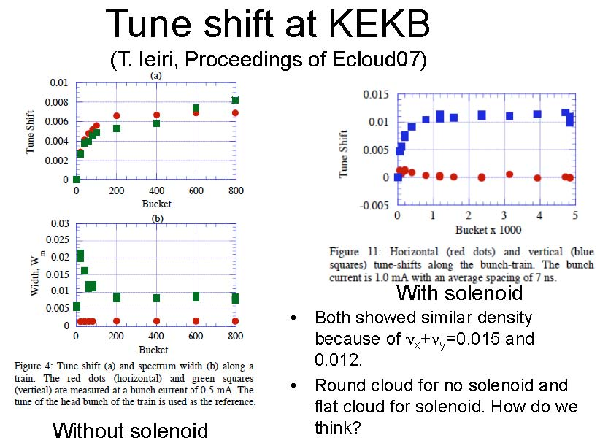
K. Ohmi, TILC08 Sendai

Slide 5
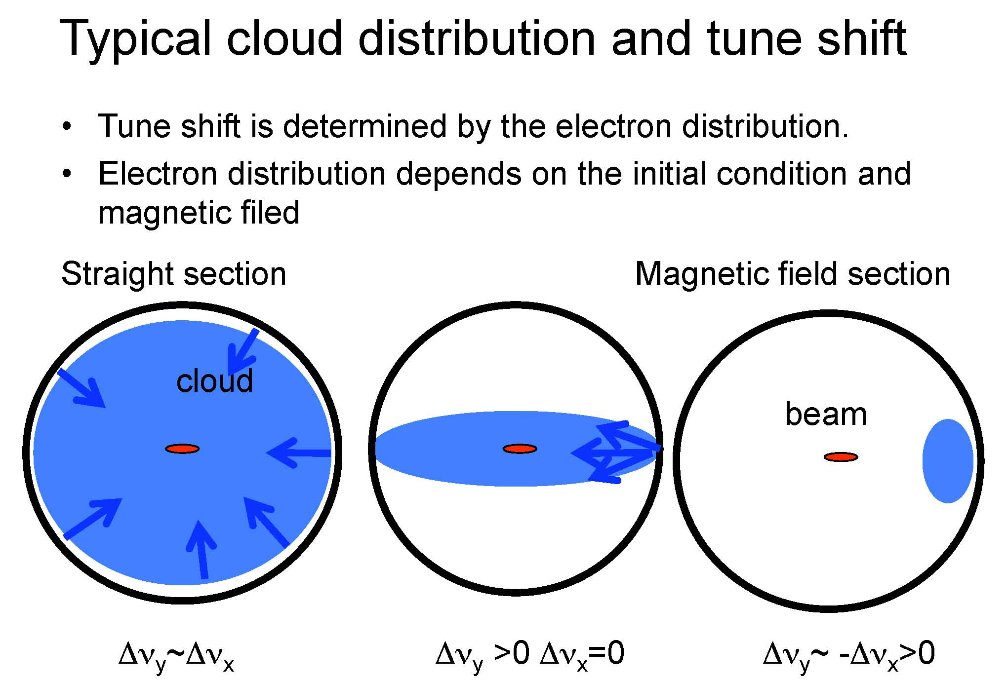
K. Ohmi, TILC08 Sendai

Slide 6
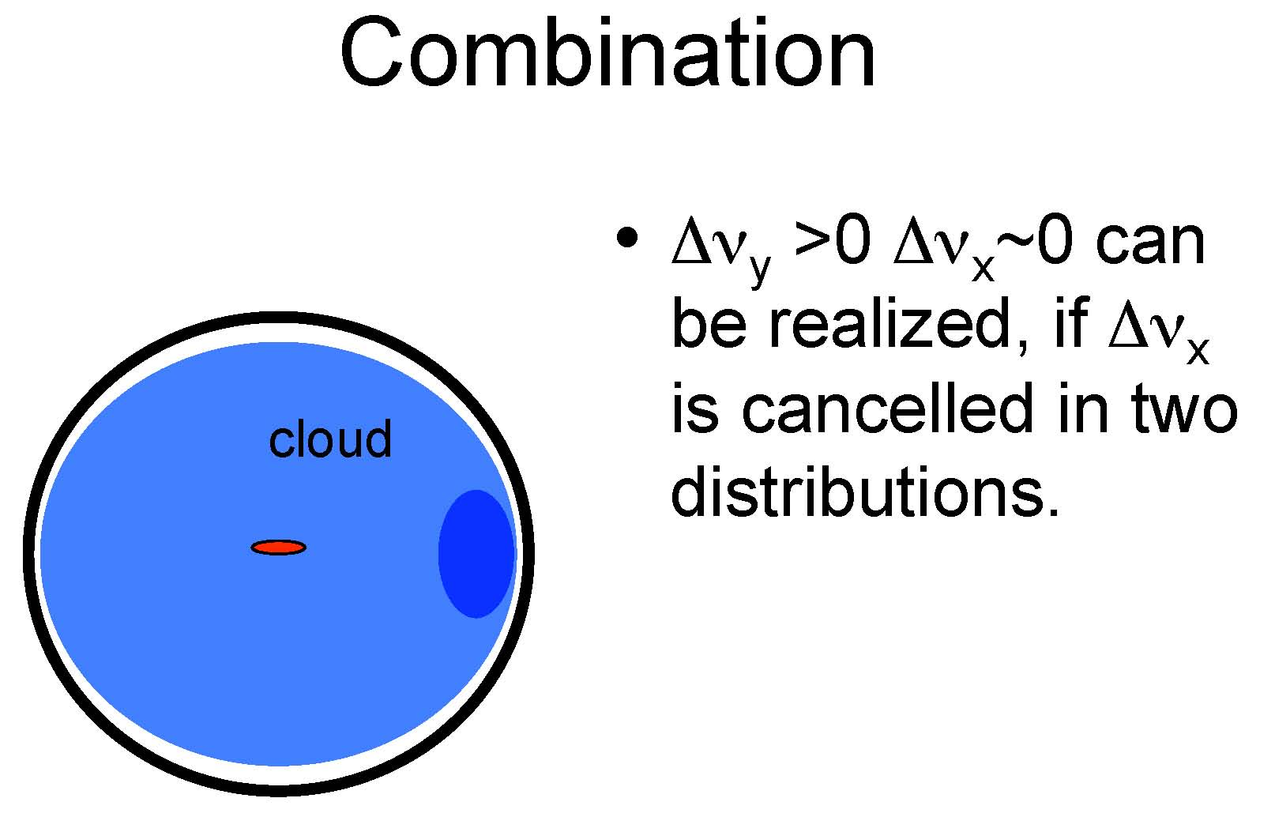
K. Ohmi, TILC08 Sendai

Slide 7
Question from Oliver Brüning, 3 February 2011
”I have been asked to give comments concerning the replacement of beam screens in Sector 34 and the installation of screens with wrong sawtooth orientation.
Do you have any comments that came up in the discussions of your working group that I should include in my comments?”

Slide 8
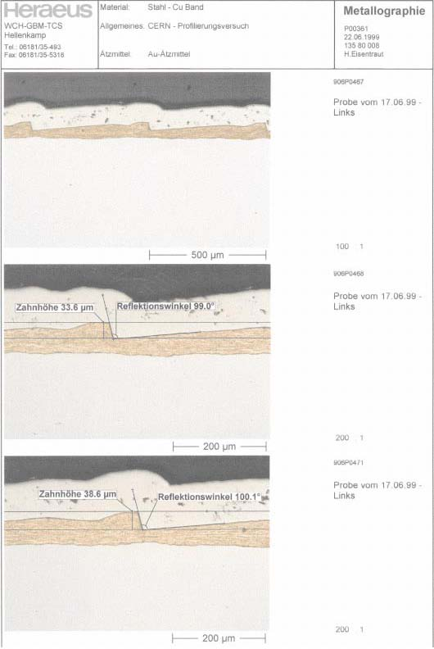
LHC arc chamber sawtooth
I. Collins,
V. Baglin,
et al.

Slide 9
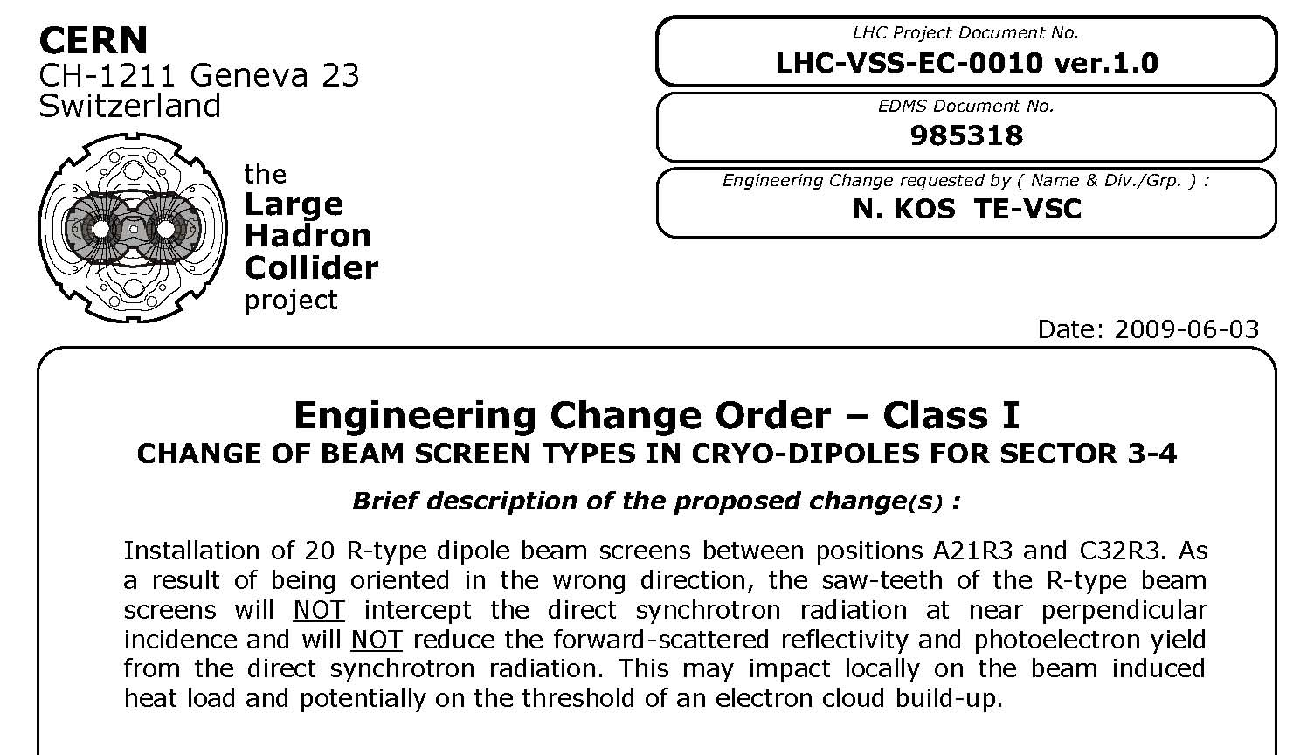
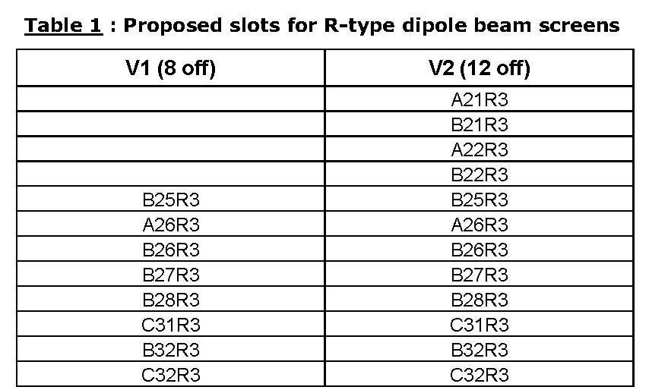
beam-screen orientation in S3-4

Slide 10
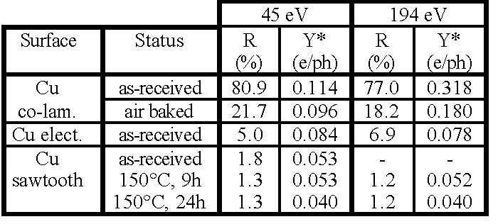
effect of the sawtooth
V. Baglin I. Collins, O. Grobner, EPAC’98
assumptions agreed with Humberto Maury
to model chamber w/o sawtooth:
change distribution of reflected photons from cos²ψ to uniform
increase reflectivity from 20% to 80%
increase photoelectron yield by factor 2

