Slide 1
Ecloud FB simulations – Update from LARP
Summary of a PAC 11 Contribution
Open Questions
Hofle
9.5.2011

Slide 2
Reminder:
shown in 2008 that FB can cure coherent motion inside bunch
- simple feedback model (2-tap FIR), estimate for bandwidth (< 1 GHz)
- estimate for gain as well (trade-off gain/bandwidth)
-pure dipole FB not enough, need large bandwidth to resolve
motion from inside the bunch
Questions not resolved in 2008: power needed, residual blow-up (“incoherent”)
New results using WARP @PAC’11:

Slide 3
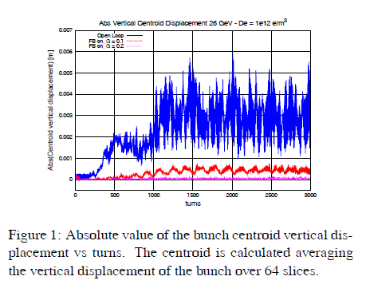
New results using WARP @PAC’11:
5-tap FIR filter (realistic FB with delays)

Slide 4
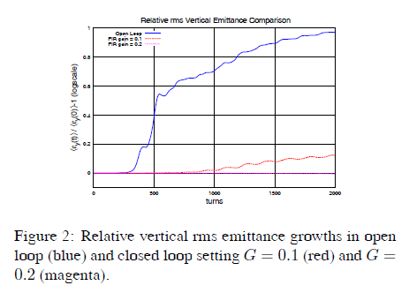
“rms beam size” evolution:

Slide 5
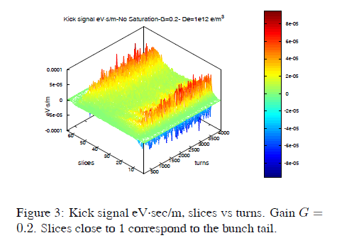
kicks need from wide band FB
large for head and tail, but constantly needed (surprise ?!)
bunch injected with offset: does kick strength depend on static offset ?

Slide 6
bunch injected with offset: does kick strength depend on static offset ?

Slide 7
Ongoing activities within LARP (meeting next week):
- proposal for kicker design (geometrical constraints from vacuum chamber)
demonstrator hardware (including some amplifiers) to be used this year in SPS
goal: excite single bunch head-tail oscillations in controlled way using digital
electronics (high speed DACs)
simulations: WARP continue (power, longer time record, different offsets)
Comparison with simulations by Headtail (CERN?) and CMAD (SLAC ?), who ?
Feasibility of FB strongly depends on the question of the power (kick strength needed)
Constant power needed as seen in WARP simulations driven by simulations noise
or a real effect of ecloud instability
looks like ecloud effect is given constantly an excitation on the beam, does it
Depend on initial static offset, i.e. asymmetry between ecloud in vacuum chamber
and bunch position
stronger collaboration for simulation, how ?

