Slide 1
Scrubbing run 2011
(06/04/2011)
C.Octavio Domínguez, Frank Zimmermann
9th May 2011 - e⁻ cloud meeting

Slide 2
Outline
First experiment – ΔP vs. batch spacing
Second experiment – ΔP Linearity
Effect of the Solenoids (simulations)
9th May 2011 - e⁻ cloud meeting

Slide 3
Scrubbing run – First night
Injection interlock due to BIC sanity checks not performed in the last 25 hours
We wanted:
6μs
4μs
2μs
1μs
Pressure close to the thresholds
9th May 2011 - e⁻ cloud meeting

Slide 4
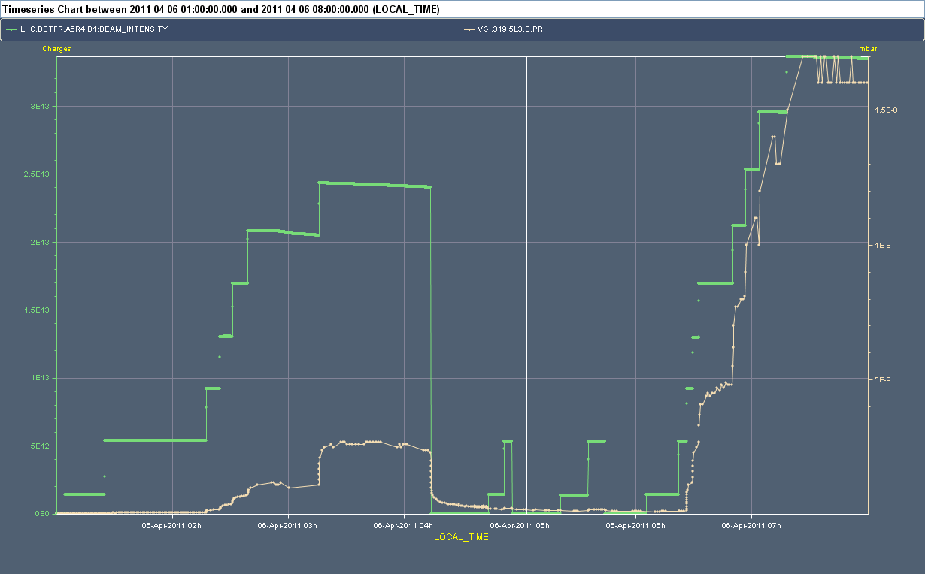
Scrubbing run – First night
ΔP₁ > ΔP₂
2μs
4μs
6μs
2μs
ΔP₁
ΔP₂
9th May 2011 - e⁻ cloud meeting

Slide 5
Outline
First experiment – ΔP vs. batch spacing
Second experiment – ΔP Linearity
Effect of the Solenoids (simulations)
9th May 2011 - e⁻ cloud meeting

Slide 6
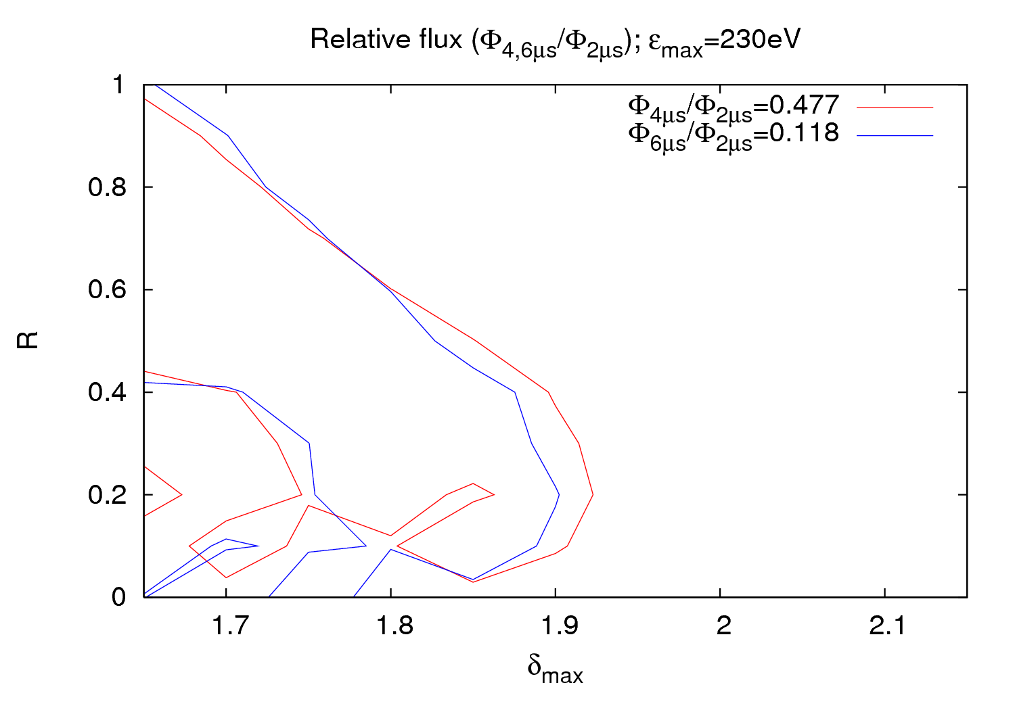
P vs. batch spacing experiment
Last meeting (28/04/2011): Mistake (24 bunches instead of 36) → Sorry!
9th May 2011 - e⁻ cloud meeting

Slide 7
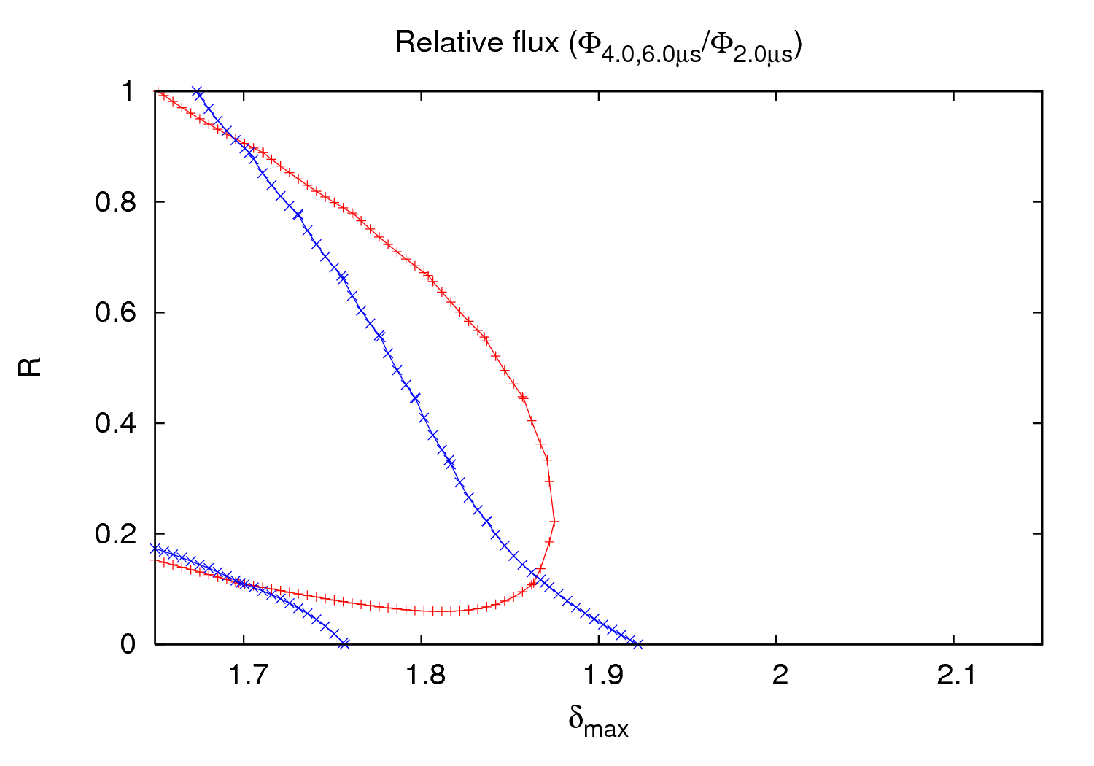
P vs. batch spacing experiment
[1.86, 0.12]
3rd order fit
[1.70, 0.11]
[1.86, 0.12]
9th May 2011 - e⁻ cloud meeting

Slide 8
P vs. batch spacing experiment
The experiment could not be carried out as planned due to several reasons:
- 225 ns batch spacing not available
- Satellite bunches in SPS (delay + 5000 RF buckets shift)
- P close to thresholds for Beam 2
- Injection interlock (BIC sanity check)
Only three points (2 relative measurements) could be done for beam 1
Pressure does not stabilize in the time used for the first batch spacings
Simulations don’t give a clear agreement (a 3rd point would be needed for a verification)
Nevertheless there is a possible solution in the same region as in the 2010 experiment
3rd and 5th order fits have been done, showing both similar solutions
Unfortunately, the experiment was not repeated at the of the scrubbing run

Slide 9
Outline
First experiment – ΔP vs. batch spacing
Second experiment – ΔP Linearity
Effect of the Solenoids (simulations)
9th May 2011 - e⁻ cloud meeting

Slide 10
2 μs batch spacing – P linearity
Linear behavior
Exponential growth
Saturation
9th May 2011 - e⁻ cloud meeting

Slide 11
2 μs batch spacing – P linearity
Similar behavior for different gauges
9th May 2011 - e⁻ cloud meeting

Slide 12
2 μs batch spacing – P linearity
Experimental data show first an exponential growth, and then a linear behavior once saturation is achieved
All gauges considered present a similar behavior
Strong effect on seed pressure → Simulations have been done with a different pressure for different number of batches
Relative ratios have been done to compare linearity in both experimental data and simulations
Several solutions ([SEY,R]) from the previous studies have been considered
Fit
Raw data
9th May 2011 - e⁻ cloud meeting

Slide 13
2 μs batch spacing – P linearity
δ_{max}=1.85
R=0.25
The agreement is much better than considering several batches with the same pressure
9th May 2011 - e⁻ cloud meeting

Slide 14
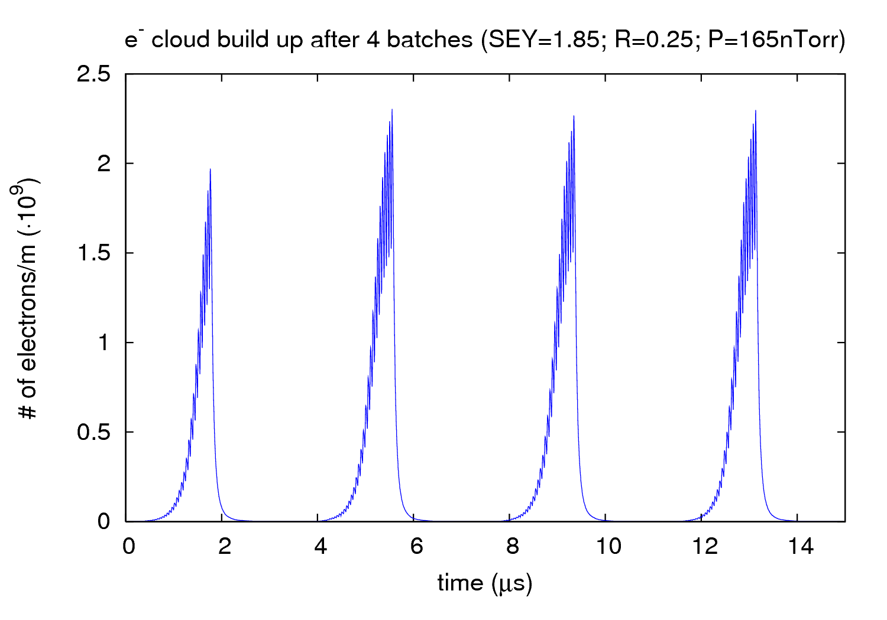
2 μs batch spacing – P linearity
9th May 2011 - e⁻ cloud meeting

Slide 15
2 μs batch spacing – P linearity
δ_{max}=1.85
R=0.25
Best guess for all cases →
(1)
VGPB.2.5L3.B.PR →
Experimental data: m = 0.1654, r²=0.9991
[1.85,0.25] : m=0.1667, r²=0.9996
ε_{rms}=0.023258
Experimental data: m = 0.1765, r²=0.9975
[1.85,0.25] : m=0.1734, r²=0.9895
(2)
VGI.141.6L4.B.PR →
ε_{rms}= 0.0246998
VGI.319.5L3.B.PR →
Experimental data: m = 0.1714, r²=0.9976
[1.85,0.25] : m=0.1904, r²=0.9756
ε_{rms}= 0.0671475
(1)
(2)
ε_{rms}[1.86,0.12]= 0.060522008; ε_{rms}[1.69,0.91]= 0.082966615 ;
9th May 2011 - e⁻ cloud meeting

Slide 16
2 μs batch spacing – P linearity
δ_{max}=1.85
R=0.25
A possible candidate solution has been found
The higher the P, the better the agreement with experimental results
Guages showing low ΔP are not suitable for this study (base pressure effect might affect considerably)
The behavior in simulations is closer to experimental data when considering different P for each batch within the machine
We cannot directly compare experimental results before and after saturation is reached (e.g. batch spacing experiment 2010 and 2011)
Work ongoing… (more checks have to be done)
9th May 2011 - e⁻ cloud meeting

Slide 17
Outline
First experiment – ΔP vs. batch spacing
Second experiment – ΔP Linearity
Effect of the Solenoids (simulations)
9th May 2011 - e⁻ cloud meeting

Slide 18
Solenoids
Location: VPGB. 123.4L2.X.PR (Close to Q3 in IP2)
Filling scheme: Two 36-bunch batches, separated 2 μs
Seed pressure chosen for simulations: 2 nTorr (taken from first night)
B field: 0 G, 5 G, 10 G, 20 G, 30 G, 40 G, 50 G, 70 G, 100 G
δ_{max}=1.85, R=0.25, ε_{max}=230 eV, N_{b}=1.1∙10¹¹ ppb
ibend=17 (uniform solenoid with Runge-Kutta integration)
9th May 2011 - e⁻ cloud meeting

Slide 19
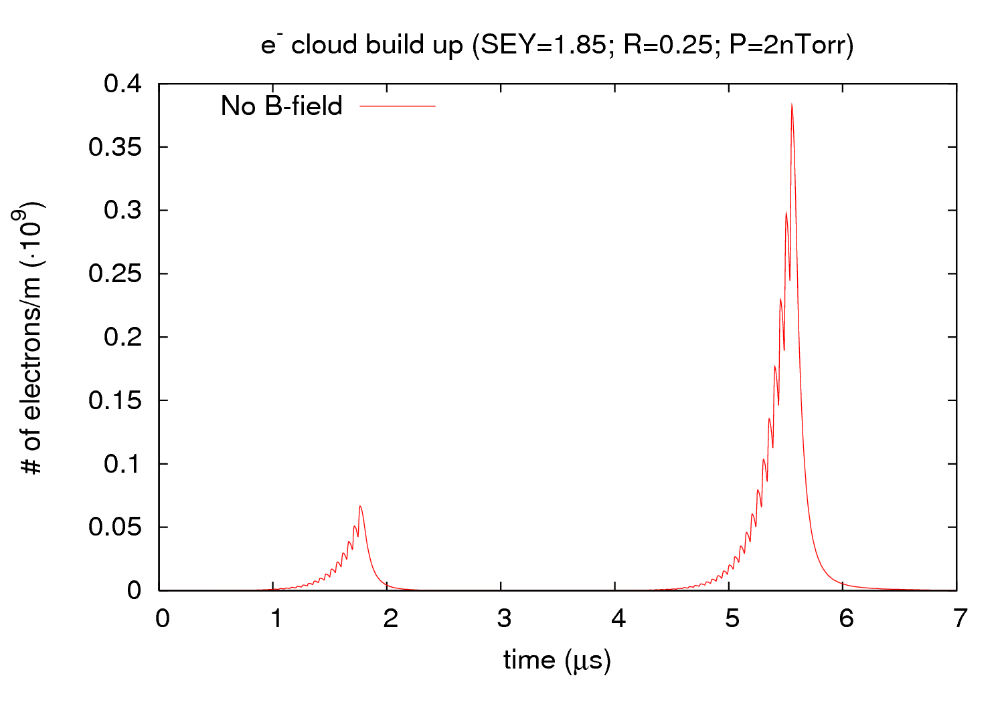
Solenoids
9th May 2011 - e⁻ cloud meeting

Slide 20
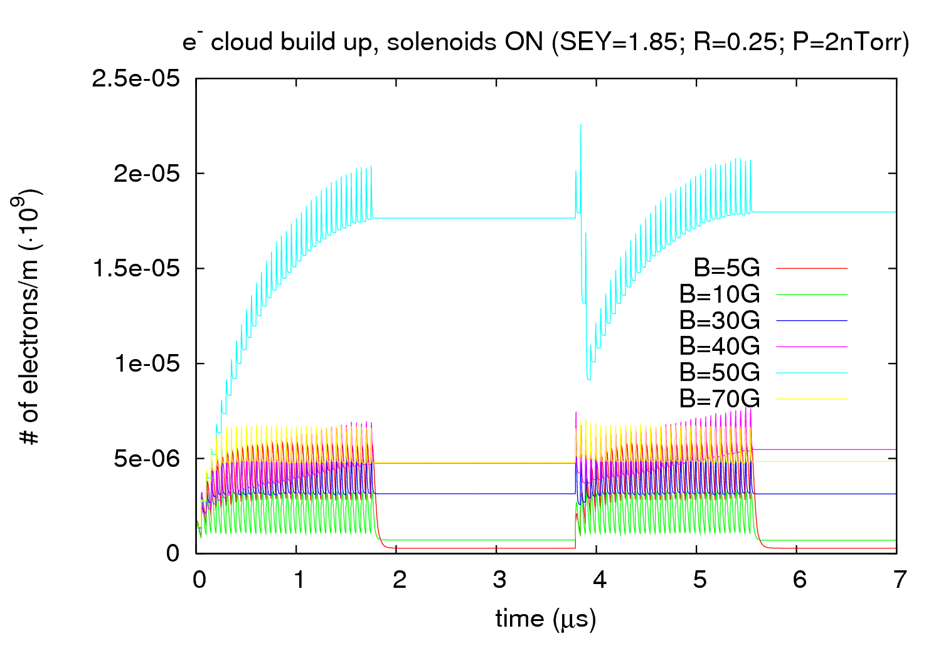
Solenoids
9th May 2011 - e⁻ cloud meeting

Slide 21
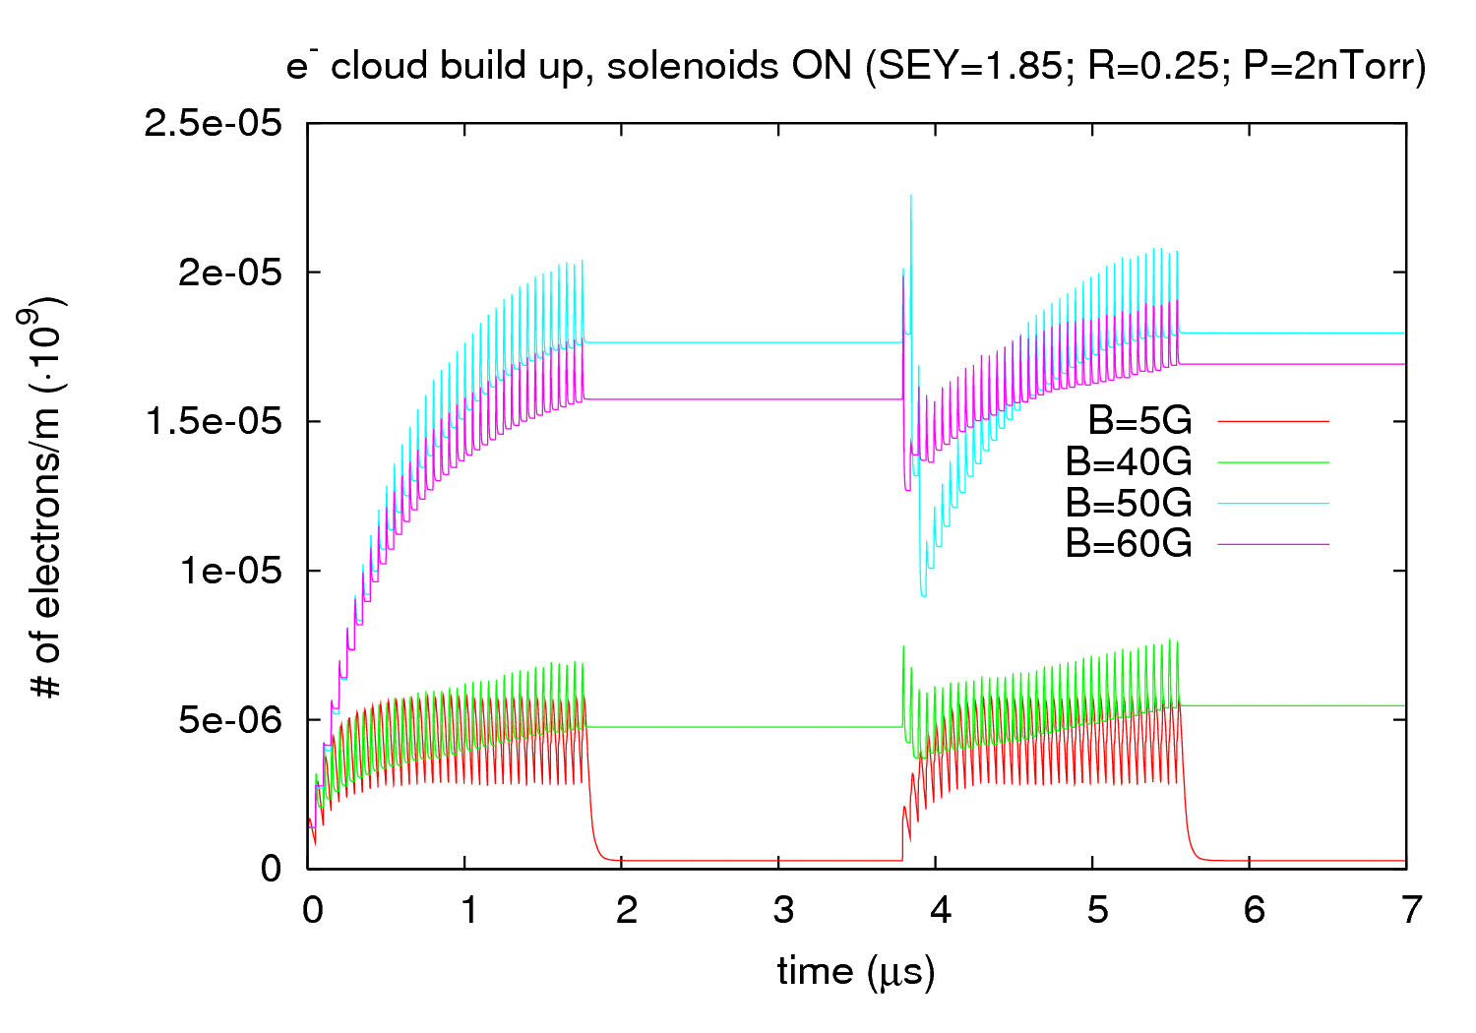
Solenoids
9th May 2011 - e⁻ cloud meeting

Slide 22
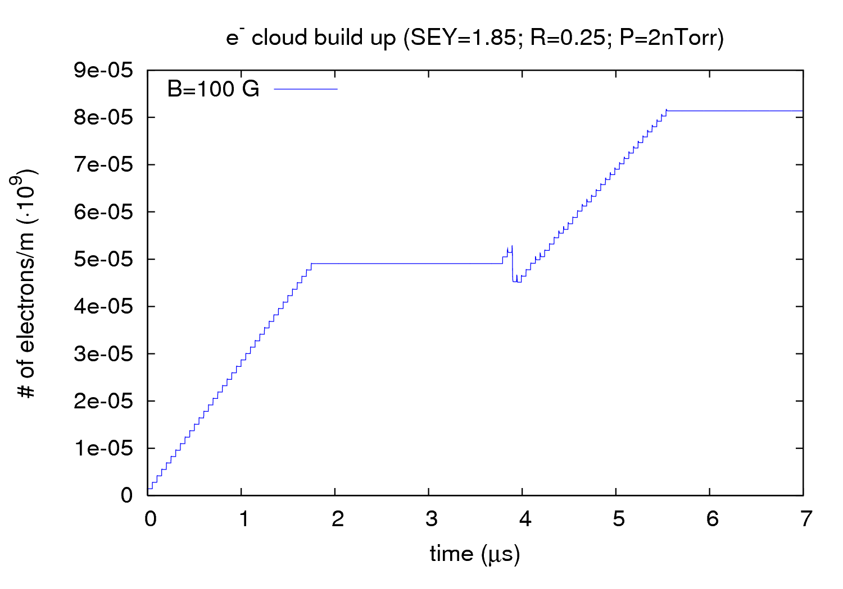
Solenoids
9th May 2011 - e⁻ cloud meeting

Slide 23
Solenoids
A B = 5 G is enough to make disappear the e⁻ cloud effects for the parameters considered
A non-monotonic behavior is observed:
- “Strange” behavior around 50 G
- B = 10 G gives the best performance
Simulations at 100 G give “funny” results (there might be some trapped electrons? Are there resonances between frequencies?)
New parameters should be explored (e.g. higher seed pressure, bunch length, bunch intensity, bunch spacing, …)
9th May 2011 - e⁻ cloud meeting

Slide 24
Thank you for your attention!
9th May 2011 - e⁻ cloud meeting

Slide 25
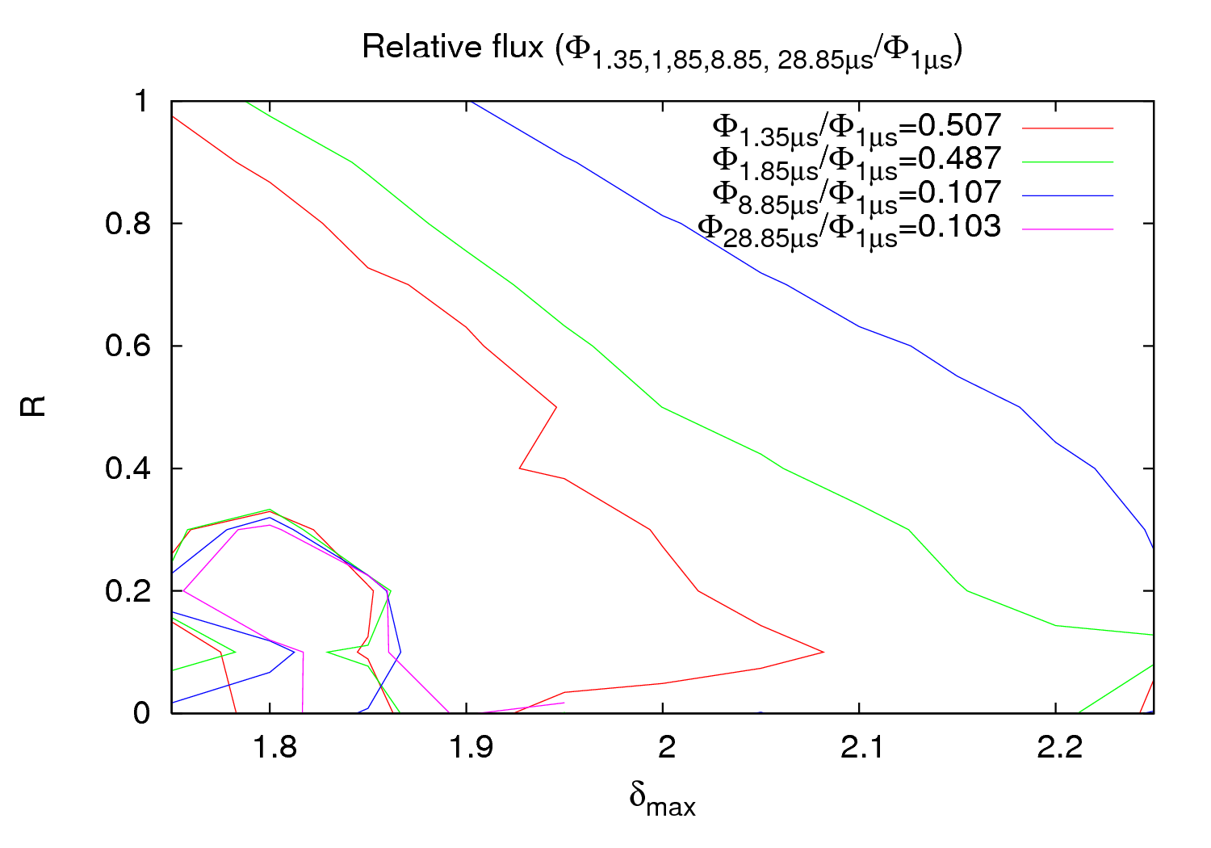
Appendix
[1.85, 0.25]
9th May 2011 - e⁻ cloud meeting

Slide 26
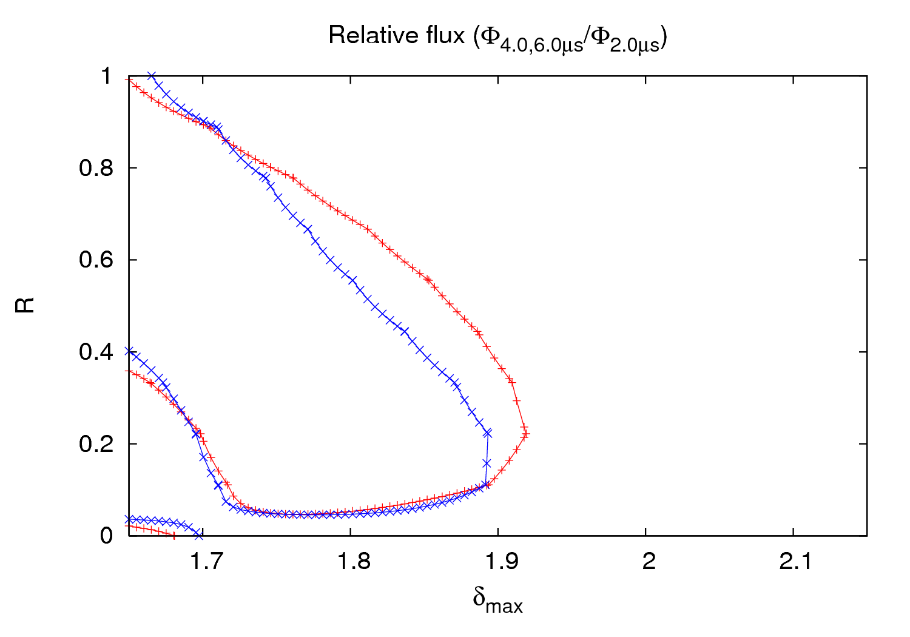
Appendix
5th order fit
9th May 2011 - e⁻ cloud meeting

