Slide 1
PS e-Cloud Simulations
Non-Standard Charge Distributions
C. M. Bhat, H. Maury Cuna,
H. Damerau, S. Hancock, E. Mahner, F. Caspers and F. Zimmermann
e-cloud simulation meeting
August 8, 2011

Slide 2
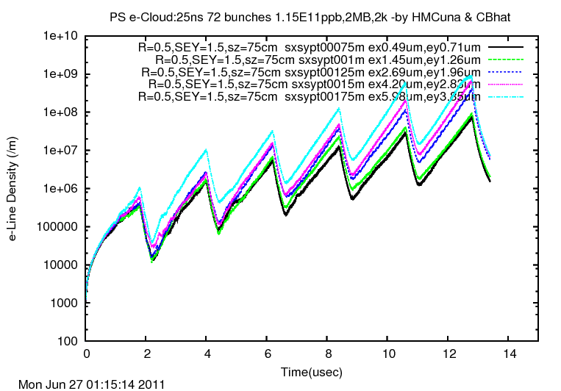
Searching for Saturation in the PS σx=σy in the range of 750-1750μm
μm
μm
μm
μm
μm
750μm≤σx≤ 1750μm
750μm≤σy≤ 1750μm
0.49μm≤εx≤ 5.98μm
0.71μm≤εy≤ 3.85μm
Preliminary simulation results presented on 27/06/2011 indicated that the e-cloud buildup in the PS has a dependence on transverse beam size which is in contrast to the studies done on LHC in the past

Slide 3
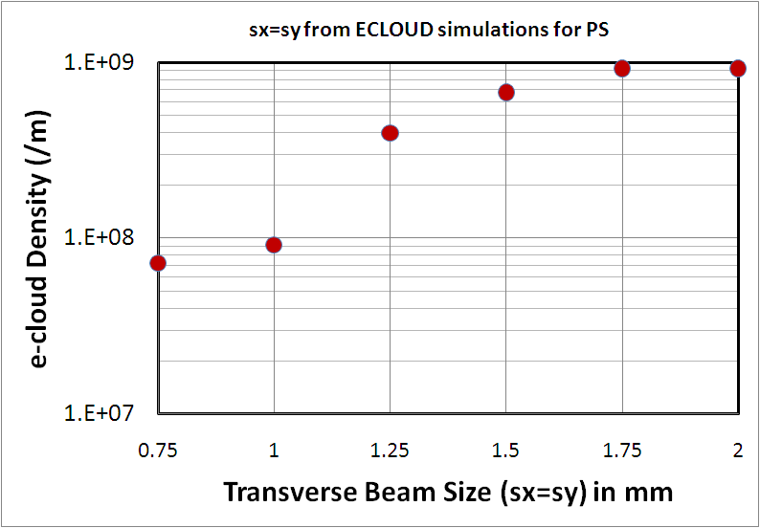
Transverse beam size Dependence of e-cloud Density
In the PS the primary electrons are produced by ionization(simple model)
σx= σy
Beam
σx’= σy’
With σx’> σx
N_{primary} should not change! However, e-cloud evolution is nonlinear phenomenon.

Slide 4
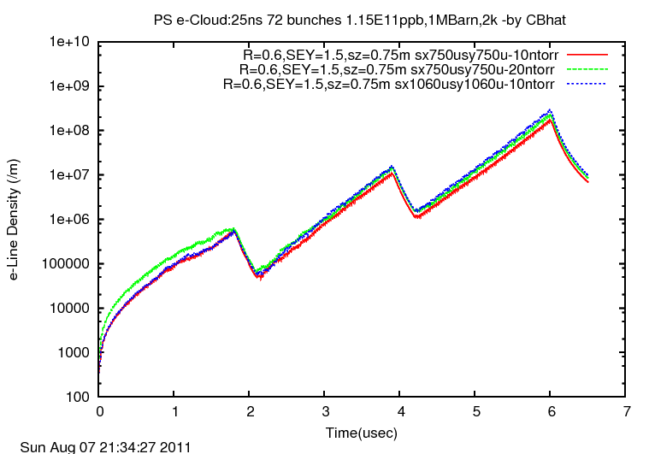
PS ECLOUD Simulations with different σx= σy and Pressures nbstp=200 (&150) nistep=3000 (&2000)
10 nTorr
20 nTorr
10 nTorr

Slide 5
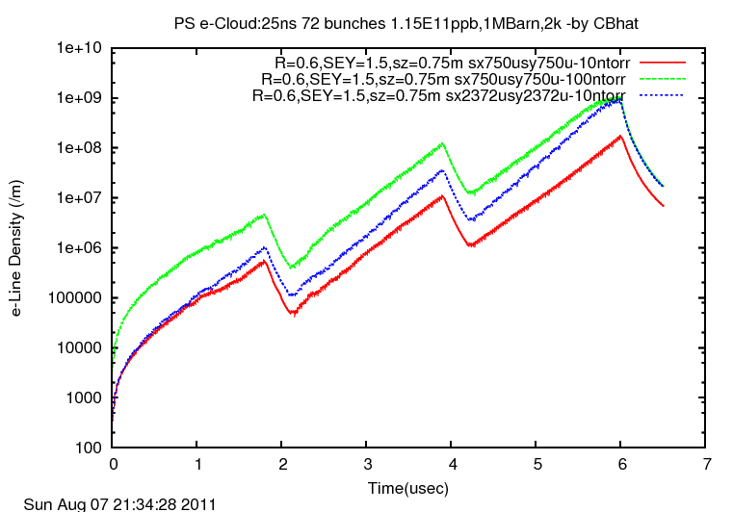
PS ECLOUD Simulations with different σx= σy and Pressures nbstp=200 (&150) nistep=3000 (&2000)
10 nTorr
100 nTorr
Simulations show that a clear evidence of e-cloud density dependence on beam size; larger the beam size larger the e-cloud density. This may be an important effect on PS and SPS e-cloud simulations.
10 nTorr

Slide 6
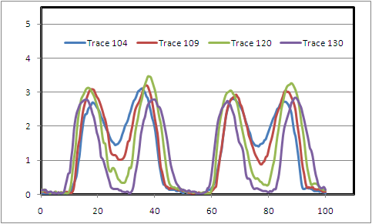
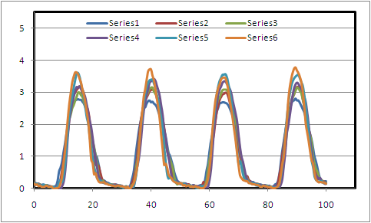
PS e-cloud Data Analysis
PS Bunch Profiles: LHC25
(Non-Standard Charge Distributions)
Bunch Int.= 1.36E11ppb
(1% less than BLM case)
Bunch Profiles
during the splitting
Start of e-cloud
Bunch Profiles
for V2/V1= 0
V1=40kV to 100kV

Slide 7
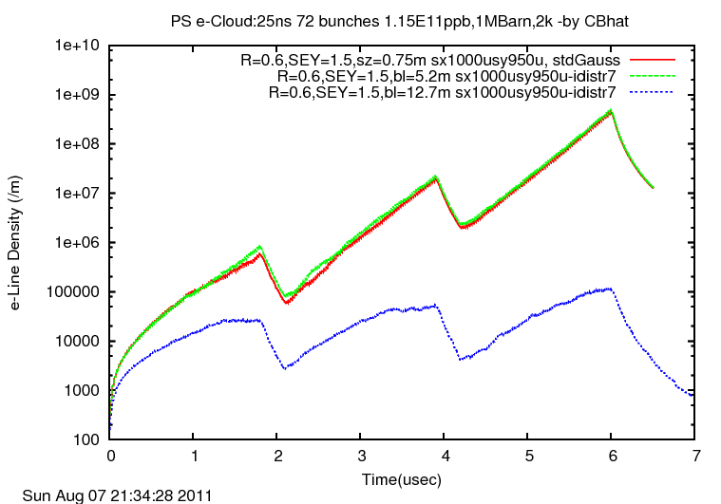
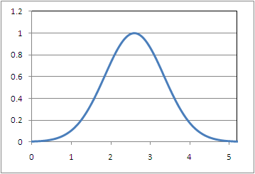
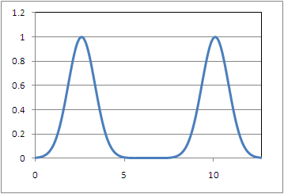
PS ECLOUD Simulations for the PS e-cloud data
single bunch
72 single bunches
=5.2 m
double bunches
36 double bunches
BL = 12.7 m
We find that
“#of partition/bunch < # of inter bunch partitions”
is a necessary condition for ECLOUD. So an improvement is needed.

