Slide 1
LHC Scrubbing-run benchmarking
(An Update)
C.Octavio Domínguez, Frank Zimmermann
9th August 2011 - e⁻ cloud meeting

Slide 2
Outline
Review on Nov’10 measurements
9th August 2011 - e⁻ cloud meeting

Slide 3
What’s new?
Nov’10 analysis re-done with all considerations from last meeting
6x6 grids (instead of 11x11 as shown in the past) → better fits
Pressure ratios: always subtracting base pressure
Pressure was increased for some cases
9th August 2011 - e⁻ cloud meeting

Slide 4
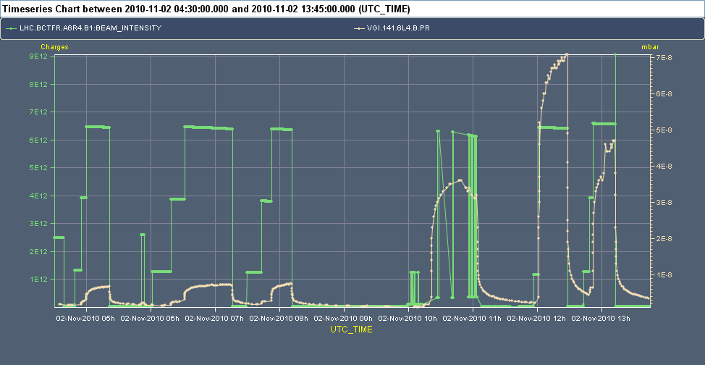
Experiment overview
VGI.141.6L4.B
1 μs
38.85 μs
28.85 μs
8.85 μs
1.85 μs
1.35 μs
9th August 2011 - e⁻ cloud meeting

Slide 5
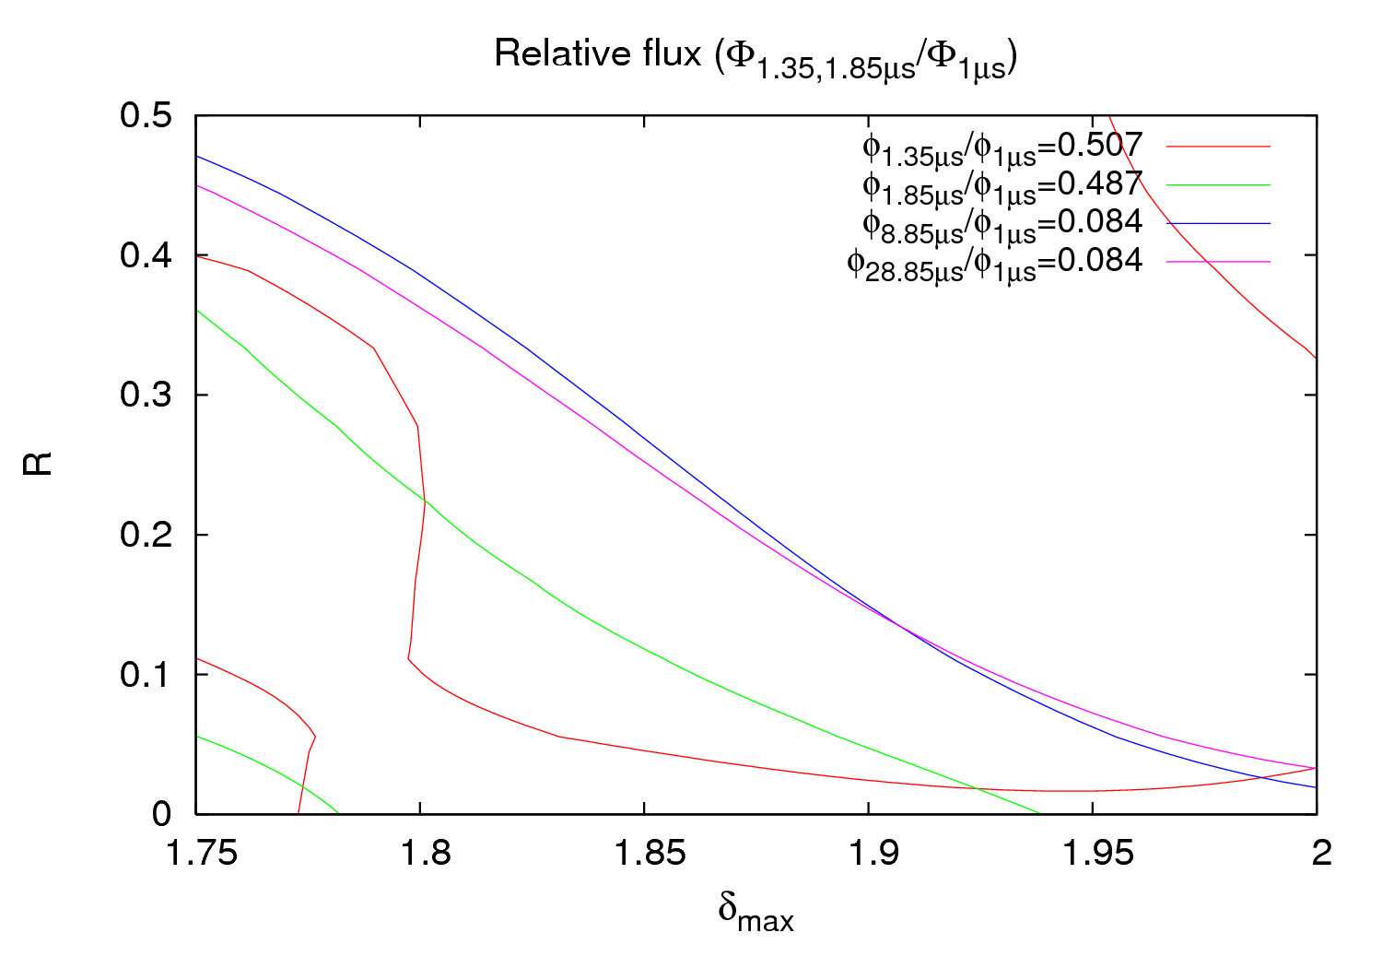
Results
9th August 2011 - e⁻ cloud meeting

Slide 6
Experiment overview
VGI.141.6L4.B
1 μs
38.85 μs
28.85 μs
8.85 μs
1.85 μs
1.35 μs
P_{1.35μs}: 27 nTorr → 35.3 nTorr
9th August 2011 - e⁻ cloud meeting

Slide 7
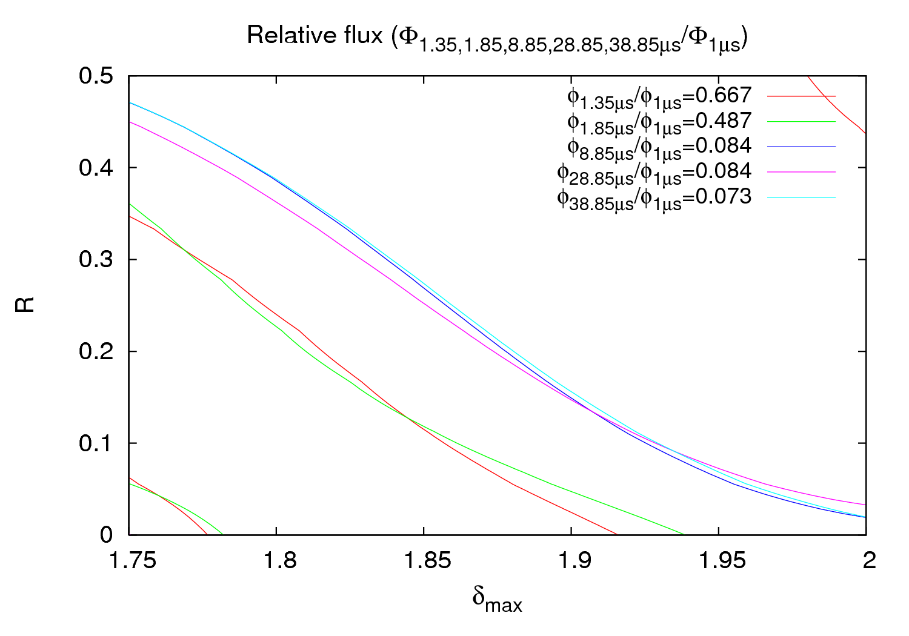
Results
9th August 2011 - e⁻ cloud meeting

Slide 8
Experiment overview
VGI.141.6L4.B
1 μs
38.85 μs
28.85 μs
8.85 μs
1.85 μs
1.35 μs
P_{1.85μs}: 26 nTorr → 27 nTorr
P_{1.0μs}: 53.3 nTorr → 60.8 nTorr
9th August 2011 - e⁻ cloud meeting

Slide 9
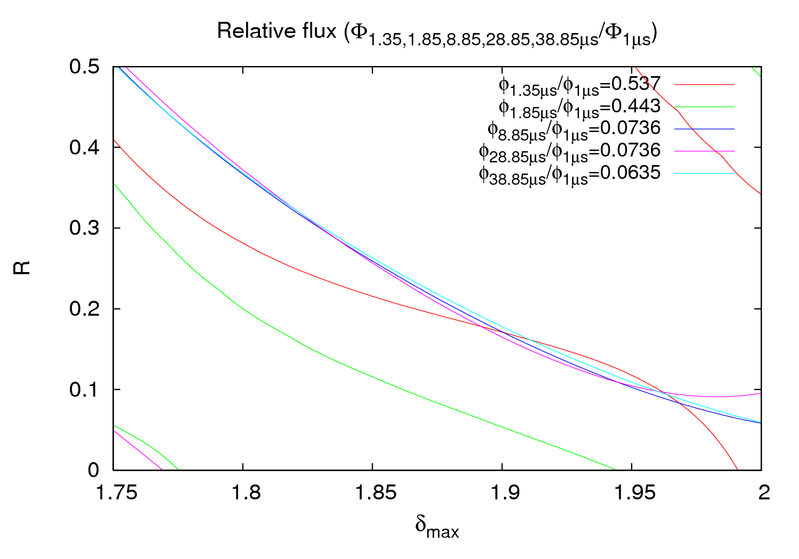
Results
(~1.9, ~0.2)
9th August 2011 - e⁻ cloud meeting

Slide 10
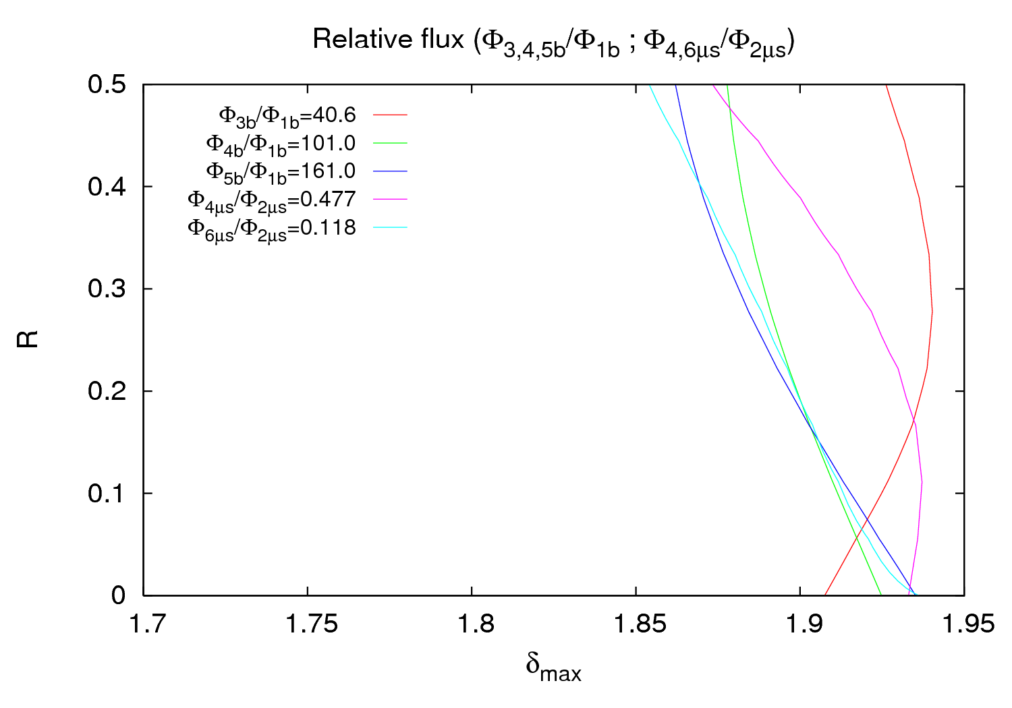
Results 6th April
(~1.9, ~0.2)
9th August 2011 - e⁻ cloud meeting

Slide 11
Conclusions
Input pressure is very important for the benchmarking
In Nov’10, lines for 8.85 μs, 28.85 μs and 38.85 μs are almost coincident → Lost of memory due to a big gap → Good confirmation of observations
For any further experiment is essential to wait until the steady-state vacuum pressure is reached!!
Next MD (if possible):
2 batches at 2 μs + clearing gap (12 μs?) + 2 batches at 1 μs
Double batches at a certain spacing (1.85 μs?). Up to 6
Double batches at another spacing (925 ns?). ≥ 6
Always reaching saturation pressure in every step!!
9th August 2011 - e⁻ cloud meeting

Slide 12
THANK YOU FOR YOUR ATTENTION

