Slide 1
Ecloud Heat Load simulations for the LHC arcs
E-cloud Simulation Meeting
Humberto Maury Cuna
May 16Th, 2011

Slide 2
Simulation parameters for 50 ns
Bunch spacing | Bunch intensity | SEY | Reflectivity | Fill pattern | Energy
50 ns | 1.2 x 10¹¹ p/b | 1.6 - 2.4 | 0.2 - 0.9 | 1 | 450 GeV* 3.5 TeV**
Bunch length | sx, sy | Magnetic field | Pressure | Energy
11.8 cm 9 cm | 1.2 mm 0.3 mm | 0.54 T 4.195 T | 32 nTorr --- | 450 GeV 3.5 TeV
* Gas ionization
** We used a primary photoelectron emission yield =0.0001233
(1)
36bunches
36 bunches
X 3
200ns
1.1 µs
Fill 1704 (13/4/2011 – 12:16 to 16:47)
nistep = 2500

Slide 3
Heat load
3.5 TeV

Slide 4
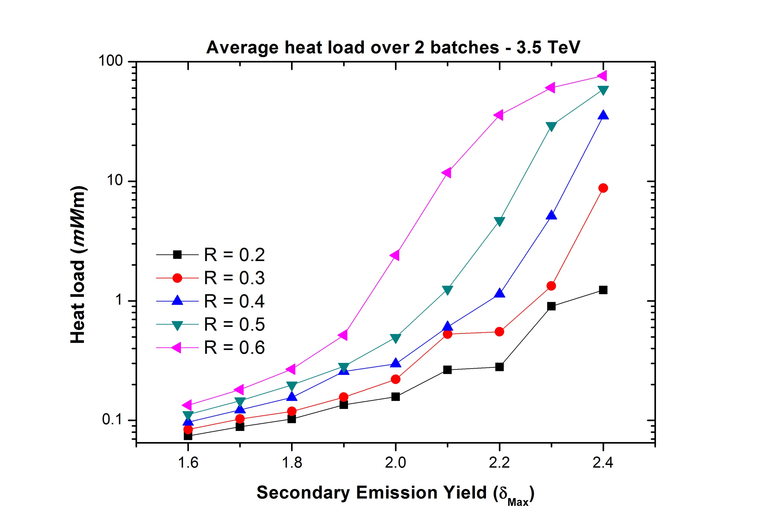

Slide 5
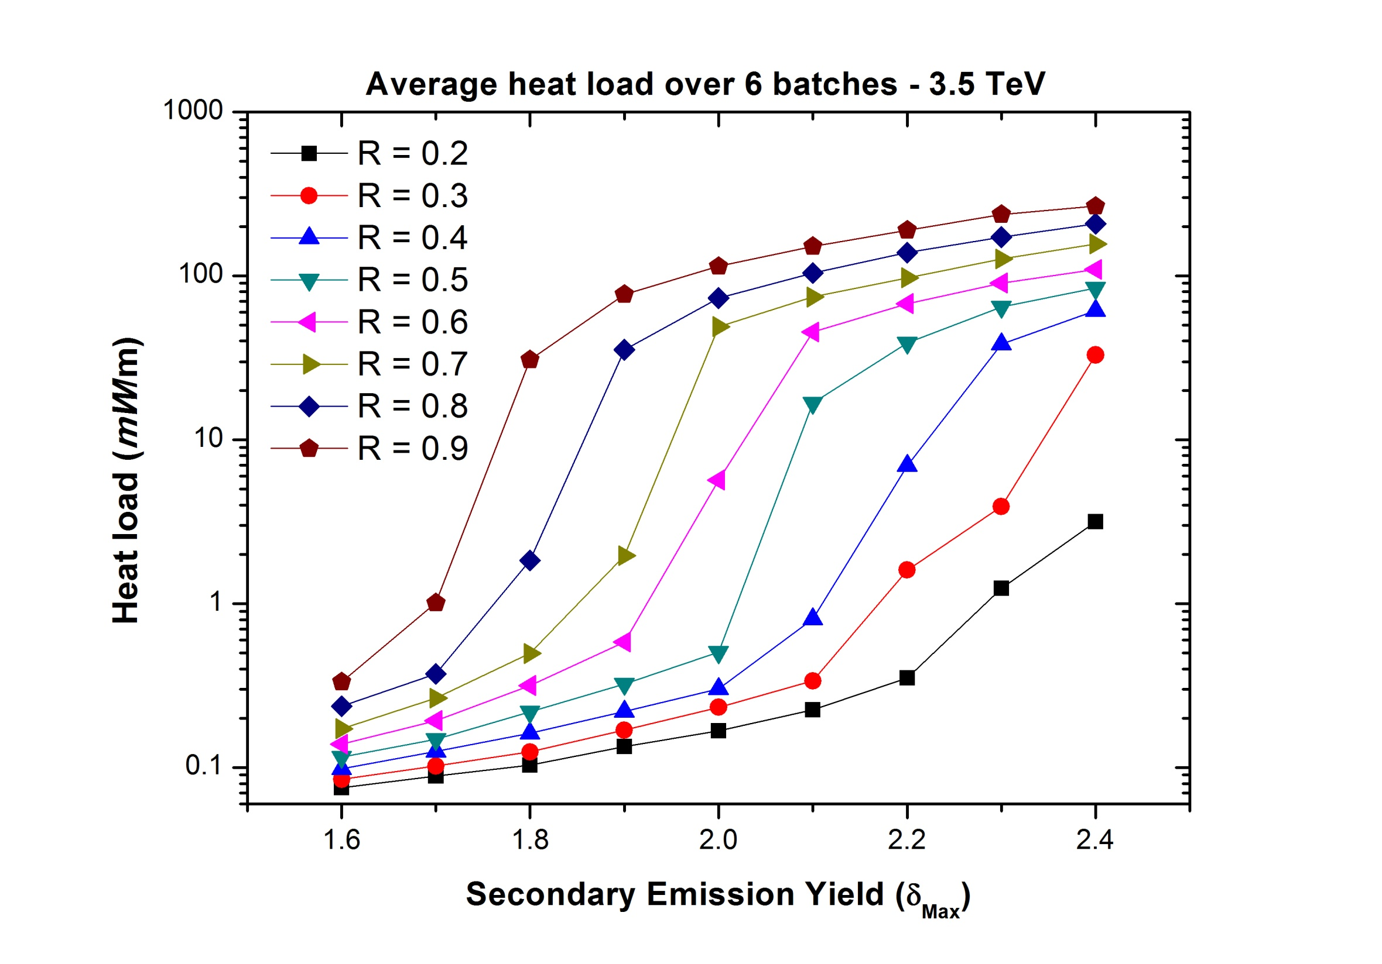

Slide 6
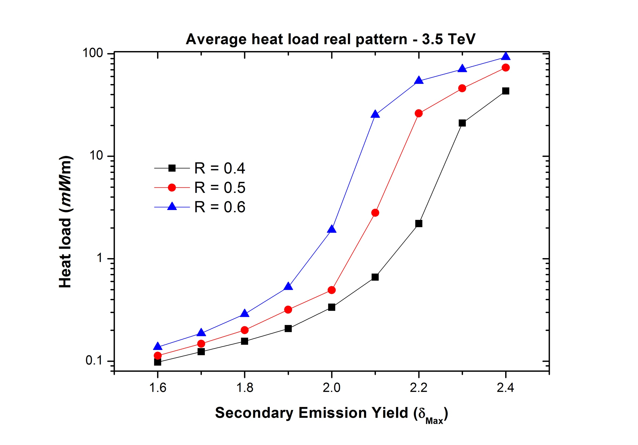

Slide 7
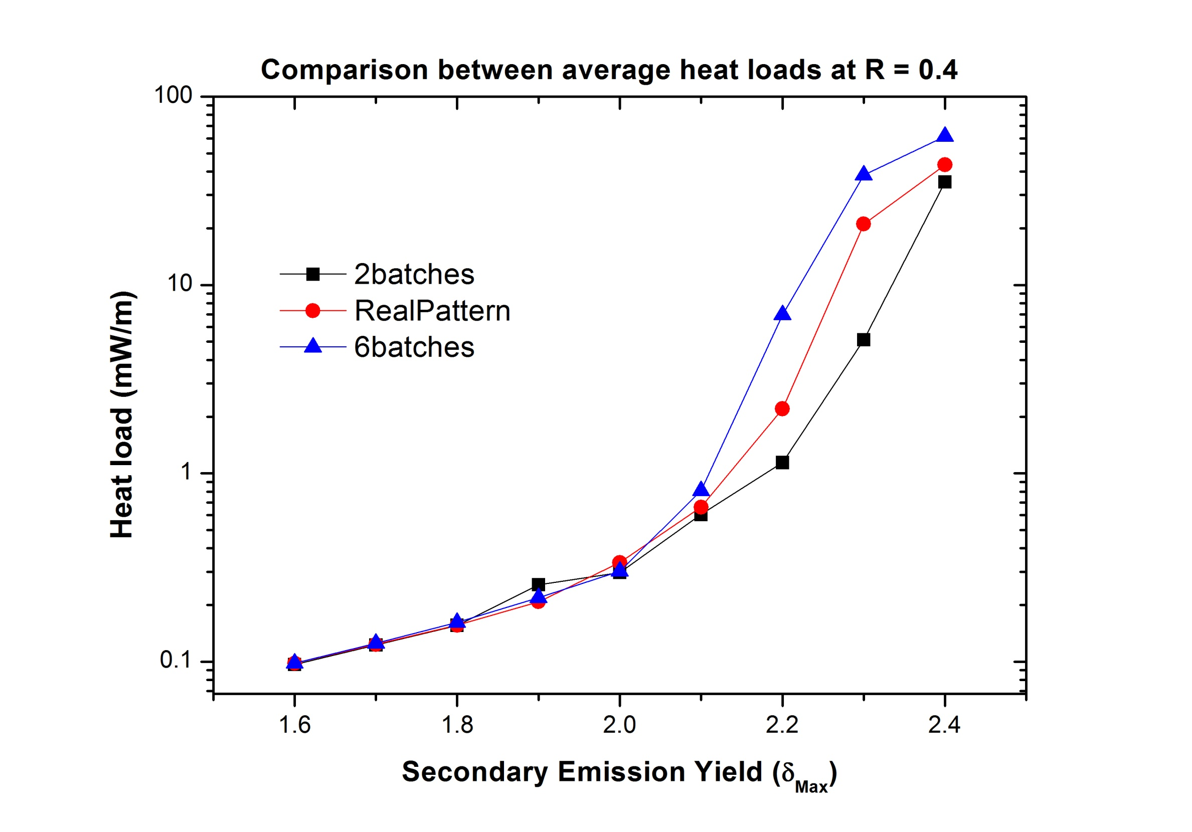

Slide 8
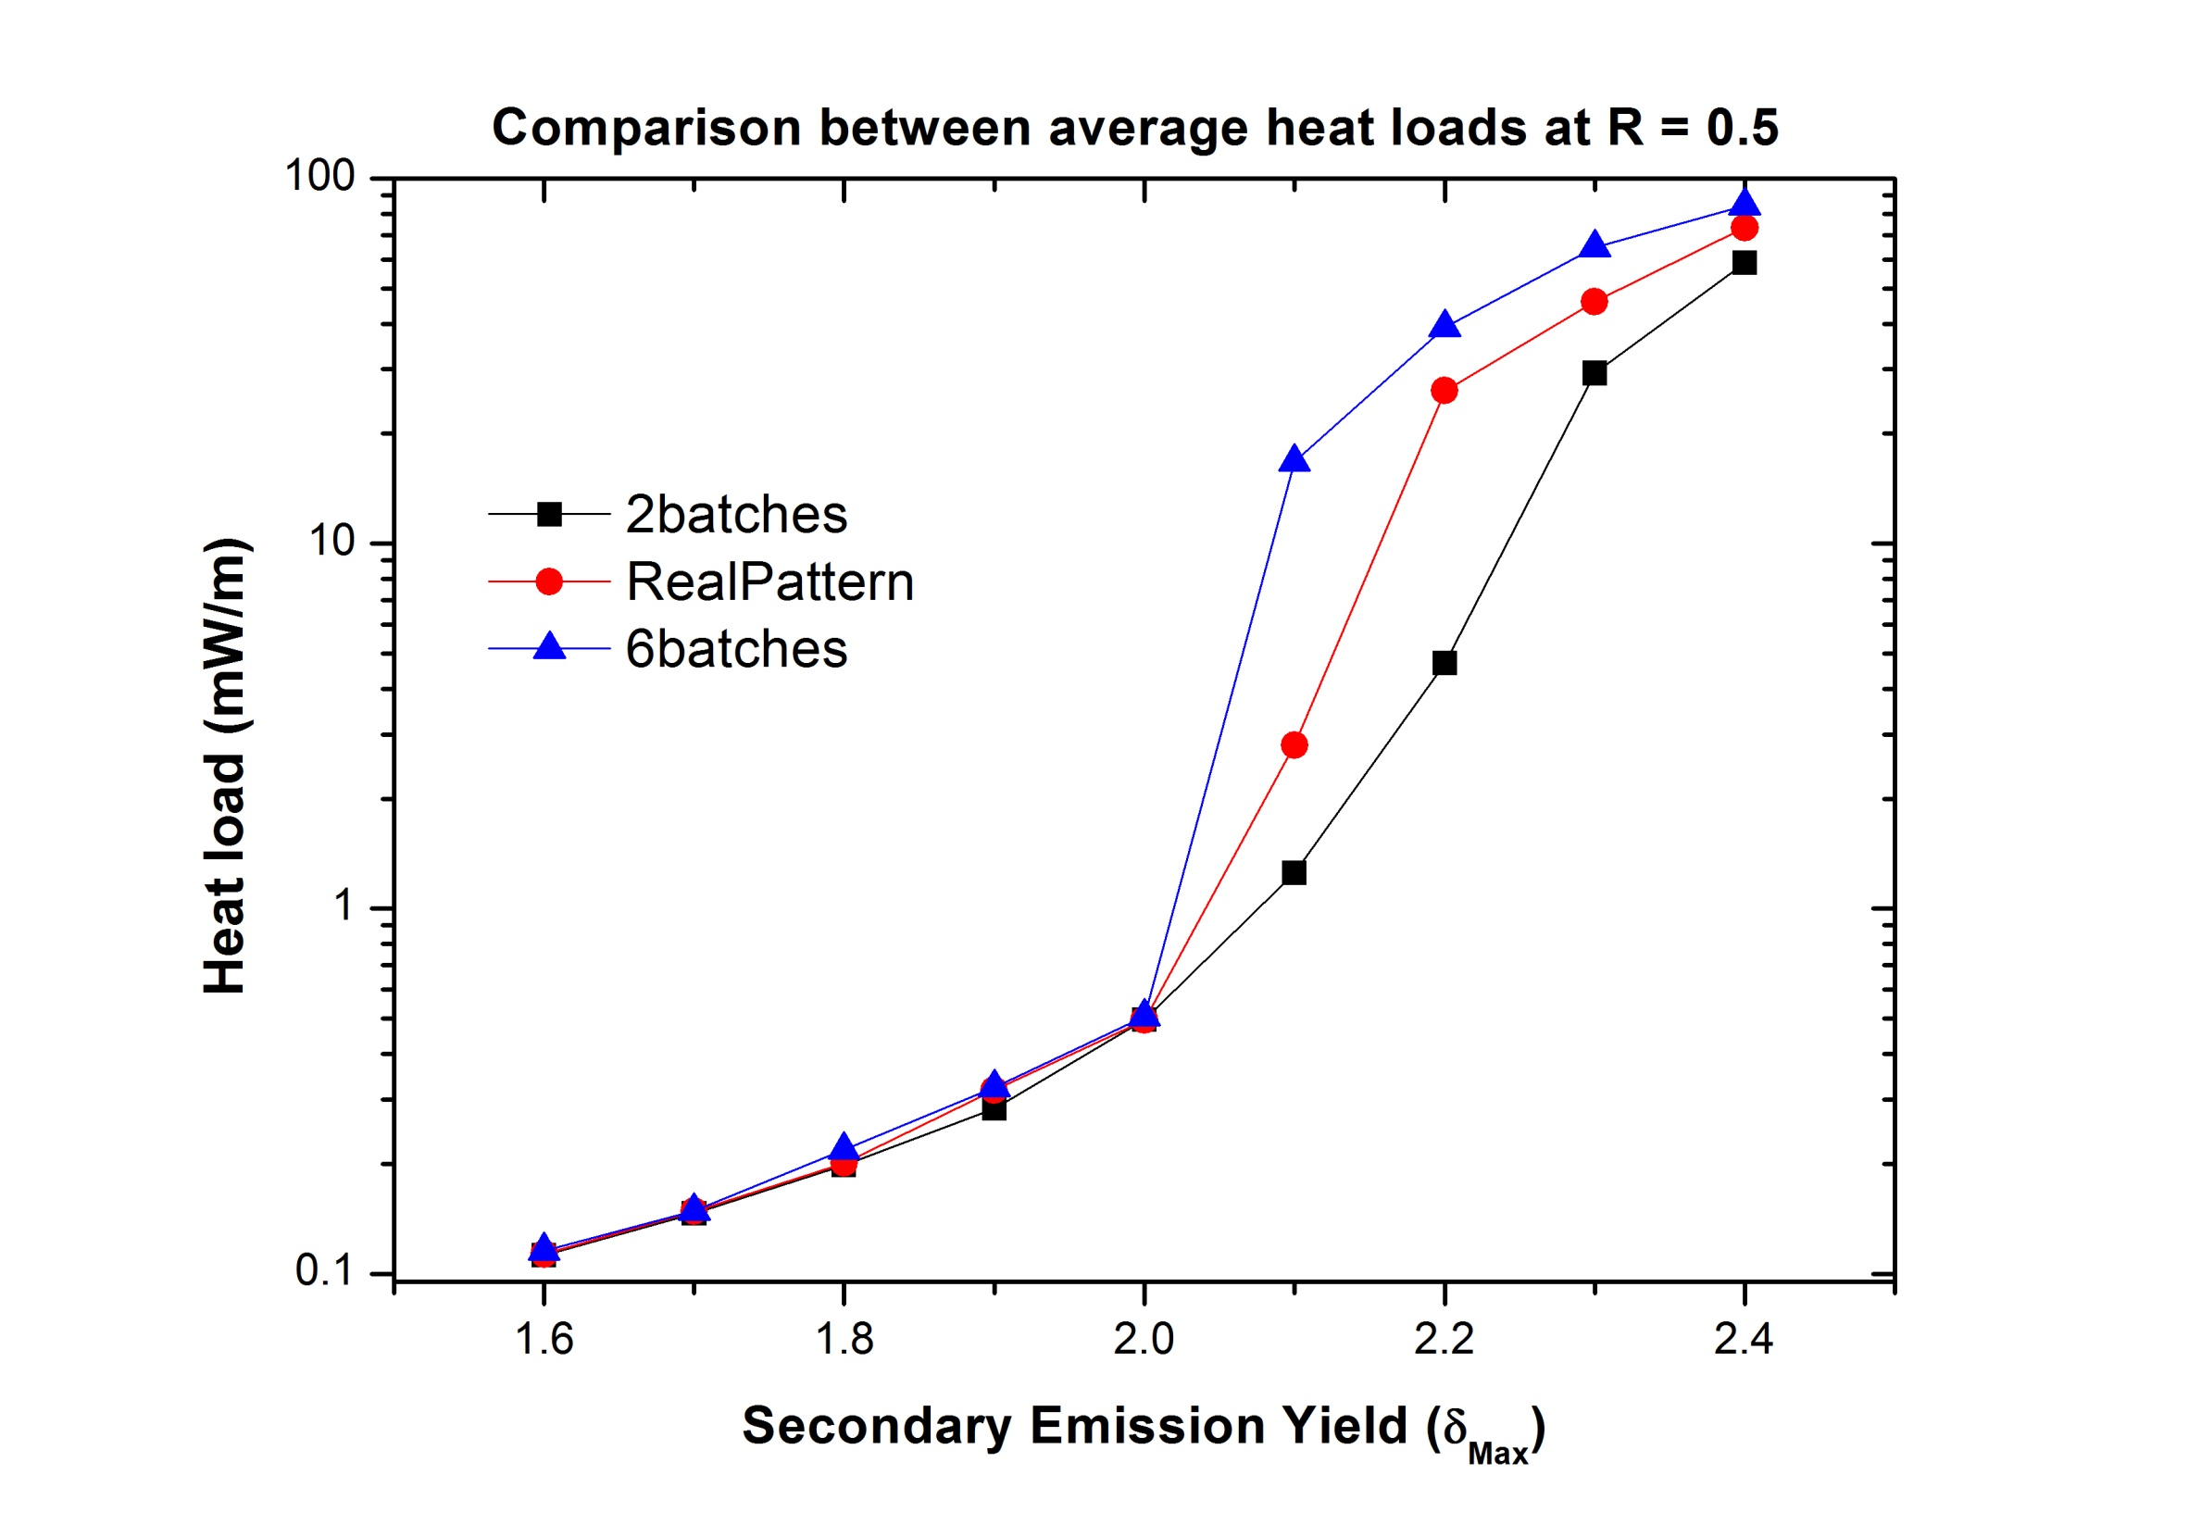

Slide 9
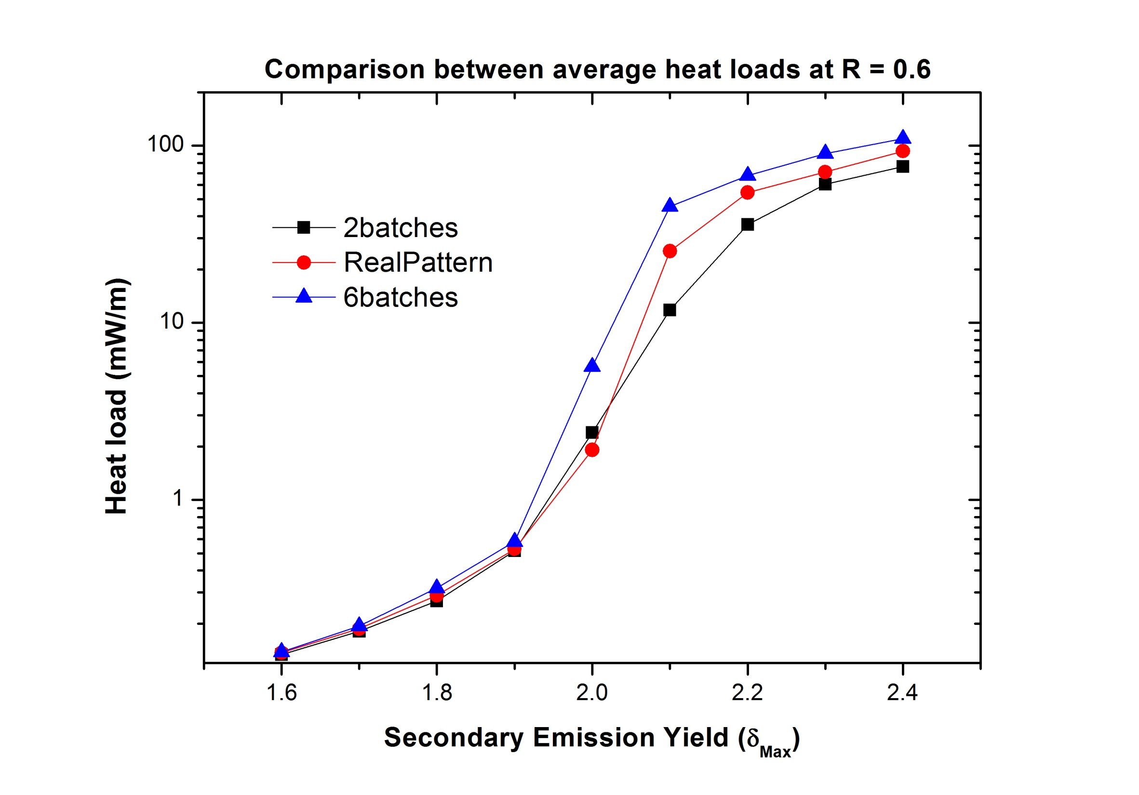

Slide 10
Multipacting
3.5 TeV

Slide 11
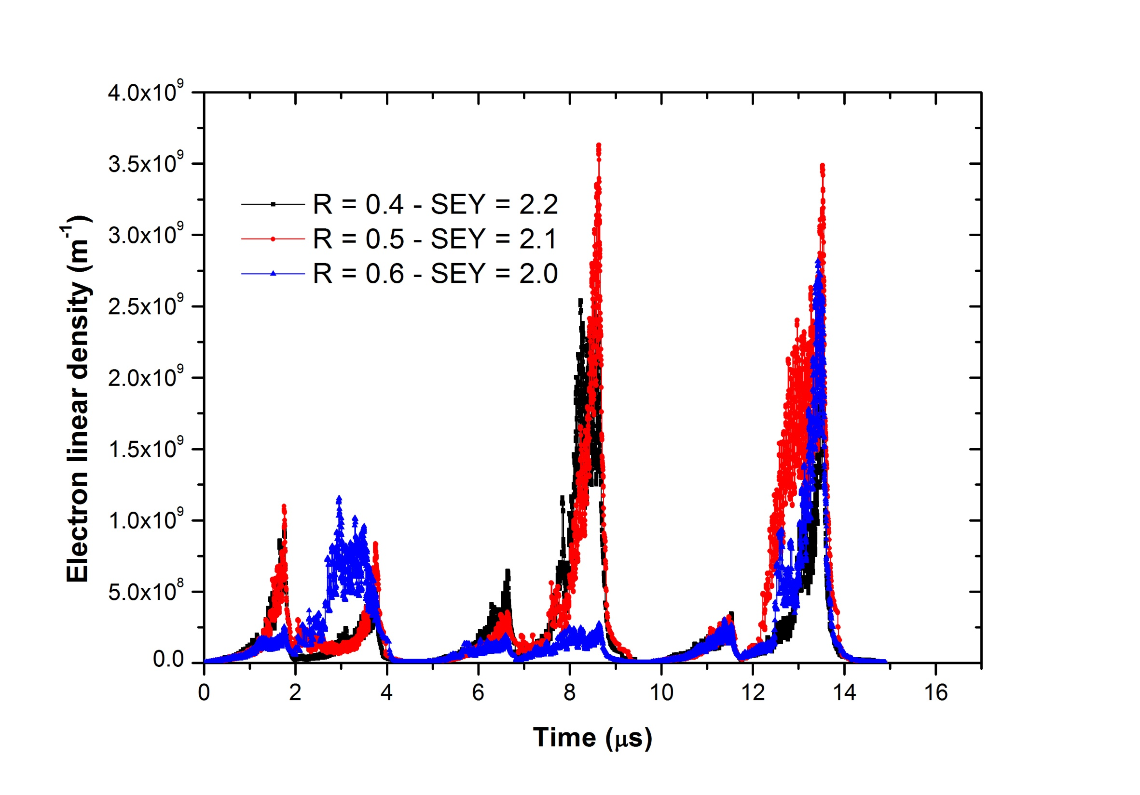

Slide 12
Conclusions
We can observe multipacting at:
Section | Energy | Reflectivity | SEY
Dipole | 3.5 TeV | 0.2 0.3 0.4 0.5 0.6 0.7 0.8 0.9 | 2.4 2.3 2.2 2.1 2.0 1.9 1.8 1.7

Slide 13
Thank you for your attention

