Slide 2
Outline
Framework (motivation)
Electromagnetic model (Radiated fields)
Results in the LHC beampipe
Next steps

Slide 3
FRAMEWORK
Work developed under the Swiss National Science Foundation (SNSF) project
SNF (contract no. 200021_129661)
LEMA:
(Laboratoire d’Electromagnétisme et d’Acoustique)
CERN:
(Organisation européenne pour la Recherche Nucléaire)
Juan R. Mosig
Michael Mattes
Edén Sorolla
Frank Zimmermann

Slide 4
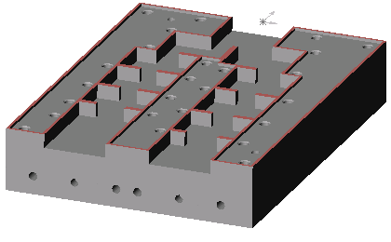
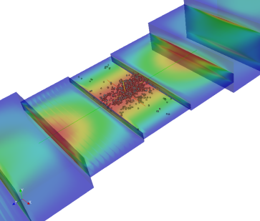
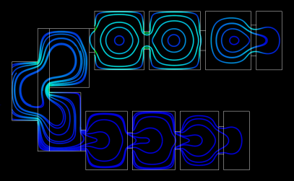
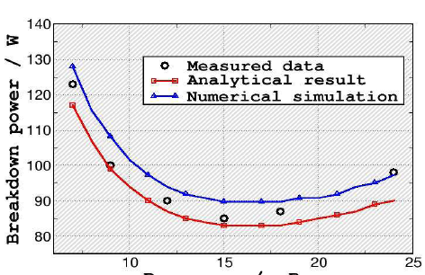
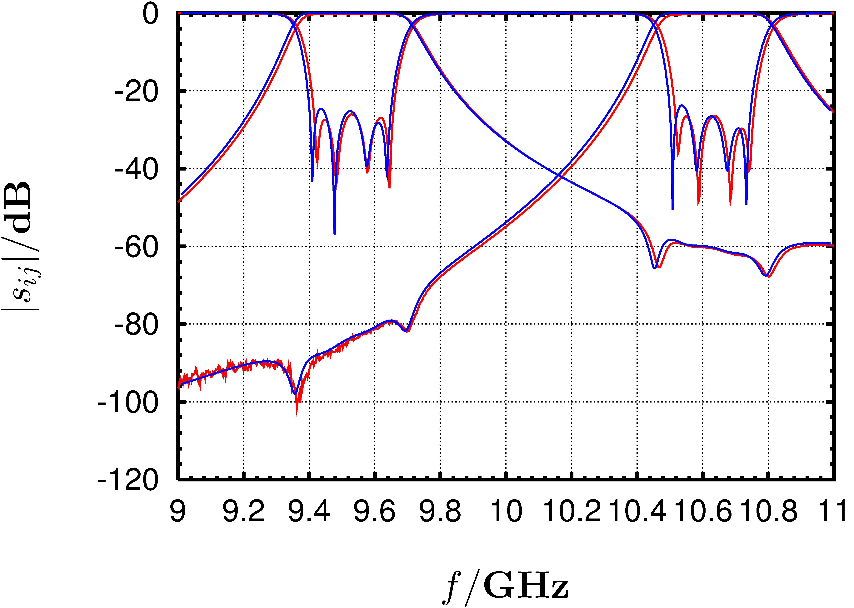
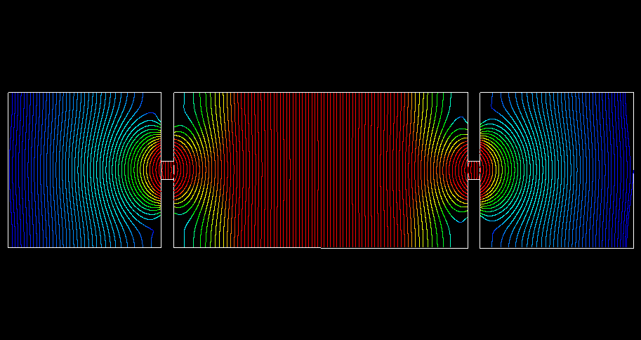
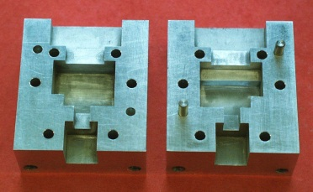
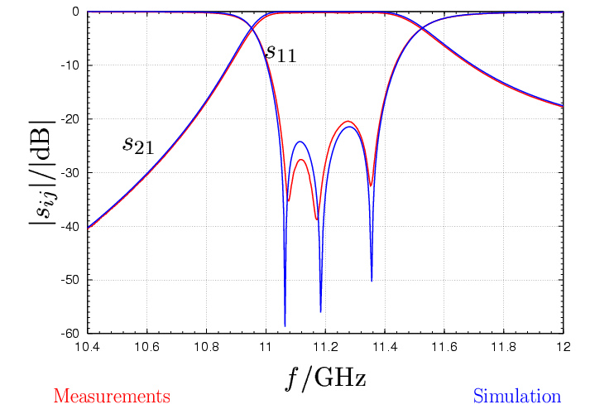
FRAMEWORK
LEMA has a solid expertise in numerical electromagnetics and integral equation
Scattering parameters
High power phenomena

Slide 5
FRAMEWORK (motivation)
MAIN IDEA
ELECTRON RADIATION
(POWER SPECTRUM)
DIAGNOSE
Hi there!
I’m an ELECTRON and I’m going to annoy you!

Slide 6
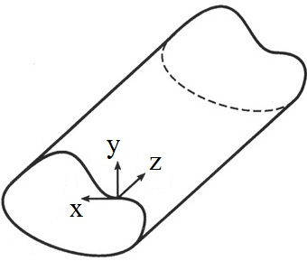
ELECTROMAGNETIC MODEL

Slide 7
ELECTROMAGNETIC MODEL
General expressions of em. fields over the waveguide cross-section
(Propagation factor)
Dependency on (x,y)
Electric and magnetic fields of the n-th mode

Slide 8
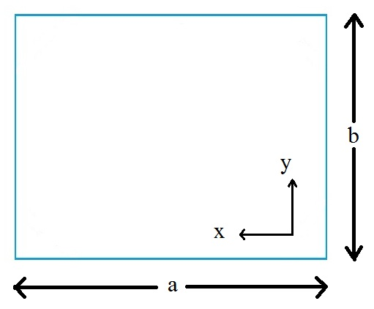
ELECTROMAGNETIC MODEL
Rectangular cavity
MODES ARE ANALYTICAL

Slide 9
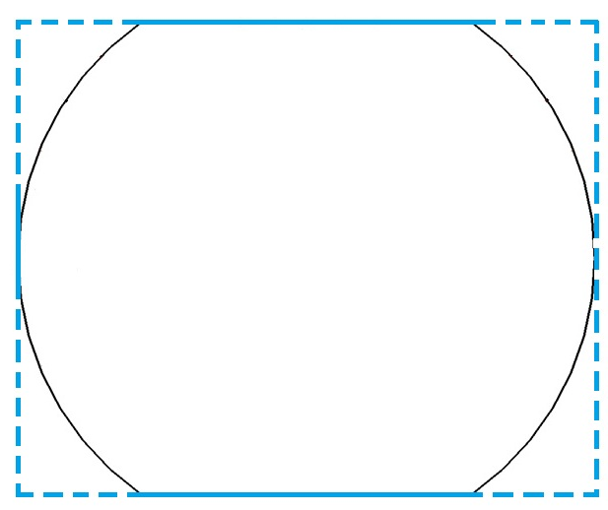
ELECTROMAGNETIC MODEL
Beam pipe
MODES ARE NON-ANALYTICAL!!!
But we can use the trigonometric functions (modes of rectangular waveguide) as the basis set to develop the solutions for the beam pipe.
BI-RME method
(Boundary Integral-Resonant Mode Expansion)

Slide 10
POWER SPECTRUM
Transversal
component
Time-average
(harmonic signals)
Lossless waveguides
Radiated power

Slide 11
RESULTS
Beam pipe

Slide 12
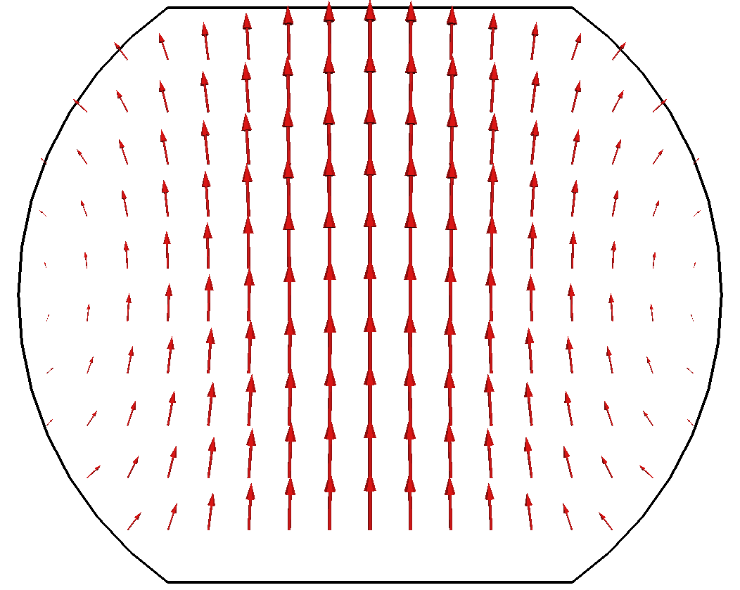
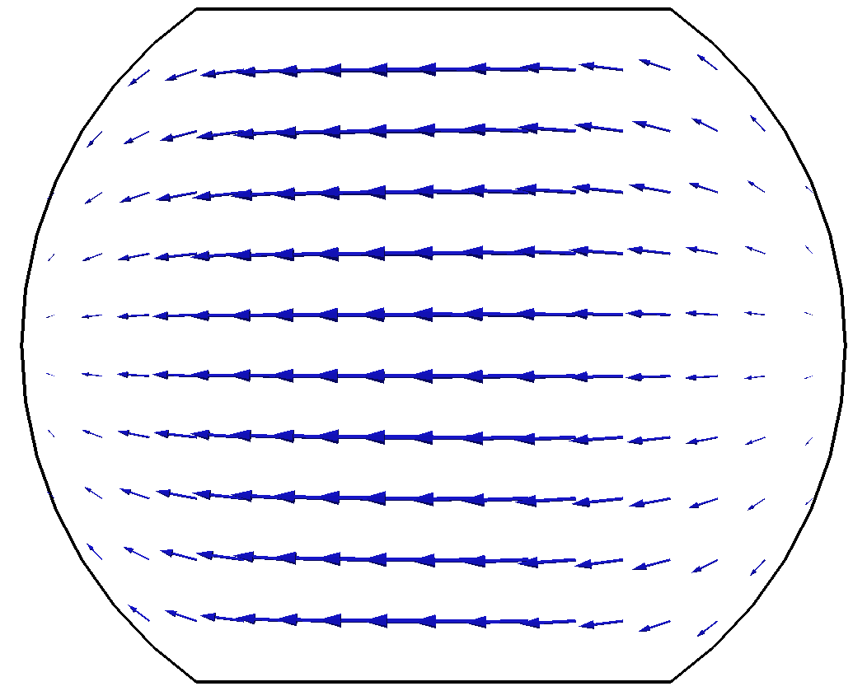
RESULTS
TE 1

Slide 13
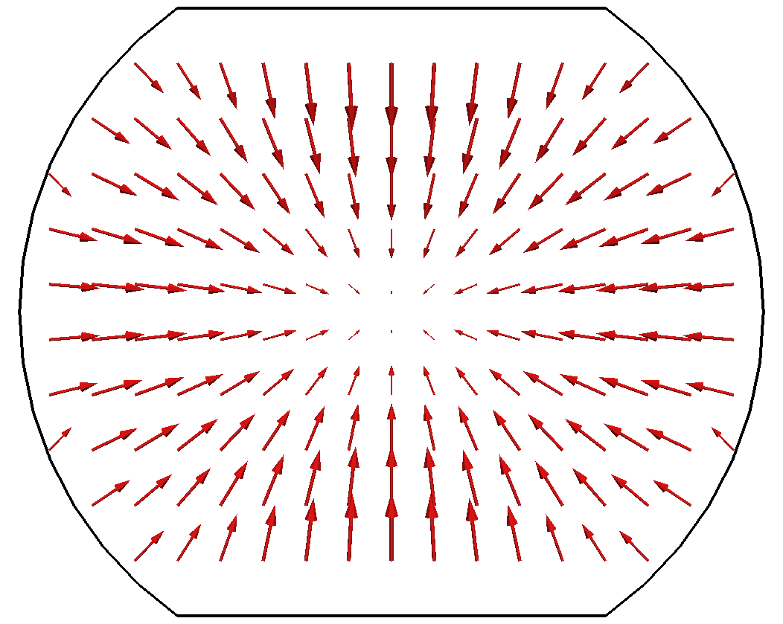
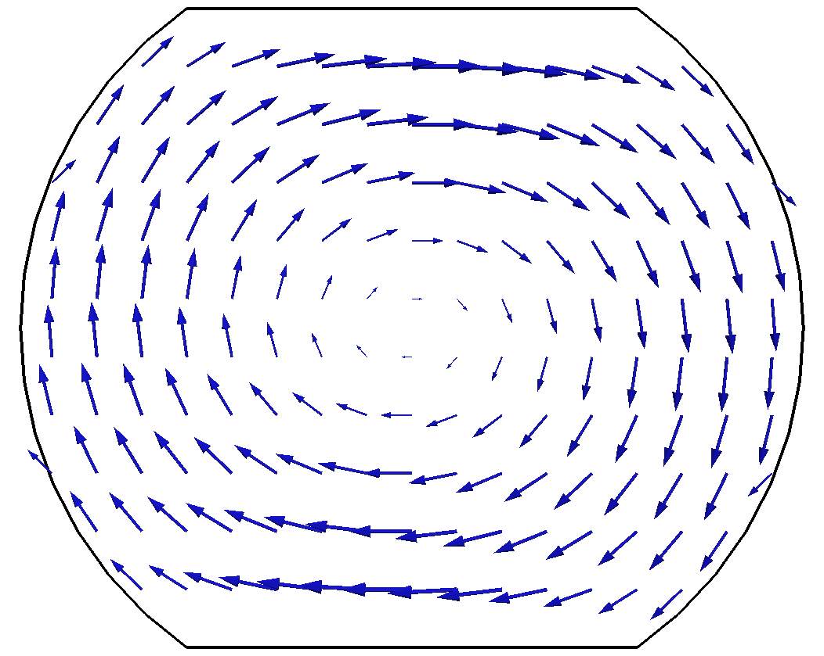
RESULTS
TM 1

Slide 14
RESULTS
“Eight” pipe

Slide 15
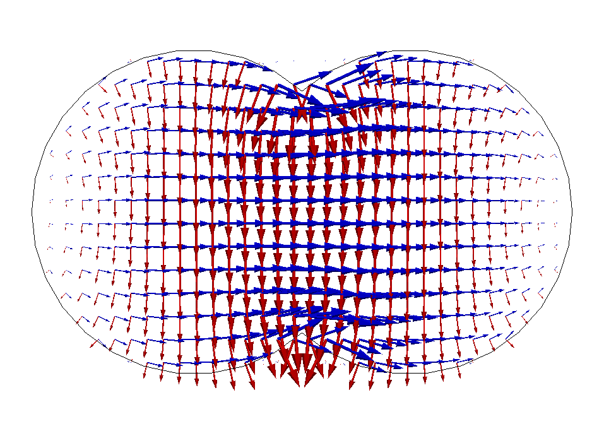
RESULTS
TE 1

Slide 16
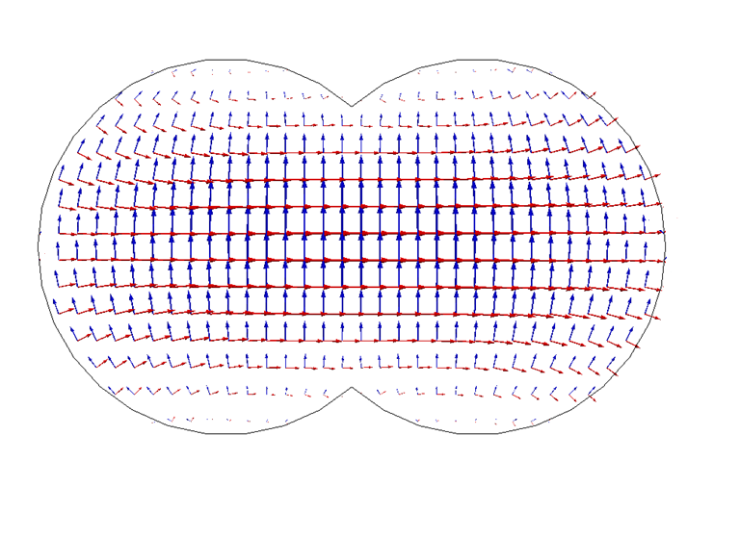
RESULTS
TE 2

Slide 17
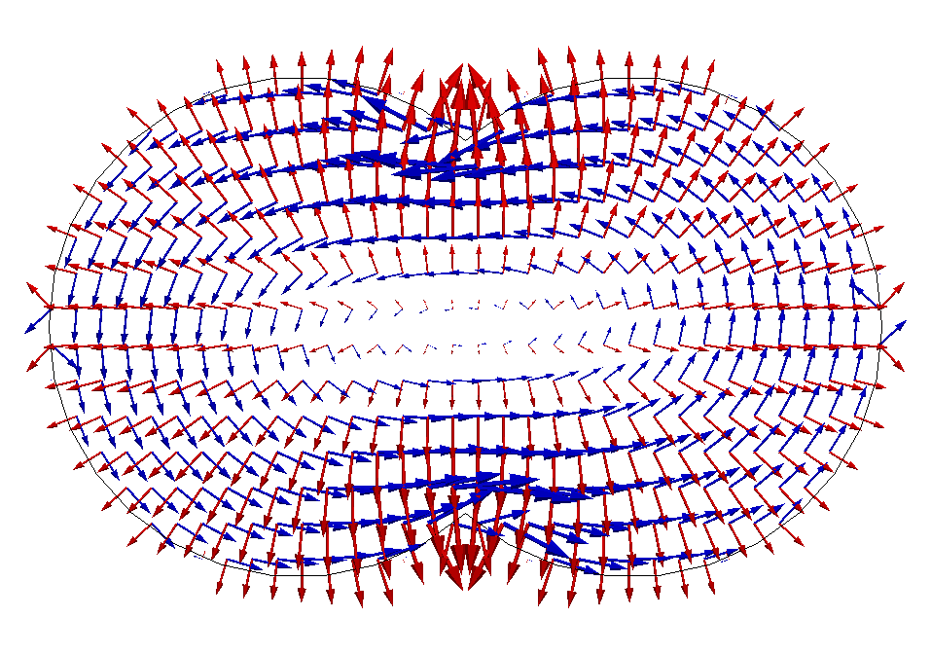
RESULTS
TM 1

Slide 18
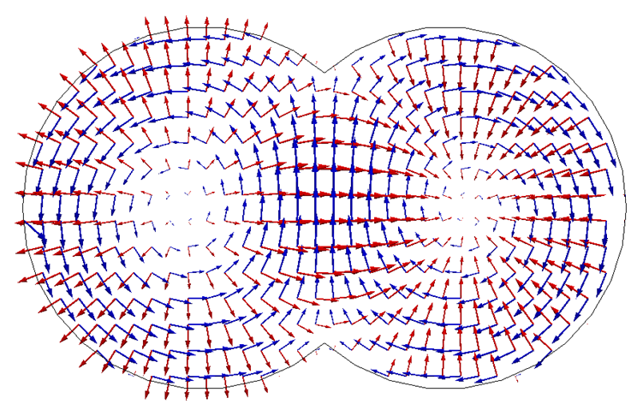
RESULTS
TM 2

Slide 19
RESULTS
Bone pipe

Slide 20
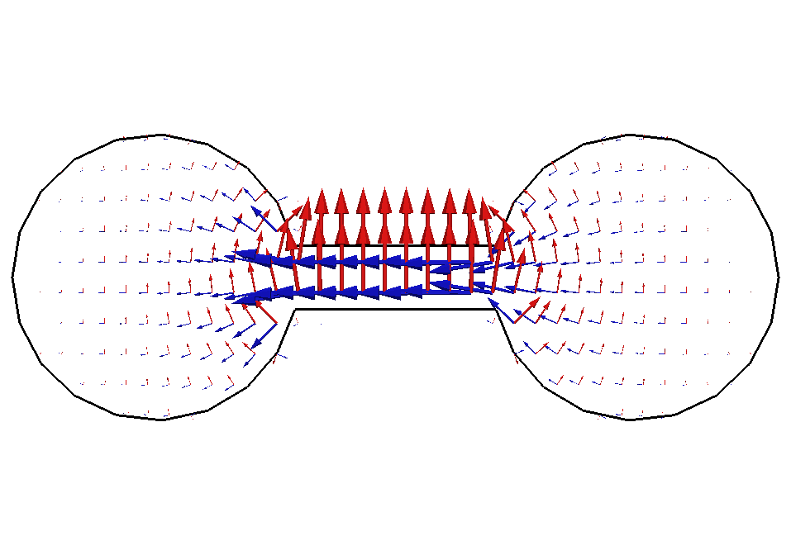
RESULTS
TE 1

Slide 21
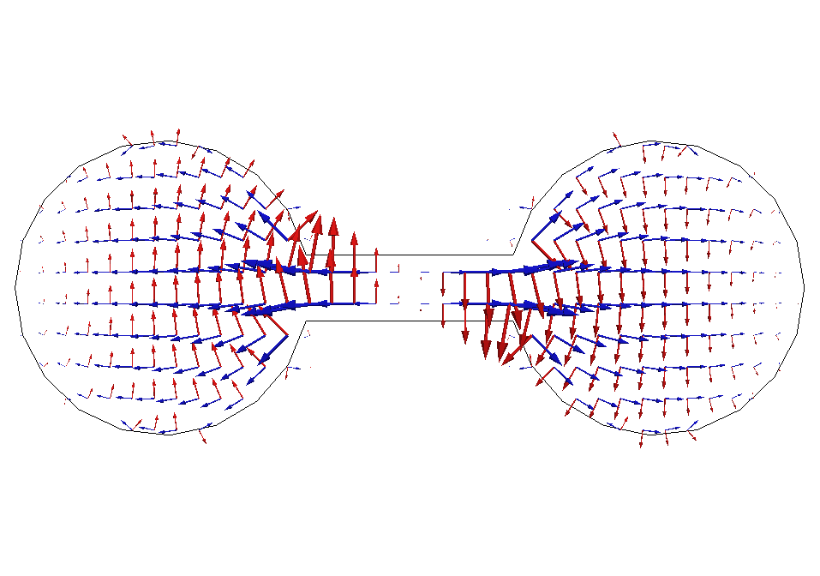
RESULTS
TE 2

Slide 22
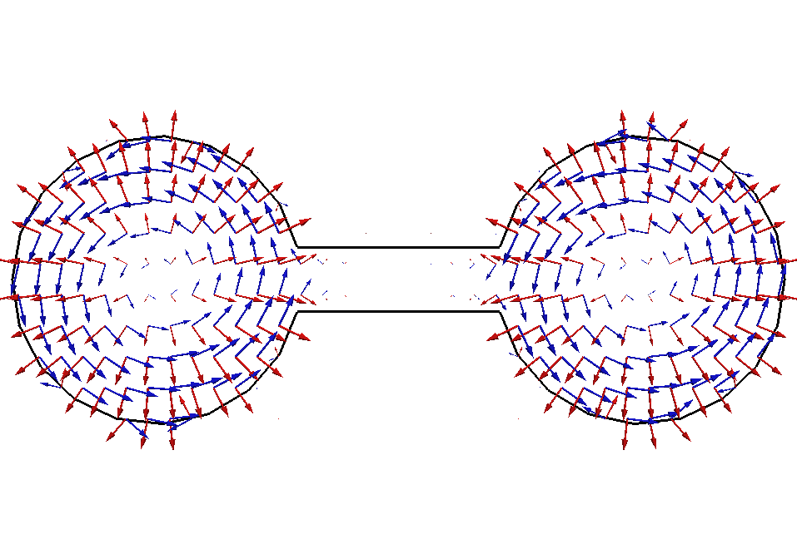
RESULTS
TM 1

Slide 23
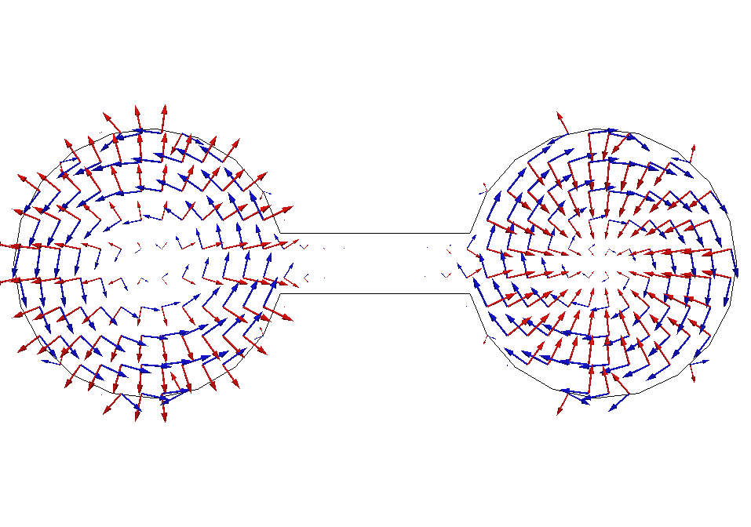
RESULTS
TM 2

Slide 24
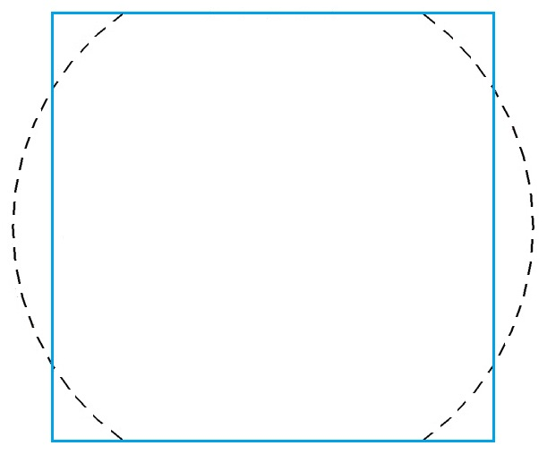
RESULTS
RECTANGULAR CAVITY
TE₁₀

Slide 25
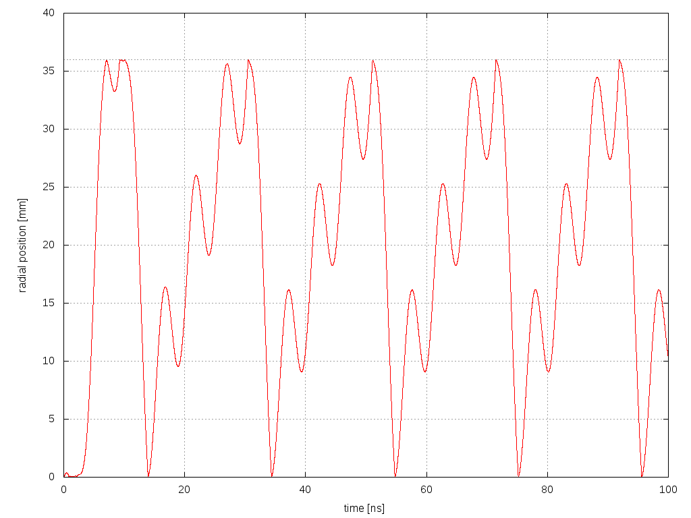
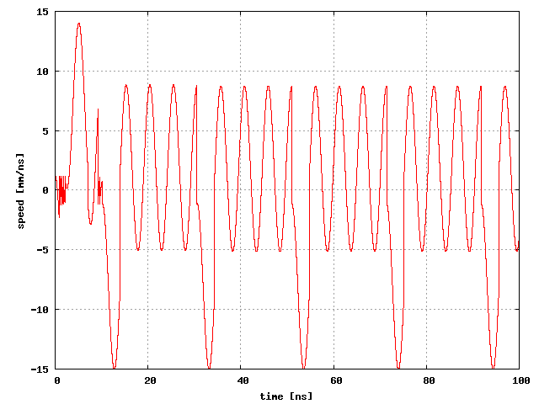
RESULTS
POSITION
5 ns
SPEED
5 ns
T.D.

Slide 26
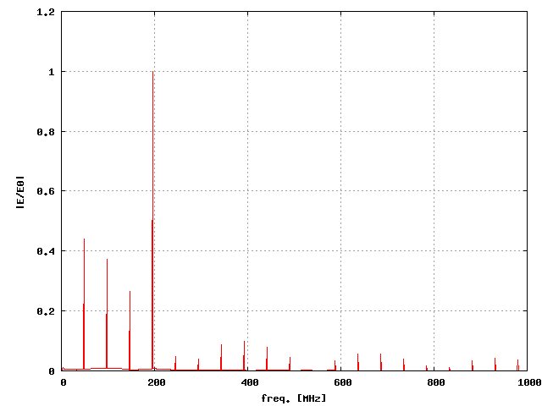
RESULTS
RADIATED FIELD
200 MHz → 5 ns

Slide 27
NEXT STEPS
* Combine BI-RME method to calculate the modes of the waveguides in LHC with e-Cloud.
In the worst case BI-RME calculates in a second the fields for the LHC beam pipe in 10000 positions per electron; further improvements can still be done.
* Implement the calculation of the radiated power spectrum of the electrons accelerated by the proton beam (alternatively an external RF field) using the ‘history’ of the electrons’ motion provided by e-Cloud.

