Slide 1
PS e-Cloud Simulations
C. M. Bhat, H. Maury Cuna,
H. Damerau, S. Hancock, E. Mahner, F. Caspers and F. Zimmermann
and Theodoros Argyropoulos
e-cloud simulation meeting
June 16, 2011

Slide 2
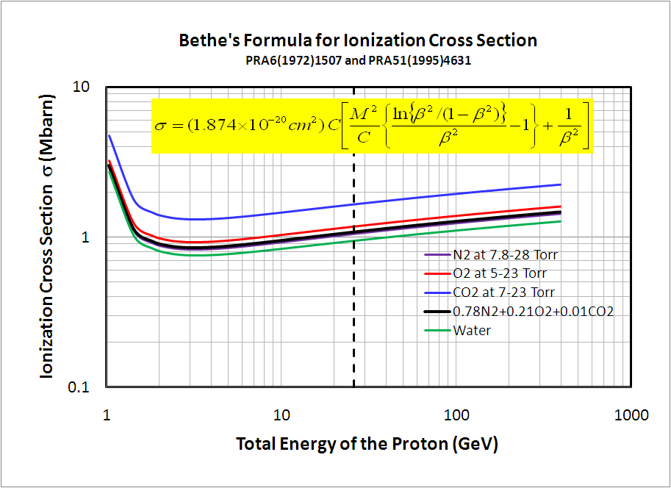
Ionization Cross Section σ
PS Ejection Energy

Slide 3
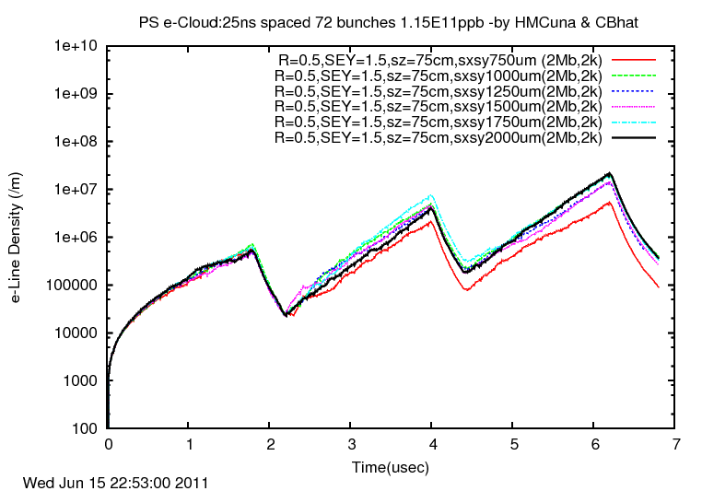

Work in Progress:
PS e-Cloud: σ_{ion}=2 MBarn, SEY=1.5, R=0.5, BF=0G,
Gaussian bunch(2k macro particles) σx = σy
Filling pattern
72 bunches
72 bunches
72 bunches
264buckets

Slide 4
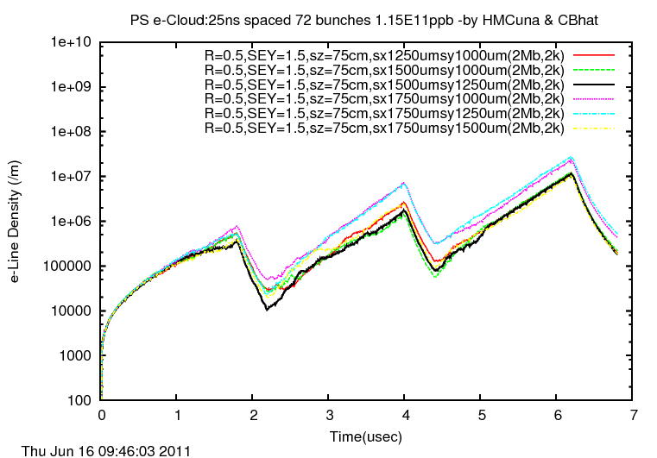
Work in Progress:
PS e-Cloud: σ_{ion}=2 MBarn, SEY=1.5, R=0.5, BF=0G,
Gaussian bunch(2k macro particles) σx > σy
Filling pattern
72 bunches
72 bunches
72 bunches
264buckets

Slide 5
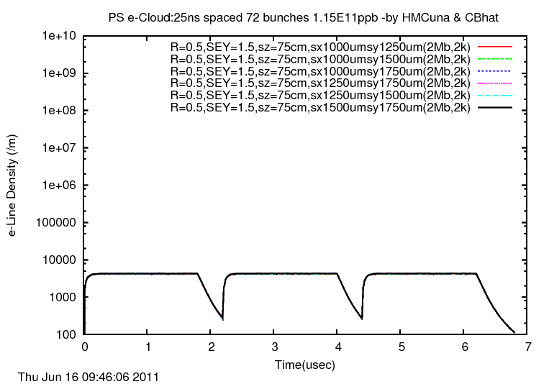
Work in Progress:
PS e-Cloud: σ_{ion}=2 MBarn, SEY=1.5, R=0.5, BF=0G,
Gaussian bunch(2k macro particles) σx < σy
Filling pattern
72 bunches
72 bunches
72 bunches
264buckets

Slide 6
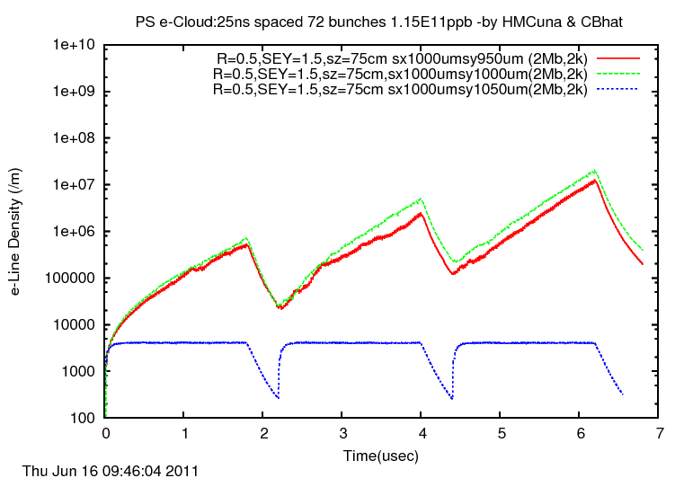
Work in Progress:
PS e-Cloud: σ_{ion}=2 MBarn, SEY=1.5, R=0.5, BF=0G,
Gaussian bunch(2k macro particles) σx > σy, σx = σy & σx < σy
σx > σy and σx = σy
σx < σy
Filling pattern
72 bunches
72 bunches
72 bunches
264buckets

Slide 7
Work in Progress
PS- e-Cloud Simulation
We have studied
  Ionization Cross Section as a function of Proton energy← Find the correct value of σ(ion) is ≈1MBarn
  e-Cloud density as a function of σ_{x} and σ_{y}

Slide 8
Work in Progress
PS- e-Cloud Experiment
We have taken
  Baseline data → on MD6 LHC25nsec with a special rf voltage configuration which includes
    Tomo-scope data (Longitudinal profiles)
    Transverse emittance, Beam Int.
    e-cloud data from PS e-cloud monitors
(June 1-10, 2011)

Slide 9
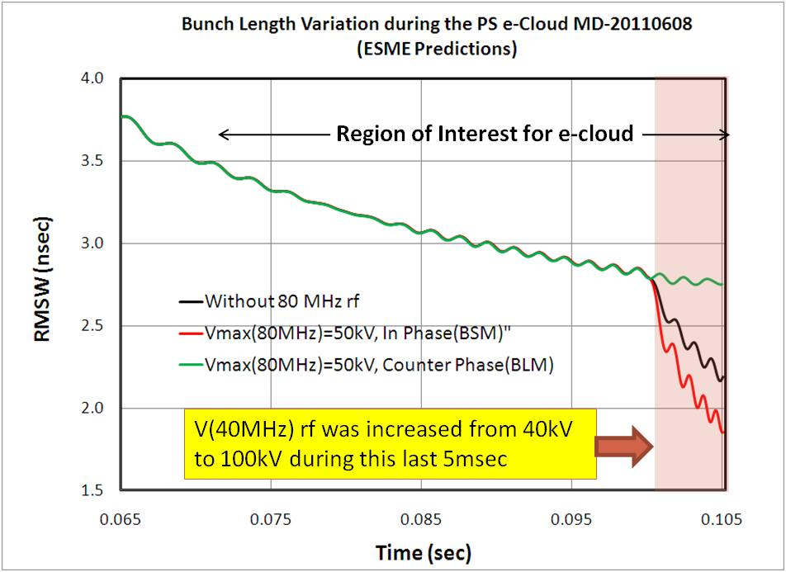
ESME Simulations
100kV
RF Manipulation in the PS at 26 GeV
50kV
40 MHz rf (h=1)
0 V
80 MHz rf (h=2)
Flat
Gaussian
Compressed

Slide 10
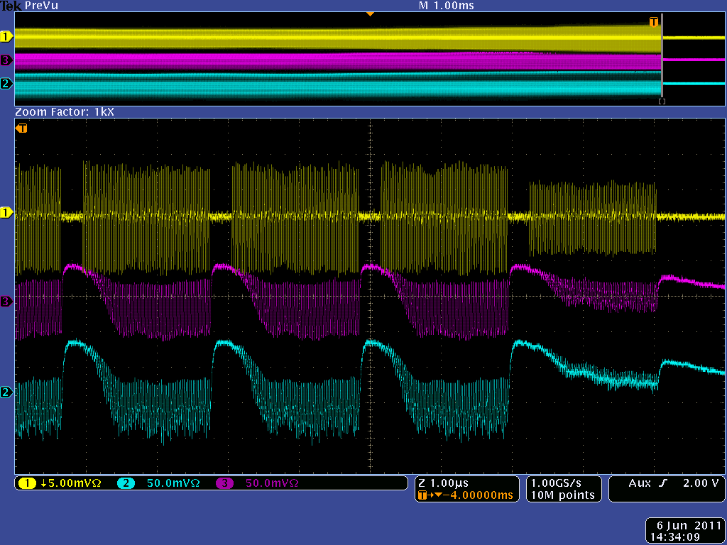
E-Cloud Measurements in the PS (20110606)
Without 80 MHz RF
E-cloud buildup LAST 4.5 Turns

Slide 11
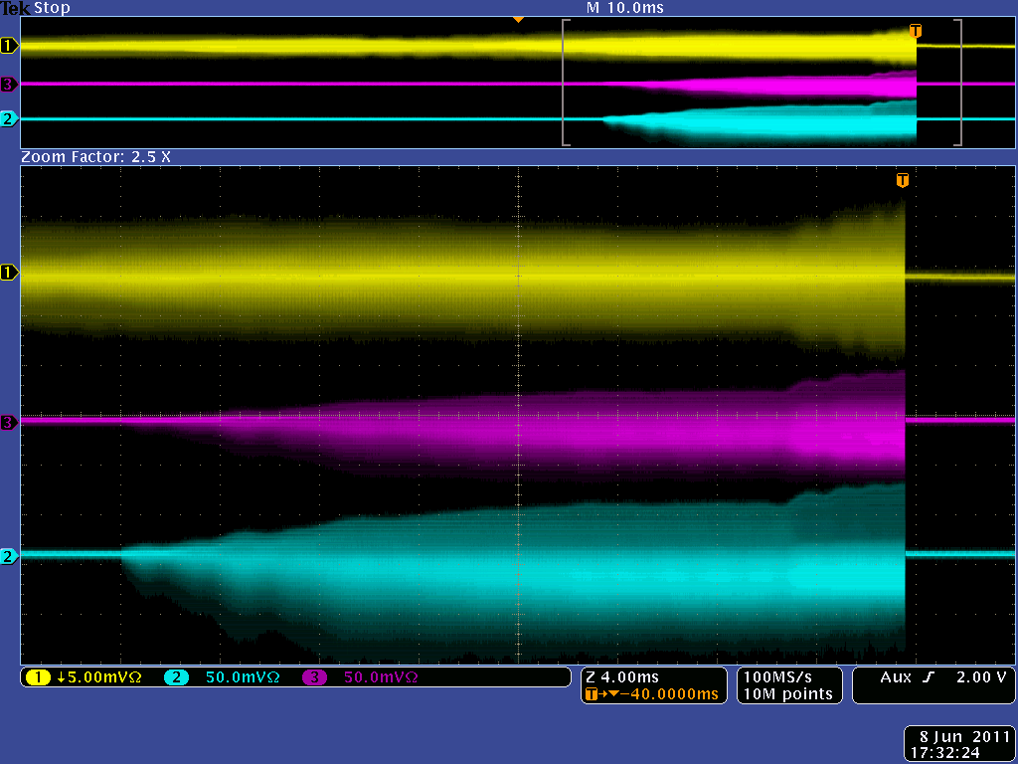
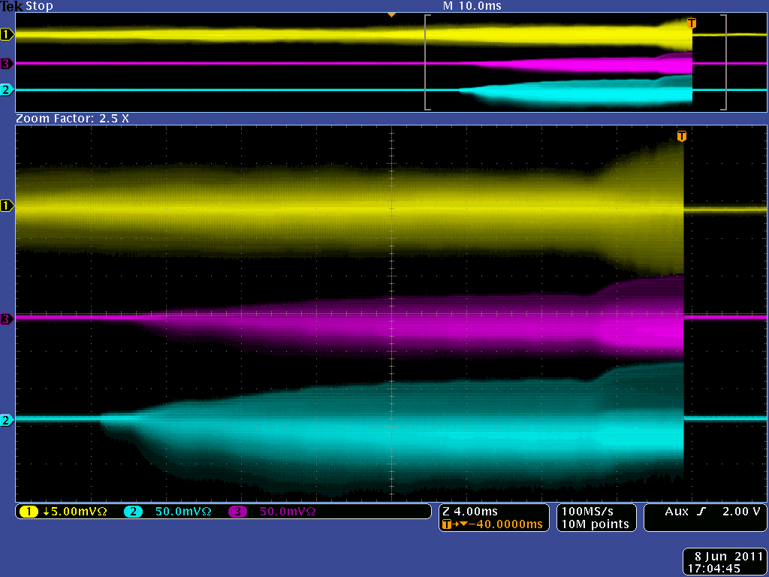
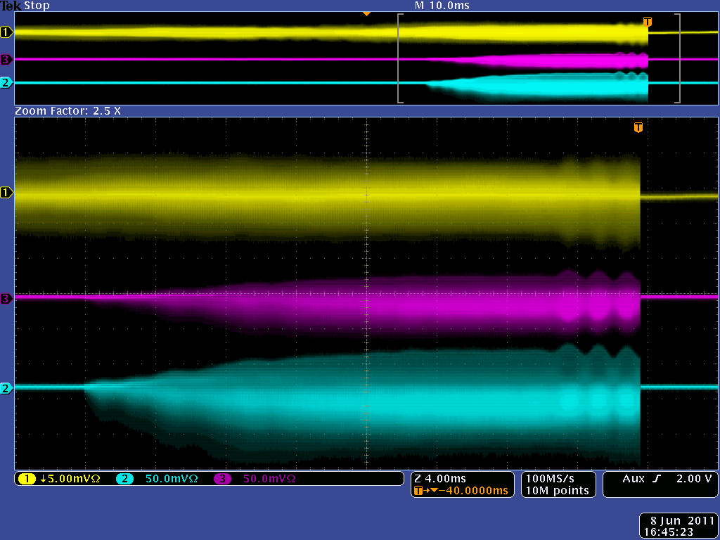
E-Cloud Measurements in the PS
20110606-20110610
Without 80MHz
In Phase
(BSM)
Counter Phase
(BLM)

Slide 12
Summary/Conclusions
Systematic approach is adopted to establish
  Minimized statistical effects
  Good set of physical parameters for the simulations
An experiment is carried out in the PS at flat-top energy for various bunch shapes and data is being analyzed.

Slide 13
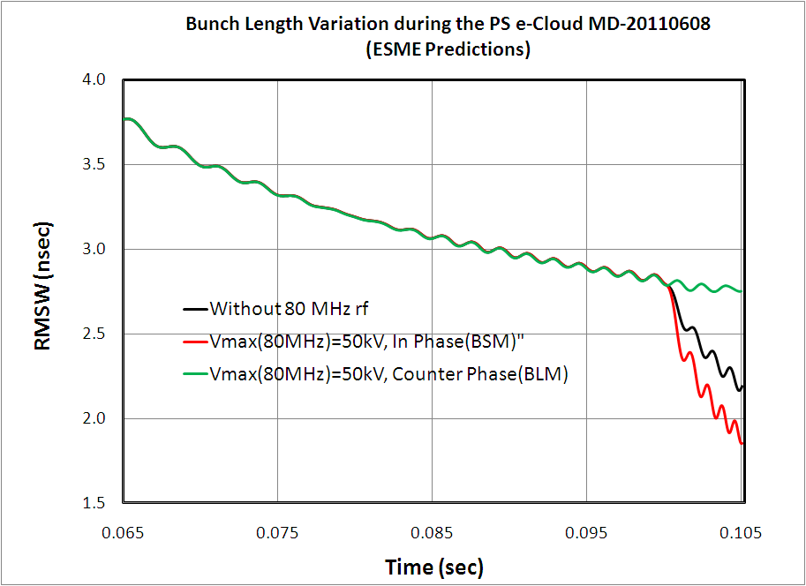
ESME Simulations
100kV
RF Manipulation in the PS at 26 GeV
50kV
40 MHz rf (h=1)
0 V
80 MHz rf (h=2)
Region of Interest for e-cloud
V(40MHz) rf was increased from 40kV to 100kV during this last 5msec

