Slide 1
Where are the electron cloud stripes in strong dipoles? G. Rumolo, for the Electron Cloud meeting, 21/01/2011
The mystery of the missing stripes in SPS and LHC simulations
ECLOUD simulations in dipoles (LHC and SPS):
Sensitivity to time steps
Influence of initial distribution
Number of macroelectrons launched per bunch
Results, discussion and recommended parameters

Slide 2
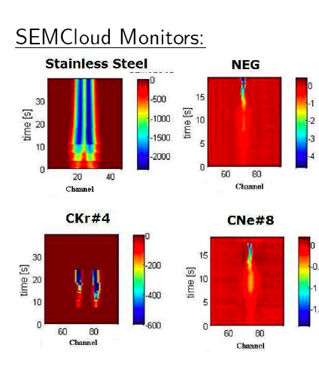
SPS measurements
Measurements at the SPS using strip monitors (with more or less space resolution) from 2001 on have always revealed the presence of two -or more- stripes in the formed electron cloud in presence of a strong dipole field
Earlier ECLOUD simulations had also anticipated this feature
The explanation for that is the existence of a peak in the SEY spectrum, which can be hit at specific horizontal locations, depending on the bunch intensity and size, and on the B field
2010
2001

Slide 3
ECLOUD simulations
Many ECLOUD simulations for the SPS dipoles (and strip monitors) in the recent years showed, however, only one strong central stripe
The reason for that was intuitively attributed to the choice to launch the primary electrons via gas ionization
In a strong dipolar magnetic field the electrons would then stay confined at the horizontal beam location
Possible stripes would not be populated because of the absence of seed electrons at their “candidate” locations
In 2008 a new feature was included in the electron generation from gas ionization:
90% of the electrons are generated in the volume swept by the beam, but it is also allowed for a 10% uniformly generated across the chamber
While this appeared to be able to seed stripes in some parameter ranges, it did not have the desired effect in other cases
Questions
Is it true that the two stripes collapse into one single central stripe in some parameter ranges?
Where does the 10% of electrons tentatively generated across the chamber come from? Cosmic radiation (multipacting in rf cavities)?
Could the stripes seen in the strip monitor also be an artifact of the measurement?
Do numerical parameters influence ECLOUD simulations in some unexpected fashion?
….

Slide 4
Overview on the parameters for the simulations in LHC arcs
Several simulations with “fine” and “coarse” time steps were run
The time steps for the “fine” runs were calculated:
Only based on the cyclotron period in the interbunch gap (i.e. taking the time step about 1/10 of the cyclotron period)
Taking the most stringent condition between resolving the cyclotron period and the electron oscillations around the bunch during the bunch passage. However, this latter number is usually in the order of few units, so that the condition really comes from the cyclotronic motion
 | Cyclotron period (ps)
SPS injection | 300
SPS top energy | 18
LHC injection | 65
3.5 TeV | 8.5

Slide 5
Overview on the parameters for the simulations in LHC arcs
Generation of primary electrons
At injection (450 GeV, B=0.5T), gas ionization with P=1nTorr. It probably overestimates, because when it converts to molecular density it uses T=300K
At 3.5 TeV (B=4.1T), photoelectrons with yield 0.1, 20% of radiation scattered around the screen wall and distributed like cos²
 | Fine slicing | Coarse slicing
Macroelectrons/bunch | 2000 (10000) | 2000
Bunch slices | 200 (1600) | 150
Interbunch steps | 8000 (60000) | 300
Bunch spacing (ns) | 50 | 50
Bunch length (ns) | 1.2 | 1.2
Transverse emittances (μm) | 2.5 | 2.5

Slide 6
Simulation in the LHC arcs (I)
Stripes could be seen at top energy (with photoelectrons), but not at injection energy (with gas ionization)
Stripes could be recovered at injection energy by using a finer bunch and interbunch gap slicing (sampling correctly the cyclotron motion)

Slide 7
Simulation in the LHC arcs (II)
From the point of view of the build up:
A significant difference between coarse and fine slicing is observed at injection energy
Smaller differences are found at top energy (although the difference in numerical parameters is more dramatic)

Slide 8
Checks in the SPS MBB dipoles (I)
Simulations with fine and coarse time step settings were launched for the SPS dipoles to study the behavior of the cloud formation with 25ns beams
The time step of the interbunch seems to affect significantly the results, and it converges when the cyclotron motion is correctly sampled
The x-distribution seems more affected than the build up evolution
δ_{max}=1.5
R=0.7
Electron flux to the wall

Slide 9
Checks in the SPS MBB dipoles (II)
The difference seems to become significant as multipacting sets in (δ_{max}≥1.2)
Secondary emission plays an important role in the formation of the stripes
R=0.7
δ_{max}=1.1
δ_{max}=1.2
δ_{max}=1.3
δ_{max}=1.4

Slide 10
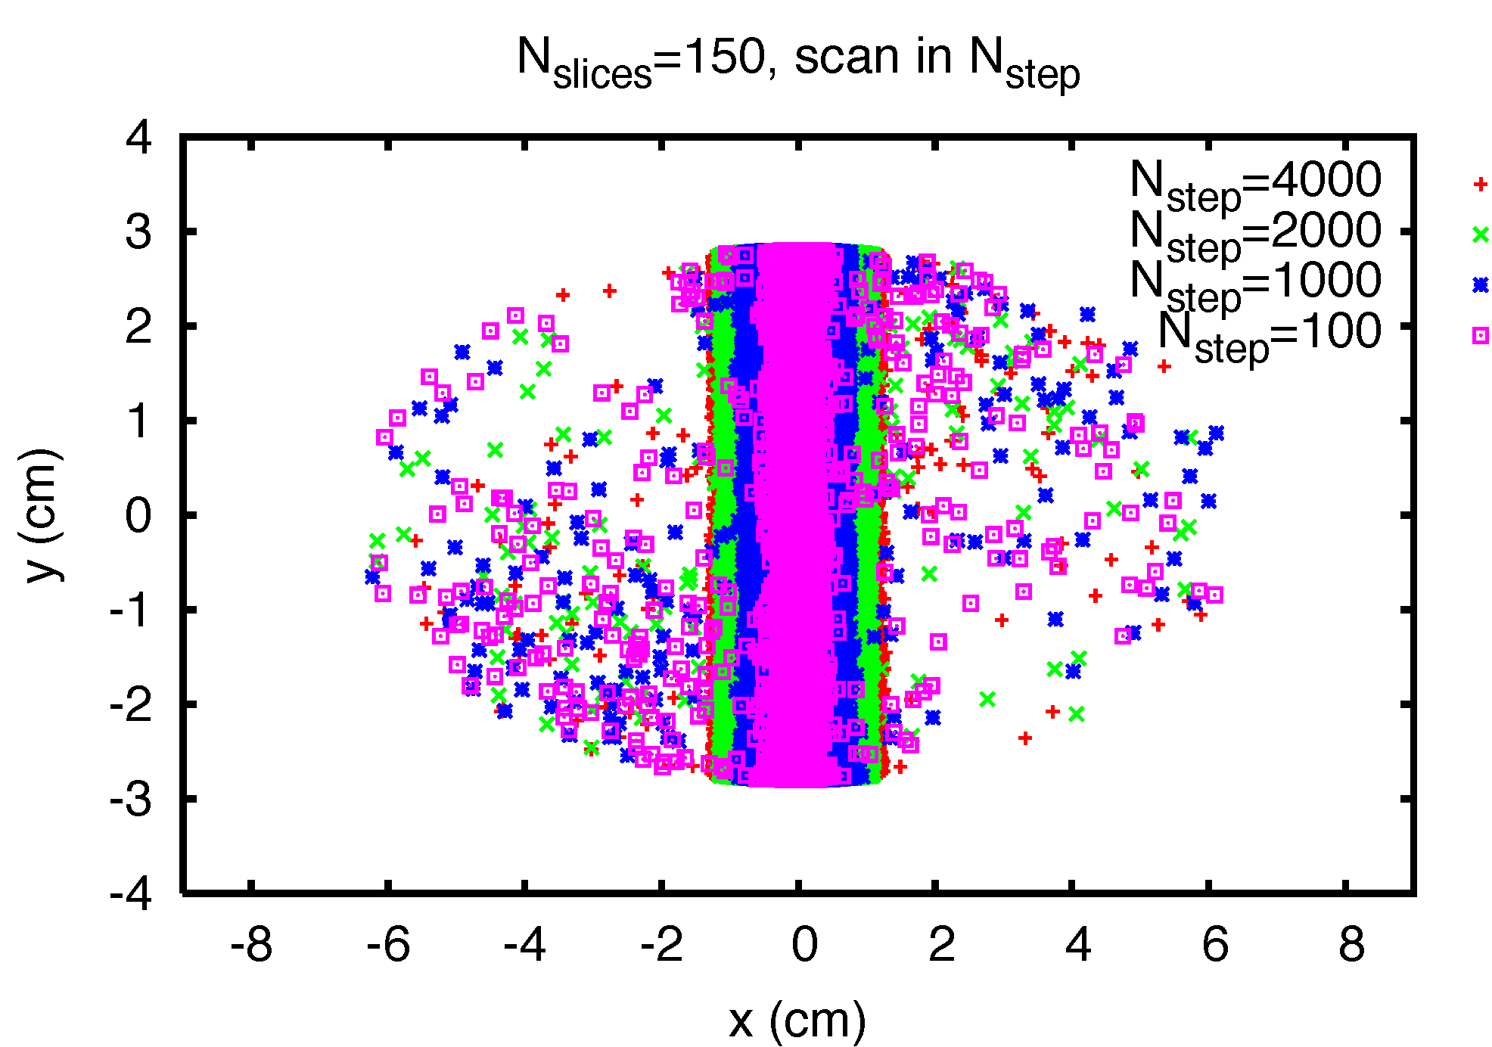
Checks in the SPS MBB dipoles (III)
Snapshot of the electron cloud distribution before bunch passage shows that the cloud distribution tends to become more and more central, as the interbunch slicing is made coarser
R=0.7
δ_{max}=1.5
1-σ beam (2mm x 3mm)

Slide 11
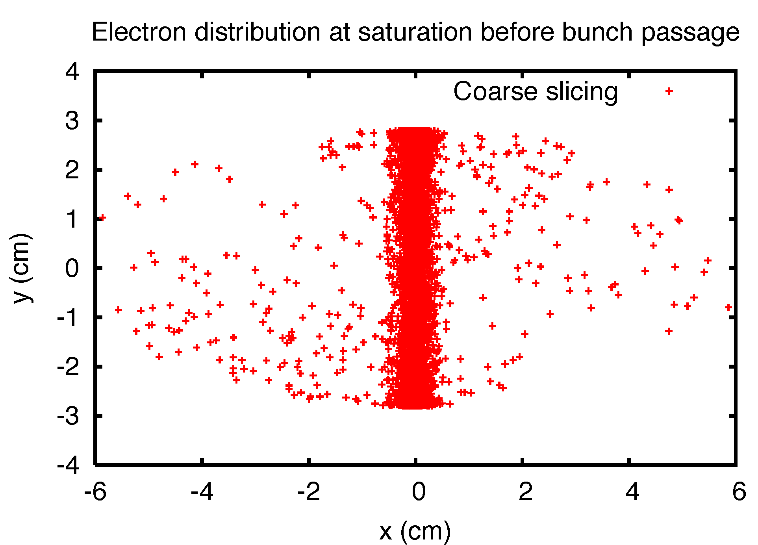
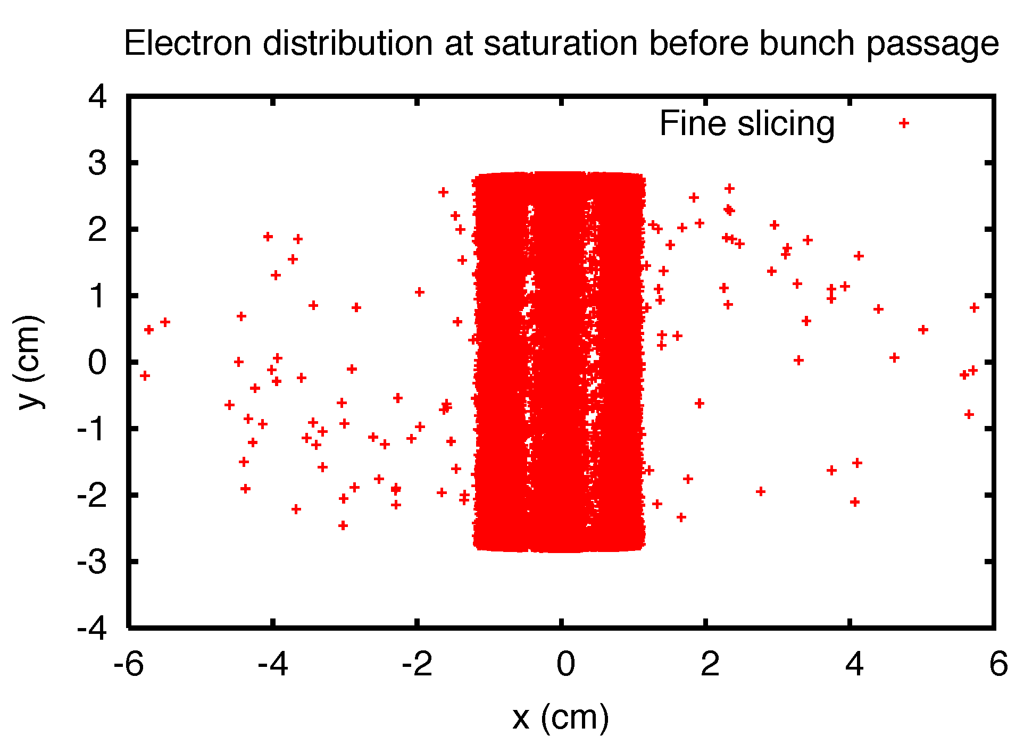
Checks in the SPS MBB dipoles (IV)
Looking into more detail, we find that the snapshot of the electron cloud distribution before bunch passage reveals three stripes with the fine slicing and only one with the coarse slicing
δ_{max}=1.5
R=0.7

Slide 12
Checks in the SPS MBB dipoles (V)
Does the initial distribution of primary (seed) electrons make a difference?
Gas ionization with 10% outside of beam volume
Electrons uniformly distributed in the chamber cross section
Electrons uniformly launched from the pipe inner wall
In all three cases we have kept the same rate of primary production
For all three case we have run fine and coarse simulations
δ_{max}=1.5
R=0.7

Slide 13
Checks in the SPS MBB dipoles (VI)
Does the initial distribution of primary (seed) electrons make a difference?
Gas ionization with 10% outside of beam volume
Electrons uniformly distributed in the chamber cross section
Electrons uniformly launched from the pipe inner wall
Final distributions above the multipacting threshold
No significant dependence with fine slicing, as it should be
δ_{max}=1.5
R=0.7

Slide 14
Checks in the SPS MBB dipoles (VII)
Does the initial distribution of primary (seed) electrons make a difference?
Gas ionization with 10% outside of beam volume
Electrons uniformly distributed in the chamber cross section
Electrons uniformly launched from the pipe inner wall
Final distributions below the multipacting threshold
Similar, low energy primary electrons dominant ?
δ_{max}=1.1
R=0.7

Slide 15
Checks in the SPS MBB dipoles (VIII)
Is there a dependence on the number of macroelectrons launched per bunch?
Coarse and fine slicing cases analyzed below threshold
No perceptible difference
δ_{max}=1.1
R=0.7

Slide 16
Checks in the SPS MBB dipoles (IX)
Is there a dependence on the number of macroelectrons launched per bunch?
Coarse and fine slicing cases analyzed above threshold
No significant difference
δ_{max}=1.5
R=0.7

Slide 17
Recommended time steps (N_{slices}, N_{step}) in few cases of interest
Nominal emittances of 2.5mm are assumed and the average beta functions inside the dipoles
CPU time to simulate two batches of 25ns beam with fine slicing at injection in the SPS is in the order of 5h
CPU times may easily become prohibitively high for LHC at top energy, but also for other cases depending on the filling pattern
 | N_{slices} | N_{step} | Bunch length (4σ)
SPS injection 25ns | 150 | 1000 | 3.2ns
SPS top energy 25ns | 1000 | 15000 | 1.6ns
LHC injection 50ns | 300 | 10000 | 1.6ns
LHC 3.5 TeV 50ns | 1500 | 60000 | 1.2ns
SPS injection 50ns | 150 | 2000 | 3.2ns
SPS top energy 50ns | 1000 | 30000 | 1.6ns

