Slide 1
e⁻ cloud simulations
LHC IR3 (Update)
C.Octavio Domínguez, Ubaldo Iriso, Giovanni Rumolo, Frank Zimmermann
21th January2011 - e⁻ cloud simulations

Slide 2
Contents
LHC IR3:
N_{b} scan
n_{b} scan
2
21th January2011 - e⁻ cloud simulations

Slide 3
Contents
LHC IR3:
N_{b} scan
n_{b} scan
3
21th January2011 - e⁻ cloud simulations

Slide 4
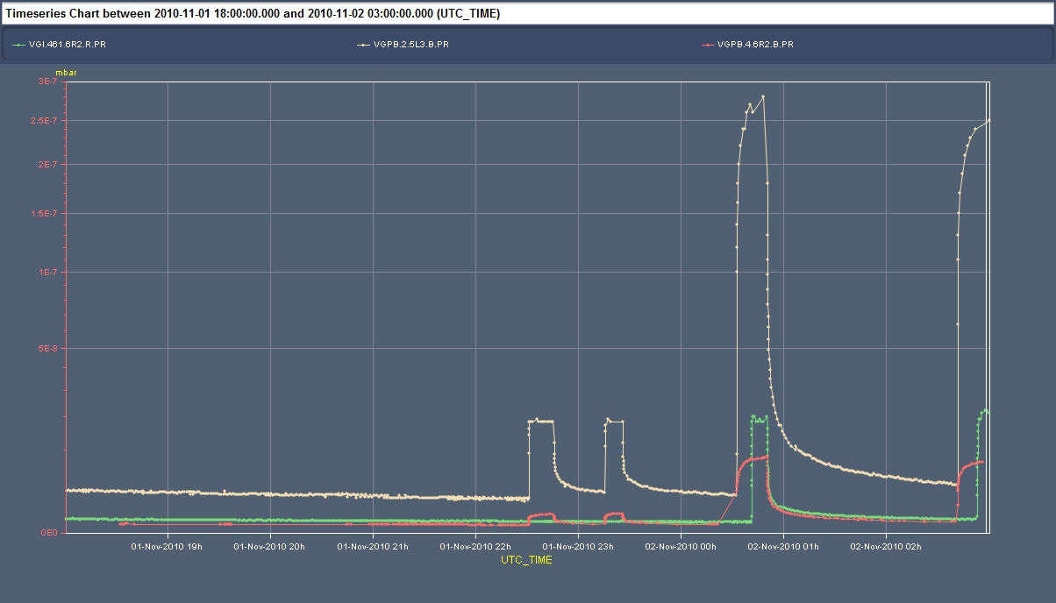
LHC IR3 – N_{b} scan
1.1x10¹¹ p/bunch
~ factor 56
0.8x10¹¹ p/bunch
0.6x10¹¹ p/bunch
~ factor 3.6
Courtesy G.Arduini
4
21th January2011 - e⁻ cloud simulations

Slide 5
LHC IR3 – N_{b} scan
N_{b} (10¹¹ ppb) | R | SEY | Av.Density (10¹¹) | Flux (10⁹#e-/s)
0.6 | 0.5 | 2.4 | 0.85 | 1.2
0.8 | 0.5 | 2.2 | 1.2 | 1.63
1.1 | 0.5 | 2.1/2.2 | 0.6/3.9 | 0.91/5.31
0.6 | 0.3 | 2.5/2.6 | 0.56/ | 0.75/
0.8 | 0.3 | 2.3 | 0.9 | 1.14
1.1 | 0.3 | 2.2/2.3 | 0.58/3 | 0.77/3.87
5
21th January2011 - e⁻ cloud simulations

Slide 6
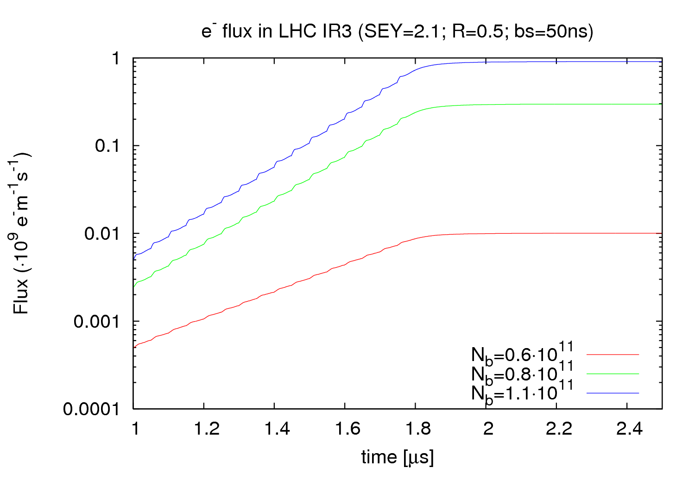
LHC IR3 – N_{b} scan
9.07·10⁸
2.97·10⁸
~ factor 91
~ factor 30
0.10·10⁸
6
21th January2011 - e⁻ cloud simulations

Slide 7
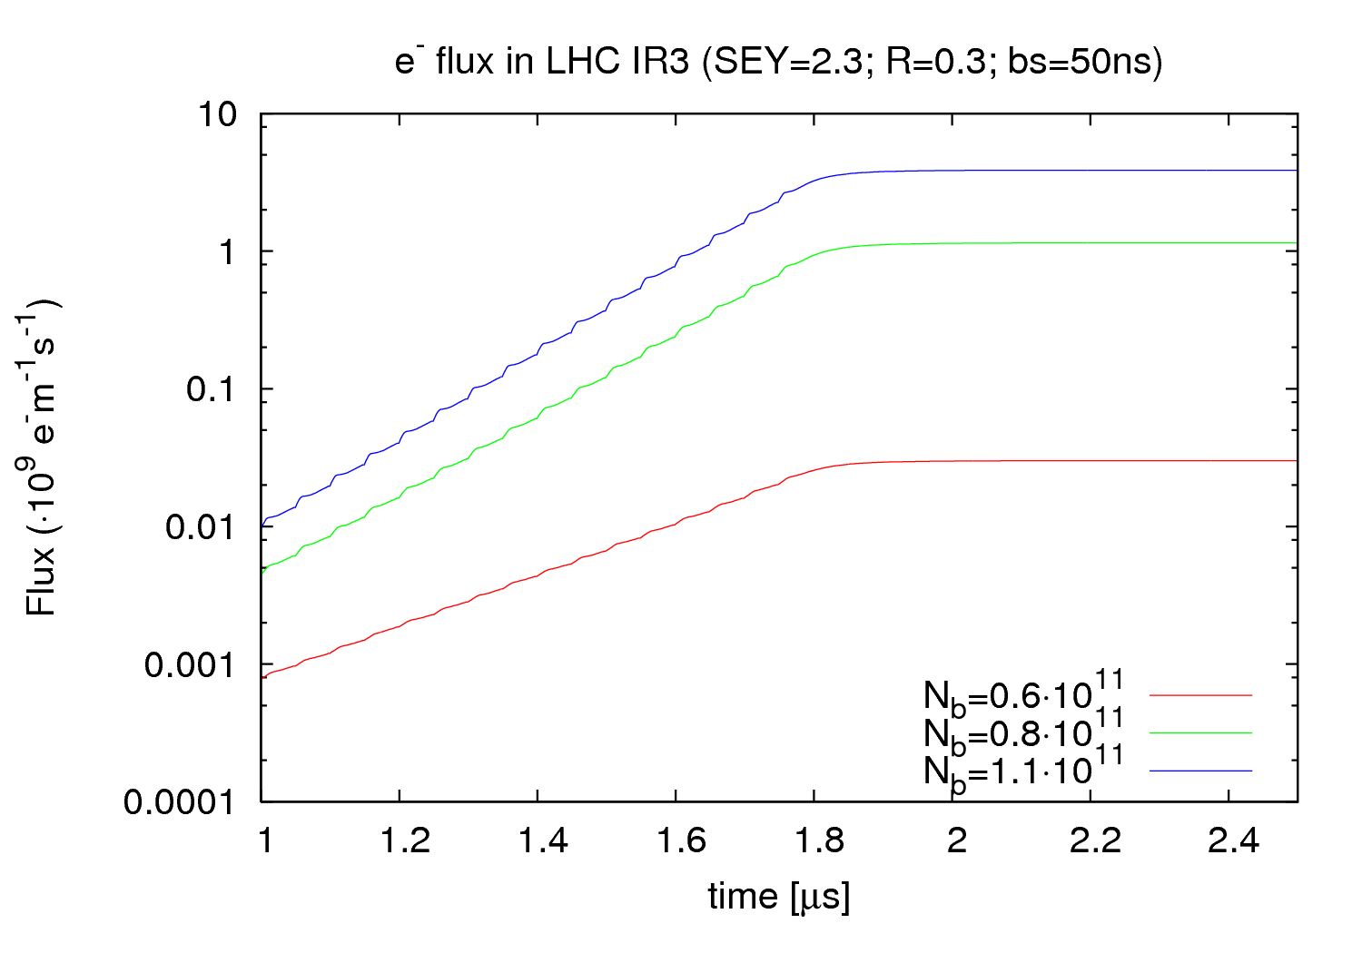
LHC IR3 – N_{b} scan
7
21th January2011 - e⁻ cloud simulations

Slide 8
Contents
LHC IR3:
N_{b} scan
n_{b} scan
8
21th January2011 - e⁻ cloud simulations

Slide 9
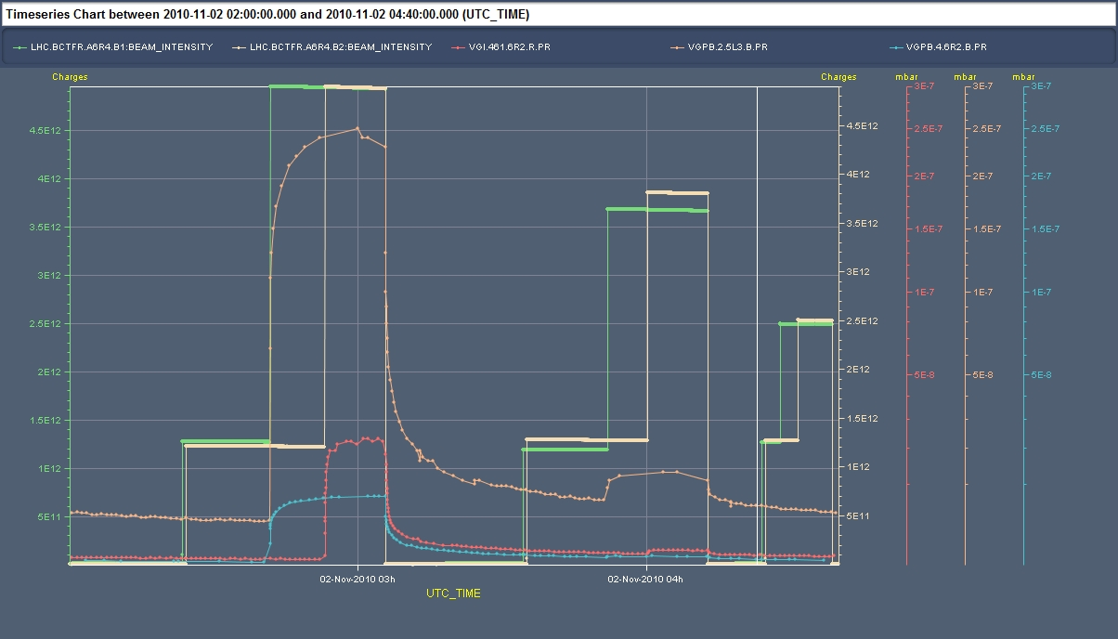
LHC IR3 – n_{b} scan
12+36
12+24
12+12
~ factor 31
~ factor 25
~ factor 1.3
Courtesy G.Arduini
9
21th January2011 - e⁻ cloud simulations

Slide 10
LHC IR3 – n_{b} scan
n_{b} (bunches) | R | SEY | Av.Density (10¹¹) | Flux (10⁹#e-/s)
12 | 0.5 | >3.0 | 0.038 | .03
24 | 0.5 | 2.4/2.5 | 0.55/1.8 | 0.60/1.81
36 | 0.5 | 2.1/2.2 | 0.6/3.9 | 0.91/5.31
10
21th January2011 - e⁻ cloud simulations

Slide 11
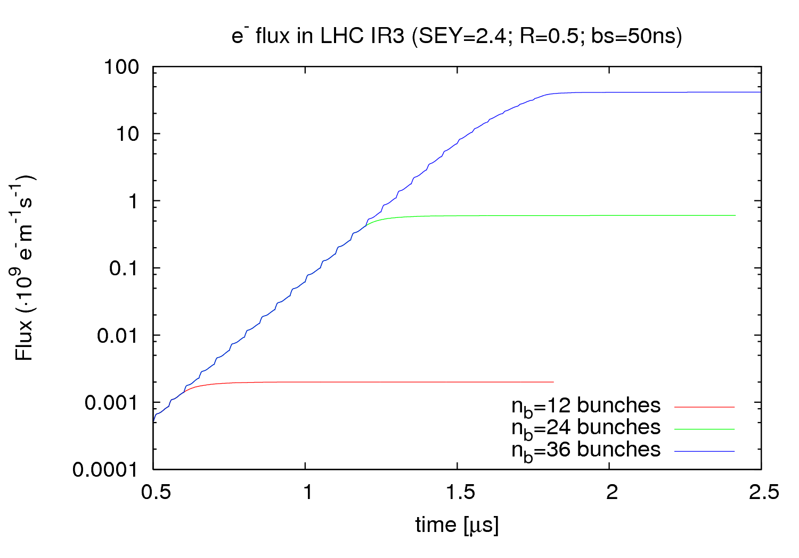
LHC IR3 – n_{b} scan
4.13·10¹⁰
~ factor 68
~ factor 2.1 ·10⁴
6.0·10⁹
~ factor 300
0.20·10⁷
11
21th January2011 - e⁻ cloud simulations

Slide 12
LHC IR3 – conclusions
Is R=0.5 too high?
Should we vary ε_{max} too?
12
21th January2011 - e⁻ cloud simulations

