Slide 1
e⁻ cloud simulations
(update)
C.Octavio Domínguez, Giovanni Rumolo, Frank Zimmermann
25th February 2011 - e⁻ cloud simulations

Slide 2
Contents
SPS simulations (2003) reproduction
Update (ε_{max} scan)
2) LHC simulations
Arcs → N_{b} scan update: stripes at 90%, 95 %, 99 % and 100%
IR3 → Lower intensities
Parameter studies at the LHC IR3: State of the art
2
25th February 2011 - e⁻ cloud simulations

Slide 3
Contents
SPS simulations (2003) reproduction
Update (ε_{max} scan)
2) LHC simulations
Arcs → N_{b} scan update: stripes at 90%, 95 %, 99 % and 100%
IR3 → Lower intensities
Parameter studies at the LHC IR3: State of the art
3
25th February 2011 - e⁻ cloud simulations

Slide 4
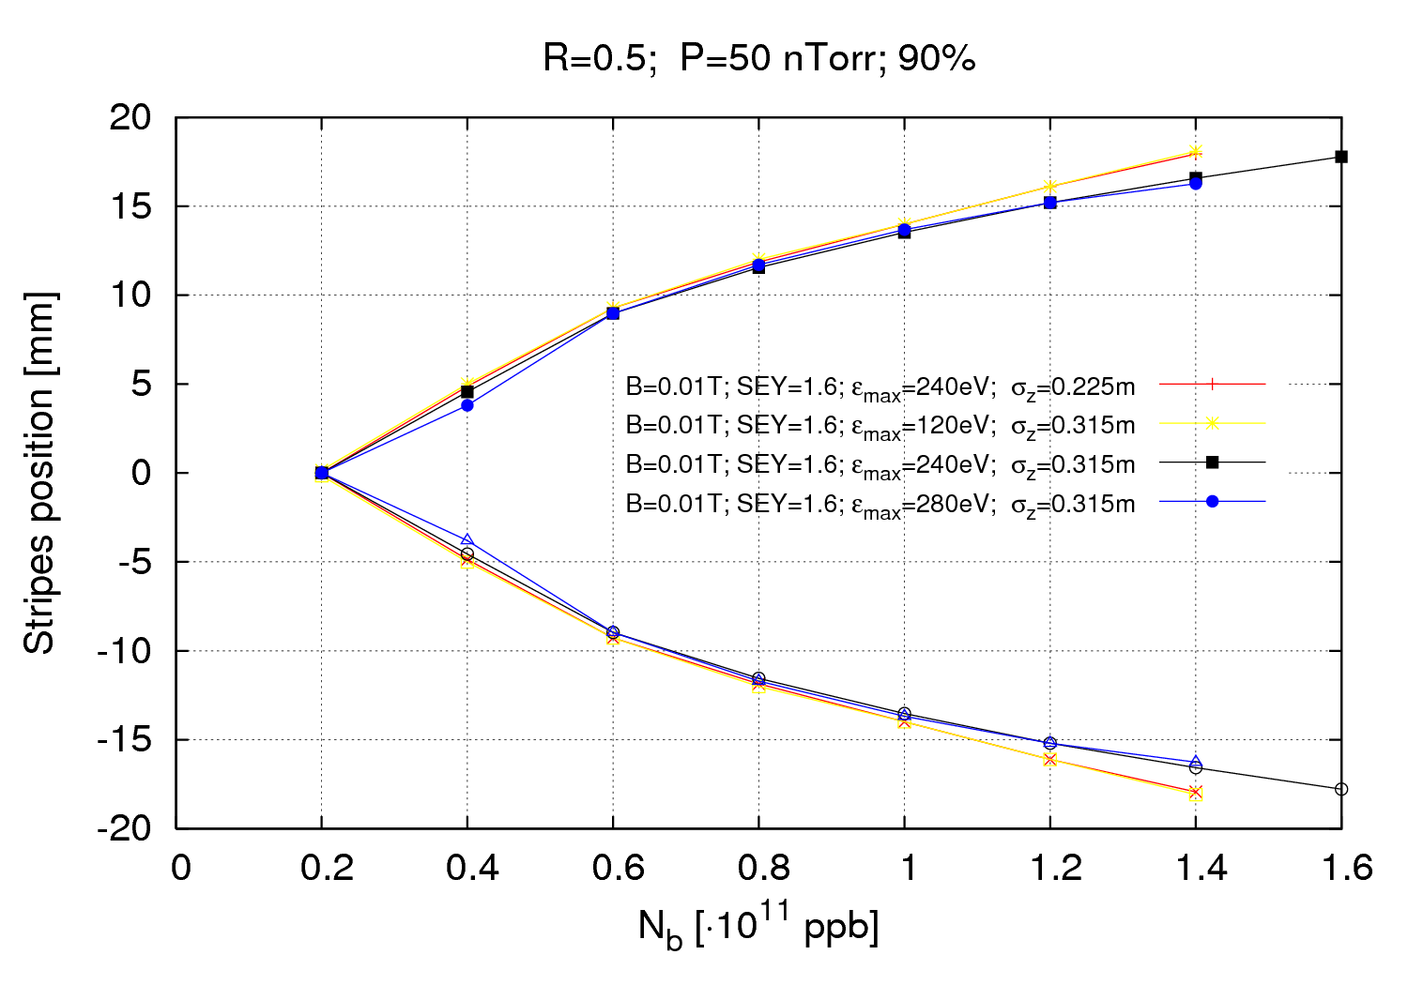
SPS measurements (2002)
4
25th February 2011 - e⁻ cloud simulations

Slide 5
SPS measurements (2002)
The “Stripes’ position plot” have been repeated with a different bunch length
A scan in ε_{max} has been done too
For ε_{max} > 280 eV we start not to appreciate much multipacting for δ_{max}=1.6
It seems that for higher values of ε_{max} the lines come slightly inwards
5
25th February 2011 - e⁻ cloud simulations

Slide 6
Contents
SPS simulations (2003) reproduction
Update (ε_{max} scan)
2) LHC simulations
Arcs → N_{b} scan update: stripes at 90%, 95 %, 99 % and 100%
IR3 → Lower intensities
Parameter studies at the LHC IR3: State of the art
6
25th February 2011 - e⁻ cloud simulations

Slide 7
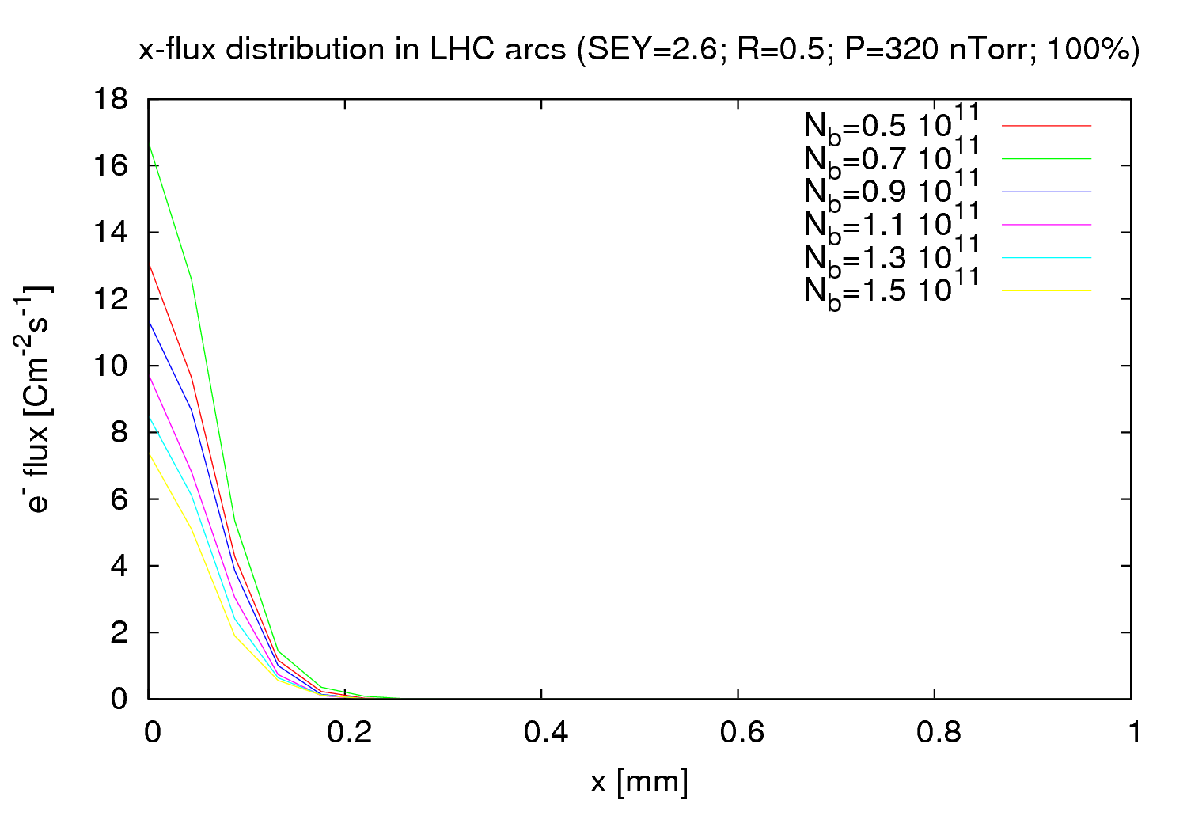
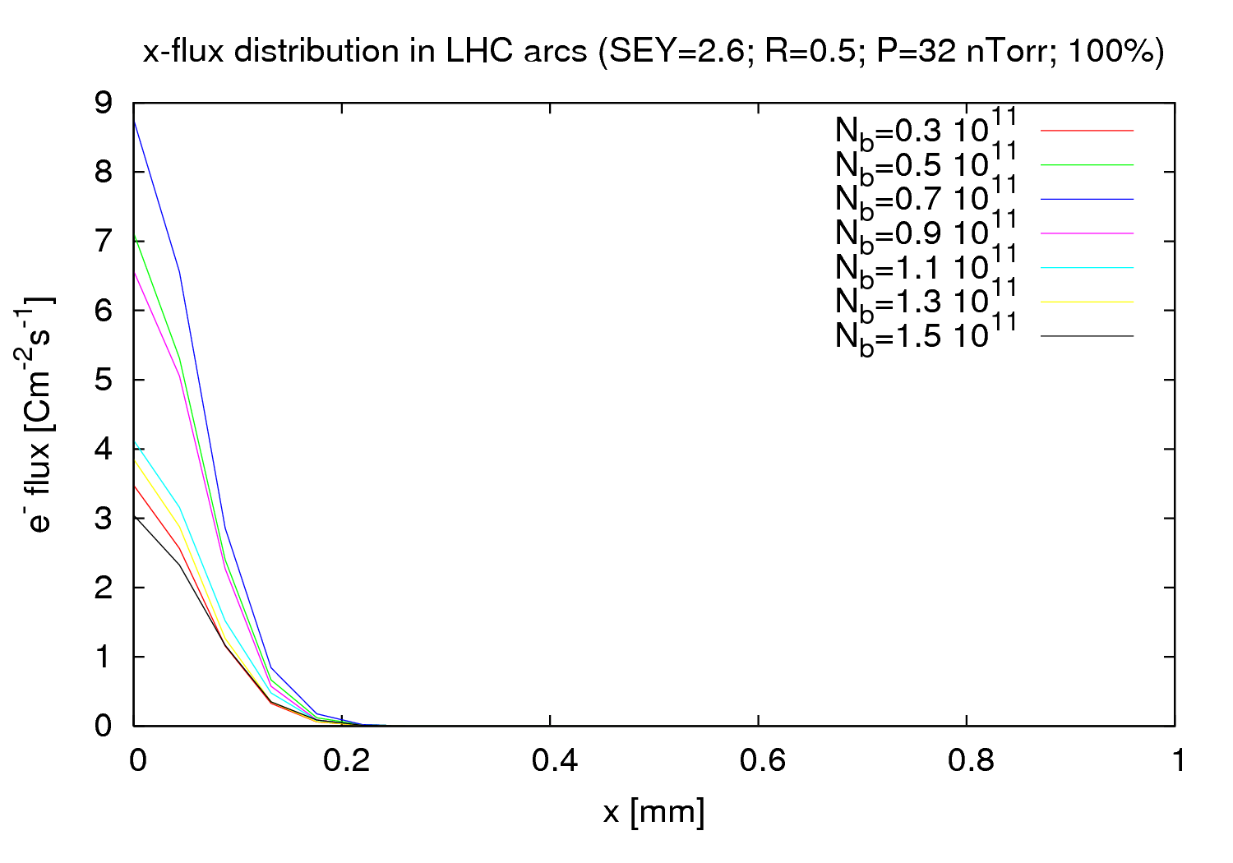
LCH arcs - N_{b} scan
For 100% of the e- generated in the beam volume no stripes at all!!!!
From last meeting ( 11/02/2011)
7
11^{h} February 2011 - e⁻ cloud simulations

Slide 8
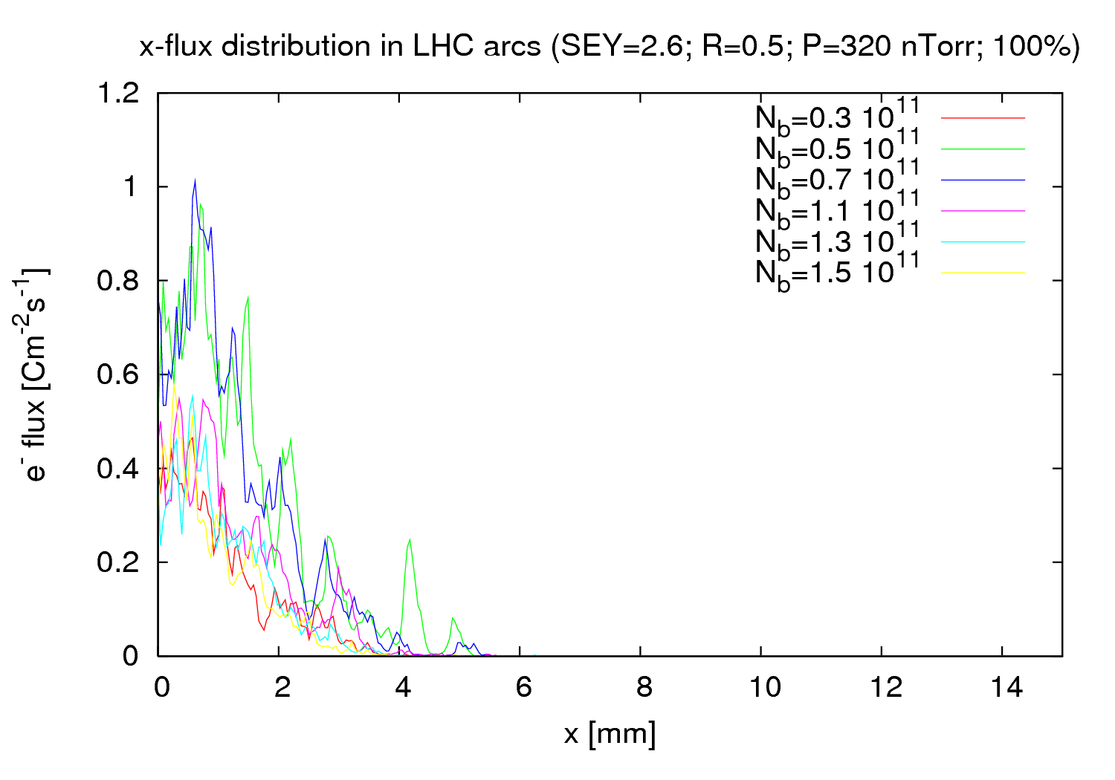
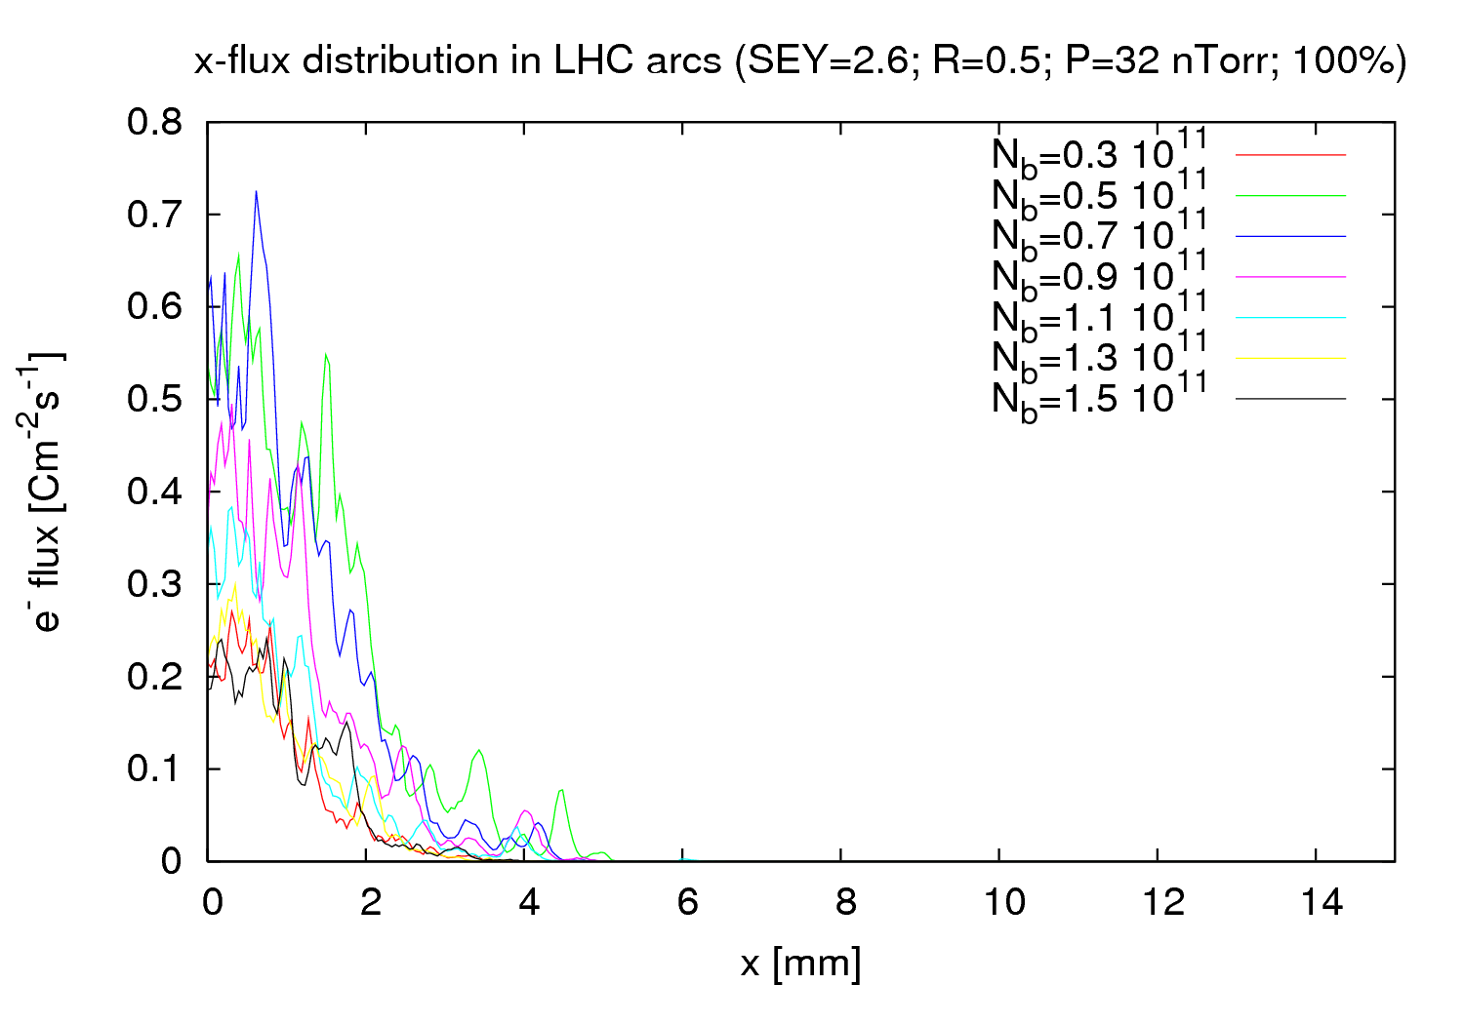
LCH arcs - N_{b} scan
There was a bug last time
We do observe flux further than the beam volume
Stripes don’t appear so clear though
8
25th February 2011 - e⁻ cloud simulations

Slide 9
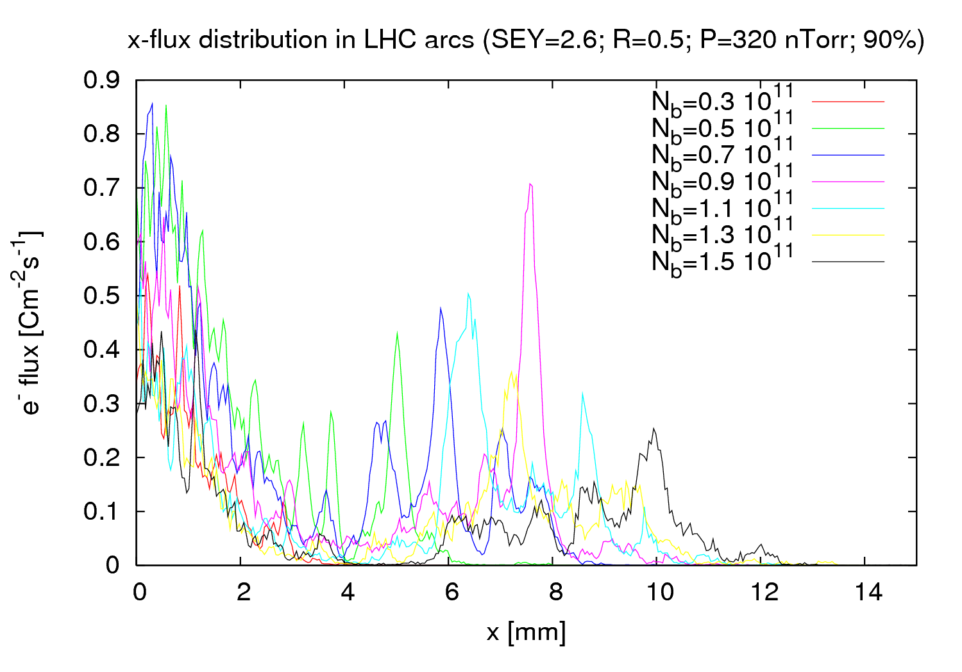
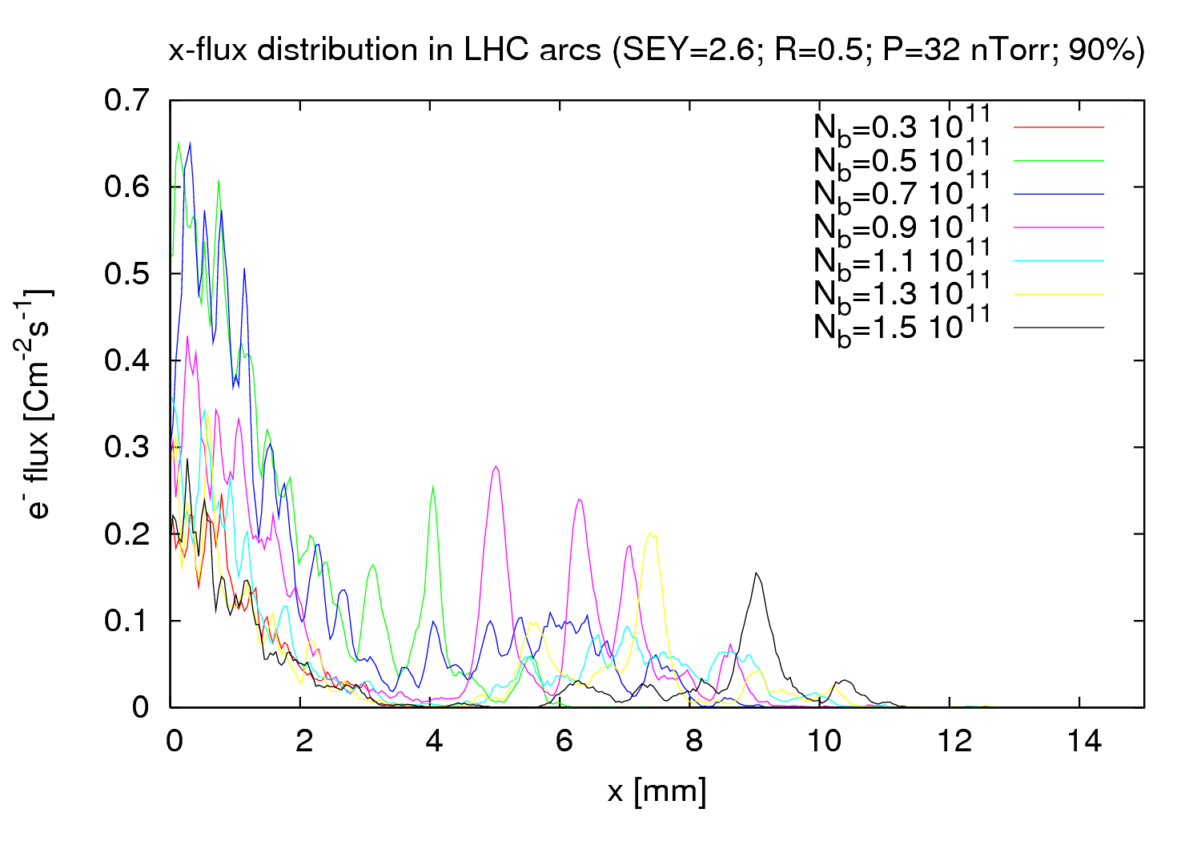
LCH arcs - N_{b} scan
Just to remind you…
9
25th February 2011 - e⁻ cloud simulations

Slide 10
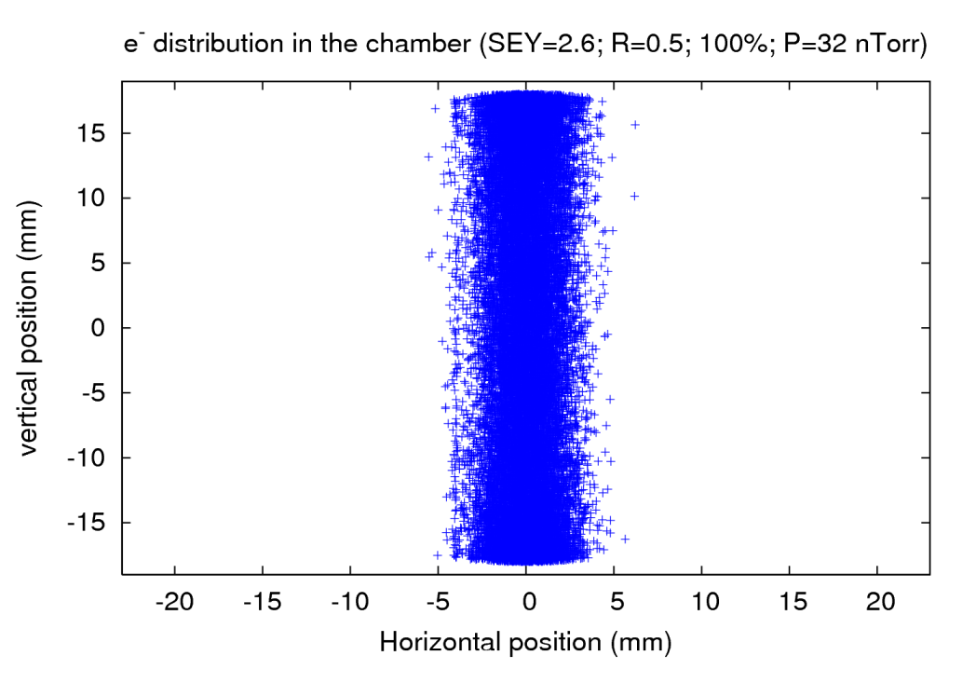
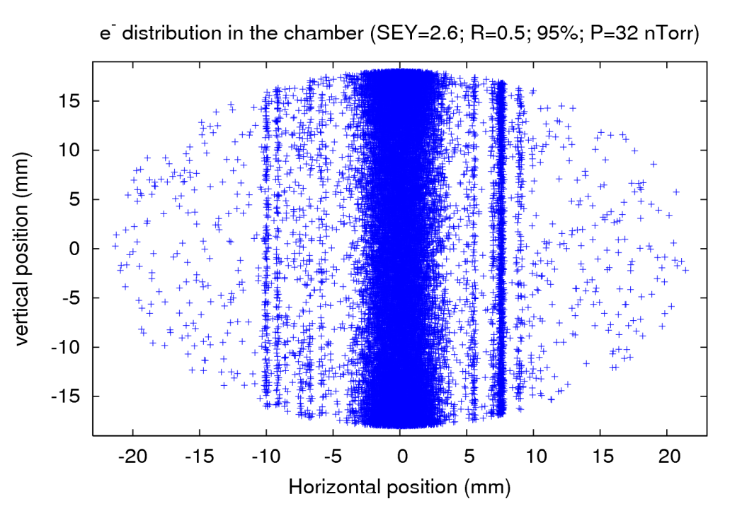
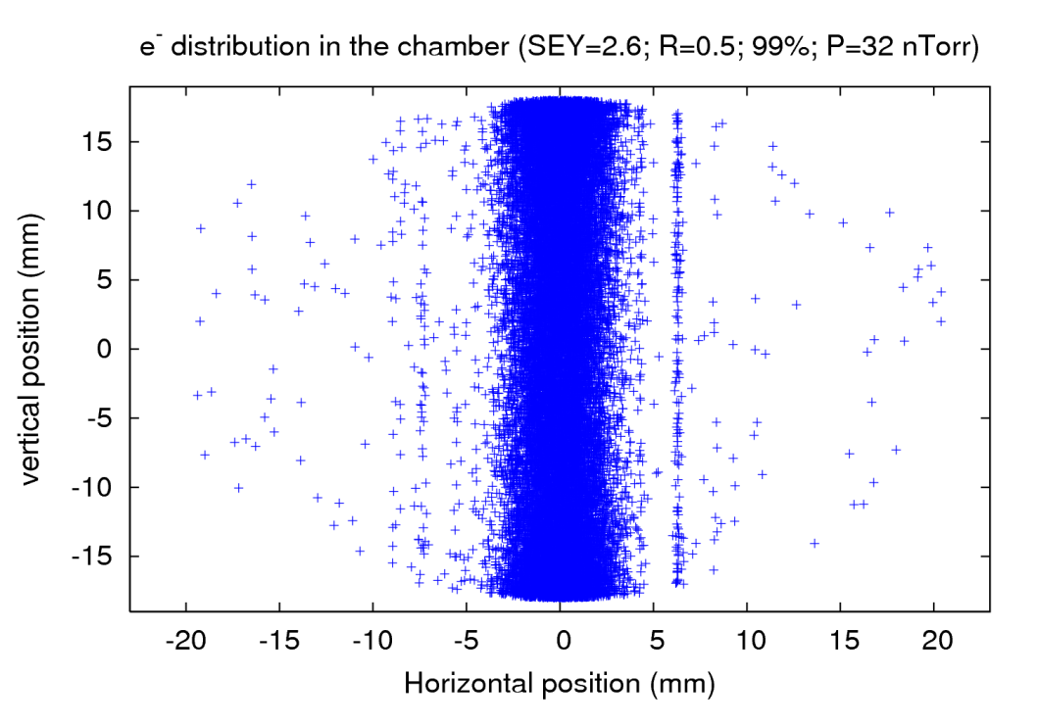
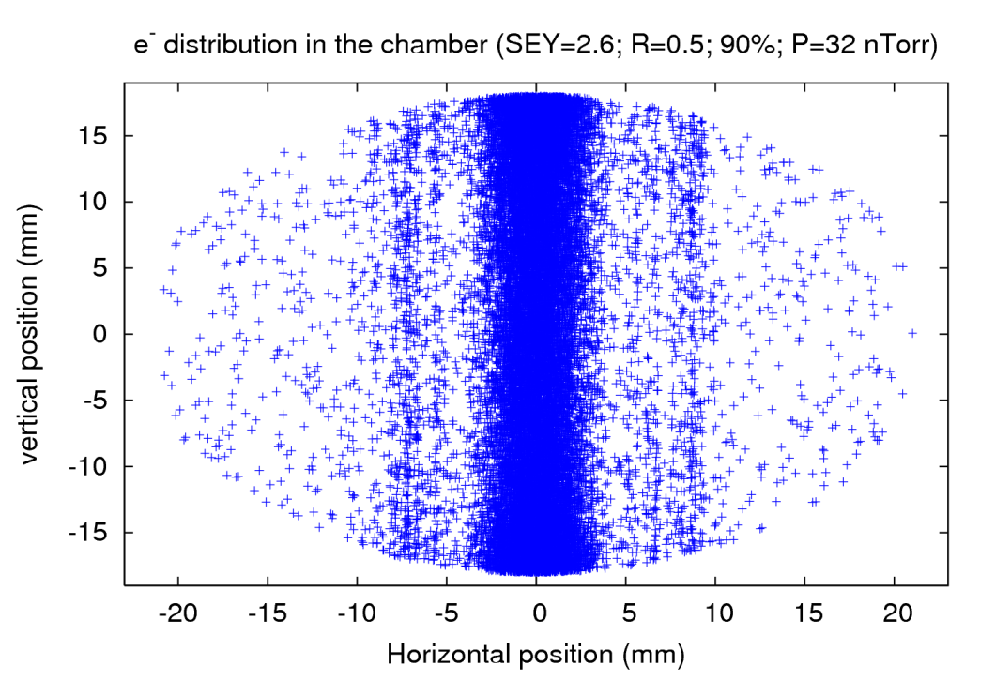
LCH arcs - N_{b} scan
10
25th February 2011 - e⁻ cloud simulations

Slide 11
LCH arcs - N_{b} scan
Stripes are not observed when the 100% of the e⁻ are generated within the beam volume
They start to appear when some portion of the e⁻ are randomly generated outside the beam volume
Nevertheless, the stripes are not so symmetric nor well defined
11
25th February 2011 - e⁻ cloud simulations

Slide 12
Contents
SPS simulations (2003) reproduction
Update (ε_{max} scan)
2) LHC simulations
Arcs → N_{b} scan update: stripes at 90%, 95 %, 99 % and 100%
IR3 → Lower intensities
Parameter studies at the LHC IR3: State of the art
12
25th February 2011 - e⁻ cloud simulations

Slide 13
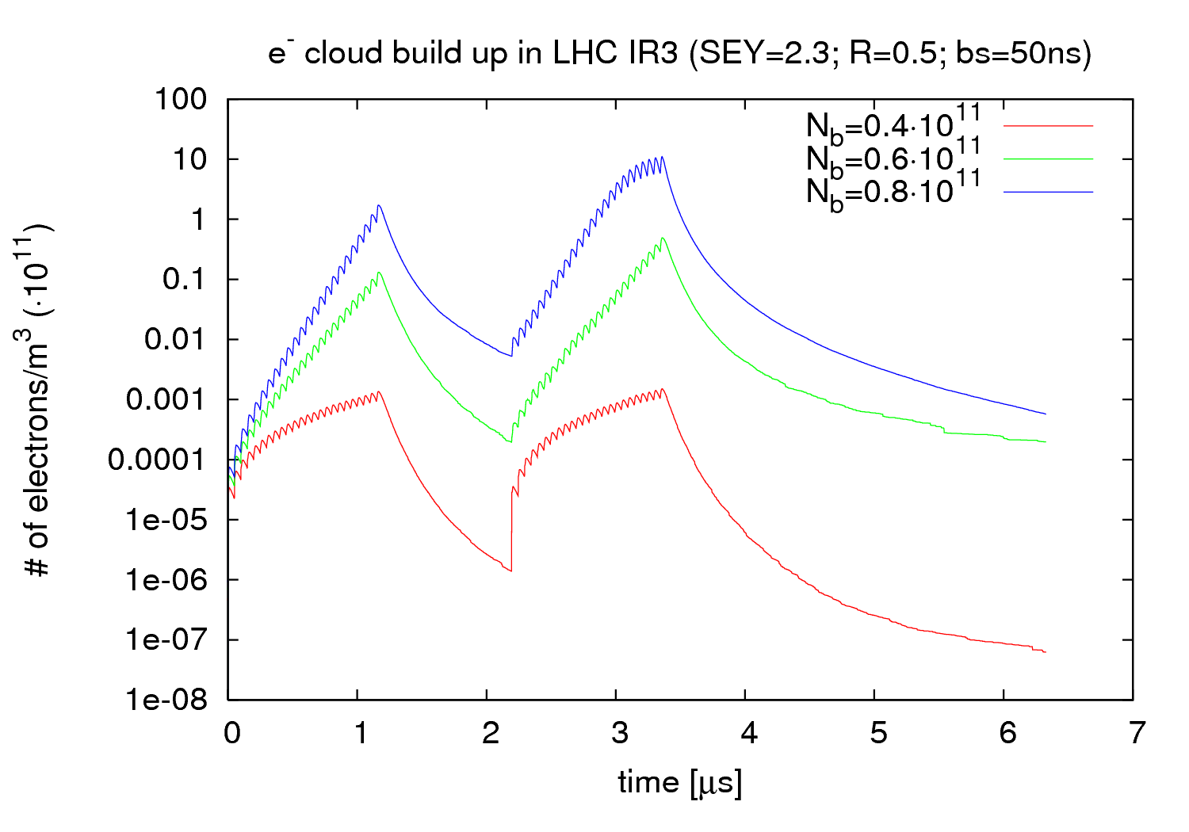
LCH IR3 – lower N_{b}
13
25th February 2011 - e⁻ cloud simulations

Slide 14
LCH arcs - N_{b} scan
Behavior of e⁻ cloud build up have been observed for intensities lower than nominal
We could set a threshold at N_{b}=0.7·10¹¹ ppb
The SEY used might be higher than the real one → Threshold should be a bit higher?
14
25th February 2011 - e⁻ cloud simulations

Slide 15
Contents
SPS simulations (2003) reproduction
Update (ε_{max} scan)
2) LHC simulations
Arcs → N_{b} scan update: stripes at 90%, 95 %, 99 % and 100%
IR3 → Lower intensities
Parameter studies at the LHC IR3: State of the art
15
25th February 2011 - e⁻ cloud simulations

Slide 16
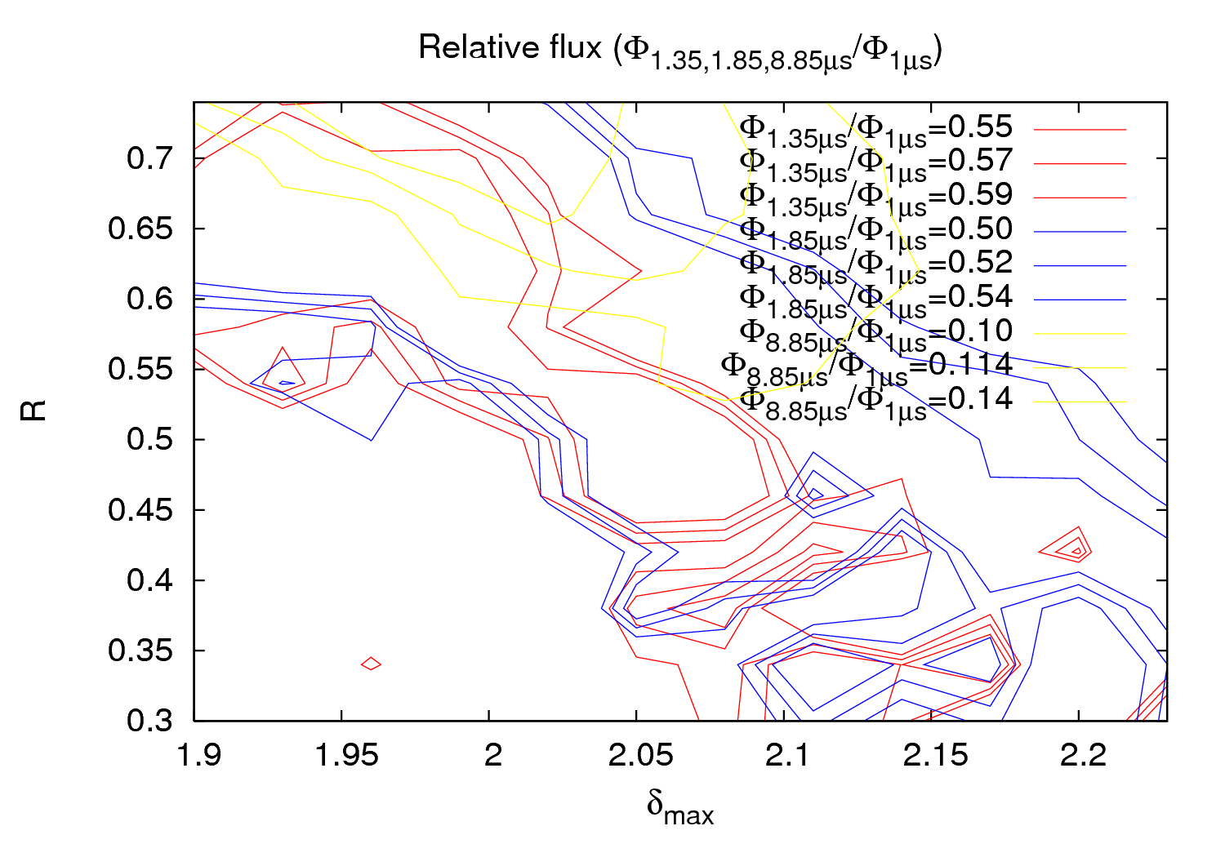
LCH arcs - N_{b} scan
16
25th February 2011 - e⁻ cloud simulations

Slide 17
LCH arcs - N_{b} scan
Preliminary conclusions (maybe too optimistic?):
2.03 < δ_{max} < 2.08
0.6< R < 0.7
Work to do:
Make finer grids
I accept any kind of suggestions, comments, …
17
25th February 2011 - e⁻ cloud simulations

