Slide 1
Parameter studies of the e⁻ cloud build up (update)
C.Octavio Domínguez, Giovanni Rumolo, Frank Zimmermann
Thanks to
G.Bregliozzi
25th March 2011 - e⁻ cloud meeting

Slide 2
Outline
New approach
Results?
MD proposal
25th March 2011 - e⁻ cloud meeting

Slide 3
Outline
New approach
Results?
MD proposal
25th March 2011 - e⁻ cloud meeting

Slide 4
New location
- Vacuum people: ”VGPB.2.5L3.B.PR is not suitable for this study”; Why?
Penning gauge → not very accurate
Close to an octupole magnet with unclear state of the NEG coating (problems during the bake out)
Only two gauges like that in the machine → difficult comparison and extrapolation
Complicated geometry
- Instead let’s use ionization gauges:
More accurate
Located between two 7 m NEG coated beam pipes
There are 173 around the ring (easier comparison and extrapolation)
They all have the same (simple) geometry
25th March 2011 - e⁻ cloud meeting

Slide 5
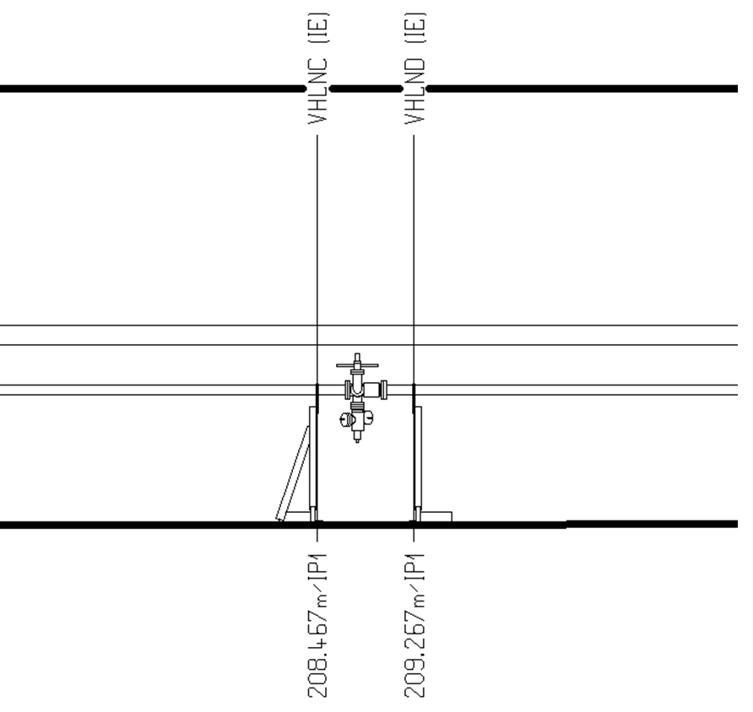
New location
7 m
7 m
25th March 2011 - e⁻ cloud meeting

Slide 6
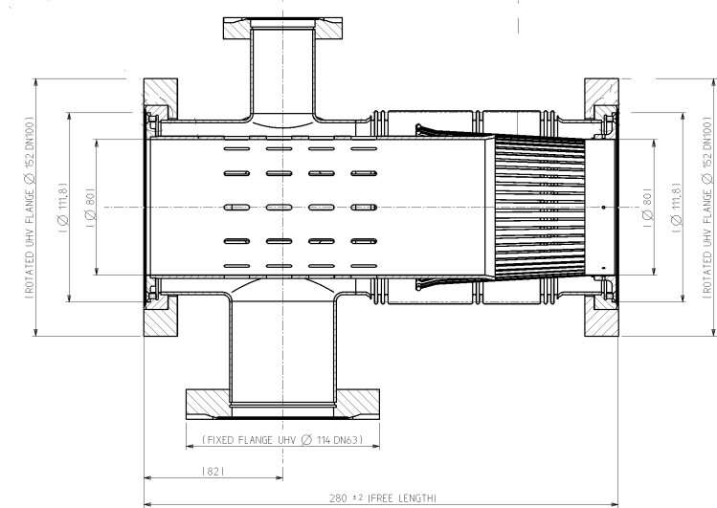
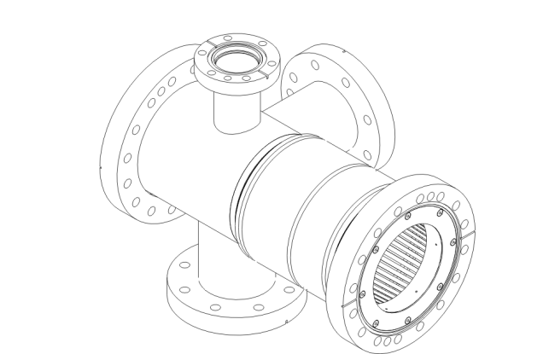
New location
25th March 2011 - e⁻ cloud meeting

Slide 7
New location
Problems:
Accuracy (~20% and get worse with aging)
No stable pressure
Different starting pressure for different batch spacing
Not clear behavior for long batch spacing
1.85 and 6.85 μs measurements not done during this MD (G.Bregliozzi)
Different beam sizes
But we have to decide a location to start…
25th March 2011 - e⁻ cloud meeting

Slide 8
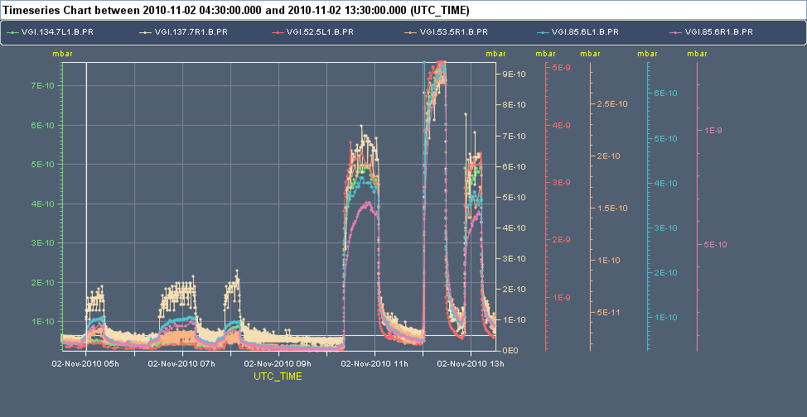
New location
25th March 2011 - e⁻ cloud meeting

Slide 9
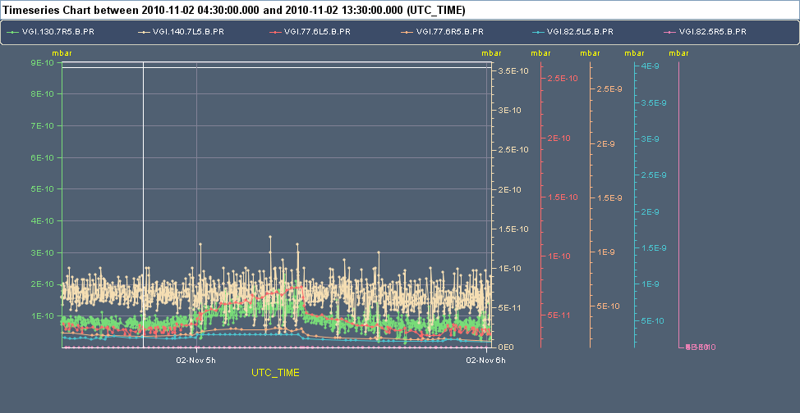
New location
25th March 2011 - e⁻ cloud meeting

Slide 10
New location
Gauge Name | Position* [m] | β_{x} [m] | β_{y} [m] | D_{x} [m] | σ_{x}/σ_{y} [mm]
VGI.543.6L2.B.PR | 3100.922 | 35.957 | 293.332 | -0.0340 | 0.476/1.355
VGI.89.5R2.B.PR | 3485.786 | 48.620 | 102.386 | 0.0536 | 0.554/0.800
VGI.319.5L3.B.PR | 6582.651 | 148.249 | 159.321 | 0.307 | 1.011/0.998
VGI.77.7R3.B.PR | 6878.895 | 36.566 | 207.785 | -0.0109 | 0.478/1.140
VGI.141.6L4.B.PR | 9847.184 | 283.684 | 315.246 | -0.0932 | 1.335/1.404
VGI.77.6L5.B.PR | 13148.149 | 147.106 | 128.667 | 0.0780 | 0.962/0.897
VGI.117.5R6.B.PR | 16849.049 | 359.358 | 351.753 | 0.222 | 1.516/1.483
VGI.53.6L7.B.PR | 19844.301 | 30.232 | 284.680 | 0.0461 | 0.437/1.334
VGI.77.6R8.B.PR | 23500.148 | 57.103 | 145.645 | -0.0391 | 0.599/0.955
VGI.35.7R8.B.PR | 23568.221 | 264.057 | 55.905 | -0.182 | 1.238/0.591
VGI.85.6L1.B.PR | 26449.409 | 129.699 | 143.134 | 0.0512 | 0.902/0.946
*Calculated from IP1
25th March 2011 - e⁻ cloud meeting

Slide 11
New location
Gauge Name | Position* [m] | β_{x} [m] | β_{y} [m] | D_{x} [m] | σ_{x}/σ_{y} [mm]
VGI.543.6L2.B.PR | 3100.922 | 35.957 | 293.332 | -0.0340 | 0.476/1.355
VGI.89.5R2.B.PR | 3485.786 | 48.620 | 102.386 | 0.0536 | 0.554/0.800
VGI.319.5L3.B.PR | 6582.651 | 148.249 | 159.321 | 0.307 | 1.011/0.998
VGI.77.7R3.B.PR | 6878.895 | 36.566 | 207.785 | -0.0109 | 0.478/1.140
VGI.141.6L4.B.PR | 9847.184 | 283.684 | 315.246 | -0.0932 | 1.335/1.404
VGI.77.6L5.B.PR | 13148.149 | 147.106 | 128.667 | 0.0780 | 0.962/0.897
VGI.117.5R6.B.PR | 16849.049 | 359.358 | 351.753 | 0.222 | 1.516/1.483
VGI.53.6L7.B.PR | 19844.301 | 30.232 | 284.680 | 0.0461 | 0.437/1.334
VGI.77.6R8.B.PR | 23500.148 | 57.103 | 145.645 | -0.0391 | 0.599/0.955
VGI.35.7R8.B.PR | 23568.221 | 264.057 | 55.905 | -0.182 | 1.238/0.591
VGI.85.6L1.B.PR | 26449.409 | 129.699 | 143.134 | 0.0512 | 0.902/0.946
*Calculated from IP1
25th March 2011 - e⁻ cloud meeting

Slide 12
New location
Gauge Name | Position* [m] | β_{x} [m] | β_{y} [m] | D_{x} [m] | σ_{x}/σ_{y} [mm]
VGI.543.6L2.B.PR | 3100.922 | 35.957 | 293.332 | -0.0340 | 0.476/1.355
VGI.89.5R2.B.PR | 3485.786 | 48.620 | 102.386 | 0.0536 | 0.554/0.800
VGI.319.5L3.B.PR | 6582.651 | 148.249 | 159.321 | 0.307 | 1.011/0.998
VGI.77.7R3.B.PR | 6878.895 | 36.566 | 207.785 | -0.0109 | 0.478/1.140
VGI.141.6L4.B.PR | 9847.184 | 283.684 | 315.246 | -0.0932 | 1.335/1.404
VGI.77.6L5.B.PR | 13148.149 | 147.106 | 128.667 | 0.0780 | 0.962/0.897
VGI.117.5R6.B.PR | 16849.049 | 359.358 | 351.753 | 0.222 | 1.516/1.483
VGI.53.6L7.B.PR | 19844.301 | 30.232 | 284.680 | 0.0461 | 0.437/1.334
VGI.77.6R8.B.PR | 23500.148 | 57.103 | 145.645 | -0.0391 | 0.599/0.955
VGI.35.7R8.B.PR | 23568.221 | 264.057 | 55.905 | -0.182 | 1.238/0.591
VGI.85.6L1.B.PR | 26449.409 | 129.699 | 143.134 | 0.0512 | 0.902/0.946
*Calculated from IP1
25th March 2011 - e⁻ cloud meeting

Slide 13
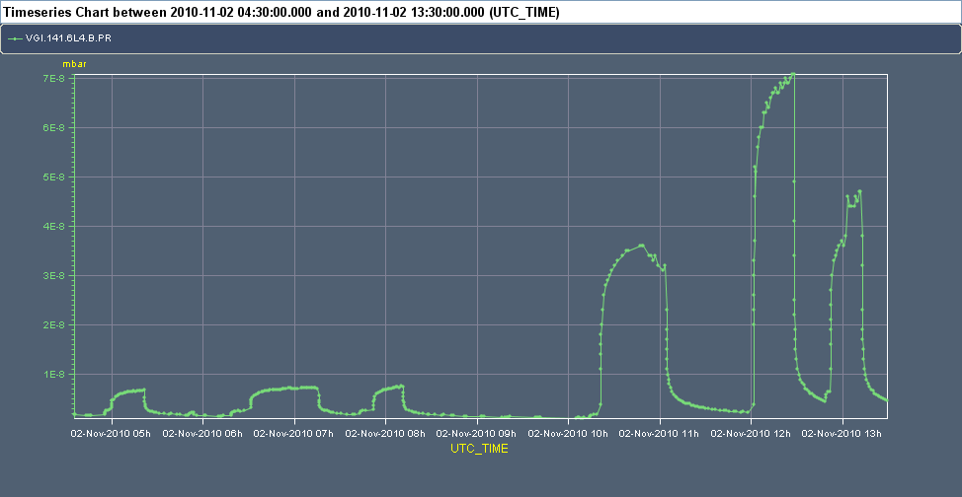
New location
VGI.141.6L4.B.PR
25th March 2011 - e⁻ cloud meeting

Slide 14
New location
Why VGI.141.6L4.B.PR?
Bigger pressure (less influence from base pressure???)
Quite similar initial pressure for long batch spacing
Clear pressure jumps
Not too noisy
Round beam (quite big size [1.35/1.40 mm], similar to IP3 [1.51/1.13 mm])
25th March 2011 - e⁻ cloud meeting

Slide 15
Outline
New approach
Results?
MD proposal
25th March 2011 - e⁻ cloud meeting

Slide 16
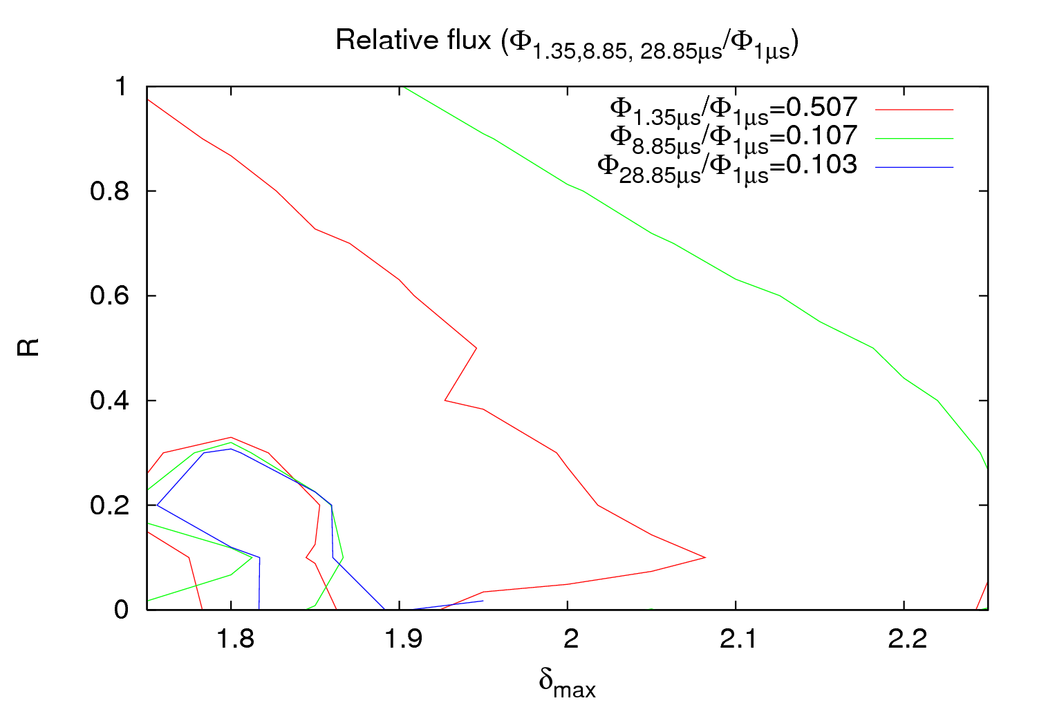
Results
25th March 2011 - e⁻ cloud meeting

Slide 17
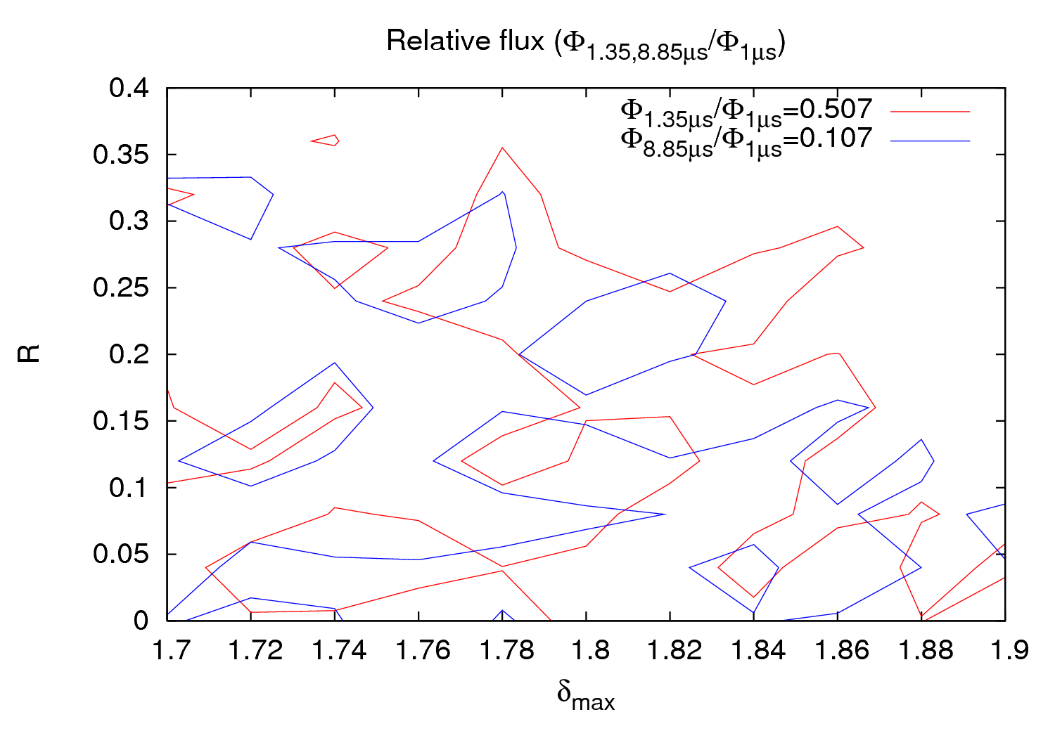
Results
25th March 2011 - e⁻ cloud meeting

Slide 18
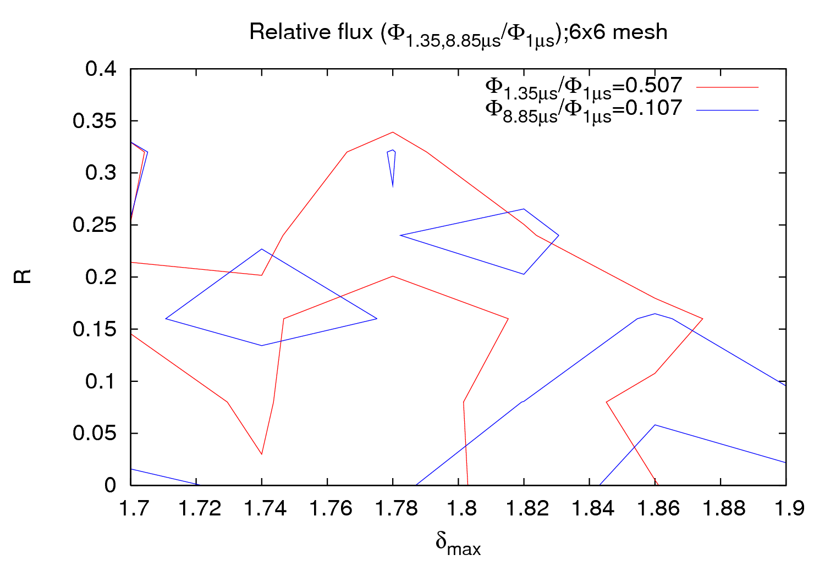
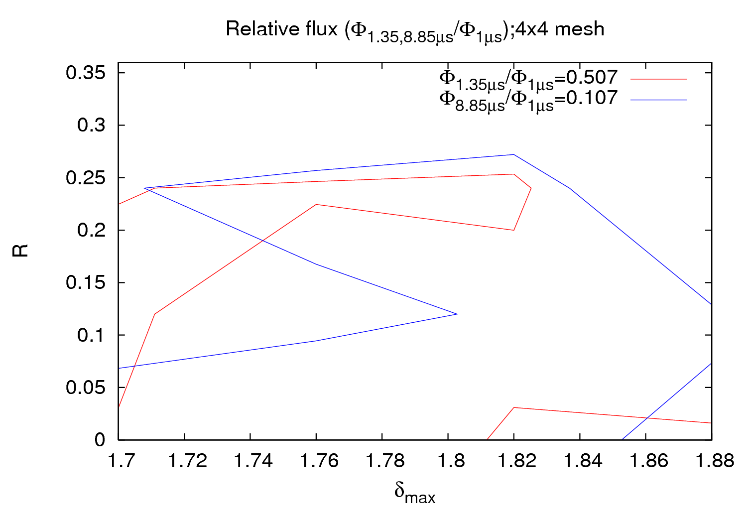
Results
The number of grid points definitely makes a difference
25th March 2011 - e⁻ cloud meeting

Slide 19
Results
Maybe the fluctuations dominate when doing a “zoom” in a certain
region
This lack of consistency could arrive from a bad fitting
Future work: Find a 2nd or 3rd order surface fitting and see if we get a
better agreement
New data from scrubbing run will be much appreciated
25th March 2011 - e⁻ cloud meeting

Slide 20
Outline
New approach
Results?
MD proposal
25th March 2011 - e⁻ cloud meeting

Slide 21
MD proposal
An ideal MD for such a study:
Longer time running for each batch spacing → To reach constant pressure
Longer relaxing time → To achieve the same initial value
Shorter batch spacing → Less influence of base pressure, less CPU time, less CPU space; E.g.: 0.225, 1.0, 2.0, 4.0, 6.0 and 10.0 μs?
25th March 2011 - e⁻ cloud meeting

