Slide 1
Parameter studies of the e⁻ cloud build up (update)
C.Octavio Domínguez, Frank Zimmermann
28th April 2011 - e⁻ cloud meeting

Slide 2
Outline
New fittings
Other locations
Scrubbing run – 6/04/2011
28th April 2011 - e⁻ cloud meeting

Slide 3
Outline
New fittings
Other locations
Scrubbing run – 6/04/2011
28th April 2011 - e⁻ cloud meeting

Slide 4
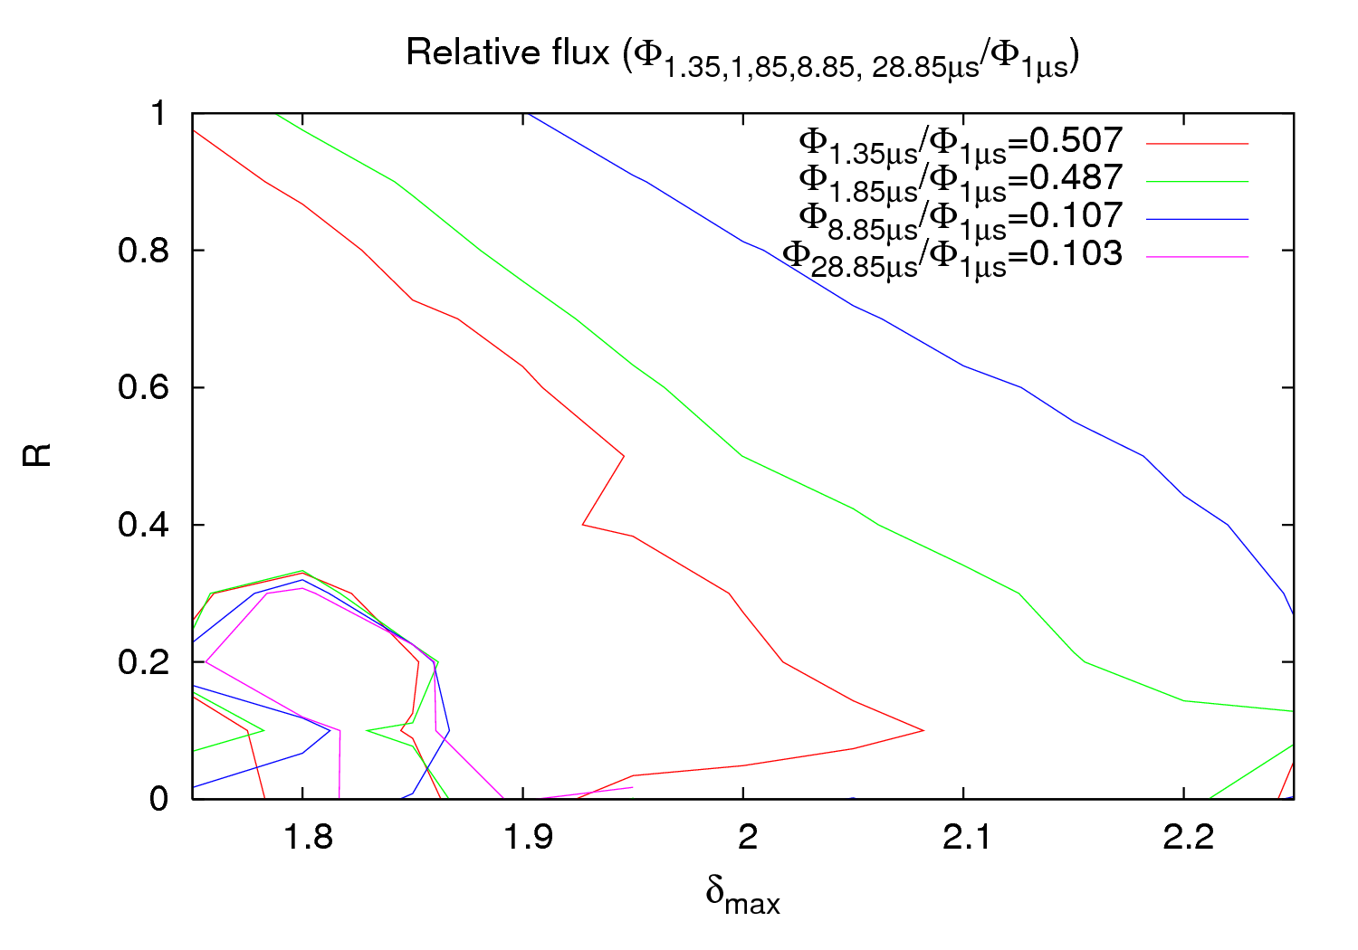
w/o fitting
As you may remember…
28th April 2011 - e⁻ cloud meeting

Slide 5
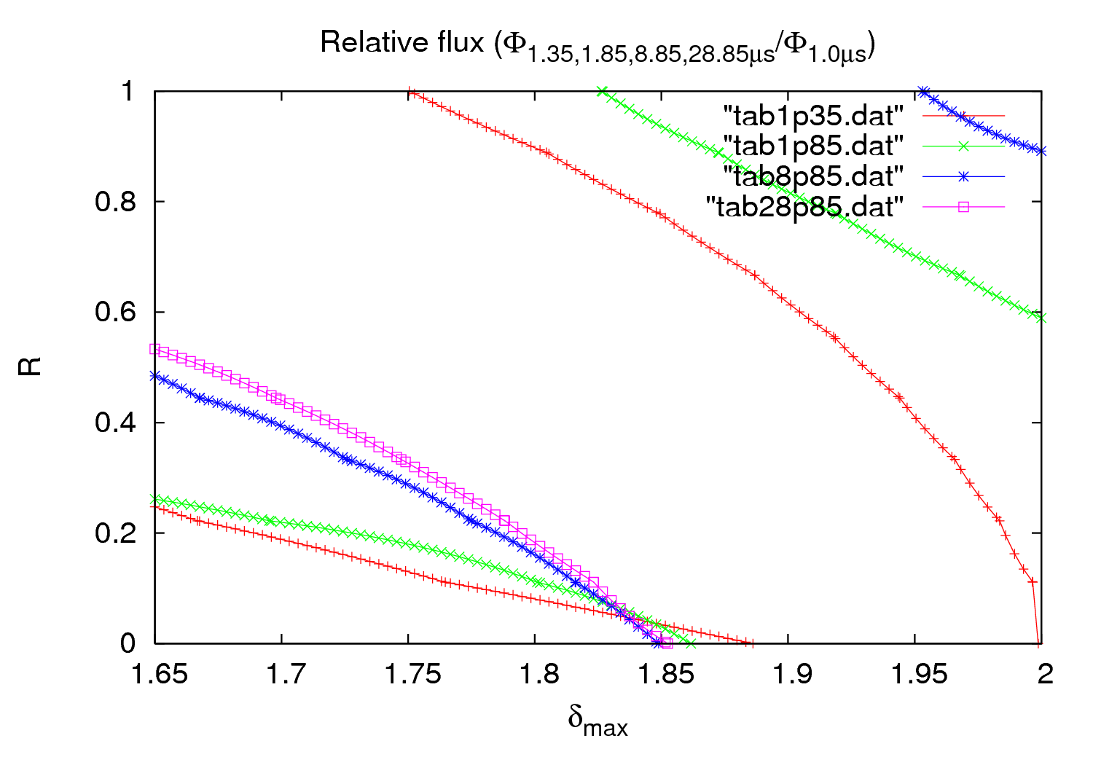
3rd order fit
Approximately same SEY but much lower R
28th April 2011 - e⁻ cloud meeting

Slide 6
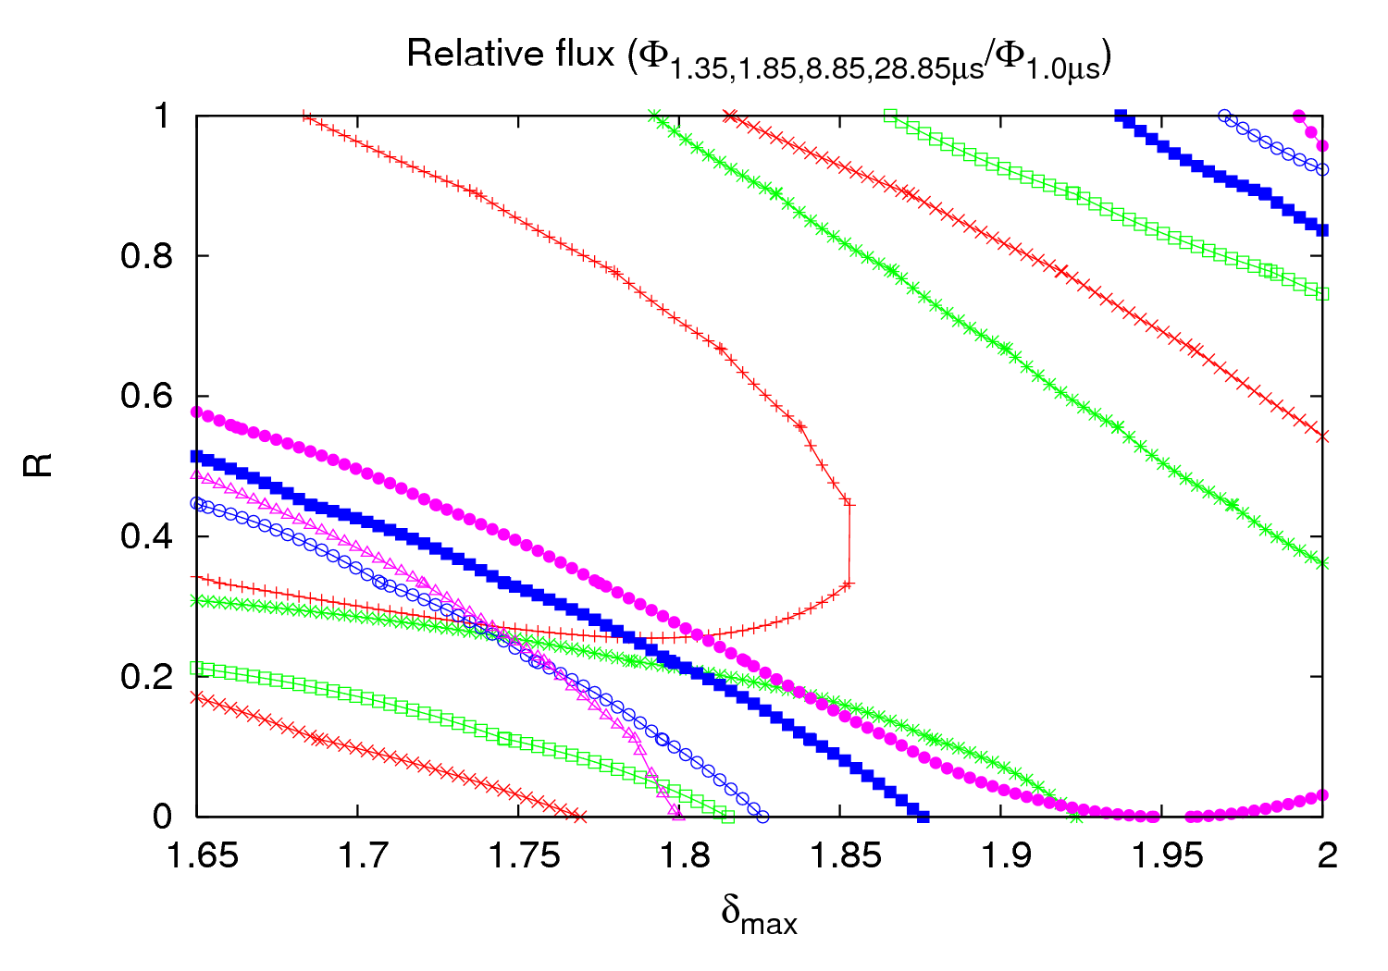
3rd order fit
Taking an arbitrary 10% error in the pressure
28th April 2011 - e⁻ cloud meeting

Slide 7
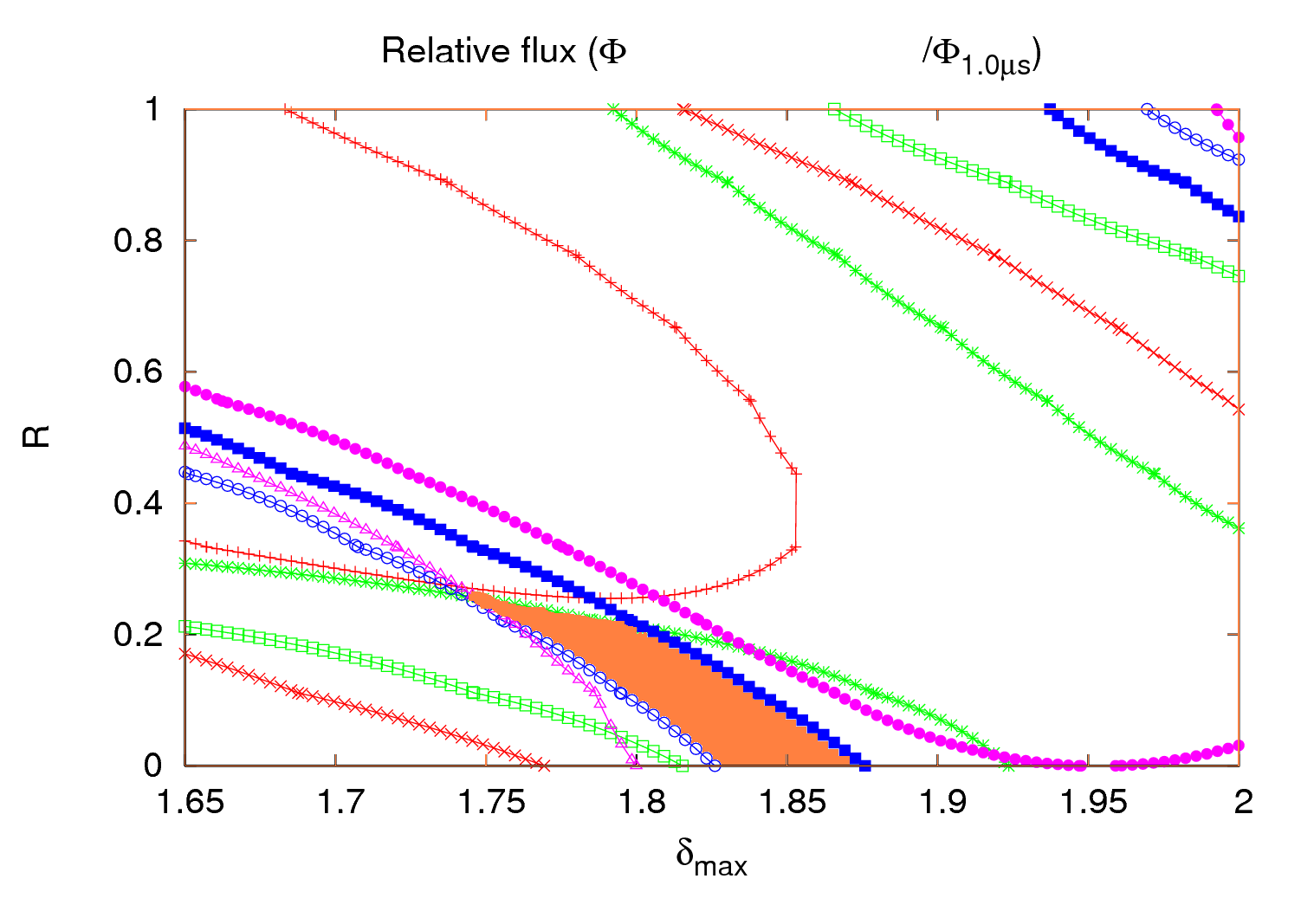
3rd order fit
1.35, 1.85, 8.85, 28.85μs
Taking an arbitrary 10% error in the pressure
Should the solution be here?
28th April 2011 - e⁻ cloud meeting

Slide 8
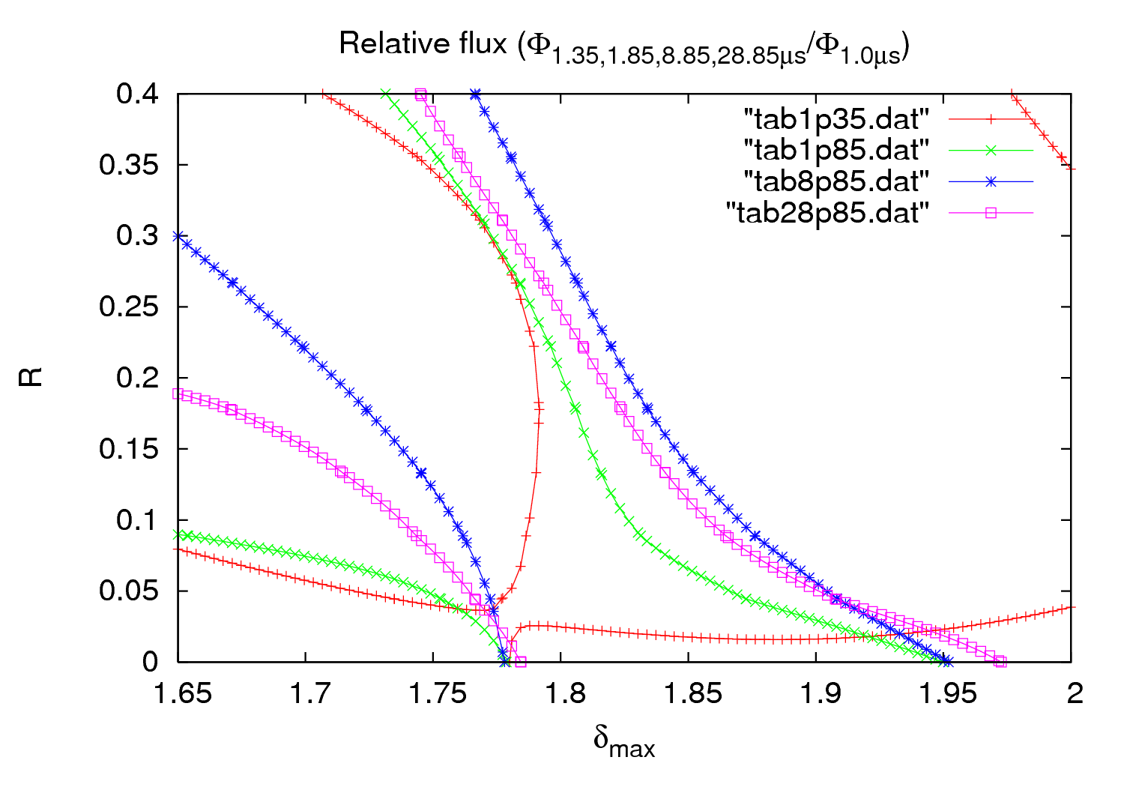
5th order fit
Almost same R as with 3rd order fit, but lower SEY
Another solution with higher SEY?
28th April 2011 - e⁻ cloud meeting

Slide 9
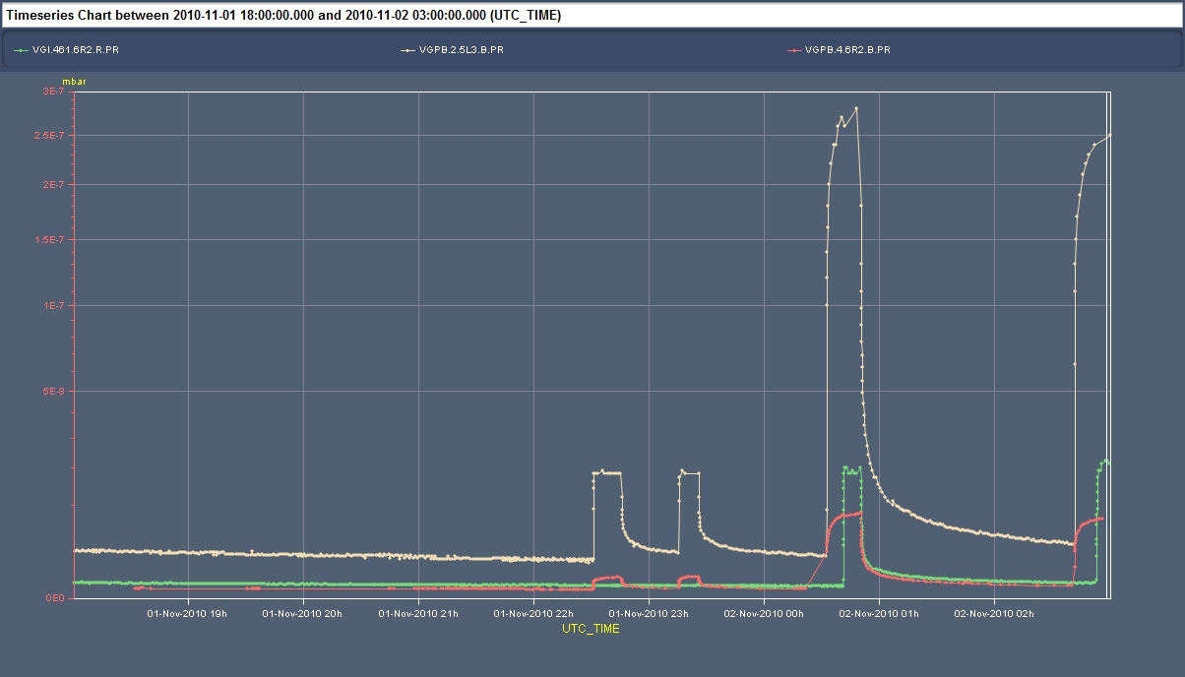
Thresholds comparison
1.1x10¹¹ p/bunch
0.8x10¹¹ p/bunch
0.6x10¹¹ p/bunch
Courtesy G.Arduini
28th April 2011 - e⁻ cloud meeting

Slide 10
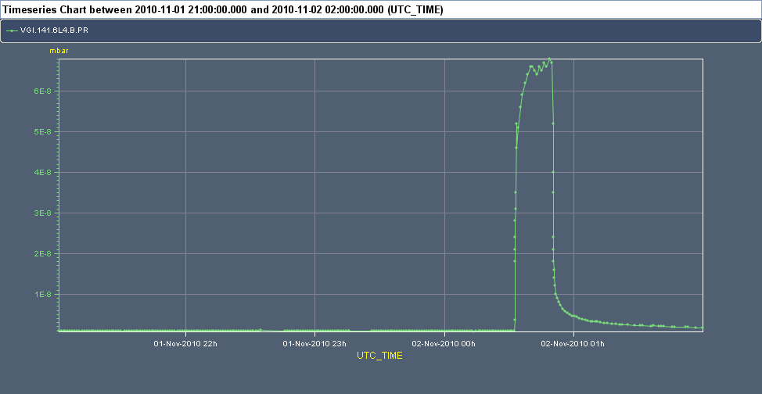
Thresholds comparison
P_{1.1}/P_{0.8}=1.6∙10⁻²
1.1 ∙10¹¹ ppb
More than one order of magnitude
0.8 ∙10¹¹ ppb
0.6 ∙10¹¹ ppb
1.77 | 0.05 → φ_{1.1}/φ_{0.8}=1.4∙10⁻³
1.84 | 0.25 → φ_{1.1}/φ_{0.8}=8.2∙10⁻⁴
1.84 | 0.08 → φ_{1.1}/φ_{0.8}=8.8∙10⁻⁴
1.94 | 0.05 → φ_{1.1}/φ_{0.8}=8.0∙10⁻⁴
28th April 2011 - e⁻ cloud meeting

Slide 11
Fitting - conclusions
Fits with 3rd and 5th order polynoms have been applied to the logarithms of the raw data for each batch spacing
The ratio of the different polynomial functions has been taken
3rd order polynoms are normally better (or more secure), but 5th order give a lower value of χ²
None of the different possible solutions found with the SEY/R scan match well with the intensity threshold simulations
Are the pressure values accurate enough for our purposes?
How could we fit better our data?
Are the results obtained with the fits more reliable?
28th April 2011 - e⁻ cloud meeting

Slide 12
Outline
New fittings
Other locations
Scrubbing run – 6/04/2011
28th April 2011 - e⁻ cloud meeting

Slide 13
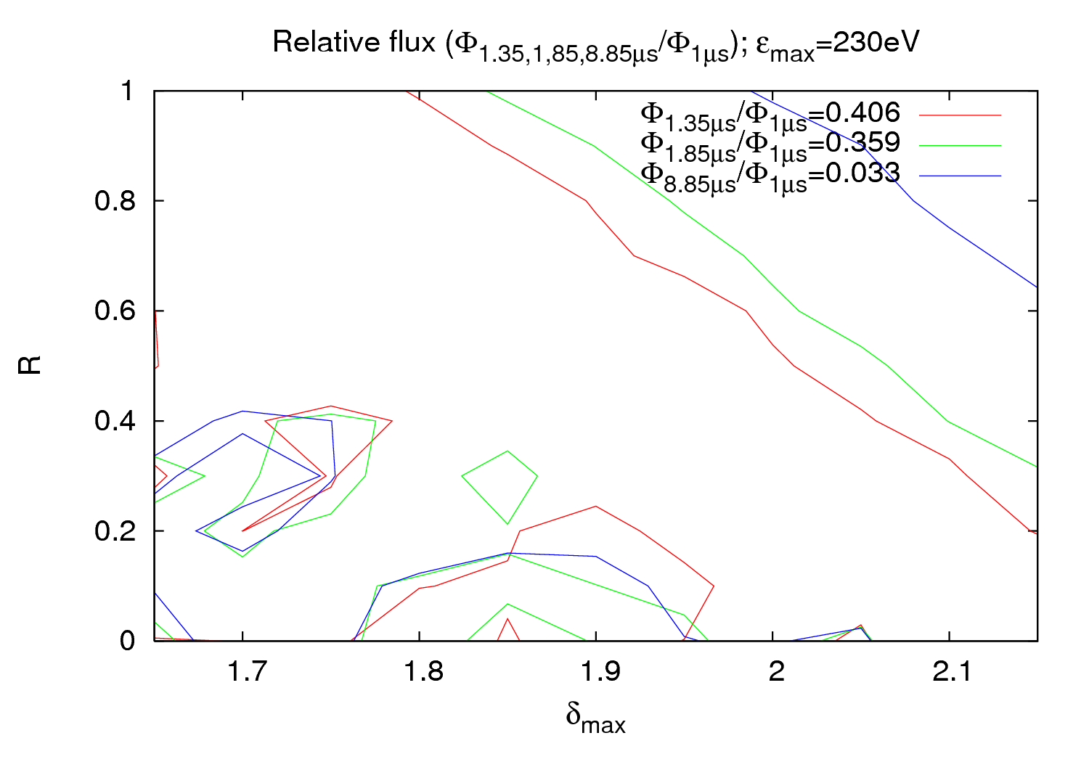
New location
Very similar SEY and R as with the other gauge
28th April 2011 - e⁻ cloud meeting

Slide 14
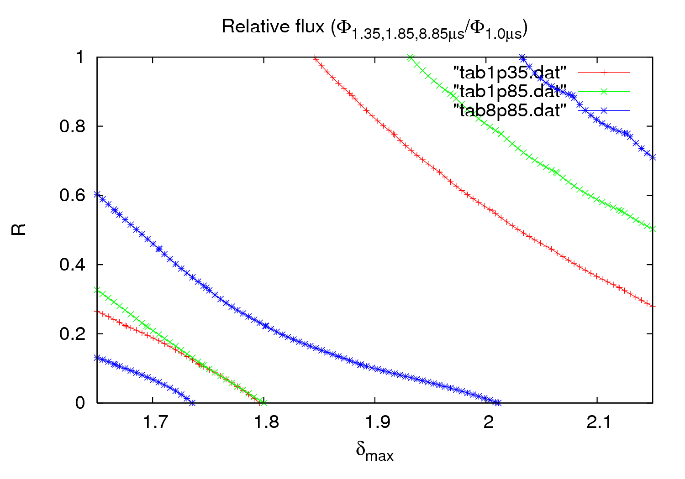
New location - fits
3rd order fit
28th April 2011 - e⁻ cloud meeting

Slide 15
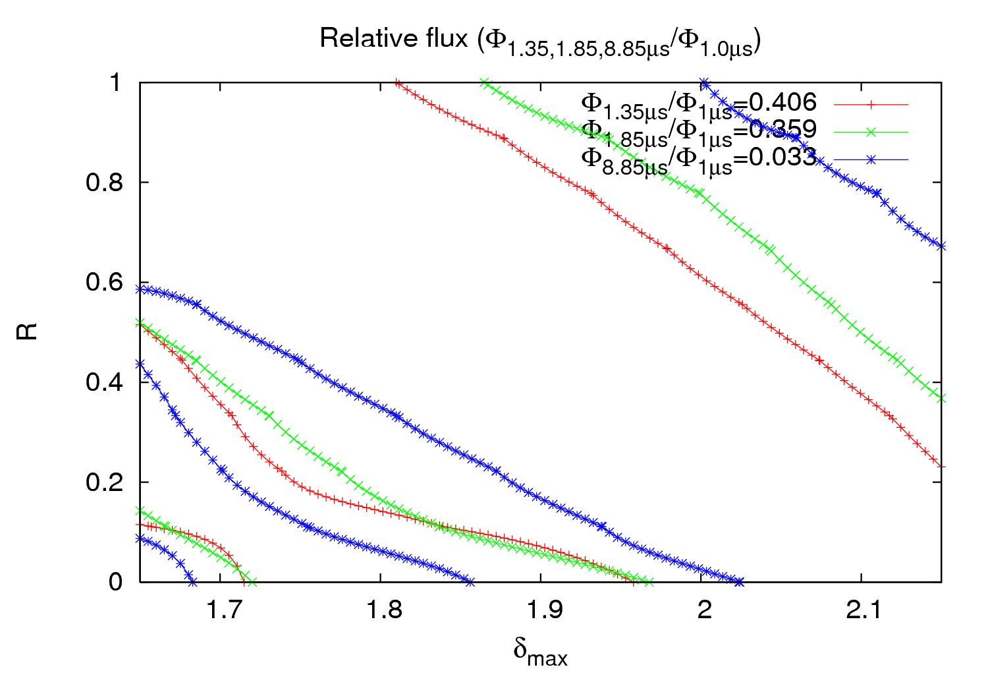
New location - fits
5rd order fit
28th April 2011 - e⁻ cloud meeting

Slide 16
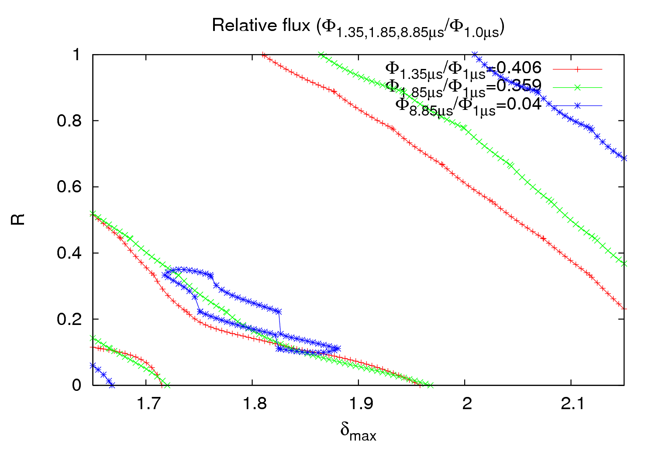
New location - fits
5rd order fit
Within 10%
28th April 2011 - e⁻ cloud meeting

Slide 17
New location - fits
A new location (VGI.319.5L3.B.PR) have been tested for 2010 measurements
The results agree quite well with the other location explored (VGI.141.6L4.B.PR)
3rd and 5th order fits have been done
5th order fits continue giving a lower value of χ²
A certain agreement has been found considering a 10% error in the pressure
First conclusion: For this kind of gauges SEY ~1.85 and R~0.2
This results has to be taken just as tentative values
Intensity thresholds for this location has to be investigated
28th April 2011 - e⁻ cloud meeting

Slide 18
Outline
New fittings
Other locations
Scrubbing run – 6/04/2011
28th April 2011 - e⁻ cloud meeting

Slide 19
P vs. batch spacing experiment
Injection interlock due to BIC sanity checks not performed in the last 25 hours
We wanted:
6μs
4μs
2μs
1μs
Pressure close to the thresholds
28th April 2011 - e⁻ cloud meeting

Slide 20
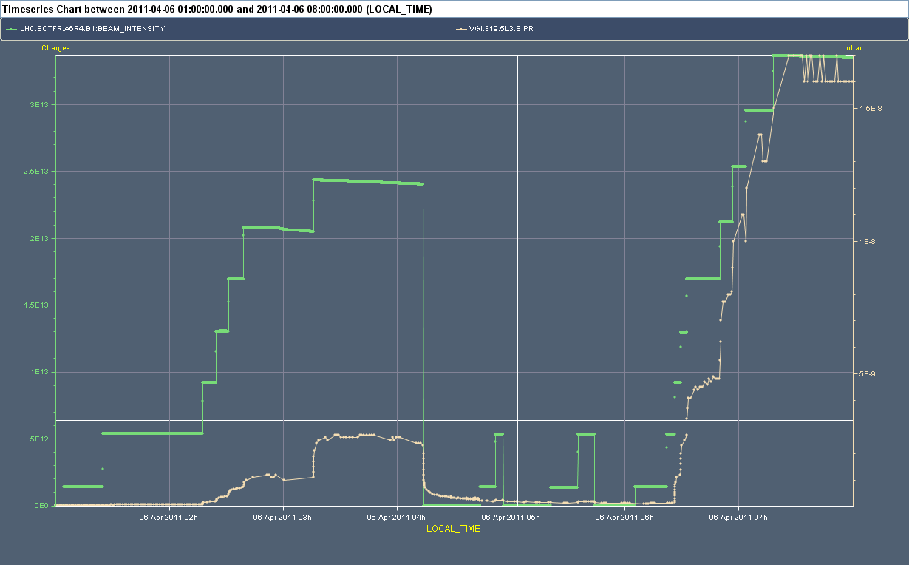
P vs. batch spacing experiment
ΔP₁ > ΔP₂
2μs
4μs
6μs
2μs
ΔP₁
ΔP₂
28th April 2011 - e⁻ cloud meeting

Slide 21
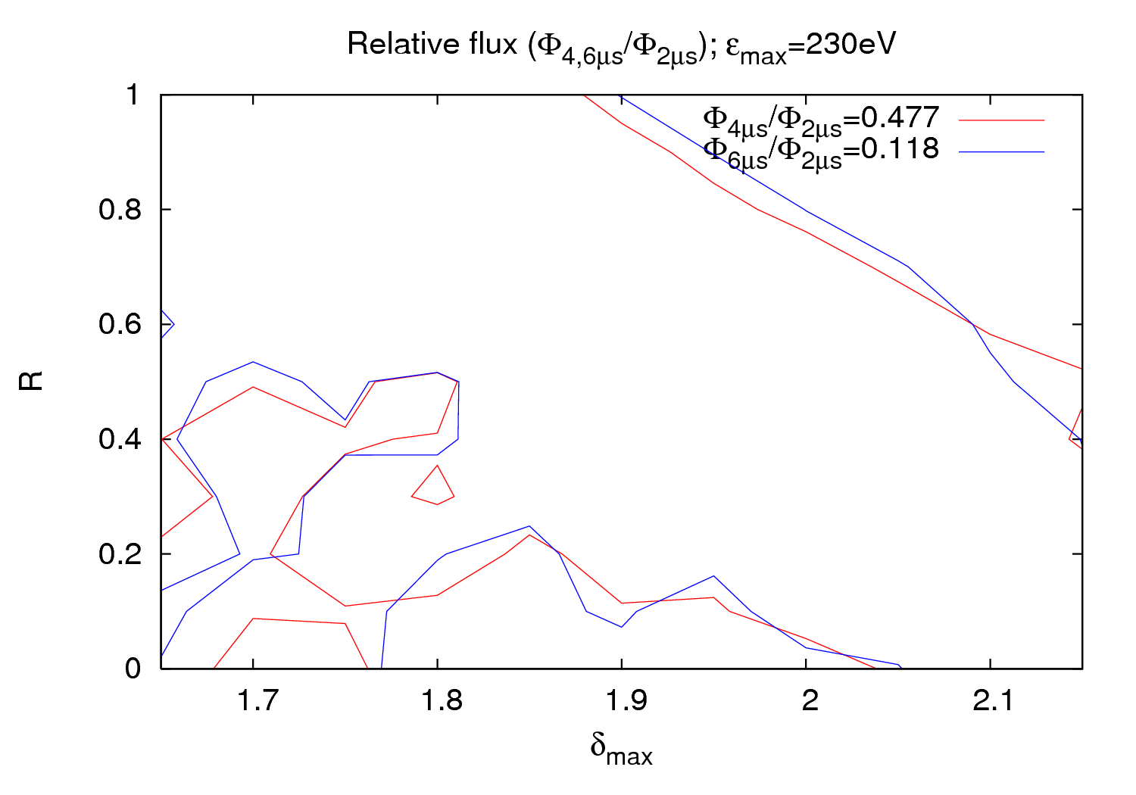
P vs. batch spacing experiment
???
28th April 2011 - e⁻ cloud meeting

Slide 22
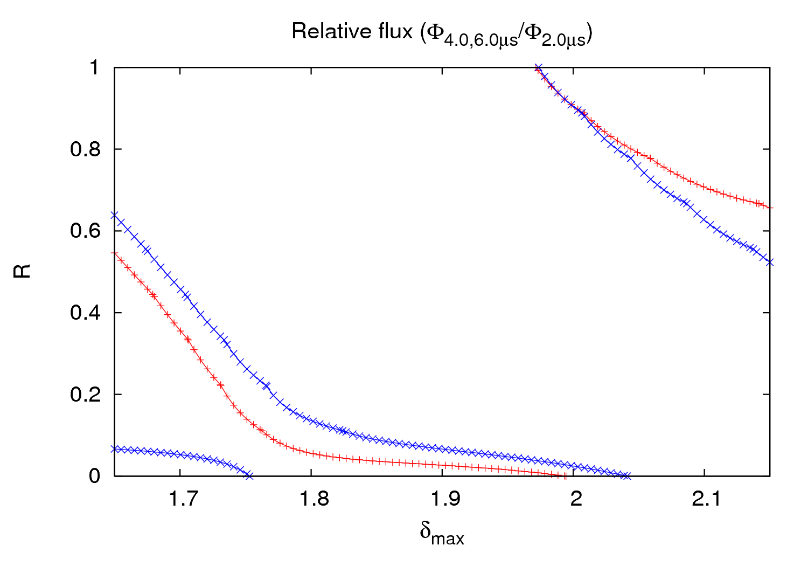
P vs. batch spacing experiment
3rd order fit
28th April 2011 - e⁻ cloud meeting

Slide 23
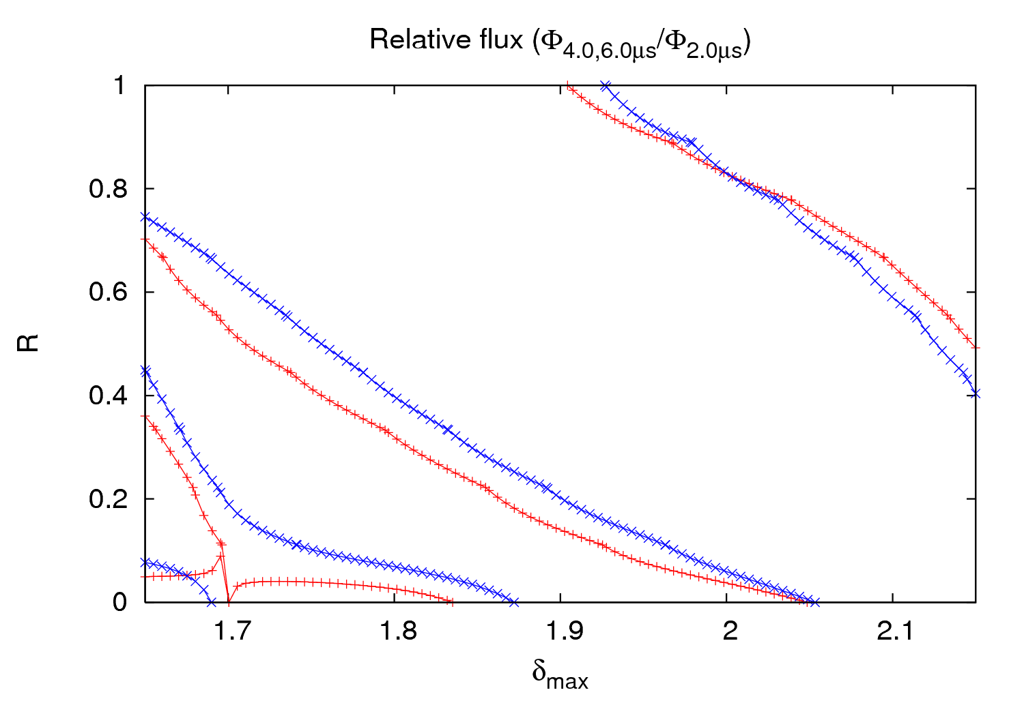
P vs. batch spacing experiment
5th order fit
28th April 2011 - e⁻ cloud meeting

Slide 24
P vs. batch spacing experiment
The experiment could not be carried out as planned due to several reasons
Only three points (2 relative measurements) could be done for beam 1
Pressure does not stabilize in the time used for the first batch spacings
Simulations don’t give a clear agreement (a 3rd point would be needed for benchmarking)
Nevertheless there is a possible solution in the same region as in the 2010 experiment
3rd and 5th order fits have been done, but no valid conclusions can be extracted
5th order fits continue giving a lower value of χ²
28th April 2011 - e⁻ cloud meeting

