Slide 1
Beam induced heating on arc beam screens during the 25 ns MD on 24-25 October 2011
L. Tavian
25 October 2011

Slide 2
25 ns MD on 24 October 2011
(S45 as typical)
Fill
2248
Fill
2247

Slide 3
25 ns MD on 24 October 2011 – Fill 2247
Qbs (SR+IC scaled w/r to DR)
Qbs (SR+IC+EC scaled w/r to DR)
Half-cell
Half-cell with wrong BS type

Slide 4
25 ns MD on 24 October 2011 – Fill 2248
Qbs (SR+IC scaled w/r to DR)
Qbs (SR+IC+EC scaled w/r to DR)
Half-cell
Half-cell with wrong BS type

Slide 5
25 ns MD on 24-25 October 2011
(S45 as typical)
Fill
2250
Fill
2249

Slide 6
25 ns MD on 24 October 2011 – Fill 2249
Qbs (SR+IC scaled w/r to DR)
Qbs (SR+IC+EC scaled w/r to DR)
Half-cell
Half-cell with wrong BS type

Slide 7
25 ns MD on 25 October 2011 – Fill 2250
Qbs (SR+IC scaled w/r to DR)
Qbs (SR+IC+EC scaled w/r to DR)
Half-cell
Half-cell with wrong BS type

Slide 8
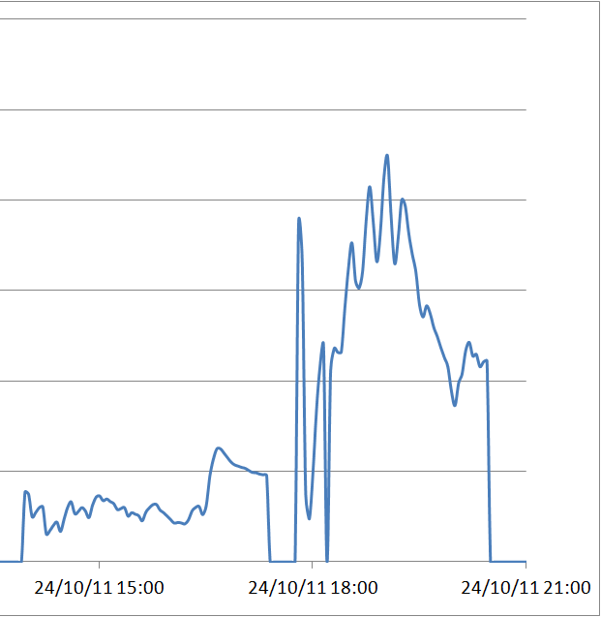
Scrubbing or not scrubbing?
Scrubbing indicator:
Ratio between the average measured heating and the heating scaled from Design Report (after beam cleaning/scrubbing)
2211 2212 2213 2247 2248 2249 2250
?
?
~2 kW per sector for the two last fills (2249 & 2250):
Global assessment from RF and/or cryoplants will be a good validation of the method !

