Slide 1
LHC at 7 TeV ECLOUD: HP vs Water Bag Dist.
Chandra Bhat and Alexey Burov
October/28/2011

Slide 2
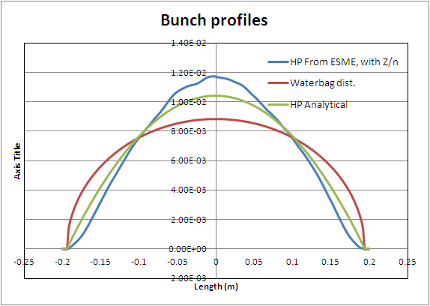
Comparison between different LHC Bunch Profiles (BL~0.40m), 2.5 eVs
BL

Slide 3
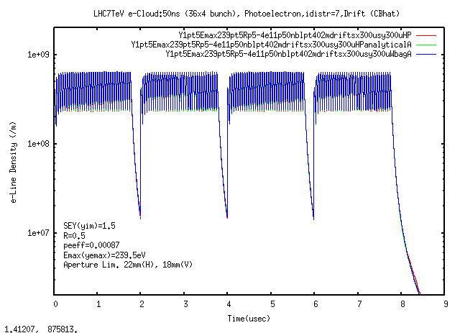
e-line Density: Drift Space

Slide 4
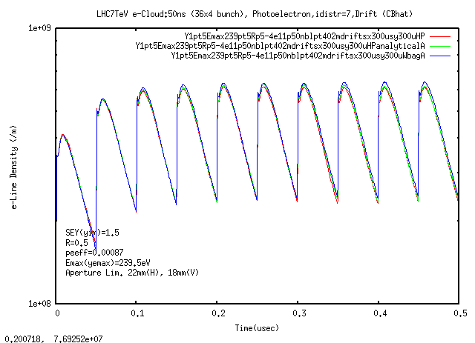
e-line Density -1 to 10 bunches :Drift Space

Slide 5
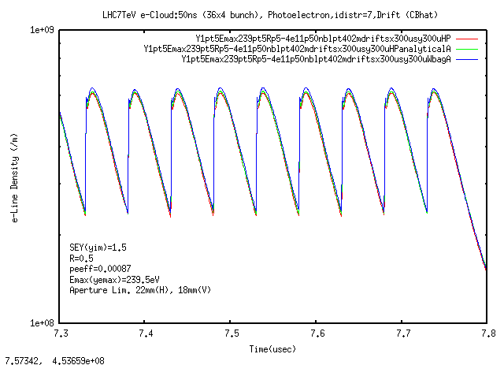
e-line Density –Last 10 bunches: : Drift Space

Slide 6
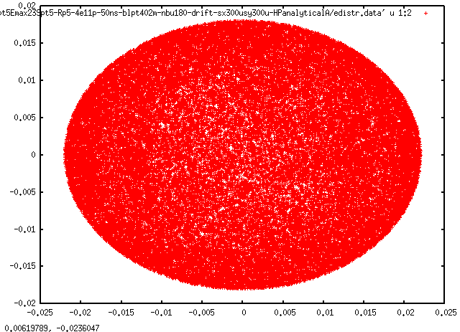
(x,y) e-distribution after bunch # 139 for HP bunch Profile

Slide 7
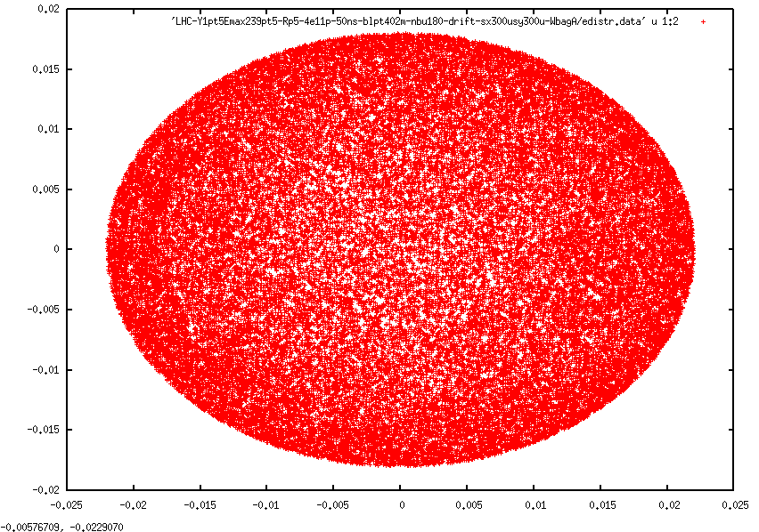
(x,y) e-distribution for after bunch # 139
Water Bag Bunch Profile

Slide 8
Average Heat Load :Drift Space
Bunch profile: HP with Z/n ← Realistic Distribution
LHCY1p5Emax239p5Rp54e11p50ns2p5eVsdriftx300uy300uHP
Average loss over 4. batches : 2.97 (Watts/m)
Bunch profile: HP Analytical
LHC-Y1pt5Emax239pt5-Rp5-4e11p-50ns-blpt402m-nbu180-drift-sx300usy300u-HPanalyticalA
Average loss over 4. batches : 2.72 (Watts/m)
Bunch profile: Water Bag
LHC-Alexey/LHC-Y1pt5Emax239pt5-Rp5-4e11p-50ns-blpt402m-nbu180-drift-sx300usy300u-WbagA
Average loss over 4. batches : 2.39 (Watts/m)
Bunch profile: Bunches in Double Harmonic RF with V2/V1=-0.5
LHCY1p5Emax239p5Rp54e11p50ns2p5eVsdriftx300uy300uBLMp50
Average loss over 4. batches : 2.43 (Watts/m)
Comparable

Slide 9
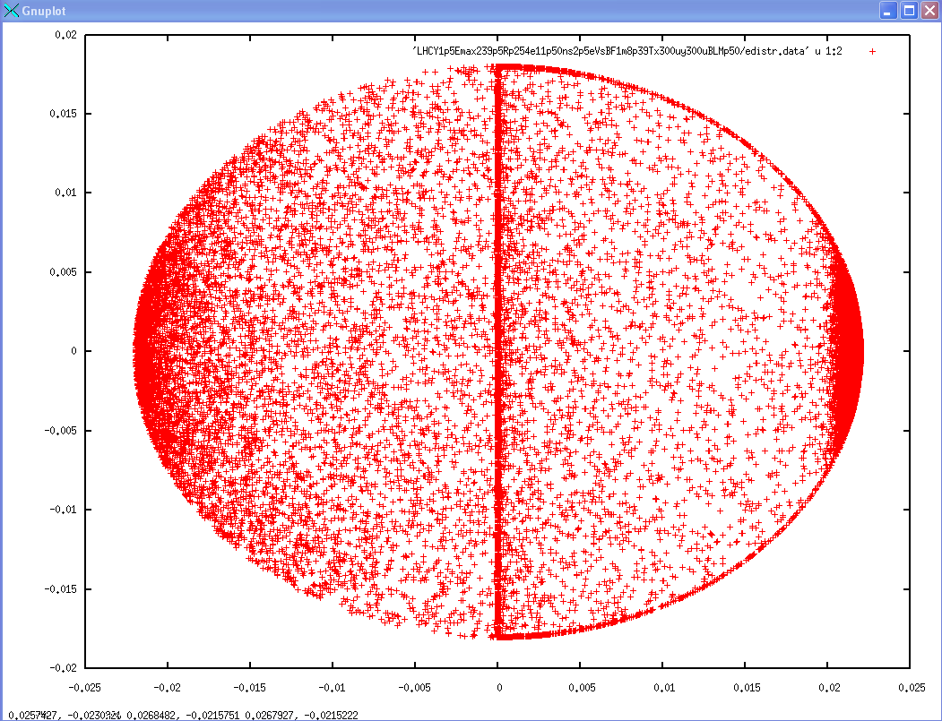
(x,y) e-distribution (Dipoles)
Why this left right
asymmetry?

