Slide 1
Status of SEY-R benchmarking with 25 ns data
C.Octavio Domínguez
Thanks to
G. Bregliozzi, G.Iadarola
28 October 2011 - e⁻ cloud meeting

Slide 2
Outline
MD 14 October
1.1 Vacuum observations overview
1.2 Emittance study
1.3 Pressure study
1.4 Surface parameters benchmarking
1.5 Proposals
2) MD 24/25 october
2.1 Vacuum observations overview
2.2 Batch spacing experiment
28 October 2011 - e⁻ cloud meeting

Slide 3
Outline
MD 14 October
1.1 Vacuum observations overview
1.2 Emittance study
1.3 Pressure study
1.4 Surface parameters benchmarking
1.5 Proposals
2) MD 24/25 October
2.1 Vacuum observations overview
2.2 Batch spacing experiment
28 October 2011 - e⁻ cloud meeting

Slide 4
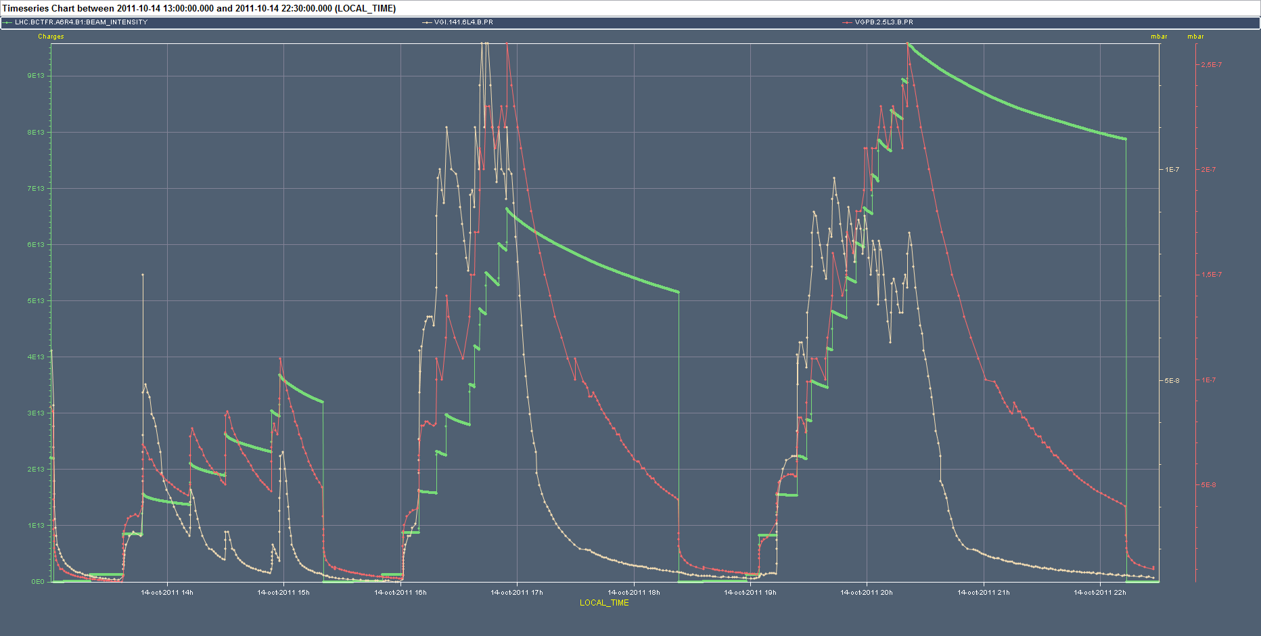
MD 14 October - Vacuum
1
2
6.325 μs
3
4 μs, 3 μs, 2 μs
3.625 μs
“Unexpected” behavior → Too many varying parameters (total current, N_{b} patern along the batch (FBCT), ε growth, … )
28 October 2011 - e⁻ cloud meeting

Slide 5
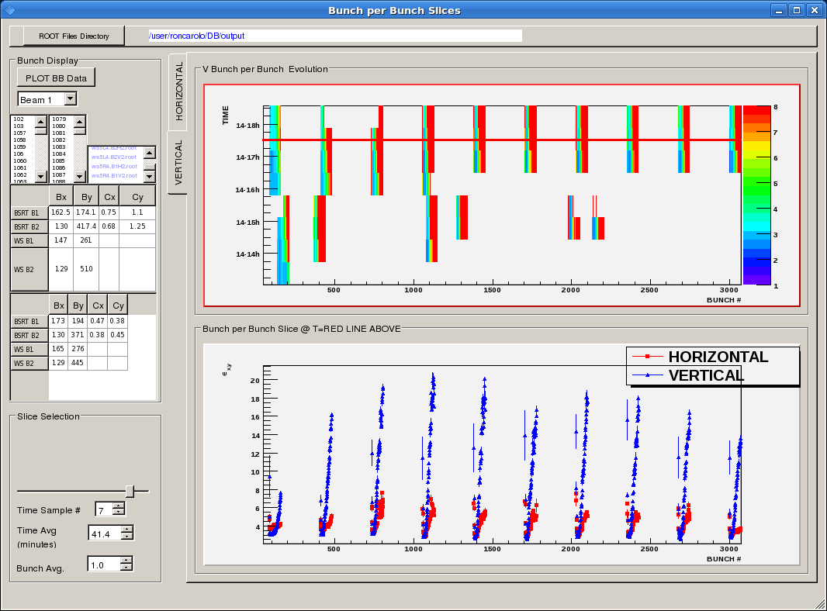
MD 14 October – ε study
28 October 2011 - e⁻ cloud meeting

Slide 6
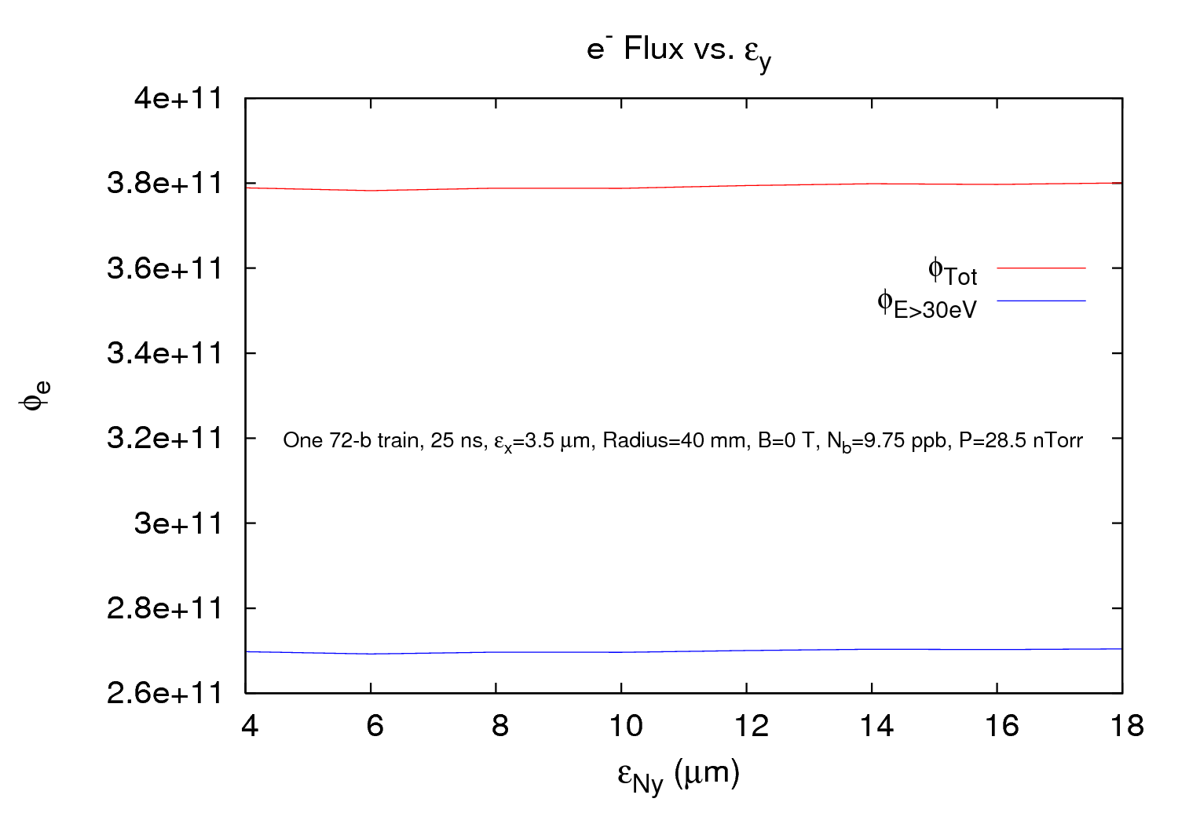
MD 14 October – ε study
Apparently the emittance growth does not have much influence within this big round chamber (Ø=80 mm)
28 October 2011 - e⁻ cloud meeting

Slide 7
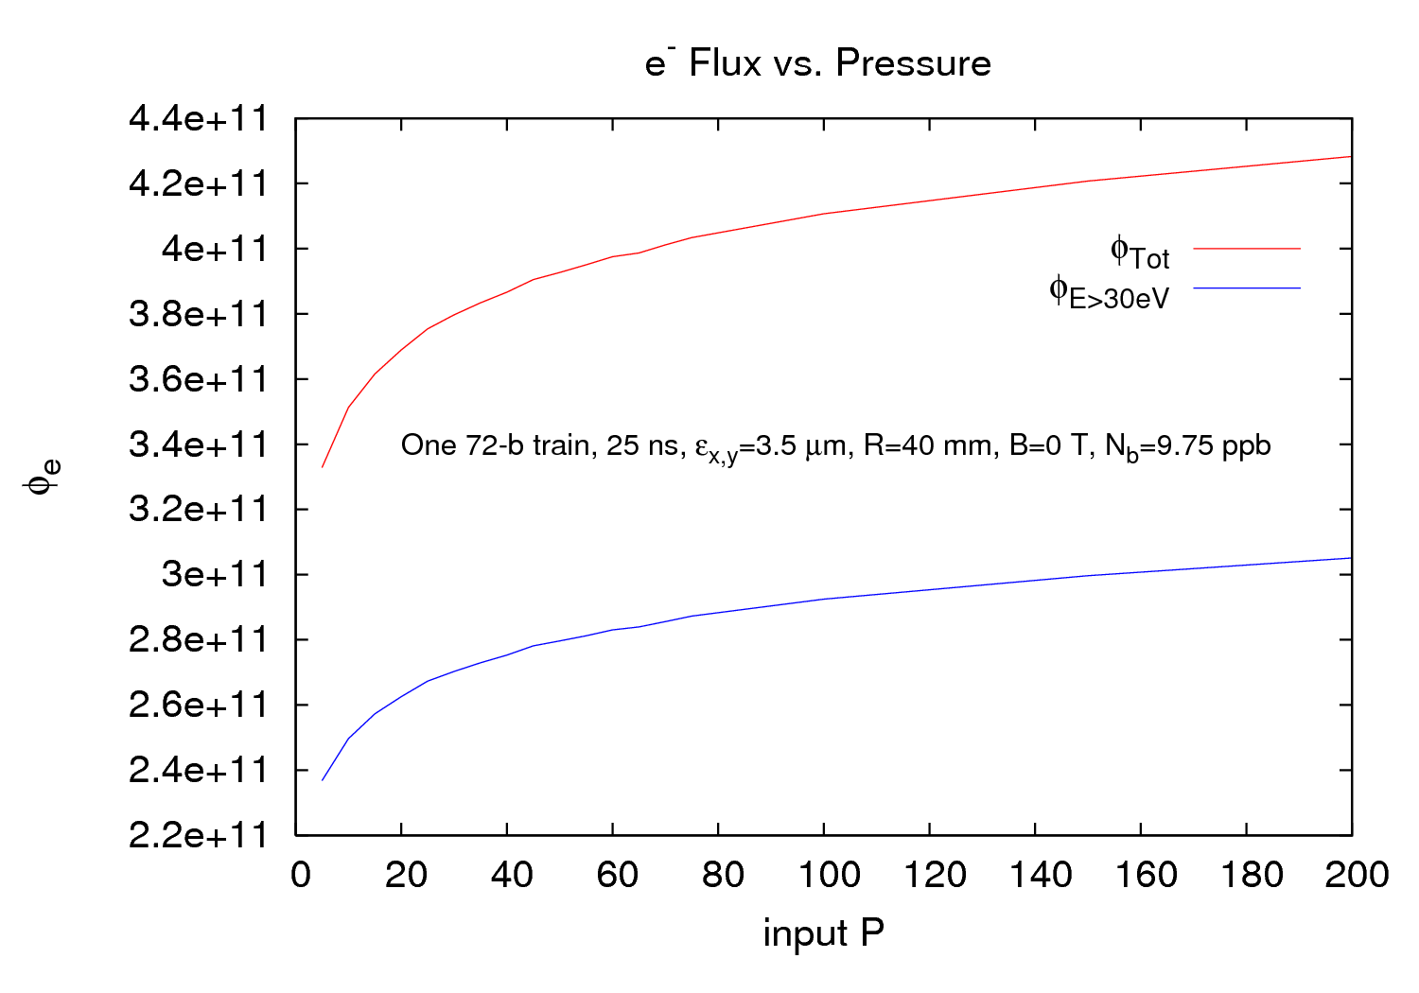
MD 14 October – P study
~30%
~30%
Input pressure is important for simulations and hence for benchmarking surface parameters
28 October 2011 - e⁻ cloud meeting

Slide 8
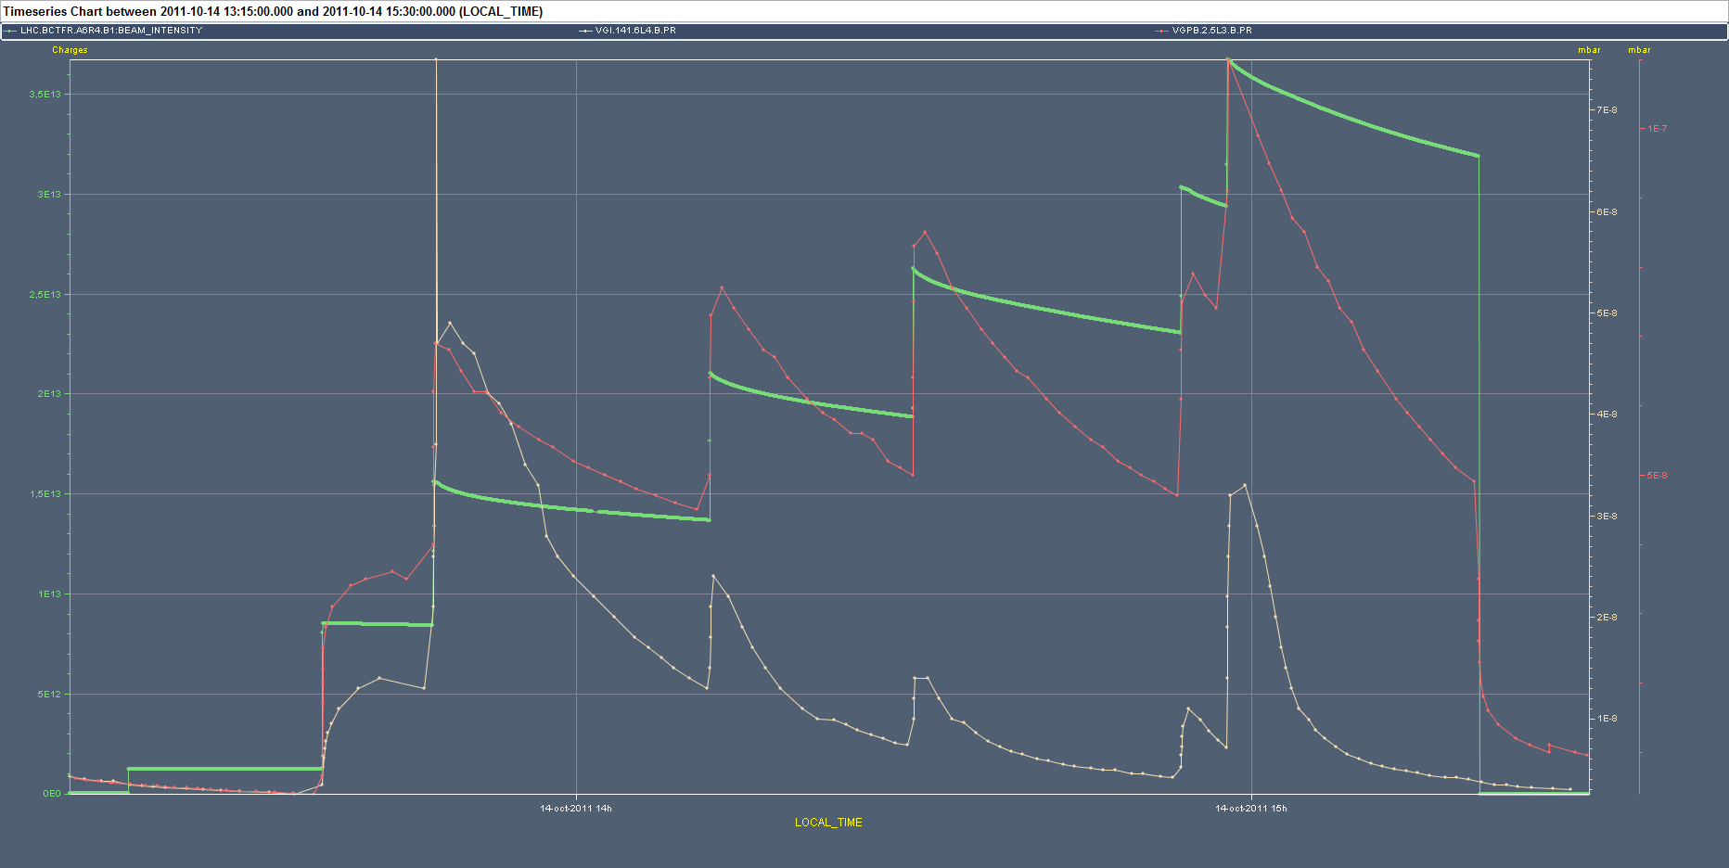
MD 14 October – Benchmarking study
Only VGI.141.6L4.B.PR studied until now
4 μs
Fill 1 → 1 point
28 October 2011 - e⁻ cloud meeting

Slide 9
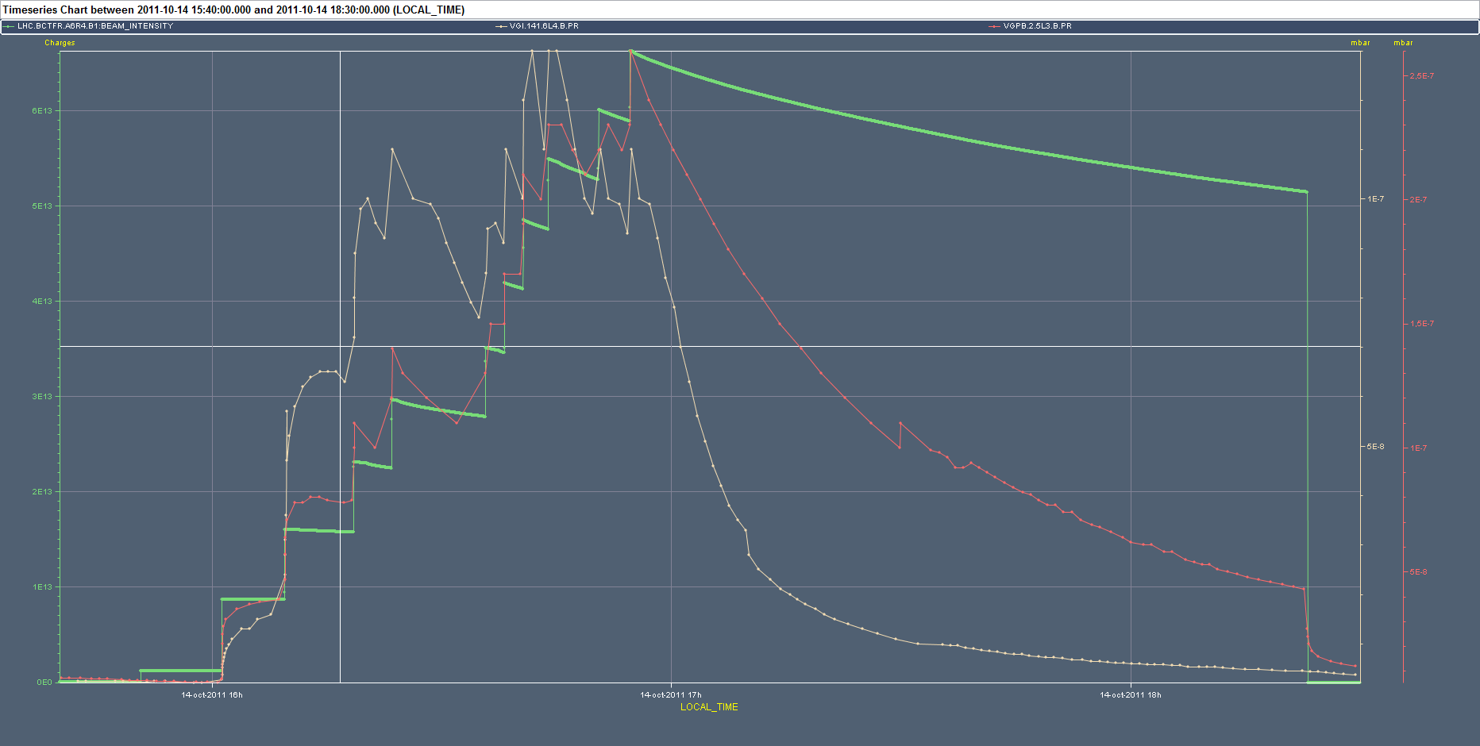
MD 14 October – Benchmarking study
6.325 μs
Fill 2 → 1 point
28 October 2011 - e⁻ cloud meeting

Slide 10
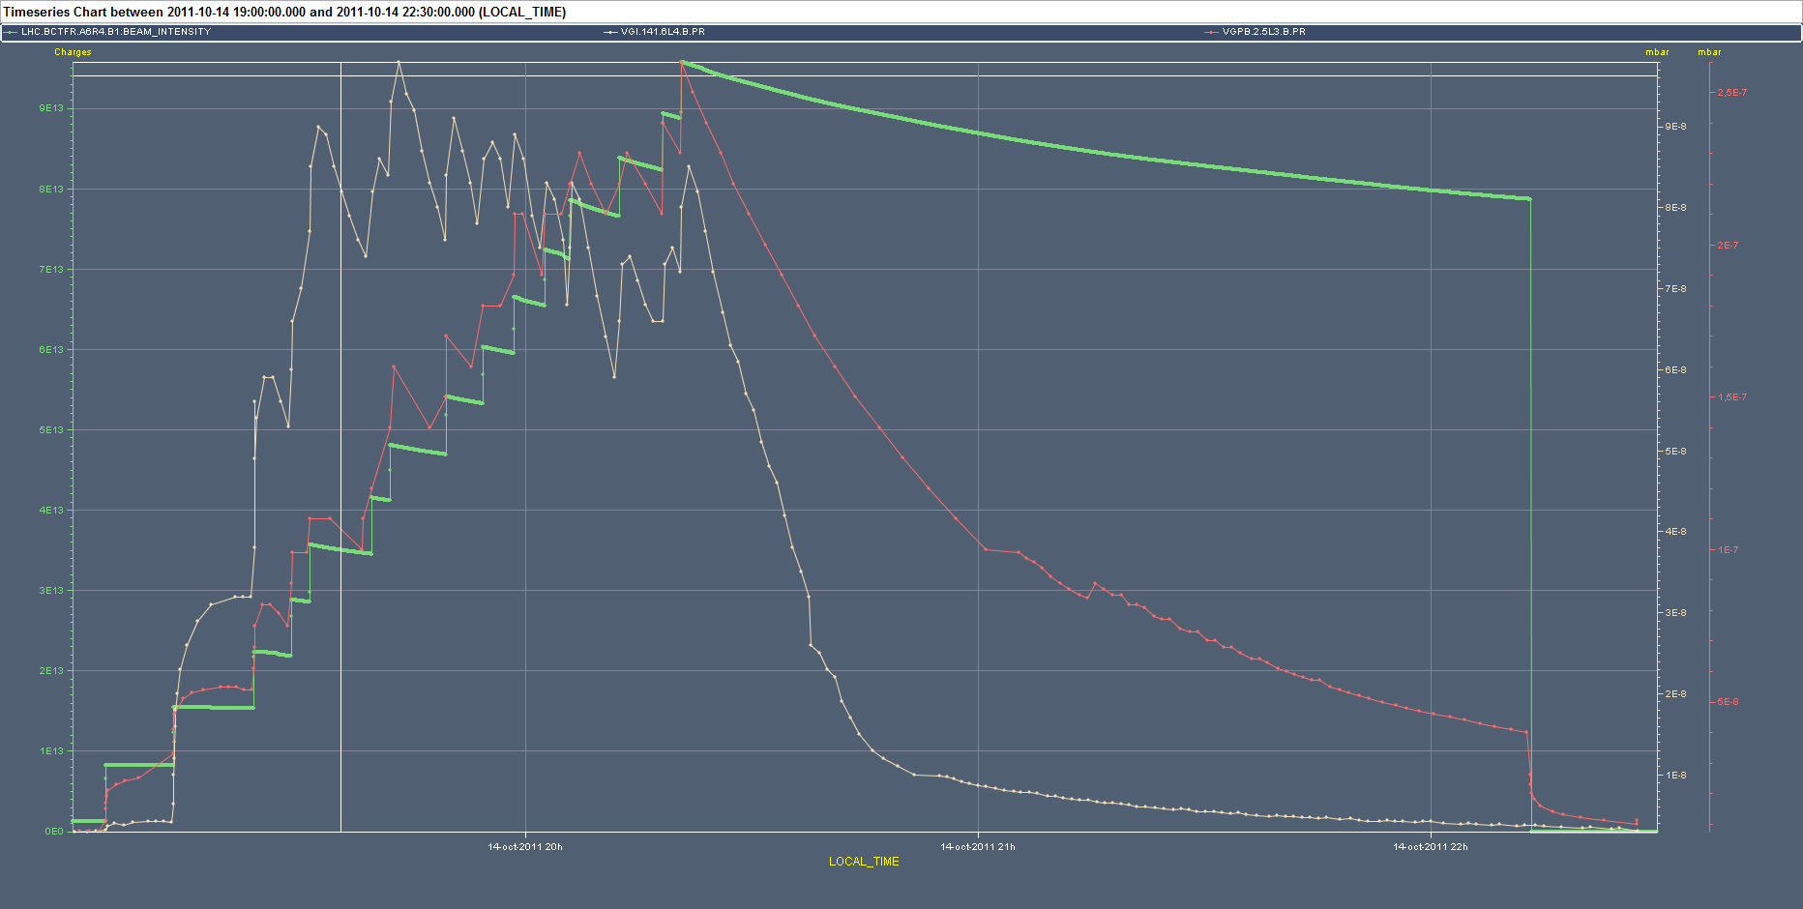
MD 14 October – Benchmarking study
3.625 μs
Fill 3 → 2 points
28 October 2011 - e⁻ cloud meeting

Slide 11
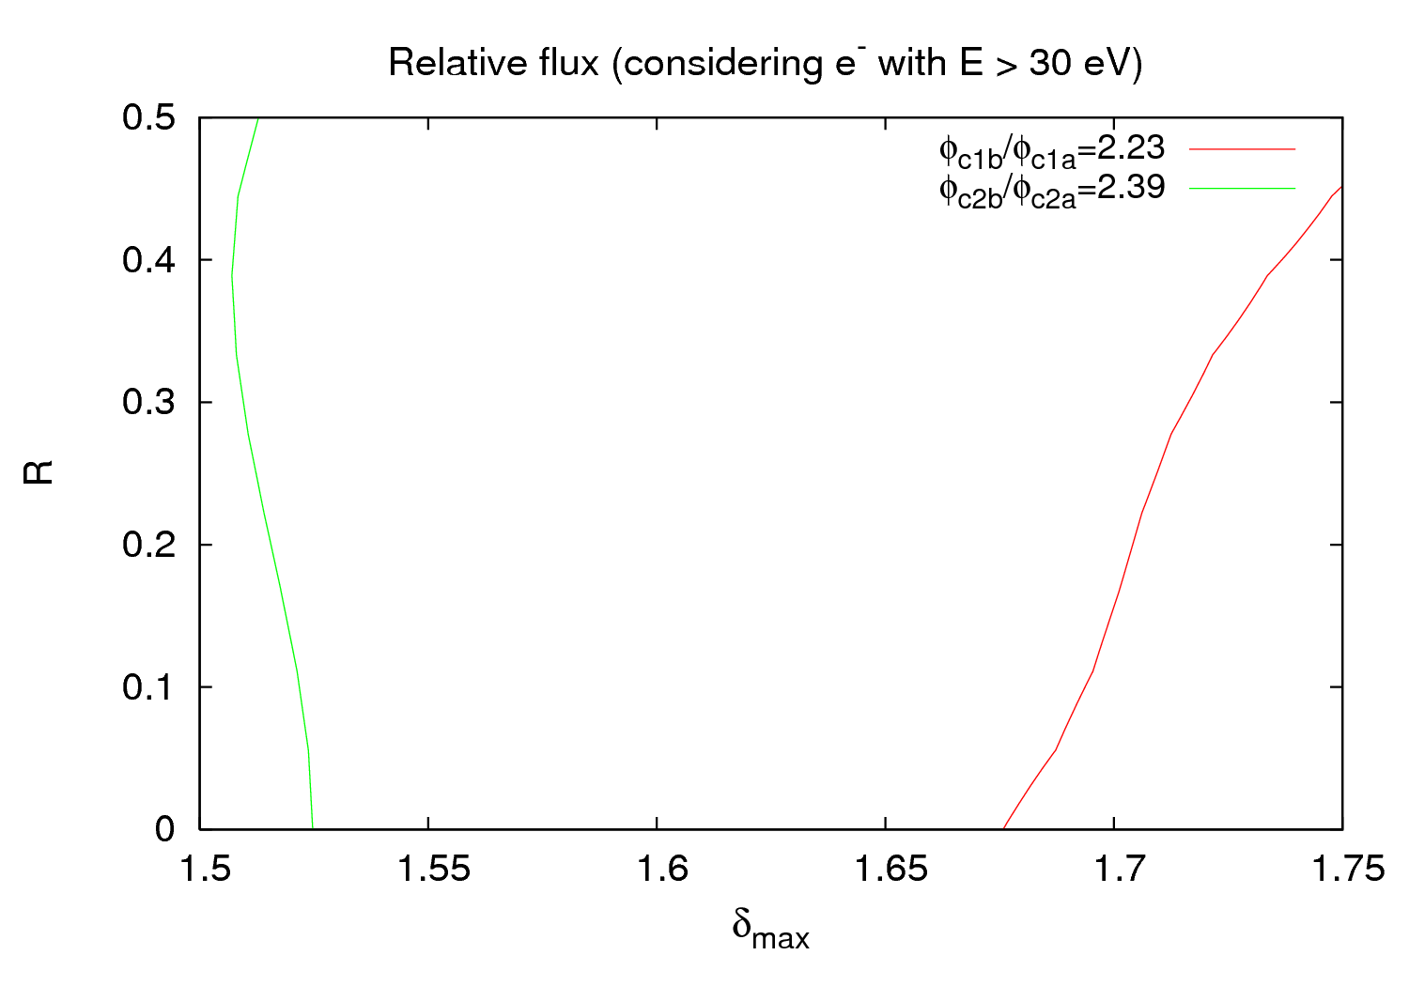
MD 14 October – Benchmarking study
4 points in total
Too many parameters varying
Scrubbing effect (variation of surface parameters during the MD)
No lines were found when using P ratios
When using normalized pressure ratios (P/(total current)) only two lines:
28 October 2011 - e⁻ cloud meeting

Slide 12
MD 14 October – Proposals
Use FBCT structure as an input for different moments of the MD with PyECLOUD (G. Iadarola) to see the effect of the flux with different N_{b} configurations along the batch
Maybe the method is only valid after some scrubbing, i.e. when machine conditions are more stabilized.
28 October 2011 - e⁻ cloud meeting

Slide 13
Outline
MD 14 October
1.1 Vacuum observations overview
1.2 Emittance study
1.3 Pressure study
1.4 Surface parameters benchmarking
1.5 Proposals
2) MD 24/25 october
2.1 Vacuum observations overview
2.2 Batch spacing experiment
28 October 2011 - e⁻ cloud meeting

Slide 14
MD 24 October – Vacuum
3 fills with 72b trains separated by 925 ns:
Fill 1: 17h30 – 20h30
Fill 2: 21h00 – 1h00
Fill 3: 3h45 – 8h20
28 October 2011 - e⁻ cloud meeting

Slide 15
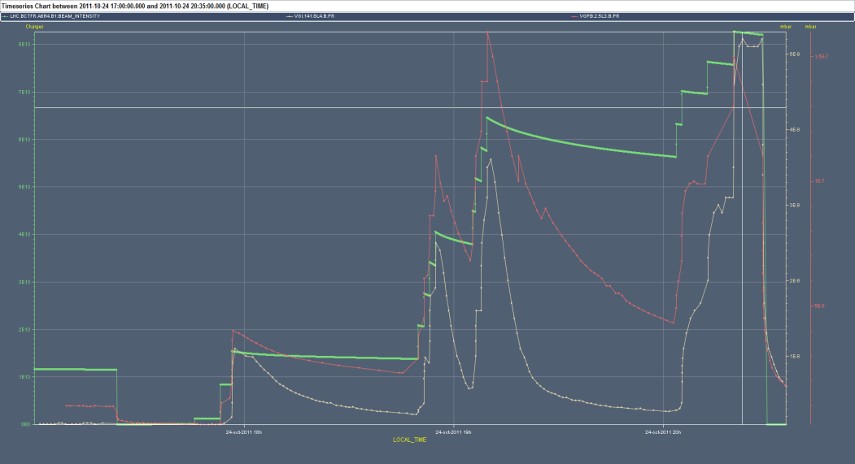
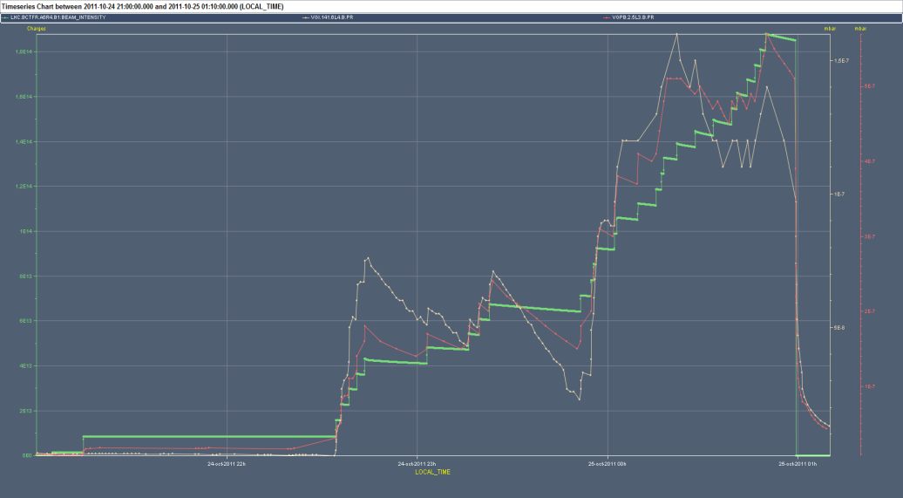
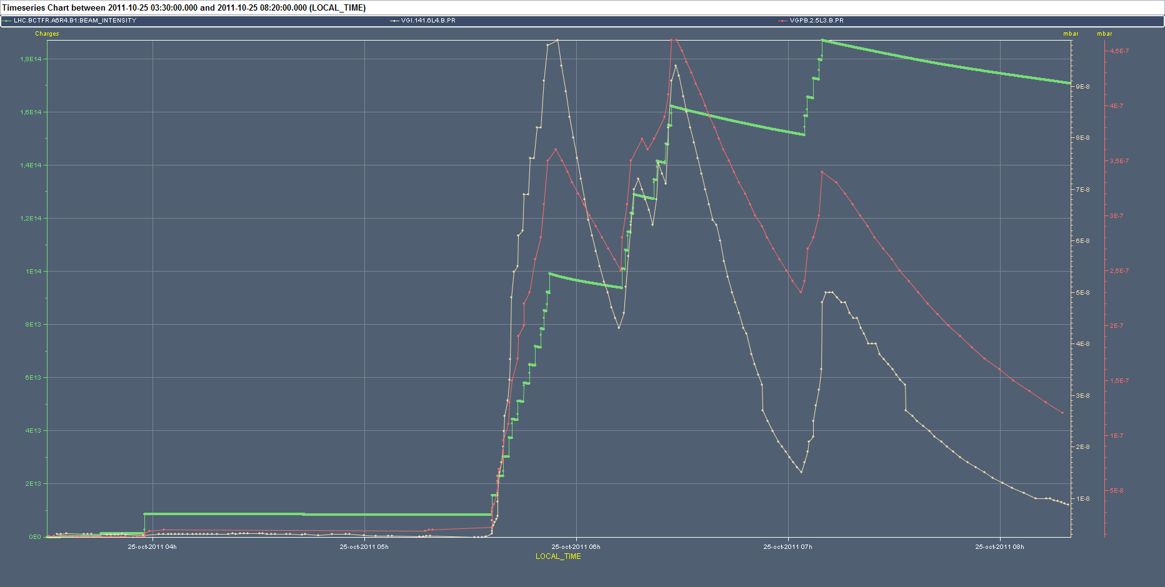
MD 24 October – Vacuum
Fill 1
Fill 2
Fill 3
Same behavior as in previous MD
28 October 2011 - e⁻ cloud meeting

Slide 16
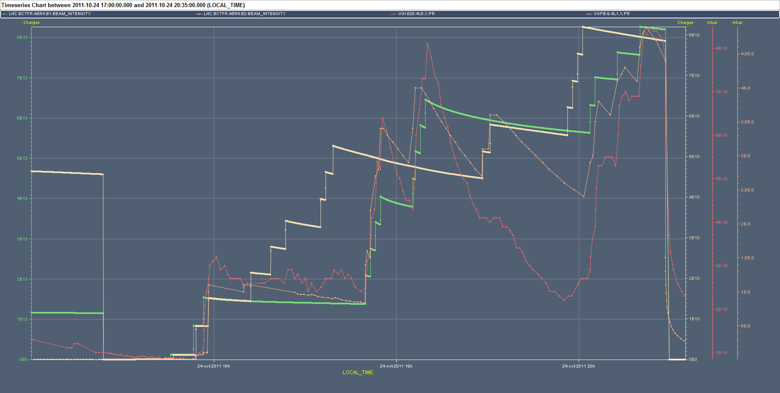
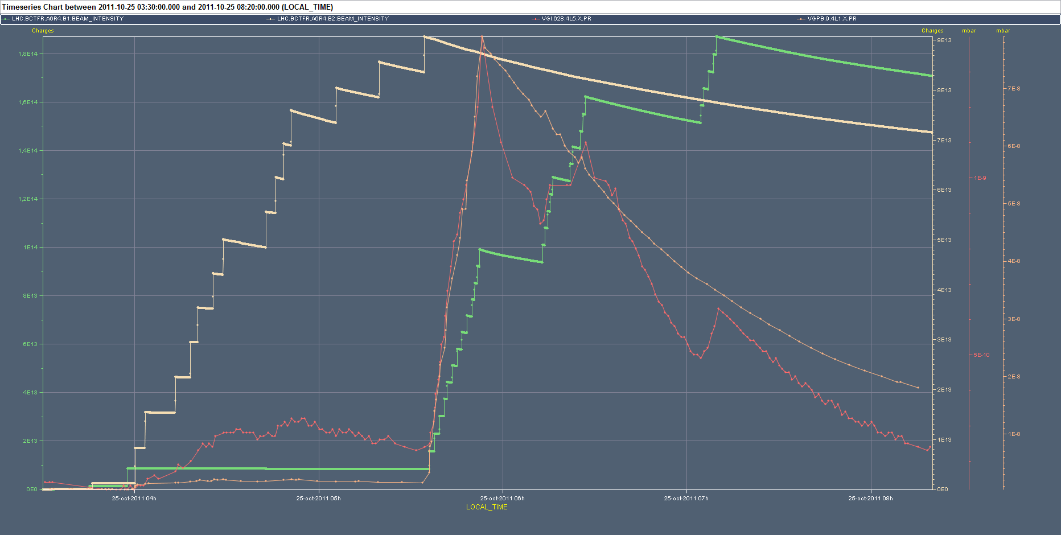
MD 24 October – Vacuum
Fill 1
Fill 3
In the common beam pipes one can observe scrubbing effect in some gauges (for example VGPB.9.4L1.X) → Despite new injections the pressure continues decreasing
28 October 2011 - e⁻ cloud meeting

Slide 17
MD 24 October – Batch spacing experiment
Batch spacing dependence experiment: 9h00 – 9h30
Filling scheme:
The pressure decrease after every injection is not any more observed
Some more time would be good to achieve steady state pressure after every two injections, but the results look quite promising
It is a (relatively) fast measurement
72b
16.5 μs
16.5 μs
16.5 μs
4 μs
3 μs
2 μs
1 μs
28 October 2011 - e⁻ cloud meeting

Slide 18
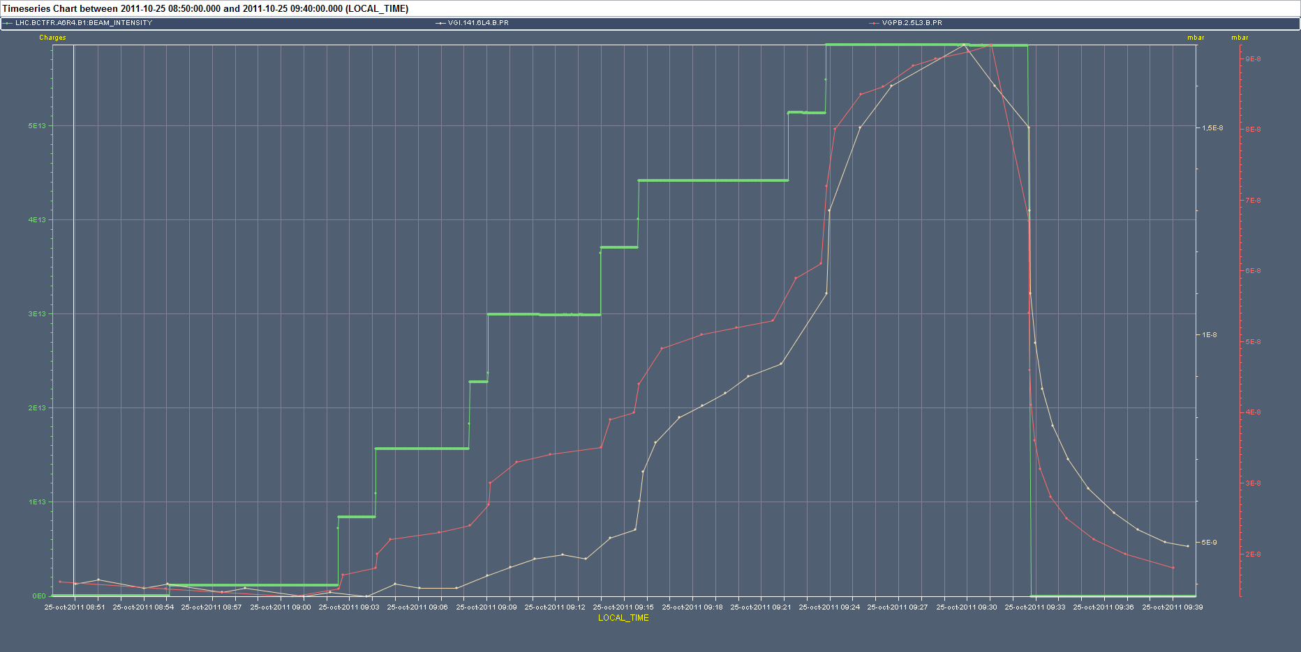
MD 24 October – Batch spacing experiment
1 μs
2 μs
3 μs
4 μs
28 October 2011 - e⁻ cloud meeting

Slide 19
THANK YOU FOR YOUR ATTENTION

