Slide 1
Ecloud simulations for the LHC arcs
E-cloud Simulation Meeting
Humberto Maury Cuna
November 28th, 2011

Slide 2
Outline
Quadrupole heat load oscillations
25-ns heat load benchmarking
Beam pipe radius scan
Gaussian-Flat bunch profile comparison.

Slide 3
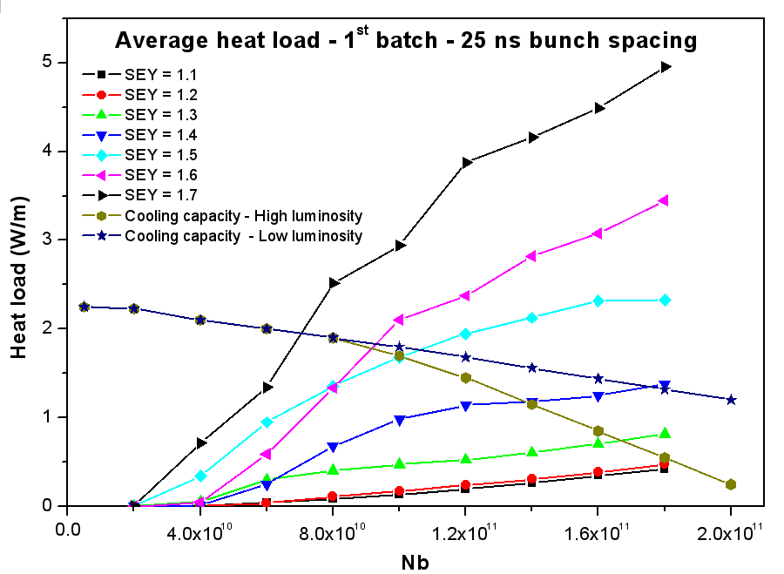

Slide 13
Simulation parameters for 25 ns
Bunch spacing | Bunch intensity | SEY | Reflectivity | Cross section | Energy
25 ns | 1.2 x 10¹¹ p/b | 1.5 - 2.0 | 0.1 – 1.0 | 2 Mbarn | 450 GeV
We used a pressure of 32 nTorr
72bunches
X 3
925ns
nistep = 2500

Slide 15
Simulation parameters for 50 ns – Drift
Bunch spacing | Bunch intensity | SEY | Reflectivity | Fill pattern | Energy
50 ns | 1.15 x 10¹¹ p/b | 1.0 - 2.3 | 0.3 | 1 | 3.5 TeV*
Bunch length | sx, sy | Magnetic field | Radius (mm) | Energy
9 cm | 0.3 mm | 4.195 T | 15 – 300 | 3.5 TeV
* We used a primary photoelectron emission yield =0.0001233
(1)
36bunches
36 bunches
200ns
nistep = 2500

Slide 17
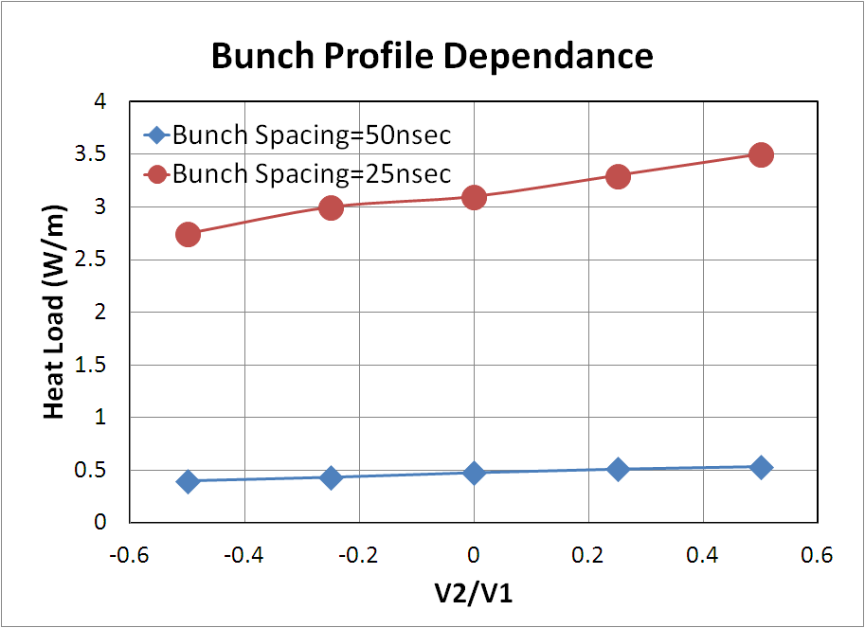
Heat load: Profile Dependence (dipole section)
4E11ppb
Average
BLM
BSM

Slide 18
Gaussian
Flat

Slide 19
Conclusions
Quadrupole oscillations still appear for different simulations parameters and solving routines.
Gaussian-bunch-profile heat load is higher than Flat-bunch-profile heat load.
For R = 0.2, the 25-ns heat load benchmarking gives a SEY ~ 1.8.
The uncertainty in the absolute heat load value is of the order of 10-20%

Slide 20
Thank you for your attention

