Slide 1
Status of SEY-R benchmarking with 25 ns data
O. Domínguez, G. Rumolo
Thanks to
M. Taborelli, C. Yin Vallgren, G. Lanza
28 November 2011 - e⁻ cloud meeting

Slide 2
Outline
Data analysis from MD 25 October 2011
Stainless Steel ε_{max} evolution
In the lab (e⁻ gun)
In the beam pipe
25 ns thresholds and estimation of scrubbing time
Conclusions
28 November 2011 - e⁻ cloud meeting

Slide 3
Outline
Data analysis from MD 25 October 2011
Stainless Steel ε_{max} evolution
In the lab (e⁻ gun)
In the beam pipe
25 ns thresholds and estimation of scrubbing time
Conclusions
28 November 2011 - e⁻ cloud meeting

Slide 4
MD 25/10/2011
As a reminder….
Batch spacing dependence experiment: 9h00 – 9h30
Filling scheme:
The pressure decrease after every injection is not any more observed
Some more time would be good to achieve steady state pressure after every two injections, but the results look quite promising
It is a (relatively) fast measurement
72b
16.5 μs
16.5 μs
16.5 μs
4 μs
3 μs
2 μs
1 μs
28 November 2011 - e⁻ cloud meeting

Slide 5
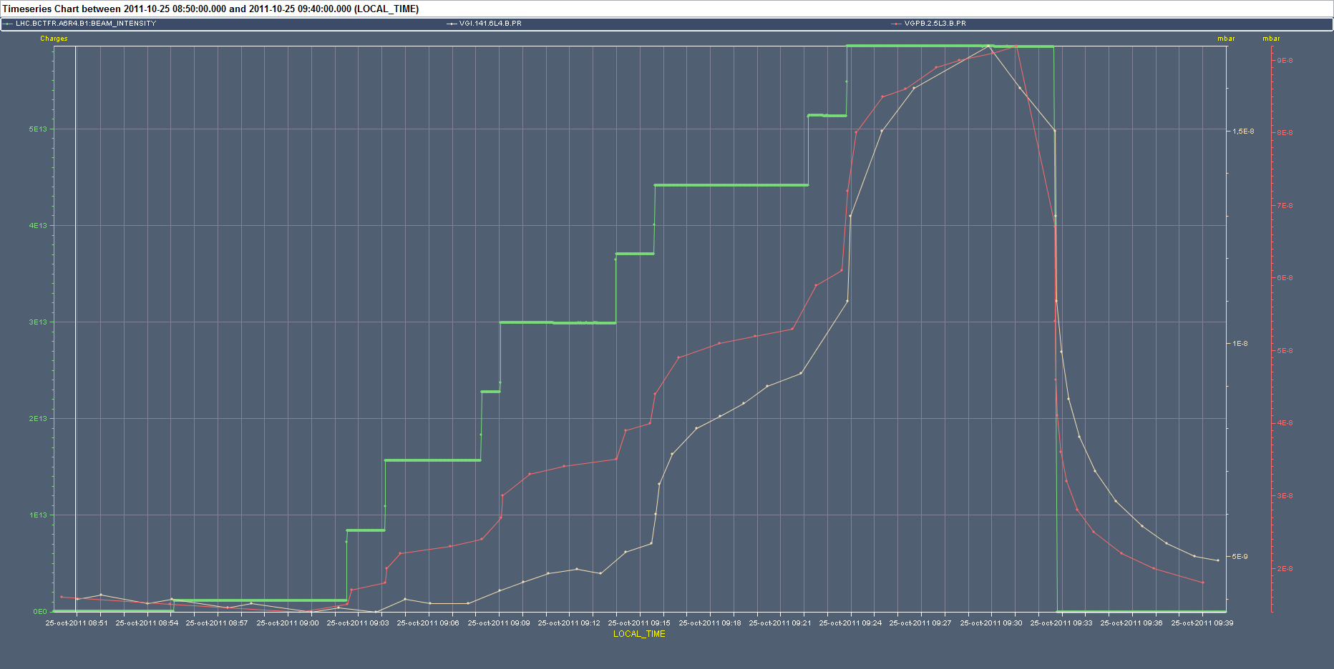
MD 25/10/2011
As a reminder….
1 μs
2 μs
3 μs
4 μs
28 November 2011 - e⁻ cloud meeting

Slide 6
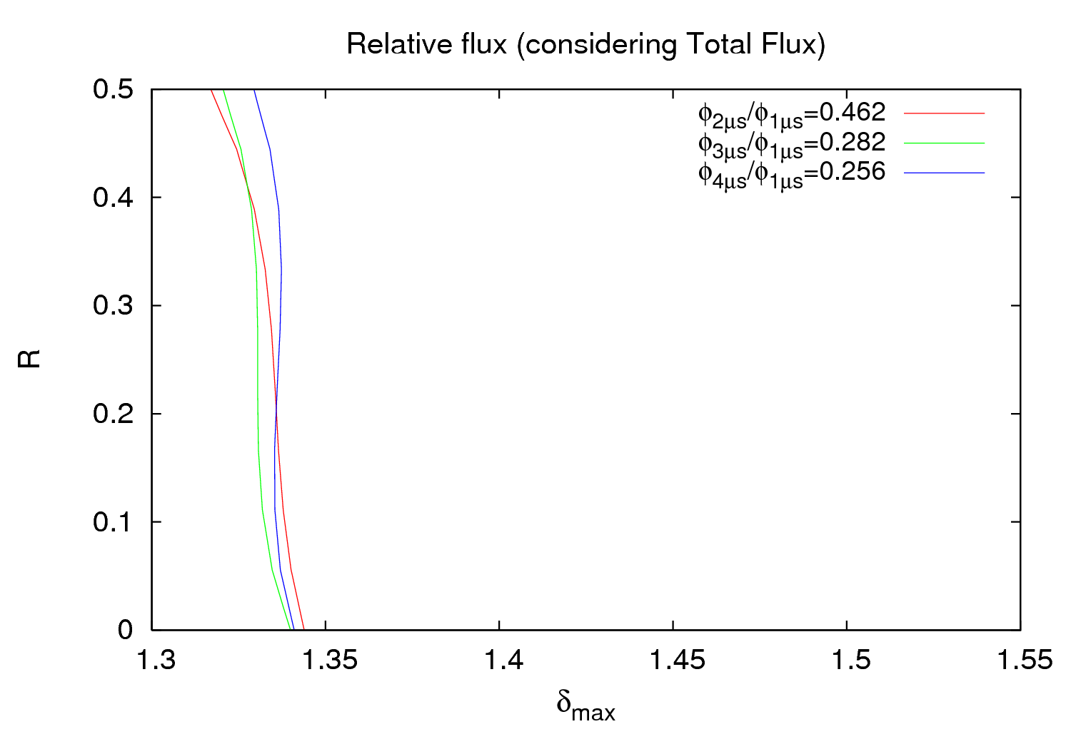
MD 25/10/2011
Gauge VGPB.2.5L3.B
ε_{max} = 230 eV
28 November 2011 - e⁻ cloud meeting

Slide 7
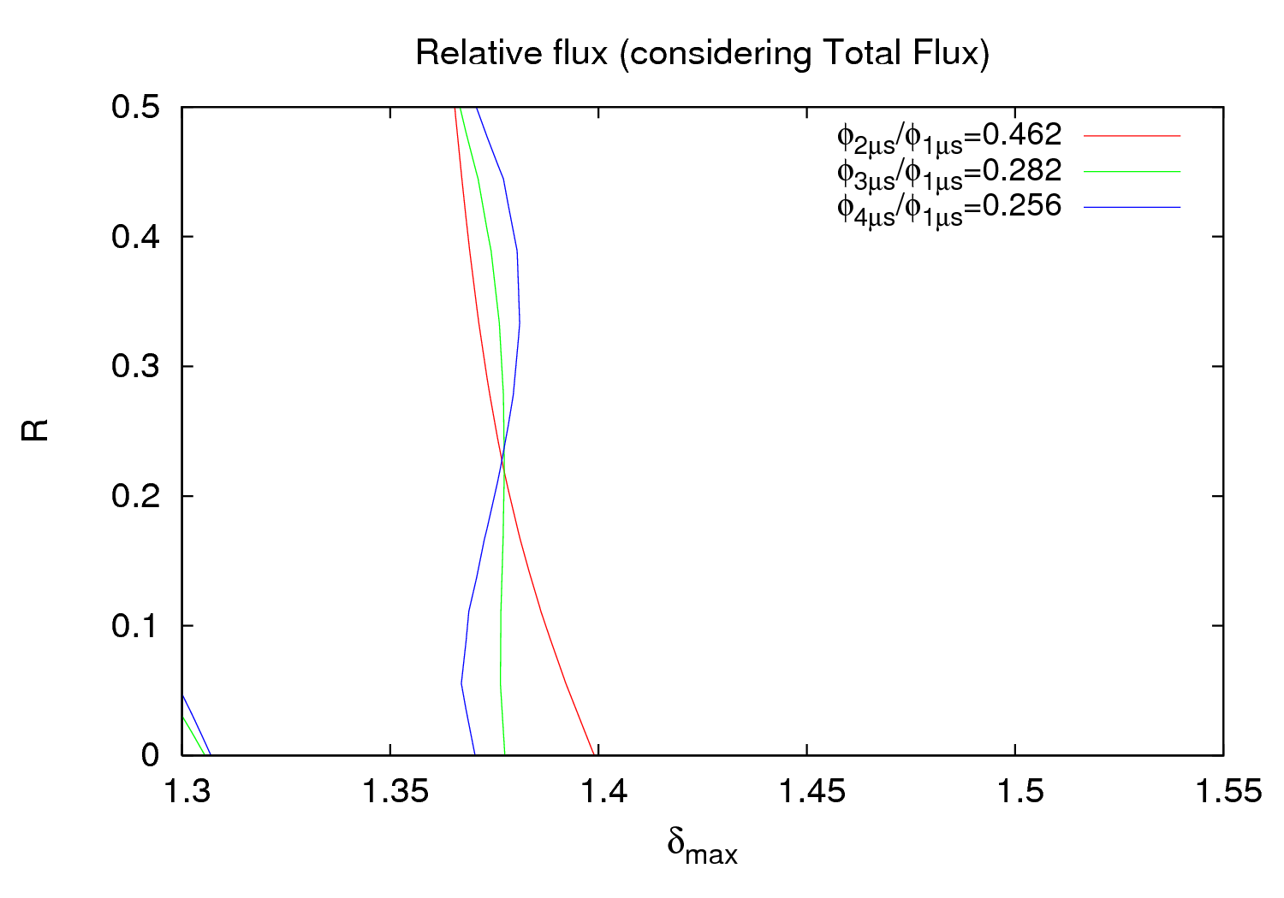
MD 25/10/2011
Gauge VGPB.2.5L3.B
ε_{max} = 260 eV
28 November 2011 - e⁻ cloud meeting

Slide 8
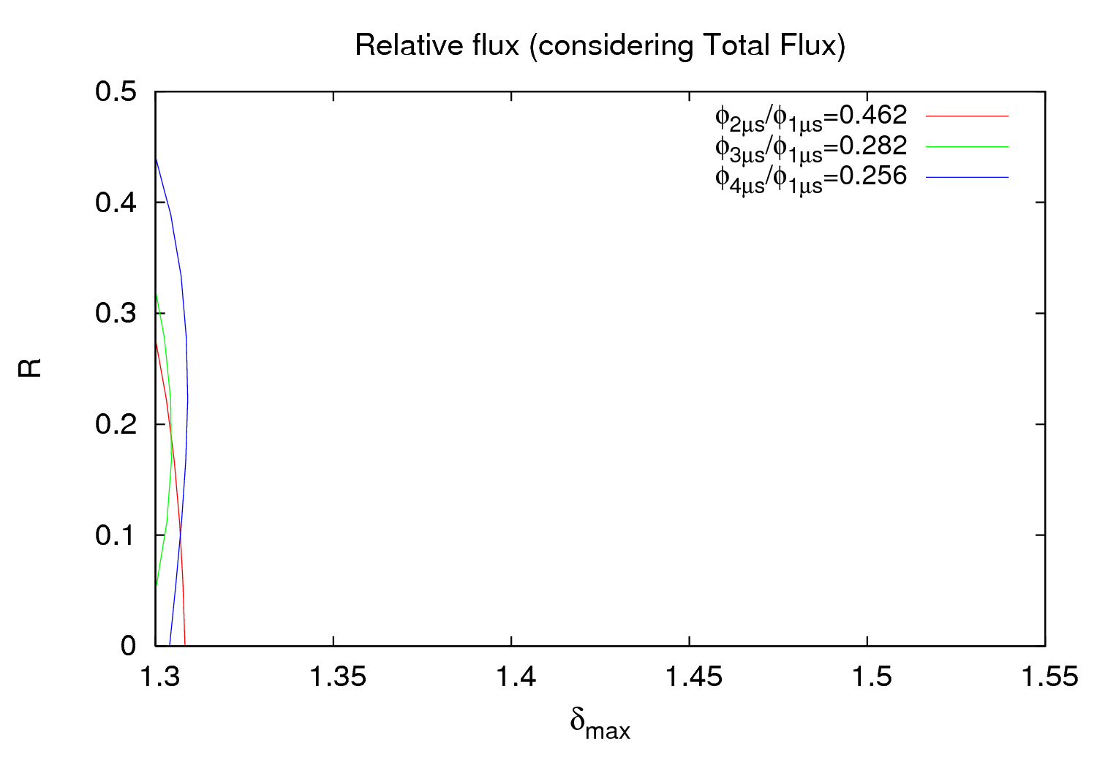
MD 25/10/2011
Gauge VGPB.2.5L3.B
ε_{max} = 200 eV
28 November 2011 - e⁻ cloud meeting

Slide 9
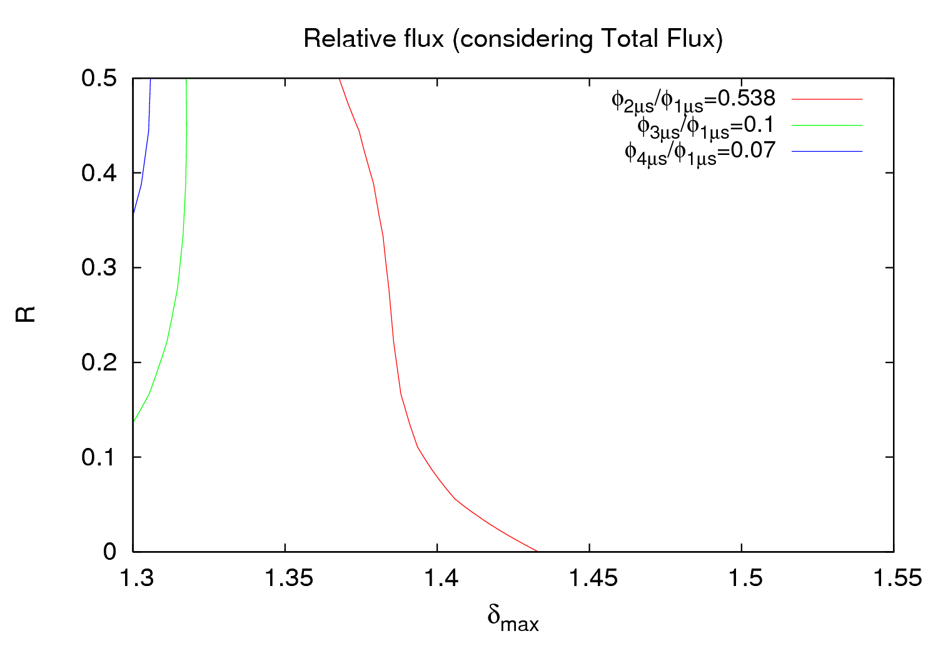
MD 25/10/2011
Unfortunately no agreement is found for the gauge VGI.141.6L4.B
Actually this should be 0.025
Different values of ε_{max} just move the lines to the right or to the left
This can be caused by the indeed worse fit surfaces (the lower the pressure, the worse is generally the fit)
The good point is that the lines are not found when exploring higher δ_{max} values, i.e. This should be the area where one should find the right value
28 November 2011 - e⁻ cloud meeting

Slide 10
Outline
Data analysis from MD 25 October 2011
Stainless Steel ε_{max} evolution
In the lab (e⁻ gun)
In the beam pipe
25 ns thresholds and estimation of scrubbing time
Conclusions
28 November 2011 - e⁻ cloud meeting

Slide 11
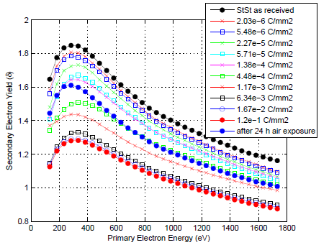
ε_{max} evolution
ε_{max} apparently evolves in a different way depending on the experiment
In the lab (e⁻ gun)
ε_{max} doesn’t change much
This slight change is an increase
StSt as received: ε_{max} ≈ 282 eV (normally I have used 230 eV for all my simulations)
Cu shows a similar behavior (with ε_{max} ≈ 332 eV as received)
C. Yin Vallgren
28 November 2011 - e⁻ cloud meeting

Slide 12
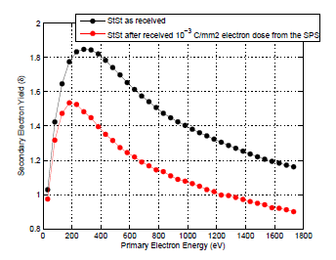
ε_{max} evolution
ε_{max} apparently evolves in a different way depending on the experiment
In the beam pipe (scrubbing)
ε_{max} change is more significant
This change shows a reduction (from ~282 eV to ~200 eV)
There aren’t many experimental data for StSt
Cu shows a similar behavior (there are more experimental data with beam)
C. Yin Vallgren
28 November 2011 - e⁻ cloud meeting

Slide 13
Outline
Data analysis from MD 25 October 2011
Stainless Steel ε_{max} evolution
In the lab (e⁻ gun)
In the beam pipe
25 ns thresholds and estimation of scrubbing time
Conclusions
28 November 2011 - e⁻ cloud meeting

Slide 14
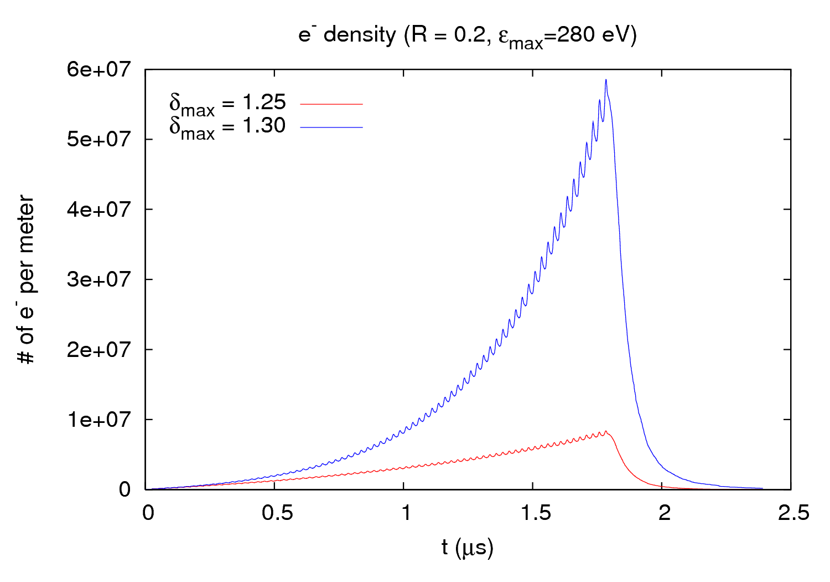
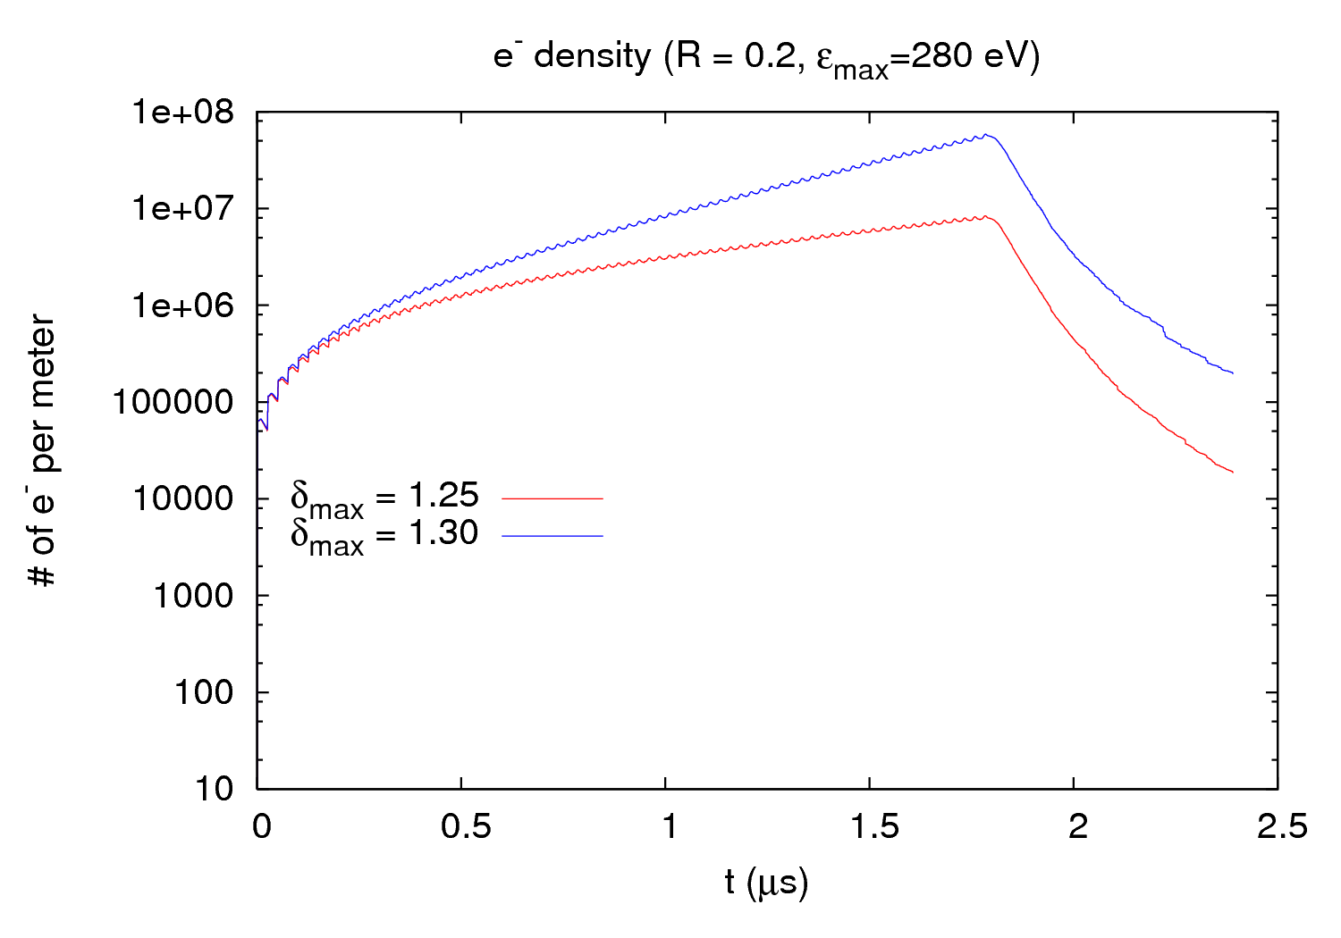
25 ns thresholds
The thresholds are the same for both gauges explored
ε_{max} (eV) | Threshold (R=0.2) | Threshold (R=0.3) | Threshold (R=0.4)
180 | 1,2 | 1,2 | 1,15/1,2
230 | 1,25 | 1,25 | 1,2/1,25
280 | 1,3 | 1,3 | 1,25/1,3
28 November 2011 - e⁻ cloud meeting

Slide 15
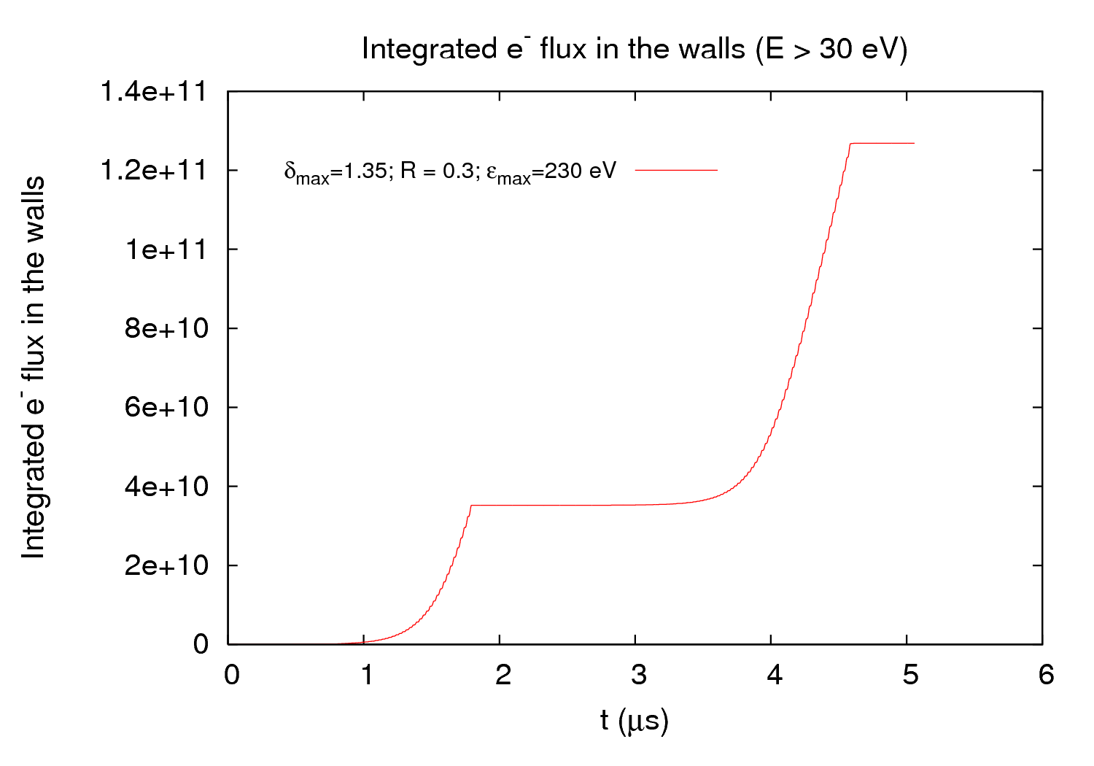
Estimation of scrubbing time
(Rough) Estimation of the scrubbing time
I consider results from the last MD (25 October): R=[0.2, 0.4] and δ_{max}=[1.3, 1.4]
I consider the configuration with bunches separated by 1 μs
I calculate the # of e⁻ impinging the wall after the passage of 1 and 2 batches, take the difference and multiply by 2 (if the machine is filled in, that will be more realistic):
I integrate this amount by the corresponding time (~ 5 μs) and multiply by e
I consider an estimate dose from C. Yin Vallgren plots and divide it by the previous number
x2
28 November 2011 - e⁻ cloud meeting

Slide 16
Estimation of scrubbing time
Lab (e⁻ gun)
SPS (scrubbing)
Is there a scrubbing limit for StSt at δ_{max}≈ 1.25 ??
C. Yin Vallgren
ε_{max} = 230 eV ; Dose = 1.67 ∙ 10⁻² C/mm² – Threshold δ_{max} ≈ 1.25
δ_{max} | 1.3 | 1.3 | 1.3 | 1.35 | 1.35 | 1.35 | 1.4 | 1.4 | 1.4
R | 0.2 | 0.3 | 0.4 | 0.2 | 0.3 | 0.4 | 0.2 | 0.3 | 0.4
t₁ (~days) | 38 | 23 | 15 | 11 | 8 | 7 | 6 | 5 | 5
t₂ (~days) | 230 | 70 | 30 | 11 | 9 | 8 | 6 | 5 | 5
t₁ = Time necessary to scrubb until threshold for VGPB.2.5L3.B
t₂ = Time necessary to scrubb until threshold for VGI.141.6L4.B (assuming same initial condtions as for VGPB.2.5L3.B)
28 November 2011 - e⁻ cloud meeting

Slide 17
Estimation of scrubbing time
Lab (e⁻ gun)
SPS (scrubbing)
Is there a scrubbing limit for StSt at δ_{max}≈ 1.25 ??
C. Yin Vallgren
ε_{max} = 260 eV ; Dose = 7.5 ∙ 10⁻³ C/mm² – Threshold δ_{max} ≈ 1.3
δ_{max} | 1.3 | 1.3 | 1.3 | 1.35 | 1.35 | 1.35 | 1.4 | 1.4 | 1.4
R | 0.2 | 0.3 | 0.4 | 0.2 | 0.3 | 0.4 | 0.2 | 0.3 | 0.4
t₁ (~days) | 190 | 115 | 50 | 14 | 8 | 5 | 5 | 4 | 3
t₂ (~days) | 1000 | 600 | 300 | 31 | 15 | 8 | 5 | 4 | 3
t₁ = Time necessary to scrubb until threshold for VGPB.2.5L3.B
t₂ = Time necessary to scrubb until threshold for VGI.141.6L4.B (assuming same initial condtions as for VGPB.2.5L3.B)
28 November 2011 - e⁻ cloud meeting

Slide 18
Estimation of scrubbing time
Lab (e⁻ gun)
SPS (scrubbing)
C. Yin Vallgren
Can we conclude that the scrubbing takes longer (~twice?) in the machine??
28 November 2011 - e⁻ cloud meeting

Slide 19
Outline
Data analysis from MD 25 October 2011
Stainless Steel ε_{max} evolution
In the lab (e⁻ gun)
In the beam pipe
25 ns thresholds and estimation of scrubbing time
Conclusions
28 November 2011 - e⁻ cloud meeting

Slide 20
Conclusions
New scrubbing status results have been shown: R=[0.2, 0.4] and δ_{max}=[1.3, 1.4]
No agreement was found for gauge VGI.141.6L4.B, possibly due to worse fitting functions This point must be further studied
Evolution of ε_{max} has been shown in different situations (lab and beam pipe)
It could be interesting to revise all previous benchmarking results for different ε_{max} values (e.g. 280 eV)
Thresholds for 25 ns has been pointed out for different ε_{max} values
A rough estimation for the time necessary to scrubb until threshold values has been given
28 November 2011 - e⁻ cloud meeting

Slide 21
THANK YOU FOR YOUR ATTENTION

