Slide 1
LHC Scrubbing-run benchmarking
(An Update)
C.Octavio Domínguez, Frank Zimmermann
28th July 2011 - e⁻ cloud meeting

Slide 2

Outline
6th April
1.1 ΔP vs. batch spacing
1.2 ΔP vs. # of batches in the machine
2) 10th - 11th April
2.1 ΔP vs. # of “double trains” (36+225 ns+36+4.850 μs)
3) 19th May
3.1 ΔP vs. # of “triple trains” (36+225 ns+36+225 ns+36+925 ns)
4) Right seed pressure for simulations
28th July 2011 - e⁻ cloud meeting

Slide 3
Outline
6th April
1.1 ΔP vs. batch spacing
1.2 ΔP vs. # of batches in the machine
2) 10th - 11th April
2.1 ΔP vs. # of “double trains” (36+225 ns+36+4.850 μs)
3) 19th May
3.1 ΔP vs. # of “triple trains” (36+225 ns+36+225 ns+36+925 ns)
4) Right seed pressure for simulations
28th July 2011 - e⁻ cloud meeting

Slide 4
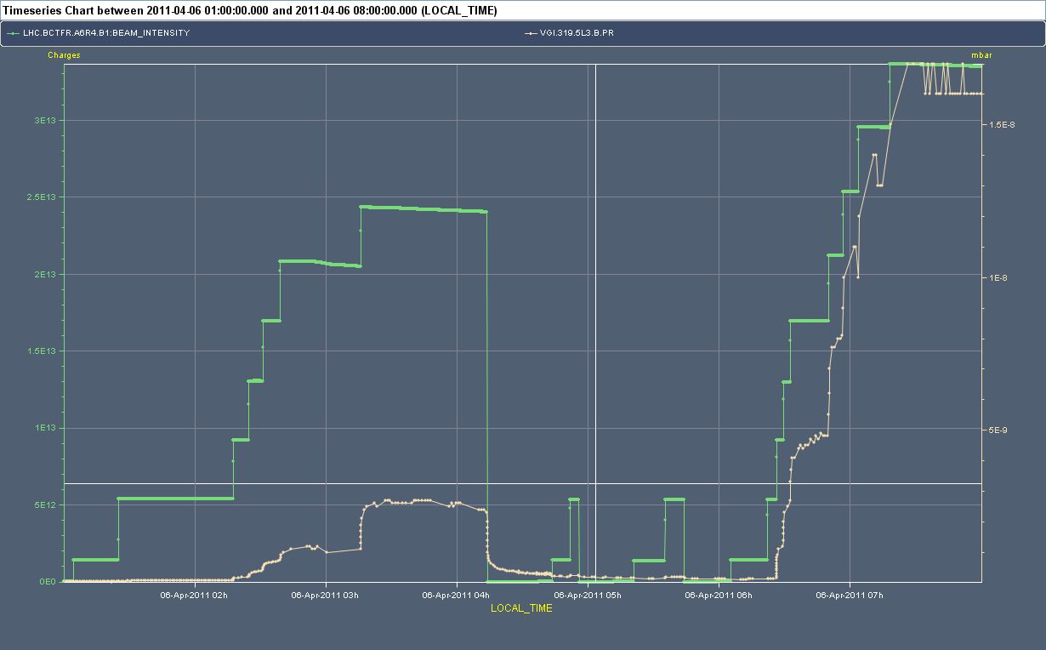
Night overview
ΔP₁ > ΔP₂
2μs
4μs
6μs
2μs
ΔP₁
ΔP₂
28th July 2011 - e⁻ cloud meeting

Slide 5
Night overview
(I use 2.15 μs in ECLOUD)
2μs
2.125μs!!!
4μs
6μs
ΔP₁
ΔP₂
28th July 2011 - e⁻ cloud meeting

Slide 6
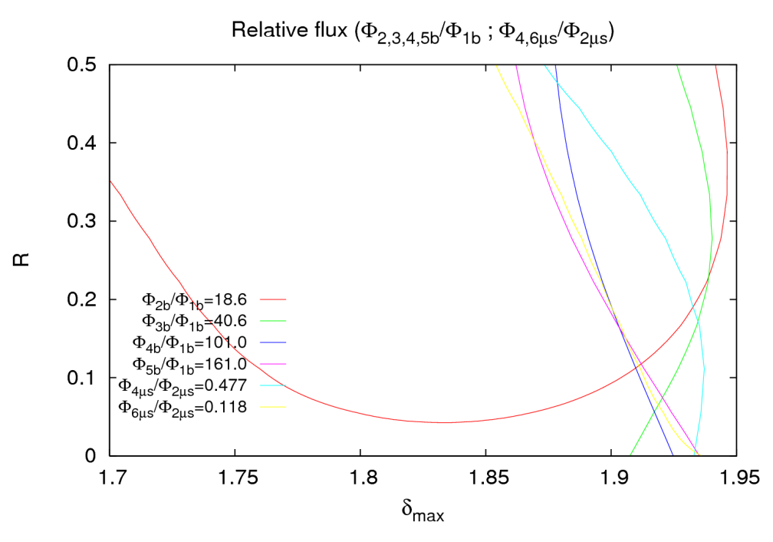
Result
But let’s talk a bit about how to define the right ratios…
28th July 2011 - e⁻ cloud meeting

Slide 7
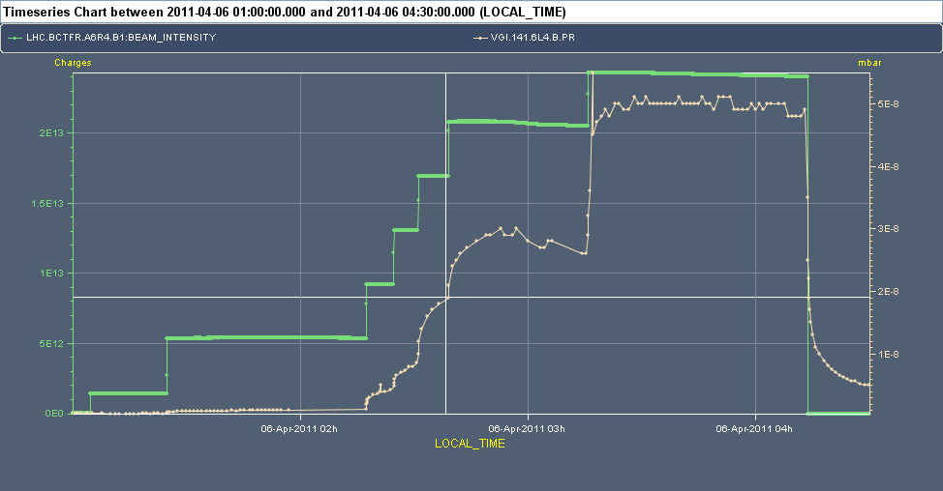
ΔP vs. batch spacing
6/April/2011 – First experiment – Variation of the batch spacing (6, 4 and 2 μs)
28th July 2011 - e⁻ cloud meeting

Slide 8
ΔP vs. batch spacing
6/April/2011 – First experiment – Variation of the batch spacing (6, 4 and 2 μs)
2 μs
11.5 μs
4 μs
11.5 μs
6 μs
28th July 2011 - e⁻ cloud meeting

Slide 9
ΔP vs. batch spacing
6/April/2011 – First experiment – Variation of the batch spacing (6, 4 and 2 μs)
4 μs
2 μs
6 μs
28th July 2011 - e⁻ cloud meeting

Slide 10
ΔP vs. batch spacing
6/April/2011 – First experiment – Variation of the batch spacing (6, 4 and 2 μs)
4 μs
2 μs
P₂
6 μs
P₄
P₆
P₀
28th July 2011 - e⁻ cloud meeting

Slide 11
ΔP vs. batch spacing
6/April/2011 – First experiment – Variation of the batch spacing (6, 4 and 2 μs)
4 μs
2 μs
P₂
ΔP₂
6 μs
P₄
ΔP₄
P₆
ΔP₆
P₀
28th July 2011 - e⁻ cloud meeting

Slide 12
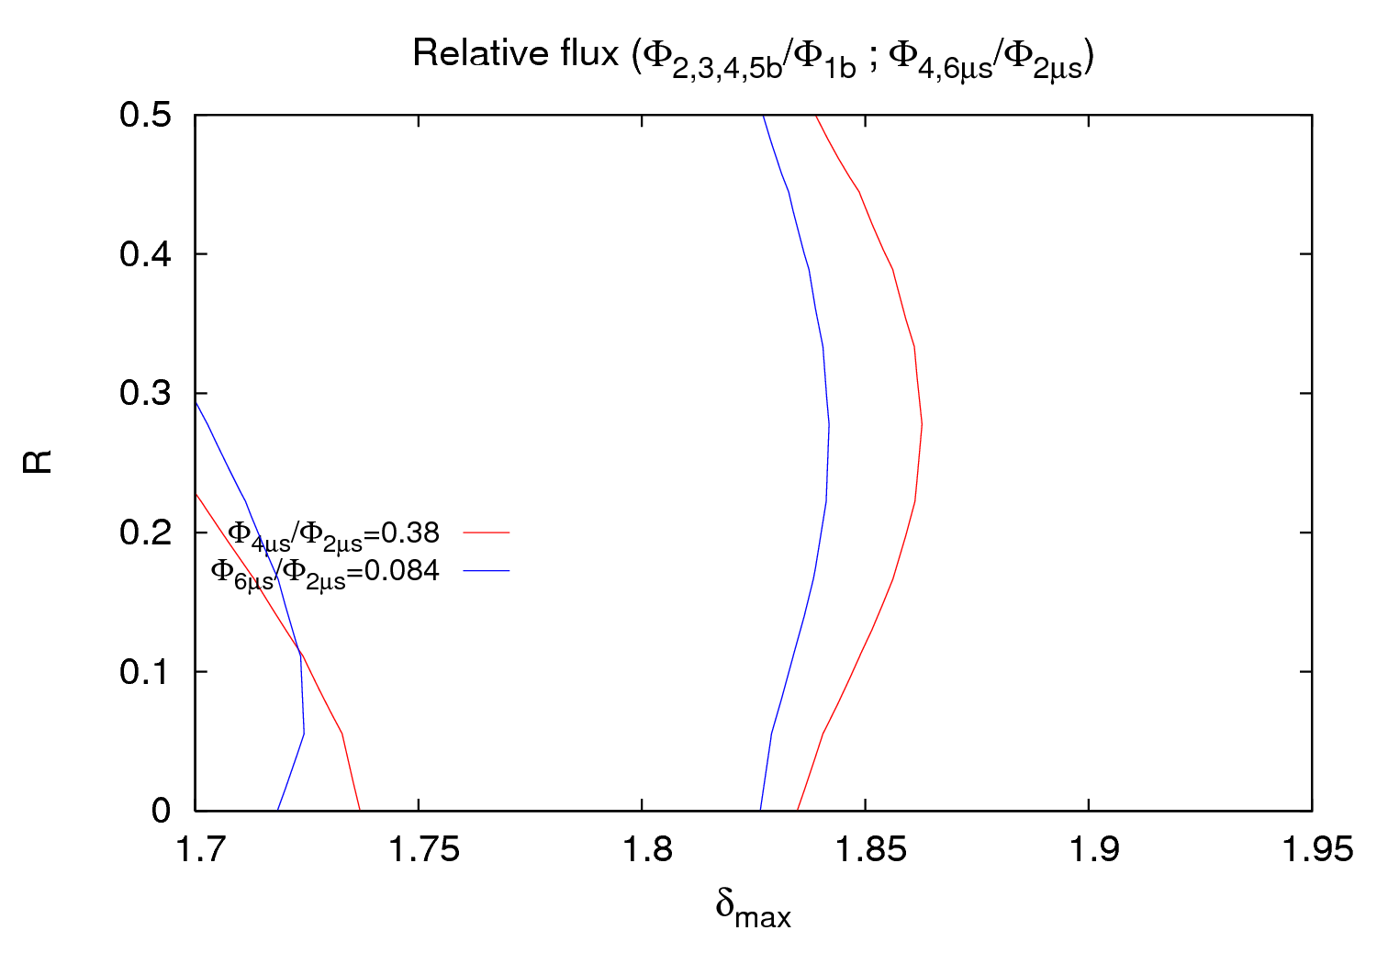
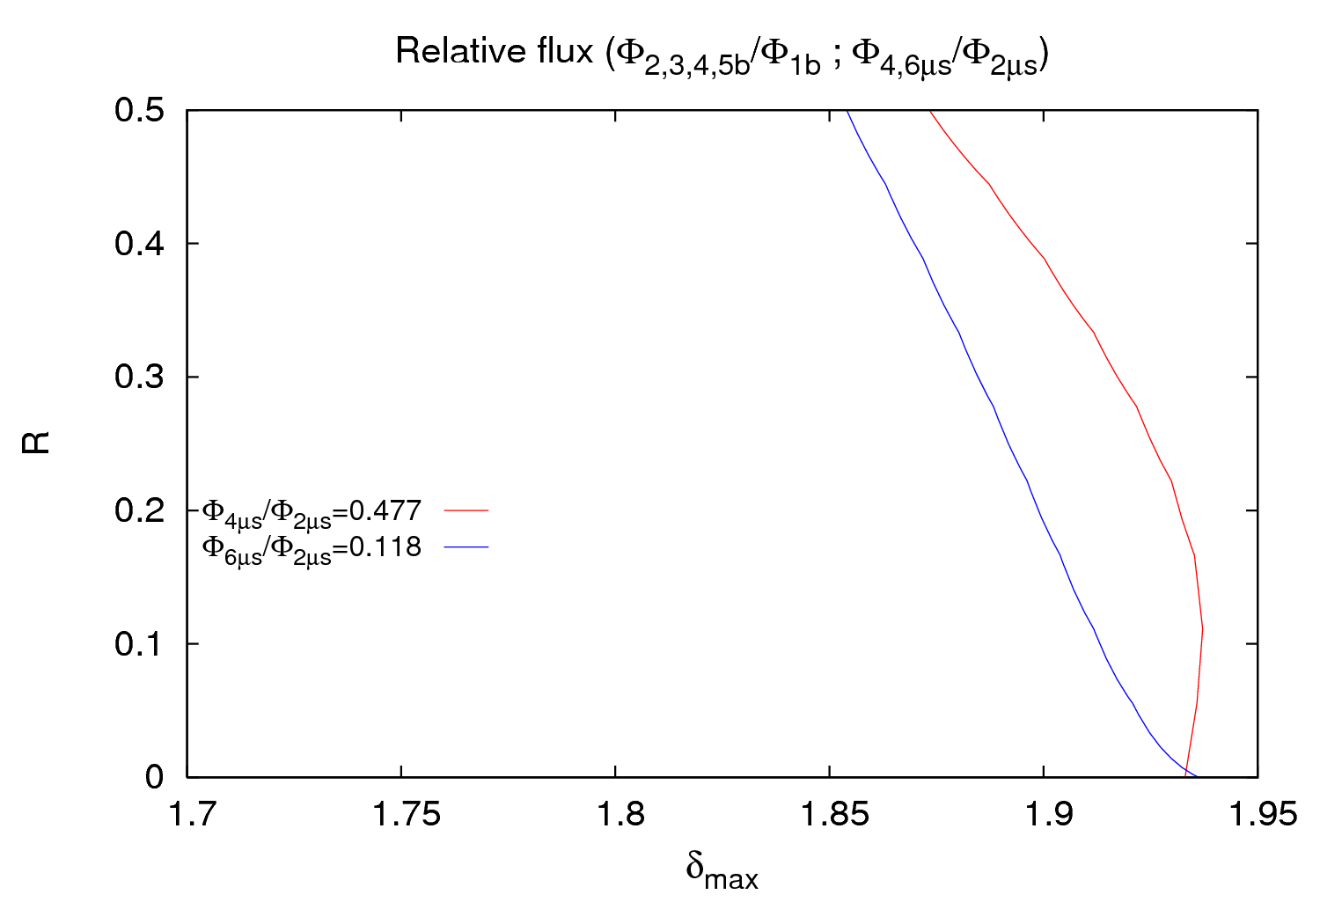
ΔP vs. batch spacing
I think that should be the right one
28th July 2011 - e⁻ cloud meeting

Slide 13
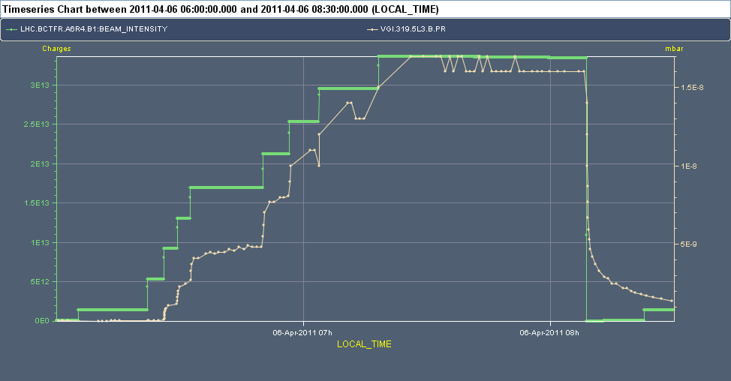
ΔP vs. # of batches
6/April/2011 – 2nd experiment – Variation of the # of batches (1, 2, 3, 4 and 5)
28th July 2011 - e⁻ cloud meeting

Slide 14
ΔP vs. # of batches
6/April/2011 – 2nd experiment – Variation of the # of batches (1, 2, 3, 4 and 5)
P_{5b}
P_{4b}
P_{3b}
P_{2b}
P_{1b}
P₀
28th July 2011 - e⁻ cloud meeting

Slide 15
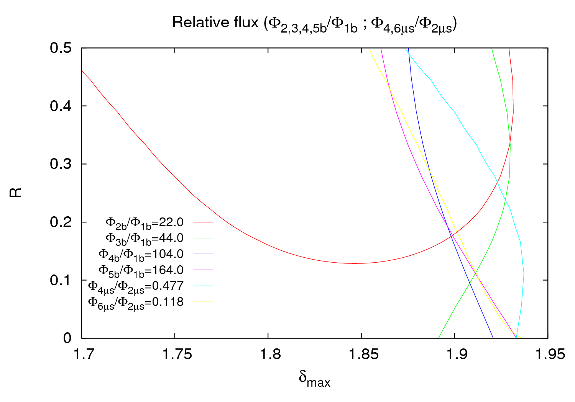

ΔP vs. # of batches
< all points of the surface → No lines are found for any # of batches
~
28th July 2011 - e⁻ cloud meeting

Slide 16
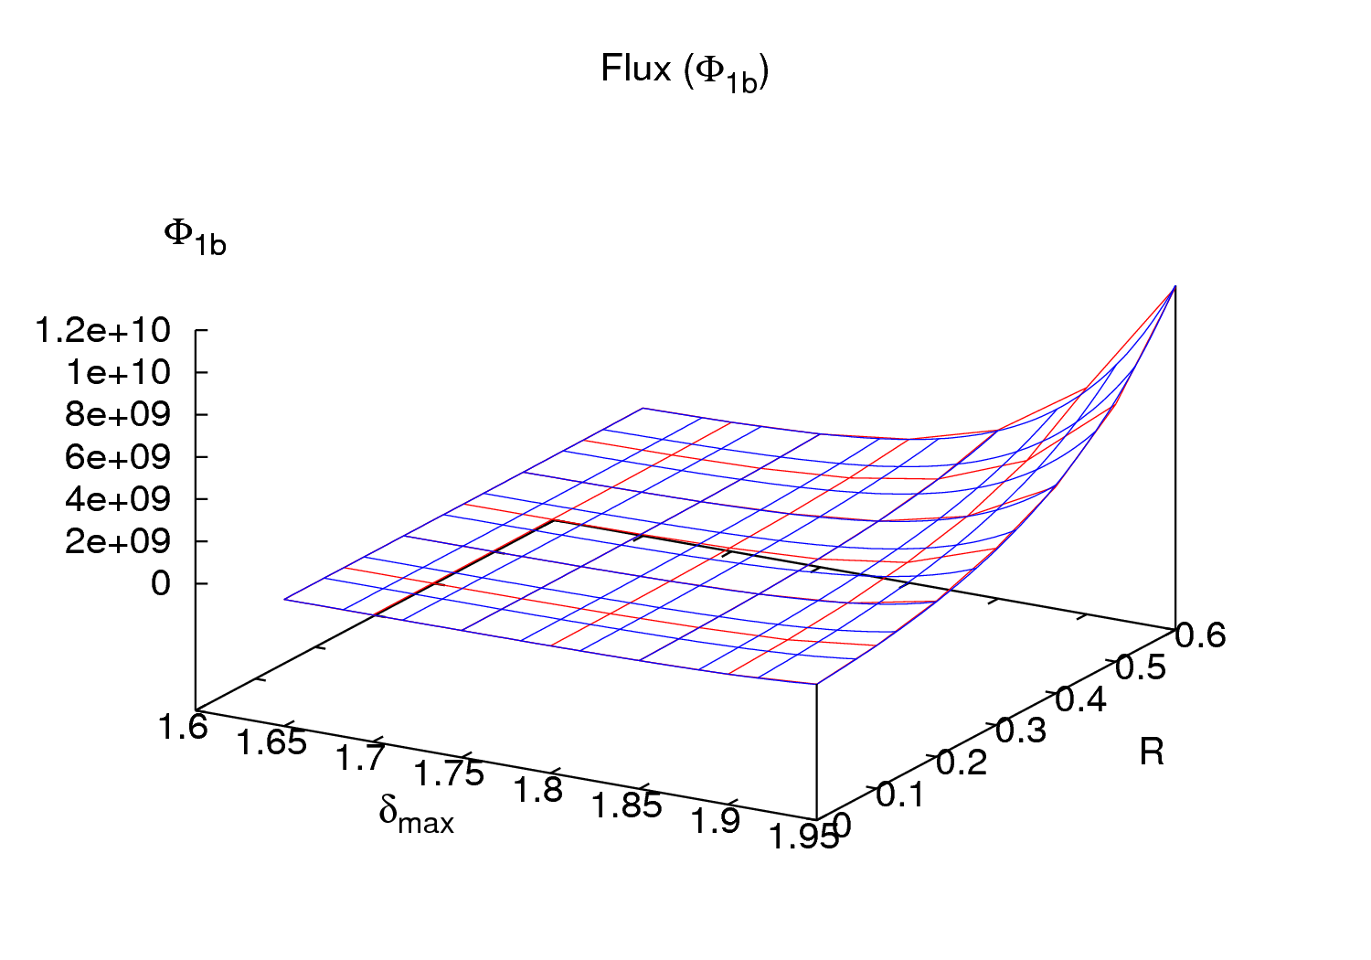
Quality of 3rd order fits
Remark → The red and green lines (φ₂/φ₁ and φ₃/φ₁) are a bit different than the others, but they φ₂ and φ₃ also have the highest value of χ².
28th July 2011 - e⁻ cloud meeting

Slide 17
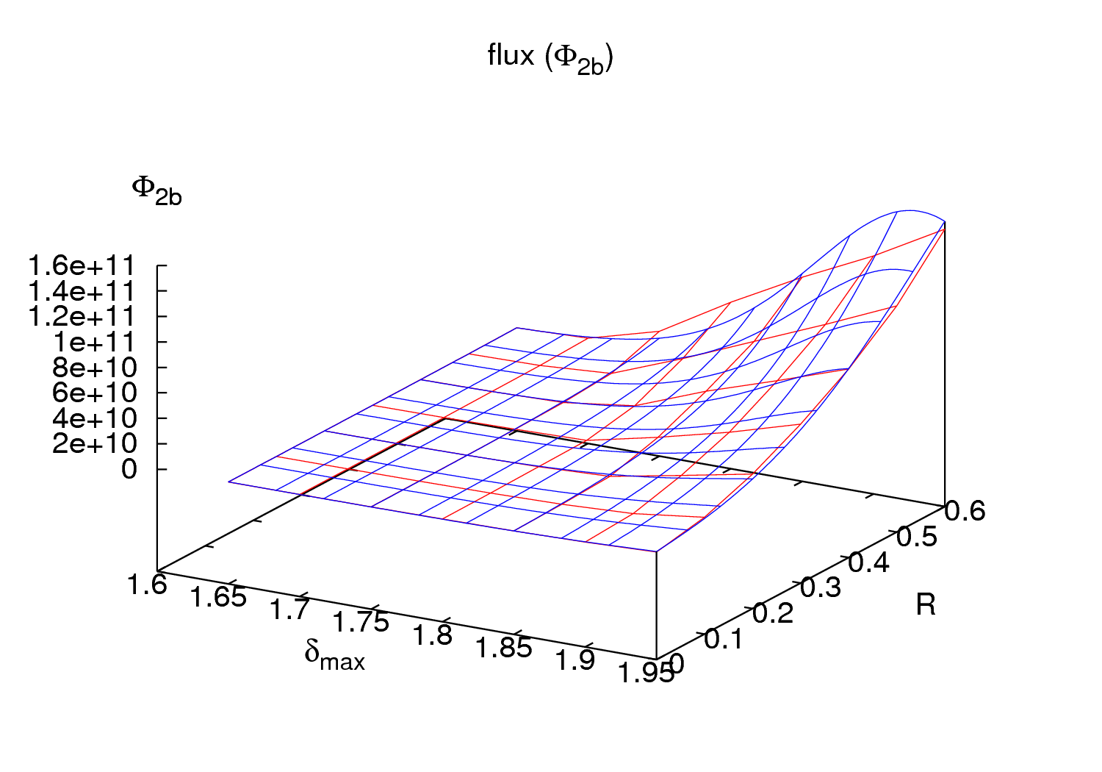
Quality of 3rd order fits
Remark → The red and green lines (φ₂/φ₁ and φ₃/φ₁) are a bit different than the others, but they φ₂ and φ₃ also have the highest value of χ².
28th July 2011 - e⁻ cloud meeting

Slide 18
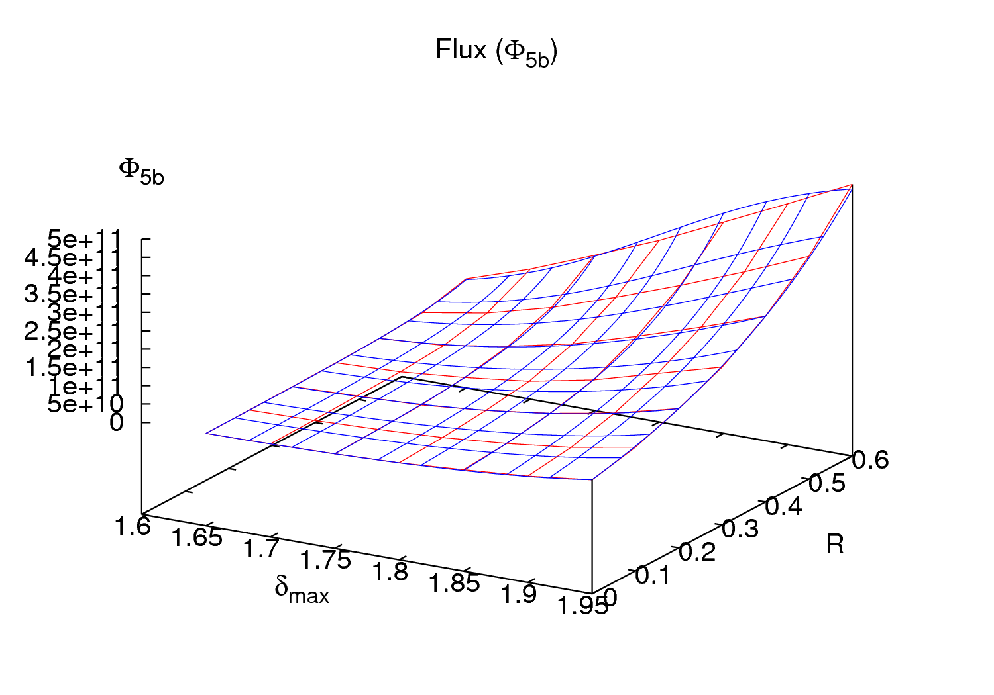
Quality of 3rd order fits
Remark → The red and green lines (φ₂/φ₁ and φ₃/φ₁) are a bit different than the others, but they φ₂ and φ₃ also have the highest value of χ².
28th July 2011 - e⁻ cloud meeting

Slide 19
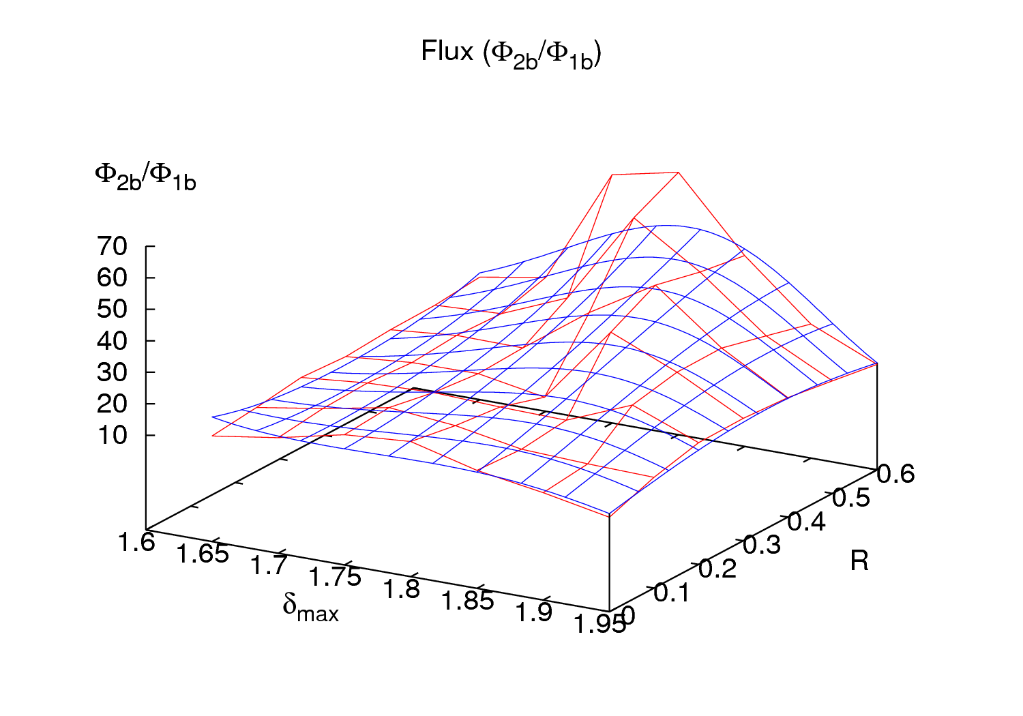
Quality of 3rd order fits
Remark → The red and green lines (φ₂/φ₁ and φ₃/φ₁) are a bit different than the others, but they φ₂ and φ₃ also have the highest value of χ².
28th July 2011 - e⁻ cloud meeting

Slide 20
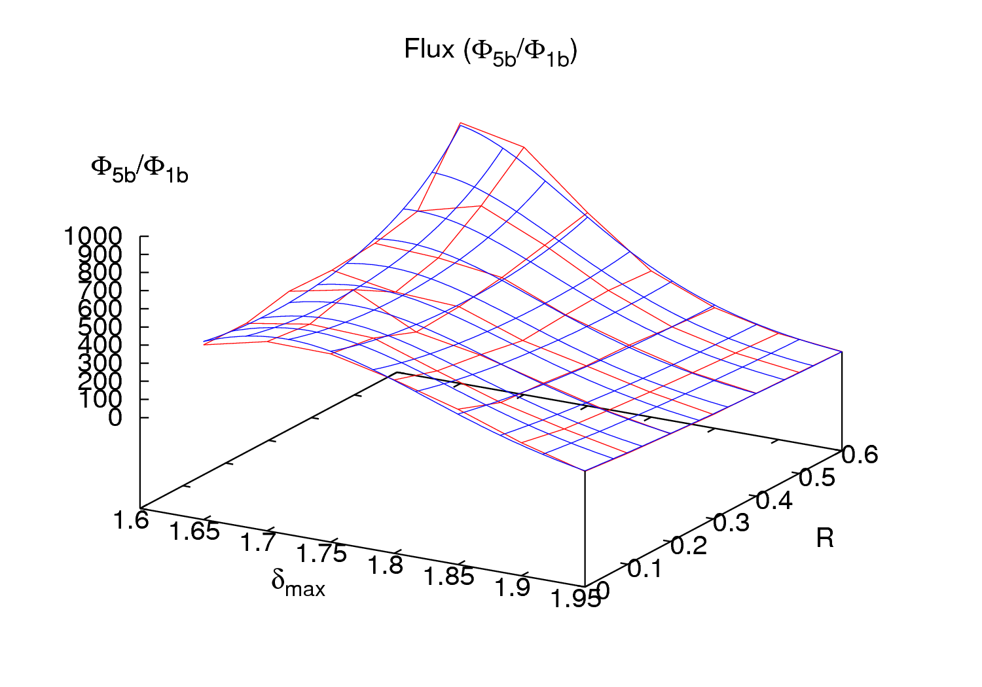
Quality of 3rd order fits
Remark → The red and green lines (φ₂/φ₁ and φ₃/φ₁) are a bit different than the others, but they φ₂ and φ₃ also have the highest value of χ².
28th July 2011 - e⁻ cloud meeting

Slide 21
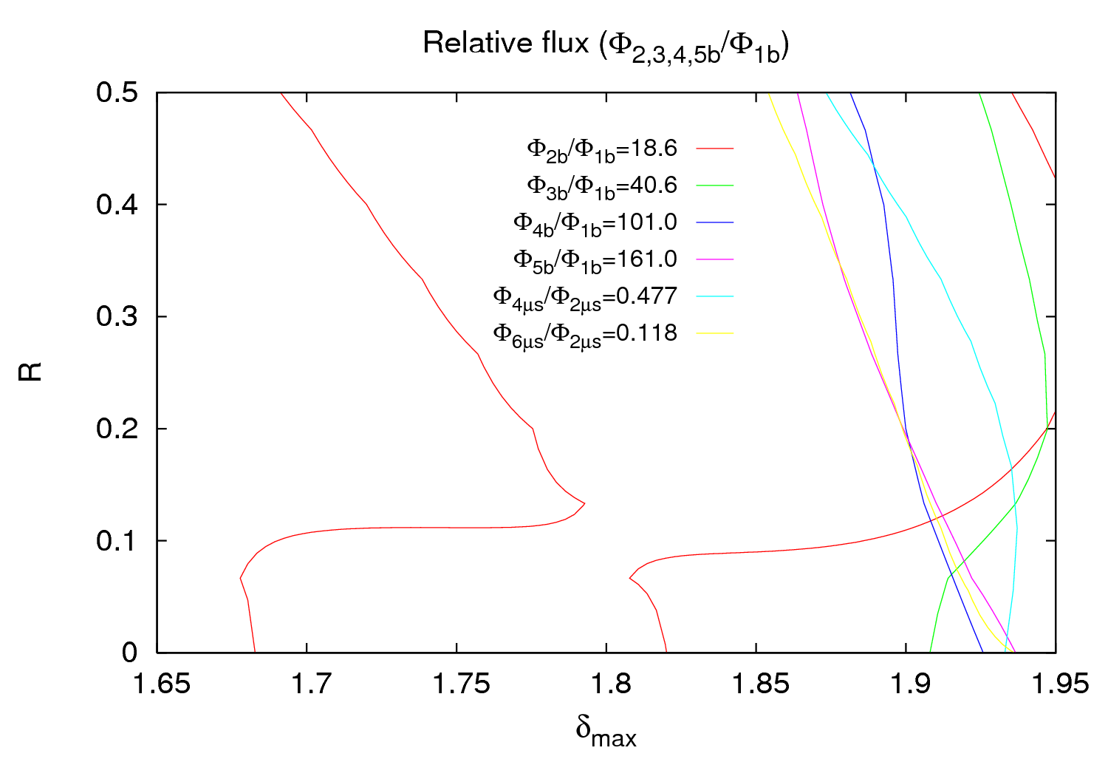
Quality of 5th order fits
With a 5th order fit φ₂ continue having the worst χ², but the cut is still in the same area
28th July 2011 - e⁻ cloud meeting

Slide 22
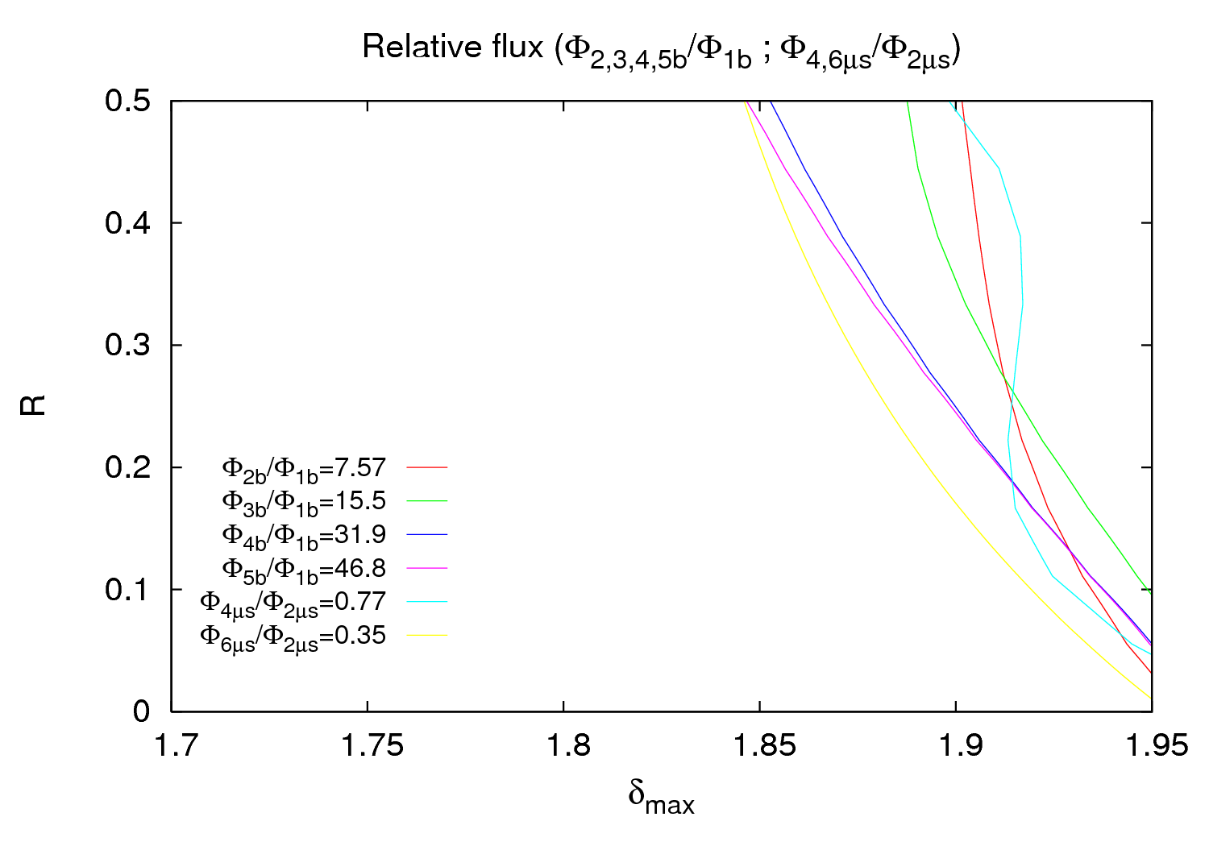
Result for another gauge
3rd order fit for gauge VGPB.2.5L3.B
28th July 2011 - e⁻ cloud meeting

Slide 23
Outline
6th April
1.1 ΔP vs. batch spacing
1.2 ΔP vs. # of batches in the machine
2) 10th - 11th April
2.1 ΔP vs. # of “double trains” (36+225 ns+36+4.850 μs)
3) 19th May
3.1 ΔP vs. # of “triple trains” (36+225 ns+36+225 ns+36+925 ns)
4) Right seed pressure for simulations
28th July 2011 - e⁻ cloud meeting

Slide 24
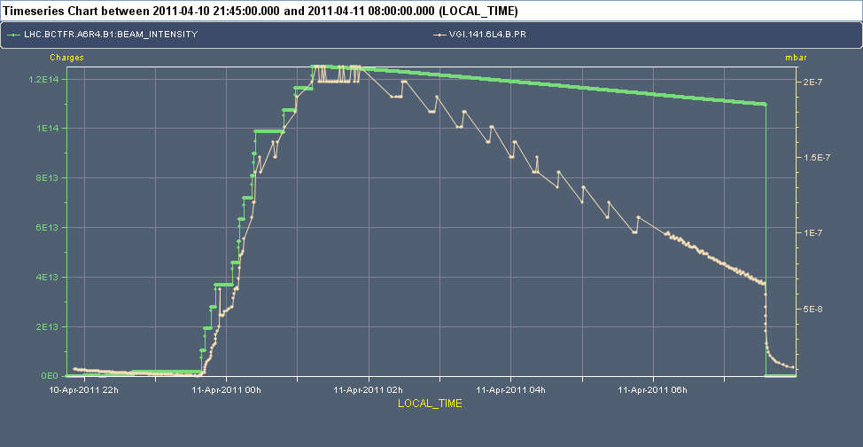
Overview
Up to 14 “double trains” (1020 bunches in the machine)
28th July 2011 - e⁻ cloud meeting

Slide 25
P vs. # of batches
28th July 2011 - e⁻ cloud meeting

Slide 26
P vs. # of batches
28th July 2011 - e⁻ cloud meeting

Slide 27
ΔP vs. # of batches
200 ns (instead of 225 ns)
ECLOUD filling scheme: 36 4 36 97
For a large number of batches I had to increase the maximum number of bunches to 2500 (nbmax=2500 in lines 127, 925, 2011 and 8294).
In a first approach, as Gianluigi proposed, I took an R=0.2 and try to fix the right SEY. I was using the values for 4, 11 and 14 batches, since the time is longer for those cases. But I didn’t succeed “in two dimensions”, so I came back to the 3D grids.
Pressure data are not very easy to read for 1, 2, 3 batches, since for the majority of the cases the time used wasn’t enough to establish pressure. So I increased a little bit in some cases extrapolating and taking in consideration previous pressure evolution.
For the rest, the procedure is exactly as for the 2nd experiment on the 6th April.
28th July 2011 - e⁻ cloud meeting

Slide 28
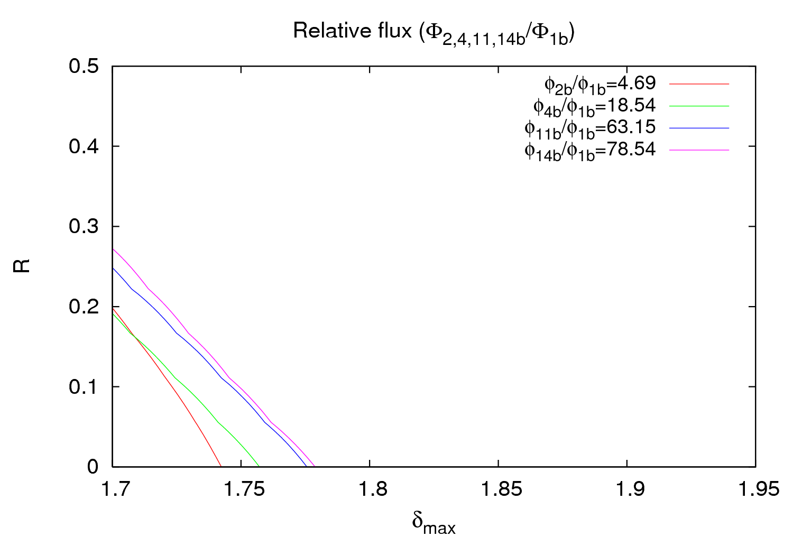
Result
28th July 2011 - e⁻ cloud meeting

Slide 29
Outline
6th April
1.1 ΔP vs. batch spacing
1.2 ΔP vs. # of batches in the machine
2) 10th - 11th April
2.1 ΔP vs. # of “double trains” (36+225 ns+36+4.850 μs)
3) 19th May
3.1 ΔP vs. # of “triple trains” (36+225 ns+36+225 ns+36+925 ns)
4) Right seed pressure for simulations
28th July 2011 - e⁻ cloud meeting

Slide 30
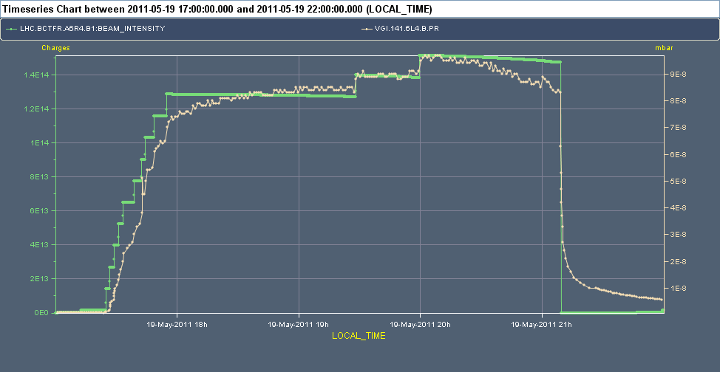
Overview
Up to 12 “triple trains” (1308 bunches in the machine)
28th July 2011 - e⁻ cloud meeting

Slide 31
P vs. # of batches
28th July 2011 - e⁻ cloud meeting

Slide 32
P vs. # of batches
28th July 2011 - e⁻ cloud meeting

Slide 33
ΔP vs. # of batches
200 ns (instead of 225 ns)
900 ns (instead of 925 ns)
ECLOUD filling scheme: 36 4 36 4 36 18
For a large number of batches I had to increase the maximum number of bunches to 2500 (nbmax=2500 in lines 127, 925, 2011 and 8294) in the code.
I also had to change the part related with the filling scheme (starting in line 1446) to add the possibility of having a third train.
Pressure data are not very easy to read for 1, 2, 3 … batches, since for the majority of the cases the time used wasn’t enough to establish pressure. So I increased again a little bit in some cases extrapolating and taking in consideration previous pressure evolution.
For the rest, the procedure is exactly as before.
28th July 2011 - e⁻ cloud meeting

Slide 34
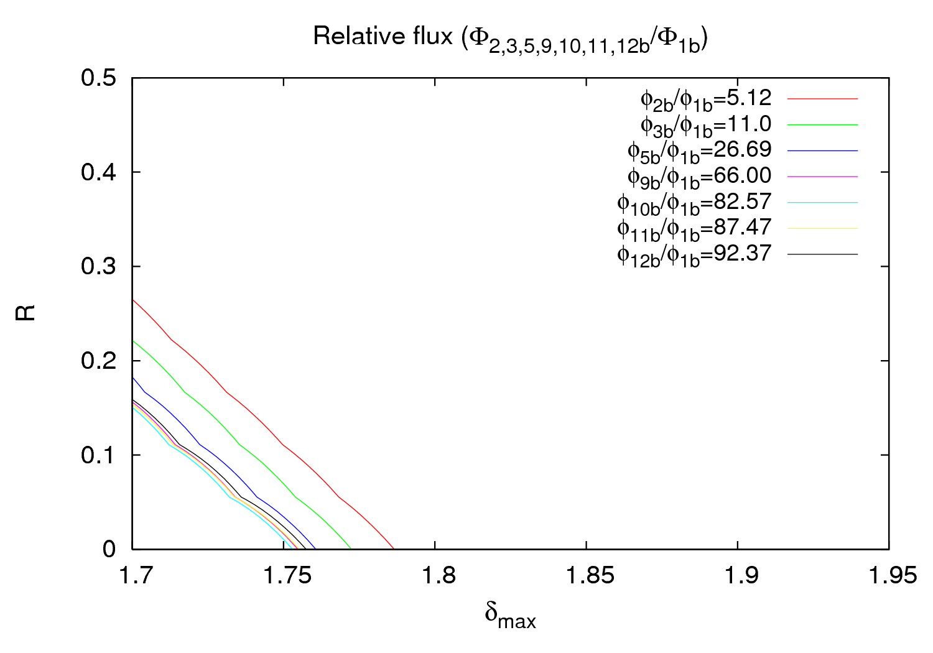
Result
28th July 2011 - e⁻ cloud meeting

Slide 35
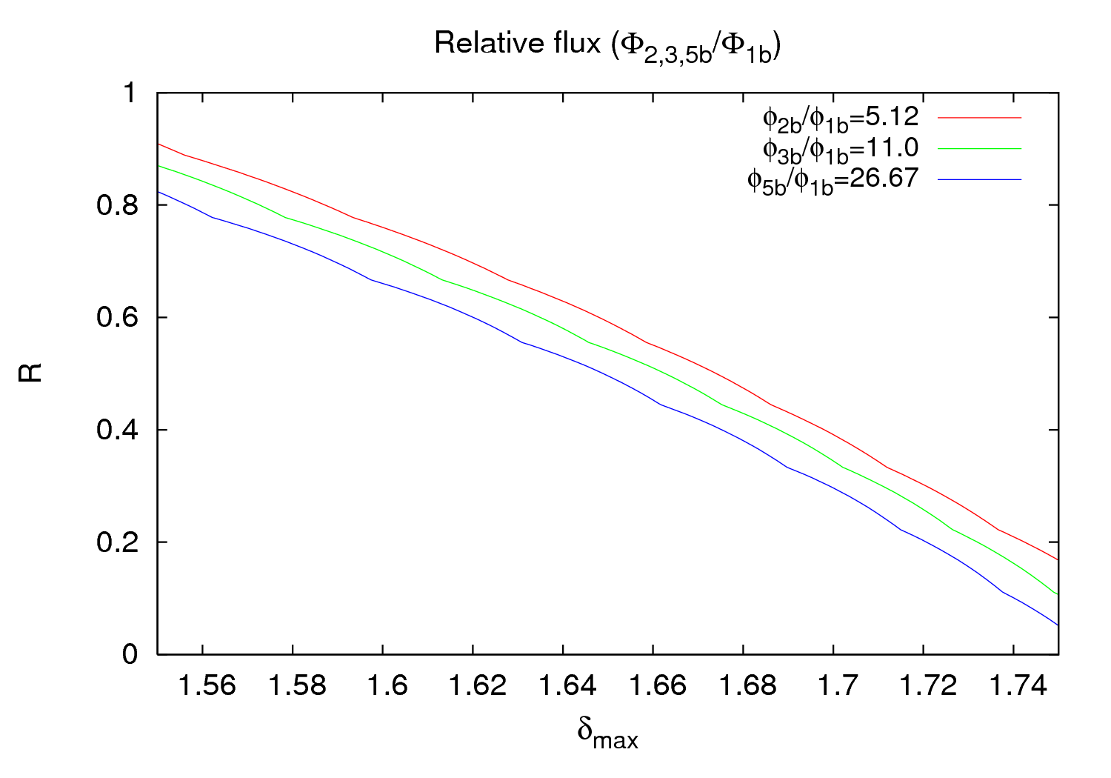
Result
28th July 2011 - e⁻ cloud meeting

Slide 36
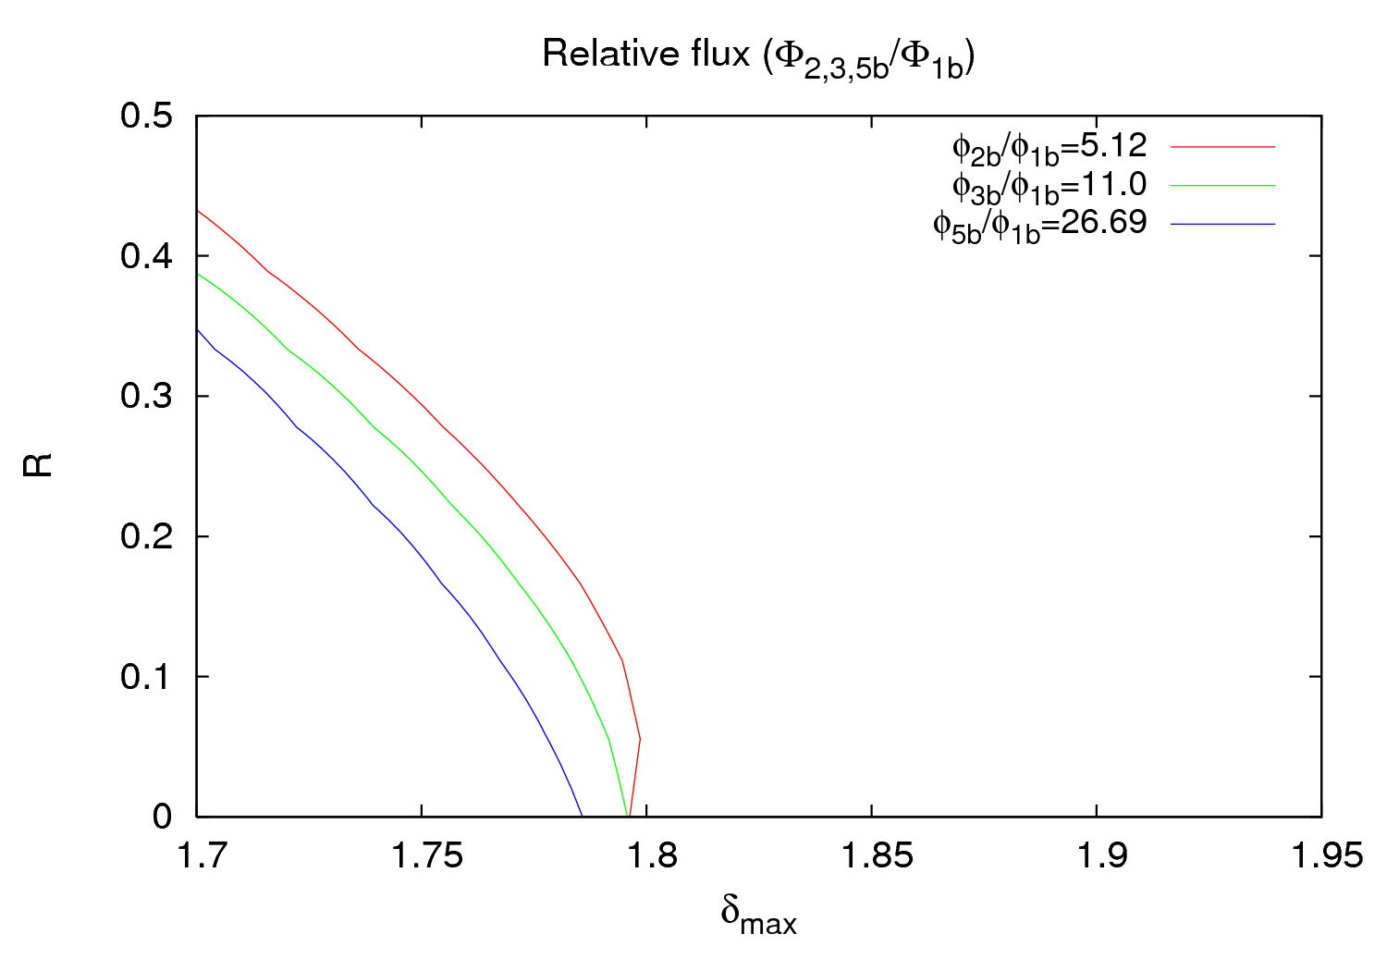
Result
ε_{max}=260 eV
28th July 2011 - e⁻ cloud meeting

Slide 37
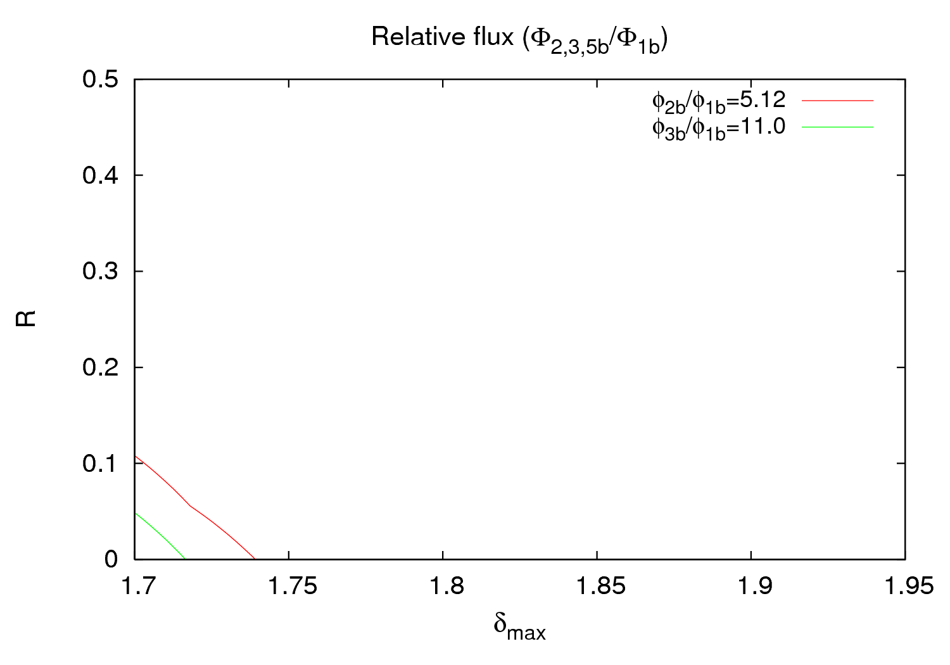
Result
ε_{max}=200 eV
28th July 2011 - e⁻ cloud meeting

Slide 38
Remarks
The variation of the ε_{max} just shifts the lines, but they continue being parallel.
Another gauge (VGPB.2.5L3.B.PR) has been explored with very similar results.
Beam 2 hasn’t been analyzed yet, but data don’t look really easy to “obtain” for the gauges I have checked.
In both cases (10th April and 19th May) the lines are quasi parallel, but there is a big difference, namely that in April smaller ratio lines were above while it’s the other way round for May. I really don’t understand why.
28th July 2011 - e⁻ cloud meeting

Slide 39
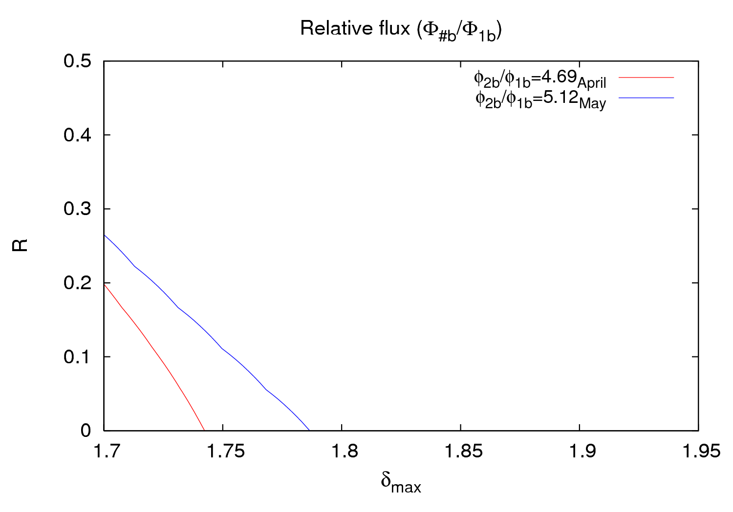
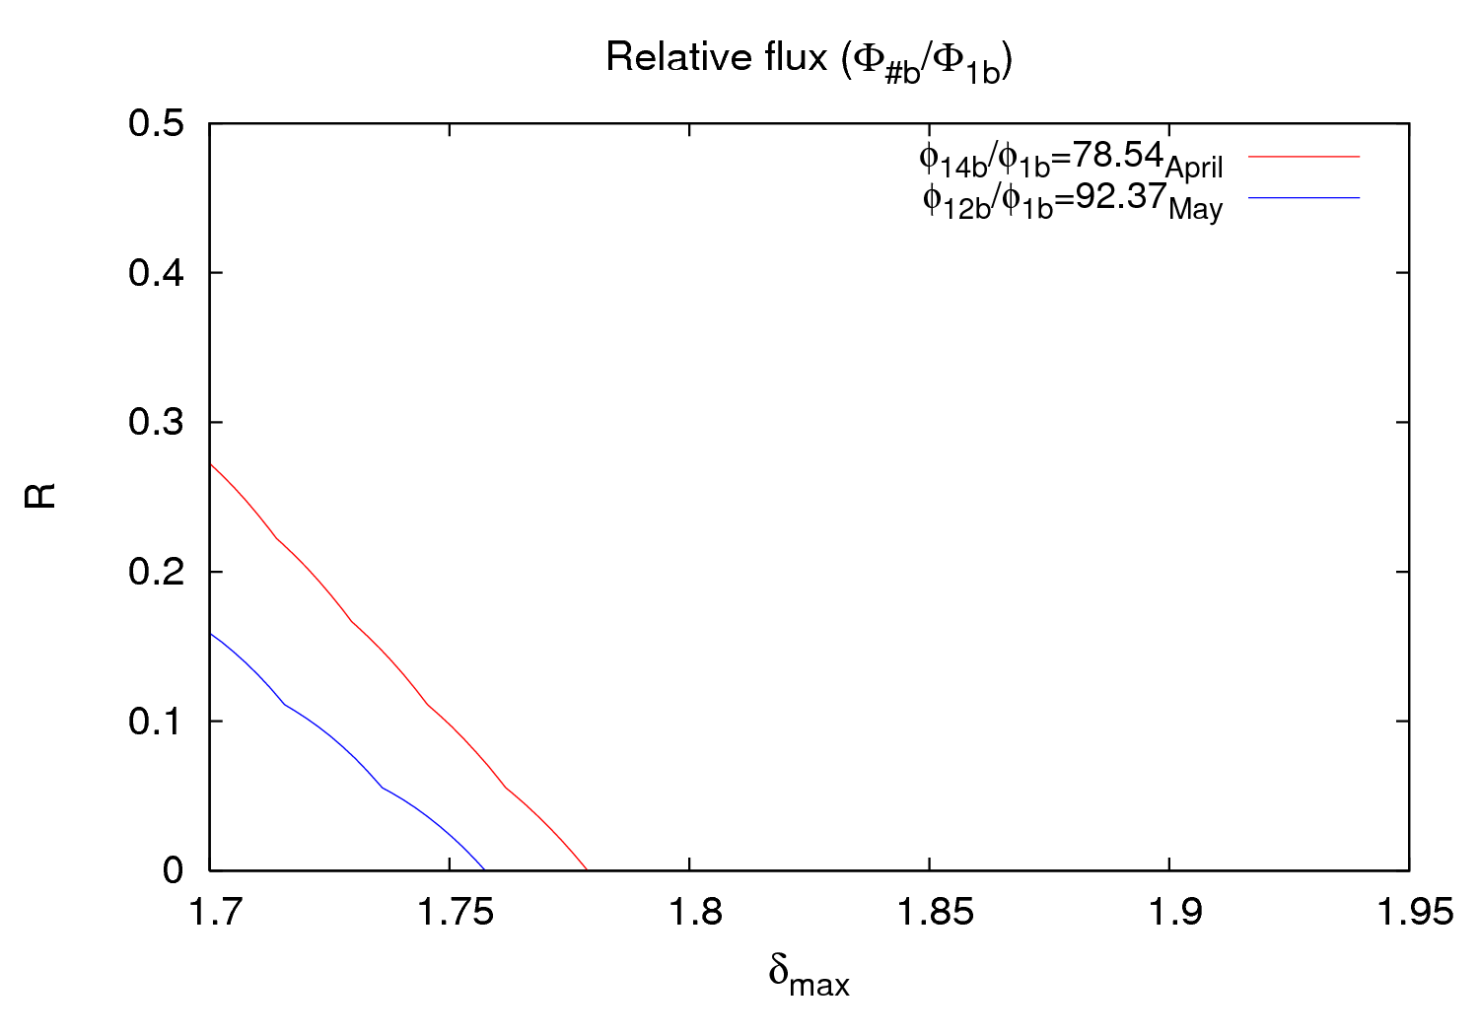
Comparison
What could be the explanation???
28th July 2011 - e⁻ cloud meeting

Slide 40
Outline
6th April
1.1 ΔP vs. batch spacing
1.2 ΔP vs. # of batches in the machine
2) 10th - 11th April
2.1 ΔP vs. # of “double trains” (36+225 ns+36+4.850 μs)
3) 19th May
3.1 ΔP vs. # of “triple trains” (36+225 ns+36+225 ns+36+925 ns)
4) Right seed pressure for simulations
28th July 2011 - e⁻ cloud meeting

Slide 41
ΔP vs. batch spacing
6/April/2011 – First experiment – Variation of the batch spacing (6, 4 and 2 μs)
4 μs
2 μs
P₂
6 μs
P₄
P₆
P₀
28th July 2011 - e⁻ cloud meeting

Slide 42
ΔP vs. batch spacing
6/April/2011 – First experiment – Variation of the batch spacing (6, 4 and 2 μs)
4 μs
2 μs
6 μs
P₂
P₄
P₆
28th July 2011 - e⁻ cloud meeting

Slide 43
ΔP vs. # of batches
6/April/2011 – 2nd experiment – Variation of the # of batches (1, 2, 3, 4 and 5)
P_{5b}
P_{4b}
P_{3b}
P_{2b}
P_{1b}
P₀
28th July 2011 - e⁻ cloud meeting

Slide 44
ΔP vs. # of batches
6/April/2011 – 2nd experiment – Variation of the # of batches (1, 2, 3, 4 and 5)
P_{5b}
P_{4b}
P_{3b}
P_{2b}
P_{1b}
28th July 2011 - e⁻ cloud meeting

Slide 45
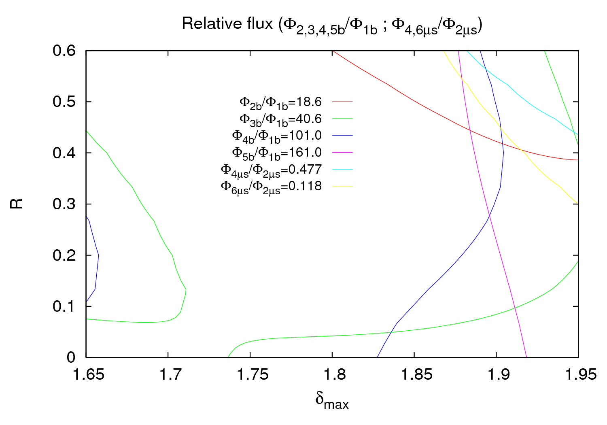
Result – Pressure before injection
28th July 2011 - e⁻ cloud meeting

Slide 46
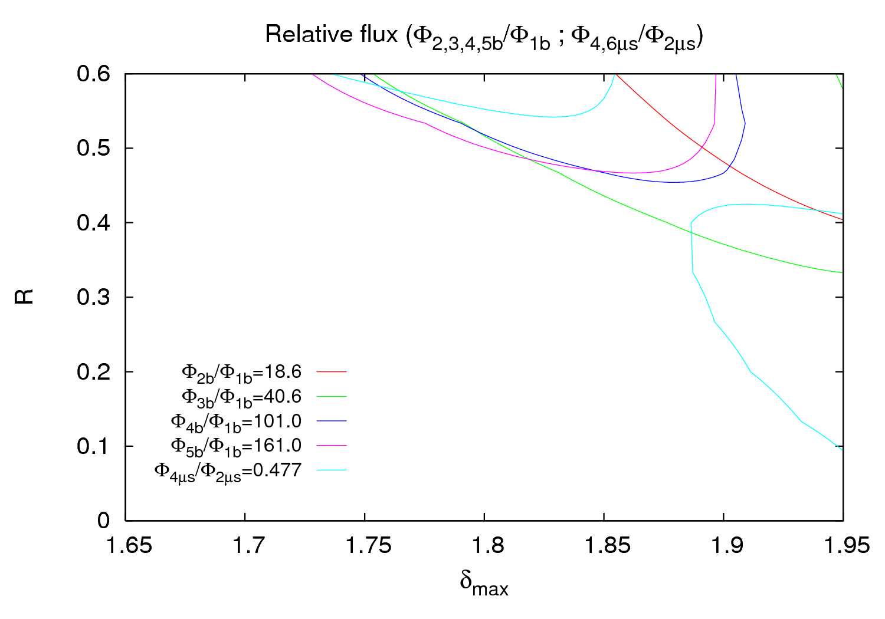
Result – Base pressure (~1 nTorr)
Note there are no points for φ_{6μs}/φ_{2μs}
28th July 2011 - e⁻ cloud meeting

Slide 47
Remarks
The χ² is smaller (so the best) for the case of the final pressure for all cases (# of bunches inside the machine):
χ²_{FinalP} < χ²_{InitialP} < χ²_{BaseP}
The worst fitted part is always at the highest values of δ_{max} and R
28th July 2011 - e⁻ cloud meeting

Slide 48
Conclusions
It seems clear to me that the P that has to be used is the final pressure reached at equilibrium.
When the varying parameter is the number of batches it’s necessary to launch simulations with different pressures for every different number of batches.
Taking flux ratios after a certain number of batches in a simulation with several batches does not give good results (all the values obtained are very much lower than the pressure ratios measured experimentally, so no contour lines can be achieved in any case).
28th July 2011 - e⁻ cloud meeting

Slide 49
THANK YOU FOR YOUR ATTENTION

