Slide 1
Scrubbing efficiency in the SPS:
5ns vs 25ns
G. Iadarola, G. Rumolo
e⁻ cloud Simulation Meeting
28 July 2011

Slide 2
SPS scrubbing – 5ns bunch spacing
One of the ideas proposed by G. Arduini in order to increase the scrubbing efficiency is the possibility to employ 5ns bunch spacing in the SPS.
B. Goddard at LIU-SPS Coordination Meeting - 22 June 2011

Slide 3
SPS scrubbing – investigated scenarios
We have considered two possible situations that are of interest for the scrubbing run of the SPS:

Slide 4
SPS scrubbing – investigated scenarios
We have considered two possible situations that are of interest for the scrubbing run of the SPS:
25ns nominal beam (bunch spacing 25ns intensity 1.1∙10¹¹ppb)
Filling pattern:
72
8
72
8
72
8
72
25ns buckets

Slide 5
SPS scrubbing – investigated scenarios
We have considered two possible situations that are of interest for the scrubbing run of the SPS:
25ns nominal beam (bunch spacing 25ns intensity 1.1∙10¹¹ppb)
Filling pattern:
72
8
72
8
72
8
72
25ns buckets
5ns beam (bunch spacing 5ns intensity <7∙10¹⁰ ppb)
Filling pattern:
About 4600
5ns buckets

Slide 6
SPS scrubbing – investigated scenarios
We have considered two possible situations that are of interest for the scrubbing run of the SPS:
25ns nominal beam (bunch spacing 25ns intensity 1.1∙10¹¹ppb)
Filling pattern:
72
8
72
8
72
8
72
25ns buckets
5ns beam (bunch spacing 5ns intensity <7∙10¹⁰ ppb)
Filling pattern:
About 4600
5ns buckets
The e⁻ cloud build-up in MBB bending magnets at injection energy has been simulated.

Slide 7
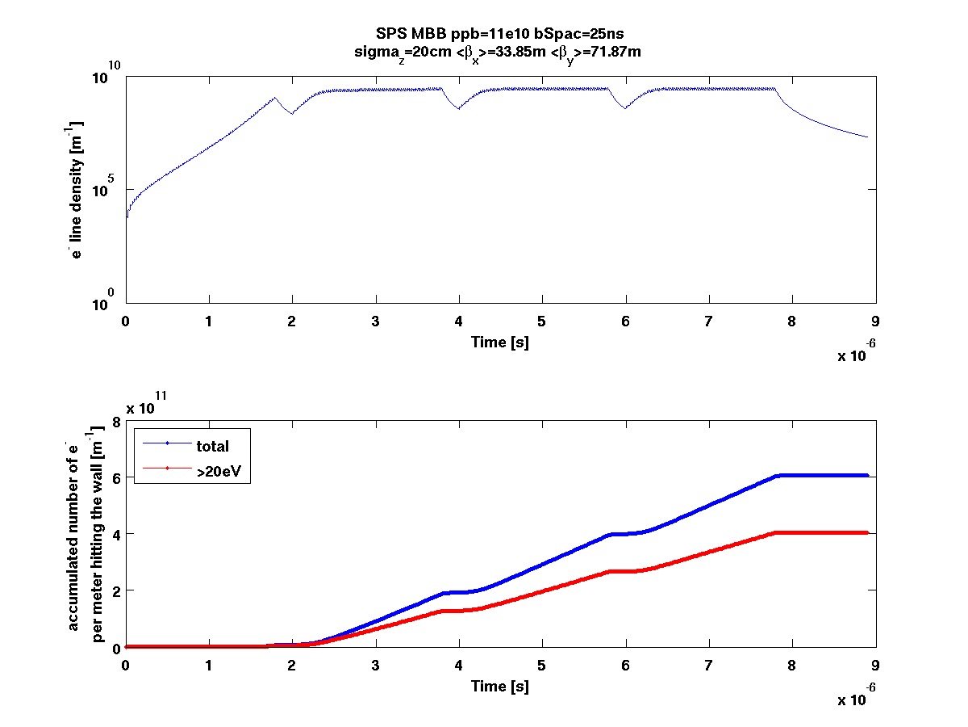
25ns scrubbing efficiency
Filling pattern
72
8
72
8
72
8
72
28
372 buckets (25ns spacing)

Slide 8
25ns scrubbing efficiency
Filling pattern
72
8
72
8
72
8
72
28
372 buckets (25ns spacing)

Slide 9
25ns scrubbing efficiency
Since the machine is not completely filled, the e⁻ density decays after the four trains passage and this build-up is repeated at each turn.
Filling pattern
72
8
72
8
72
8
72
28
372 buckets (25ns spacing)

Slide 10
25ns scrubbing efficiency
Since the machine is not completely filled, the e⁻ density decays after the four trains passage and this build-up is repeated at each turn.
Number of electrons per unit length hitting the wall in one turn.
Filling pattern
72
8
72
8
72
8
72
28
372 buckets (25ns spacing)

Slide 11
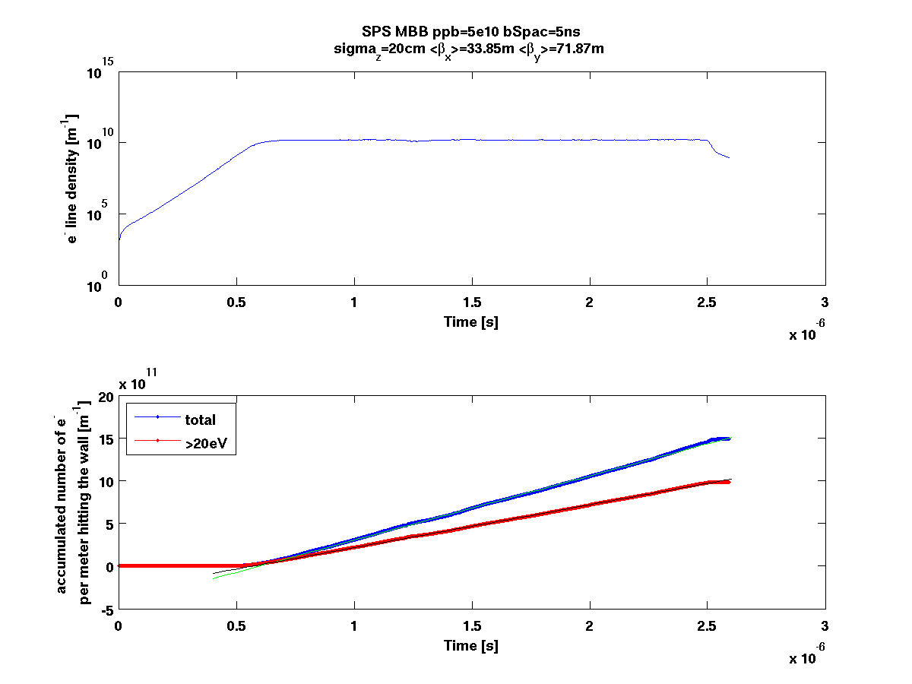
5ns scrubbing efficiency
Filling pattern
500
8
508 buckets (5ns spacing)

Slide 12
5ns scrubbing efficiency
Filling pattern
500
8
508 buckets (5ns spacing)

Slide 13
5ns scrubbing efficiency
In this case the machine is completely filled and the e⁻ density is always at its saturation value.
Filling pattern
500
8
508 buckets (5ns spacing)

Slide 14
5ns scrubbing efficiency
In this case the machine is completely filled and the e⁻ density is always at its saturation value.
This slope gives the number of e⁻ per meter hitting the wall in one second.
Filling pattern
500
8
508 buckets (5ns spacing)

Slide 15
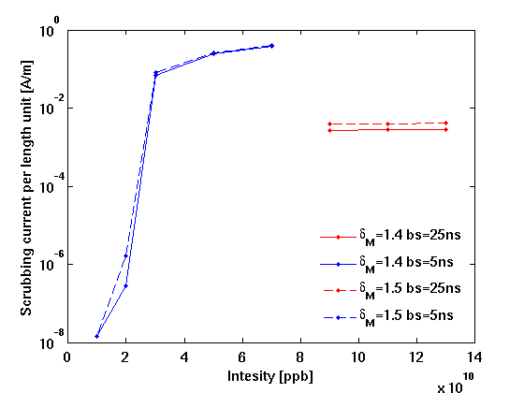
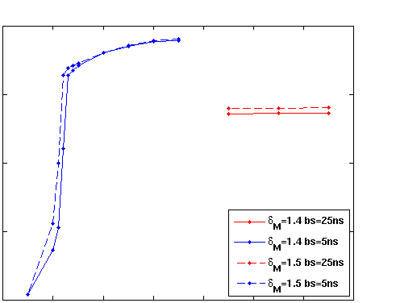
SPS scrubbing – 25ns vs. 5ns

Slide 16
SPS scrubbing – 25ns vs. 5ns
The 5ns beam scrubs more efficiently then the nominal 25ns if its intensity is >2.5 ∙10¹⁰ppb

Slide 17
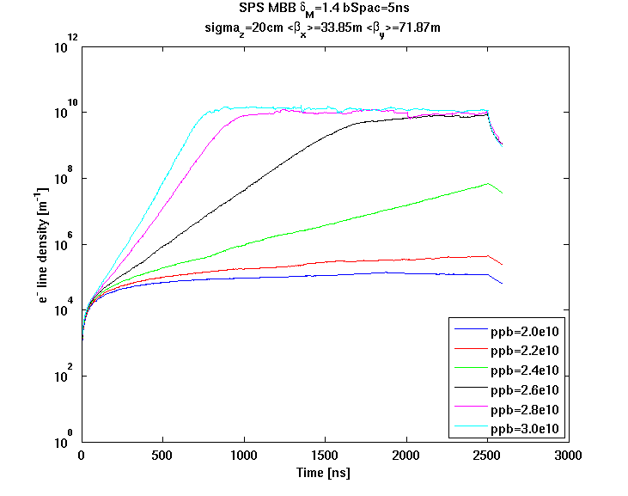
SPS scrubbing – 25ns vs. 5ns

Slide 18
SPS scrubbing – 25ns vs. 5ns
Another possibility is to use a 5ns train at “nominal intensity” having length 2.1μm (about 10% SPS length).
A rough calculation suggests that this solution is more efficient with respect to the nominal 25ns beam by a factor 7.5.

Slide 19
Conclusion and future studies
The 5ns beam filling the machine scrubs more efficiently then the nominal 25ns if its intensity is >2.5 ∙10¹⁰ppb.

Slide 20
Conclusion and future studies
The 5ns beam filling the machine scrubs more efficiently then the nominal 25ns if its intensity is >2.5 ∙10¹⁰ppb.
Ideas for future studies
B. Goddard at LIU-SPS Coordination Meeting - 22 June 2011

Slide 21
Thanks for your attention!

