Slide 1
ECLOUD code SVN repository
G. Iadarola, K. Li, G. Rumolo
e⁻ cloud Simulation Meeting
28 July 2011

Slide 2
ECLOUD code SVN repository
The last stable version of ECLOUD code can be retrieved from the SVN repository:
On Linux machines using the command:
svn co svn+ssh://svn.cern.ch/reps/ecldcode/trunk
From the Web interface at the link:
http://svnweb.cern.ch/world/wsvn/ecldcode/trunk/#path_trunk_

Slide 3
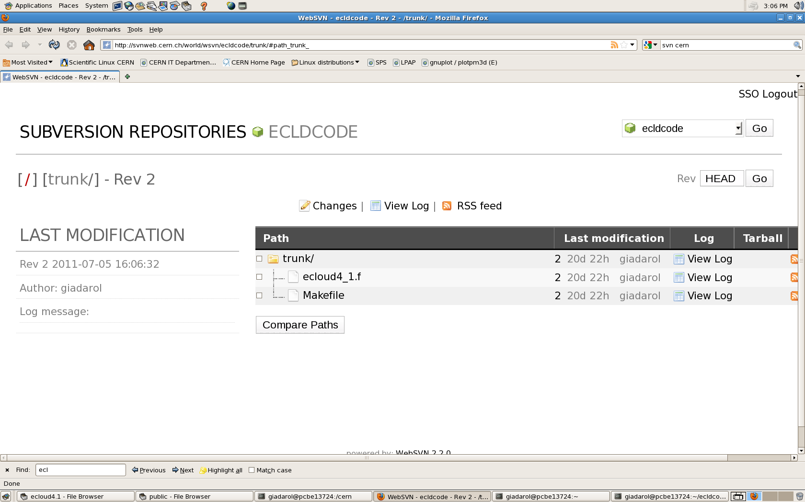
ECLOUD code SVN repository

Slide 4
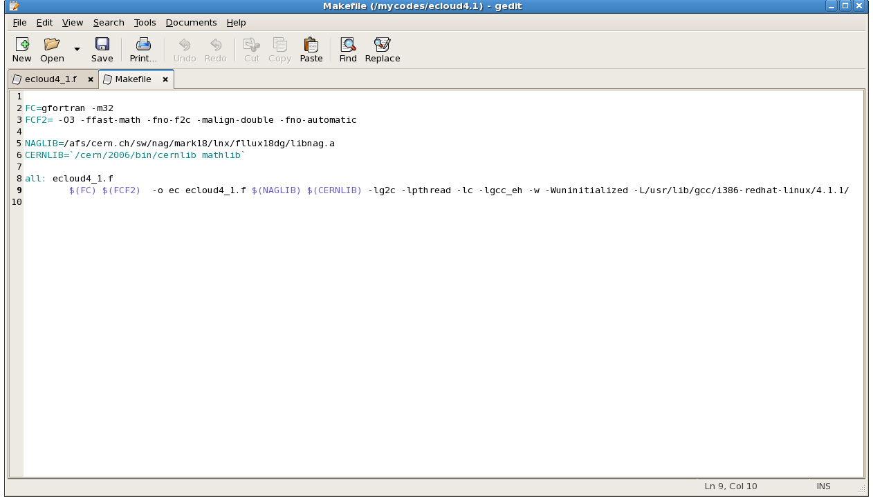
ECLOUD code SVN repository

Slide 5
ECLOUD code SVN repository

Slide 6
ECLOUD code SVN repository

Slide 7
ECLOUD code SVN repository
SVN protocol also gives the possibility to upload modified versions (e.g. new features implementation) and automatically keeps track of modifications.
More information about SVN can be found at:
http://indico.cern.ch/conferenceDisplay.py?confId=130634
(K. Li talk at HEADTAIL group meeting)
http://svn.web.cern.ch/svn/

