Slide 1
e-Cloud Simulations for LHC LPA upgrade scheme
C. M. Bhat and F. Zimmermann
e-cloud simulation meeting
September 30, 2011

Slide 2
Motivation
Recent studies in the LHC showed that
LHC beam-beam tune shift can be > 0.015/IP (LHC design limit <0.015/2IPs)
Acceptable pileup events at IP <200 (from experimenters)
In view of these the LHC LPA parameter list is revised ← Next Table
Here we address the e-cloud issues for new parameters using realistic bunch profiles
Longitudinal bunch profiles are derived from ESME simulations
HP distribution ← Initial distribution
LE(4σ)= 2- 2.5 eVs
Various bunch profiles are generated with h=1(400MHz rf) and h=2 rf (800MHz rf) systems
BSM and BLM ; V2/V1= 0.25, and 0.5
Bunch Intensity 1E11-4E11ppb, Simulations for Dipoles and Drift sections
Bunch Spacing 25 nsec and 50 nsec
Assuming
SEY =2.3 -1.5 (← Only the 1.5 results will be presented)
R = 0.25

Slide 3
New Parameter List for LPA scheme
LHC at 7 TeV: “BLMpt5” and “BSMpt5” represent the rf voltage ratio of 0.5 with 180 deg phase apart for 1st and 2nd harmonic rf cavities. (IPAC2011)
μ
μ
/2IPs

Slide 4
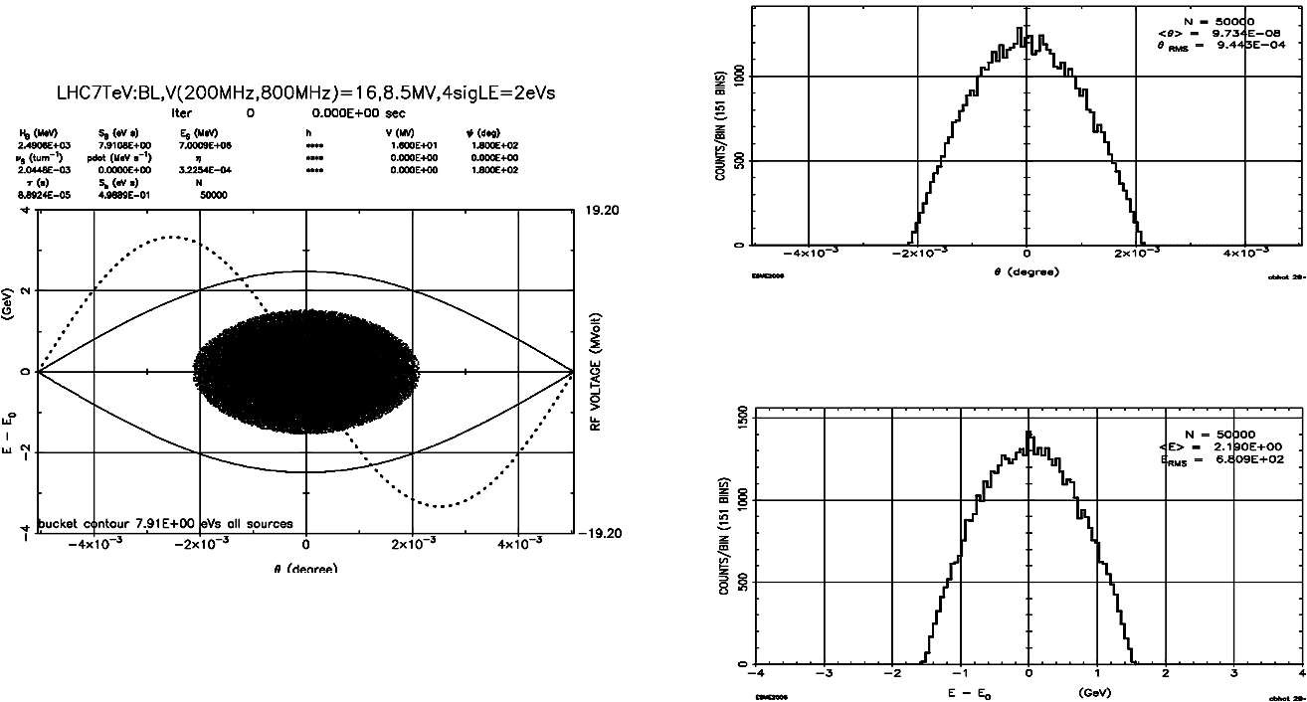
LHC Bunch Profiles for 2 eVs beam with V2/V1=0.5, BLM (400MHz ⊕ 800MHz rf)
Hoffmann-Pedersen Dists.
LE(4σ)=2 eVs
(ΔE,Δt) Distributions

Slide 5
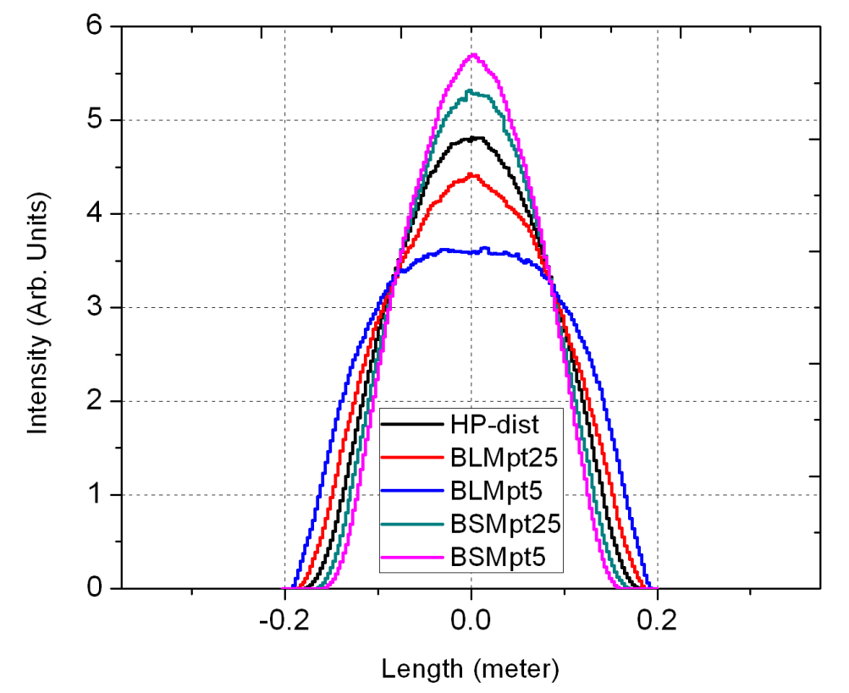
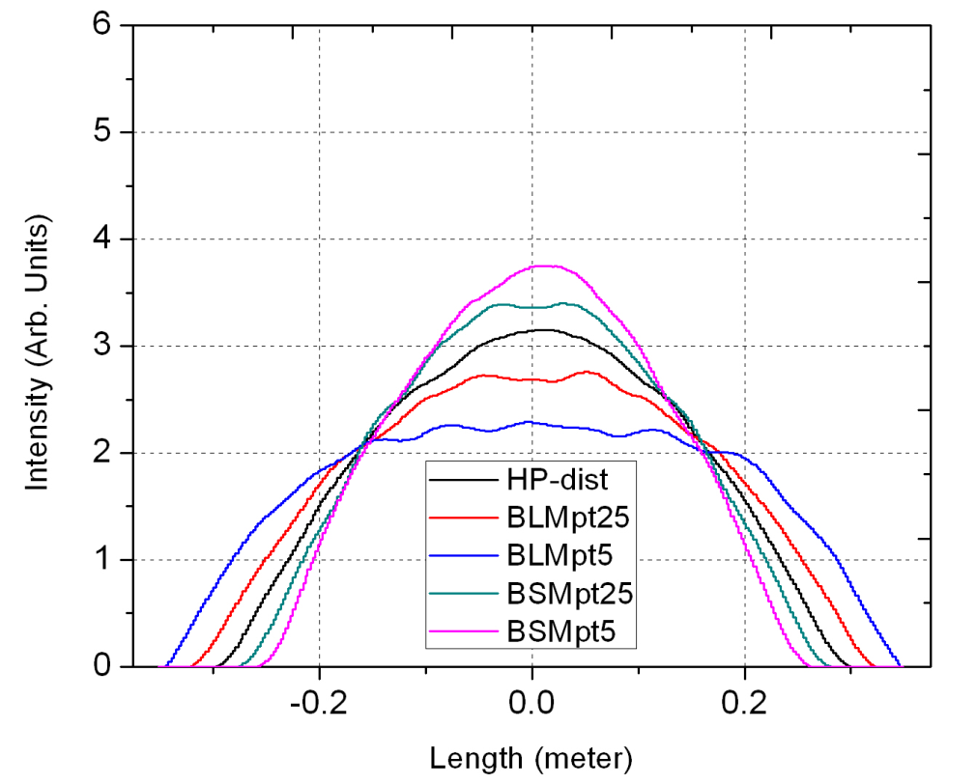
Longitudinal Profiles of the LHC Bunches from ESME 2eVs
400MHz ⊕800MHz rf
200MHz ⊕ 400MHz rf

Slide 6
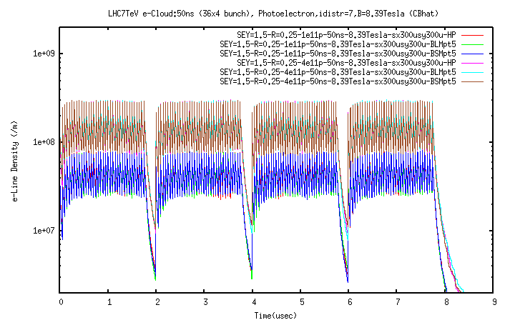
Linear e-Density from ECLOUD: Dipole Section (50 nsec)
4E11ppb
1E11ppb

Slide 7
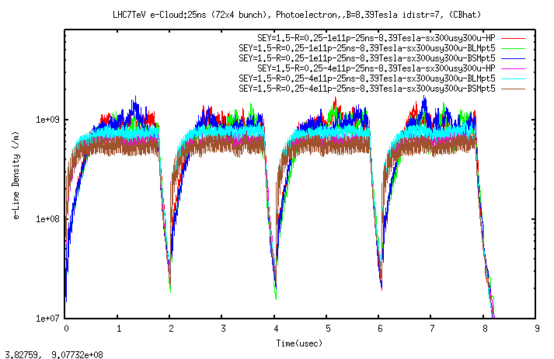
Linear e-Density from ECLOUD: Dipole Section (25 nsec)
4E11ppb
1E11ppb

Slide 8
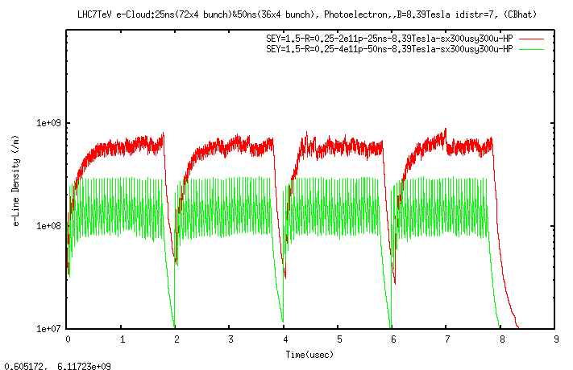
Linear e-Density from ECLOUD: Dipole Section (25ns & 50 ns)
Same Beam Current in the LHC
2E11ppb
25nsec
4E11ppb
50 nsec

Slide 9
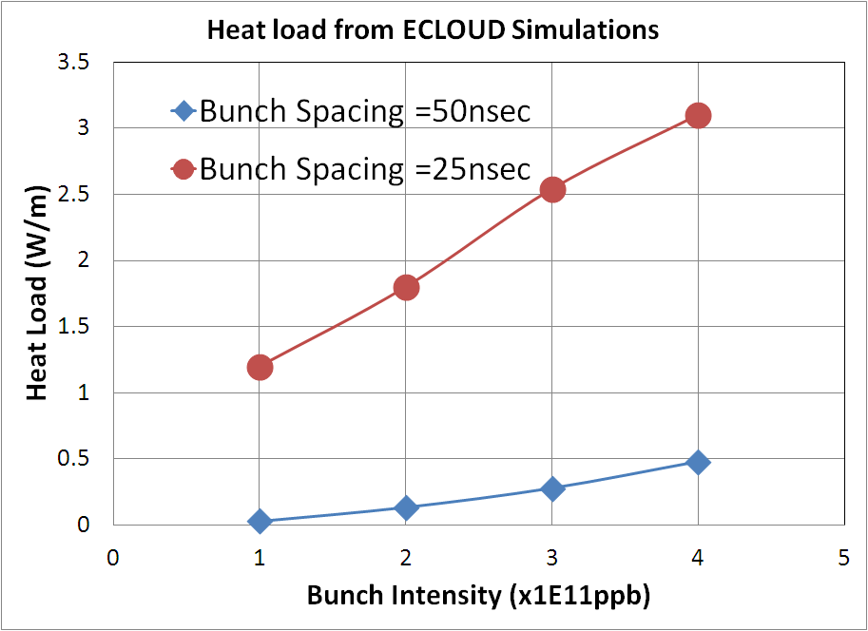
Heat load: Bunch Intensity Dependence (dipole section)
Average
Same Beam Intensity

Slide 10
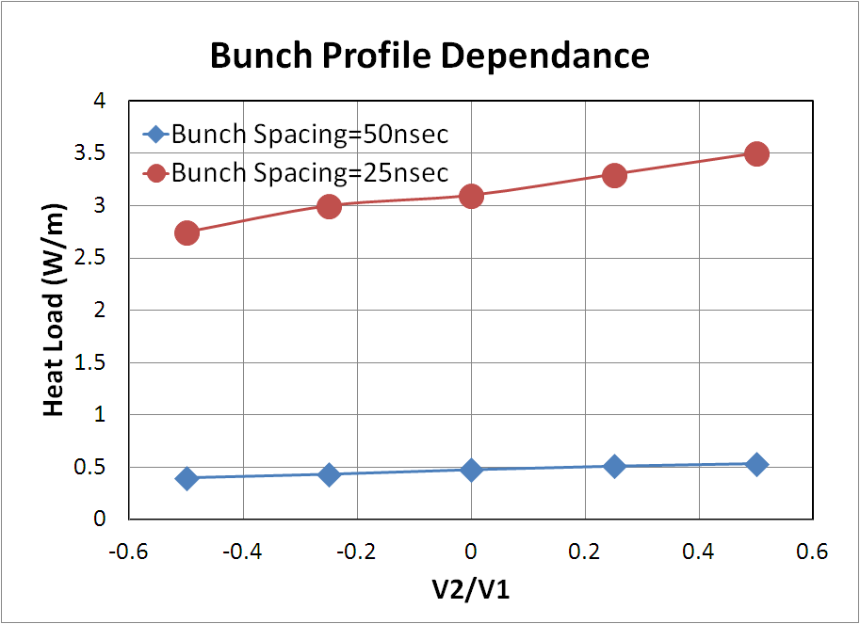
Heat load: Profile Dependence (dipole section)
4E11ppb
Average
BLM
BSM

Slide 11
Summary
e-Cloud simulations have been carried out for LHC LPA upgrade beam parameters using realistic bunch profiles.
The heat load for 25 nsec bunch filling pattern is about six times larger than that for 50 nsec filling in the range of 1E11 to 4E11ppb.
From e-cloud point of view, 50 ns filling pattern is 3.5 times better than 25 ns filling pattern for the same beam current.
For a given intensity the BSM has about 30% larger heat load as compared to BLM profiles.

Slide 12
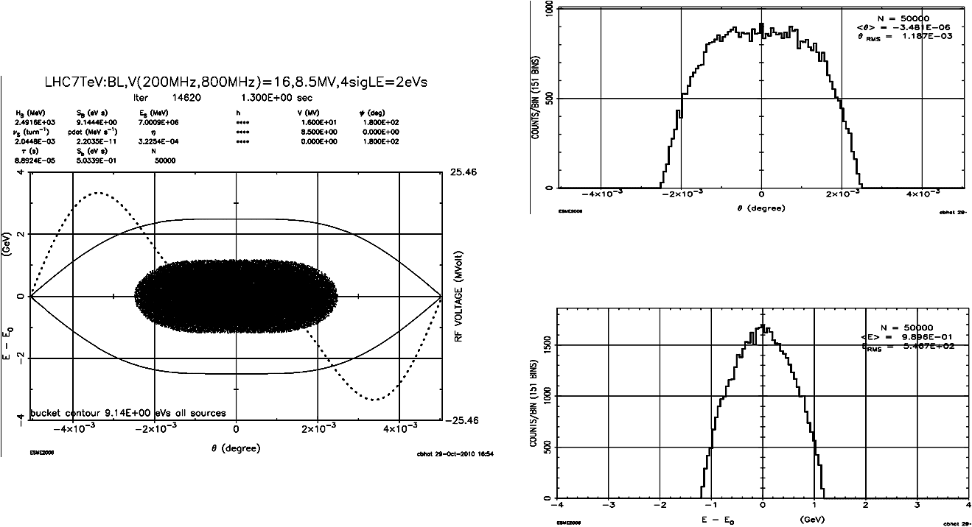
LHC Bunch Profiles for 2 eVs beam with V2/V1=0.5, BLM (400MHz ⊕ 800MHz rf)
LE(4σ)=2 eVs
(ΔE,Δt) Distributions

Slide 13
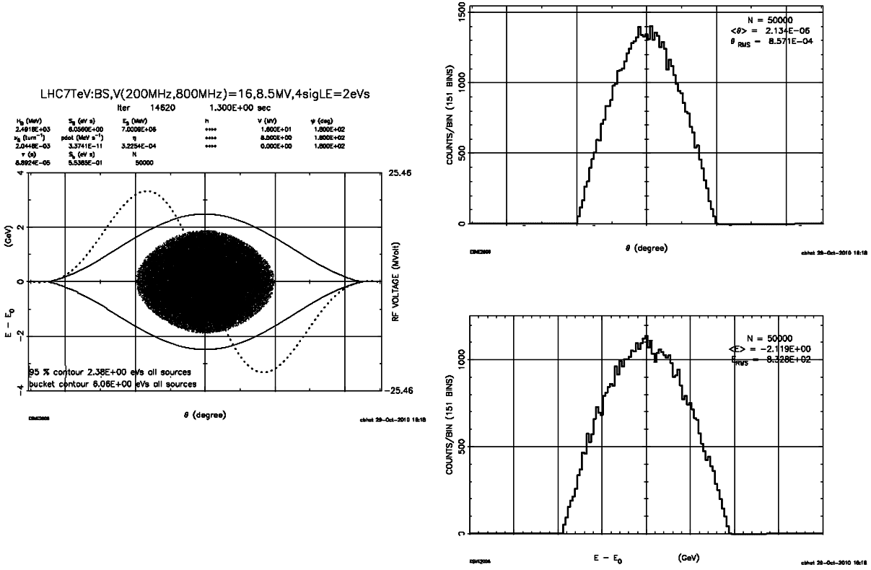
LHC Bunch Profiles for 2 eVs beam with V2/V1=-0.5, BSM (400MHz ⊕ 800MHz rf)
LE(4σ)=2 eVs
(ΔE,Δt) Distributions

Slide 14
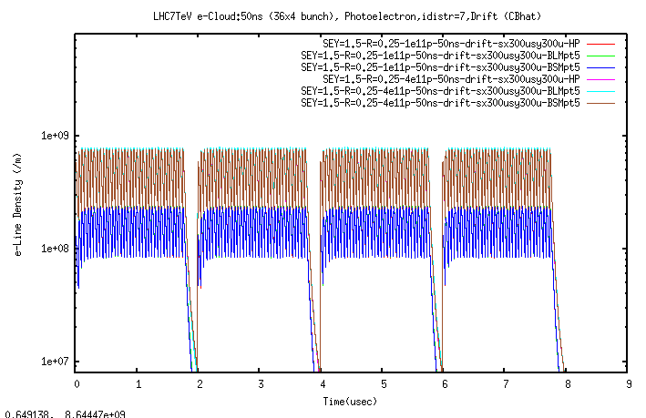
Linear Density from ECLOUD: Drift Section (50 nsec)
4E11ppb
1E11ppb

Slide 15
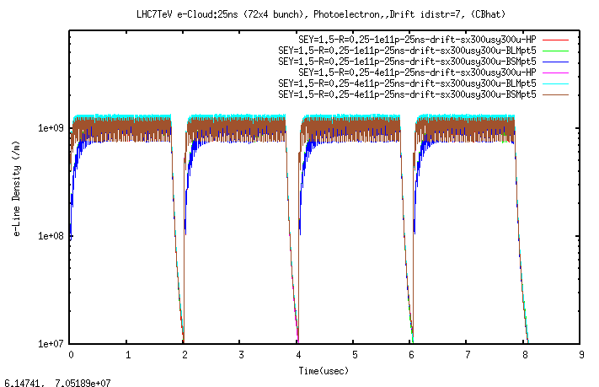
Linear Density from ECLOUD: Drift Section (25 nsec)
4E11ppb
1E11ppb

Slide 16
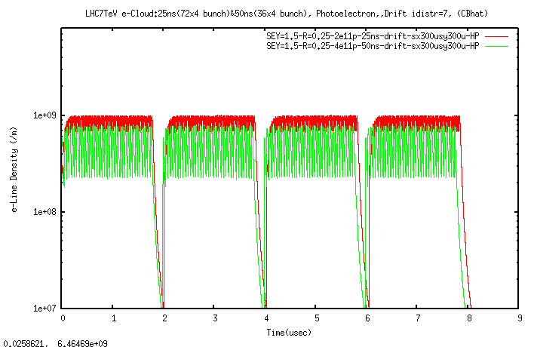
Linear Density from ECLOUD: Drift Section (25ns & 50 nsec)
Same Beam Current in the LHC
2E11ppb
25nsec
4E11ppb
50 nsec

