Slide 1
Ecloud simulations for the LHC arcs
E-cloud Simulation Meeting
Humberto Maury Cuna
September 30th, 2011

Slide 2
Outline
Electron volume density in function of the bunch intensity
Comparison between a Gaussian bunch profile and a flat one:
Electron linear density (25 ns and 50 ns)
Heat load (25ns and 50 ns)

Slide 3
Simulation parameters
Bunch spacing | Filling pattern | SEY (δ_{max}) | Reflectivity | Bunch intensity ( x 10¹⁰ p/b) | Energy
25ns | I | 1.1 – 1.7 | 0.5 | 2 - 20 | 7 TeV*
Bunch profile | Bunch length | Magnetic field | Transversal bunch size | Section
Gaussian | 7.55 cm | 8.4 T | 0.3 mm | Dipole
(I)
72bunches
72 bunches
200ns
Macroparticles = 2500

Slide 4
Results
Electron cloud density for different bunch intensities.

Slide 5
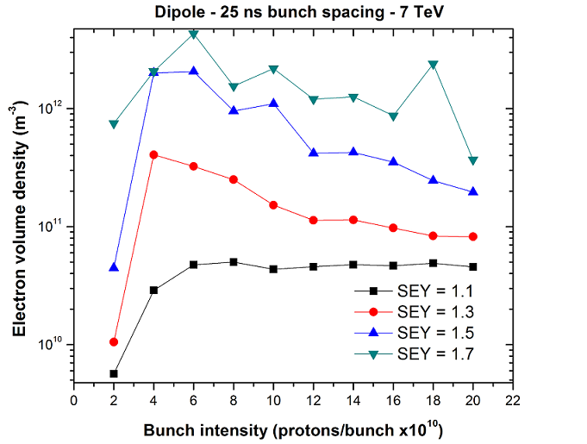

Slide 6
Simulation parameters for bunch profiles comparison
Bunch spacing | Filling pattern | SEY (δ_{max}) | Reflectivity | Bunch intensity ( x 10¹¹ p/b) | Energy
25ns 50 ns | I II | 1.7 | 0.5 | 1, 2, 3, 4, 5 | 7 TeV*
Bunch profile | Bunch length | Magnetic field | Transversal bunch size | Section
Gaussian Flat | 7.55 cm 11.8 cm | 8.4 T | 0.3 mm | Dipole
* We used a primary photoelectron emission yield =0.0015
(I)
72bunches
72 bunches
200ns
(1I)
36bunches
36 bunches
200ns
Macroparticles = 2500

Slide 7
Results
Comparison between bunch profiles at 25 ns bunch spacing.

Slide 8
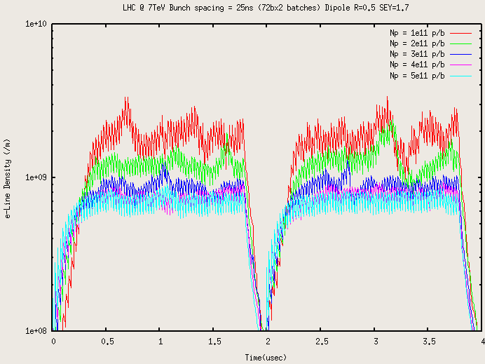
Flat bunches

Slide 9
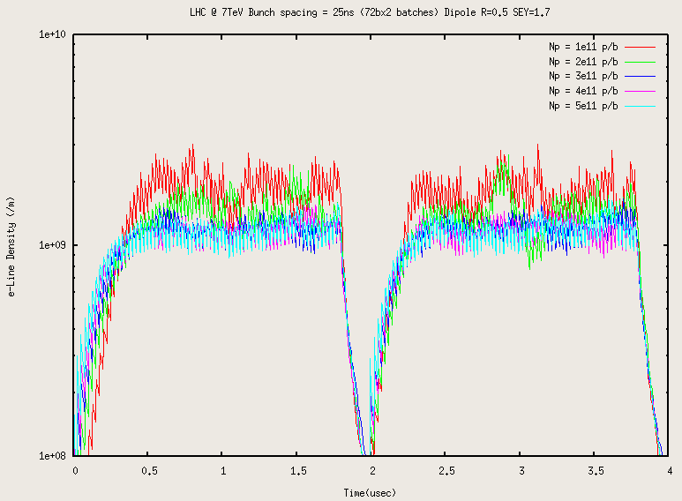
Gaussian bunches

Slide 10
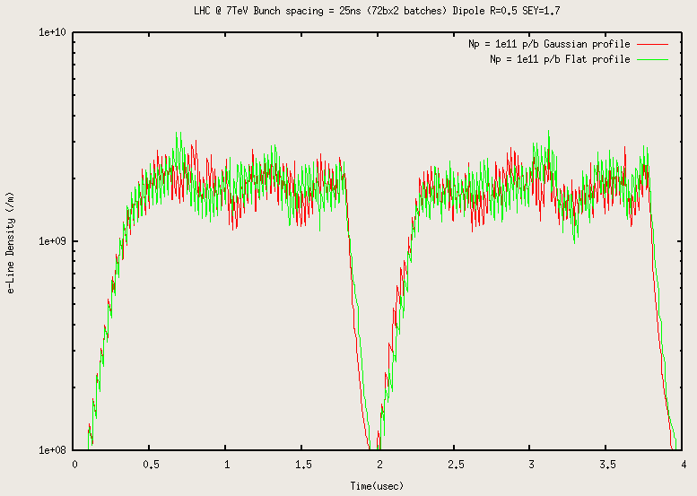
Comparison at low intensity

Slide 11
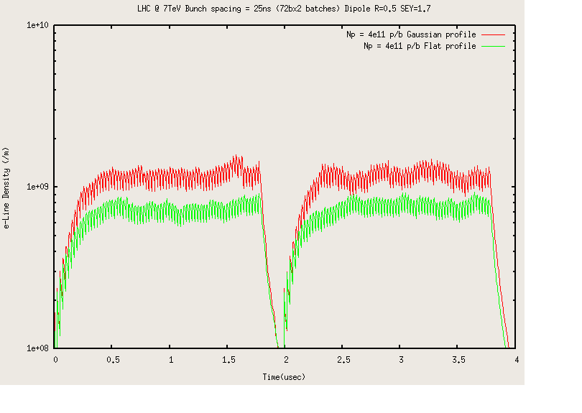
Comparison at high intensity

Slide 12
Results
Comparison between bunch profiles at 50 ns bunch spacing.

Slide 13
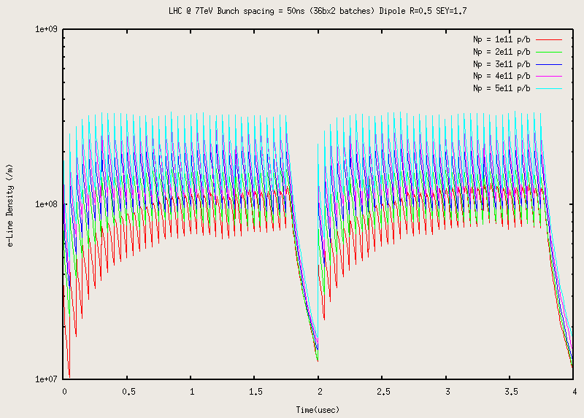
Flat bunches

Slide 14
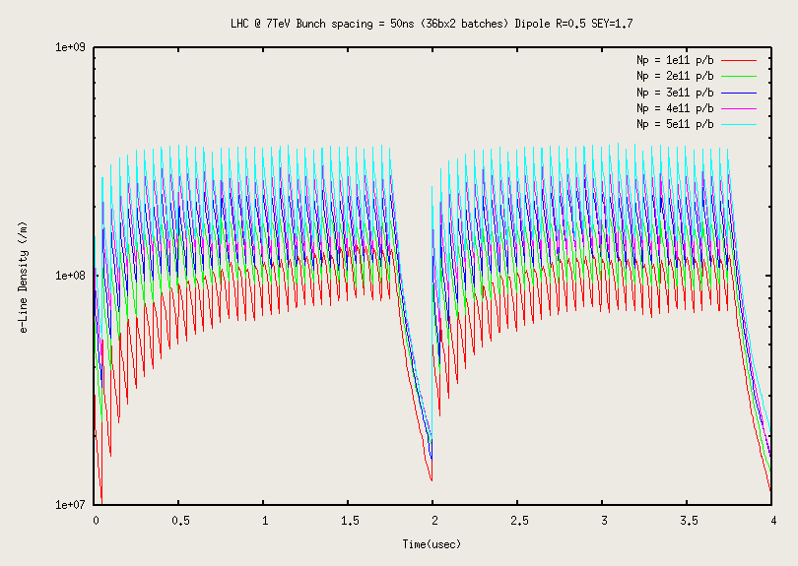
Gaussian bunches

Slide 15
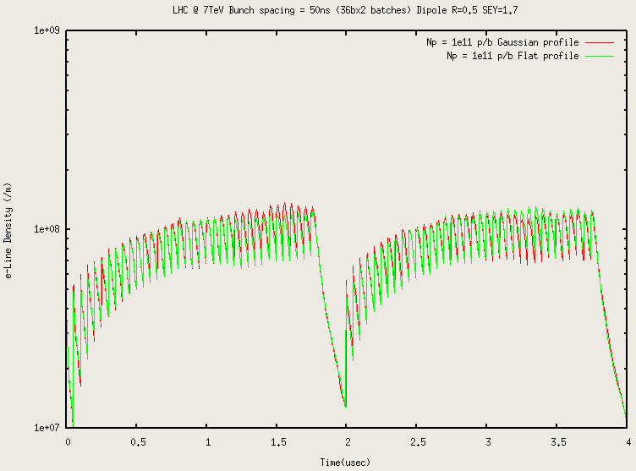

Slide 16
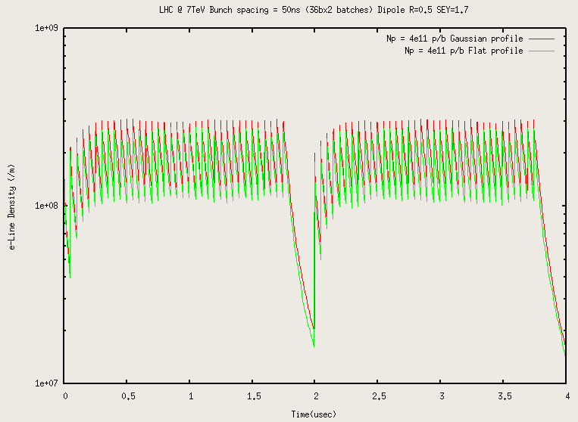
Comparison at high intensity

Slide 17
Results
Heat load for both bunch profiles.

Slide 19
Conclusions
For 25 ns:
The electron density starts to grow up until a maximum value and then decay for higher intensities.
At higher intensities we have less electron density for both profiles.
The Gaussian bunches give more e-densities than the flat ones at higher intensities.
The Flat bunches gives higher heat load values than the Gaussian ones.

Slide 20
Conclusions
For 50 ns:
At higher intensities we have more electron density for both profiles.
The Gaussian bunches give more e-densities than the flat ones at higher intensities.
The Flat bunches gives higher heat load values than the Gaussian ones. But both profiles present heat load values one order of magnitude less in comparison with 25 ns.

Slide 21
Thank you for your attention

