Slide 1
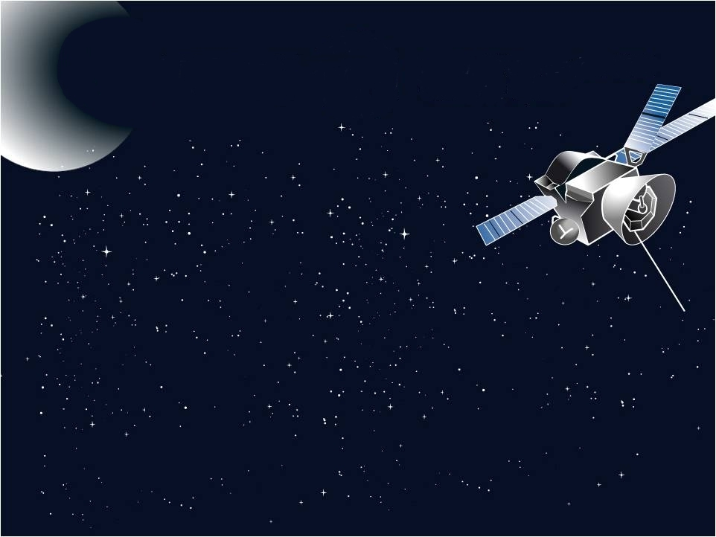
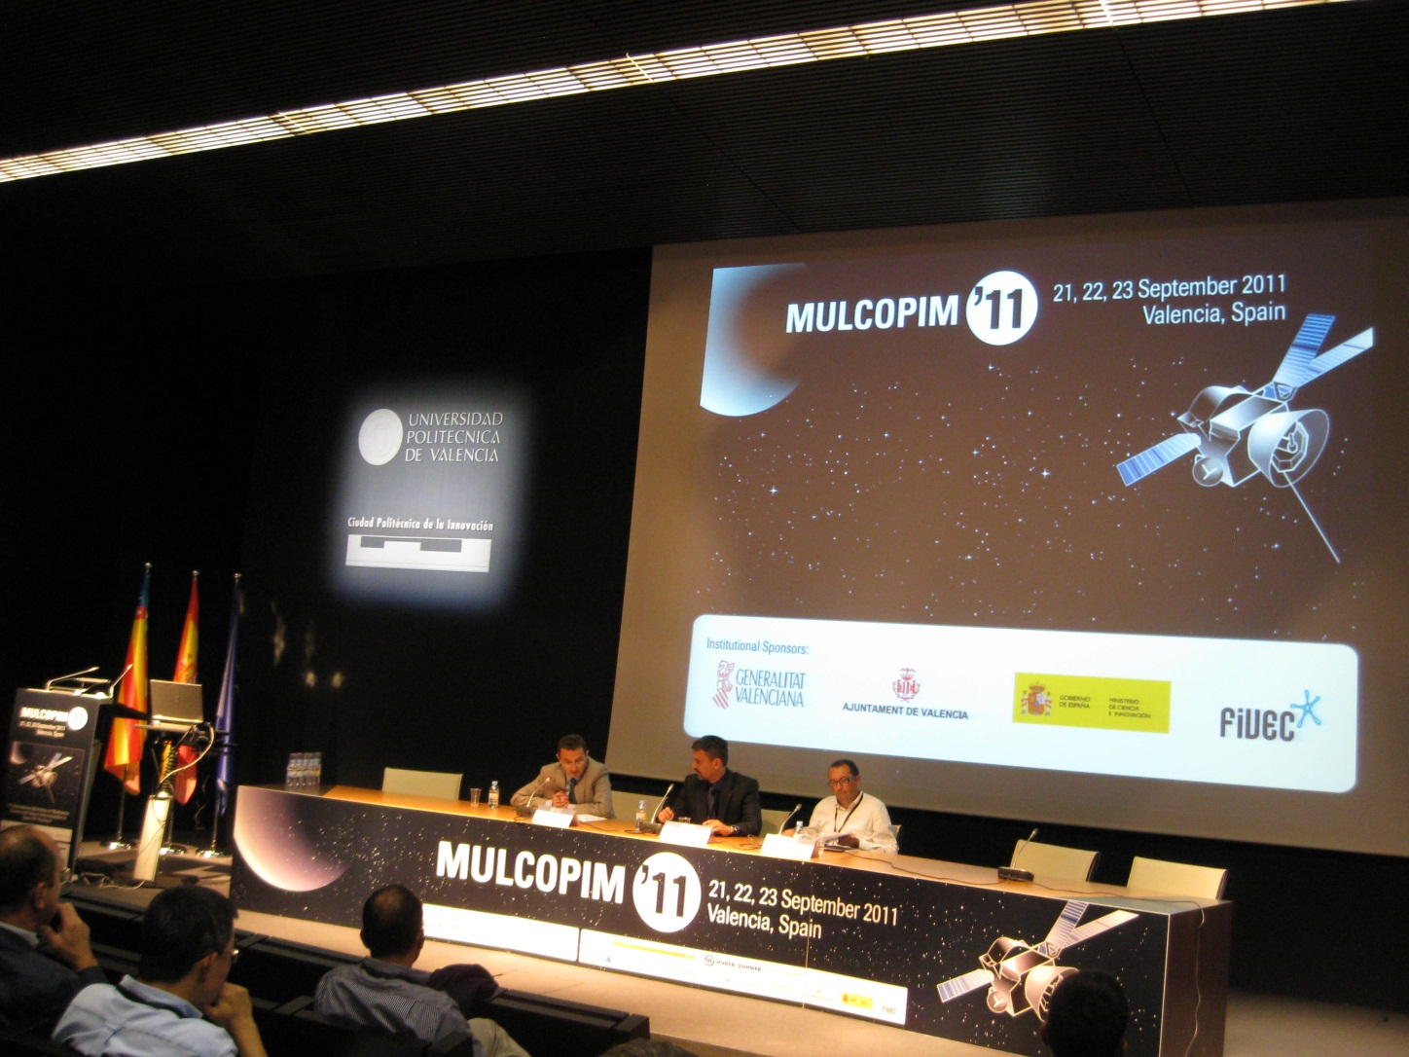
Report from MulCoPim’11
Frank Zimmermann
Ecloud Meeting 29 September 2011

Slide 2
Industrial sponsors
David Raboso, General Chairman
Notes:
2

Slide 3
Institutional sponsors
David Raboso, General Chairman
Notes:
3

Slide 4
Particle Accelerators
technical sponsors
David Raboso, General Chairman
Notes:
4

Slide 5
programme
Tuesday: 3 lectures
Wednesday: multipactor components I+II, multipactor Tx lines, multipactor dielectrics
Thursday; corona, multipactor experimental, multipactor software, multipactor multicarrier
Friday: PIM, SEY, Accelerators

Slide 6
“Accelerator People” at MulCoPim2011
Monika Balk – speaker (CST)
Micha Dehler - speaker
Octavio Dominguez - speaker
Angeles Faus-Golfe – former session co-chair
Nuria Fuster – our former summer student
Benito Gimeno – session co-chair
Manual Jimenez – speaker
Rami Kishek – speaker (Maryland)
Silvia Verdu-Andres - speaker
Walter Wunsch – cancelled (CLIC-ESA collaboration)
Frank Zimmermann – session chair

Slide 7
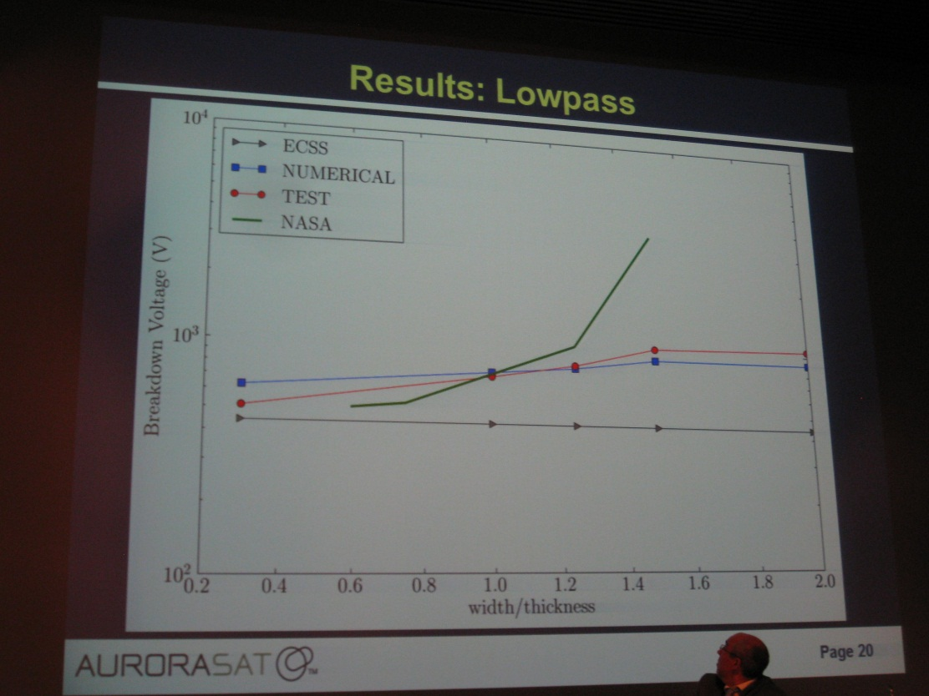
S. Anza

Slide 8
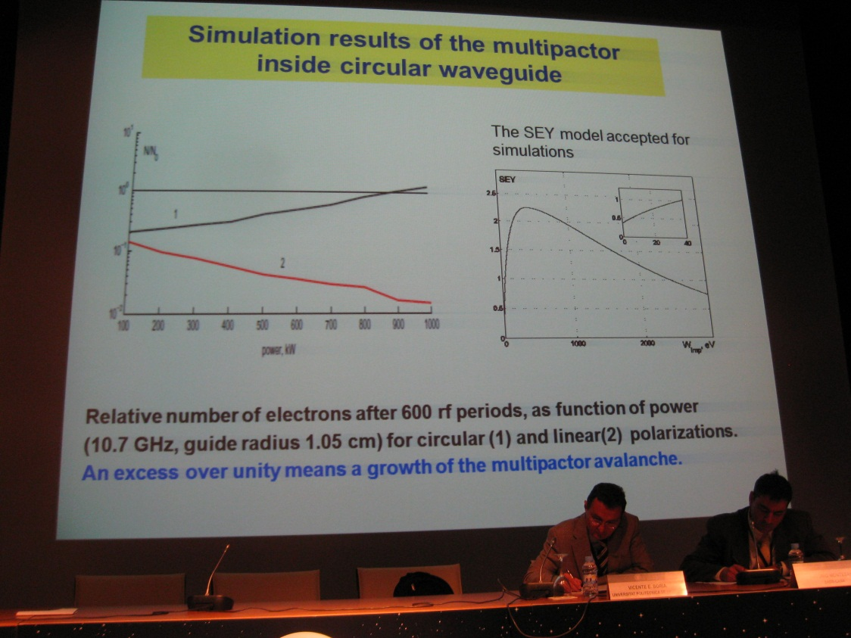
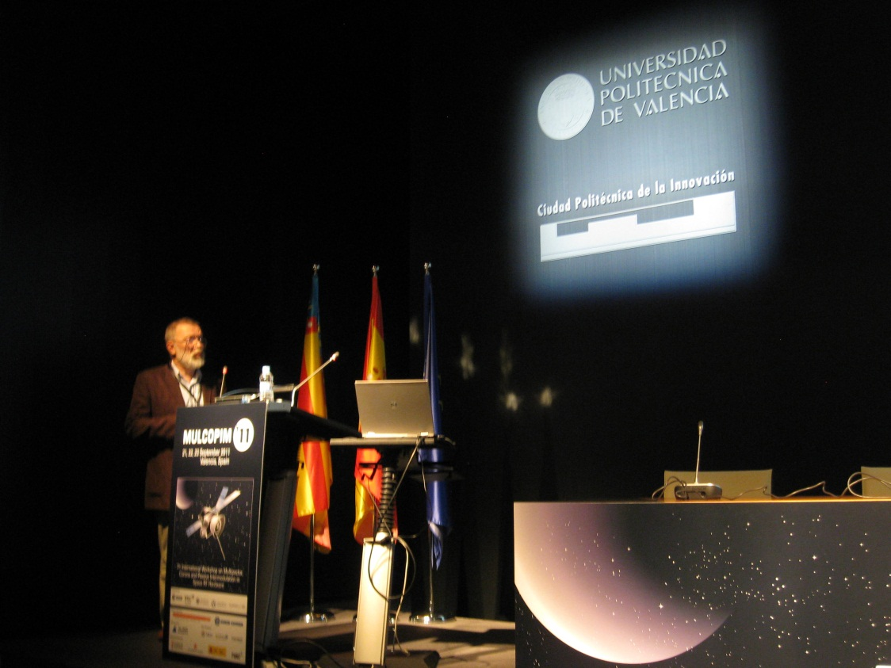
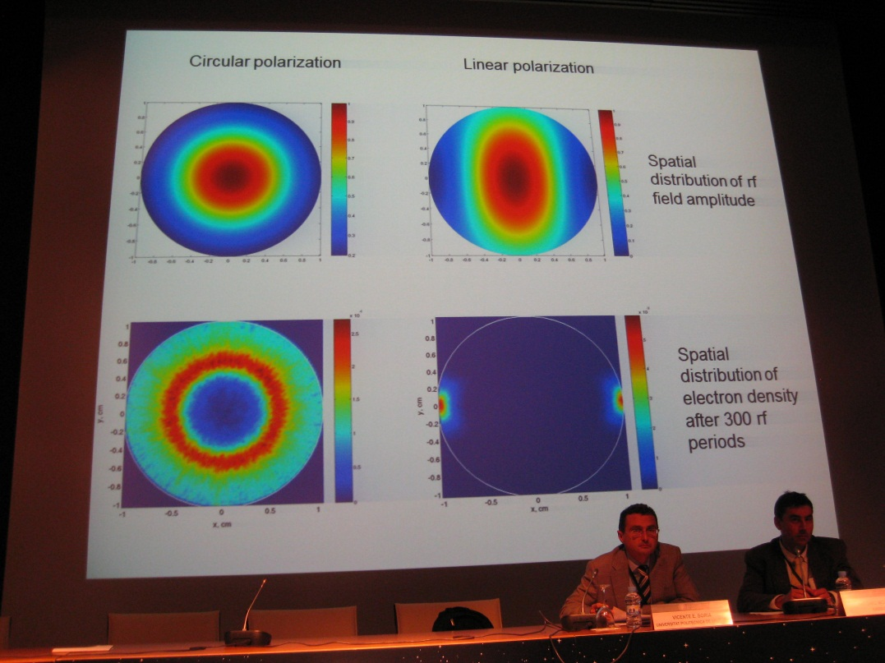
V. E. Semenov

Slide 9
A. Sounas et al

Slide 10
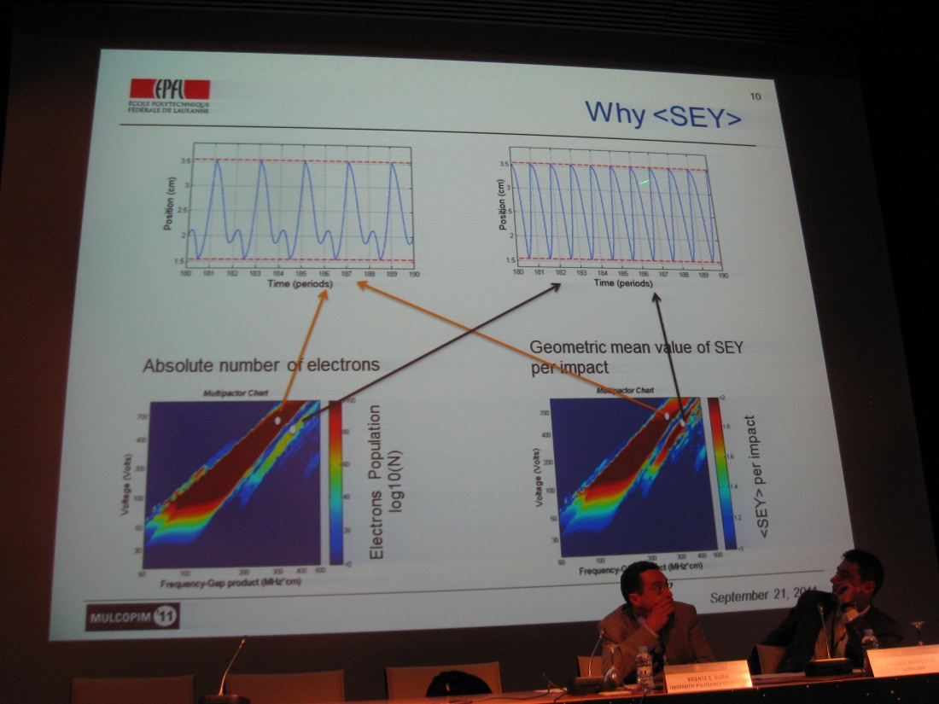

Slide 11
F.J. Perez Soler

Slide 12
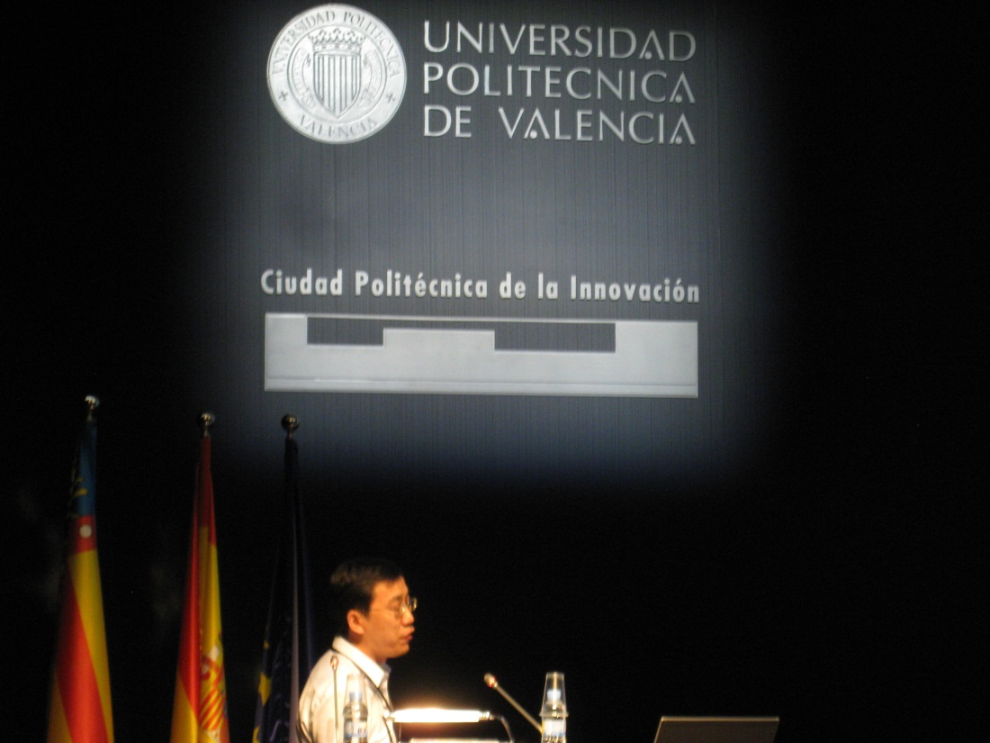
V.A. Ivanov
W.Z. Cui

Slide 13
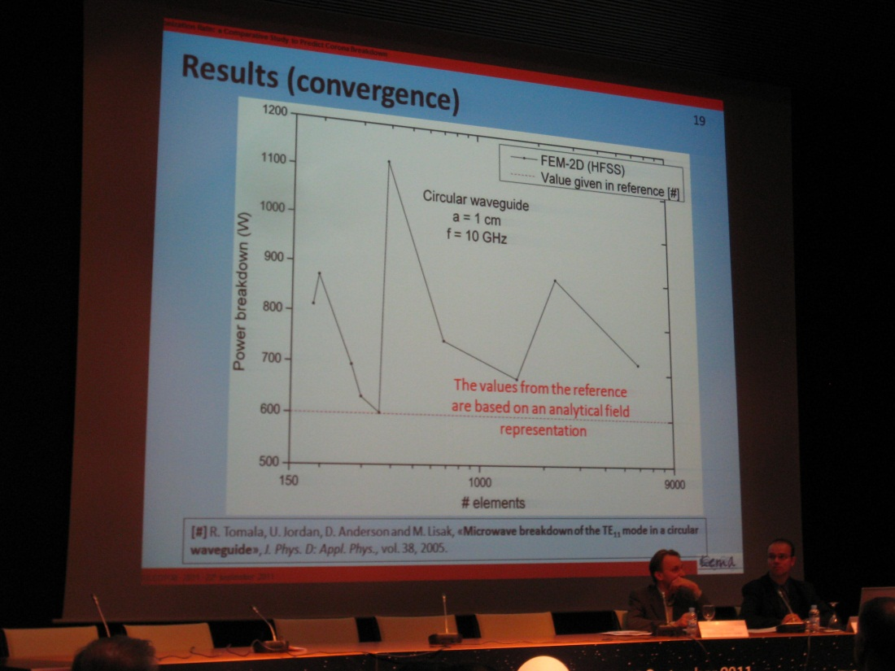
J. Rasch

Slide 14
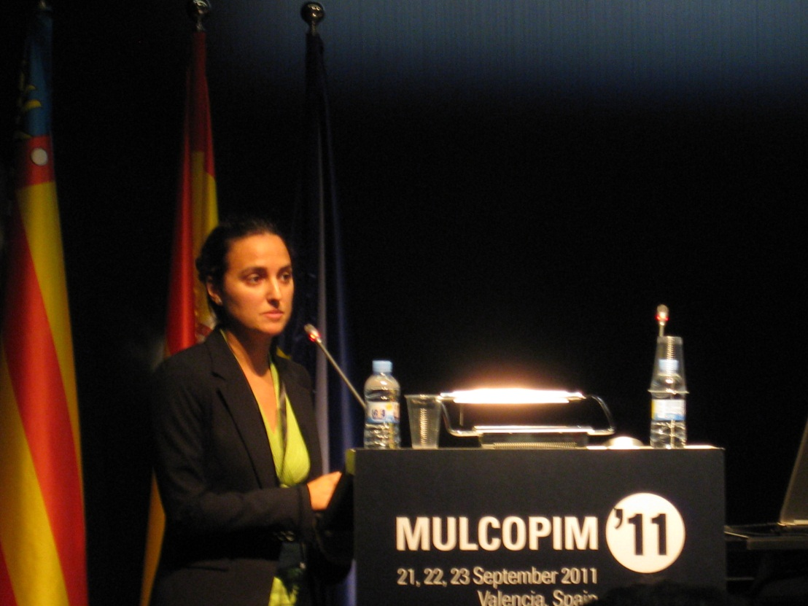
T. Pinheiro-Ortega
I.A. Kossyi, V.E. Semenov

Slide 15
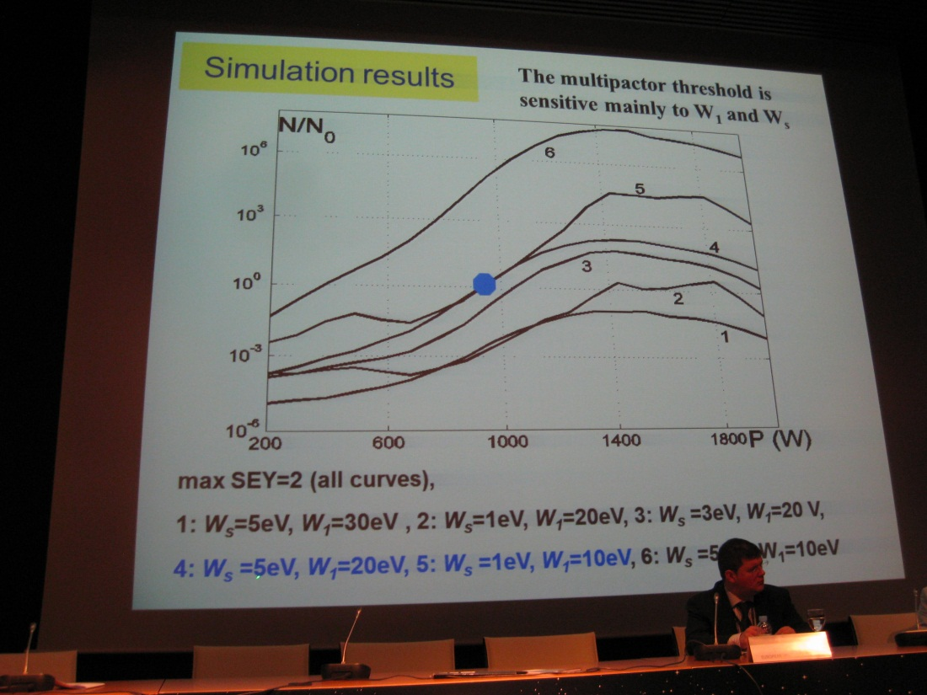
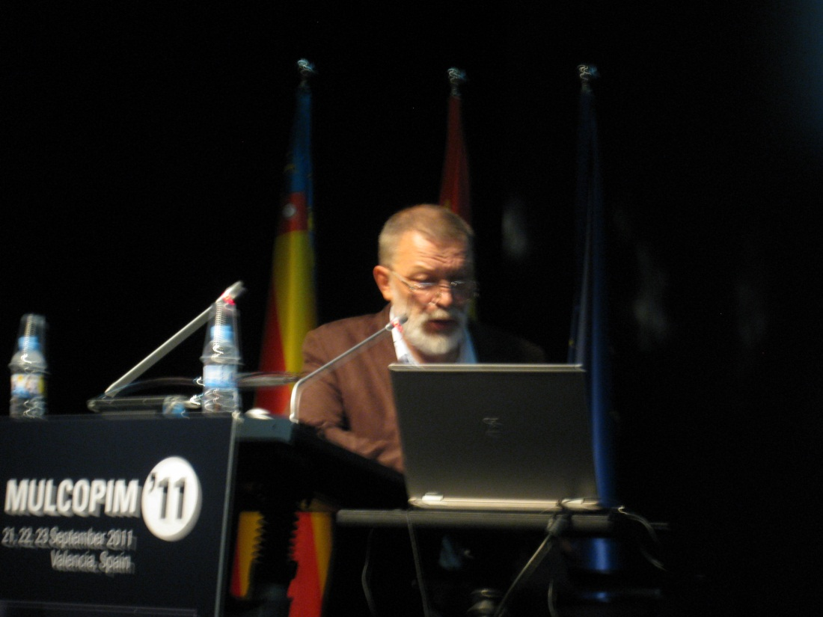
V.E. Semenov

Slide 16
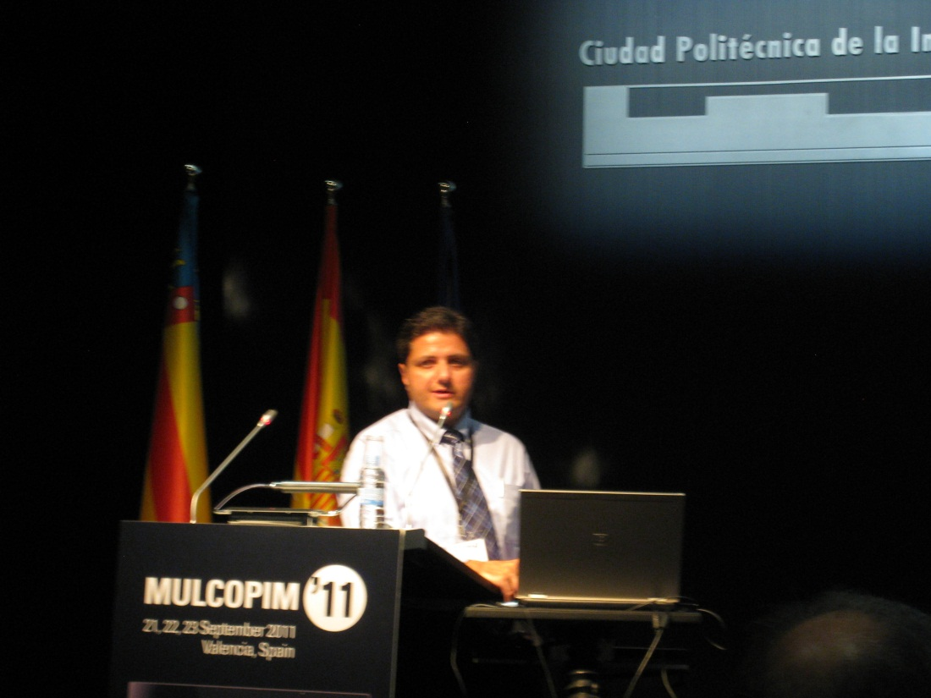
L. Esteve
R.A. Kishek

Slide 17
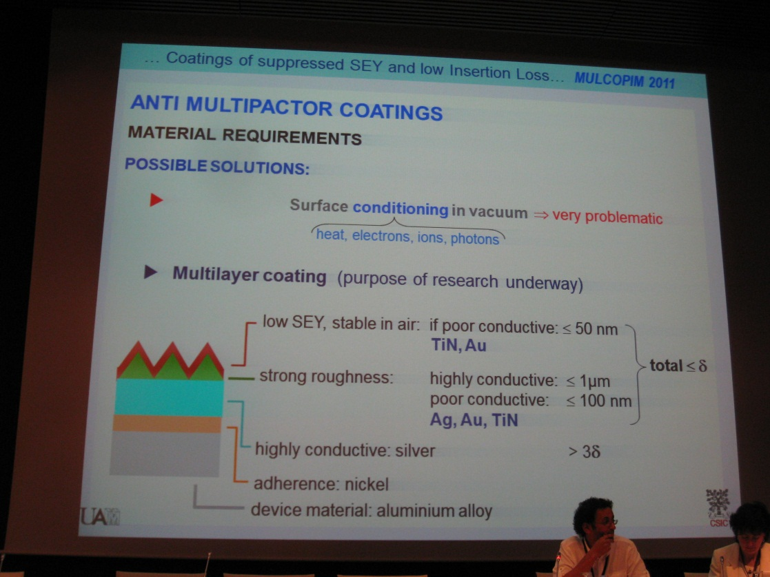
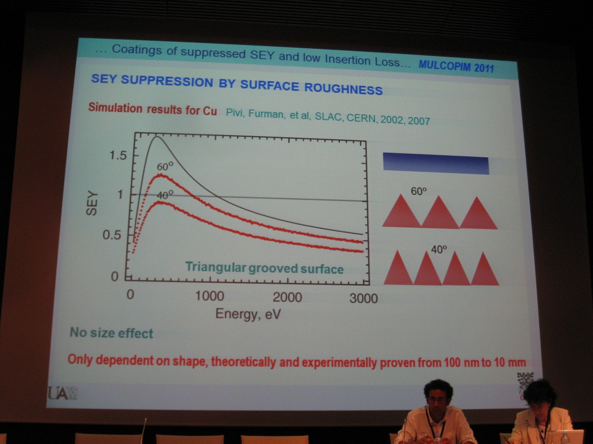
L. Galan

Slide 18
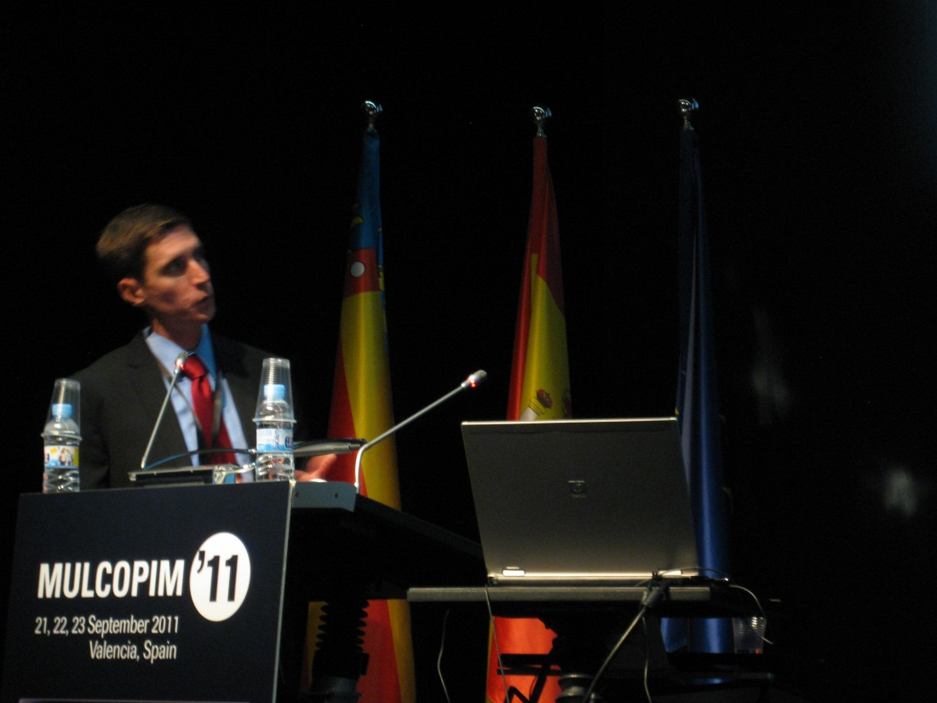
T.P. Graves

Slide 19
M. Belhaj

Slide 20
J. Roupie

Slide 21
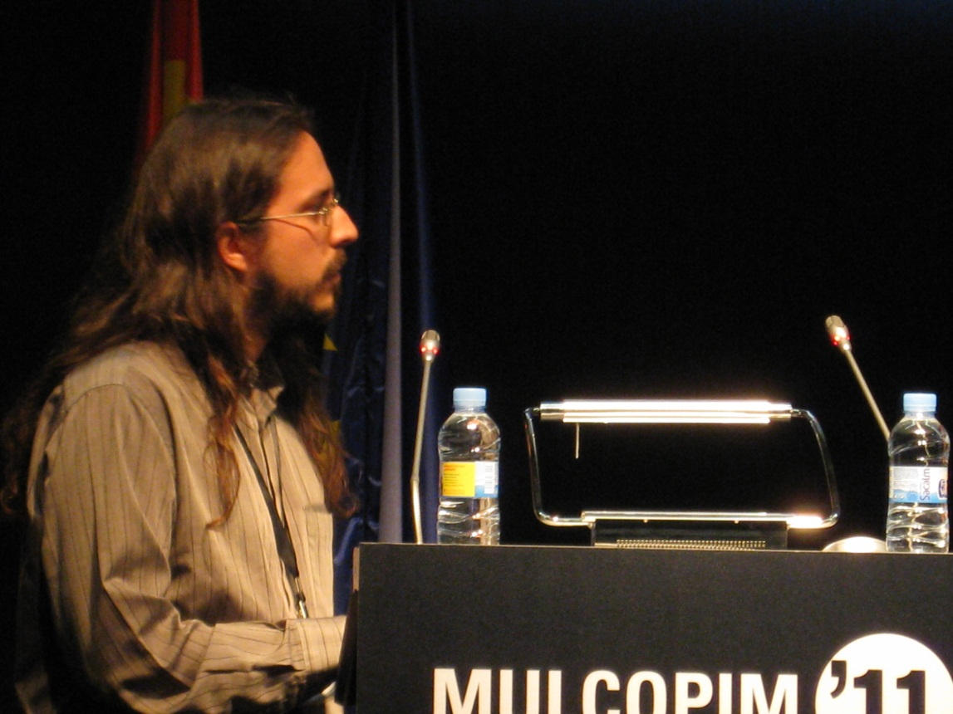
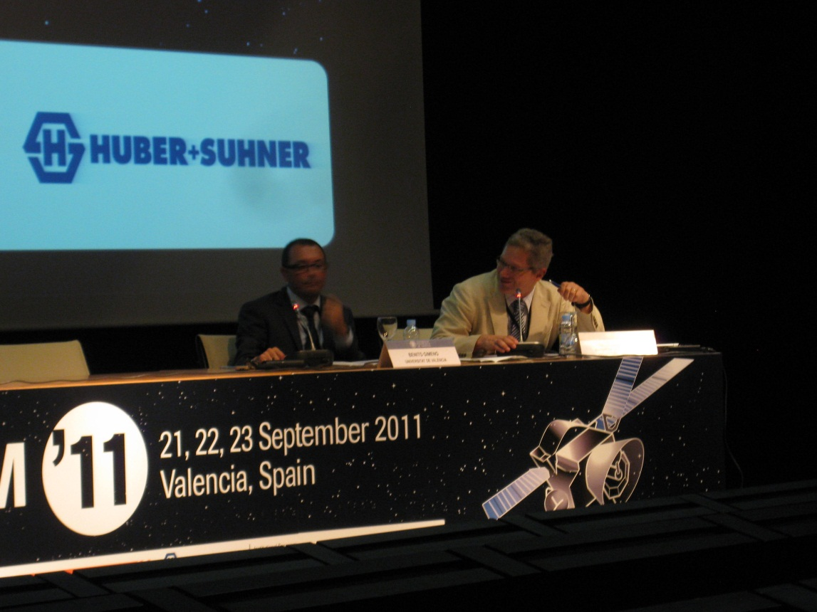
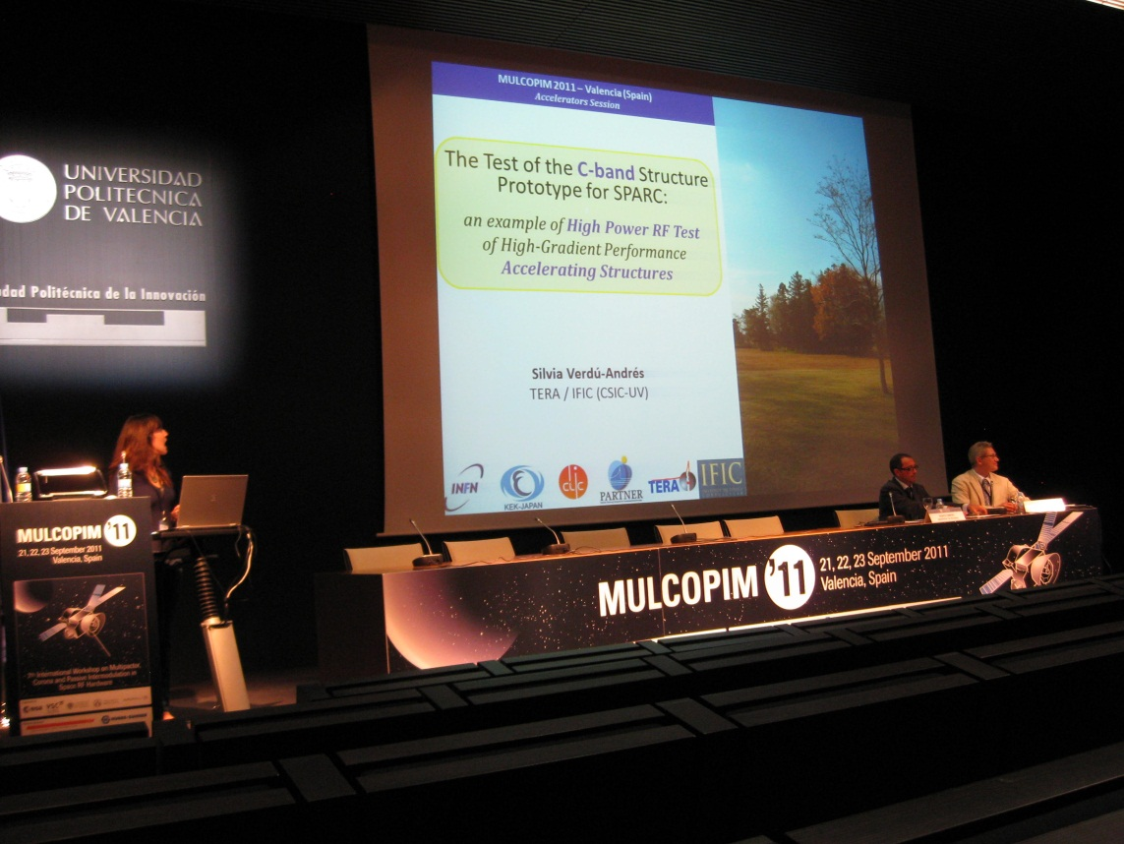
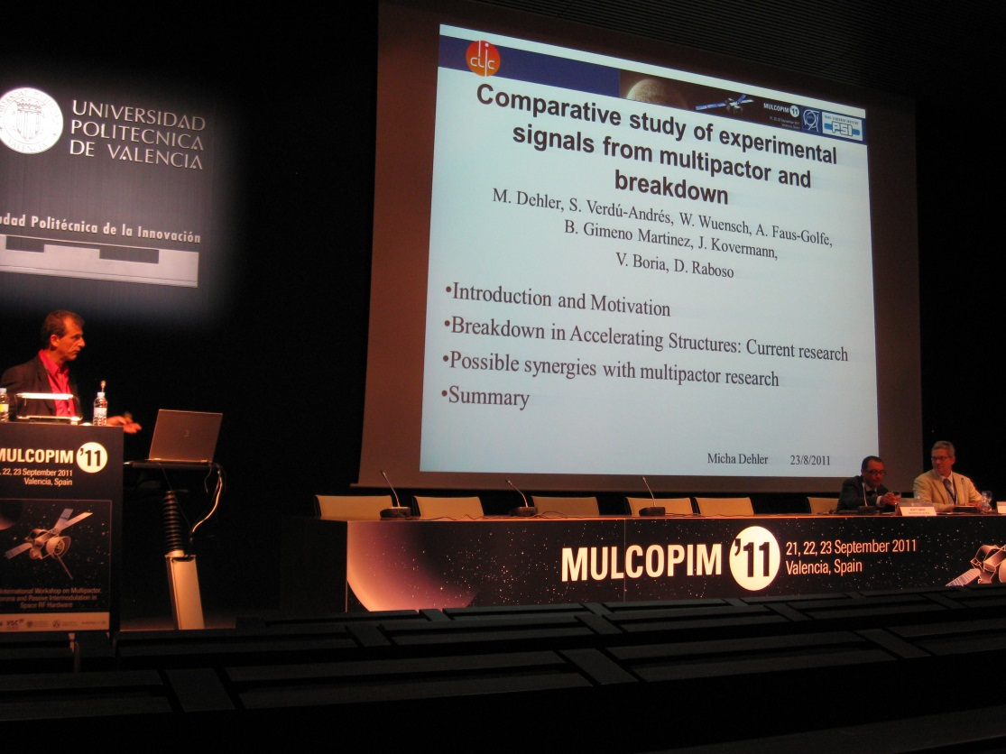
Accelerator Session

Slide 22
in conclusion
a very stimulating 3.5 days
also this community finds surface graphitization as reason for conditioning
issue of elastic reflection remains controversial; some observations and experiments suggest R=100%, other suggest R=0!?
ultimate layer against e-cloud with good conductivity is constructed by group in Spain
nice new simulation tools, FEST3D, SPARK3D, OSMOSEE,…

