Slide 1
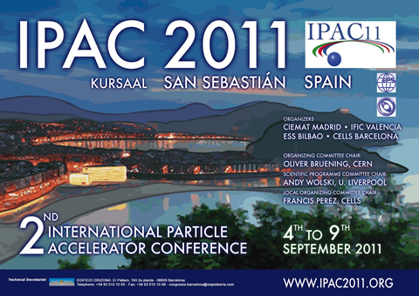
IPAC 2011: An e⁻ cloud summary
C. Octavio Domínguez

Slide 2
Outline
List of papers
Some highlights on…
Instabilities
Mitigation techniques
Instrumentation
Vacuum and surfaces
Other studies
30th September 2011 - e⁻ cloud meeting

Slide 3
Outline
List of papers
Some highlights on…
Instabilities
Mitigation techniques
Instrumentation
Vacuum and surfaces
Other studies
30th September 2011 - e⁻ cloud meeting

Slide 4
List of e⁻ cloud papers 1/6
A total of 18 papers (17 posters + 1 oral presentation) on e⁻ cloud related topics have been presented at IPAC 2011:
Instabilities
MOPS001.PDF: Electron-cloud Pinch Dynamics in Presence of Lattice Magnet Fields, Giuliano Franchetti (GSI, Darmstadt), Frank Zimmermann (CERN, Geneva)
MOPS069.PDF : Review of Beam Instabilities in the Presence of Electron Clouds in the LHC, Kevin Shing Bruce Li, Giovanni Rumolo (CERN, Geneva)
MOPS084.PDF : Status of Electron Cloud Dynamics Measurements at CESRTA, Michael Gerard Billing, Gerald Dugan, Michael Forster, David Louis Kreinick, Robert Edwin Meller, Mark Alan Palmer, Gabriel Ramirez, Matthew Rendina, Nate Rider, John Sikora, Kiran G. Sonnad, Heather Williams (CLASSE, Ithaca, New York), Jennifer Yuenjane Chu (CMU, Pittsburgh, Pennsylvania), Robert Holtzapple, Matthew Randazzo (CalPoly, San Luis Obispo, California), John Walter Flanagan (KEK, Ibaraki)
MOPS088.PDF : Simulation of Electron Cloud Beam Dynamics for CesrTA , Kiran G. Sonnad, Gerald Dugan, Mark Alan Palmer, Gabriel Ramirez, Heather Williams (CLASSE, Ithaca, New York), Kaitlin Butler (Cornell University, Ithaca, New York), Mauro Torino Francesco Pivi (SLAC, Menlo Park, California)
30th September 2011 - e⁻ cloud meeting

Slide 5
List of e⁻ cloud papers 2/6
Mitigation techniques
MOPS083.PDF : Update on Electron Cloud Mitigation Studies at Cesr-TA, Joseph Calvey, Michael Gerard Billing, Joseph Vincent Conway, Gerald Dugan, Shlomo Greenwald, Yulin Li, Xianghong Liu, Jesse Alexander Livezey, Junki Makita, Robert Edwin Meller, Mark Alan Palmer, Steven Santos, Robert Schwartz, John Sikora, Charles Ralph Strohman (CLASSE, Ithaca, New York), Sergio Calatroni, Giovanni Rumolo (CERN, Geneva), Ken-ichi Kanazawa, Yusuke Suetsugu (KEK, Ibaraki), Mauro Torino Francesco Pivi, Lanfa Wang (SLAC, Menlo Park, California)
TUPC030.PDF : Recommendation for Mitigations of the Electron Cloud Instability in the ILC, Mauro Torino Francesco Pivi, Lanfa Wang (SLAC, Menlo Park, California), Laura Boon, Katherine C. Harkay (ANL, Argonne), Christina Yin Vallgren (CERN, Geneva; Chalmers University of Technology, Gothenburg), James Arthur Crittenden, Gerald Dugan, Mark Alan Palmer (CLASSE, Ithaca, New York), Theo Demma, Susanna Guiducci (INFN/LNF, Frascati (Roma)), Kazuhito Ohmi, Kyo Shibata, Yusuke Suetsugu, Junji Urakawa (KEK, Ibaraki), Miguel Furman (LBNL, Berkeley, California)
30th September 2011 - e⁻ cloud meeting

Slide 6
List of e⁻ cloud papers 3/6
Instrumentation
TUPC170.PDF : Resonant TE Wave Measurements of Electron Cloud Densities at CesrTA John Sikora, Michael Gerard Billing, Mark Alan Palmer, Kiran G. Sonnad (CLASSE, Ithaca, New York), Benjamin Carlson (CMU, Pittsburgh, Pennsylvania), Kenneth Hammond (Harvard University, Cambridge, Massachusetts), Stefano De Santis (LBNL, Berkeley, California)
MOPS089.PDF : Identification of Bunch Dynamics in the Presence of E-cloud and TMCI for the CERN SPS Ring , Ozhan Turgut, John Fox, Claudio Hector Rivetta, Sho Uemura (SLAC, Menlo Park, California), Wolfgang Höfle (CERN, Geneva)
30th September 2011 - e⁻ cloud meeting

Slide 7
List of e⁻ cloud papers 4/6
Vacuum and surfaces
TUPS018.PDF : Observations of Electron Cloud Effects with the LHC Vacuum System, Vincent Baglin, Giuseppe Bregliozzi, Paolo Chiggiato, Paul Cruikshank, Bernard Henrist, José Miguel Jimenez, Giulia Lanza (CERN, Geneva)
TUPS023.PDF : Secondary Electron Yield on Cryogenic Surfaces as a Function of Physisorbed Gases, Asena Kuzucan, Holger Neupert, Mauro Taborelli (CERN, Geneva), Herbert Stoeri (IAP TUW, Wien)
TUPS027.PDF : Characterization of Carbon Coatings with Low Secondary Electron Yield, Christina Yin Vallgren, Sergio Calatroni, Pedro Costa Pinto, Asena Kuzucan, Holger Neupert, Mauro Taborelli (CERN, Geneva)
TUPS028.PDF : Performance of Carbon Coating for Mitigation of Electron Cloud in the SPS, Christina Yin Vallgren, Paolo Chiggiato, Pedro Costa Pinto, Holger Neupert, Giovanni Rumolo, Elena Shaposhnikova, Mauro Taborelli (CERN, Geneva)
30th September 2011 - e⁻ cloud meeting

Slide 8
List of e⁻ cloud papers 5/6
Other studies
MOPS053.PDF: Electron Cloud Effects in Coasting Heavy-ion Beams, Fedor Petrov, Thomas Weiland (TEMF, TU Darmstadt, Darmstadt), Oliver Boine-Frankenheim (GSI, Darmstadt)
MOPS056.PDF : An Analytical Formula of the Electron Cloud Linear Map Coefficient in a Strong Dipole, Theo Demma (INFN/LNF, Frascati (Roma)), Giovanni Rumolo (CERN, Geneva), Stefania Petracca, Arturo Stabile (U. Sannio, Benevento)
MOPS091.PDF : Study of Electron Cloud for MEIC Shahid Ahmed, Justin Don Dolph, Geoffrey Arthur Krafft, Todd Satogata, Byung Chel Yunn (JLAB, Newport News, Virginia)
TUPZ003.PDF : Simulation of Electron-cloud Build-Up for the Cold Arcs of the LHC and Comparison with Measured Data, Georfrey Humberto Israel Maury Cuna (CINVESTAV, Mérida), Gianluigi Arduini, Giovanni Rumolo, Laurent Tavian, Frank Zimmermann (CERN, Geneva)
TUPZ015.PDF : Electron Cloud Parameterization Studies in the LHC, César Octavio Domínguez, Gianluigi Arduini, Vincent Baglin, Giuseppe Bregliozzi, José Miguel Jimenez, Elias Métral, Giovanni Rumolo, Daniel Schulte, Frank Zimmermann (CERN, Geneva)
30th September 2011 - e⁻ cloud meeting

Slide 9
List of e⁻ cloud papers 6/6
Oral presentation (by Giovanni)
THOBA01.PDF : Electron Cloud Observations in LHC, Giovanni Rumolo, Gianluigi Arduini, Vincent Baglin, Hannes Bartosik, Philippe Baudrenghien, Nicolo Biancacci, Giuseppe Bregliozzi, Serge Claudet, Riccardo De Maria, Juan Esteban Muller, Mathilde Favier, Christian Hansen, Wolfgang Höfle, José Miguel Jimenez, Verena Kain, Eirini Koukovini, Giulia Lanza, Kevin Shing Bruce Li, Georfrey Humberto Israel Maury Cuna, Elias Métral, Giulia Papotti, Tatiana Pieloni, Federico Roncarolo, Benoit Salvant, Elena Shaposhnikova, Ralph Jeffrey Steinhagen, Laurent Tavian, Daniel Valuch, Walter Venturini Delsolaro, Frank Zimmermann (CERN, Geneva), Ubaldo Iriso (CELLS-ALBA Synchrotron, Cerdanyola del Vallès), Nicolas Mounet, Carlo Zannini (EPFL, Lausanne), Chandra Bhat (Fermilab, Batavia)
30th September 2011 - e⁻ cloud meeting

Slide 10
Outline
List of papers
Some highlights on…
Instabilities
Mitigation techniques
Instrumentation
Vacuum and surfaces
Other studies
30th September 2011 - e⁻ cloud meeting

Slide 11
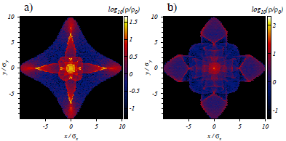
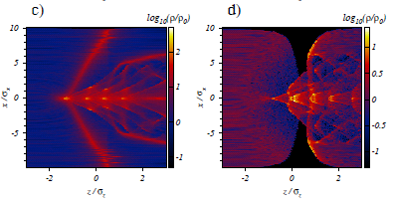
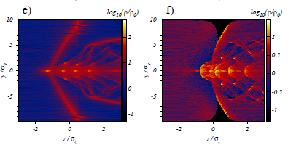
Some highlights… Instabilities 1/3
MOPS001.PDF: Electron-cloud Pinch Dynamics in Presence of Lattice Magnet Fields, Giuliano Franchetti (GSI, Darmstadt) and Frank Zimmermann (CERN, Geneva)
Study of the strong field approximation for the electron pinch in quadrupoles and sextupoles.
Evaluation of the relative magnitude of the peak tune shift along the bunch expected for the different fields.
30th September 2011 - e⁻ cloud meeting

Slide 12
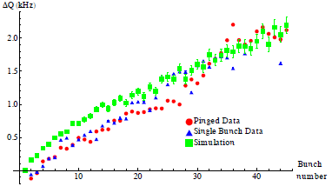
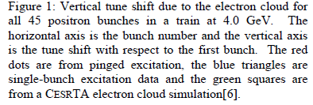
Some highlights… Instabilities 2/3
MOPS084.PDF : Status of Electron Cloud Dynamics Measurements at CESRTA, Michael Gerard Billing (CLASSE, Ithaca, New York) et al.
Report on the most recent observations and results for e⁻ cloud dynamics at CesrTA.
Three basic observations:
Tune shifts of individual bunches along a train
Detection of the coherent self-excited spectrum for each bunch within a train
Pulsed excitation of either the betatron dipole or head-tail mode for each individual bunch within the train
30th September 2011 - e⁻ cloud meeting

Slide 13
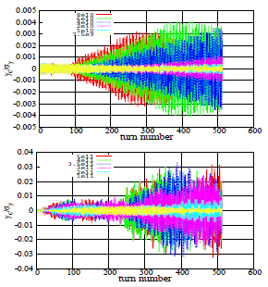
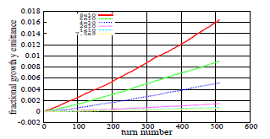
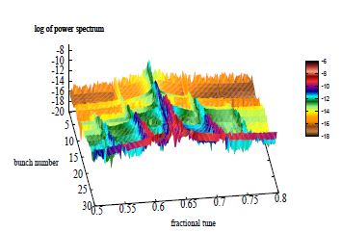
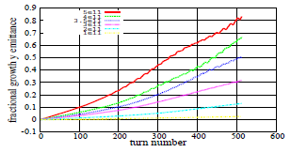
Some highlights… Instabilities 3/3
MOPS088.PDF: Simulation of Electron Cloud Beam Dynamics for CesrTA , Kiran G. Sonnad (CLASSE, Ithaca, New York) et al.
e⁻ cloud simulation studies (using CMAD code) for CesrTA (test facility for understanding physics associated with e⁻ and e⁺ damping rings), focused on positron beams.
Study of head-tail motion, emittace growth and incoherent tune shifts.
Simulations reproduce qualitatively experimental observations (CMAD improvement needed).
30th September 2011 - e⁻ cloud meeting

Slide 14
Outline
List of papers
Some highlights on…
Instabilities
Mitigation techniques
Instrumentation
Vacuum and surfaces
Other studies
30th September 2011 - e⁻ cloud meeting

Slide 15
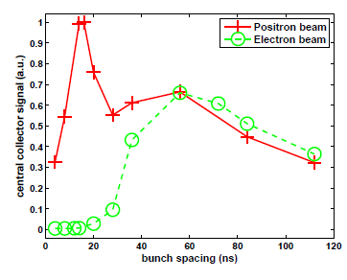
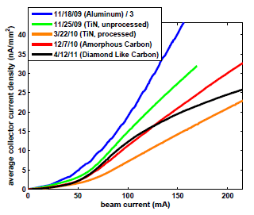
Some highlights… Mitigation techniques 1/2
MOPS083.PDF : Update on Electron Cloud Mitigation Studies at Cesr-TA, Joseph Calvey (CLASSE, Ithaca, New York) et al.
Several Retarding Field Analyzers (RFAs) have been installed in CESR. These devices provide information on the local electron cloud density and energy distribution.
A RFA measures the flux of the electron cloud on the vacuum chamber wall, from which we can infer the local cloud density. It can also measure the energy distribution of the cloud.
In addition, most RFAs allow characterization of the geometry of the cloud build-up.
The RFAs have been used to evaluate the efficacy of different cloud mitigation techniques (bunch spacing, coatings, etc.).
30th September 2011 - e⁻ cloud meeting

Slide 16
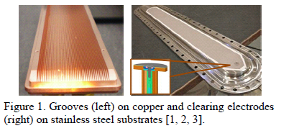
Some highlights… Mitigation techniques 2/2
TUPC030.PDF : Recommendation for Mitigations of the Electron Cloud Instability in the ILC, Mauro Torino Francesco Pivi (SLAC, Menlo Park, California) et al.
Mitigation options for ILC: Coatings, clearing electrodes, grooves and novel concepts.
A recommendation process is presented including efficacy of mitigations, costs, risks and impact on the machine performance (evaluating several issues in each step).
Decision criteria for that process are shown.
30th September 2011 - e⁻ cloud meeting

Slide 17
Outline
List of papers
Some highlights on…
Instabilities
Mitigation techniques
Instrumentation
Vacuum and surfaces
Other studies
30th September 2011 - e⁻ cloud meeting

Slide 18
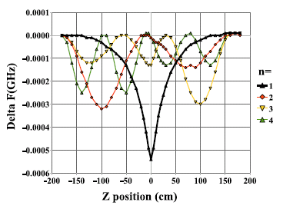
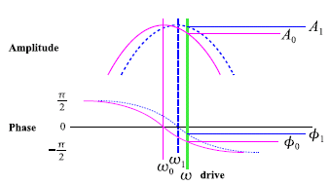
Some highlights… Instrumentation 1/1
TUPC170.PDF : Resonant TE Wave Measurements of Electron Cloud Densities at CesrTA John Sikora (CLASSE, Ithaca, New York) et al.
Measurements of e⁻ cloud densities have been made at CesrTA using the TE Wave transmission technique → problems due to beam pipe discontinuities
New approach: Resonant cavity and theory for the measurement of plasma densities in cavities.
The cutoff resonance should be very useful in enabling localized measurements, so it will be the subject of further study. A method to identify it in situ is also needed.
30th September 2011 - e⁻ cloud meeting

Slide 19
Outline
List of papers
Some highlights on…
Instabilities
Mitigation techniques
Instrumentation
Vacuum and surfaces
Other studies
30th September 2011 - e⁻ cloud meeting

Slide 20
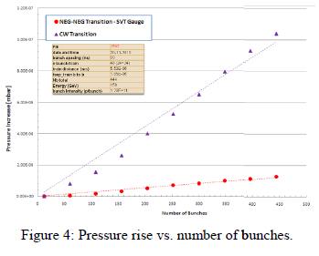
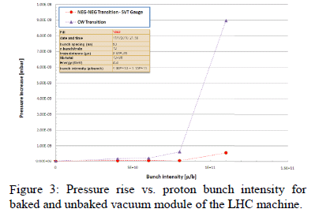
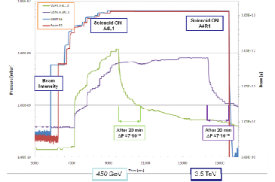
Some highlights… Vacuum and surfaces 1/4
TUPS018.PDF : Observations of Electron Cloud Effects with the LHC Vacuum System, Vincent Baglin (CERN, Geneva) et al.
Summary of the e⁻ cloud vacuum observations at the LHC
30th September 2011 - e⁻ cloud meeting

Slide 21
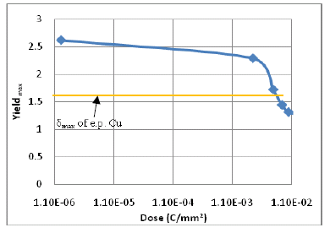
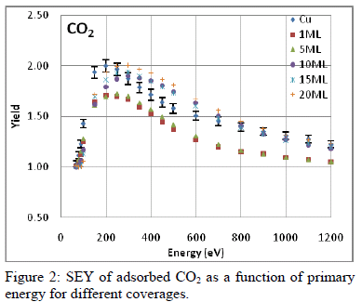
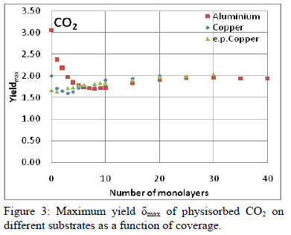
Some highlights… Vacuum and surfaces 2/4
TUPS023.PDF : Secondary Electron Yield on Cryogenic Surfaces as a Function of Physisorbed Gases, Asena Kuzucan (CERN, Geneva) et al.
At low surface temperatures, the SEY is strongly influenced by the nature of the physisorbed gases and by the corresponding surface coverage.
Study of the variation of the SEY of copper, aluminum and electro-polished copper as a function of physisorbed N₂, CO, CO₂, CH₄, Kr, C₂H₆ at cryogenic temperatures.
Conditioning by electron bombardment of the surface after the physisorption of H2O on electro-polished copper will also be presented.
The results of the various gases are compared in order to find a rationale for the behavior of the secondary electrons for the various adsorbates.
The SEY of the physisorbed layers of the different gases at 4.7K on copper and aluminum show a non monotonic behavior as a function of coverage.
Water and CO₂ are the potentially most perturbing adsorbates from the point of view of SEY and hence electron cloud.
30th September 2011 - e⁻ cloud meeting

Slide 22
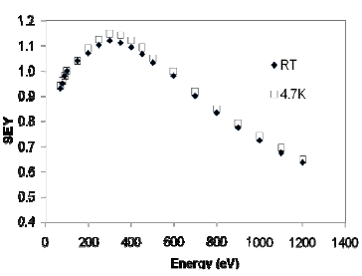
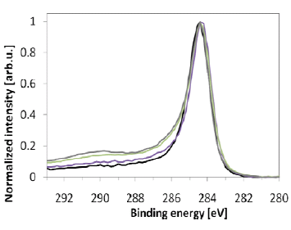
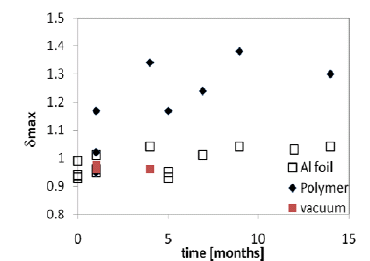
Some highlights… Vacuum and surfaces 3/4
TUPS027.PDF : Characterization of Carbon Coatings with Low Secondary Electron Yield, Christina Yin Vallgren et al. (CERN, Geneva)
Studies on a-C (SEY ≈ 1) are presented.
Analysis by XPS shows a correlation between the line shape of C1s spectrum in XPS and the maximum SEY of the investigated samples.
The increase of the SEY with air exposure time on each individual sample is related to the amount of oxygen containing adsorbates.
Storage in different environments has been investigated (static vacuum, aluminium foil, dry nitrogen and desiccators) → different aging behavior.
The SEY of a-C coatings is independent of the temperature in the range 4.7 K – RT.
30th September 2011 - e⁻ cloud meeting

Slide 23
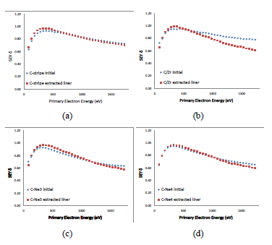
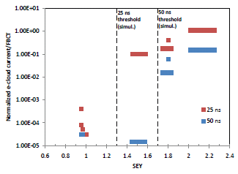
Some highlights… Vacuum and surfaces 4/4
TUPS028.PDF : Performance of Carbon Coating for Mitigation of Electron Cloud in the SPS, Christina Yin Vallgren et al. (CERN, Geneva)
Amorphous carbon (a-C) coatings have been tested in electron cloud monitors (ECM) in the SPS and have shown for LHC type beams a reduction of the electron cloud current by a factor 10⁴ compared to StSt.
The compatibility of coexisting StSt and a-C surfaces has been studied in an ECM having coated and uncoated areas.
The results show no degradation of the properties of the a-C areas in 3 years.
A complete suppression of e-cloud can be achieved by coating of liners with a thin layer of a-C (SEY ≈1.0 ).
30th September 2011 - e⁻ cloud meeting

Slide 24
Outline
List of papers
Some highlights on…
Instabilities
Mitigation techniques
Instrumentation
Vacuum and surfaces
Other studies
30th September 2011 - e⁻ cloud meeting

Slide 25
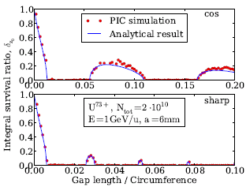
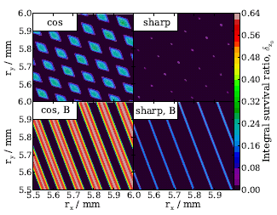
Some highlights… Other studies 1/3
MOPS053.PDF: Electron Cloud Effects in Coasting Heavy-ion Beams, Fedor Petrov (TEMF, TU Darmstadt, Darmstadt) et al.
To avoid EC build-up in a heavy-ion coasting beam (SIS-18 at GSI) one can introduce a gap in the beam using barrier RF bucket.
The reduction of the build-up efficiency caused by the gap is studied in details based on analytical methods (solution of the Hill’s equation for electrons).
Estimation of the saturation level for the electron cloud density.
30th September 2011 - e⁻ cloud meeting

Slide 26
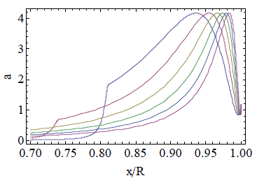
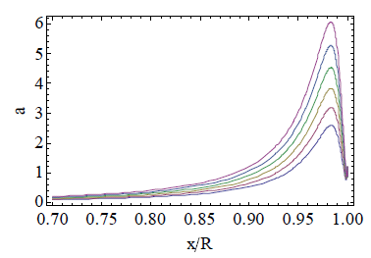
Some highlights… Other studies 2/3
MOPS056.PDF : An Analytical Formula of the Electron Cloud Linear Map Coefficient in a Strong Dipole, Theo Demma (INFN/LNF, Frascati (Roma)) et al.
Derivation of a simple approximate formula relating the linear coefficient in the electron cloud density map to the parameters relevant for the electron cloud evolution with particular reference to the LHC dipoles.
30th September 2011 - e⁻ cloud meeting

Slide 27
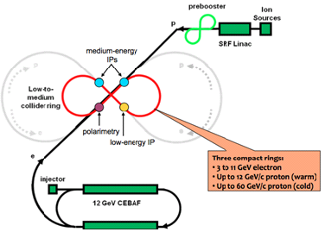
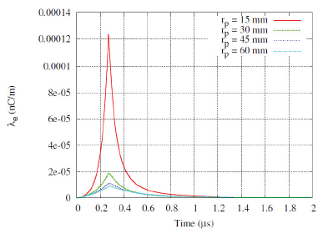
Some highlights… Other studies 3/3
MOPS091.PDF : Study of Electron Cloud for MEIC Shahid Ahmed et al. (JLAB, Newport News, Virginia)
First EC build up study for the future Medium energy Electron Ion Collider (MEIC at Jefferson Laboratory ).
Assumed δ_{max} = 1.6 → Saturation level of 0.7 nC/m for 1500 consecutive bunches separated by 40 cm, with a tune shift per unit length of 2.6∙10⁻⁵ m⁻¹.
30th September 2011 - e⁻ cloud meeting

Slide 28
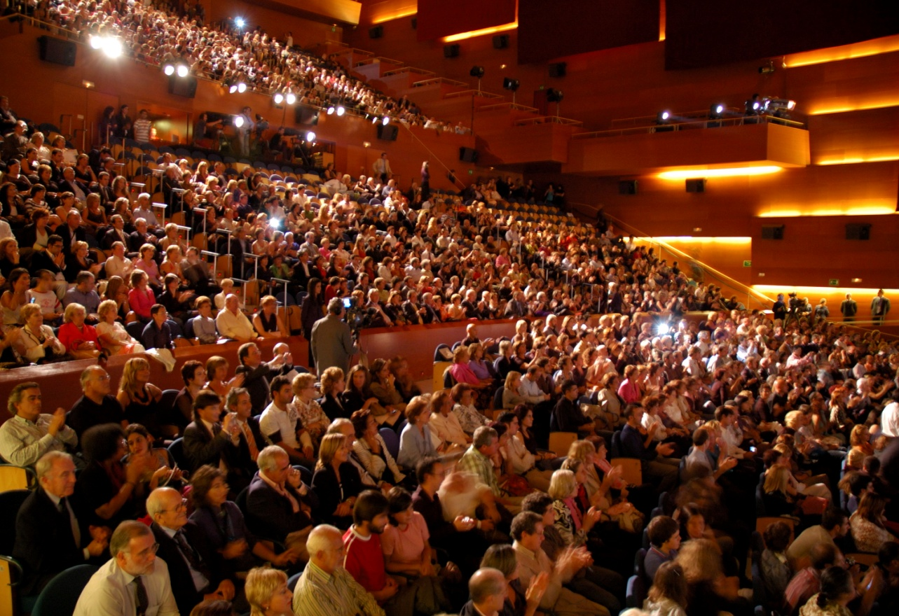
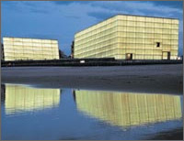
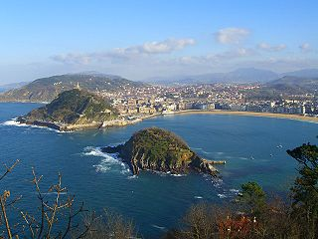
THANK YOU FOR YOUR ATTENTION!

