Slide 1
EC Simulations for HL-HLC Beam Scenarios
C. M. Bhat
ECLOUD Meeting
CERN
October 1, 2012

Slide 2
Motivation of the PS Expt.
Can Bunch lengthening be a viable e-cloud mitigation technique for the LHC or the HL-LHC?
  PS studies undeniably proved that bunch profiles have significant effect on e-cloud growth. BSM50 mode gives rise to about a factor of two smaller e-cloud growth. Objective is to extend the studies to the LHC using HL-LHC beam parameters
Simulations Only
  ECLOUD and PyECLOUD

Slide 3
Comparison between
ECLOUD and PyECLOUD simulations
Gaussian Bunches
PyeCloud gives 5% smaller heat-load in arcs
*
*
*
*
PyeCloud gives ~35% larger heat-load in arcs !?!
*
*
*
*

Slide 4
Simulated Bunch Profiles (ESME) and Analytical form for WB
These bunch profiles are used to generate one SPS batch of injected beam to the LHC
25 nsec filling pattern: 288 bunches with 200 nsec kicker gap between every 72 bunches
50 nsec filling pattern: 144 bunches with 200 nsec kicker gap between every 36 bunches

Slide 5
HL-LHC Beam Parameters

Slide 6
Simulations with
ECLOUD and PyECLOUD

Slide 7
Average Heatload for the HLLHC beam scenarios
PyECLOUD
ECLOUD
&
PyECLOUD

Slide 8
Conclusions
We find that changing the bunch profiles will keep EC growth nearly constant. So BSM is not going to help EC growth in the LHC.
However, foreseen use of second harmonic Landau cavity that would change bunch profiles (shorter or nearly flat bunches) and makes beam longitudinally more stable, will not pose any additional EC related problem in the LHC/HL-LHC.

Slide 9
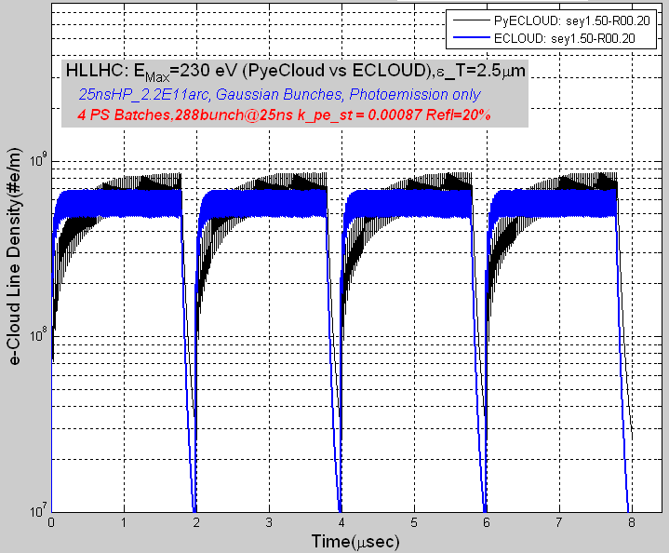
Comparison between
ECLOUD and PyECLOUD simulations

