Slide 1
PS e-Cloud Experiment and Simulations
C. M. Bhat
  H. Damerau, S. Hancock, E. Mahner, F. Caspers, G. Iadarola, T. Argyropoulos and F. Zimmermann,
ECLOUD Meeting
CERN
October 1, 2012

Slide 2
Motivation of the PS Expt.
Some early e-cloud simulation studies showed that “flat” bunches are more favorable than Gaussian bunches in the LHC. Bunch lengthening may be a viable e-cloud mitigation technique. In this regard, a dedicated e-Cloud study has been undertaken in the PS@26 GeV by,
  Exploiting PS-rf capability & using the existing e-Cloud detector to study e-cloud growth on varieties of bunch profiles .
  Compare the measurements with simulations using ECLOUD and PyECLOUD. Thereby bench-mark the codes.
Extend the results to the LHC using HL-LHC beam parameters.

Slide 3
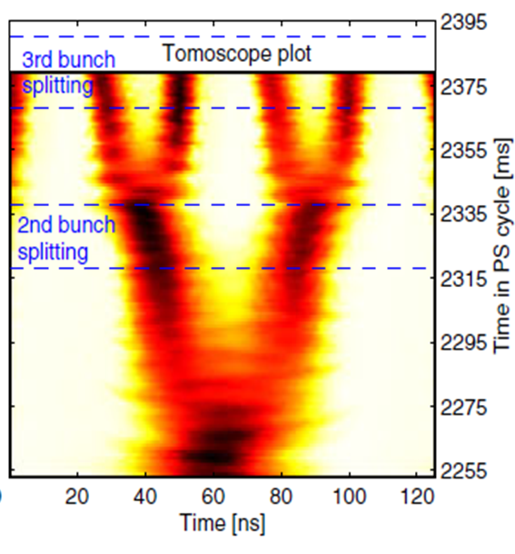

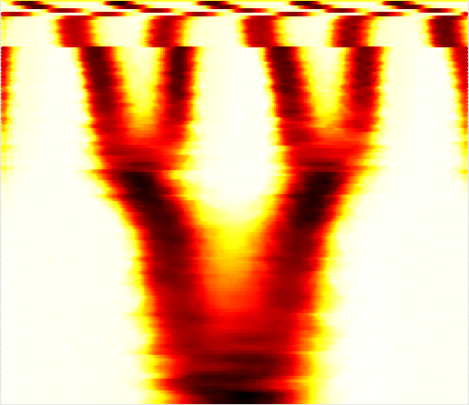
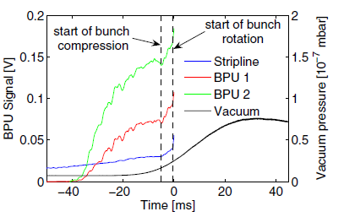
e-cloud studies in the PS
(past)
(Past and Present)
E. Mahner et.al, PRSTAB
Vol. 11, 094401(2008)
LHC25@26GeV
Varying
bunch-length,
shape and inter-bunch distances
e-Cloud Signals
Tomoscope Data
PS RF Systems
40MHz(+80MHz)
40MHz(h=84)
40MHz+ 20MHz
3rd Bunch Splitting
20MHz (h=42)
New e-cloud studies are done with special RF
manipulations
20MHz+ 10MHz
Present Expt.:
2nd Bunch Splitting
10MHz(h=21)
e-cloud is observed in the PS during quadrupole splitting

Slide 4
600
(a)
40 KV
Snap Bunch Rotation
Vrf(kV)
300
RF Manipulations and Bunch length
(Standard LHC25)
V2: 80 MHz, h=168
RF Manipulations and Bunch length
(New Experiment )
V1: 40 kV(40 MHz, h=84)

Slide 5
Scope Data of the Observed EC

Slide 6
Bunch Profiles and the e-Cloud
(measurements)
Bunch
Profiles
e-Cloud
Line-density
from BU1

Slide 7
PS: Simulations with PyECLOUD

Slide 8
e-cloud @ Ejection
Data versus Simulations
Experiment
After steady-state is reached
Using measured bunch profiles
Simulations

Slide 9
Simulated cumulative electrons during the entire e-cloud activity in PS
ε_{Max} = 287 eV
_{Max} = 1.57
R0 = 0.55
*
*
Data@ Ejection show that
BSM50/BLM50≈2.7 and SH/BLM50≈2.3

Slide 10
Summary
A dedicated study was carried out in the PS@26 to investigate the e-cloud dependence on the bunch profile. We find that
  A significant dependence of e-cloud on the bunch profiles.
  Simulations explain the data quite well.
  Comparison between the experimental data and the simulations sets a very tight range on the SEY parameters. We find ε_{Max}= 287 eV (±3%), δ_{Max} =1.57 (±1%) and R0=0.55 (±3%) in the region of PS e-cloud monitor.
  BSM50 mode gives rise to about a factor of two smaller e-cloud growth.

