Slide 1
Ecloud Simulations Update
E-cloud Simulation Meeting
Humberto Maury Cuna
October 1st, 2012

Slide 2
Outline
Convergency studies
Heat load values
Reflection fraction problem (pending list)
Multipacting thresolds for a round beam pipe (pending list)

Slide 3
Simulation parameters for 25 ns – Dipole
Bunch spacing | Bunch intensity | SEY | Reflectivity | Fill pattern | Energy
25 ns | 1.15 x 10¹¹ p/b | 1.1 1.5 | 0.5 | 1 | 7 TeV
PyEcloud
Parameter | Range | Default value
N_mp_max | 50k – 300k | 100k
N_mp_regen | 25k -80k | 50k
N_mp_regen_low | 2.5k – 30k | 5k
N_mp_after_regen | 1k – 40k | 10k
Nel_mp_ref_0 | 5k – 30k | 15k
Dt | 0.1ps – 100ps | 25ps
Dt_sc | 1-100 (x10⁻¹⁰) | 5x10⁻¹⁰
Dh_sc | 0.5-50 (x10⁻⁵) | 0.5x10⁻³⁾
Ecloud
Parameter | Range | Default value
Npepb | 500 – 10000 | 2500
Nbstep | 150 – 6000 | 450
nistep | 500 – 5000 | 2000

Slide 4
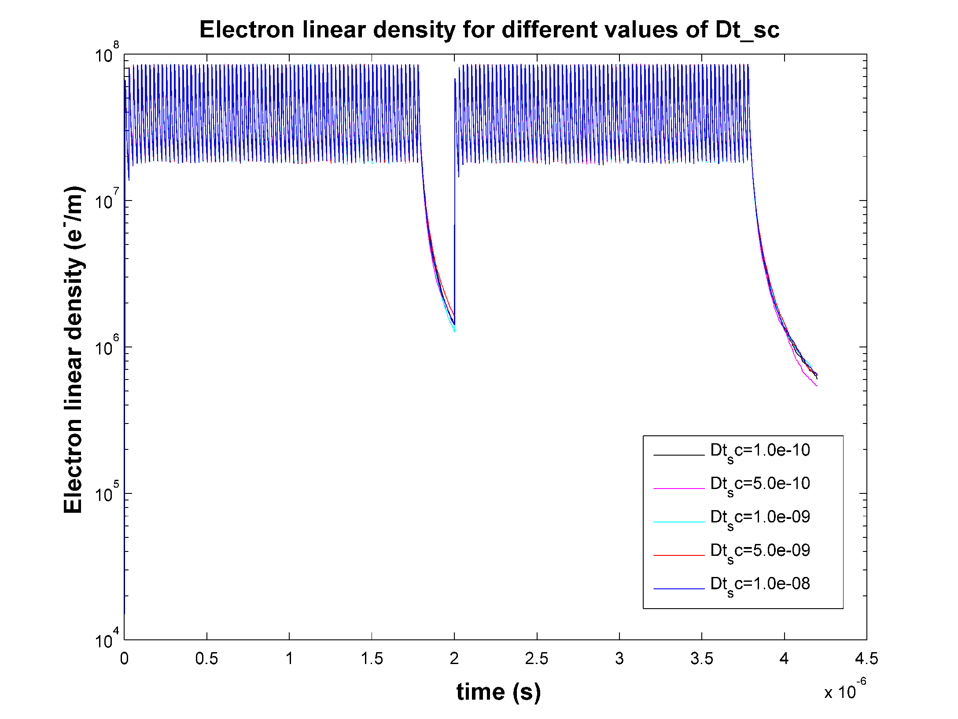

Slide 5
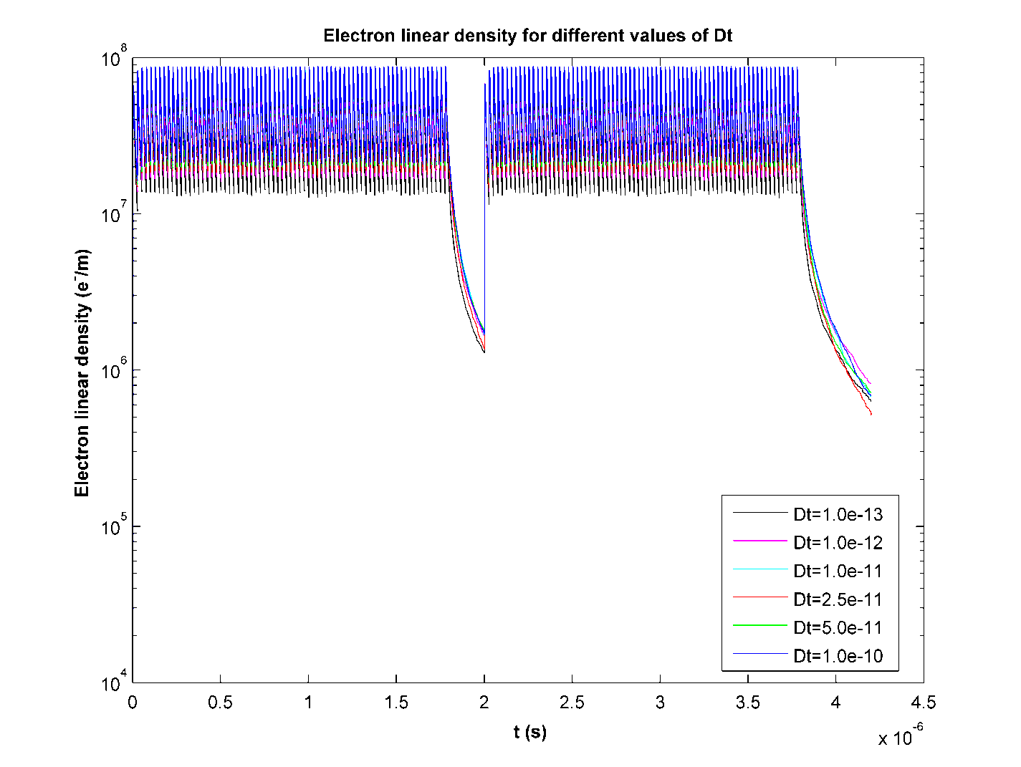
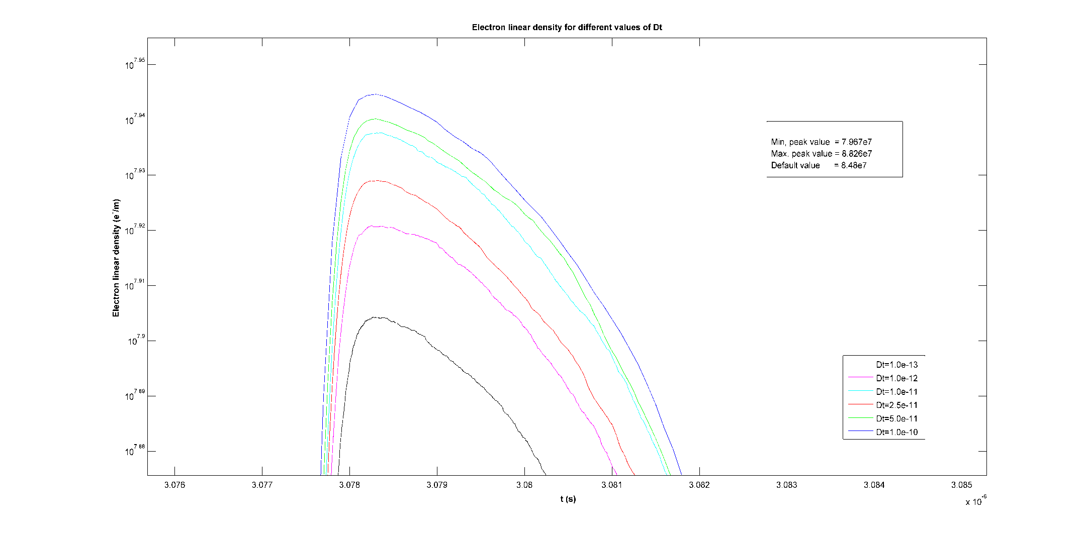

Slide 6
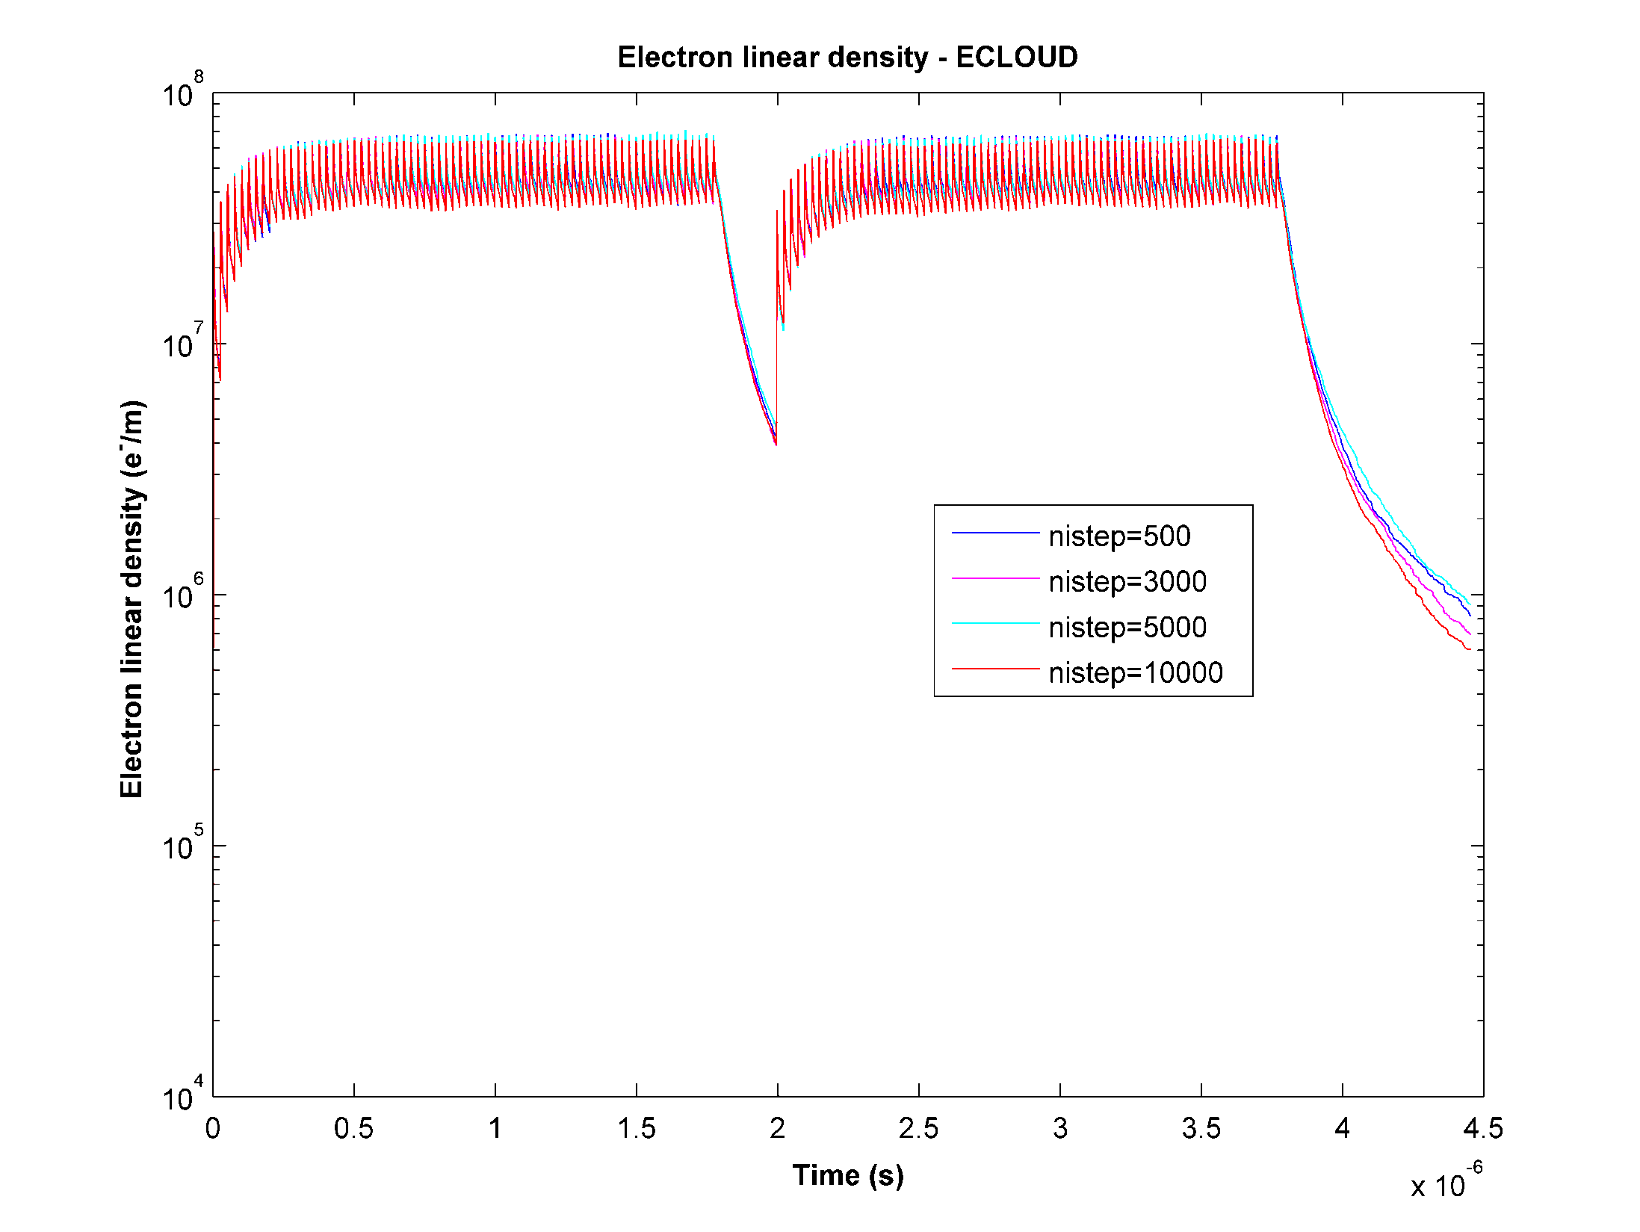

Slide 7
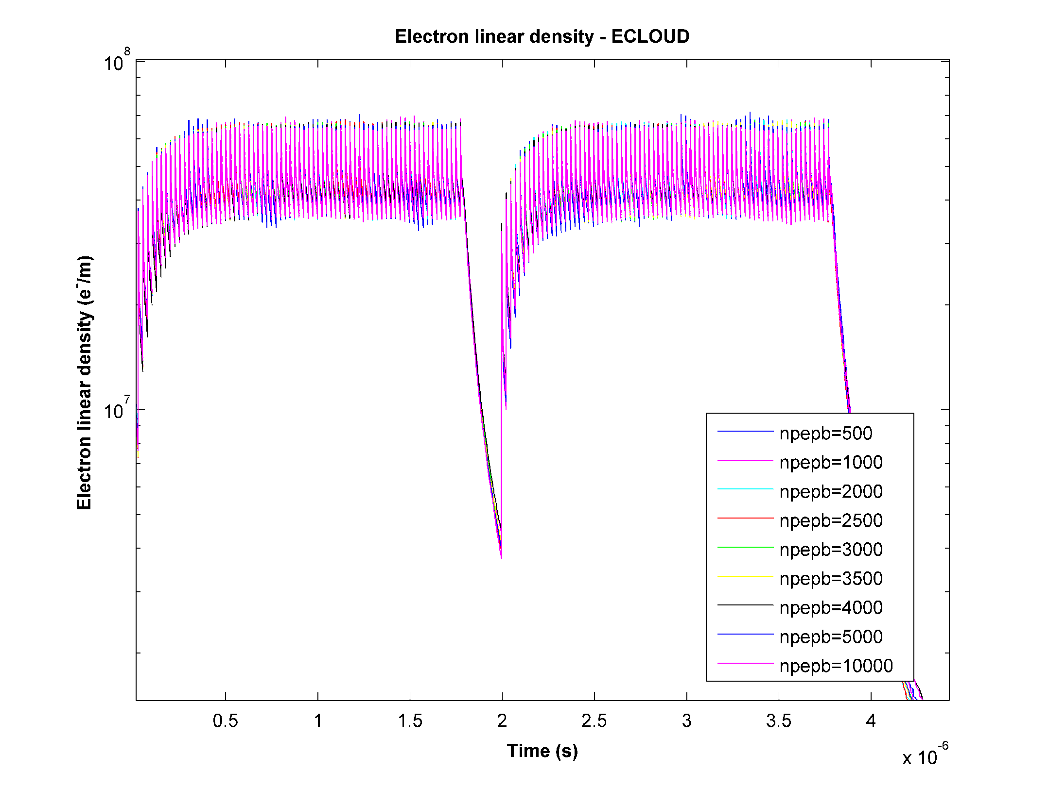

Slide 8
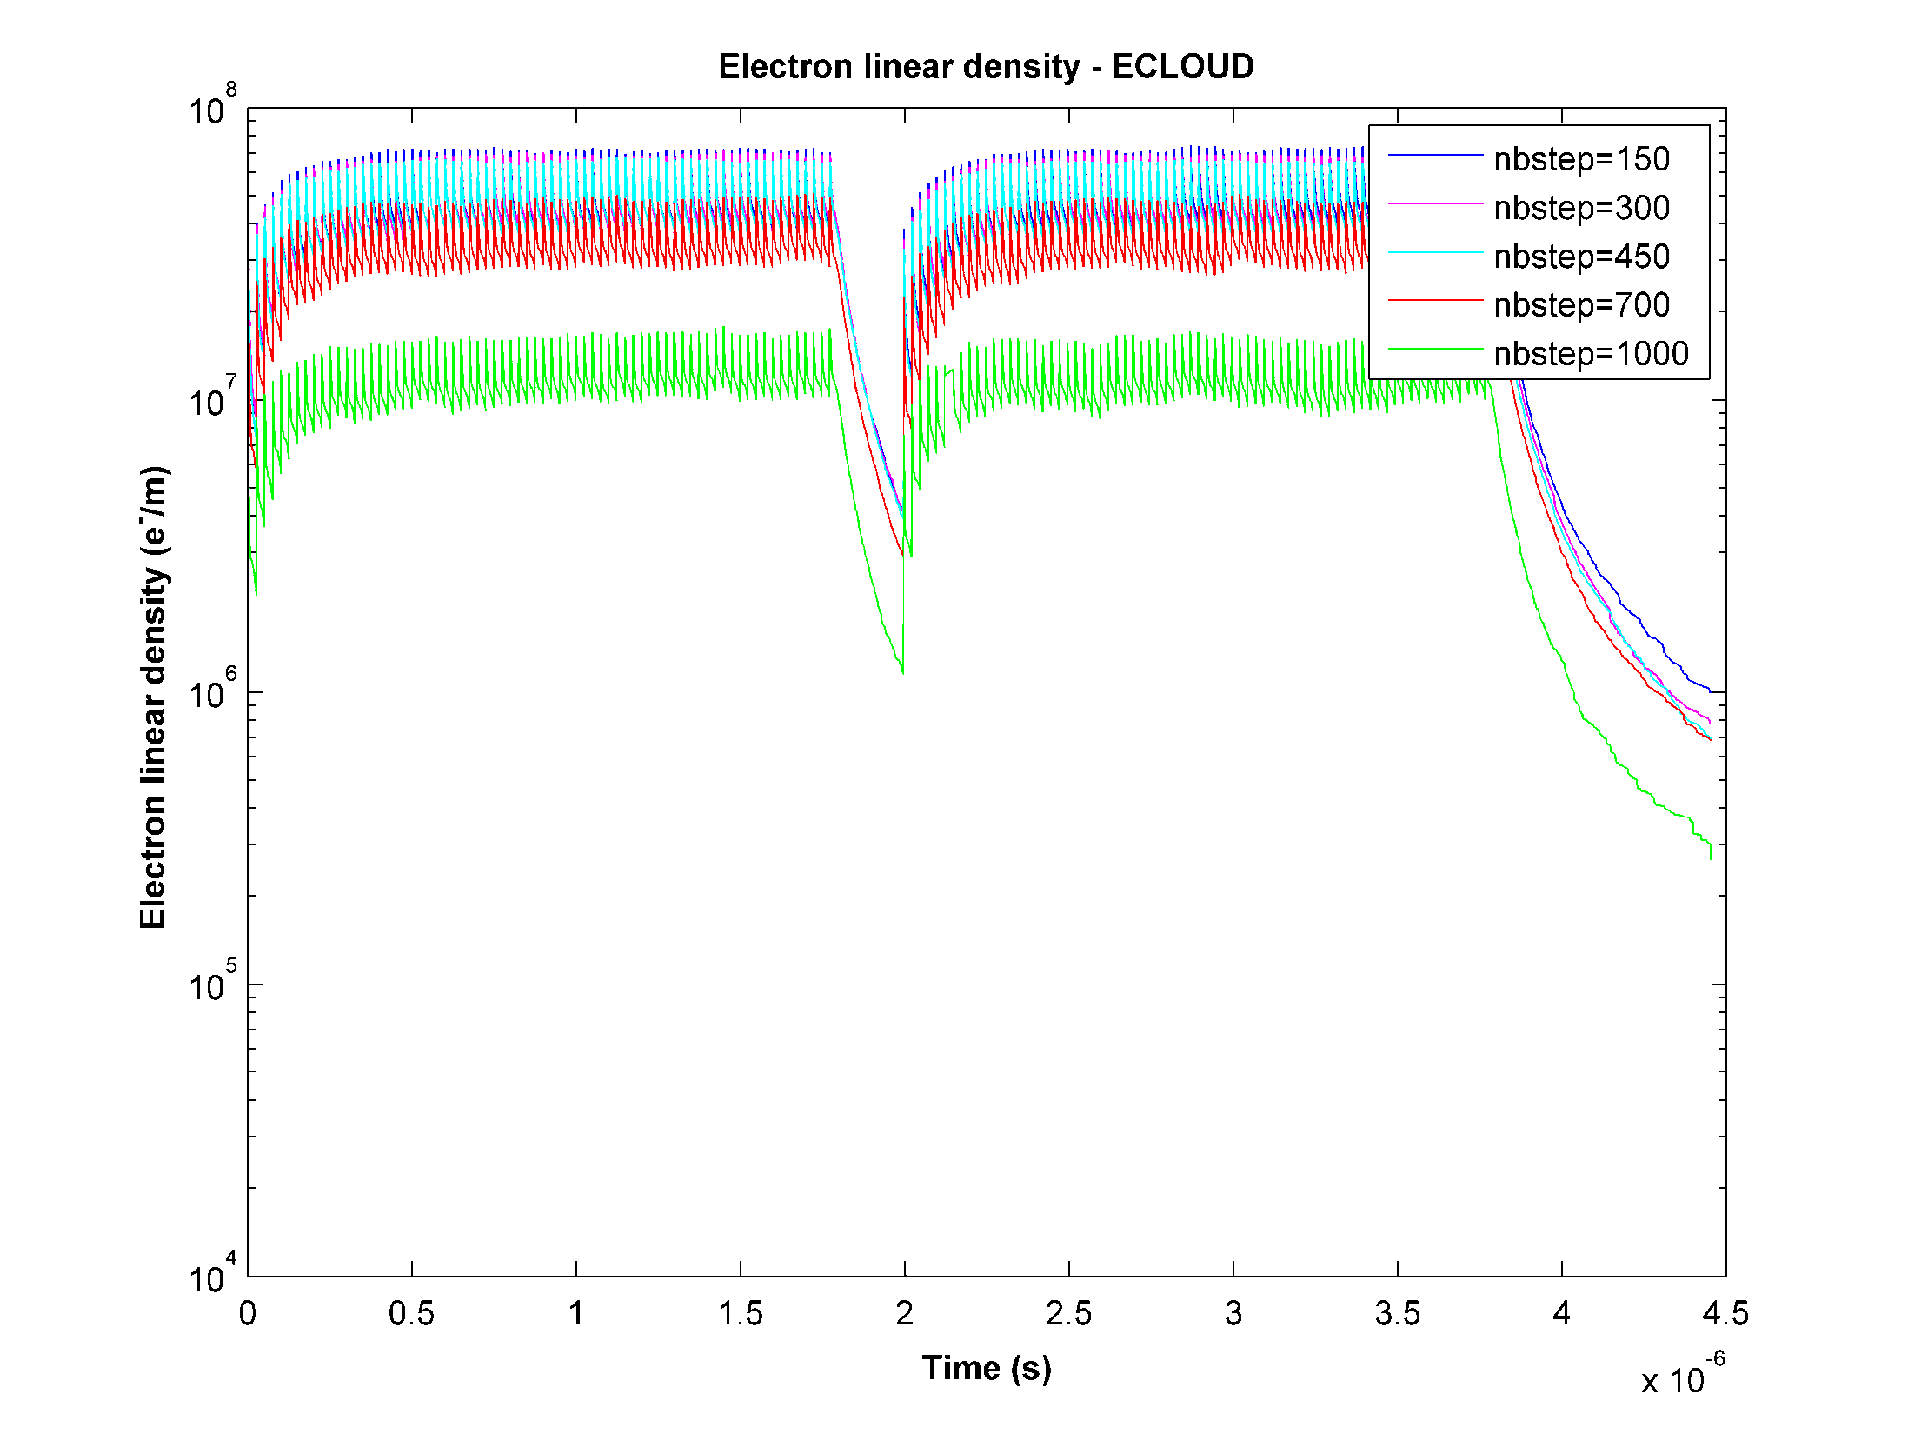

Slide 9
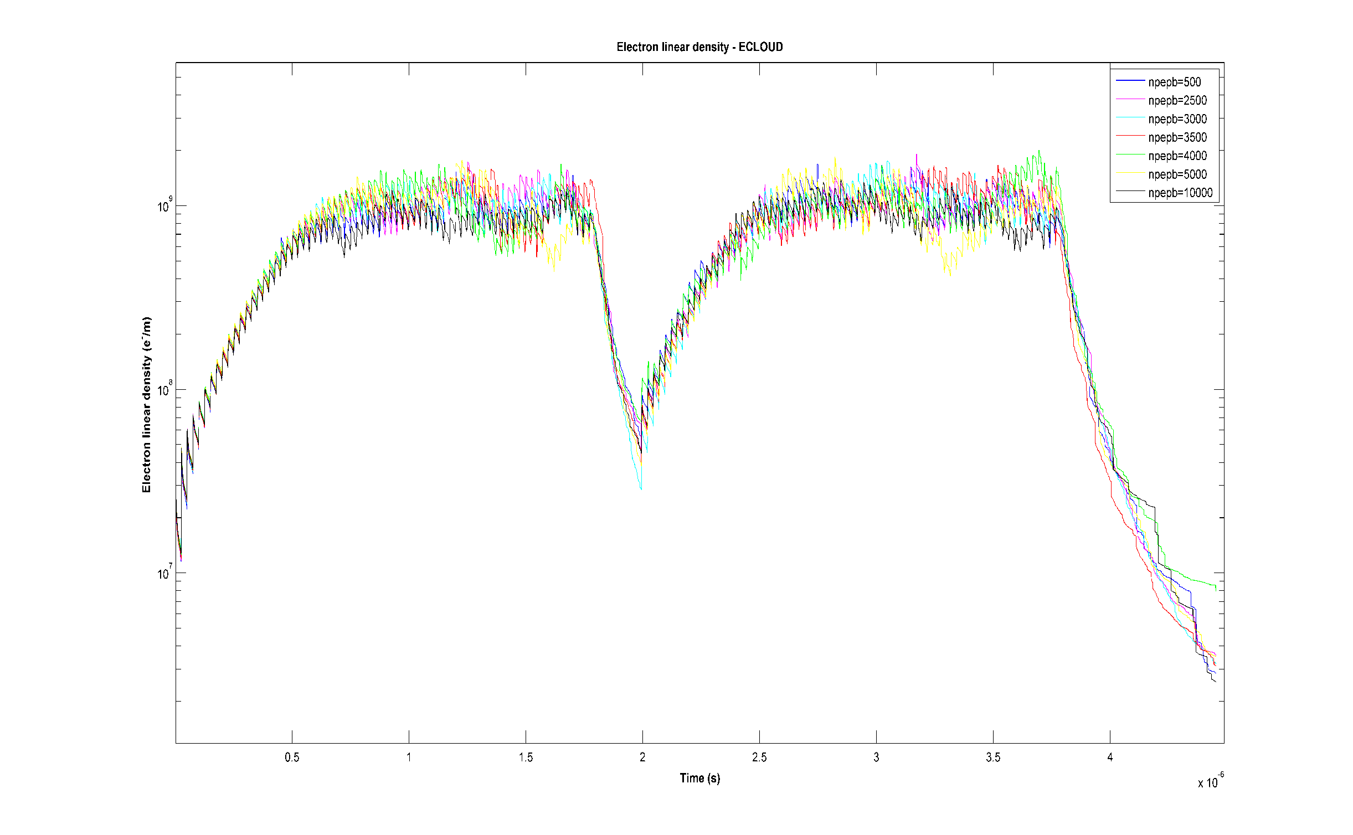

Slide 10
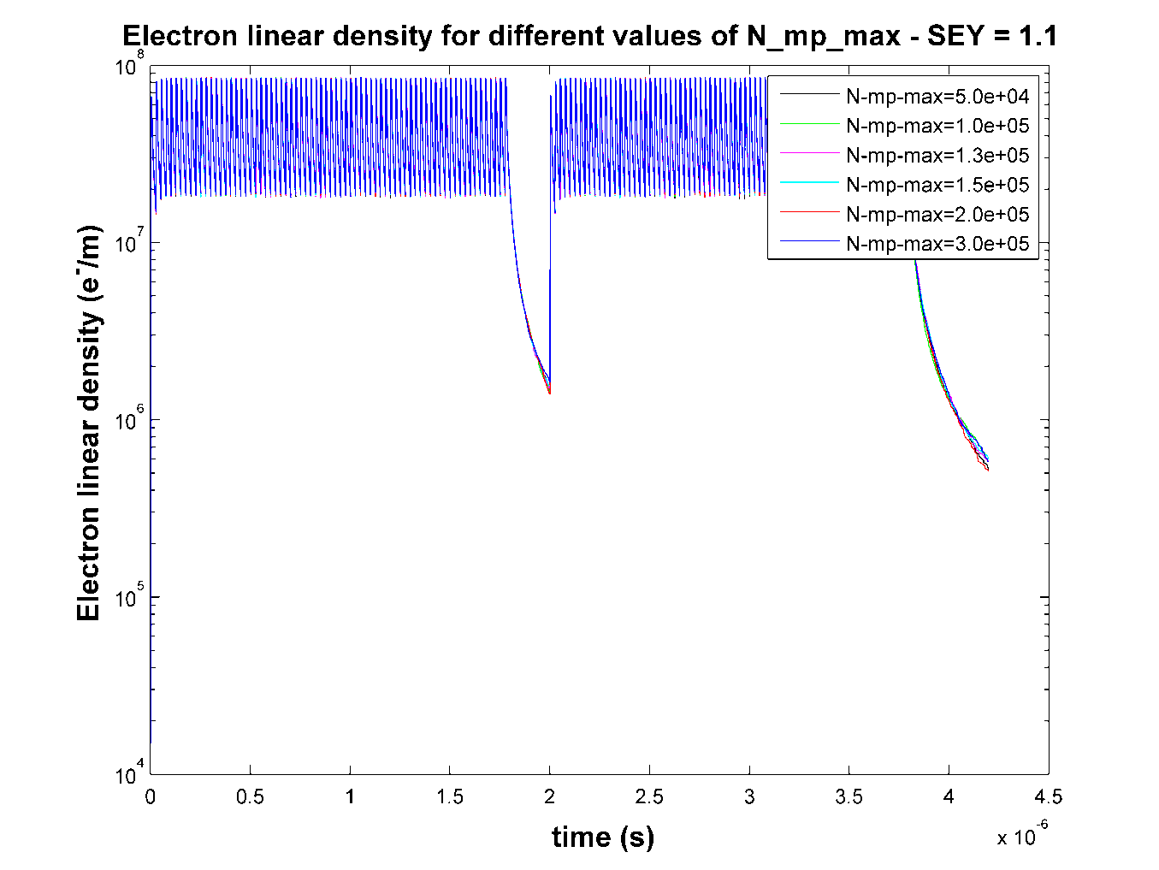
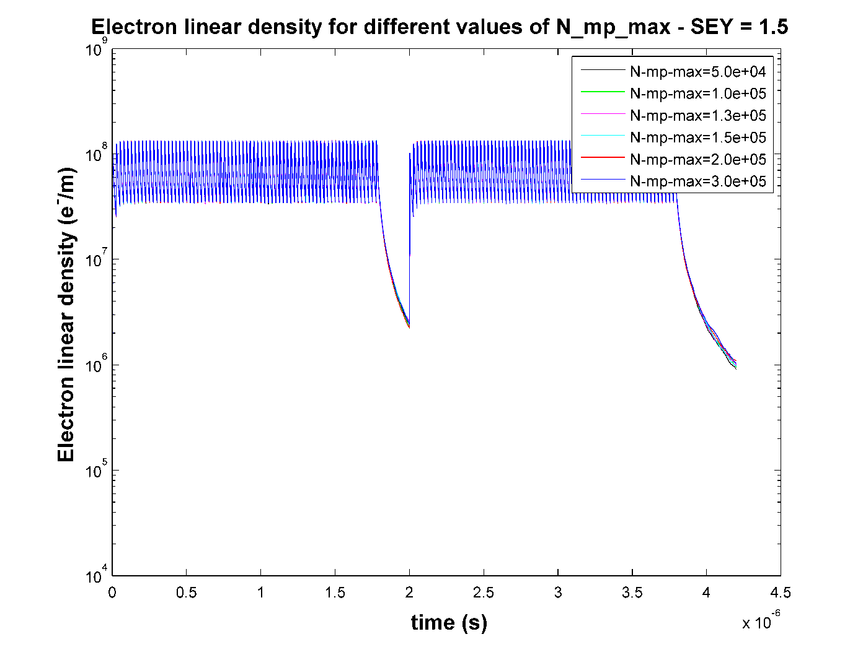

Slide 11
Heat-load comparison studies for 25 ns
Bunch spacing | Bunch intensity | SEY | Reflectivity | Fill pattern | Energy
25 ns | (2 – 20) x 10¹⁰ | 1.1 - 1.7 | 0.5 | 1 | 7 TeV
Bunch length | sx, sy | Magnetic field | Normalize emittance | Section
7.55 cm | 0.3 mm | 8.4 T | 3.75 um rad | Dipole
(1)
72bunches
200ns
nistep = 2500

Slide 13
Conclusions
PyEcloud is very robust when changing simulation parameters
Ecloud has some issues changing time steps.
Heat load values are near each other for higher SEY and Nb.

Slide 14
Thank you for your attention

