Slide 1
The Mystery of the Missing Photoelectrons
ECLOUD and PyECOUD Simulations Update
Thanks to C. Bhat, G. Iadarola and F. Zimmermann
Humberto Maury Cuna
CINVESTAV/CERN
August 10th, 2012

Slide 2
Outline
Introduction:
Photoemission model
How the total number of photoelectrons is calculated?
EClOUd vs. PyECLOUD Simulations
Methodology
Results
Different PE reflection fractions
Conclusions

Slide 3
Introduction: Photoemission Model
The assumed creation rate of primary photoelectrons (PPE), corresponds to the computed synchrotron radiation flux in the arcs and the photoelectron generation rate inferred from measurements with test beams on prototype chambers.
Total Number of primary photoelectrons due to synchrotron radiation, PPE = (peeff)(I_{b}),
where peeff = photoelectron emission yield (e-/proton/meter) and I_{b} the intensity per bunch.
Both codes divide the PPE in two separated categories with different distributions:
PE created at the primary impact point of the synchrotron radiation(PE’). Gaussian distribution.
PE created by diffusively reflected photons (PE’’). Cosine square distribution.

Slide 4
Introduction: Photoemission Model
A percentage of the total flux of photons is reflected:
this fraction is called “refl” in ECLOUD and “refl_frac” in PyECLOUD.
A typical value of this reflected fraction is 20%.
About 80% of the incident photon flux produces PE at the primary impact point within a narrow cone of rms angle 11.25⁰. Due to the strong magnetic bending field some of these electrons cannot approach to the photon beam and do not contribute to the further electron-cloud build up.
PE’ = (1-refl)(PPE) and PE’’ = (refl)(PPE). Therefore,
PE’ + PE’’ = PPE
PE’ are produced at the primary impact point and following a Gaussian distribution.
PE’’ are distributed azimuthally according to a cos²φ distribution.
Beam pipe
Where φ denotes the azimuthal angle with respect to the horizontal plane, spanned from the primary impact point of the synchrotron radiatio.

Slide 5
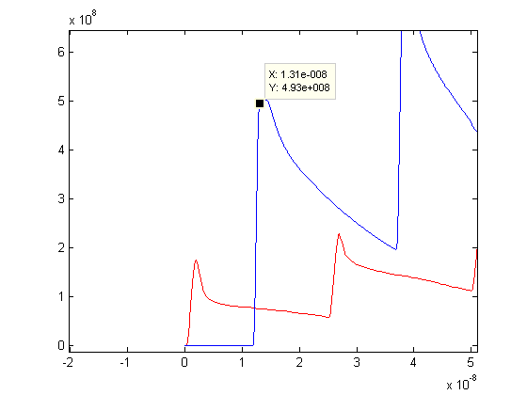
Motivation
C. BHAT pointed out an inconsistency observed during comparison studies between PyECLOUD and ECLOUD.
In the image, C. Bhat presented the results of 2 equivalent simulations.
Analitically, the total number of photoelectrons produced is PPE = (peeff)(I_{b}) = 4.932e8.
In the case of PyECLOUD simulation we can observe the intensity of the first peak of the electron linear density is equal to the expected value.
For ECLOUD, this value is aprox. 40% of the expected value.
PyECLOUD
Electron linear density (e-/m)
ECLOUD
Time (s)
Image courtesy by C. Bhat. Peeff = 0.001233, Ib = 4e11.

Slide 6
Electron Cloud Simulations: Methodology
All the simulations were performed for a bending magnet and considering photoemission as the main electron source.
Only 5 bunches were simulated in both codes.
The refl % was varied from 0 % to 100%.

Slide 7
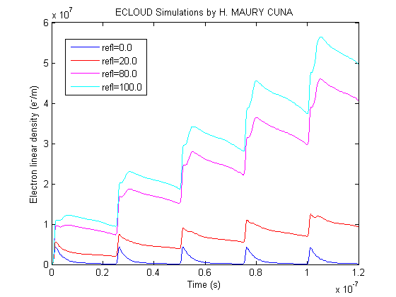
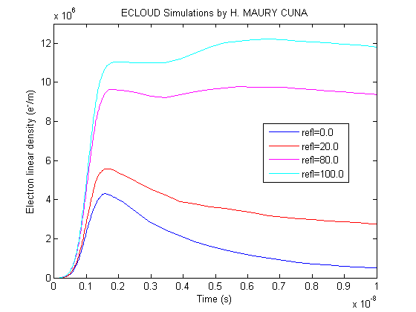
Results: ECLOUD Simulations
Simulated electron linear density at 3.5 TeV for a bending section, peeff = 0.0001233 and I_{b} = 1.15e11 -> PPE = 1.417e7 (e-/m)
REFL (%) | Peak (e-/m) | Peak/PPE
0 20 80 100 | 4.313e6 5.574e6 9.645e6 1.105e7 | 0.3044 0.3934 0.6807 0.7798

Slide 8
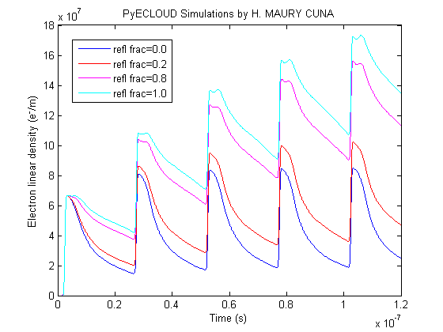
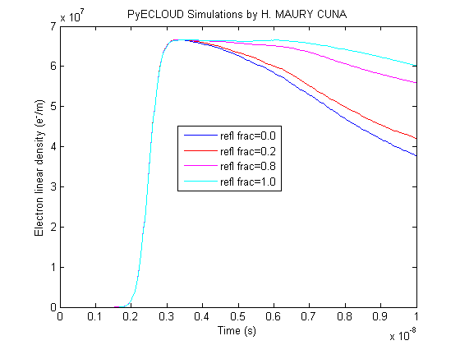
Results: PyECLOUD Simulations
Simulated electron linear density at 3.5 TeV for a bending section, peeff = 0.000580 and I_{b} = 1.15e11 -> PPE = 6.67e7 (e-/m)
REFL (%) | Peak (e-/m) | Peak/PPE
0 20 80 100 | 6.658e7 6.664e7 6.661e7 6.656e7 | 0.9982 0.9991 0.9987 0.9979

Slide 9
Conclusions
For both codes:
There is a difference for the further EC evolution depending on the reflection fraction.
Higher refl fraction gives higher EC linear density
ECLOUD:
At 0% reflected fraction there is no evidence of multipacting, however the total number of electrons created by the first butch is around 30% of the total expected number of PE.
At 100% reflected fraction we have the larger contribution to multipacting but the electrons due to the first butch is roughly 80% of the total expected number of PE.
PyECLOUD:
For all the reflection fractions considered in this study the simulated number of electrons due to the first butch is around 99.9% of the expected number of PE.

Slide 10
Open Questions and Future Work
In principle, both codes use the same photoemission model. Then, why there is a difference in the peak of the electron linear density calculated by ECLOUD in comparison with the expected value?
Is this difference due to the fact that some of the PE created in the primary impact point don´t contribute with the further EC build up? Is this taken into account in ECLOUD simulations? If yes, where?
Or, both codes are correct but they are just showing different aspects of the same thing?

Slide 11
Open Questions and Future Work
Heat load calculations are qualitatively in agreement with PyECLOUD and POSINST.
A crosscheck between PyECLOUD and ECLOUD heat load calculated values is being performed.

Slide 12
Thank you for your attention
Questions and feedback is totally welcome ☺

