Slide 1
ECLOUD vs PyECLOUD
LHC Scenario
Are there some issues?
C. M. Bhat, Humberto M Cuna
ECLOUD Meeting
CERN
August 10, 2012

Slide 2
Motivation
PyECLOUD (Giovanni Iadarola) is replacing ECLOUD code in many of the recent simulations.
  PS ecloud simulations (Chandra, Giovanni,…)
  LHC ecloud simulations (Humberto, Chandra, Octavio, …)
  SPS (Giovanni, Octavio …)
  HLLHC (Chandra, Humberto …)
PyECLOUD is
  python based, New, Less confusing, many-many times faster, Flexible for more complicated filling pattern or bunch profiles
We want to make sure that the results from PyeCLOUD are believable and consistent (with ECLOUD, which is used, tested and benchmarked for decades).
However, some recent comparative studies raised a few questions ( Humberto, Octavio, Chandra …)
Even with the nominal LHC beam parameters the e-cloud related issues are currently prohibiting us to go to 25 ns bunch spacing. During the HL-LHC era the bunch brightness will be ≈ 4 x the LHC nominal value.
  Mitigation of the e-cloud effect in the LHC is highly critical. Some early simulation studies on LHC indicated that the longitudinal profiles of the bunches may have effect on growth of e-cloud and bunch lengthening may be a possible mitigation technique. In this regard we have carried out
    An experiment in the PS and Bench-marking with e-cloud simulations using ECLOUD and PyECloud
    Results are extended to the e-cloud scenarios for the HL-LHC
  Here we present our findings

Slide 3
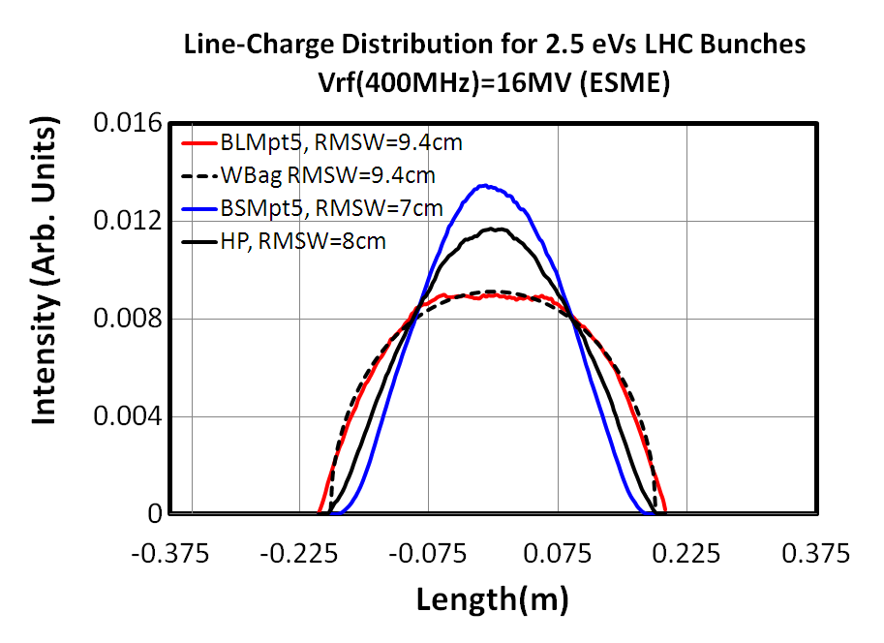
Longitudinal Bunch Profiles for the HL-LHC cases @7TeV
400MHz (16MV) ⊕800MHz (8MV) rf
Each bunch profile is repeated to produce a LHC batch of
  288 bunches for 25 nsec case
  144 bunches for 50 nsec case
  with 200ns gaps between PS batches in both cases
As an input to the ECLOUD and PyECLOUD simulations
For Wbag,
400 MHz rf only
BL(Wbag)
=0.37m
288/144 Bunches
PS
Batch
PS
Batch
PS
Batch
PS
Batch
All bunch profiles (except WaterBag) are
simulated using ESME
72/36 Bunches

Slide 4
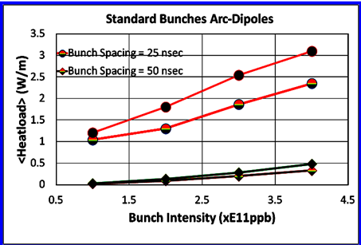
Comparison between ECLOUD and PyECLOUD simulations
Heatload (PyECLOUD)=
sum(En_imp_eV_time)-sum(En_emit_eV_time)
Agree within
3%
6%
Y*=0.001233
R=0.25
There quite good agreement between two codes within the uncertainties of
  Selection of grid sizes
  Significant digits and etc.
Same Beam Intensity

