Slide 1
Fast scrubbing optimization: e- cloud maps
C. Octavio Domínguez
Thanks to
G. Iadarola, G. Rumolo, F. Zimmermann
15 February 2012 - e⁻ cloud meeting

Slide 2
Outline
Motivation
e⁻ cloud maps
Strategy for the LHC scrubbing + Discussion
Summary
15 February 2012 - e⁻ cloud meeting

Slide 3
Outline
Motivation
e⁻ cloud maps
Strategy for the LHC scrubbing + Discussion
Summary
15 February 2012 - e⁻ cloud meeting

Slide 4
Motivation
Detailed simulation codes that typically track particles (ECLOUD, PyECLOUD, CSEC, …) need a lot of time for the computation of forces and fields that affect the particles.
Maps are a way of treating the e⁻ cloud evolution in an abstract way.
Expressing the e⁻ density of one bunch (ρ_{m+1}) as a function of the density in the previous bunch (ρ_{m}) we can predict long evolutions using simple arithmetics:
This allows to reduce the computing time in about 7 orders of magnitude!!!!
We can simulate several LHC turns in miliseconds
Also the bunch by bunch e⁻ dose into the wall can be treated with maps
We can easily predict which parameters will allow for a better scrubbing
15 February 2012 - e⁻ cloud meeting

Slide 5
Outline
Motivation
e⁻ cloud maps
Strategy for the LHC scrubbing + Discussion
Summary
15 February 2012 - e⁻ cloud meeting

Slide 6
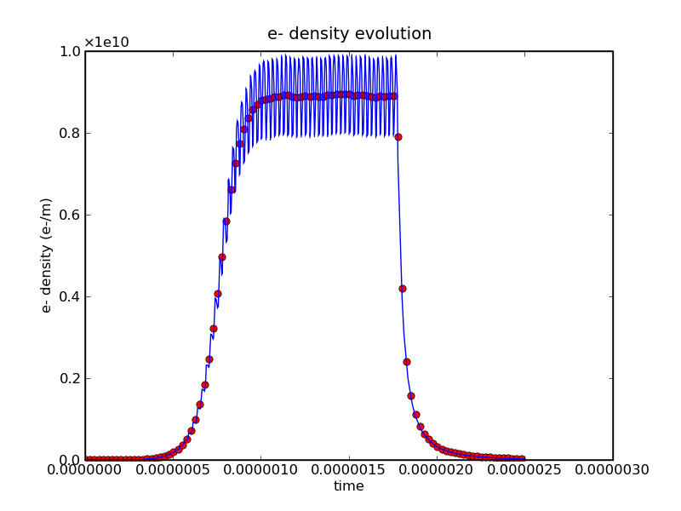
e⁻ cloud maps
avg. bunch-to-bunch
72 bunches; N_{b} = 1.2∙1011 ppb; ε_{x,y}=3.5 μm.rad; R=0.5; E_{max}=330eV; r=40 mm;
15 February 2012 - e⁻ cloud meeting

Slide 7
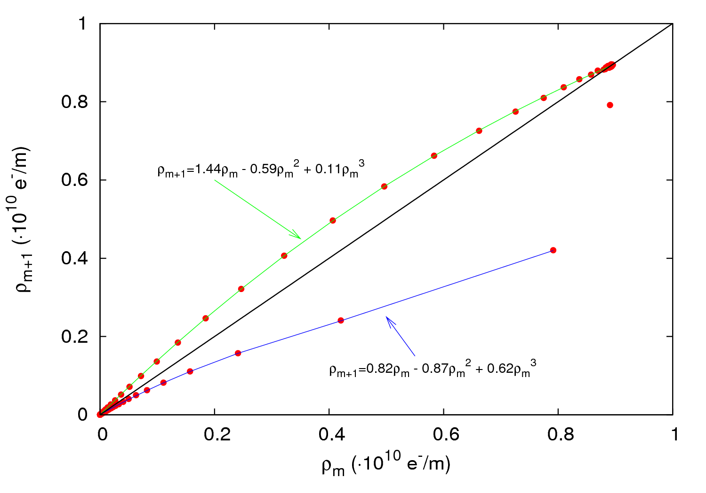
e⁻ cloud maps
15 February 2012 - e⁻ cloud meeting

Slide 8
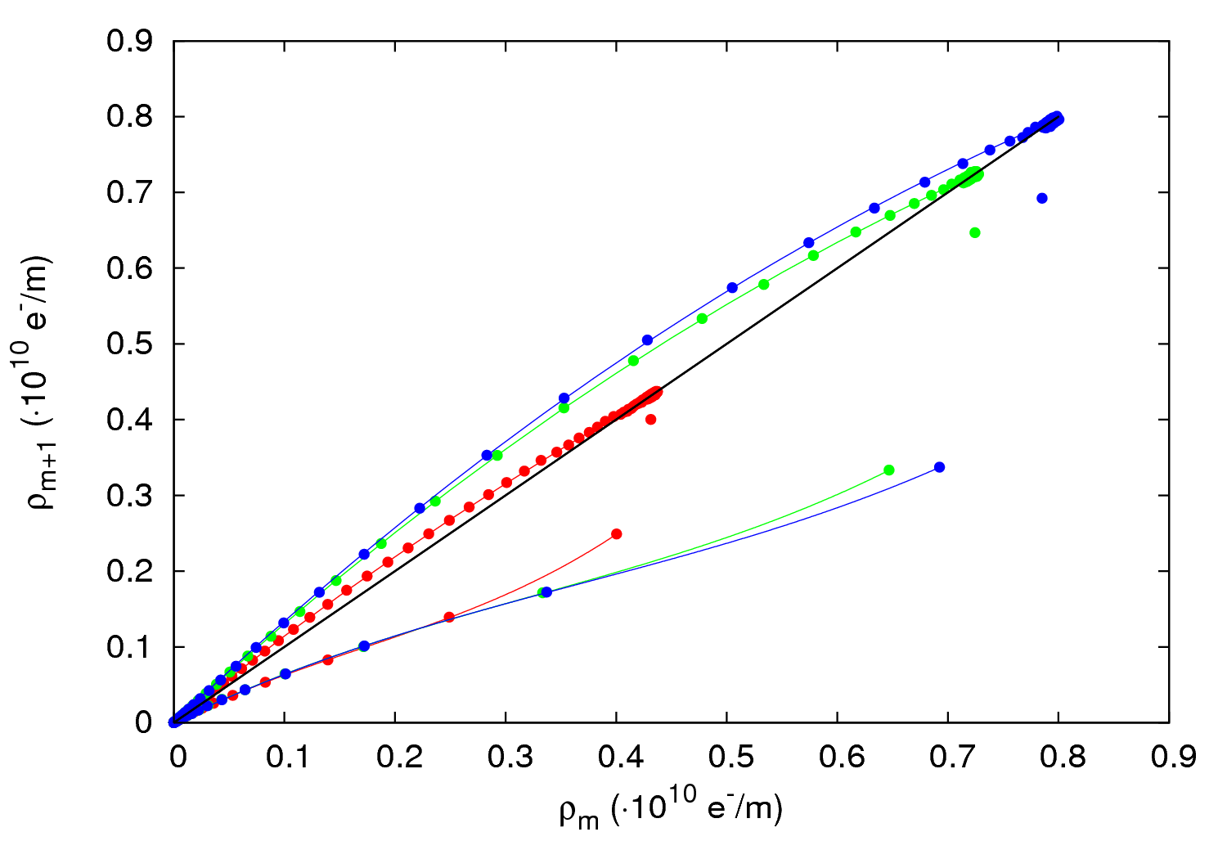
e⁻ cloud maps
N_{b} = 0.8∙10¹¹ ppb
N_{b} = 1.1∙10¹¹ ppb
N_{b} = 1.4∙10¹¹ ppb
Identity map
15 February 2012 - e⁻ cloud meeting
δ_{max}=1.5 ; R=0.2 ; E_{max}=260 eV ; P=200 nTorr;

Slide 9
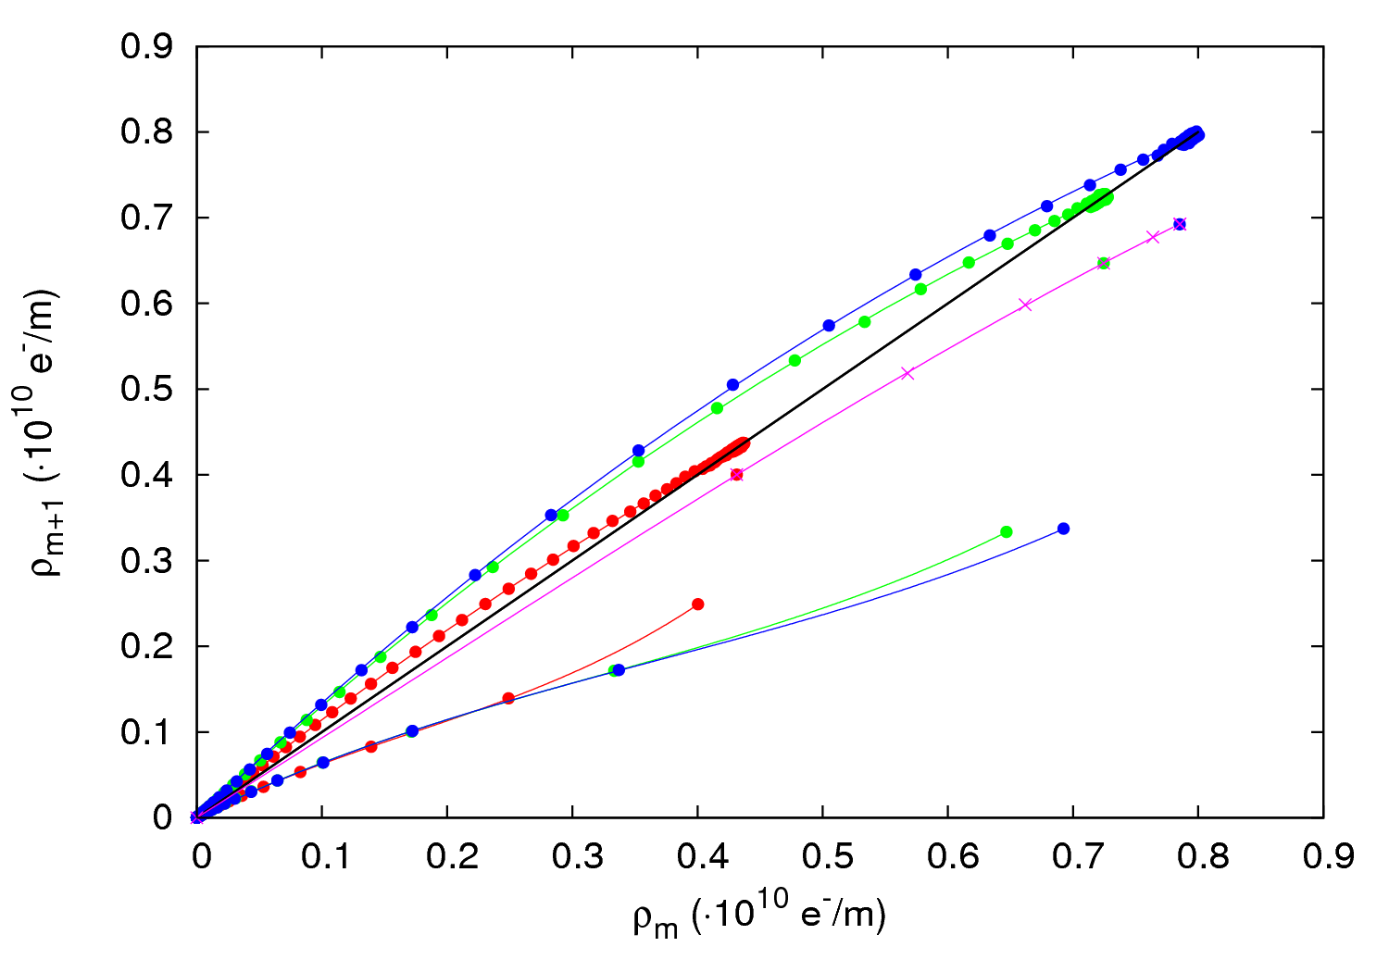
e⁻ cloud maps
N_{b} = 0.8∙10¹¹ ppb
N_{b} = 1.1∙10¹¹ ppb
N_{b} = 1.4∙10¹¹ ppb
Identity map
Fit 10
x
15 February 2012 - e⁻ cloud meeting
δ_{max}=1.5 ; R=0.2 ; E_{max}=260 eV ; P=200 nTorr;

Slide 10
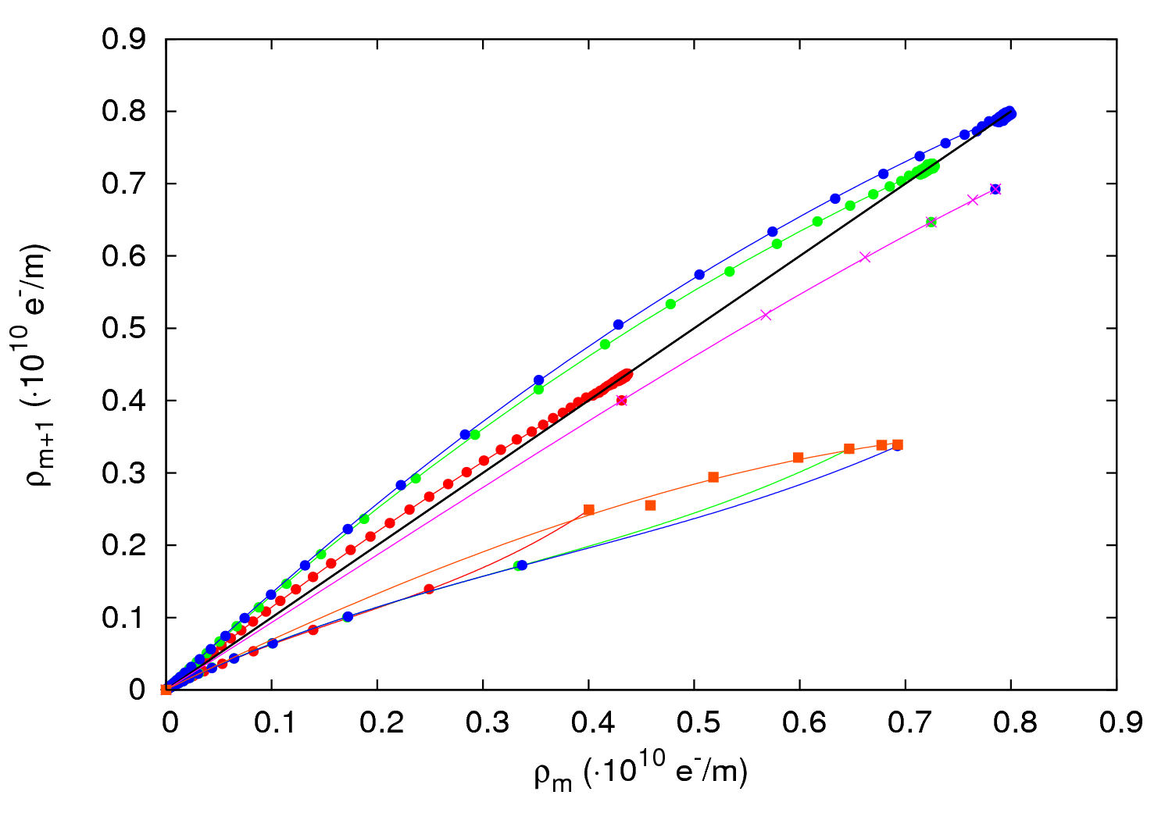
e⁻ cloud maps
N_{b} = 0.8∙10¹¹ ppb
N_{b} = 1.1∙10¹¹ ppb
N_{b} = 1.4∙10¹¹ ppb
Identity map
Fit 10
Fit 10 b
x
15 February 2012 - e⁻ cloud meeting
δ_{max}=1.5 ; R=0.2 ; E_{max}=260 eV ; P=200 nTorr;

Slide 11
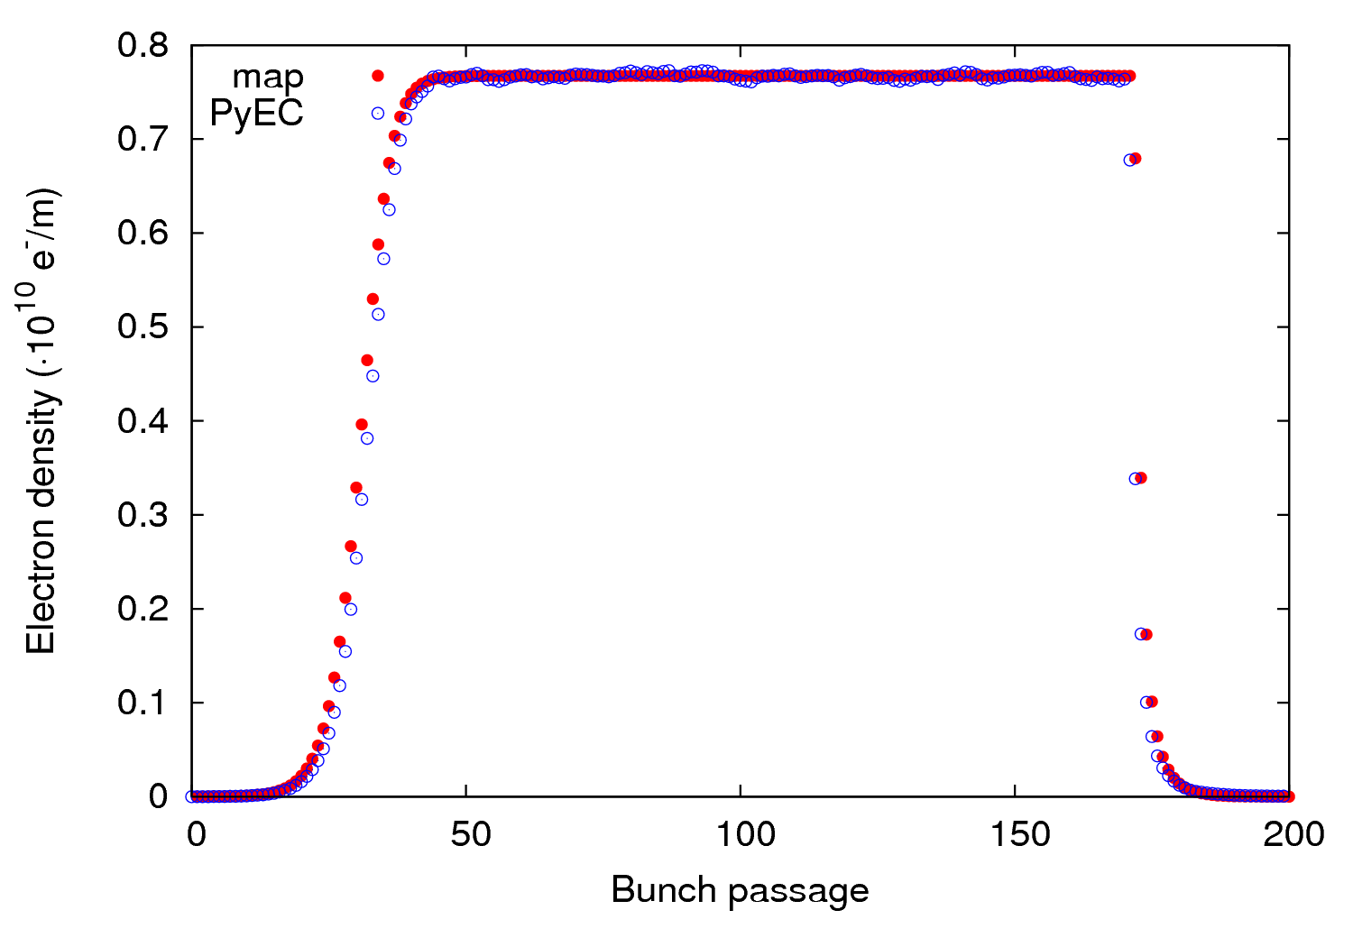
e⁻ cloud maps
We need four maps for each parameters configuration:
For the first “full” bunch →M₀₁=(a₀₁[, b₀₁, c₀₁]*)
For “full” bunches →M₁₁=(a₁₁, b₁₁, c₁₁)
For the first “empty” bunch →M₁₀=(a₁₀, b₁₀, c₁₀)
For “empty” bunches →M₀₀=(a₀₀, b₀₀, c₀₀)
* At small densities a linear map works better
Once we have them we can reproduce whatever filling pattern we want
Filling scheme: 72f-28e x1
15 February 2012 - e⁻ cloud meeting

Slide 12
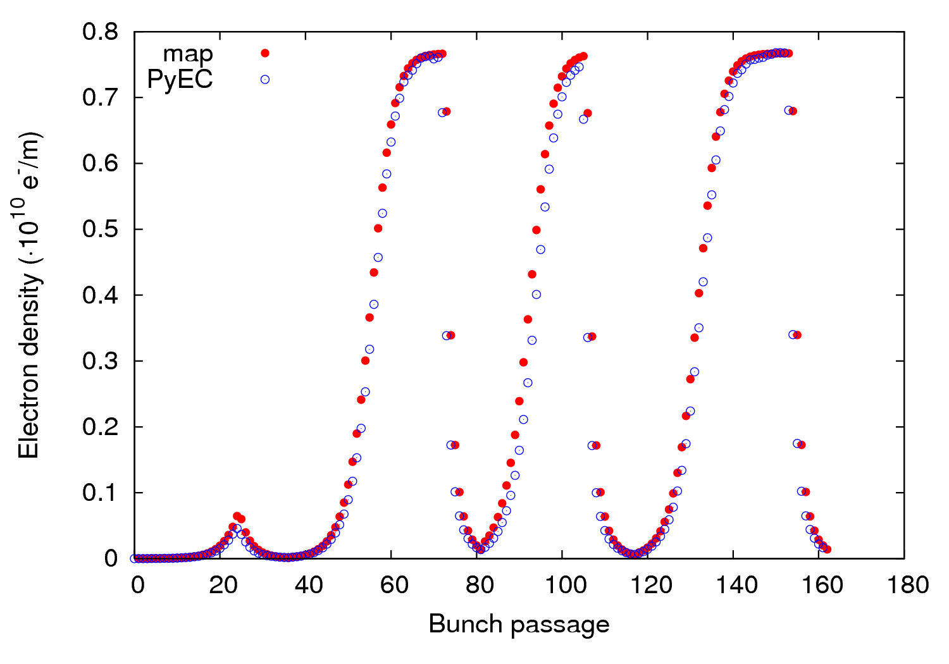
e⁻ cloud maps
We need four maps for each parameters configuration:
For the first “full” bunch →M₀₁=(a₀₁[, b₀₁, c₀₁]*)
For “full” bunches →M₁₁=(a₁₁, b₁₁, c₁₁)
For the first “empty” bunch →M₁₀=(a₁₀, b₁₀, c₁₀)
For “empty bunches →M₀₀=(a₀₀, b₀₀, c₀₀)
* At small densities a linear map works better
Once we have them we can reproduce whatever filling pattern we want
Filling scheme: 24f-12e-36f-9e x2
15 February 2012 - e⁻ cloud meeting

Slide 13
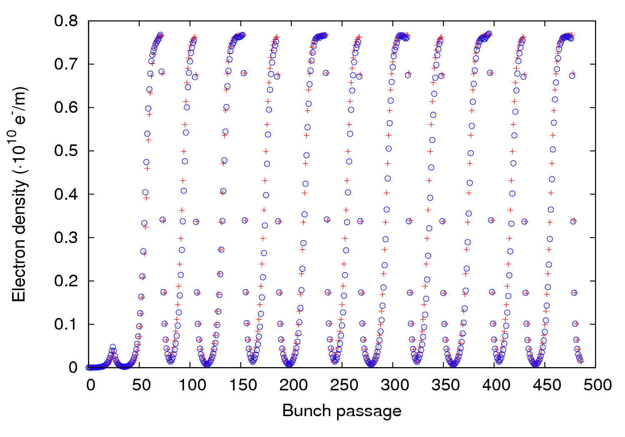
e⁻ cloud maps
We need four maps for each parameters configuration:
For the first “full” bunch →M₀₁=(a₀₁[, b₀₁, c₀₁]*)
For “full” bunches →M₁₁=(a₁₁, b₁₁, c₁₁)
For the first “empty” bunch →M₁₀=(a₁₀, b₁₀, c₁₀)
For “empty bunches →M₀₀=(a₀₀, b₀₀, c₀₀)
* At small densities a linear map works better
Once we have them we can reproduce whatever filling pattern we want
map
PyEC
+
Filling scheme: 24f-12e-36f-9e x6
15 February 2012 - e⁻ cloud meeting

Slide 14
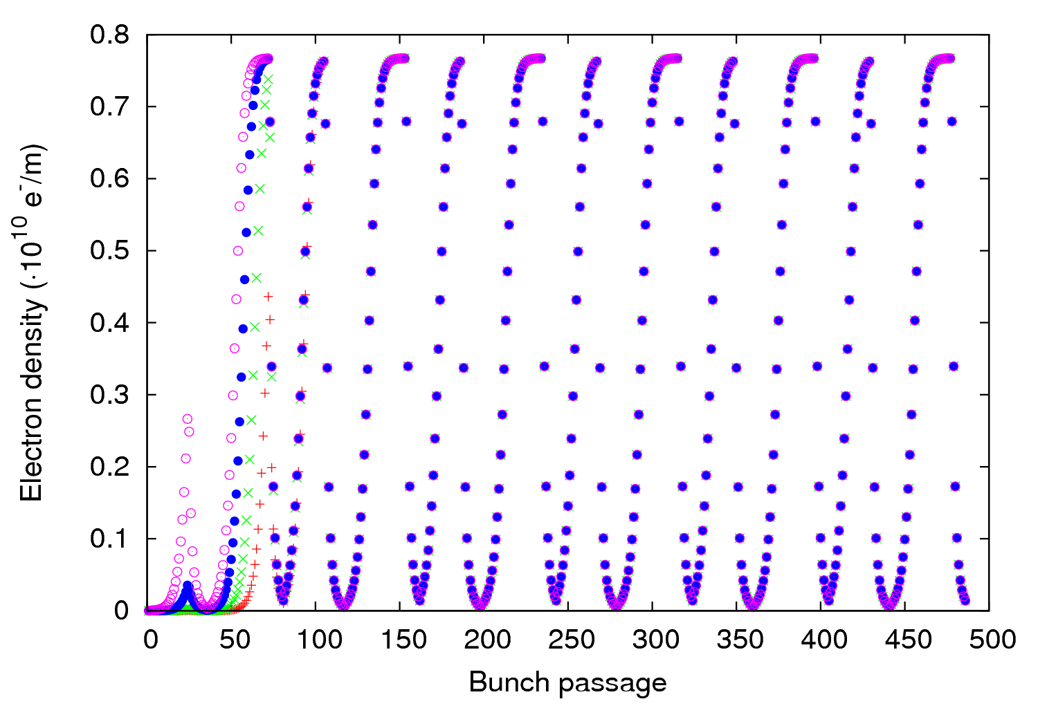
e⁻ cloud maps
The initial pressure only matters for the first batches:
P₀= 2nTorr
P₀= 20nTorr
P₀= 200nTorr
P₀= 2000nTorr
+
x
Filling scheme: 24f-12e-36f-9e x6
15 February 2012 - e⁻ cloud meeting

Slide 15
Outline
Motivation
e⁻ cloud maps
Strategy for the LHC scrubbing + Discussion
Summary
15 February 2012 - e⁻ cloud meeting

Slide 16
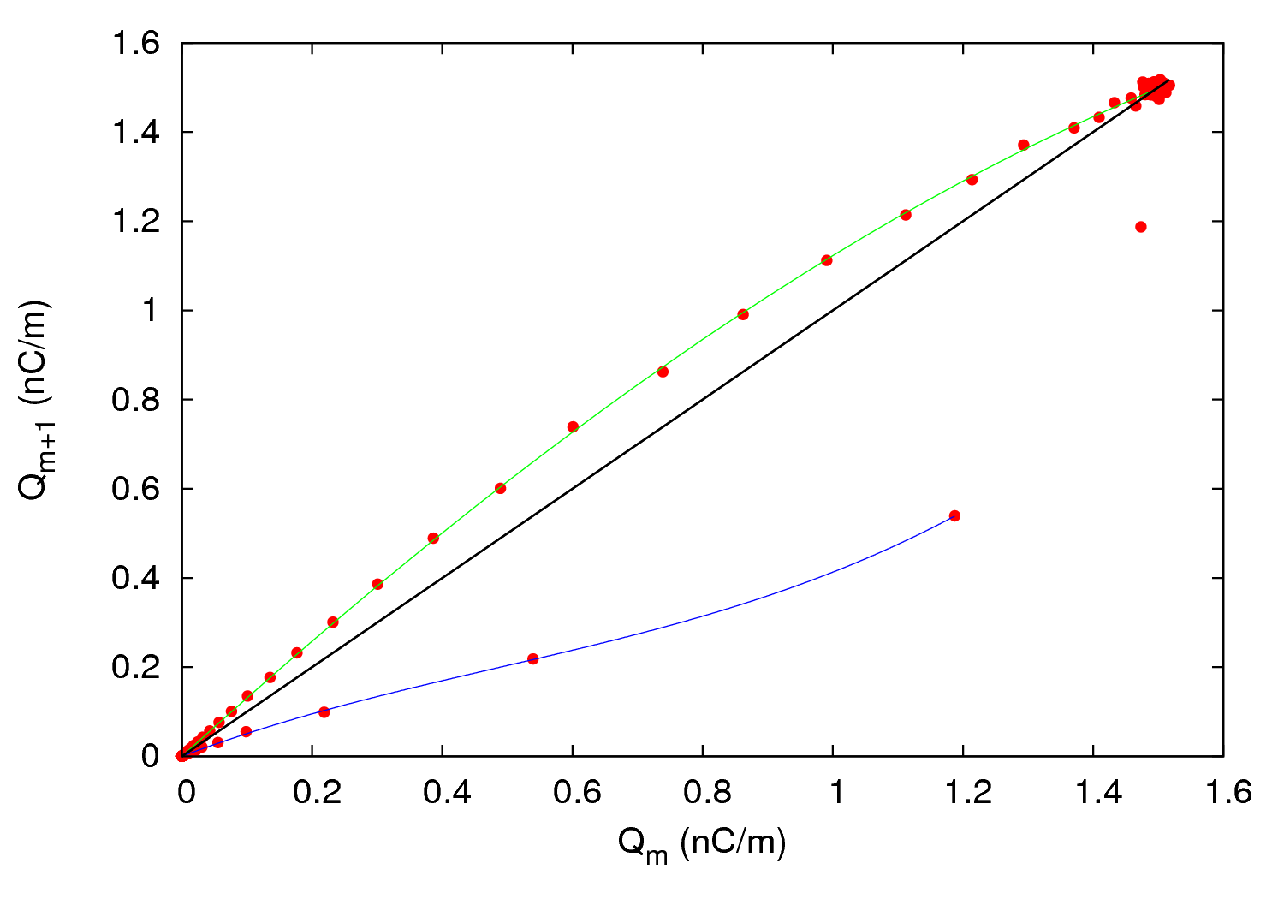
Strategy for the LHC
The map idea works also for the electron dose:
15 February 2012 - e⁻ cloud meeting

Slide 17
Strategy for the LHC
The map idea works also for the electron dose
This fact allow us to infer quickly which are the filling patterns that could optimize the scrubbing run
We can prepare maps for different sets of parameters (δ_{max}, E_{max}, R, N_{b}) and investigate what would be the best filling scheme
Approach idea → setting limits to the electron flux for each filling pattern:
Φ_{map} < Φ_{vacuum} (interlock pressure)
P₀ = Static pressure
η_{e} = Electron induced molecular desorption
coefficient
K = Boltzmann’s constant
T = Temperature
2L= Distance between two gauges
2S= Pumping speed
c = Specific molecular conductance
Φ_{1turn}
15 February 2012 - e⁻ cloud meeting

Slide 18
Strategy for the LHC
The map idea works also for the electron dose
This fact allow us to infer quickly which are the filling patterns that could optimize the scrubbing run
We can prepare maps for different sets of parameters (δ_{max}, E_{max}, R, N_{b}) and investigate what would be the best filling scheme
Approach idea → setting limits to the electron flux for each filling pattern:
Φ_{map} < Φ_{vacuum} (interlock pressure)
ρ < 3∙10¹¹ m⁻³ (to avoid instabilities/losses)
15 February 2012 - e⁻ cloud meeting

Slide 19
Strategy for the LHC
The map idea works also for the electron dose
This fact allow us to infer quickly which are the filling patterns that could optimize the scrubbing run
We can prepare maps for different sets of parameters (δ_{max}, E_{max}, R, N_{b}) and investigate what would be the best filling scheme
Approach idea → setting limits to the electron flux for each filling pattern:
Φ_{map} < Φ_{vacuum} (interlock pressure)
ρ < 3∙10¹¹ m⁻³ (to avoid instabilities/losses)
We could also design filling patterns which minimize e-cloud for eventually starting with 25 ns after the LS1.
Any other suggestions?
15 February 2012 - e⁻ cloud meeting

Slide 20
Outline
Motivation
e⁻ cloud maps
Strategy for the LHC scrubbing + Discussion
Summary
15 February 2012 - e⁻ cloud meeting

Slide 21
Summary
A map formalism can be applied to the electron cloud build up
Maps allow to make predictions very quickly (around 7 orders of magnitude compare to detailed simulation codes)
The electron dose impinging in the walls can be treated as well through maps
We can use maps to find the fastest way to optimize the scrubbing runs at the LHC
15 February 2012 - e⁻ cloud meeting

Slide 22
Thank you for your attention!
15 February 2012 - e⁻ cloud meeting

