Slide 1

PyEcloud simulations for the LHC
G. Iadarola, G. Rumolo
Thanks to:
G. Arduini, V. Baglin, G. Bregliozzi, S. Claudet, O. Dominguez, J. Esteban-Muller,
H. Maury-Cuna, G. Papotti, F. Roncarolo, E. Shaposhnikova, L. Tavian, M. Taborelli,
C. Yin Vallgren
E-cloud simulation meeting
15/02/2012

Slide 2
Outline
  PyEcloud simulations for the benchmarking of 25ns tests in the LHC:
    Historical
    Simulation approach
    Heat load
    Bunch by bunch energy loss
  Attempt of scrubbing time estimation

Slide 3
Outline
  PyEcloud simulations for the benchmarking of 25ns tests in the LHC:
    Historical
    Simulation approach
    Heat load
    Bunch by bunch energy loss
  Attempt of scrubbing time estimation

Slide 4
25ns tests in the LHC
Beam 1
Beam 2
Energy
29/06
07/10
14/10
24-25/10
DATE | SHORT DESCRIPTION
29 June | Injections of 9 x 24b trains per beam with different spacings between them
26 August | Two attempts to inject a 48b train with damper on and off: fast instability dumps the beam within 500 turns in both cases (SBI and CBI)
7 October | High chromaticity (Q’_{x,y} ≈15): Injection tests with trains of 72-144-216-288 bunches from the SPS + ramp to 3.5 TeV & 5h store with 60b (12+24+24) per beam
14 October | High chromaticity: injection of up to 1020 bunches per beam in 72b trains (decreasing spacings between trains at each fill: 6.3–3.2–1 μs)
24-25 October | Injection of up to 2100 bunches in Beam 1 and 1020 in Beam 2 (1μs train spacing)
Scrubbing

Slide 5
Outline
  PyEcloud simulations for the benchmarking of 25ns tests in the LHC:
    Historical
    Simulation approach
    Heat load
    Bunch by bunch energy loss
  Attempt of scrubbing time estimation

Slide 6
Simulation approach
  The entire beam with measured bunch intensities and bunch lengths has been simulated:
  From FBCT
  From BQM

Slide 7
Simulation approach
  The entire beam with measured bunch intensities and bunch lengths has been simulated:
  From FBCT
  From BQM

Slide 8
Simulation approach
  The entire beam with measured bunch intensities and bunch lengths has been simulated:
  From FBCT
  From BQM

Slide 9
Simulation approach
  Assumptions for the benchmarking:
  Uniform SEY in the chamber’s region interested by multipacting
  Same SEY for the two beams (The two ‘stories’ are not so different, some crosscheck performed)
  R0=0.7 (Lower values give unreasonable SEY at the beginning of the scrubbing process. Could be higher!? Try to understand more with next SPS scrubbing run data)
  No memory effect between turns (abort gap + pilot + 12bunches clear residual electrons, suggested by several observables)

Slide 10
Outline
  PyEcloud simulations for the benchmarking of 25ns tests in the LHC:
    Historical
    Simulation approach
    Heat load
    Bunch by bunch energy loss
  Attempt of scrubbing time estimation

Slide 11
Heat load
Beam 1
Beam 2
Energy
29/06
07/10
14/10
24-25/10
29/06
07/10
14/10
24-25/10

Slide 12
Heat load
Beam 1
Beam 2
Energy
29/06
07/10
14/10
24-25/10
29/06
07/10
14/10
24-25/10
Six snapshots from the 25ns MDs to reproduce the measured heat load by simulations!

Slide 13
Heat load
29/06
07/10
14/10
24-25/10
50ns
2011 scrubbing history of LHC arcs
δ_{max} has decreased from the initial 2.1 to 1.52 in the arcs !
25ns threshold @450 GeV
25ns threshold @3.5 TeV

Slide 14
Heat load
29/06
07/10
14/10
24-25/10
Three snapshots from the 25ns MDs to try disentangling difference of Beam1 from Beam2

Slide 15
Heat load
29/06
07/10
14/10
24-25/10
50ns
2011 scrubbing history of LHC arcs
δ_{max} has decreased from the initial 2.1 to 1.52 in the arcs !

Slide 16
Outline
  PyEcloud simulations for the benchmarking of 25ns tests in the LHC:
    Historical
    Simulation approach
    Heat load
    Bunch by bunch energy loss
  Attempt of scrubbing time estimation

Slide 17
Bunch energy loss estimation from buildup simulation
P_{wall} (t)
E_{bunch} (t)
E_{el} (t)
  We consider a slice of the accelerator (supposed to be small with respect to the bunch length) in witch ecloud build-up is ongoing
  We would like to estimate (from our buildup simulation) the energy lost by a bunch passing through such slice

Slide 18
Bunch energy loss estimation from buildup simulation
Energy transfers
E_{bunch} (t)
E_{el} (t)
P_{wall} (t)

Slide 19
Bunch energy loss estimation from buildup simulation
Energy transfers
The bunch energy loss can be obtained as the area of this peak…
E_{bunch} (t)
E_{el} (t)
P_{wall} (t)

Slide 20
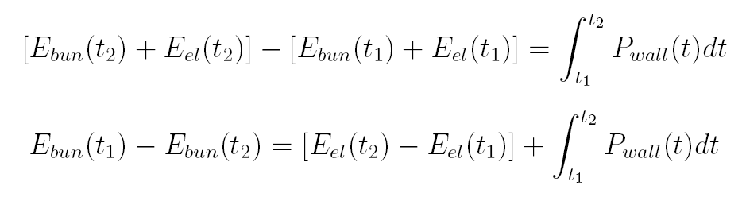
Bunch energy loss estimation from buildup simulation
…or by the an energy balance:
P_{wall} (t)
t=t₁
E_{bunch} (t)
E_{el} (t)
P_{wall} (t)
t=t₂
E_{el} (t)
E_{bunch} (t)
Bunch en. loss
e⁻ en. gain
(electrostatic + kinetic)
En. transferred to walls

Slide 21
Bunch energy loss
We focus on beam 1 shape at the end of injection last 25ns fill (25 October)
Beam 1
Beam 2
Energy
29/06
07/10
14/10
24-25/10

Slide 22
Bunch energy loss
Simulations → δ_{max} fixed to 1.6
Measurements → the energy loss per bunch is obtained from the stable phase shift
ZOOM
Beam 1

Slide 23
Bunch energy loss

Slide 24
Bunch energy loss
  Remarks:
  Very good agreement between bunch by bunch synchronous phase shift and simulated energy loss at the saturation of the e-cloud
  Build up phase of the electron cloud still not reproduced by simulations with the same accuracy and level of detail. Possible reasons:
    Simulation underestimates the primary electron generation (orders of magnitude ?!)
    Larger R0? (unlikely, because 0.7 is already a high value?!)
    Uncaptured beam between batches? (SPS experience)
  For the first batches energy loss measurements show a different behavior compared to bunch losses and emittance growth

Slide 25
Bunch energy loss
  Remarks:
  Very good agreement between bunch by bunch synchronous phase shift and simulated energy loss at the saturation of the e-cloud
  Build up phase of the electron cloud still not reproduced by simulations with the same accuracy and level of detail. Possible reasons:
    Simulation underestimates the primary electron generation (orders of magnitude ?!)
    Larger R0? (unlikely, because 0.7 is already a high value?!)
    Uncaptured beam between batches? (SPS experience)
  For the first batches energy loss measurements show a different behavior compared to bunch losses and emittance growth

Slide 26
Bunch energy loss
Simulations → δ_{max} fixed to 1.5
(added 2e9p⁺/m uncapt. beam)
Measurements → the energy loss per bunch is obtained from the stable phase shift
ZOOM
Beam 1

Slide 27
Bunch energy loss

Slide 28
Bunch energy loss
  Remarks:
  Very good agreement between bunch by bunch synchronous phase shift and simulated energy loss at the saturation of the e-cloud
  Build up phase of the electron cloud still not reproduced by simulations with the same accuracy and level of detail. Possible reasons:
    Simulation underestimates the primary electron generation (orders of magnitude ?!)
    Larger R0? (unlikely, because 0.7 is already a high value?!)
    Uncaptured beam between batches? (SPS experience)
  For the first batches energy loss measurements show a different behavior compared to bunch losses and emittance growth

Slide 29
Bunch energy loss
  For the first batches energy loss measurements show a different behavior compared to bunch losses and emittance growth

Slide 30
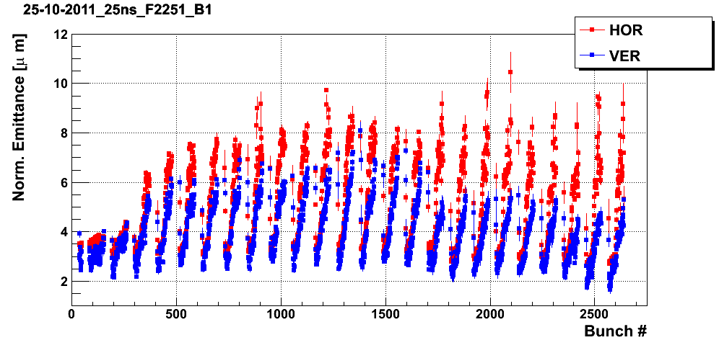
Bunch energy loss
  For the first batches energy loss measurements show a different behavior compared to bunch losses and emittance growth

Slide 31
Bunch energy loss

Slide 32
Outline
  PyEcloud simulations for the benchmarking of 25ns tests in the LHC:
    Historical
    Simulation approach
    Heat load
    Bunch by bunch energy loss
  Attempt of scrubbing time estimation

Slide 33
The estimation approach
From δ(t_{n}) compute the scrubbing current J(t_{n})
Update scrubbing dose
d(t_{n+1})= d(t_{n})+ J(t_{n}) Δt
Update SEY
δ(t_{n+1}) from scrubbing curve
t_{n+1}=t_{n}+Δt

Slide 34
The estimation approach
From δ(t_{n}) compute the scrubbing current J(t_{n})
Update scrubbing dose
d(t_{n+1})= d(t_{n})+ J(t_{n}) Δt
Update SEY
δ(t_{n+1}) from scrubbing curve
t_{n+1}=t_{n}+Δt

Slide 35
The estimation approach
From δ(t_{n}) compute the scrubbing current J(t_{n})
Update scrubbing dose
d(t_{n+1})= d(t_{n})+ J(t_{n}) Δt
Update SEY
δ(t_{n+1}) from scrubbing curve
PyEcloud simulations with the beam 1 shape of last 25ns fill (25 October)
t_{n+1}=t_{n}+Δt

Slide 36
The estimation approach
From δ(t_{n}) compute the scrubbing current J(t_{n})
Update scrubbing dose
d(t_{n+1})= d(t_{n})+ J(t_{n}) Δt
Update SEY
δ(t_{n+1}) from scrubbing curve
t_{n+1}=t_{n}+Δt

Slide 37
The estimation approach
  C. Y. Vallgren, Cu scrubbing curve measured with e⁻ at 500eV
From δ(t_{n}) compute the scrubbing current J(t_{n})
Update scrubbing dose
d(t_{n+1})= d(t_{n})+ J(t_{n}) Δt
Update SEY
δ(t_{n+1}) from scrubbing curve
t_{n+1}=t_{n}+Δt

Slide 38
The estimation approach
PyEcloud simulations with the beam 1 shape of last 25ns fill (25 October)
PyEcloud simulations with the beam 2 shape of last 25ns fill (25 October)

Slide 39
The estimation approach
PyEcloud simulations with the beam 1 shape of last 25ns fill (25 October)
PyEcloud simulations with the beam 2 shape of last 25ns fill (25 October)

Slide 40
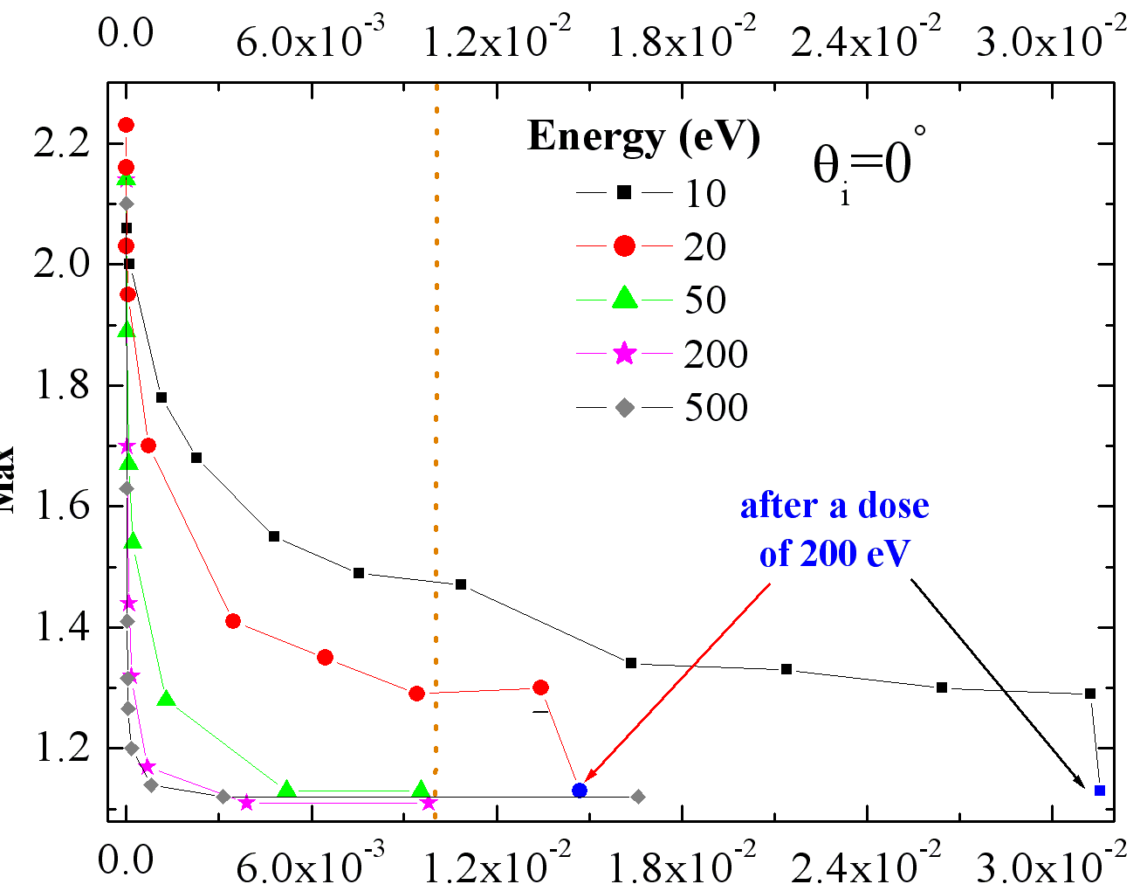
Scrubbing time estimation
  R. Cimino, e-cloud meeting 29/07/2011
~2h
~9h
~8h
SEY_{max}
Dose [C/mm²]
  Seem to be consistent with the estimation obtained from the heat load

Slide 41
Scrubbing time estimation
From G. Arduini, ‘Performance Reach in the LHC for 2012’,
Chamonix 2012:
How much machine time for operation at 25ns:
  At least 20 hours of beam time starting with at least 2100 bunches circulating and going to ~2800 bunches
  During the MD 25 ns (after 3 MDs) 2 h of beam time at maximum current required in total ~14 h of machine time (slowed down by losses and dumps due to LSS6 BPMs, MKI vacuum activity, etc…). Scrubbing Hübner Factor=0.14. Machine availability was close to 100 %. TDI was kept IN all the time. We should not do it in 2012.
  At least 140 hours = 6 days of machine time without setting-up (of injections up to 288 bunches) and intensity ramp-up to 2800 bunches (not done so far)
  1 day setting-up of 25 ns beam (72 bunches) + 2 shifts commissioning per injection step (144-216-288) ➔ 3 days
  2 days for operation/scrubbing at 3.5-4 TeV with increasing number of bunches to validate operation at high energy.
  Total of 11 days with very good machine availability and no contingency

Slide 42
Electron cloud 800mm
G. Iadarola, O. Dominguez, G. Rumolo
Thanks to:
V. Baglin, G. Papotti
E-cloud simulation meeting
15/02/2012

Slide 43
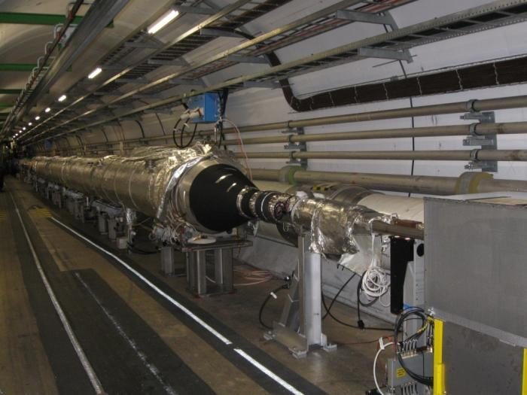
Electron cloud in 800mm chamber near ALICE

Slide 44
Electron cloud in 800mm chamber near ALICE
  In the considered section both beams circulate in the same pipe:

Slide 45
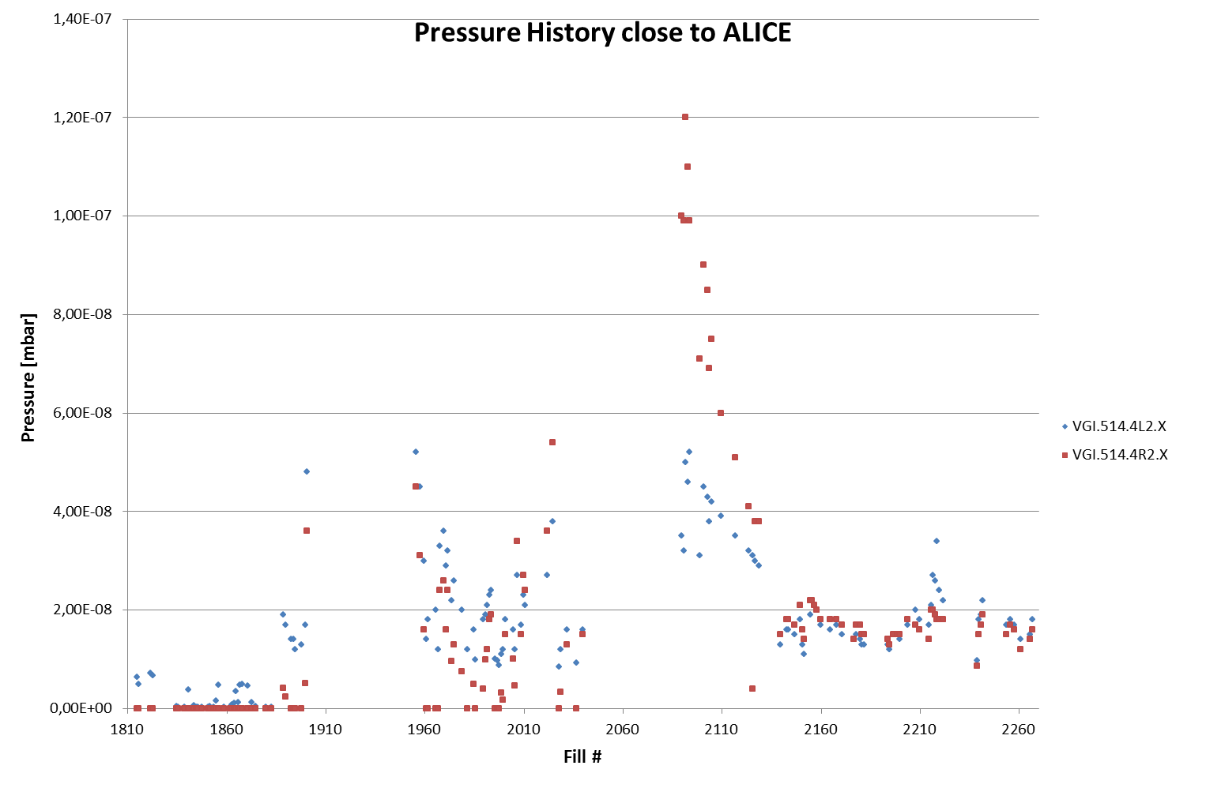
Electron cloud in 800mm chamber near ALICE
MD block + TS
22/08 – 09/09
First Fill with 1236b
3 x 25ns MD block
07/10 – 14/10 – 24-25/10
First Fill with 1380b
1092b
One can observe some ΔP after the last injection of the last batch

Slide 46
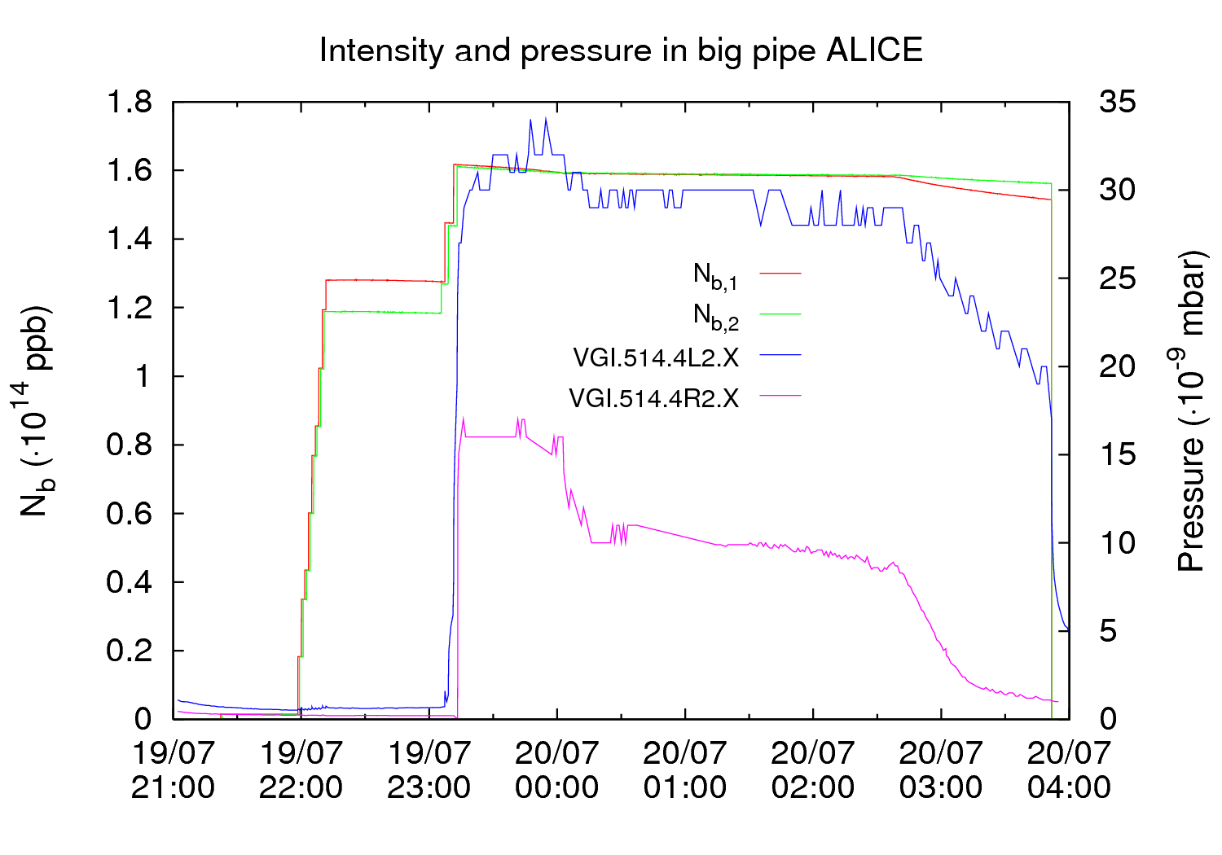
Electron cloud in 800mm chamber near ALICE
  Fill 1960 19-20/07/2011

Slide 47
Hybrid spacings
We never have a gap in the beam that is larger than 2μs!
  Detail
Filling scheme: 50ns_1380b+1small_1318_39_1296_144bpi13inj
(before last 2 inj. on both beams)

Slide 48
Hybrid spacings
We never have a gap in the beam that is larger than 2μs!
  Detail
Filling scheme: 50ns_1380b+1small_1318_39_1296_144bpi13inj
(before last 2 inj. on both beams)

Slide 49
Hybrid spacings
We never have a gap in the beam that is larger than 2μs!
  Detail
Filling scheme: 50ns_1380b+1small_1318_39_1296_144bpi13inj
(before last 2 inj. on both beams)

Slide 50
Hybrid spacings
We never have a gap in the beam that is larger than 2μs!
  Detail
Filling scheme: 50ns_1380b+1small_1318_39_1296_144bpi13inj
(before last 2 inj. on both beams)

Slide 51
Hybrid spacings
We never have a gap in the beam that is larger than 2μs!
  Detail
Filling scheme: 50ns_1380b+1small_1318_39_1296_144bpi13inj
(before last 2 inj. on both beams)

Slide 52
Hybrid spacings
We never have a gap in the beam that is larger than 2μs!
  Detail
Filling scheme: 50ns_1380b+1small_1318_39_1296_144bpi13inj
(before last 2 inj. on both beams)

Slide 53
Hybrid spacings
We never have a gap in the beam that is larger than 2μs!
  Detail
Filling scheme: 50ns_1380b+1small_1318_39_1296_144bpi13inj
(before last 2 inj. on both beams)

Slide 54
Hybrid spacings
We never have a gap in the beam that is larger than 2μs!
  Detail
Filling scheme: 50ns_1380b+1small_1318_39_1296_144bpi13inj
(before last 2 inj. on both beams)

Slide 55
Hybrid spacings
We never have a gap in the beam that is larger than 2μs!
  Detail
Filling scheme: 50ns_1380b+1small_1318_39_1296_144bpi13inj
(before last 2 inj. on both beams)

Slide 56
Hybrid spacings
  Before the last two injections (1380 - 288 bunches)
Filling scheme: 50ns_1380b+1small_1318_39_1296_144bpi13inj

Slide 57
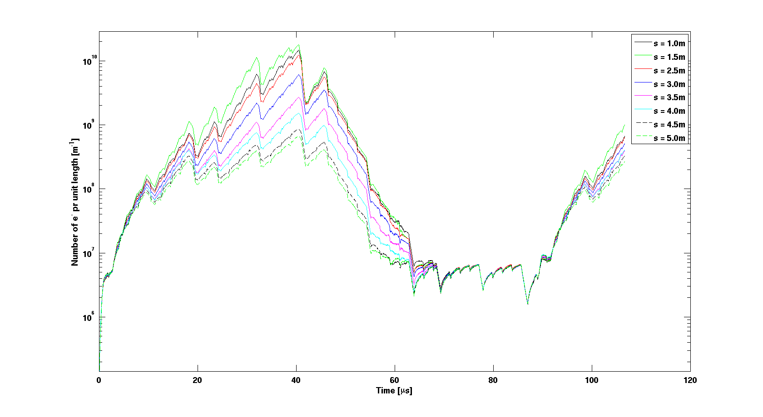
Hybrid spacings: realistic situation
Hybrid spacings
50ns beam
Hybrid spacings
  Before the last two injections (1380 - 288 bunches per beam)
  SEY 1.6
No multipacting

Slide 58
Hybrid spacings
  At the end of injection (1380 bunches)
Filling scheme: 50ns_1380b+1small_1318_39_1296_144bpi13inj

Slide 59
Hybrid spacings: multiturn effect
Hybrid spacings
50ns beam
Hybrid spacings
50ns beam
  Before the last two injections (1380 - 288 bunches per beam)
Hybrid spacings
Hybrid spacings
  At the end of injection (1380 bunches per beam)
  SEY 1.6
  1st turn
  2nd turn

Slide 60
Conclusions
  A multi-turn buildup is possible in common pipes
  Only qualitative benchmarking was possible (not many observables available)
  The transverse displacement of the two beams seems to have an effect (more pressure rise observed after ALICE polarity change)
  The whole chamber is sensitive to ecloud (localized solenoid is not a solution)

Slide 61
Thanks for your attention!

Slide 62
Energy spectrum of impacting electrons
δ_{max}=1.5

Slide 63
Scrubbing simulation
  C. Y. Vallgren, Cu
  measured with e⁻ at 500eV
  The scrubbing process seems to be too fast

Slide 64
Remarks
  The time required to scrub from 1.5 (the point we are now) to 1.45 (threshold for 25ns) differs by a factor 5 or 10 from that required to scrub from 1.65 to 1.5 (what we did on 24-25 October)
    Expectation ~30h (?!)
  If we measure heat load, we have sufficient dose to continue scrubbing
  At the end only last trains scrub (long build-up), but we should have a better beam (less losses) and we could try to limit the effect of the abort gap:
    Study a better filling pattern (pilot + 12 + 288 + N*(72))
    Over-injection (12 + N*72)
    Uncaptured beam

Slide 65
In case we cannot fill the machine…
  R. Cimino, e-cloud meeting 29/07/2011
  (Is it copper??)
SEY_{max}
Dose [C/mm²]
  Seem to be consistent with the estimation obtained from the heat load

Slide 66
Scrubbing simulation

Slide 67
Scrubbing simulation

Slide 68
Scrubbing simulation

Slide 69
Scrubbing simulation

