Slide 1
Update on e- cloud maps
C. Octavio Domínguez
Thanks to
Gianluigi Arduini, Giovanni Iadarola
28 March 2012 - e⁻ cloud meeting

Slide 2
Outline
Some brief considerations
1.1 Maps 110&100 and 01
1.2 Maps 110&100 vs. Map10
1.3 Pressure influence
1.4 Conclusions
Different filling schemes for scrubbing optimization
2.1 Warm-warm uncoated straight sections
2.2 Arcs
2.3 Conclusions
28 March 2012 - e⁻ cloud meeting

Slide 3
Outline
Some brief considerations
1.1 Maps 110&100 and 01
1.2 Maps 110&100 vs. Map10
1.3 Pressure influence
1.4 Conclusions
Different filling schemes for scrubbing optimization
2.1 Warm-warm uncoated straight sections
2.2 Arcs
2.3 Conclusions
28 March 2012 - e⁻ cloud meeting

Slide 4
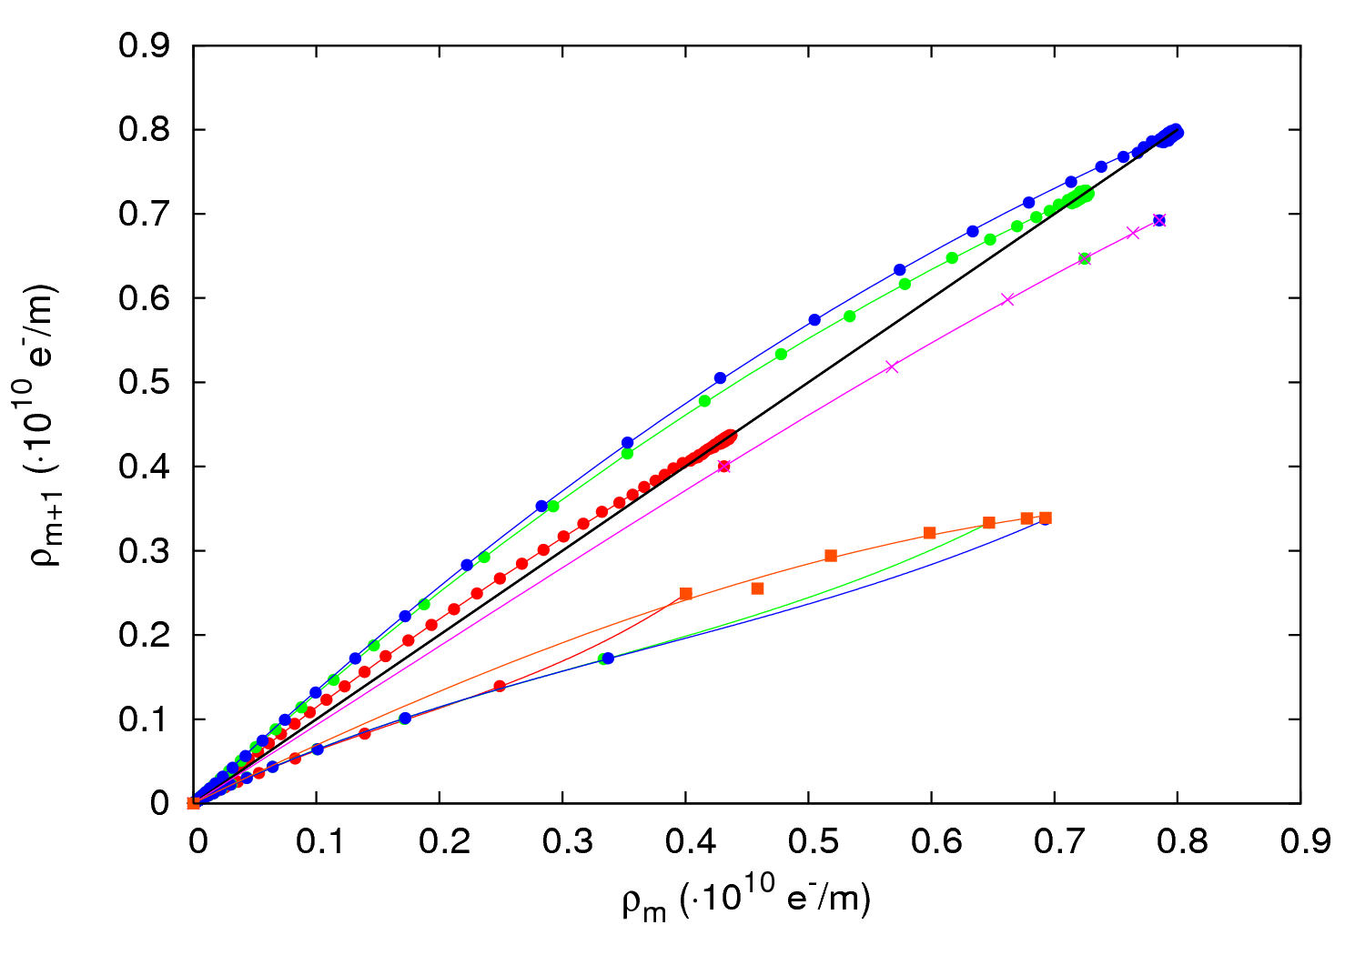
Maps 110&100
From last e-cloud meeting: Maps 110&100 need several N_{b} to be calculated
N_{b} = 0.8∙10¹¹ ppb
N_{b} = 1.1∙10¹¹ ppb
N_{b} = 1.4∙10¹¹ ppb
Identity map
Fit 110
Fit 100
x
28 March 2012 - e⁻ cloud meeting

Slide 5
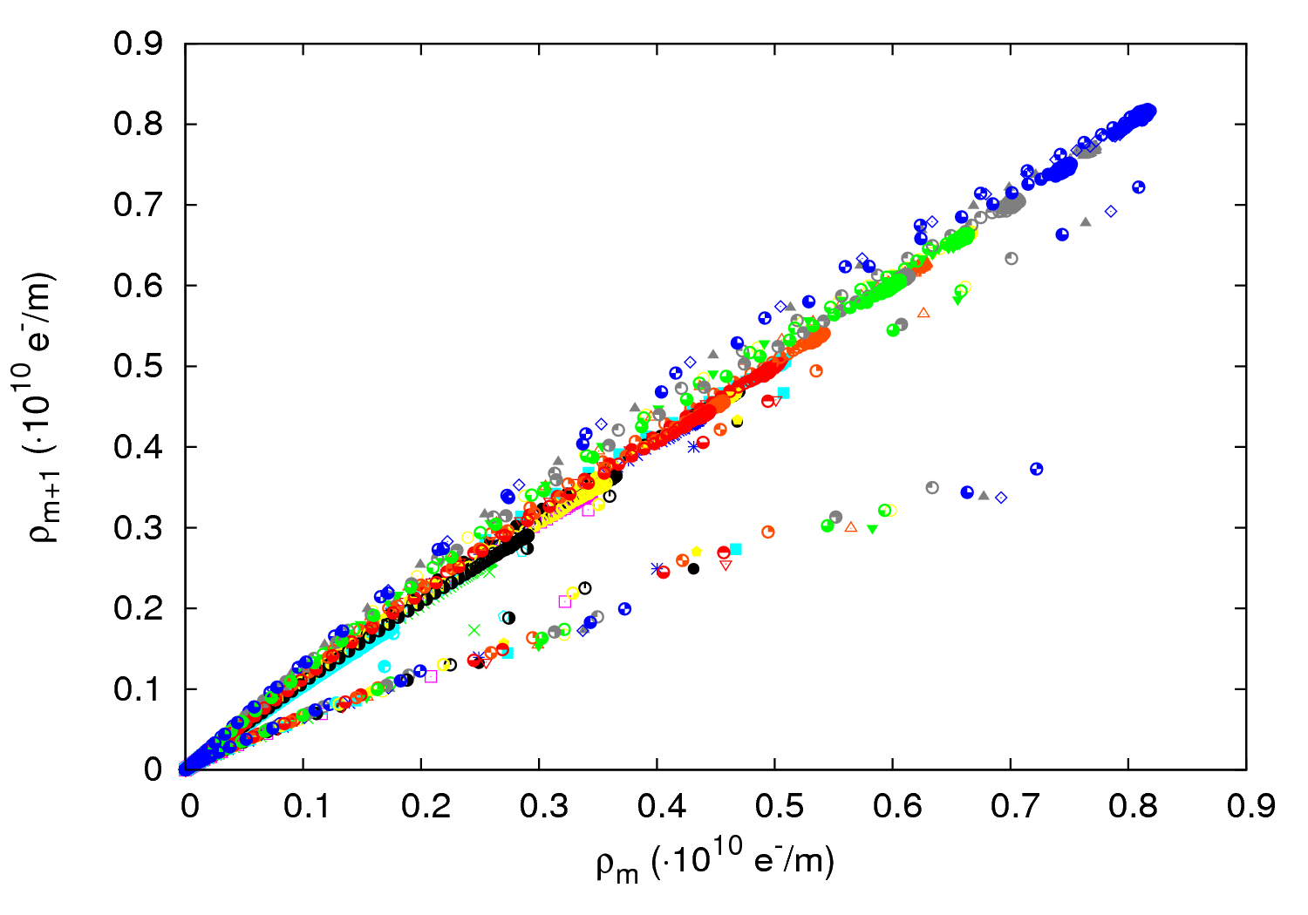
Maps 110&100
It’s not only different N_{b}s what generates the maps 110&100 → Any parameter set yields to the same decay maps
30 parameter sets (varying N_{b}, δ_{max}, ε_{max} and R)
28 March 2012 - e⁻ cloud meeting

Slide 6
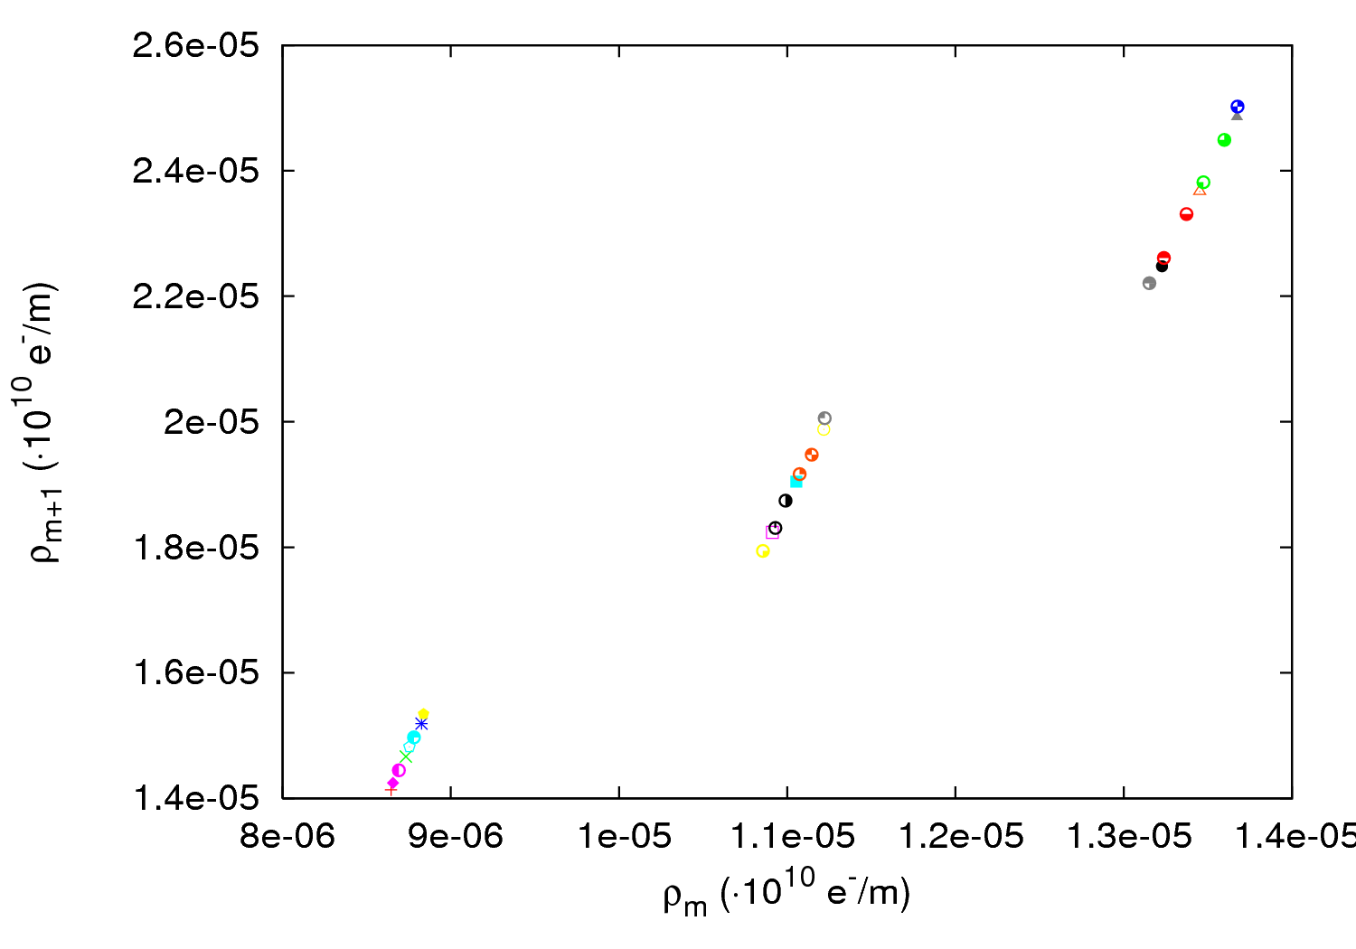
Maps 01
! Instead, for map 01 different parameters yield to different curves → Different N_{b}s yield to the right map.
N_{b}=1.2∙10¹¹ ppb
N_{b}=1.0∙10¹¹ ppb
N_{b}=0.8∙10¹¹ ppb
28 March 2012 - e⁻ cloud meeting

Slide 7
Outline
Some brief considerations
1.1 Maps 110&100 and 01
1.2 Maps 110&100 vs. Map10
1.3 Pressure influence
1.4 Conclusions
Different filling schemes for scrubbing optimization
2.1 Warm-warm uncoated straight sections
2.2 Arcs
2.3 Conclusions
28 March 2012 - e⁻ cloud meeting

Slide 8
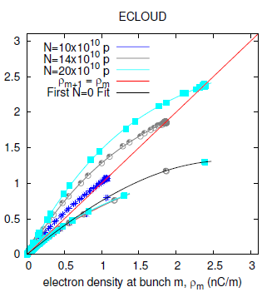
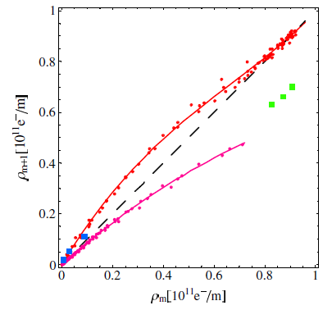
Maps 110&100 vs. Map10
Why 2 maps (110&100) instead of only one (10)?
U. Iriso
Only 10
Only 10
T. Demma et al.
N_{b} = 0.8∙10¹¹ ppb
N_{b} = 1.1∙10¹¹ ppb
N_{b} = 1.4∙10¹¹ ppb
Identity map
Fit 110
Fit 100
x
Both 110&100
28 March 2012 - e⁻ cloud meeting

Slide 9
Maps 110&100 vs. Map10
Why 2 maps (110&100) instead of only one (10)?
It depends on how the bunch-to-bunch average density is calculated
| | | |
Bunch m-1 Bunch m Bunch m+1 Bunch m+2
1
Both Maps 110&100
| | | |
Bunch m-1 Bunch m Bunch m+1 Bunch m+2
2
Only Map10
28 March 2012 - e⁻ cloud meeting

Slide 10
Maps 110&100 vs. Map10
Why 2 maps (110&100) instead of only one (10)?
It depends on how the average density is taken
Is there any physical difference?
In principle No
28 March 2012 - e⁻ cloud meeting

Slide 11
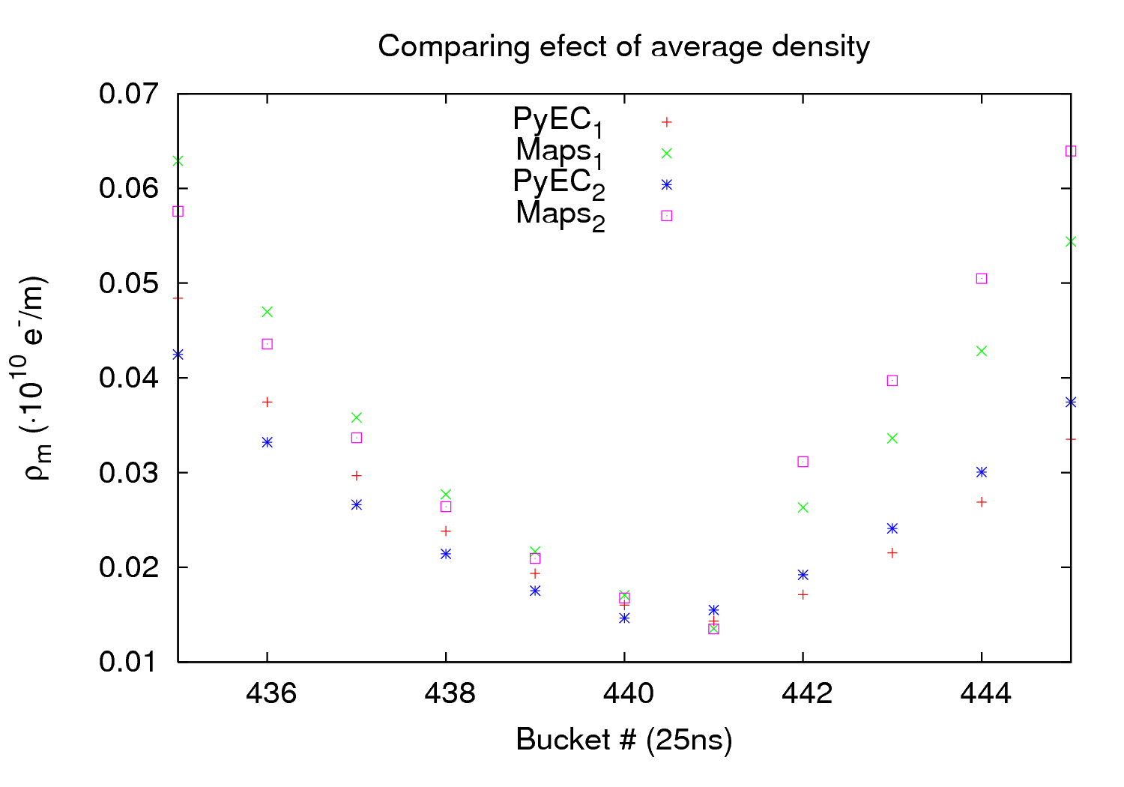
Maps 110&100 vs. Map10
Why 2 maps (110&100) instead of only one (10)?
It depends on how the average density is taken
Is there any physical difference?
In principle No
Which work better?
41%
38%
38%
35%
28 March 2012 - e⁻ cloud meeting

Slide 12
Maps 110&100 vs. Map10
Why 2 maps (110&100) instead of only one (10)?
It depends on how the average density is taken
Is there any physical difference?
In principle No
Which work better?
They are basically equivalent. Slightly better performance for 110&100
(All calculations have been done with 110&100)
28 March 2012 - e⁻ cloud meeting

Slide 13
Outline
Some brief considerations
1.1 Maps 110&100 and 01
1.2 Maps 110&100 vs. Map10
1.3 Pressure influence
1.4 Conclusions
Different filling schemes for scrubbing optimization
2.1 Warm-warm uncoated straight sections
2.2 Arcs
2.3 Conclusions
28 March 2012 - e⁻ cloud meeting

Slide 14
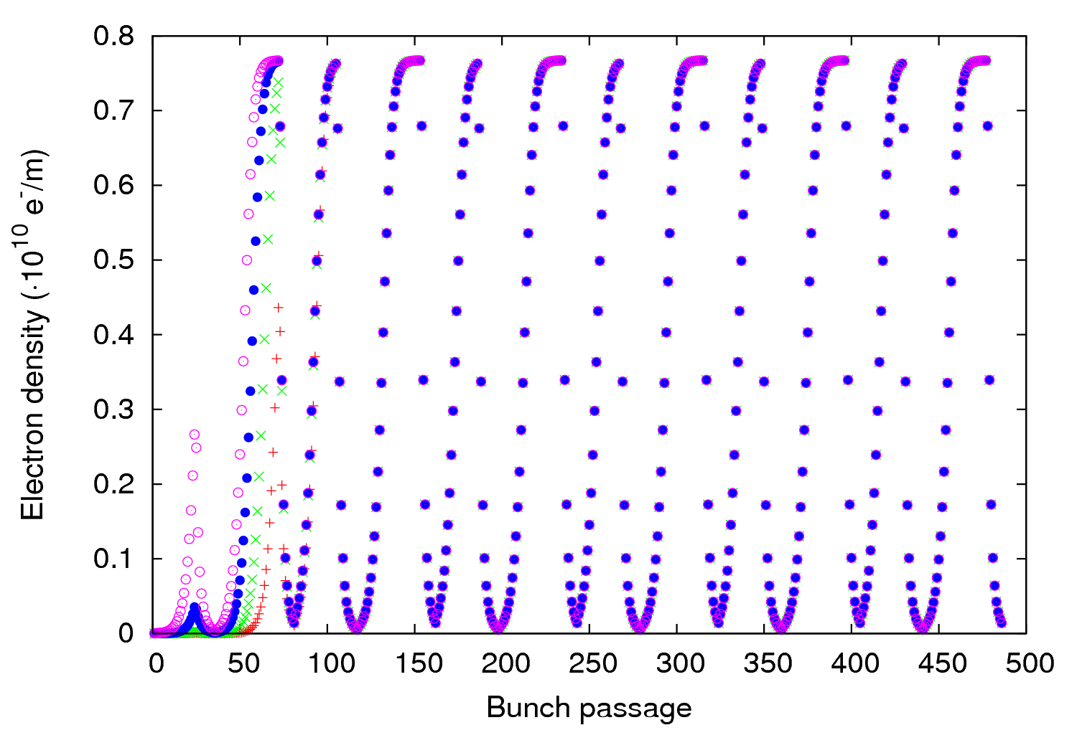
Pressure influence
From last e-cloud meeting: P₀ in maps build up is important only in first batches
P₀= 2nTorr
P₀= 20nTorr
P₀= 200nTorr
P₀= 2000nTorr
+
x
28 March 2012 - e⁻ cloud meeting

Slide 15
Pressure influence
From last e-cloud meeting: P₀ in maps build up is important only in first batches
But: Does P₀ in simulations alter much the maps?
P₀= 2nTorr
P₀= 20nTorr
P₀= 200nTorr
P₀= 2000nTorr
+
x
28 March 2012 - e⁻ cloud meeting

Slide 16
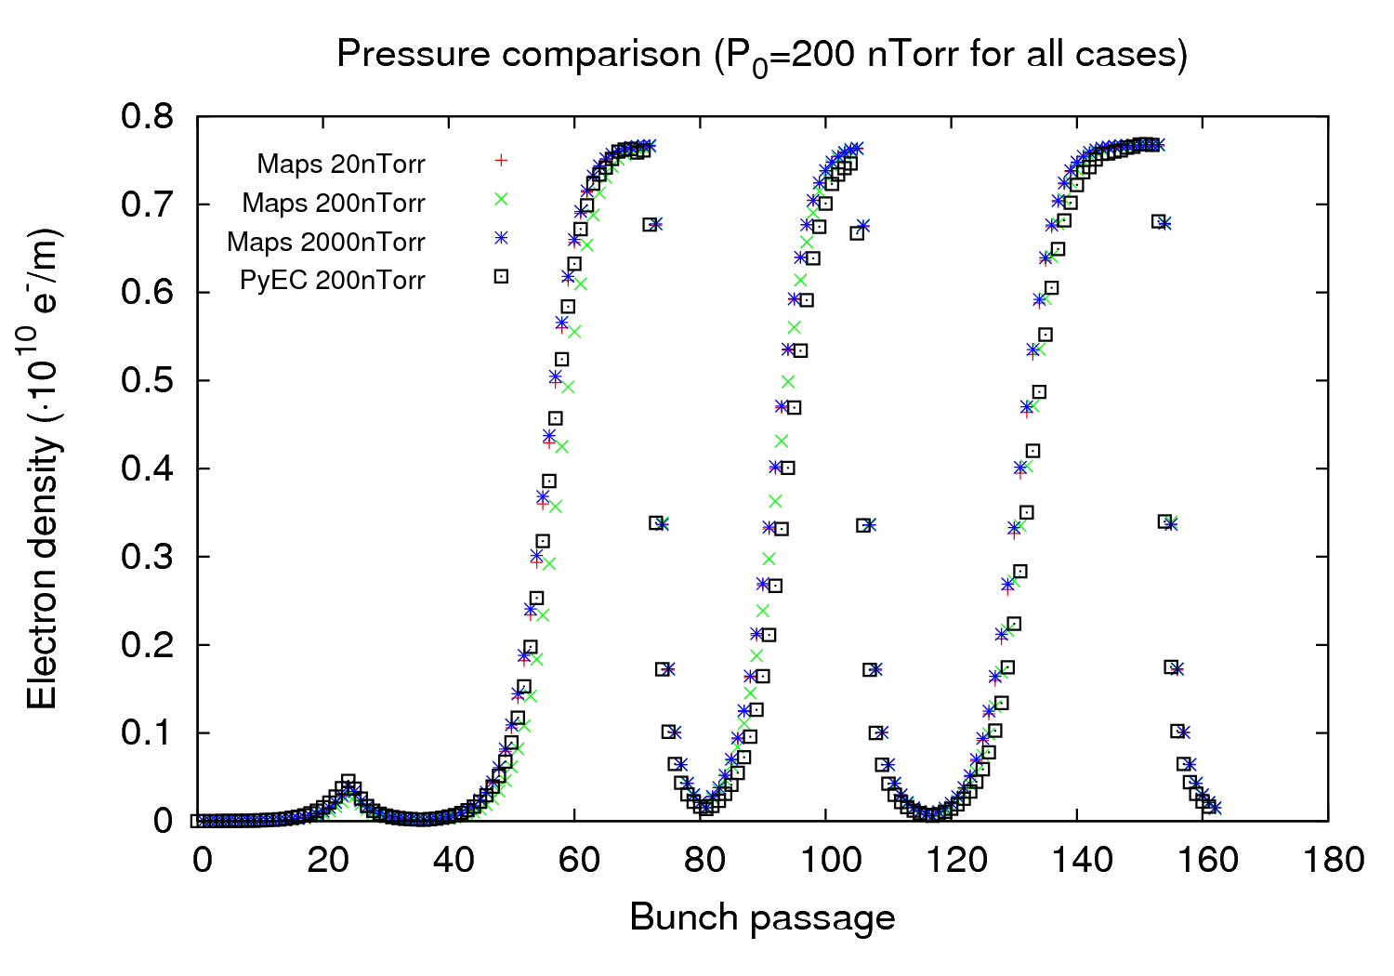
Pressure influence
From last e-cloud meeting: P₀ in maps build up is important only in first batches
But: Does P₀ in simulations alter much the maps?
28 March 2012 - e⁻ cloud meeting

Slide 17
Pressure influence
From last e-cloud meeting: P₀ in maps build up is important only in first batches
But: Does P₀ in simulations alter much the maps? Not really
28 March 2012 - e⁻ cloud meeting

Slide 18
Outline
Some brief considerations
1.1 Maps 110&100 and 01
1.2 Maps 110&100 vs. Map10
1.3 Pressure influence
1.4 Conclusions
Different filling schemes for scrubbing optimization
2.1 Warm-warm uncoated straight sections
2.2 Arcs
2.3 Conclusions
28 March 2012 - e⁻ cloud meeting

Slide 19
Map considerations - Conclusions
Decay maps (10, 110&100 and 00) seem to be universal
Build-up maps (01 and 11) are parameter dependence:
- Map 01 must be constructed using a same parameter set changing only N_{b}
- Map 11 is specific for every parameter set
Having one (10) or two maps (110&100) at the beginning of the decay depends on how the bunch-to-bunch average density is calculated
Both options give a similar performance (maybe slightly better with 110&100)
Using a different initial pressure in the simulations used to infer the maps does not vary much the performance → No need to launch simulations at different P₀
28 March 2012 - e⁻ cloud meeting

Slide 20
Outline
Some brief considerations
1.1 Maps 110&100 and 01
1.2 Maps 110&100 vs. Map10
1.3 Pressure influence
1.4 Conclusions
Different filling schemes for scrubbing optimization
2.1 Warm-warm uncoated straight sections
2.2 Arcs
2.3 Conclusions
28 March 2012 - e⁻ cloud meeting

Slide 21
Scrubbing optimization - Gauges
Default scheme: (72b + 925 ns) x 32
Can we optimize the scrubbing with a different filling scheme?
First approach: Check total flux (to get a similar or higher one) and peak flux (trying to minimize it)
Schemes investigated so far:
Single batch: (72b + 925 ns) x 32
Double batch: ((36b + 12e + 24b + 225 ns)x2 + 925 ns) x18
((48b + 12e + 12b + 225 ns)x2 + 925 ns) x18
(48b + 12e + 12b + 225 ns + 60b + 12e + 925 ns) x18
((60b + 12e + 225 ns)x2 + 925 ns) x18
Triple batch: ((36b + 12e + 24b + 225 ns)x3 + 925 ns) x13
((48b + 12e + 12b + 225 ns)x3 + 925 ns) x13
((60b + 12e + 225 ns)x3 + 925 ns) x13
28 March 2012 - e⁻ cloud meeting

Slide 22
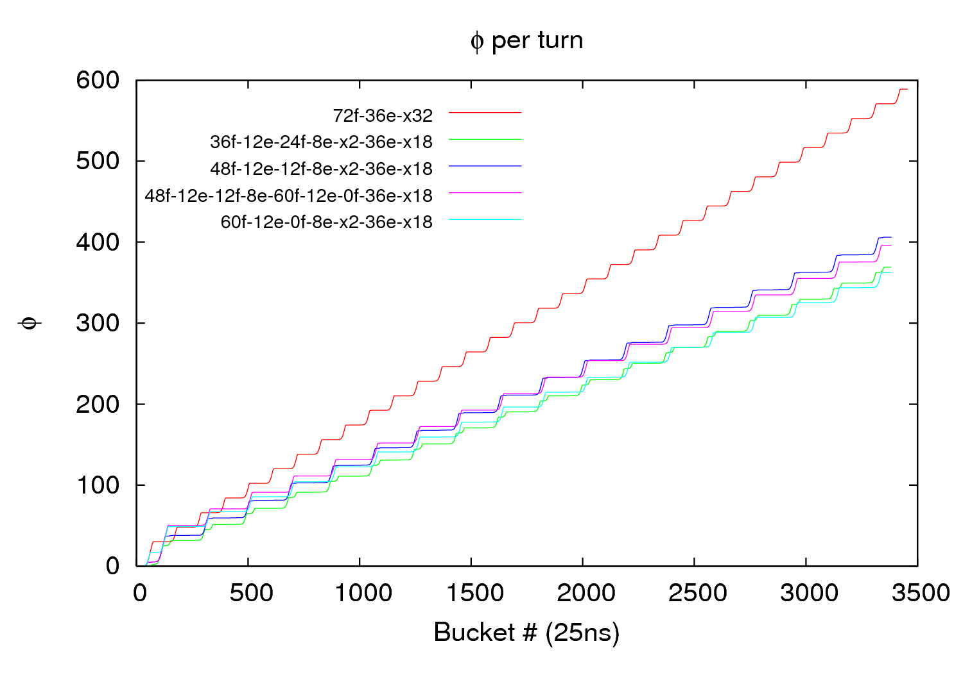
Scrubbing optimization - Gauges
δ_{max}= 1.4; R=0.3; ε_{max}=290eV; N_{b}= 1.2∙10¹¹ ppb
28 March 2012 - e⁻ cloud meeting

Slide 23
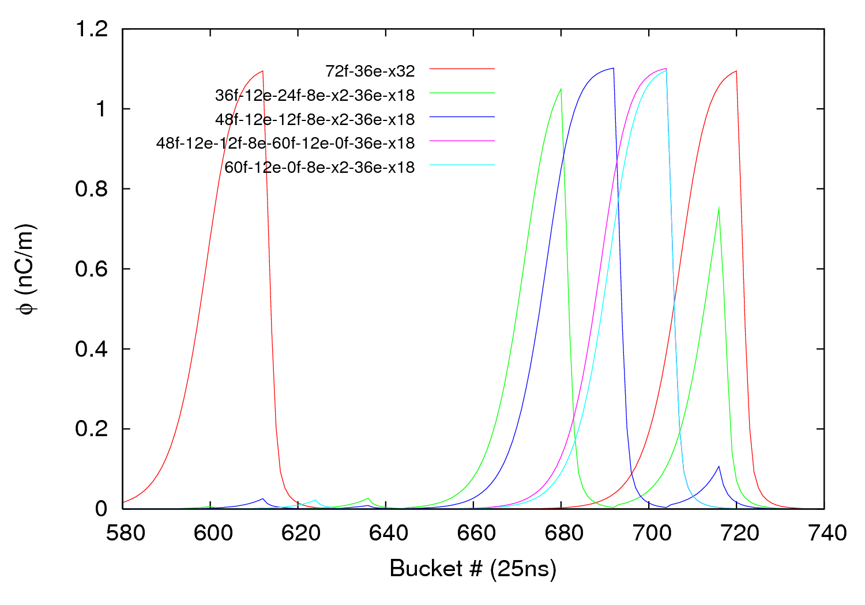
Scrubbing optimization - Gauges
δ_{max}= 1.4; R=0.3; ε_{max}=290eV; N_{b}= 1.2∙10¹¹ ppb
28 March 2012 - e⁻ cloud meeting

Slide 24
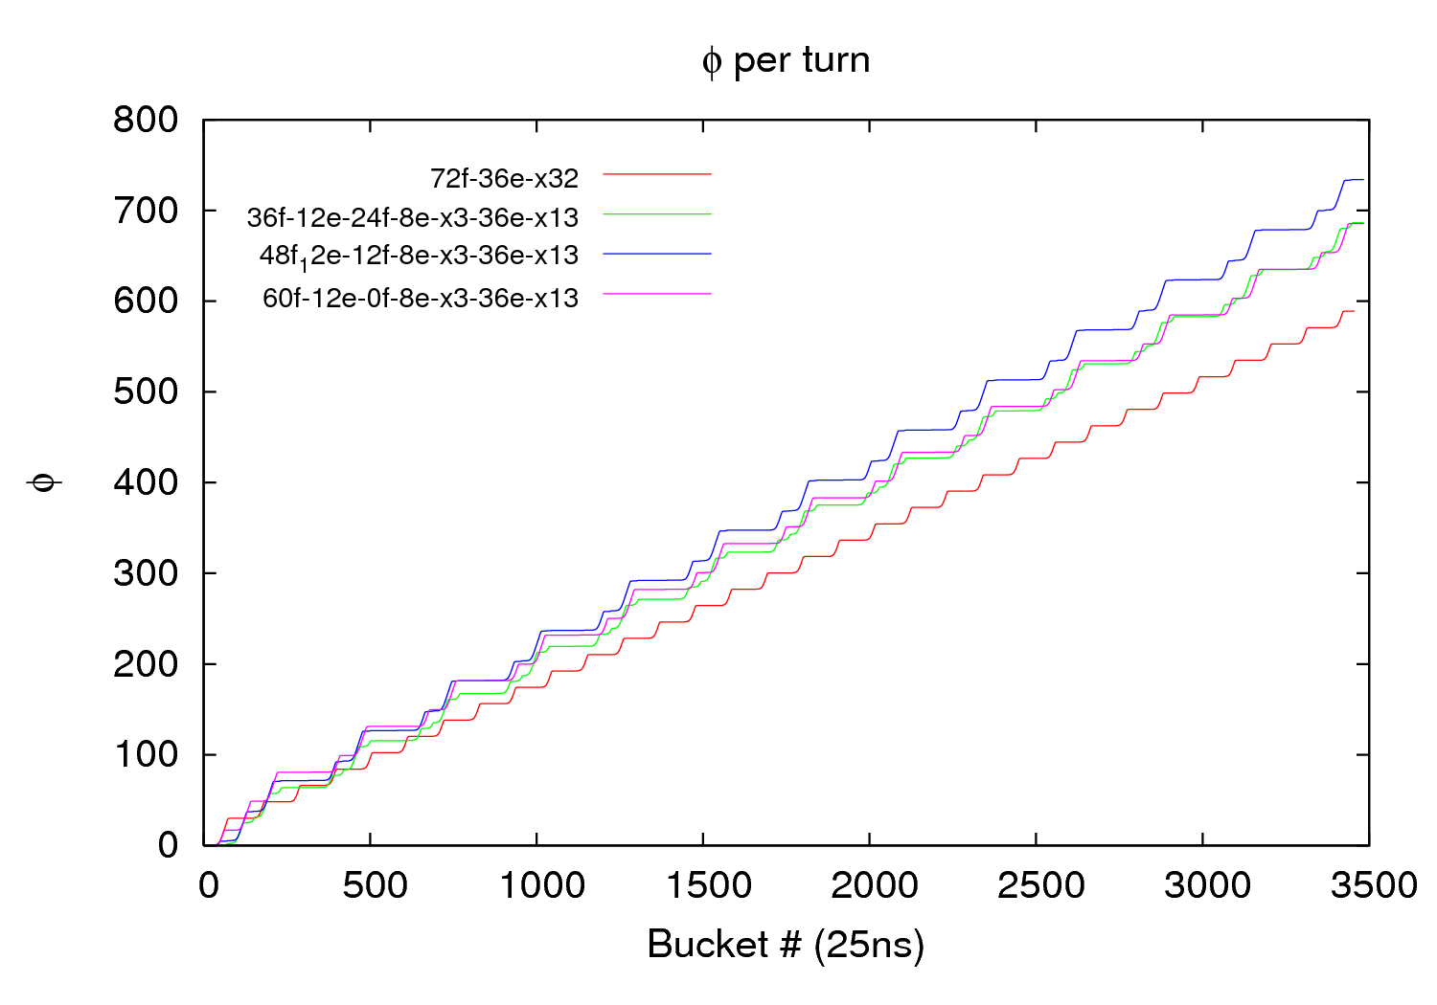
Scrubbing optimization - Gauges
δ_{max}= 1.4; R=0.3; ε_{max}=290eV; N_{b}= 1.2∙10¹¹ ppb
28 March 2012 - e⁻ cloud meeting

Slide 25
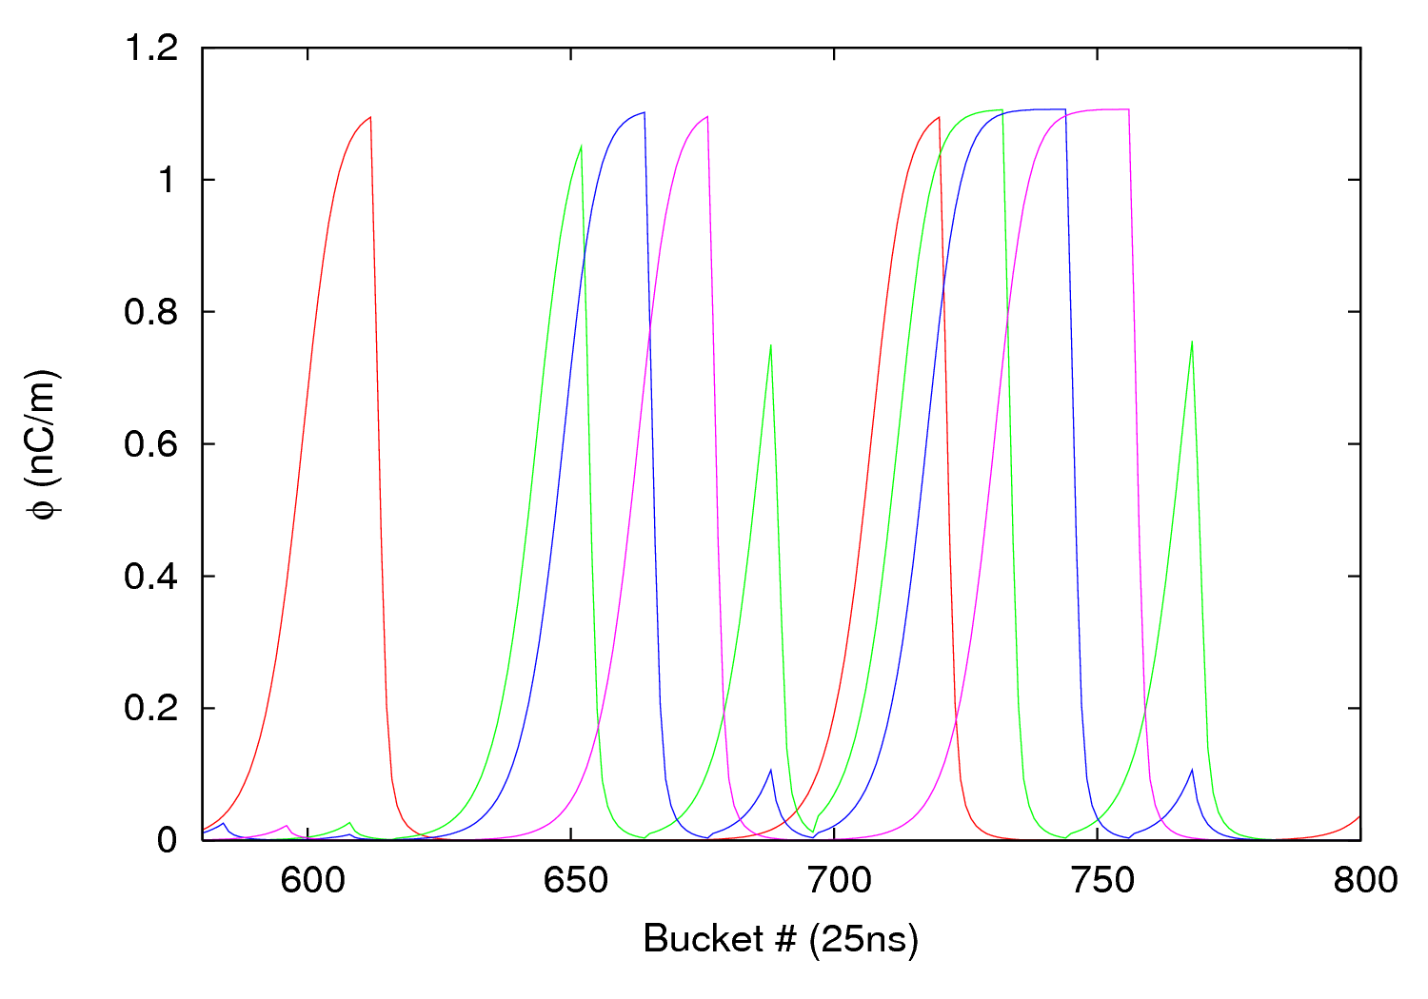
Scrubbing optimization - Gauges
δ_{max}= 1.4; R=0.3; ε_{max}=290eV; N_{b}= 1.2∙10¹¹ ppb
28 March 2012 - e⁻ cloud meeting

Slide 26
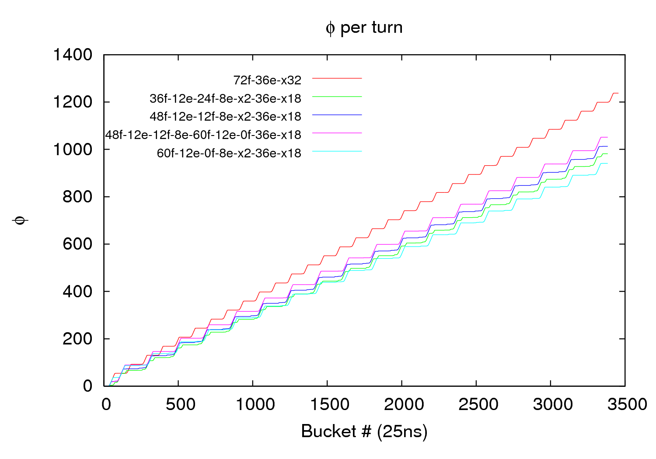
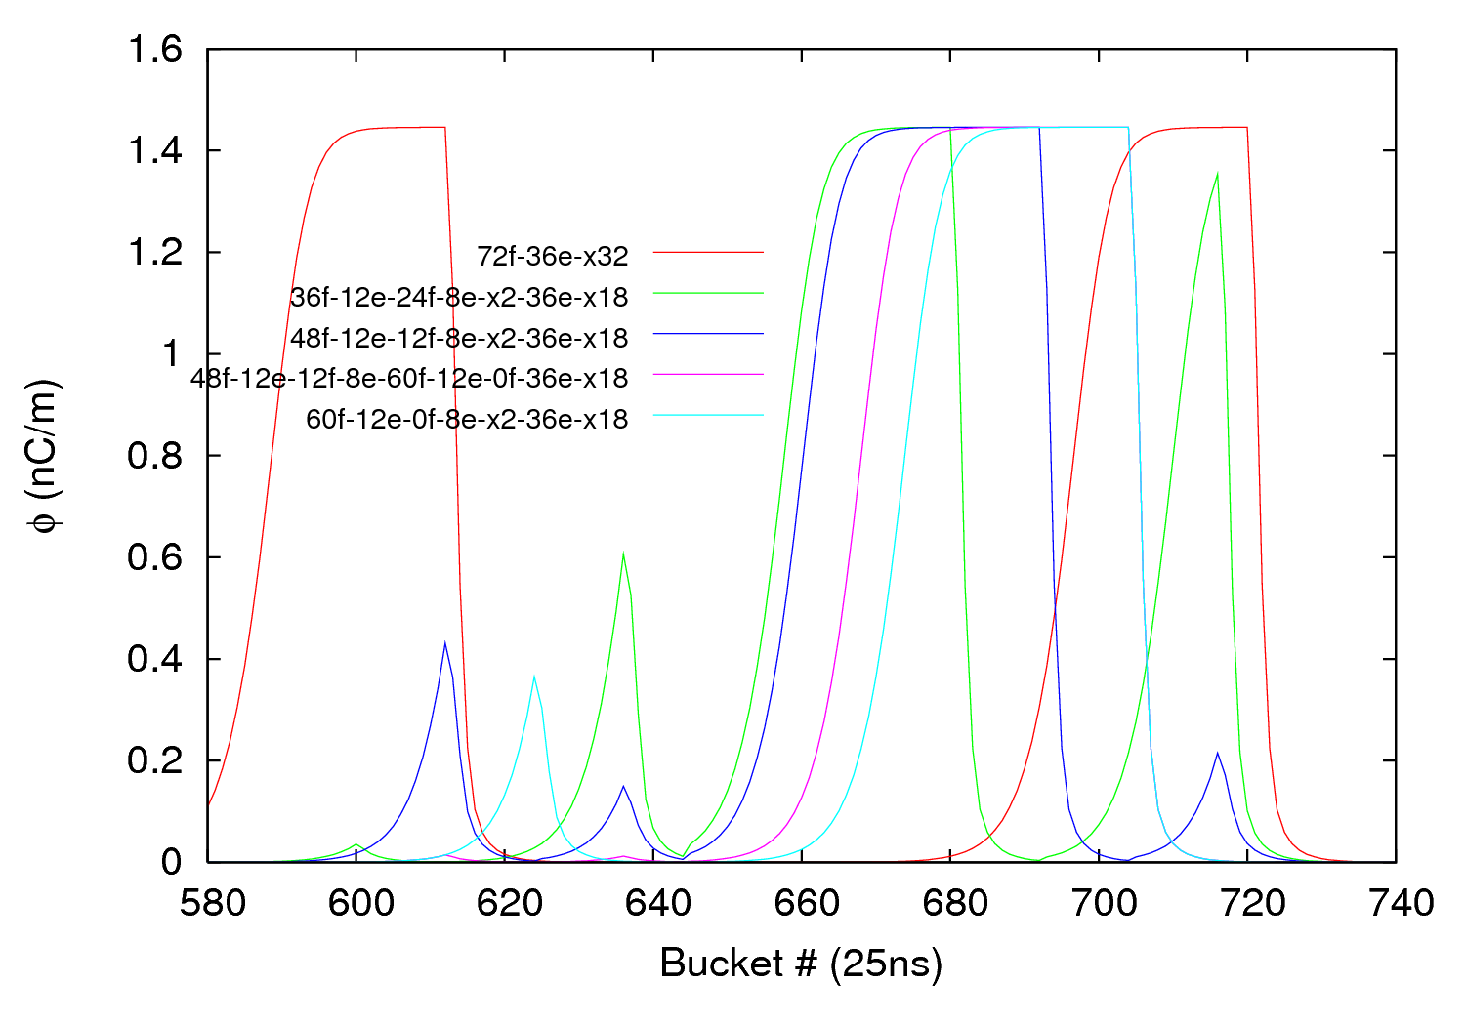
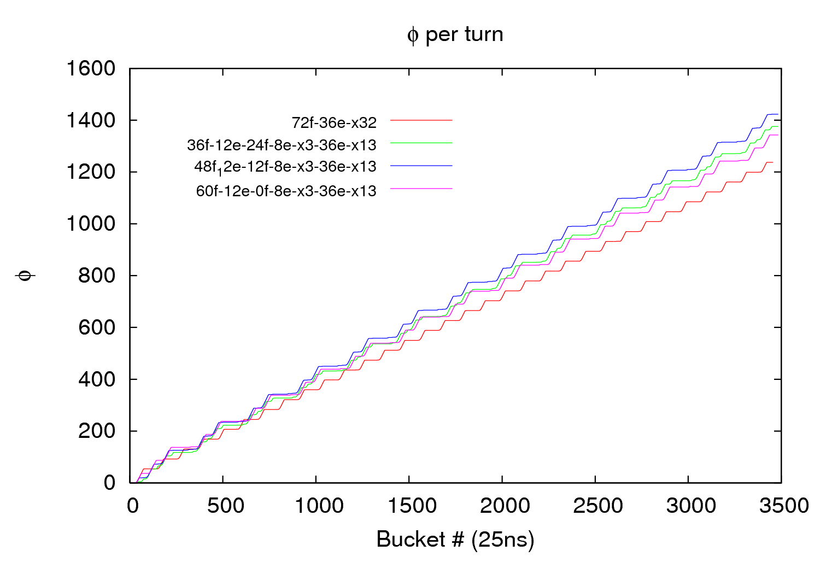
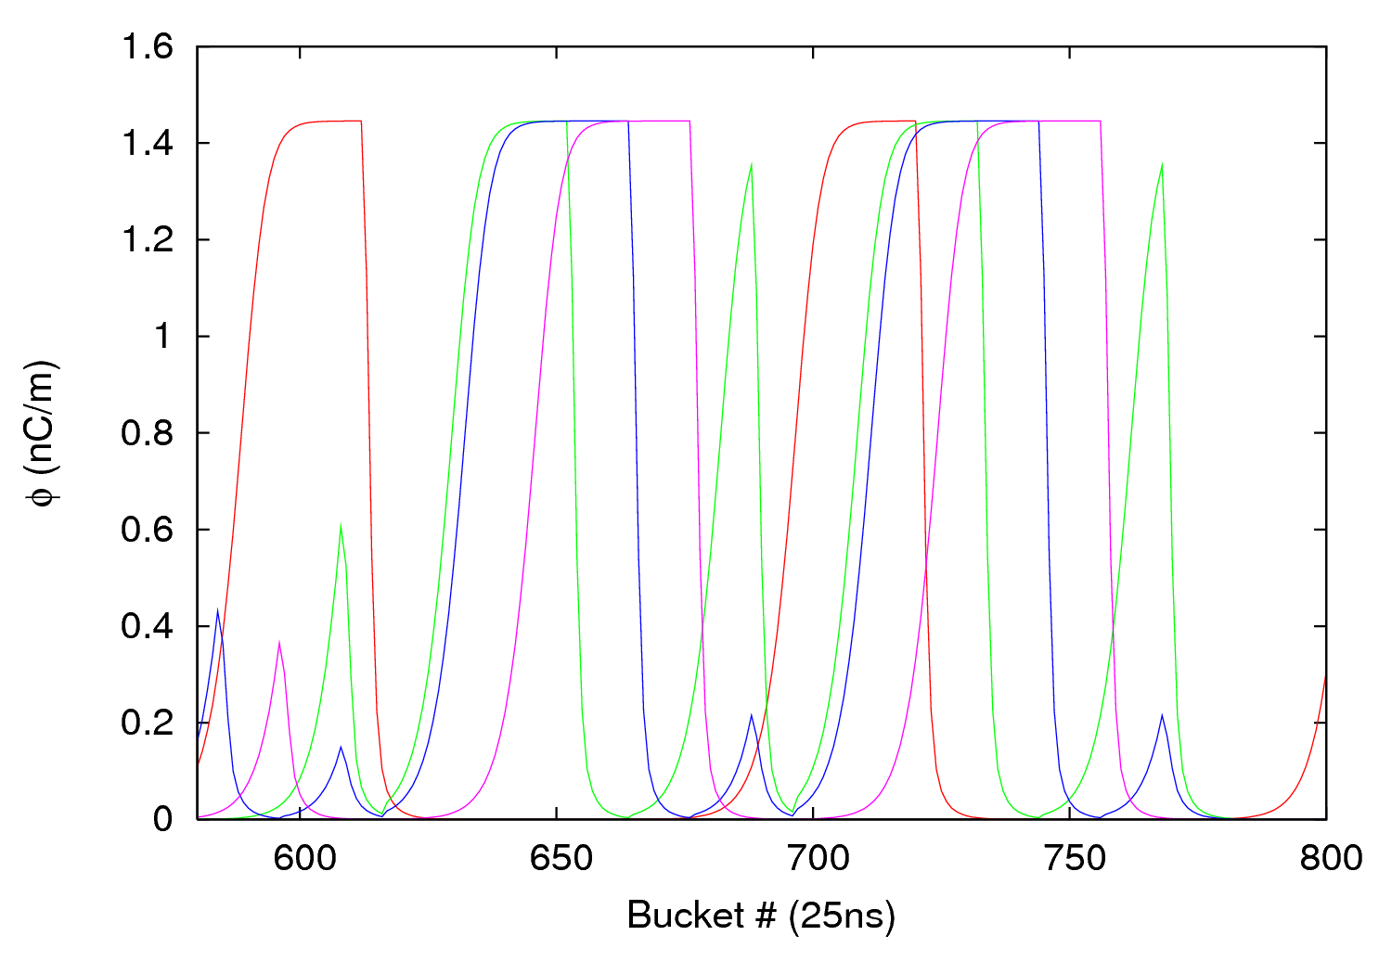
Scrubbing optimization - Gauges
δ_{max}= 1.5; R=0.3; ε_{max}=290eV; N_{b}= 1.2∙10¹¹ ppb
28 March 2012 - e⁻ cloud meeting

Slide 27
Outline
Some brief considerations
1.1 Maps 110&100 and 01
1.2 Maps 110&100 vs. Map10
1.3 Pressure influence
1.4 Conclusions
Different filling schemes for scrubbing optimization
2.1 Warm-warm uncoated straight sections
2.2 Arcs
2.3 Conclusions
28 March 2012 - e⁻ cloud meeting

Slide 28
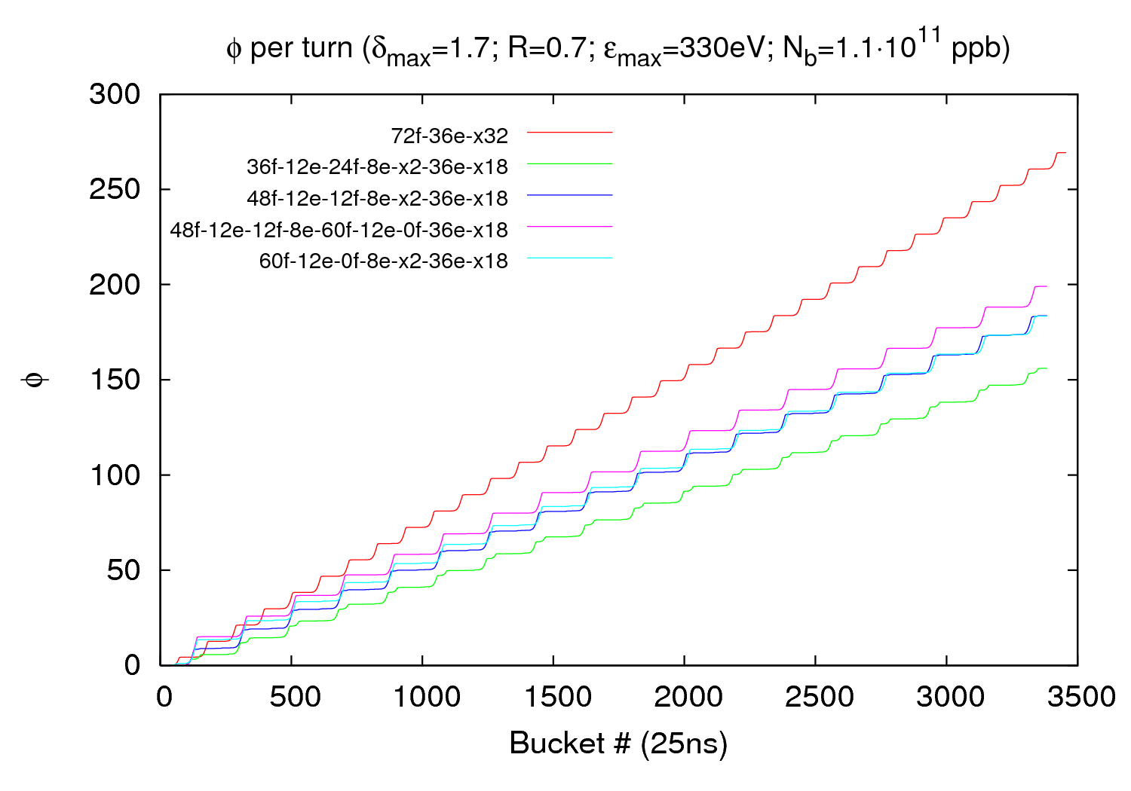
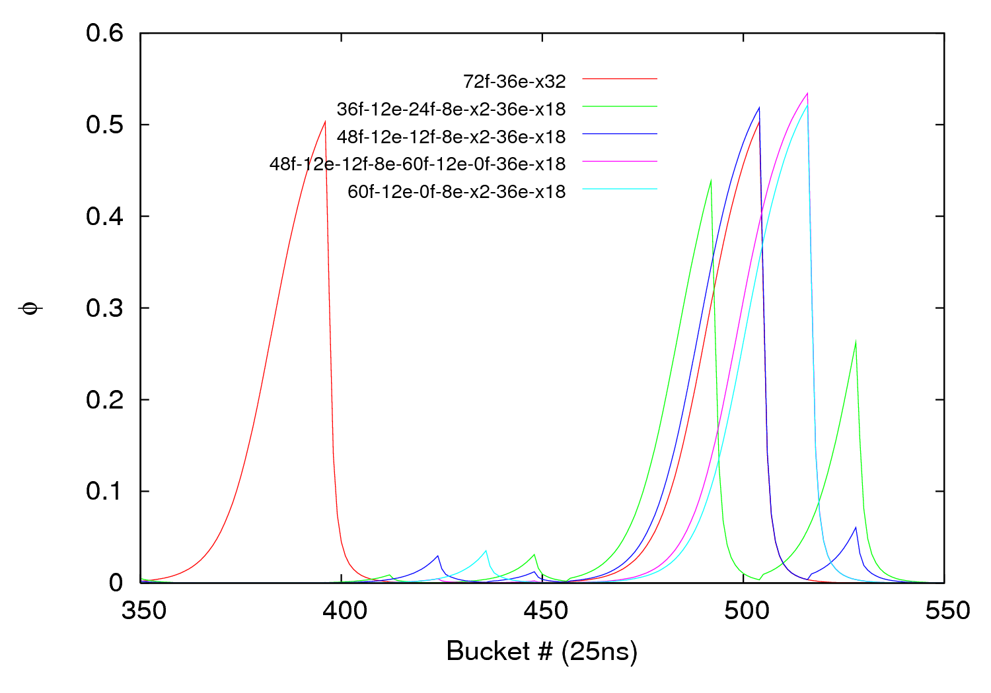
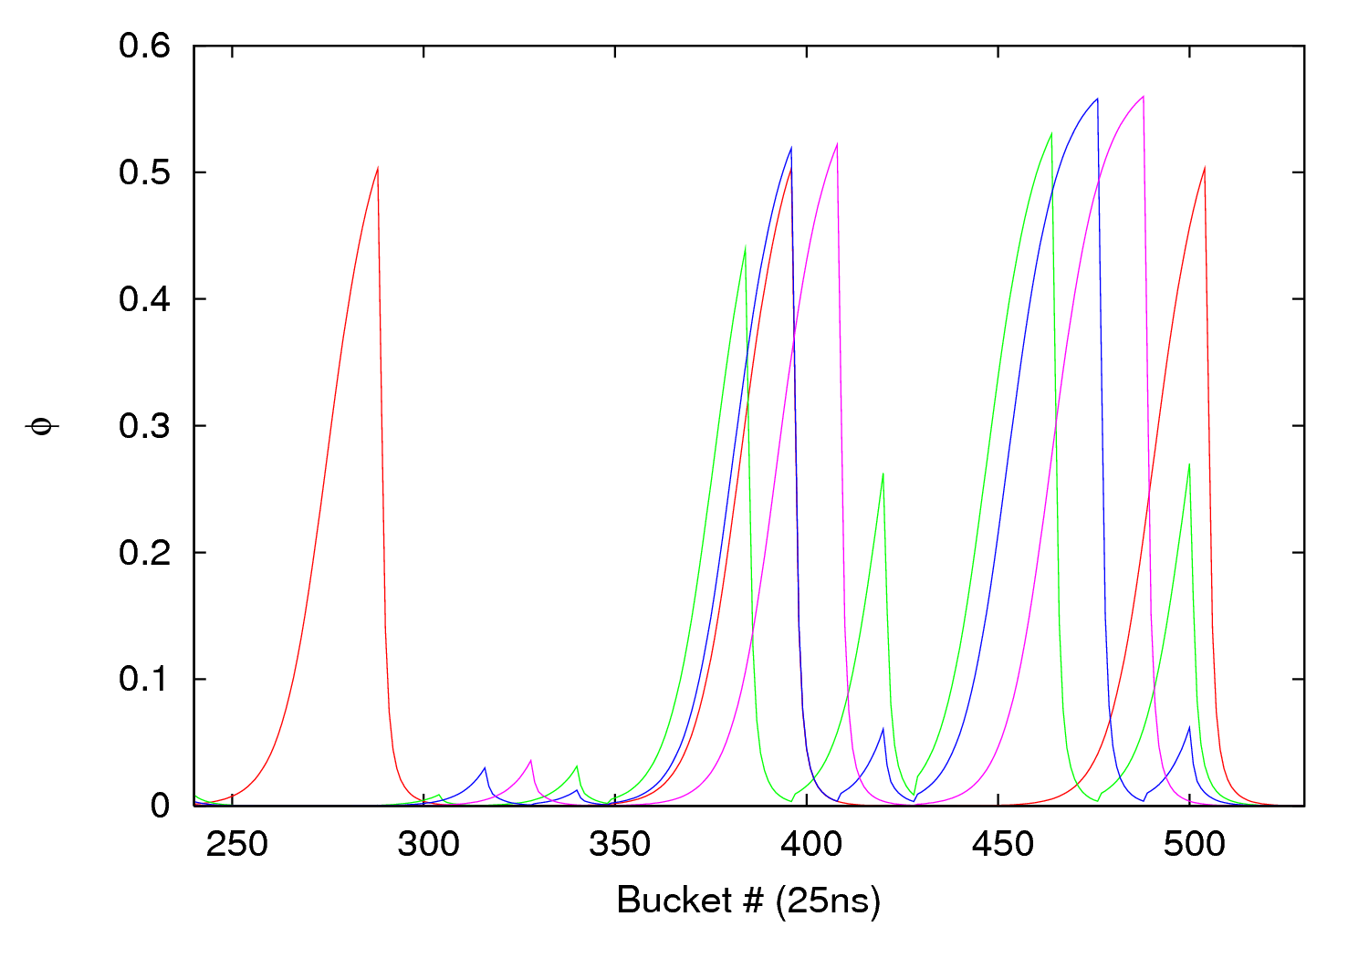
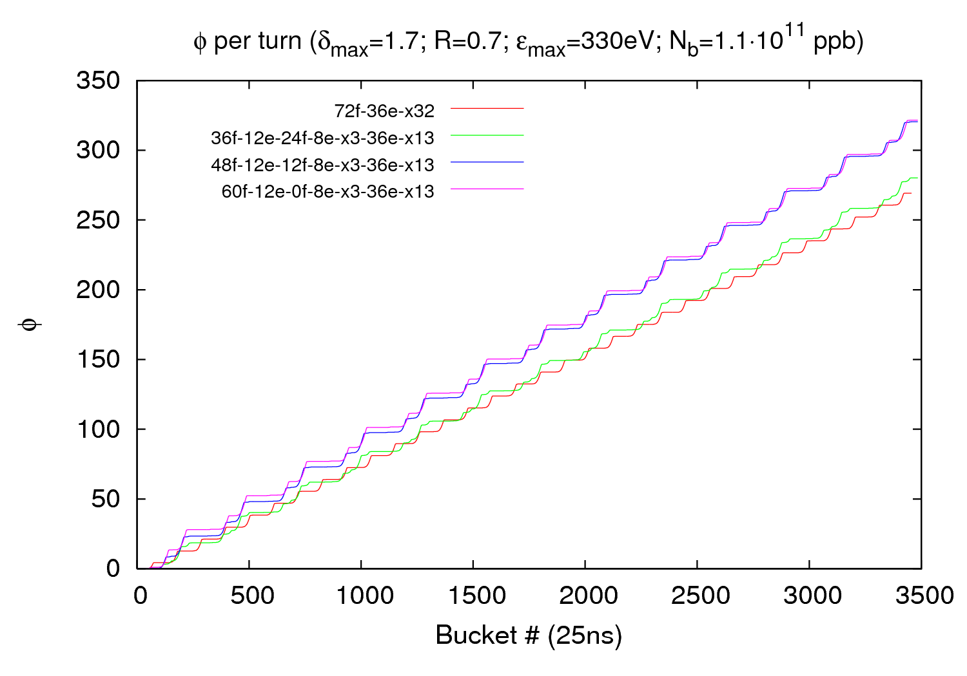
Scrubbing optimization - Arcs
δ_{max}= 1.7; R=0.7; ε_{max}=330eV; N_{b}= 1.1∙10¹¹ ppb
28 March 2012 - e⁻ cloud meeting

Slide 29
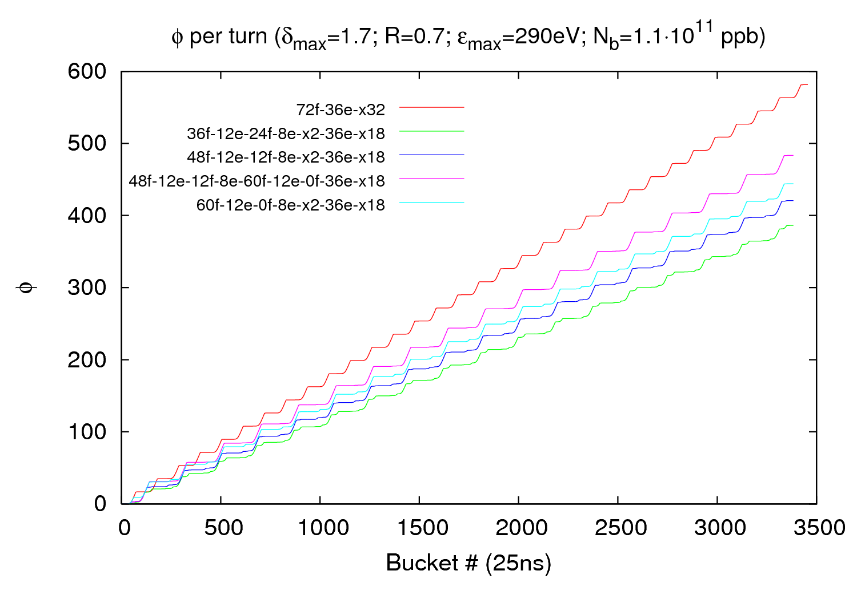
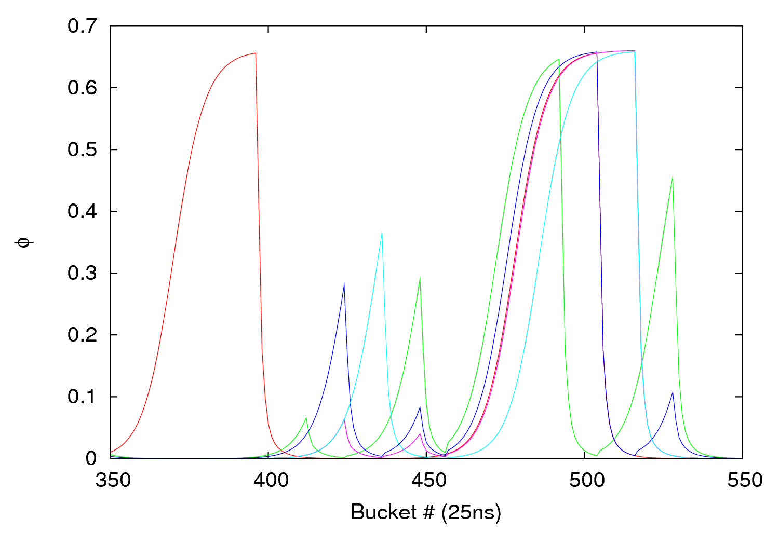
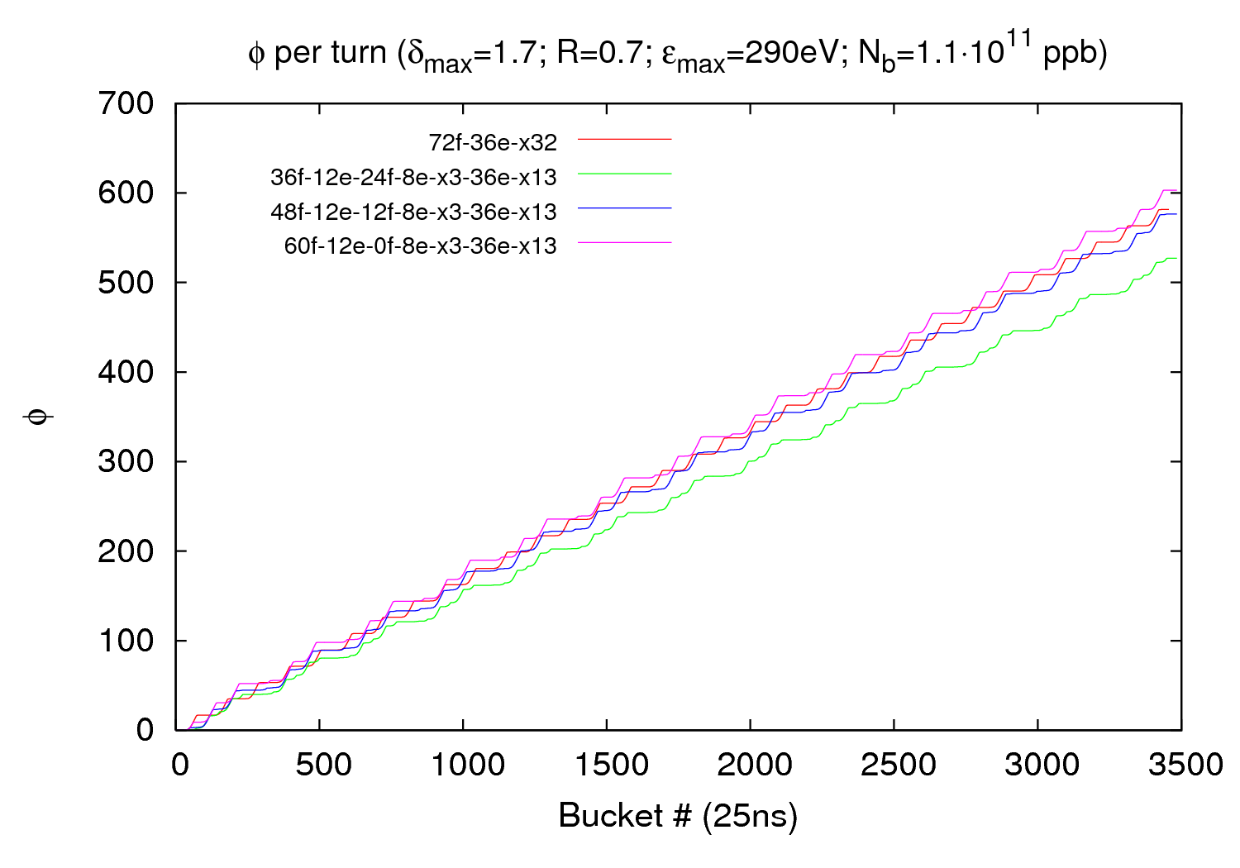
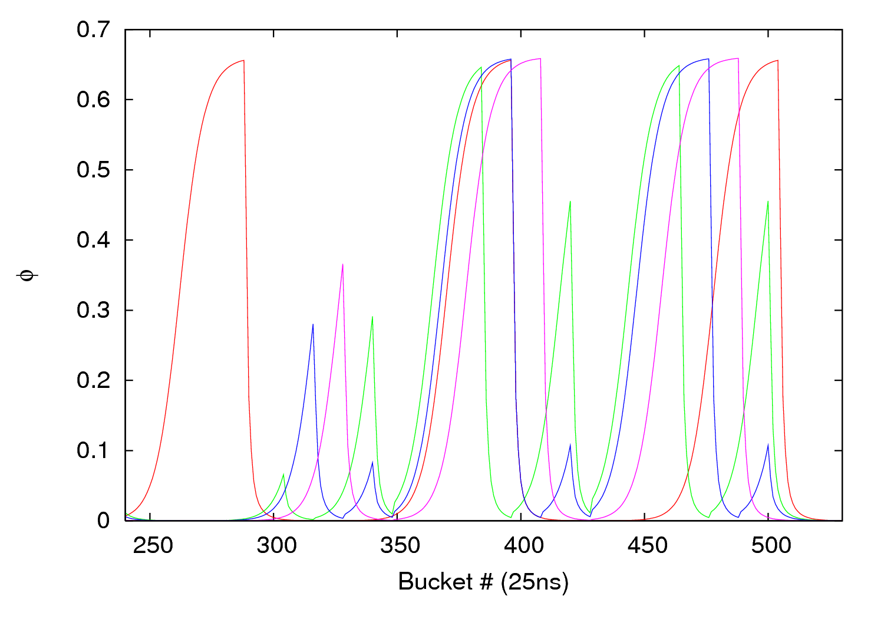
Scrubbing optimization - Arcs
δ_{max}= 1.7; R=0.7; ε_{max}=290eV; N_{b}= 1.1∙10¹¹ ppb
28 March 2012 - e⁻ cloud meeting

Slide 30
Outline
Some brief considerations
1.1 Maps 110&100 and 01
1.2 Maps 110&100 vs. Map10
1.3 Pressure influence
1.4 Conclusions
Different filling schemes for scrubbing optimization
2.1 Warm-warm uncoated straight sections
2.2 Arcs
2.3 Conclusions
28 March 2012 - e⁻ cloud meeting

Slide 31
Scrubbing optimization - Conclusions
Different parameter sets (states of the machine) yield to different “preferred” scheme
The scheme ((36b + 12e + 24b + 225ns)x3 + 925 ns) x13 seems to offer a better performance than the nominal single batch scheme both in terms of integrated dose and peak flux (i.e. less instability)
More schemes have to be investigated to reduce the peak flux while keeping a good integrated flux
28 March 2012 - e⁻ cloud meeting

Slide 32
Thank you for your attention!

