Slide 1

e-cloud update from the SPS: results from 2012 MDs and studies for a possible scrubbing beam
G. Iadarola, H.Bartosik, H. Damerau, S. Hancock,
G. Rumolo, M. Taborelli
Many thanks to:
G. Arduini, T. Argyropoulos, T. Bohl, F. Caspers, S. Cettour Cave, B. Goddard,
M. Driss Mensi, J. Esteban Mullet, S. Federmann, F. Follin, M. Holz, W. Hofle,
L. Kopylov, C. Lazaridis, H. Neupert, Y. Papaphilippou, B. Salvant, E. Shaposhnikova,
H. Timko, Ulsroed, U. Werhle
Special thanks to all the SPS operator crew
e-cloud simulation meeting - 08/04/2012

Slide 2
Outline
  Qualification of the LHC 25ns beam in the SPS
  Direct electron cloud measurements on the strip detectors
  Studies for a possible scrubbing beam

Slide 3
Outline
  Qualification of the LHC 25ns beam in the SPS
  Direct electron cloud measurements on the strip detectors
  Studies for a possible scrubbing beam

Slide 4
2012 SPS Scrubbing Run – measured beam parameters
25ns beam nominal intensity
PS (before bunch rotation): N_{b}~1.25x10¹¹ppb / ε_{h}~2.5μm / ε_{v}~2.5μm
SPS flat bottom (18s): N_{b}~1.15x10¹¹ppb / ε_{h}~3μm / ε_{v}~3.5μm
SPS flat top: N_{b}~1.15x10¹¹ppb / ε_{h}~3μm / ε_{v}~3.5μm
(within specifications)
25ns beam ultimate intensity
PS (before bunch rotation): N_{b}~1.8x10¹¹ppb / ε_{h}~4μm / ε_{v}~3.5μm
SPS flat bottom (8s): N_{b}~1.6 x10¹¹ppb / ε_{h}~5μm / ε_{v}~4.5μm

Slide 5
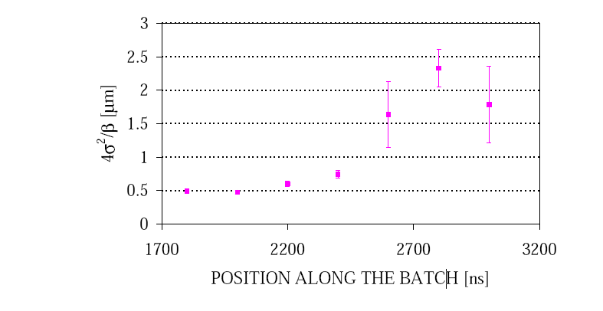
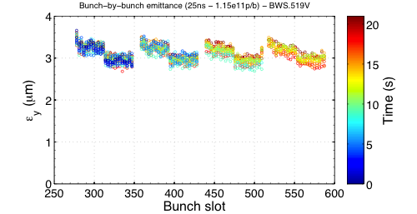
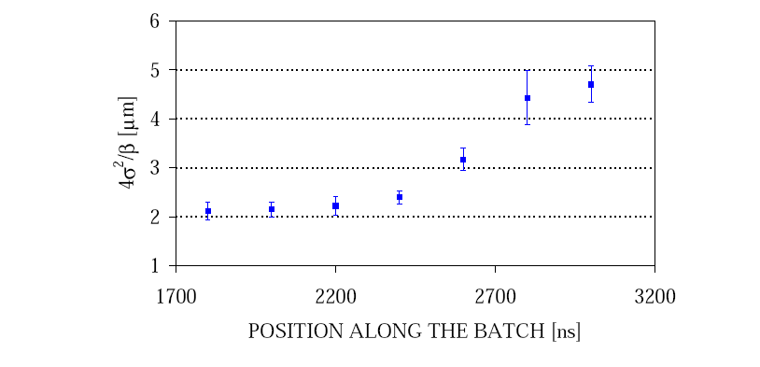
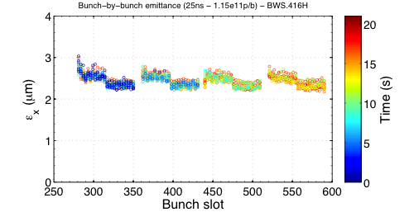
LHC 25ns beam: emittances
  2000 (1 batch 0.8x10¹¹ppb)
  2012 (4 batches 1.15x10¹¹ppb)
  Vertical emittance
  Vertical
  Horizontal emittance
  Horizontal

Slide 6
LHC 25ns beam: emittances
  2000 (1 batch 0.8x10¹¹ppb)
  2012 (4 batches 1.15x10¹¹ppb)
  Vertical
No emittance growth in 2012 with 4 batches
With low chromaticity in both planes
Identical behavior of all 4 batches
No blow-up along bunch train
  Vertical
  Horizontal
  Horizontal

Slide 7
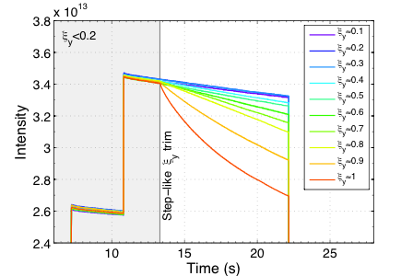
LHC 25ns beam: chromaticity
  2012
2002 - G. Arduini, K. Cornelis et al.
No need for large chromaticity in 2012 with 4 batches of 1.15x10¹¹p/b
Best life-time with smallest chromaticity
No instability or beam degradation with chromaticity around 0.1

Slide 8
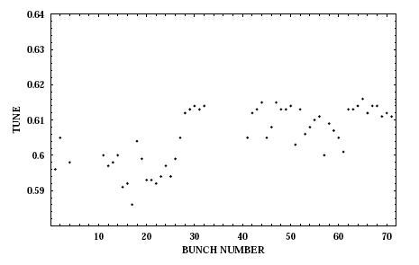
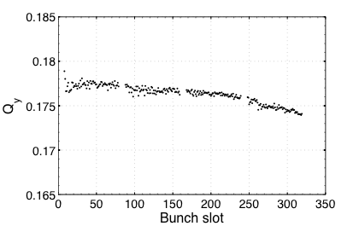
LHC 25ns beam: bunch by bunch tune
  2000 (one batch)
  2012 (four batches)
  Vertical
ΔQ<0.005
ΔQ>0.02
G. Arduini, K. Cornelis et al.
Positive tune shift!
(dominated by ecloud)
Negative tune shift!
(dominated by resistive wall impedance?)

Slide 9
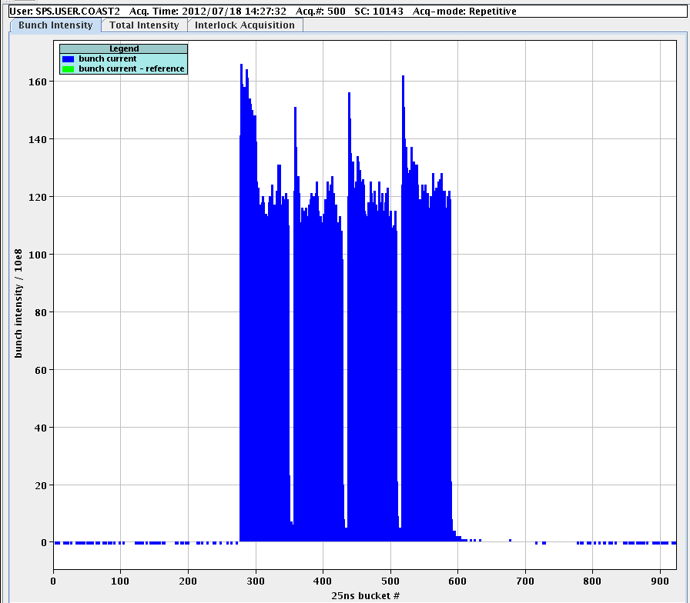
Preliminary: coast 270GeV (UA9 run)
25ns beam, 270GeV

Slide 10
Outline
  Qualification of the LHC 25ns beam in the SPS
  Direct electron cloud measurements on the strip detectors
  Studies for a possible scrubbing beam

Slide 11
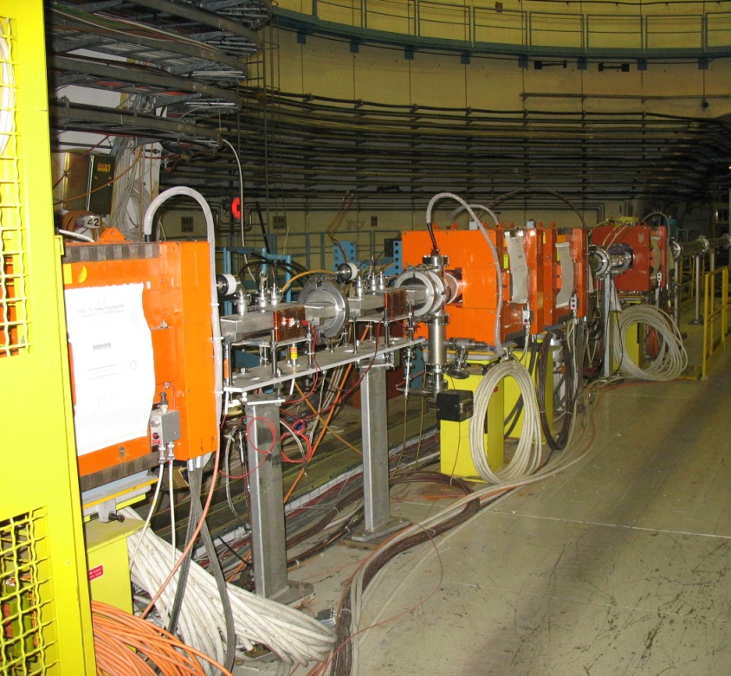
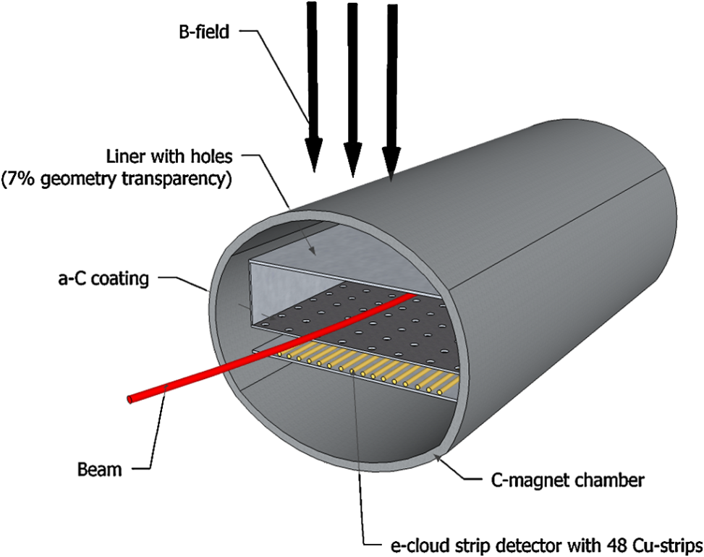
Strip detectors
C. Y. Vallgren et al., PRSTAB
Very powerful tool since they allows to measure the horizontal profile of the electron flux to the wall (av. over 10 – 100 ms) , but:
It is not representative of the present conditioning state of the machine
The holes may significantly affect (slow down) the conditioning of the chamber

Slide 12
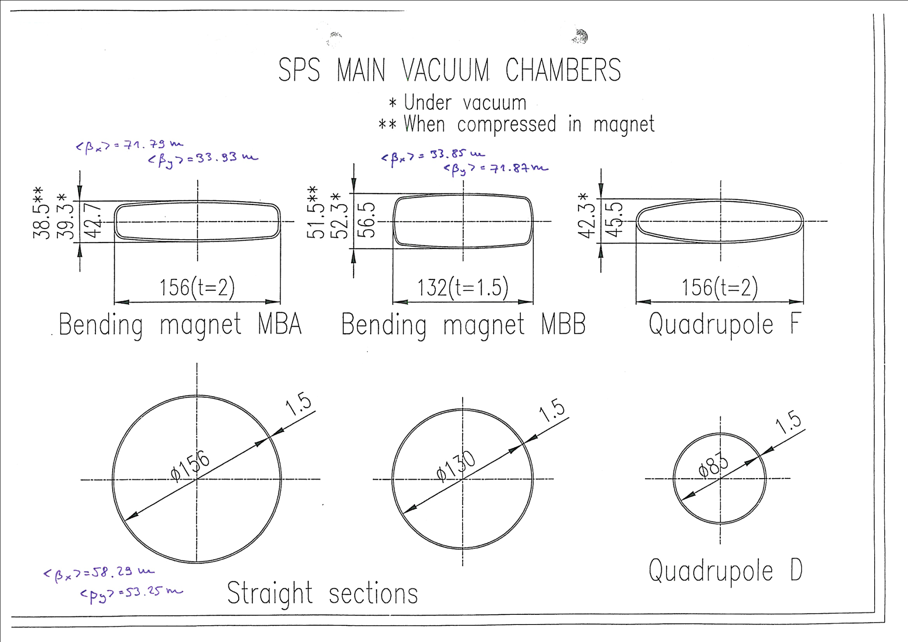
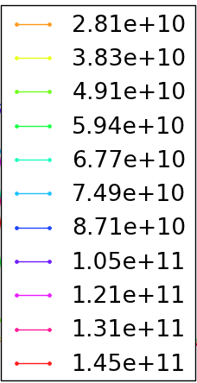
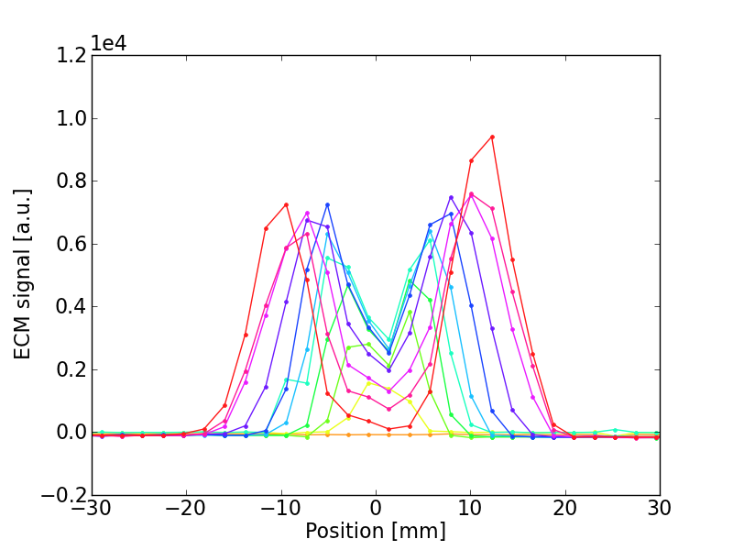
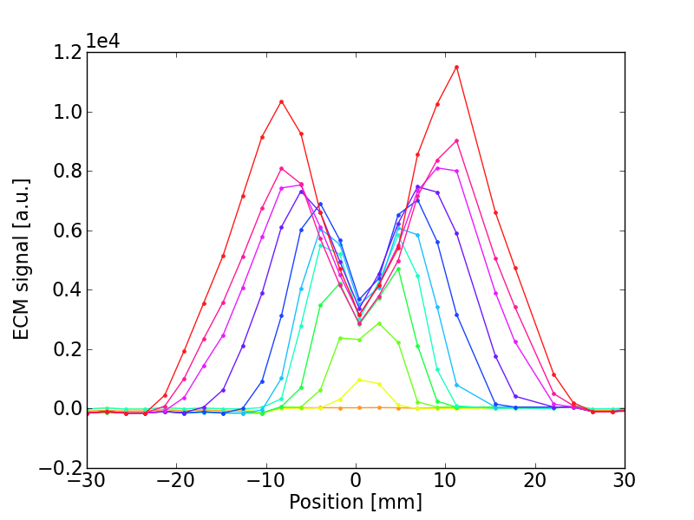
Strip detectors – dependence on bunch intensity
  MBA
  MBB
Ramarks:
MBA is less critical than MBB
E-cloud in the central region (important for beam quality) is non increasing with bunch intensity (consistent with our EC model ☺)

Slide 13
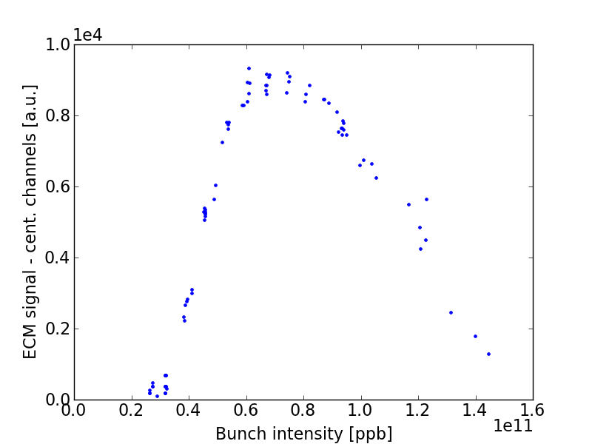
Strip detectors
  MBA
  MBB
Ramarks:
MBA is less critical than MBB
E-cloud in the central region (important for beam quality) is non increasing with bunch intensity (consistent with our EC model ☺)

Slide 14
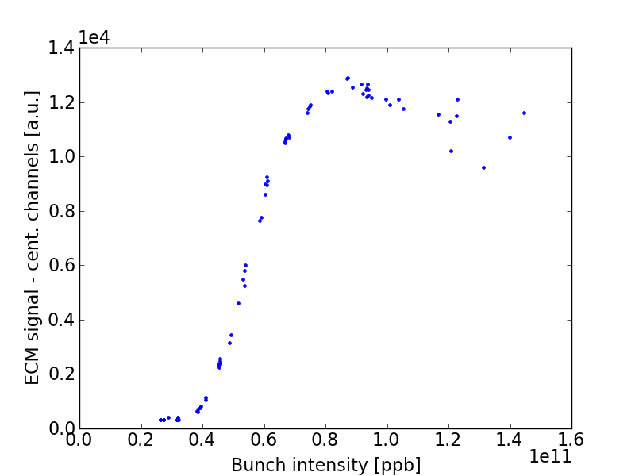
Strip detectors
  MBA
  MBB
Ramarks:
MBA is less critical than MBB
E-cloud in the central region (important for beam quality) is non increasing with bunch intensity (consistent with our EC model ☺)

Slide 15
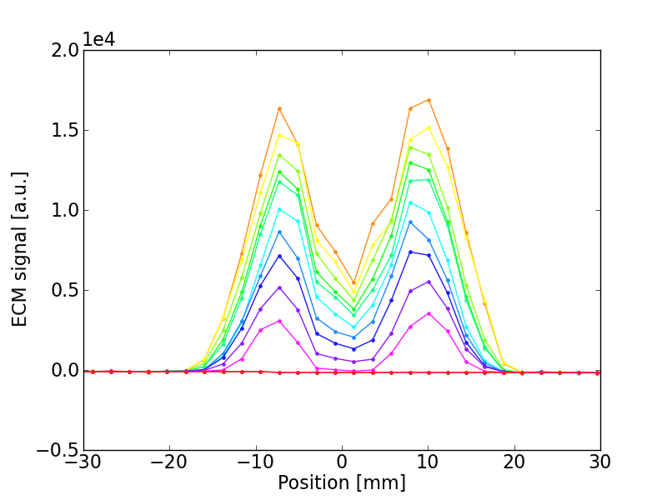
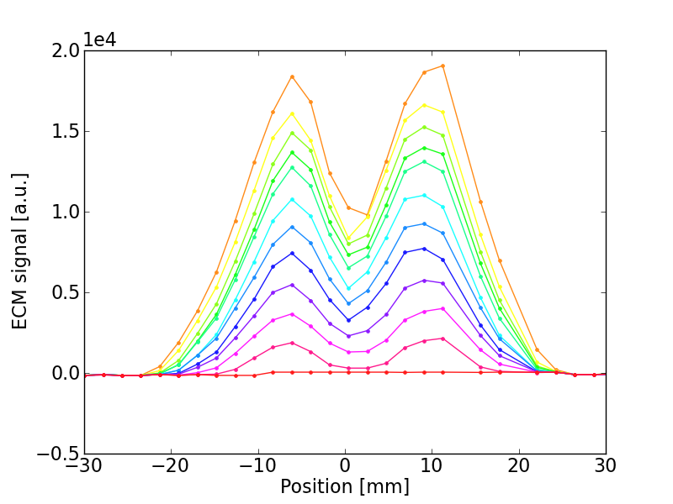
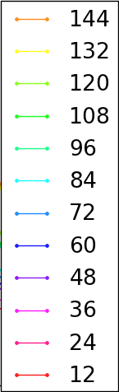
Strip detectors – dependence on number of bunches
  MBA
  MBB
Ramarks:
MBA is less critical than MBB
225ns gap is not enough to decouple

Slide 16
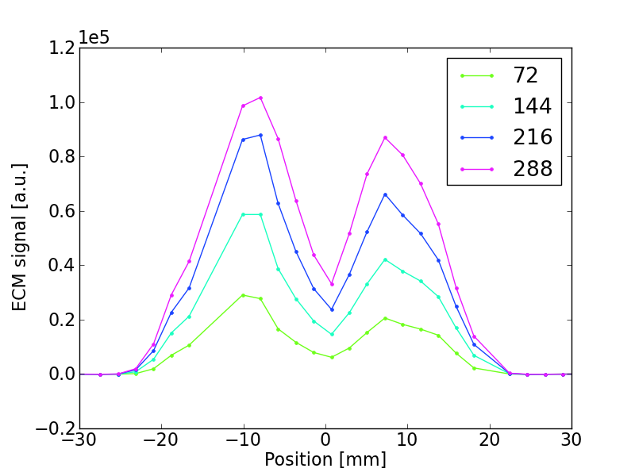
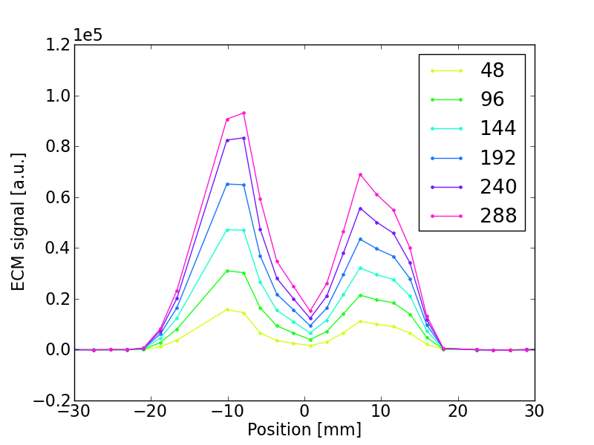
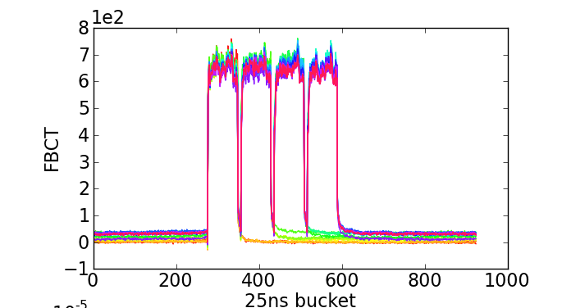
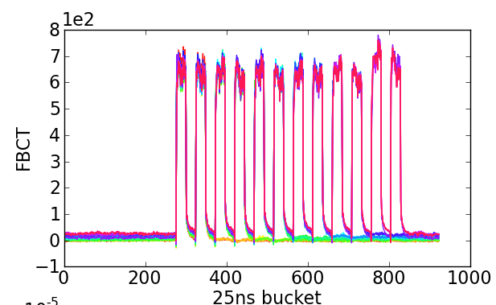
Strip detectors – “microbatches”
  Nominal
  Microbatch

Slide 17
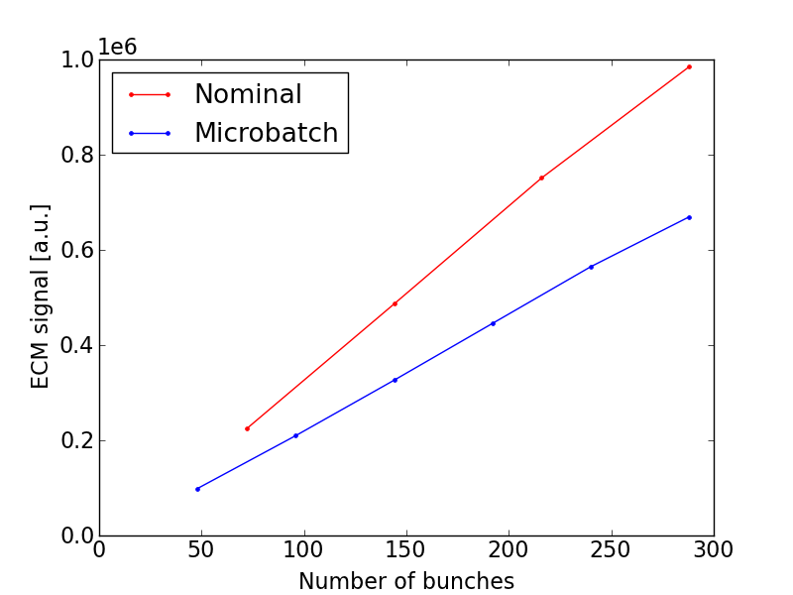
Strip detectors – “microbatches”
  Nominal
  Microbatch
~ 30%

Slide 18
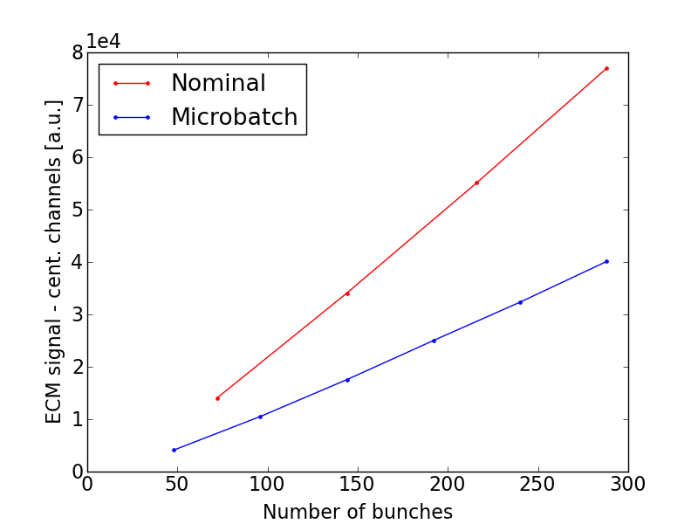
Strip detectors – “microbatches”
  Nominal
  Microbatch
~50%

Slide 19
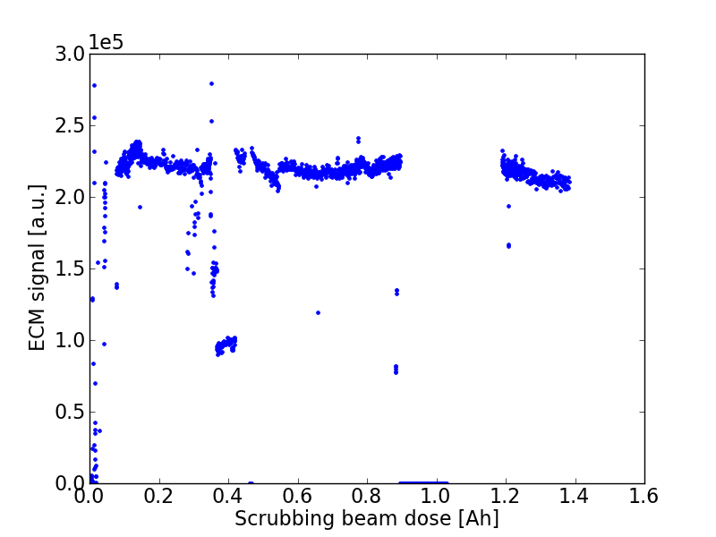
Strip detectors – conditioning
Warning: expected to be slower than in “real” bending magnets!
2012 Scrubbing run
MBB

Slide 20
Strip detectors – conditioning
Warning: expected to be slower than in “real” bending magnets!
Not much conditioning observed during SR, but the liner had been already exposed to 25ns beam
2012 Scrubbing run
B = 0
B = 0.12T
  Scrubbing beam dose [p⁺]
MBB

Slide 21
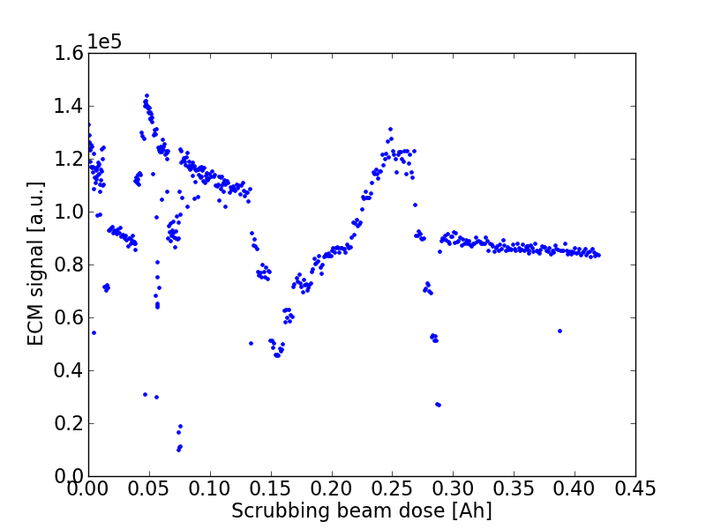
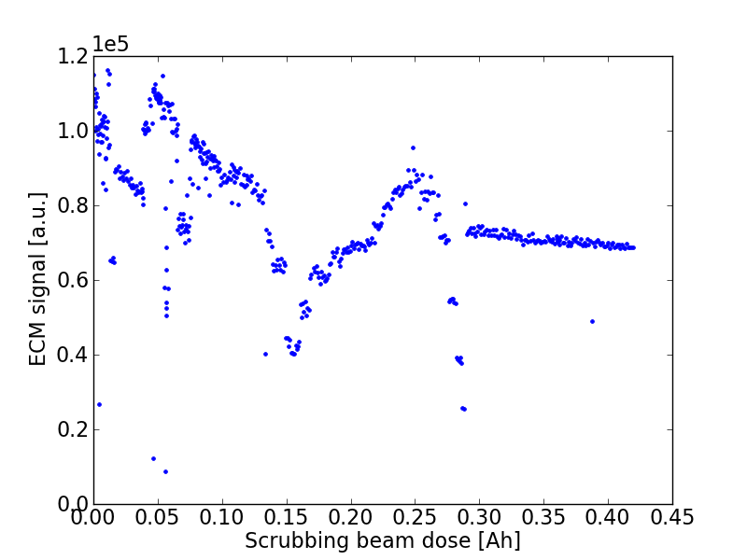
Strip detectors – conditioning
Warning: expected to be slower than in “real” bending magnets!
MD 25/04/2012 (few h.)
~40%
2012 Scrubbing run
MBB
~ 40%
MBB
MBA

Slide 22
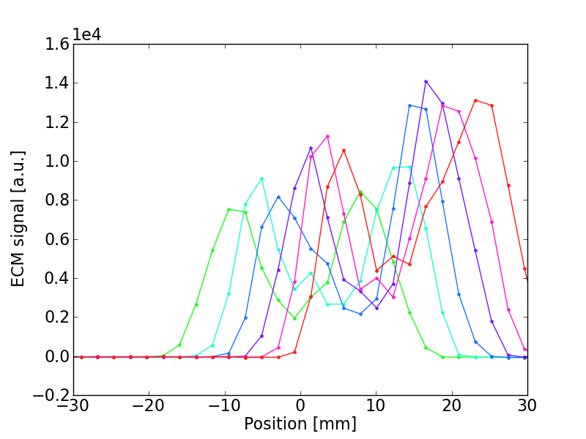
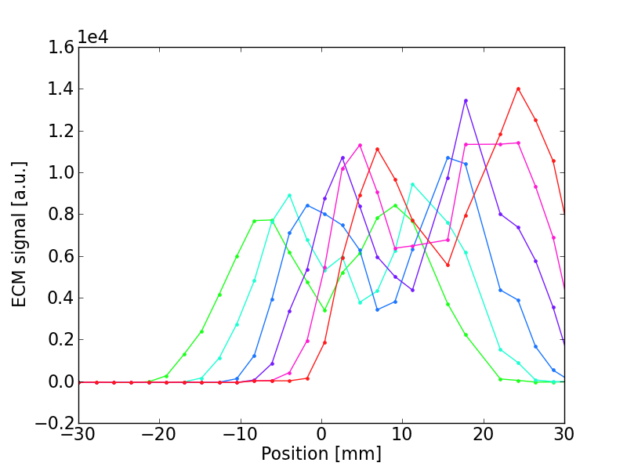
Strip detectors – conditioning
The conditioned area can be localized with horizontal displacements of beam in the ECM
MBA
MBB

Slide 23
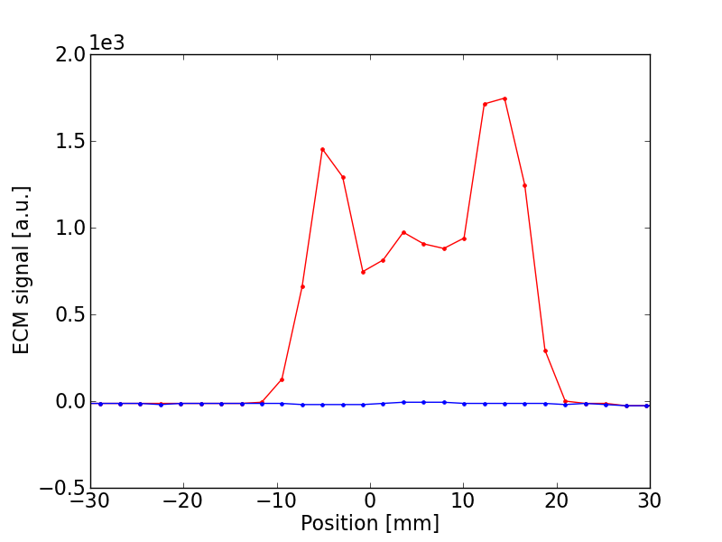
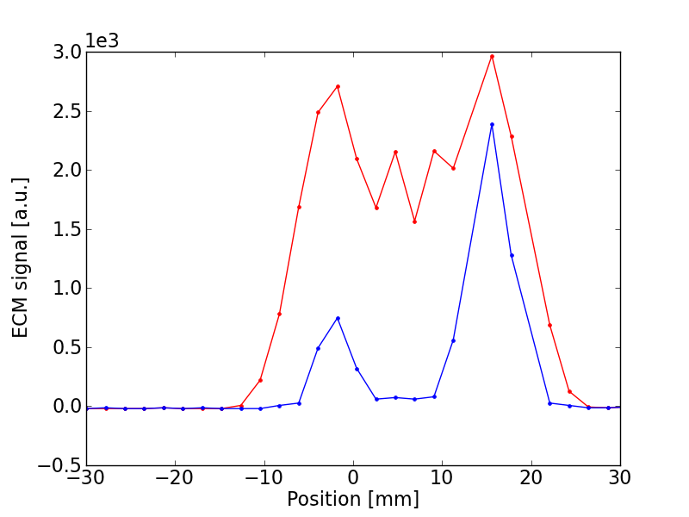
Strip detectors – conditioning
Measurements with 50ns beam before and after few hours of scrubbing
Before scrubbing
After scrubbing
MBA
MBB
Ramarks:
MBA is less critical than MBB

Slide 24
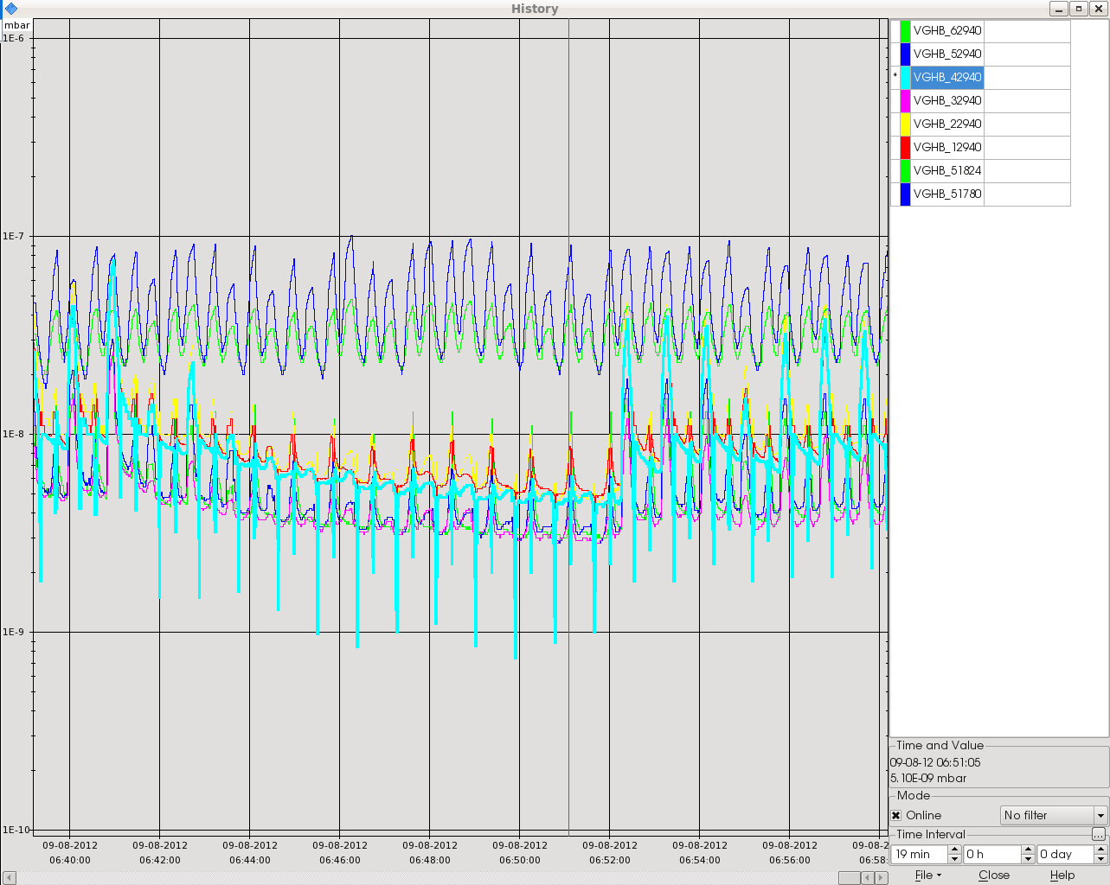
Effect of radial steering on pressure along the ring
50ns beam, 26 GeV, 23s cycle
Radial steering

Slide 25
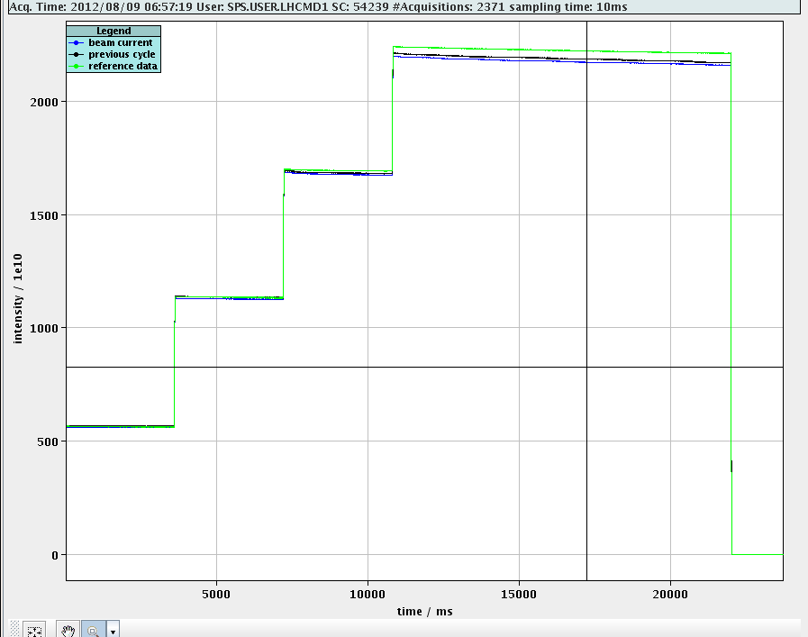
Effect of radial steering on pressure along the ring
50ns beam, 26 GeV, 23s cycle
Radial steering

Slide 26
Outline
  Qualification of the LHC 25ns beam in the SPS
  Direct electron cloud measurements on the strip detectors
  Studies for a possible scrubbing beam

Slide 27
Why do we need a scrubbing beam?
What do we need?
“Example” scrubbing curve from lab

Slide 28
Why do we need a scrubbing beam?
What do we need?
“Example” scrubbing curve from lab
What do we have?
MBB – 25ns beam

Slide 29
Why do we need a scrubbing beam?
What do we need?
  Possible issue:
  The beam is still degraded due to EC
  The dose is not sufficient to continue scrubbing in a reasonable time
“Example” scrubbing curve from lab
What do we have?
MBB – 25ns beam

Slide 30
Why do we need a scrubbing beam?
What do we need?
  Possible issue:
  The beam is still degraded due to EC
  The dose is not sufficient to continue scrubbing in a reasonable time
“Example” scrubbing curve from lab
  Possible solution:
  A “scrubbing beam” which exhibits a lower multipacting threshold
What do we have?
Scrubbing beam
MBB – 25ns beam

Slide 31
Why do we need a scrubbing beam?
What do we need?
  Possible issue:
  The beam is still degraded due to EC
  The dose is not sufficient to continue scrubbing in a reasonable time
“Example” scrubbing curve from lab
  Possible solution:
  A “scrubbing beam” which exhibits a lower multipacting threshold
  No need for acceleration
  No stringent requirements on beam quality
What do we have?
Scrubbing beam
MBB – 25ns beam

Slide 32
Why “doublets”?
  The “simplest” idea would be to shrink the bunch spacing:
  PS bunch rotation is designed “around” 40MHz → Not possible to inject “bunch to bucket” with spacing shorted than 25ns

Slide 33
Why “doublets”?
  The “simplest” idea would be to shrink the bunch spacing:
  PS bunch rotation is designed “around” 40MHz → Not possible to inject “bunch to bucket” with spacing less than 25ns
  A “relatively easy” scheme could be to extract a 25ns bunch train with long bunches (~10ns) and capture each bunch in two SPS buckets getting a 25ns “doublet” beam.

Slide 34
Why “doublets”?
  Why should it work?
Electron emission
Electron absorption
PyECLOUD simulation

Slide 35
Why “doublets”?
  Why should it work?
Below the threshold the two effects compensate each other, no accumulation over subsequent bunch passages
PyECLOUD simulation

Slide 36
Why “doublets”?
  Why should it work?
Shorter e-cloud decay
More efficient e⁻ production
PyECLOUD simulation

Slide 37
Why “doublets”?
  Why should it work?
Accumulation between subsequent turns
PyECLOUD simulation

Slide 38
Simulation study
MBB - 26GeV
  Intensity per bunch of the doublet (b.l. 4ns)
(b.l. 3ns)
  Remarks:
  The doublet beam shows a lower multipacting threshold compared to the standard 25ns beam if the intensity is larger than 0.8e11ppb (1.6e11ppb from the PS)

Slide 39
Simulation study
MBB - 26GeV
  Intensity per bunch of the doublet (b.l. 4ns)
(b.l. 3ns)
  Remarks:
  The doublet beam shows a lower multipacting threshold compared to the standard 25ns beam if the intensity is larger than 0.8e11ppb (1.6e11ppb from the PS)
  The scrubbed region is smaller → to be used, with radial steering, as a last stage of the scrubbing

Slide 40
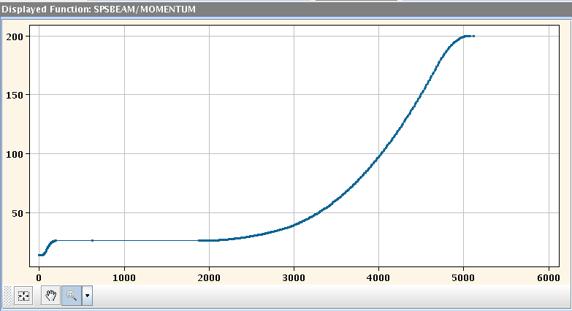
Test with single bunch
  On 25-26 Oct. a first test was carried out with a single bunch to test the capture scheme:
  Special PS cycle for a single 10ns long bunch was setup by PS experts
  SPS cycle (Q26) with one injection + 1s flat bottom + acceleration to 32GeV

Slide 41
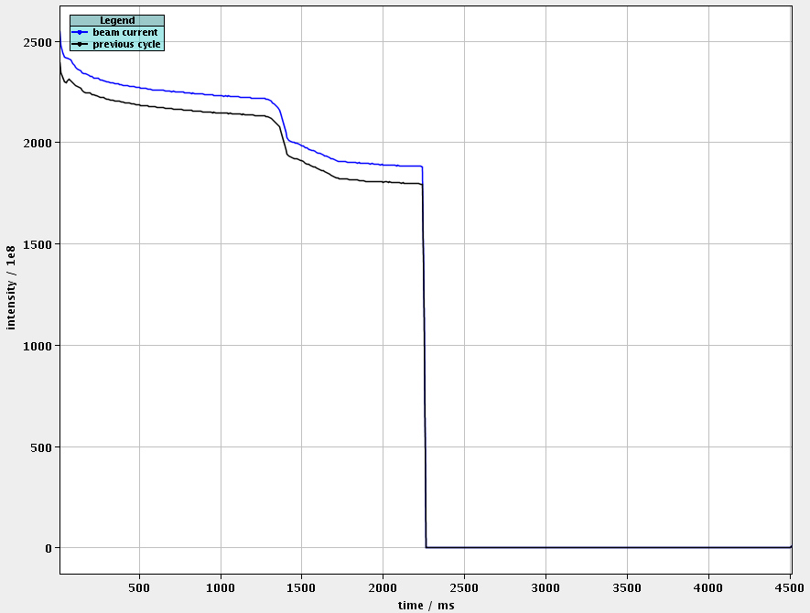
Test with single bunch
  On 25-26 Oct. a first test was carried out with a single bunch to test the capture scheme:
  Special PS cycle for a single 10ns long bunch was setup by PS experts
  SPS cycle (Q26) with one injection + 1s flat bottom + acceleration to 32GeV
ramp

Slide 42
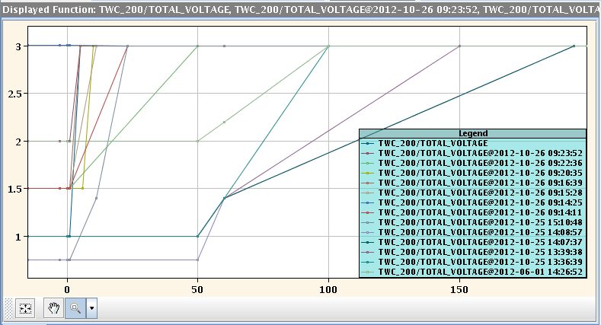
Test with single bunch
  On 25-26 Oct. a first test was carried out with a single bunch to test the capture scheme:
  Special PS cycle for a single 10ns long bunch was setup by PS experts
  SPS cycle (Q26) with one injection + 1s flat bottom + acceleration to 32GeV
  RF Voltage program has been optimized to maximize the capture

Slide 43
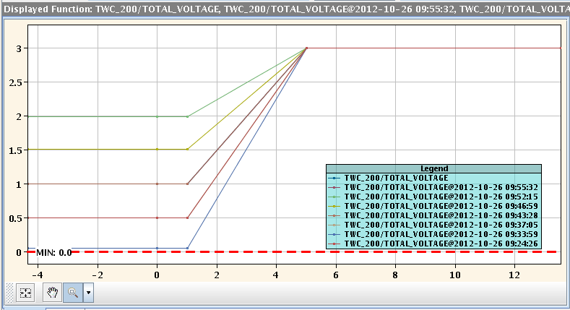
Test with single bunch
  Main indications from these tests:
  Max. capture (>95%) is obtained injecting on V_{RF}≤1MV and increasing to 3MV after few ms

Slide 44
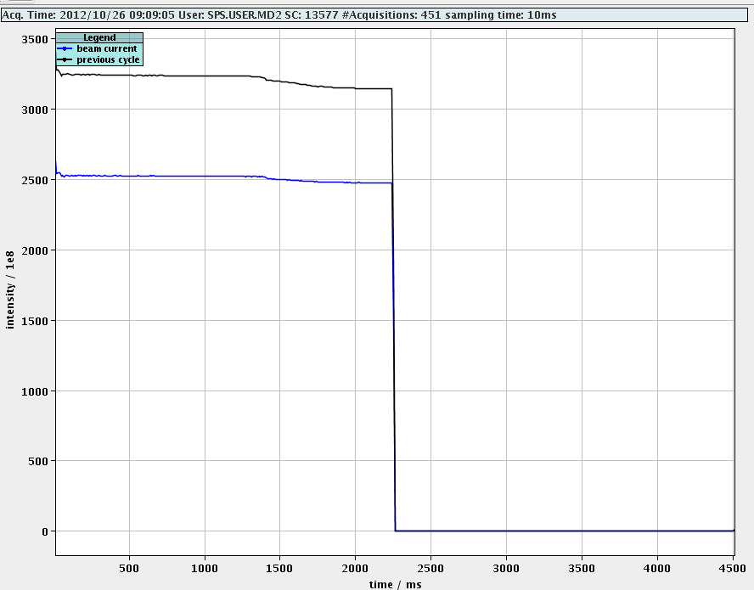
Test with single bunch
  Main indications from these tests:
  Max. capture (>95%) is obtained injecting on V_{RF}≤1MV and increasing to 3MV after few ms

Slide 45
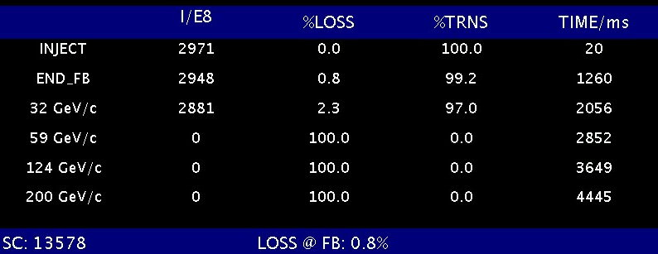
Test with single bunch
  Main indications from these tests:
  Max. capture (>95%) is obtained injecting on V_{RF}≤1MV and increasing to 3MV after few ms

Slide 46
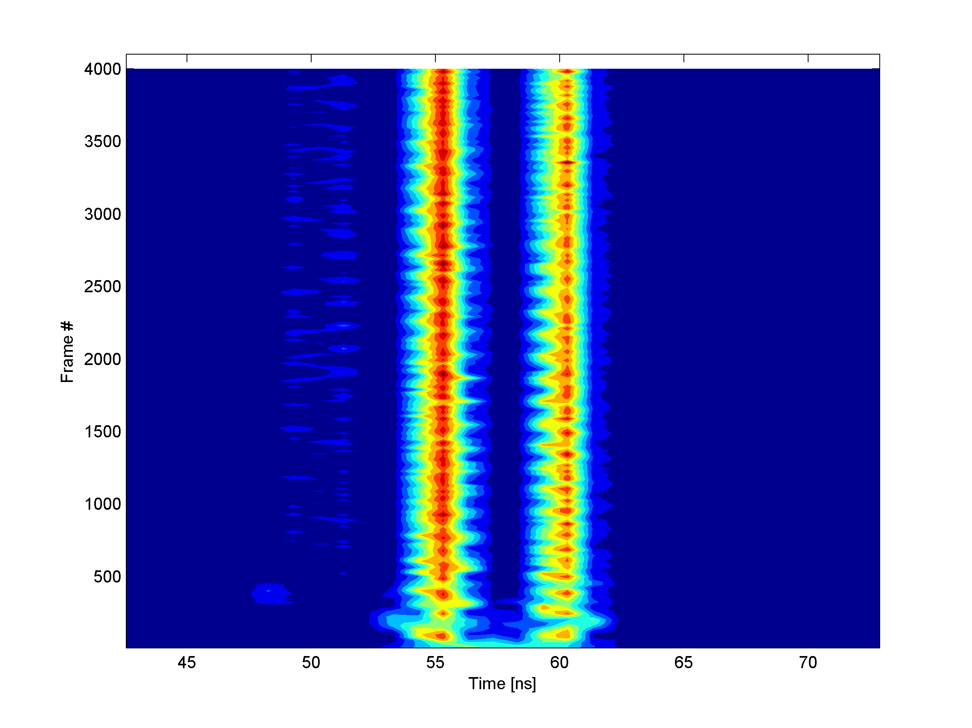
Test with single bunch
  Main indication from these tests:
  Max. capture (>95%) is obtained injecting on V_{RF}≤1MV and increasing to 3MV after few ms
Thanks to C. Lazaridis

Slide 47
Outline
  Why a scrubbing beam
  Why “doublets”
  Tests with single bunch in the SPS
  Test with a bunch train
    Effect on strip-detector signal
    Effect on pressure along the ring
  Conclusions and future studies

Slide 48
Test with bunch train
  On 15 Oct. a first test was carried out with a single bunch:
  Special PS cycle for 72x(10ns long bunch) was setup by PS experts (up to 1.85ppb injected in the SPS)
  Same SPS cycle as for single bunch test (to check capture)
  Injecting with V_{RF}=1MV and ramping to 3MV in 5ms
  Damper OFF (setup to be done) → beam stabilized with high chromaticity (ξ_{x}=0.5, ξ_{y}=0.35)

Slide 49
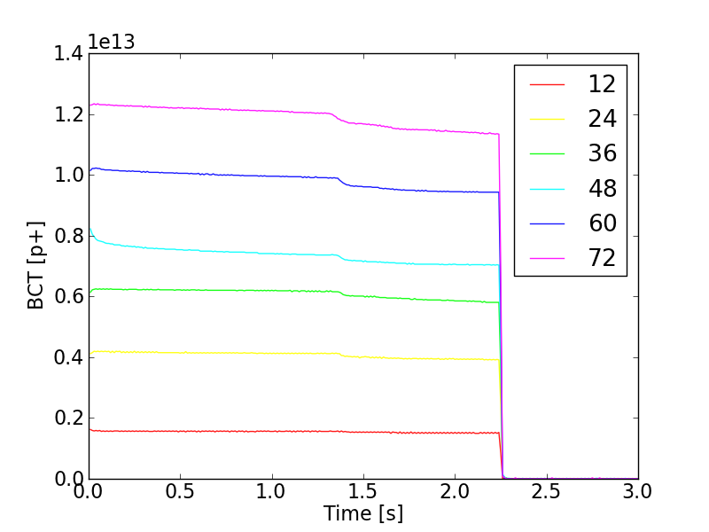
Test with bunch train
  Remarks:
  Still good capture

Slide 50
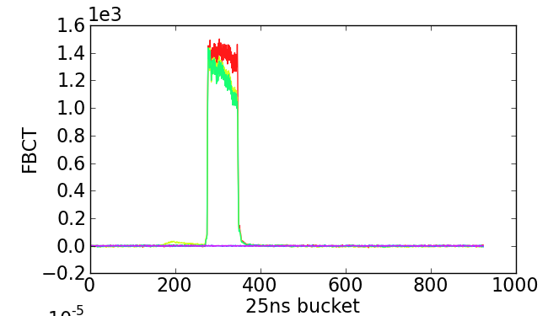
Test with bunch train
Increased chroma.
  Remarks:
  Still good capture
  We can control slow losses with high chromaticity settings

Slide 51
Test with bunch train: beam profile
  Beam profile along the cycle
Thanks to T. Argyropoulos and J. Esteban Muller

Slide 52
Test with bunch train: beam profile
  Beam profile along the cycle
Thanks to T. Argyropoulos and J. Esteban Muller

Slide 53
Test with bunch train: beam profile
  Beam profile along the cycle
Thanks to T. Argyropoulos and J. Esteban Muller

Slide 54
Test with bunch train: beam profile
  Beam profile along the cycle
Thanks to T. Argyropoulos and J. Esteban Muller

Slide 55
Test with bunch train
  Beam profile along the cycle
Thanks to T. Argyropoulos and J. Esteban Muller

Slide 56
Test with bunch train: beam profile
  Beam profile along the cycle
Thanks to T. Argyropoulos and J. Esteban Muller

Slide 57
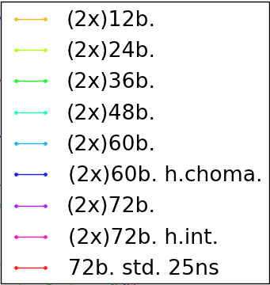
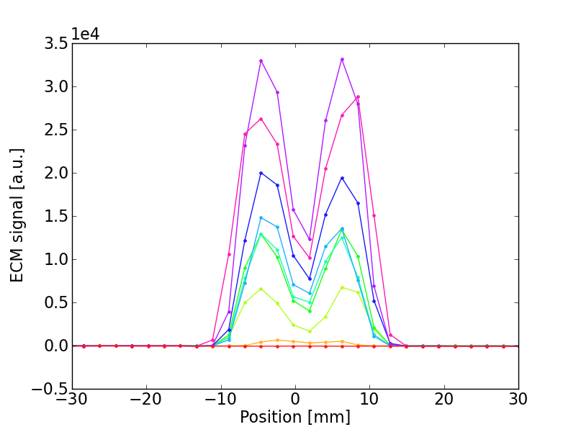
Test with bunch train: EC strip detectors
  MBA-like Stainless Steel liner
25ns “doublet” (1.7e11p/doublet)
25ns standard
(1.6e11p/bunch)

Slide 58
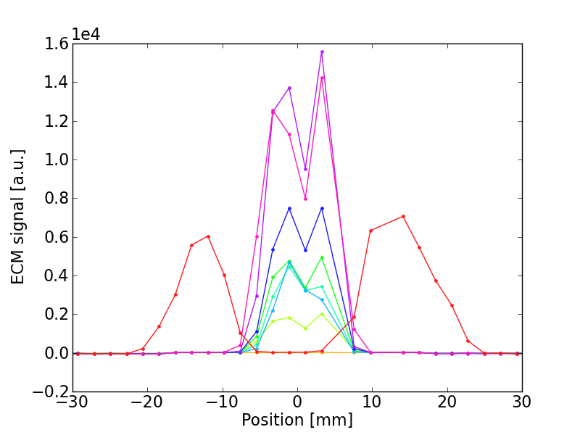
Test with bunch train: EC strip detectors
  MBB-like Stainless Steel liner
25ns “doublet” (1.7e11p/doublet)
25ns standard
(1.6e11p/bunch)

Slide 59
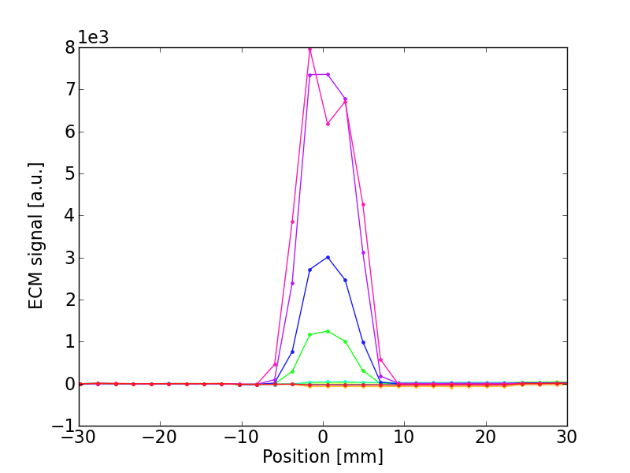
Test with bunch train: EC strip detectors
  MBB-like Copper liner
25ns “doublet” (1.7e11p/doublet)
25ns standard
(1.6e11p/bunch)

Slide 60
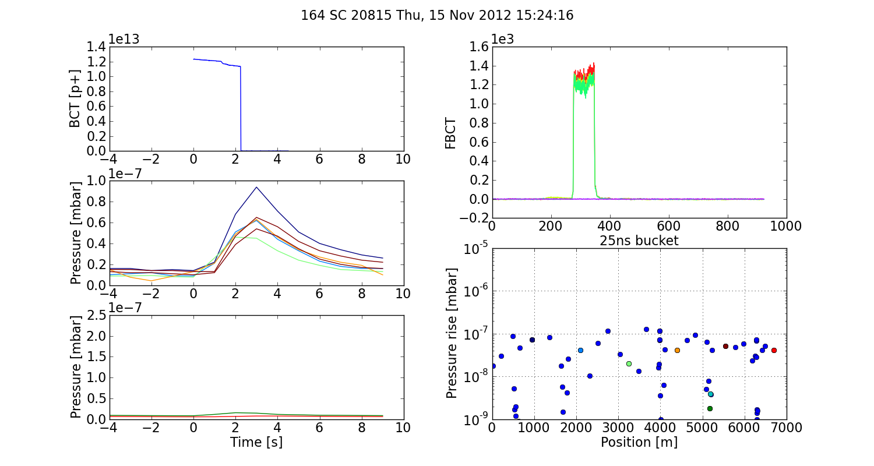
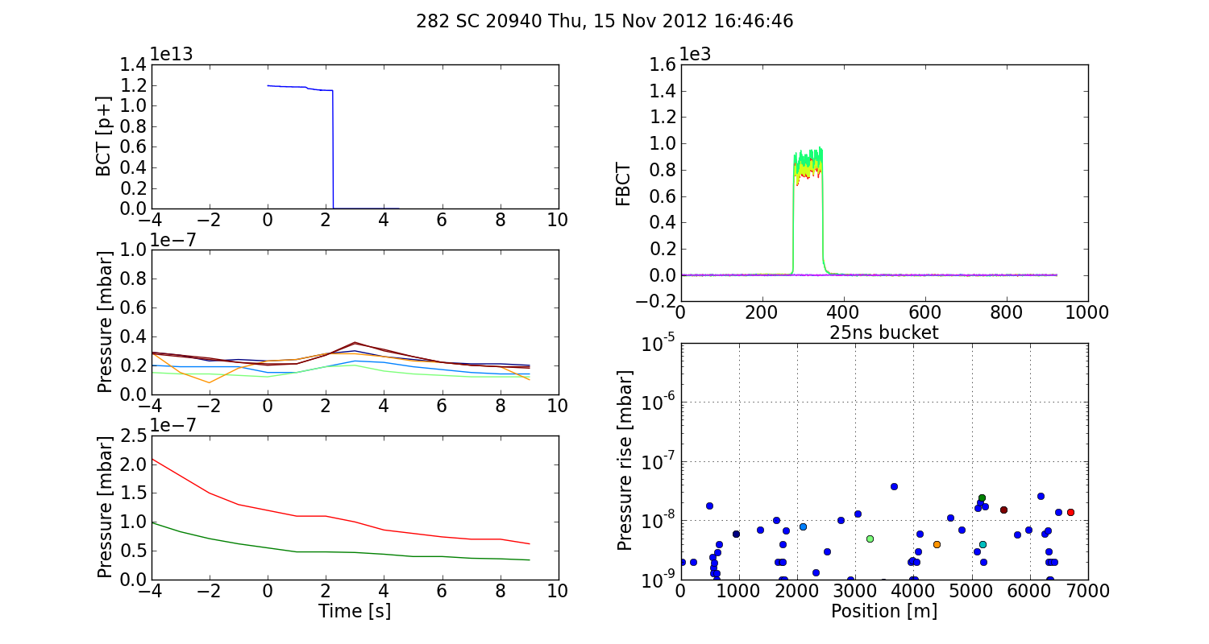
Test with bunch train: pressure
  72 “doublets”
Arcs
  72 bunches
Higher press. rise
Arcs

Slide 61
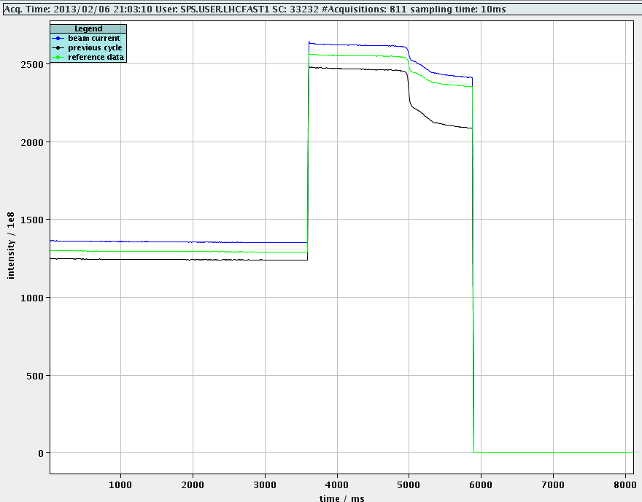
Doublets - 2 injections
  On 6th Feb. we could successfully inject and capture two batches

Slide 62


Doublets - 2 injections
  Faster voltage ramp-up was needed

Slide 63

Doublets - 2 injections
  Faster voltage ramp-up was needed

Slide 64
Thanks for your attention!

Slide 65


Slide 66


2006 vs 2012

Slide 68


Slide 69

Bending Magnet MBB: e⁻ density
No
EC
y
z
Courtesy C. Y. Vallgren
x
z

