Slide 1
The Mystery of the Missing Photoelectrons (and other demons) – Part II
ECLOUD and PyECOUD Simulations Update
Thanks to C. Bhat, G. Iadarola, F. Zimmermann and D. Sagan
Humberto Maury Cuna
CINVESTAV/CERN
April 8th, 2013

Slide 2
Previously on…

Slide 3
Introduction: Photoemission Model
The assumed creation rate of primary photoelectrons (PPE), corresponds to the computed synchrotron radiation flux in the arcs and the photoelectron generation rate inferred from measurements with test beams on prototype chambers.
Total Number of primary photoelectrons due to synchrotron radiation, PPE = (peeff)(I_{b}),
where peeff = photoelectron emission yield (e-/proton/meter) and I_{b} the intensity per bunch.
Both codes divide the PPE in two separated categories with different distributions:
PE created at the primary impact point of the synchrotron radiation(PE’). Gaussian distribution.
PE created by diffusively reflected photons (PE’’). Cosine square distribution.

Slide 4
Introduction: Photoemission Model
A percentage of the total flux of photons is reflected:
this fraction is called “refl” in ECLOUD and “refl_frac” in PyECLOUD.
A typical value of this reflected fraction is 20%.
About 80% of the incident photon flux produces PE at the primary impact point within a narrow cone of rms angle 11.25⁰. Due to the strong magnetic bending field some of these electrons cannot approach to the photon beam and do not contribute to the further electron-cloud build up.
PE’ = (1-refl)(PPE) and PE’’ = (refl)(PPE). Therefore,
PE’ + PE’’ = PPE
PE’ are produced at the primary impact point and following a Gaussian distribution.
PE’’ are distributed azimuthally according to a cos²φ distribution.
Beam pipe
Where φ denotes the azimuthal angle with respect to the horizontal plane, spanned from the primary impact point of the synchrotron radiatio.

Slide 5
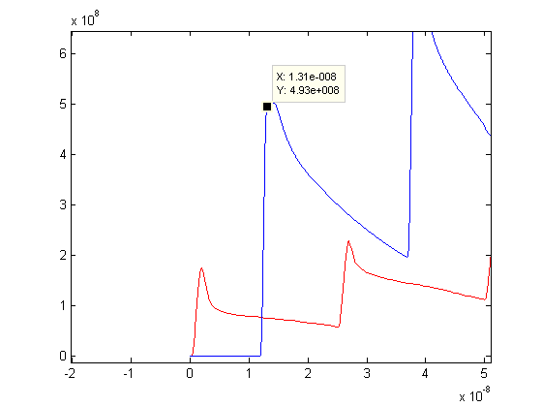
Motivation
C. BHAT pointed out an inconsistency observed during comparison studies between PyECLOUD and ECLOUD.
In the image, C. Bhat presented the results of 2 equivalent simulations.
Analitically, the total number of photoelectrons produced is PPE = (peeff)(I_{b}) = 4.932e8.
In the case of PyECLOUD simulation we can observe the intensity of the first peak of the electron linear density is equal to the expected value.
For ECLOUD, this value is aprox. 40% of the expected value.
PyECLOUD
Electron linear density (e-/m)
ECLOUD
Time (s)
Image courtesy by C. Bhat. Peeff = 0.001233, Ib = 4e11.

Slide 6
Electron Cloud Simulations: Methodology
All the simulations were performed for a bending magnet and considering photoemission as the main electron source.
Only 5 bunches were simulated in both codes.
The Magnetic field was varied from 0-8 T

Slide 7
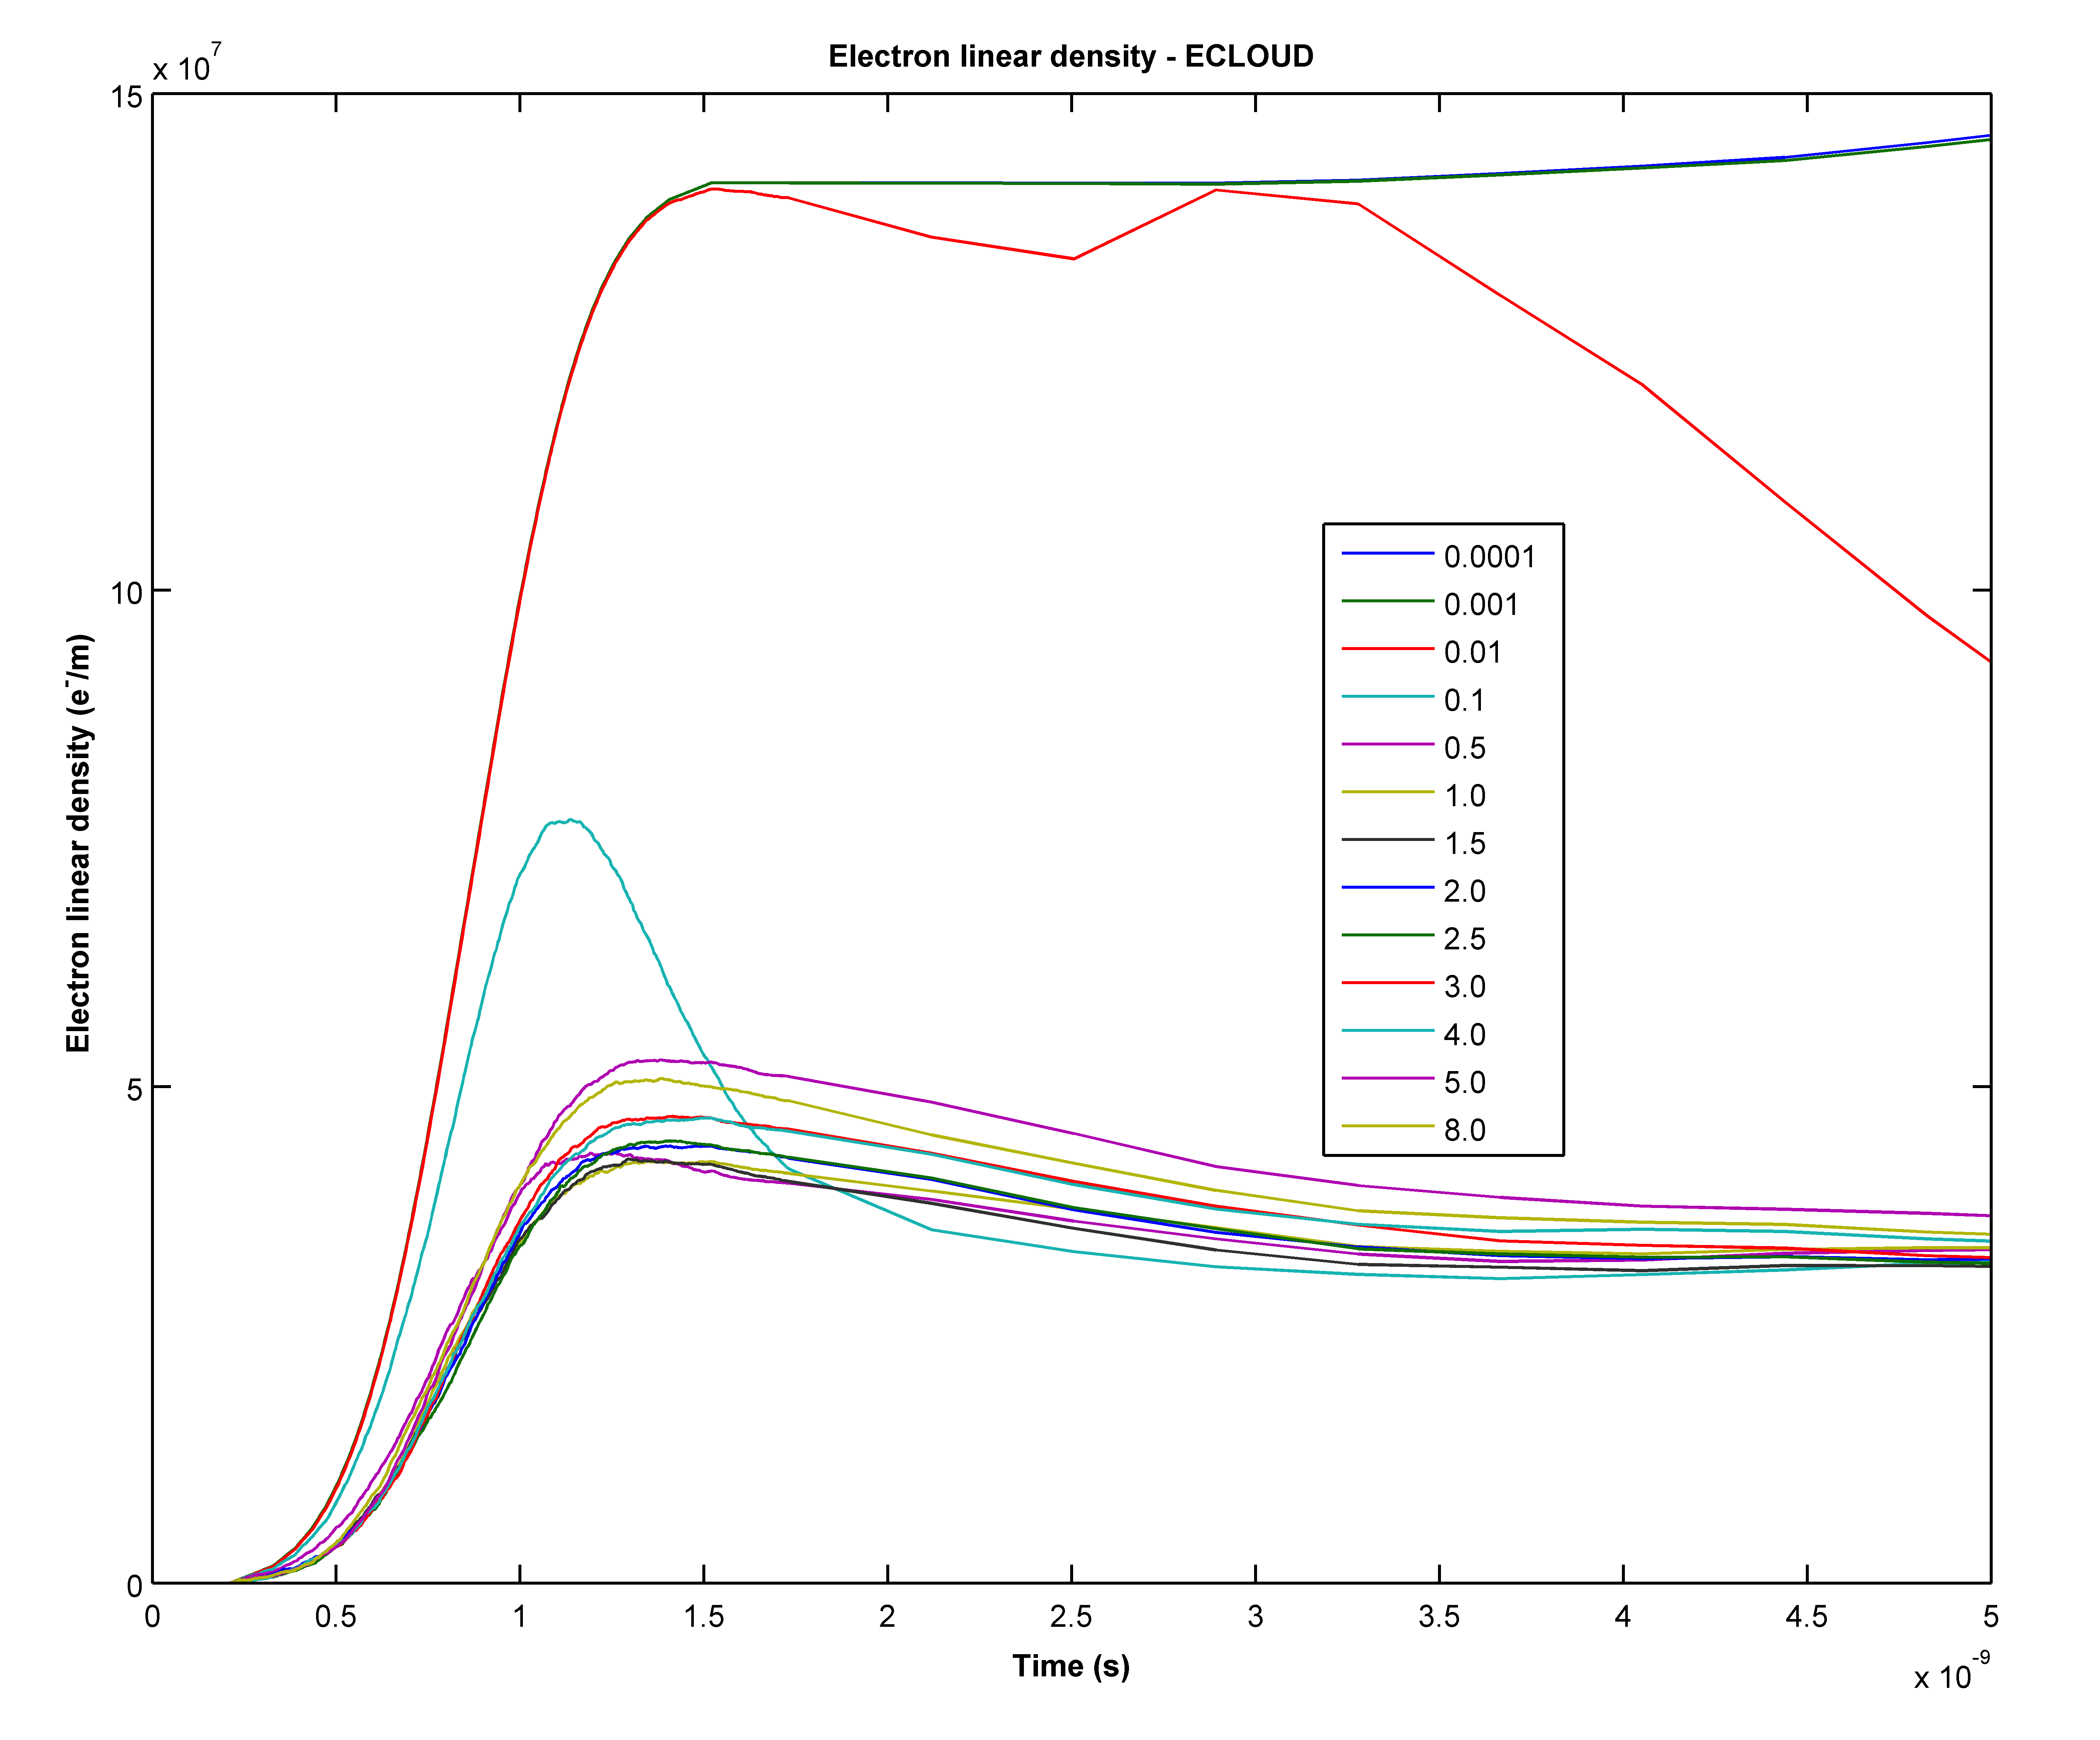
Simulated electron linear density at 3.5 TeV for a bending section, peeff = 0.001233 and I_{b} = 1.15e11 -> PPE = 1.417e8 (e-/m)
Magnetic field (T)

Slide 8
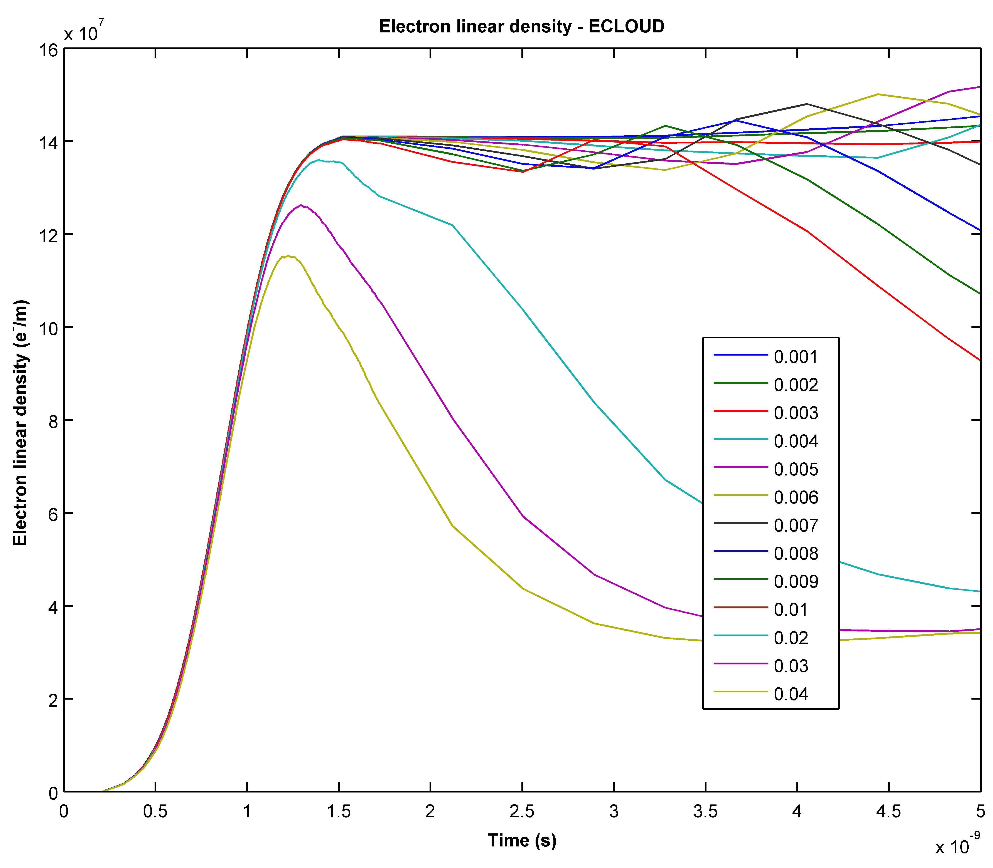
Magnetic field (T)

Slide 9
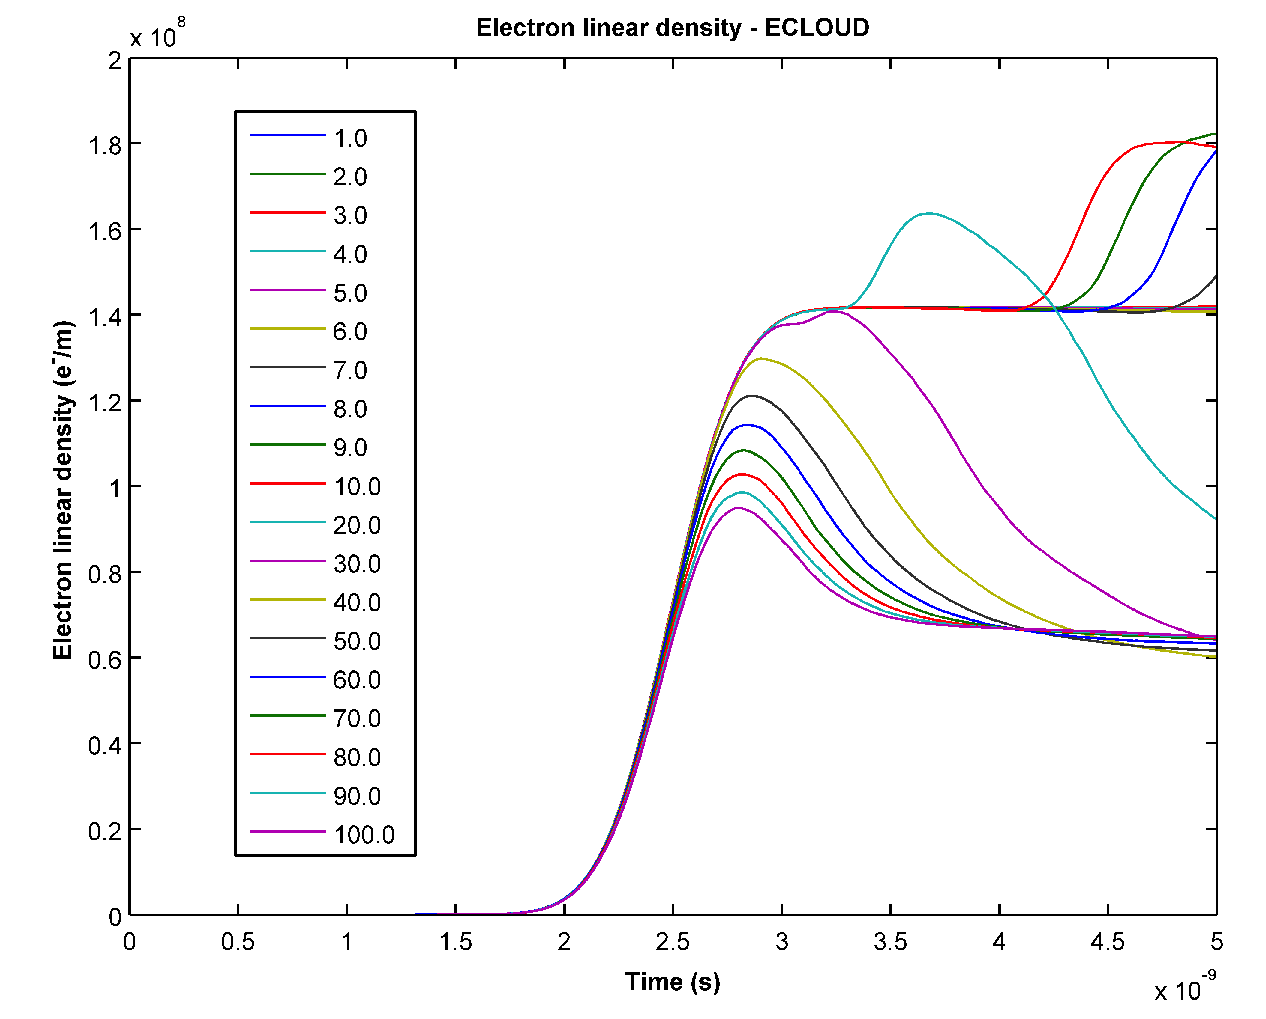
PyECLOUD
Magnetic field (x 10⁻³ T)

Slide 10
Synrad3d
Synrad3d can now read LHC lattice files.
LHC-sawtooth pattern fully implemented along with the option to have different surfaces (cu, ss, etc.,).
Simulation Methodology:
V6.5.seq has been use as the input lattice file.
Getting the distribution for different sections of the machine.

Slide 11
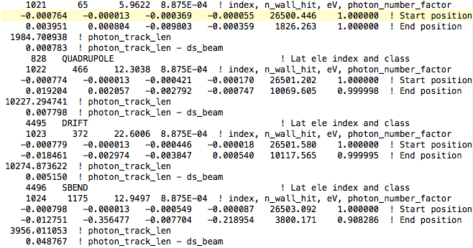
How a synrad3d raw data looks like…

Slide 12
Conclusions
For both codes:
We got a similar behavior and a suppression of the photoelectrons due to the magnetic field
Synrad3d:
Finally, the code is working with LHC lattice files!!!
Photon distributions for different sections are being produced.

Slide 13
Thank you for your attention
Questions and feedback is totally welcome ☺

Slide 14
Ion Cloud Studies - MD on 20/03/2013-
Machine Development Meeting
Alexander Kling, Rainer Wanzenberg, Joachim Keil, Gajendra Sahoo, Humberto Maury Cuna
March 25th, 2013

Slide 15
Outline
1 days of ion studies:
60 bunches filling mode with different bunch spacing (8 – 80 ns)
Different filling modes: 320, 720 and 960 bunches.

Slide 16
Methodology
60 bunches filling mode:
320b, 720b and 960b.
For all the cases, measurements of life time, BM average rate, vertical and horizontal emittance were taken.
1
…
60
Bunch spacing varied from 8 ns to 80 ns

Slide 17
60 bunches filling mode with different bunch spacing

Slide 19
60 b filling mode: 24 ns
22 mA
beam losses observed (70.5 mA)
beam lost due to RF problem (76 mA)

Slide 20
60 b filling mode: 32 ns
20 mA
beam lost due to RF problem around 70 mA. FB suppressed instability.

Slide 21
60 b filling mode: 40 ns
20,6 mA
beam losses observed and emittance blow-up; instability line appeared on first and last bunches; FB suppressed instability. Beam lost at 92 due to RF problem.

Slide 22
Conclusions
For 60 b filling mode:
For 8-ns bunch spacing was impossible to get rid of the instabilities using FB system. Other cases, the instability was supressed using FB.
Beam was lost several times due to RF issues.
For 320b and 960b filling mode instability was handled without difficulties with the FB system. 720 b no sign of issues.

