Slide 1
Ecloud Simulations Update
E-cloud Simulation Meeting
Thanks to L. Taviant, G. Iadarola, D. Sagan. G. Dugan, F. Zimmermann
Humberto Maury Cuna
Janaury 11th, 2013

Slide 2
Outline
Heat load benchmarking at 4 TeV and 25-ns bunch spacing.
Future work: Photon distribution

Slide 3
Heat-load benchmarking at 4 TeV and 25 ns
Fill number | Bunch intensity (x10¹¹) | Fill pattern | R0 | SEY
3425 3427 3428 3429 3436 | 1.1 (84b) 1.2 (156b) 1.1 (372b) 1.06 (804b) 0.91 (804b) | 25ns_84b_72_0_0_BBMD1 25ns_156b_72_72_72_BBMD2 25ns_372_72bpi_6inj_2012_MD 25ns_804b_72bpi_12inj_2012_MD25ns_804b_72bpi_12inj_2012_MD | 0.3 - 0.7 | 1.3 - 1.7
Only dipoles considered.
Simulations done with PyECLOUD.

Slide 4
Measured heat load
Thanks to Laurent Tavian

Slide 5
δ_{max} = 1.58

Slide 6
δ_{max} = 1.54

Slide 7
δ_{max} = 1.51

Slide 8
SEY time evolution (1):

Slide 9
SEY time evolution (1):
What about if R0 is higher?

Slide 10
SEY time evolution (II):
~4-5%

Slide 11
SEY time evolution (III):
3x photo emission yield
< 3%
< 3%

Slide 12
Outline
Heat load benchmarking at 4 TeV and 25-ns bunch spacing.
Future work: Synrad3d

Slide 13
Synrad3D
It simulates the production and scattering of synchrotron radiation generated by an electron (or proton) beam in a high energy machine.
Developed at Cornell University by David Sagan and Gerry Dugan.
It can handle any planar lattice and a wide variety of vacuum chamber profiles.
It uses Monte Carlo techniques to generate photons based on the standard synchrotron radiation formulas for dipoles, quadrupoles and wigglers.
Photons are tracked to the vacuum chamber wall, where the probability of being scattered is determined by the angle of incidence, the energy of the photon, and the properties of the wall’s surface.

Slide 14
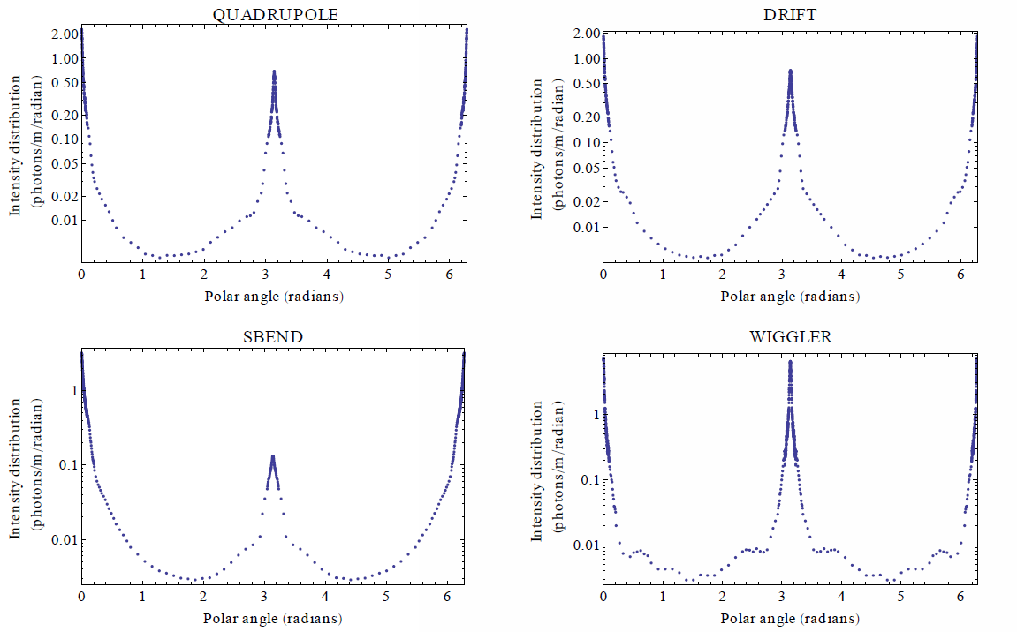
SYNRAD3D predictions for photon absorption site distributions
Photon emission throughout the ring, averaged over different magnetic environments.
Actual Cesr vacuum chamber, specular reflection only, beam energy 2.1 GeV
polar angle
chamber wall
Thanks to G. Dugan

Slide 15
Motivation
Employ Synrad3d to simulate the photon distribution for future machines as LEP III
LHC (coming soon) and LHC-like machines.

Slide 16
Conclusions
For R0 = 0.5 → SEY = 1.51
For R0 = 0.7 → SEY = 1.45
Changing 3x peef only decrease SEY’s values less than 3%.
Synrad3D is a useful tool to find the photon distribution and then use it as input file to Ecloud or PyEcloud.

Slide 17
Thank you for your attention

